Slide 1
The Cleansing of the Temple:
Christ’s Teaching on Redemption and Resurrection for All Nations

Slide 2
Why Did Christ Cleanse the Temple?

Slide 3
I. The Progress of Redemption to all Nations(v. 13-17)

Slide 4
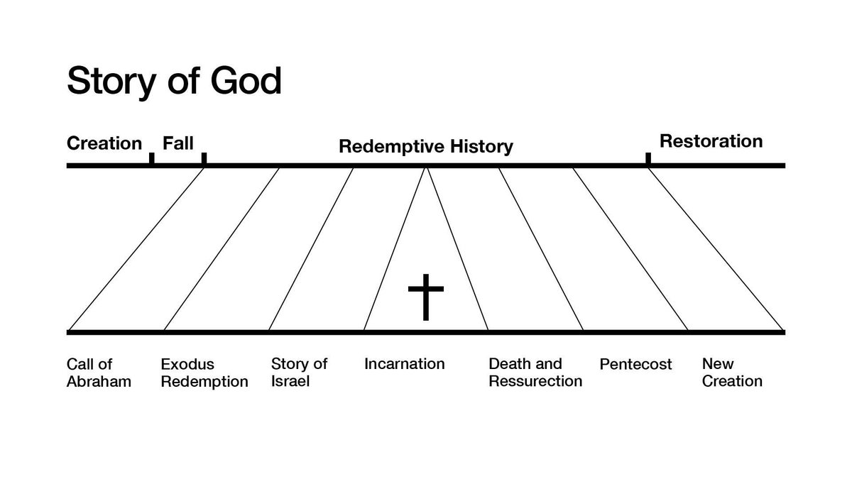

Slide 5
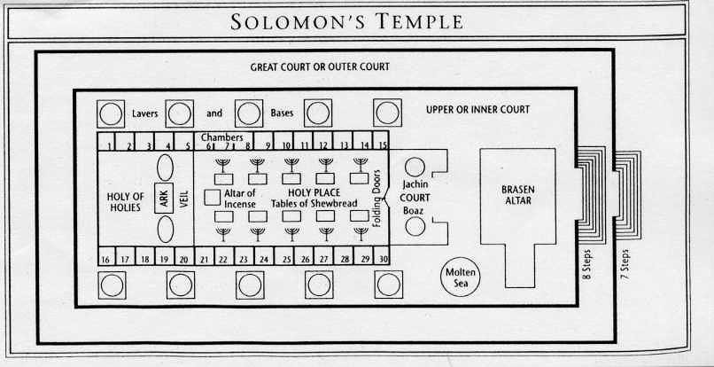

Slide 6
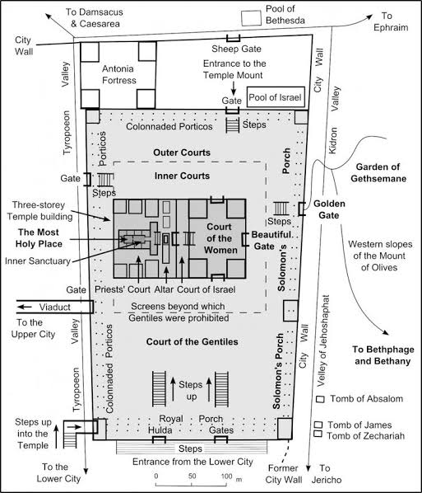

Slide 7
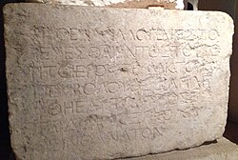
Μηθένα ἀλλογενῆ εἰσπορεύεσθαι
ἐντὸς τοῦ περὶ τὸ ἱερὸν τρυφάκτου καὶ περιβόλου. Ὃς δ᾽ ἂν ληφθῇ, ἑαυτῷ αἴτιος ἔσται διὰ τὸ ἐξακολουθεῖν θάνατον.
No stranger is to enter
within the balustrade round
the temple and
enclosure. Whoever is caught
will be himself responsible
for his ensuing
death

Slide 8
II. The Promise of Resurrection to all Nations (v. 18-22)

Slide 9
Resurrection Promises
CREATION
His Resurrection is Promised (v. 19)
Our Resurrection is Promised (Romans 6, I Corinthians 15:35-55)
Our Resurrection Provides Union With Christ (I Peter 2:4-8, 21-25)

Slide 10
III. The People Who Responded from all Nations (v. 23-25)

Slide 11
The Progress of Redemption (Salvation) and the Promise of Resurrection (Sanctification) will be accomplished among all the nations.
CREATION
Ephesian 2:11-22
13 But now in Christ Jesus you who previously were far away have been brought near by the blood of Christ. For He Himself is our peace, who made both groups into one and broke down the barrier of the dividing wall. . .
19 So then you are no longer strangers and foreigners, but you are fellow citizens with the saints, and are of God’s household,
20 having been built on the foundation of the apostles and prophets, Christ Jesus Himself being the cornerstone, 21 in whom the whole building, being fitted together, is growing into a holy temple in the Lord, 22 in whom you also are being built together into a dwelling of God in the Spirit.

