Slide 1
WELCOME

Slide 2
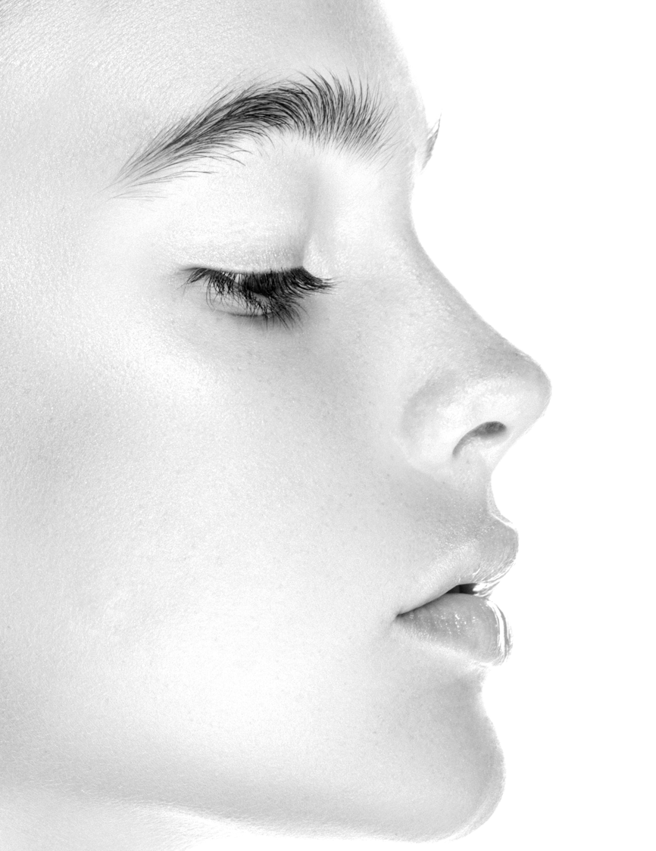
SPA
HOUR
Notes:
Welcome to this Spa Hour.
(tell your brief ID and experience with the products you’ll present)
I’m excited to share with you the best kept age-defying secrets of skin care. The goal is that you’ll leave here empowered with knowledge to keep yourselves and your loved ones safe, healthy and glowing. We’ll also have a fun time of pampering ourselves with a Self-Spa Treatment using the age-defying Nutriance Organic skin care line. The Self-Spa Treatment will take place towards the end of this presentation, so for now you can sit back and relax.

Slide 3
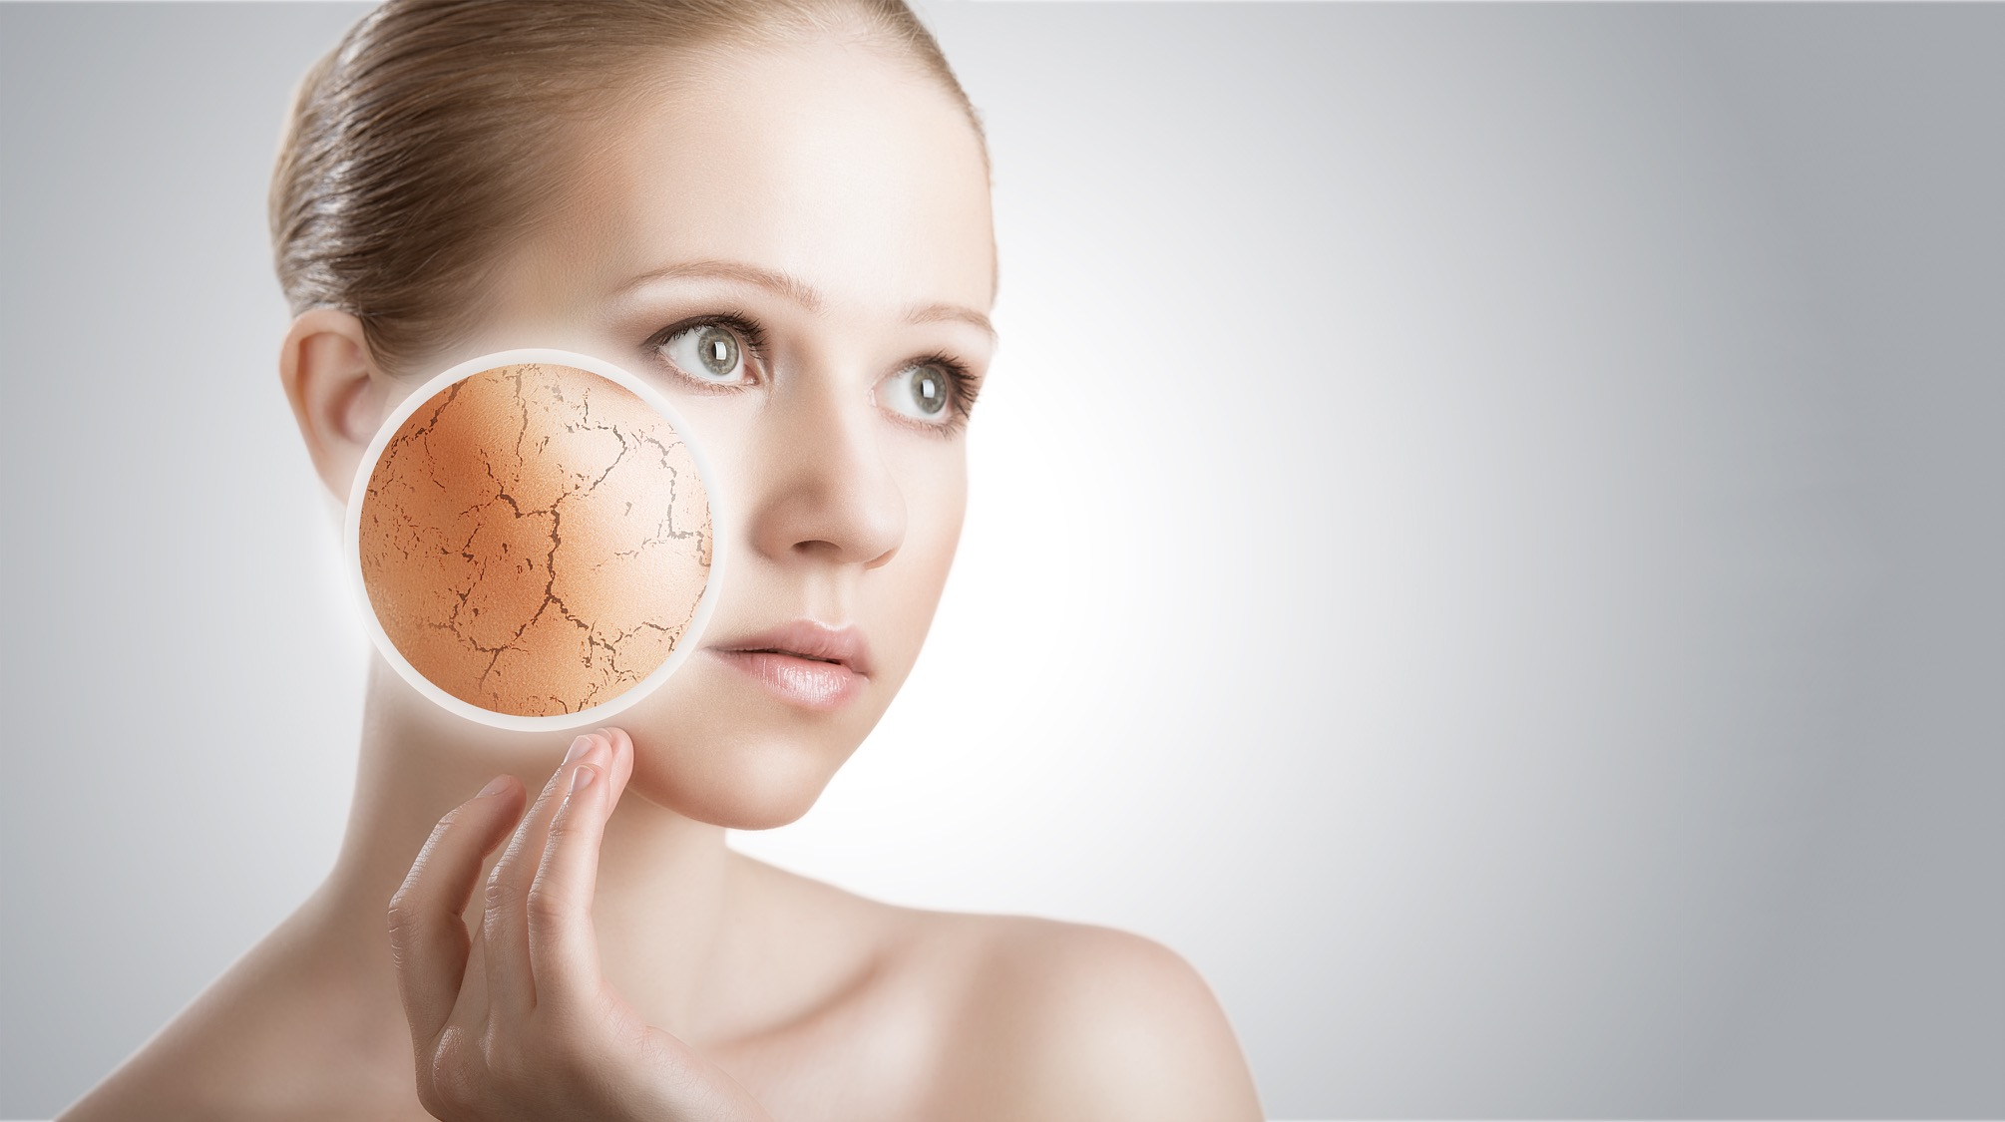
DID YOU KNOW?
Your skin is your largest organ
Notes:
For most of us, when we think about healthy lifestyle we automatically think of things like diet, supplementation and exercise. Skin care usually doesn’t make it on that list. But maybe it should. Did you know that the skin is actually the largest organ of the human body?
It’s actively refreshing and renewing itself and what you put on your skin can enter your body. Both the good and the bad. We actually shed 30,000 to 40,000 skin cells every day. That means the skin you see now wont be there in about a month. It’s replaced.
That’s why skin care is so important, and why a holistic approach to healthy lifestyle also needs to address our skin care needs.

Slide 4

1
The science of healthy aging: FACT or FICTION
2
How to address the underlying causes of skin aging and damage
3
How to build your skincare routine
Notes:
During our time together we’re going to explore 3 major topics:
1. The science of healthy aging: fact or fiction
2. How to address the causes of skin aging and damage
3. And How to build your skincare routine

Slide 5
THE SCIENCE OF HEALTHY AGING:
FACT
or
FICTION?
Notes:
I’ll be the first to admit, it’s hard to judge between what’s hype and what’s reality in the world of skincare. So many companies boast of finding the latest exotic miracle ingredient, only to later find out that it wasn’t all that miraculous. But that’s why we want to start by looking at the science of healthy aging: fact vs. fiction. This is a little test of your skin care knowledge…. I’m now going to read 6 statements and you’ll guess whether they’re fact or fiction.

Slide 6
FACT
or
FICTION?
SKIN AGING IS DETERMINED BY GENETICS
FICTION
(MOSTLY)
Notes:
Skin aging is determined by genetics
Mostly FICTION. Some scientists estimate that only 10% of skin aging is based on DNA and gene expression. That means 90% of skin aging is determined by external factors. We are in control.

Slide 7
FACT
or
FICTION?
DIET HAS NOTHING TO DO WITH SKIN AGING
FICTION
Notes:
Diet has nothing to do with skin aging
FICTION. A good rule of thumb to follow is ‘if it’s bad for your waist, it’s bad for your face’. Diet and nutrition can play a huge role in the rate at which we age. A diet rich in protective phytonutrients, like those found in colorful fruits and vegetables, has even been shown to increase the skins natural defenses against sun damage and aging.

Slide 8
FACT
or
FICTION?
SKIN AGING IS A REFLECTION
OF OUR OVERALL HEALTH
FACT
Notes:
Skin aging is a reflection of our overall health
FACT. The health of our skin is often a reflection of our overall health, or lack thereof. An obvious example of this is jaundice. When the liver isn’t functioning properly the skin can turn yellow. But even acne and wrinkles can be linked to inadequate skincare, smoking, poor diet and nutrition.

Slide 9
FACT
or
FICTION?
ONCE THE SIGNS OF AGING APPEAR,
IT’S TOO LATE TO CHANGE
FICTION
Notes:
Once the signs of aging appear, it’s too late to change
FICTION. Adopting a daily skin care routine with products that moisturize the skin and restore the skin’s natural barrier can help reverse at least some of the visible signs of aging. It is clear that it is important to lead a balanced and healthy lifestyle with a good diet, plenty of relaxation and sleep, to complement the efforts spent on a skincare routine.

Slide 10
FACT
or
FICTION?
SCRUBBING YOUR FACE WILL
KEEP YOU BLACKHEAD AND PIMPLE FREE
FICTION
Notes:
Scrubbing your face will keep you blackhead and pimple free
FICTION. Blackheads and pimples are caused by clogged pores. Excessive scrubbing can remove protective oils and cause micro tears that may lead to irritated skin. A daily, gentle cleanser is a better alternative for most people.

Slide 11
FACT
or
FICTION?
SKIN AGING AND DAMAGE CAN
BE REVERSED QUICKLY
FACT
&
FICTION
Notes:
Skin aging and damage can be reversed quickly
BOTH FACT & FICTION. On one hand, skin aging and damage don't happen overnight, and they cant be reversed overnight either. However, implementing a skincare routine that addresses the underlying causes of aging and damage can make a remarkable difference. But stick with it, it typically takes 27 days for the skin to regenerate itself, and 2 or 3 cycles of regeneration for best results.

Slide 12
HOW DO WE FIGHT THE CAUSES OF
AGING AND DAMAGE?
Notes:
OPTION 1
I think it’s fair to assume that we all want to healthy, youthful-looking skin. And we all want to age gracefully and fight the causes of aging and damage. But how do we make sure our skin care routine does this?

Slide 13

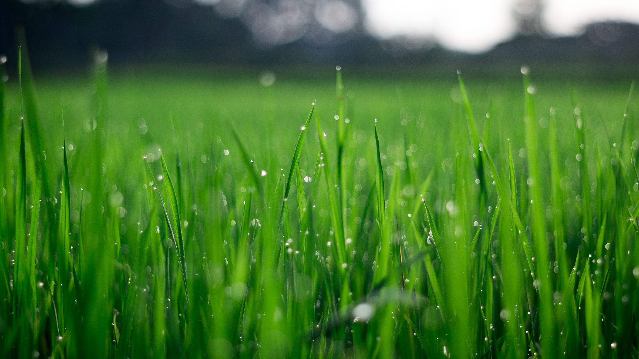
SKIN NOURISHMENT SOURCES
Blood stream
Topically applied
Notes:
It can be helpful to think of the skin like a lawn. Given the right nutrients and environment, it will stay healthy and lush.
The skin can be nourished from 2 main sources, <<CLICK to ANIMATE>>
… the bloodstream, so that nice fertile soil we get through diet and supplementation, and topically applied nutrients. <<CLICK for NEXT SLIDE>>

Slide 14
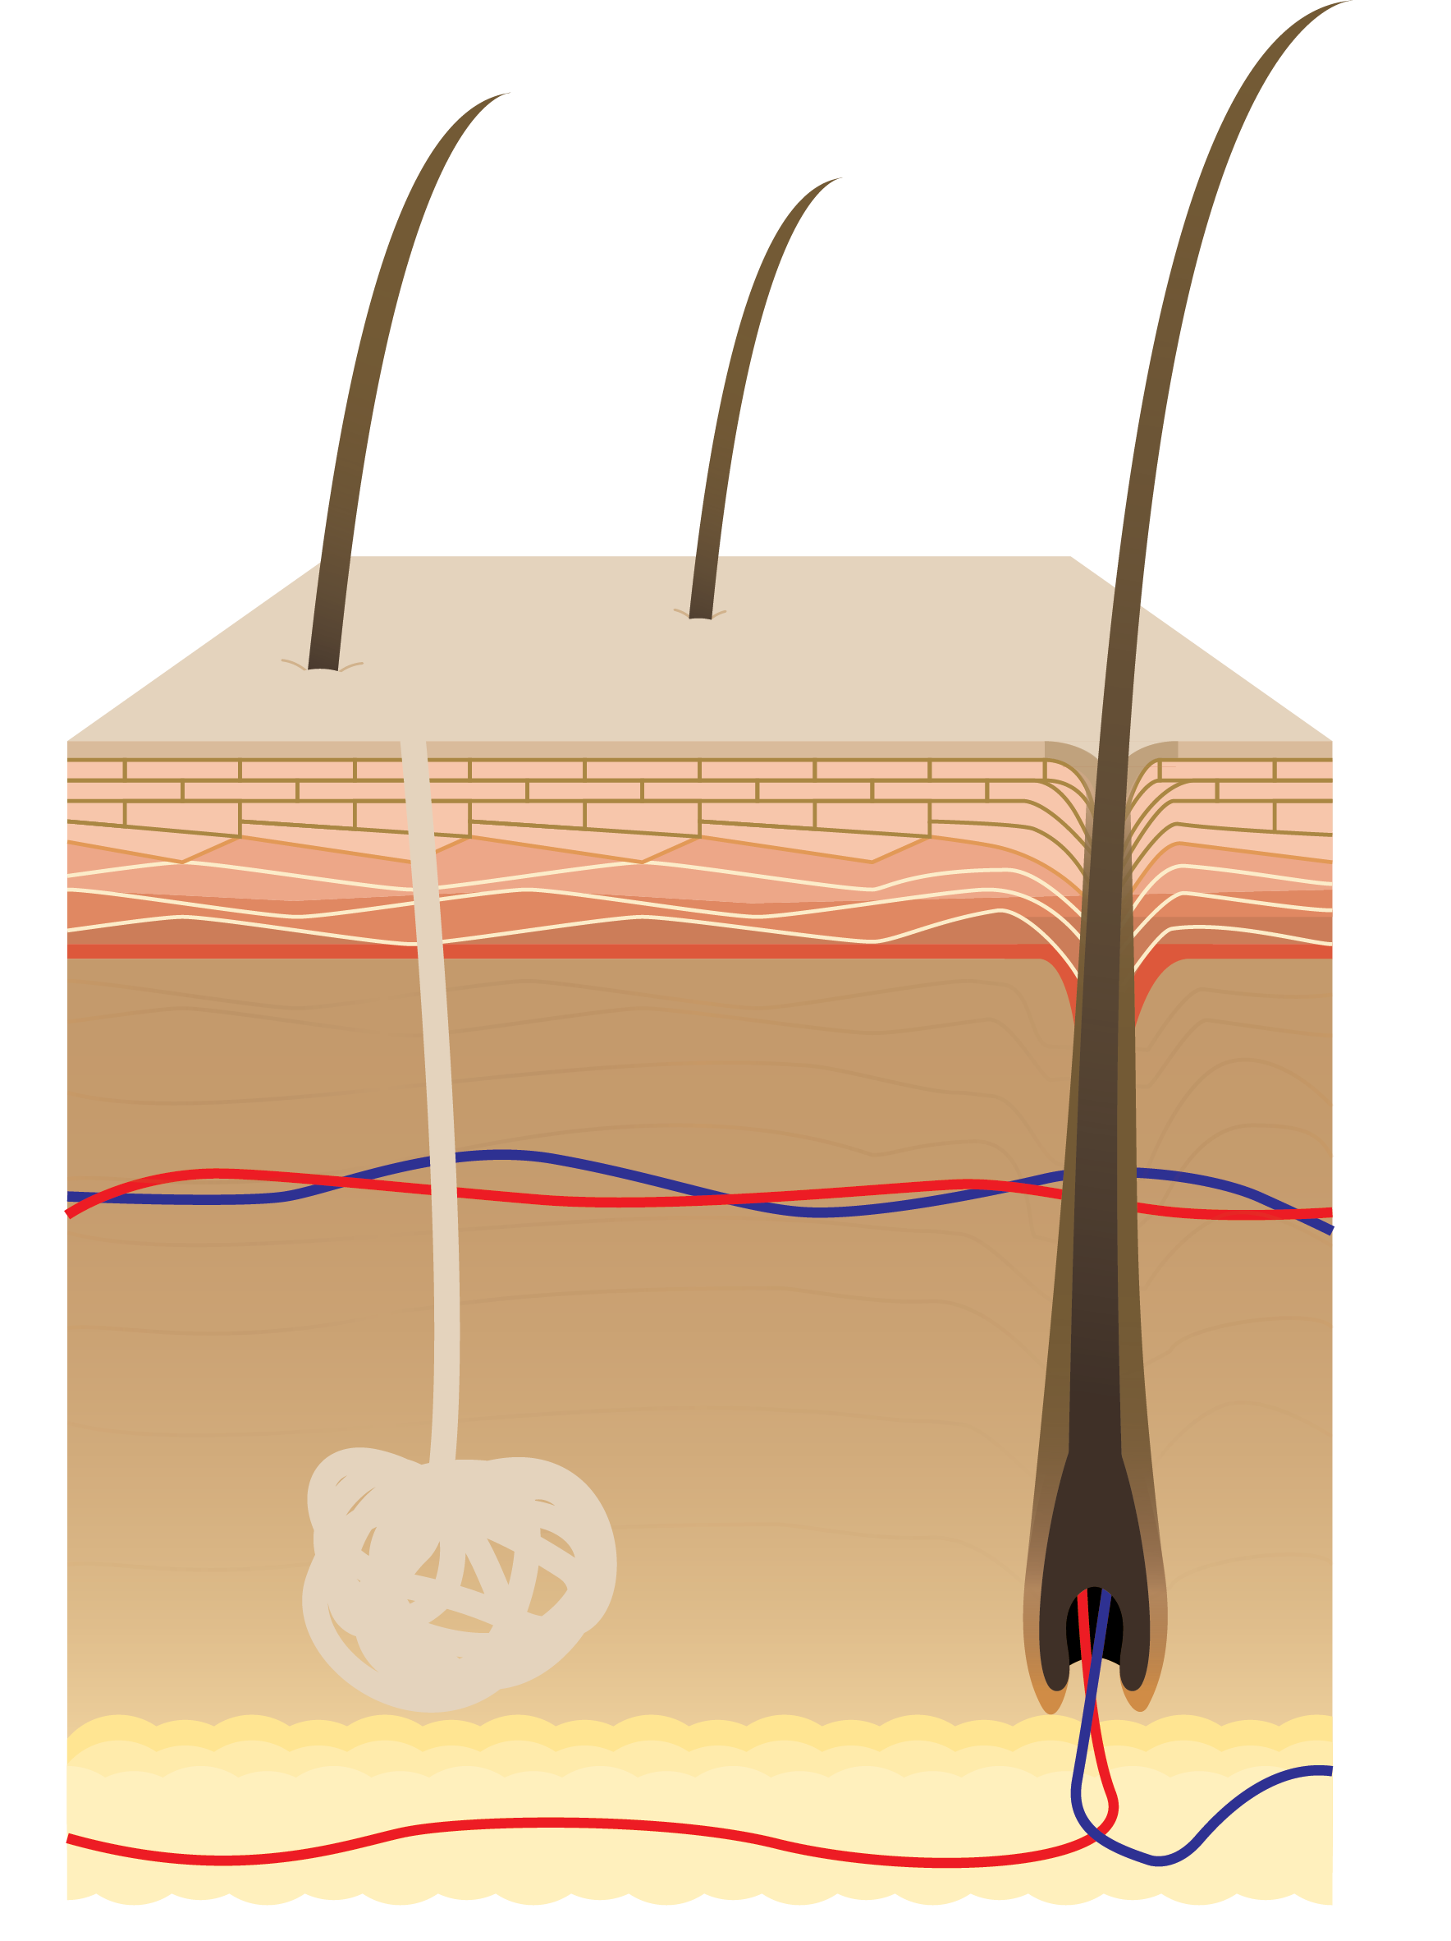
ACID MANTLE
pH balance is an important factor of healthy skin that often gets overlooked
Notes:
It’s important to understand that the skin has natural defense mechanisms. The skin’s outer layer the epidermis is the barrier defending our body from the environment. Maintaining and strengthening these defenses, also called the skin’s barrier function, is key for healthy, youthful-looking skin.
They are :
1. The skin’s protective acid mantle
2. The skin’s outer layer –the horny layer
3. Active cell renewal- “Morphing” skin cells
The acid mantle is an invisible slightly acidic, protective film that sits on the skin’s surface. If you’ve ever used harsh soap to wash your face and was left feeling sensitive and uncomfortably tight and dry, that’s what it feels like to have your acid mantle stripped away.
pH is a measure of the acid-alkaline ratio of a substance. And pH balance is an important factor of healthy skin that often gets overlooked. Using the wrong products and unhealthy diet and lifestyle factors all have a tendency to throw off pH levels which can lead sensitive skin, skin irritation, dryness and even premature wrinkles. Changes in pH are even reported to play a role in the pathogenesis of skin diseases. For example, people with eczema have a higher measured pH value in areas that are affected.

Slide 15
ACID MANTLE
MICROBES
(THE RIGHT TYPE)
Notes:
We can think of pH balance like gut health, but for your skin. Just like our gut needs a healthy balance of bacteria in order to function optimally, so does our skin. It’s known that an acidic pH encourages the right type of microbes on the skin surface whereas a more alkaline pH disturbs the balance.
So our skin’s health depends on preserving a unique ecosystem of microbes that live in harmony on our skin surface - they depend on a specific pH, an acidic pH.
The acidity of the protective acid mantle plays a critical role in preserving the integrity of the layers of skin that make up the barrier function.

Slide 16
ACID MANTLE
MICROBES
(THE RIGHT TYPE)
“HORNY LAYER”
Notes:
It is the outermost layer of the skin cells that work as an impermeable barrier, critical for keeping in moisture and lipids as well as defending the body against all kinds of environmental attacks-microbes, pollution, and all sorts of toxins.
This outermost layer of the skin is called the “horny" layer.
The horny layer is also responsible for maintaining hydration, firmness, and softness of the skin, and keeping toxins out.
If you’re ever wondering why your skin is dry, flaky, irritated or sensitive, it’s probably because your horny layer has been compromised.
When the skin is exposed to harsh soaps, chemicals, and alkaline pH products, the acid mantle is stripped away and the horny layer is left compromised.
Maintaining the protective impermeability of the horny layer requires a constant regeneration of skin cells from the lower layers of the epidermis.
Which leads to the third element of natural defense mechanisms, the active organization and renewal of the skin cells.

Slide 17
ACID MANTLE
MICROBES
(THE RIGHT TYPE)
“HORNY LAYER”
ACTIVE CELL RENEWAL
Notes:
The rate at which the body is able to replace skin cells in the skin barrier impacts how fresh and youthful-looking we are. This rate of active cell renewal is dependent on the quality of the nutrition that the cells receive.
These nutrients come to the skin cells from two main sources, the bloodstream and those that are topically applied. Topically applied nutrients can make a remarkable difference to the Active Cell Renewal processes, when they are biocompatible for assimilation into the cells and also deliver vital nutritive elements including protective phytonutrients, essential oils & fats, peptides, and a wealth of minerals.

Slide 18
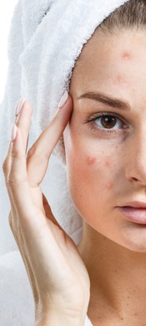
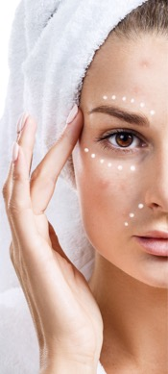
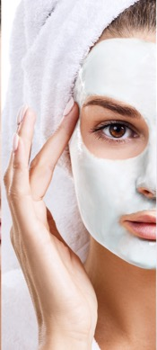
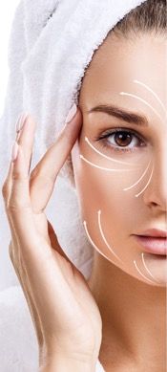
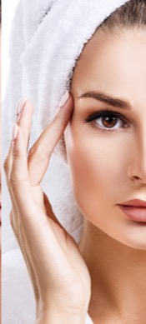
DOES YOUR SKIN CARE ROUTINE PASS THE TEST?
Does it strengthen the skin’s natural defenses?
1. pH balance of acid mantle
2. integrity of horny layer
3. nutrients for active cell renewal
Notes:
So, now’s a good time to ask yourself, Does your skincare routine pass the test so far?
Does it act gently to maintain the skins natural defenses, by addressing those three key factors? the pH balance of the acid mantle, the integrity of the horny layer, and providing important nutrients and phytonutrients for active cell renewal?
That’s a pretty tall order, especially when as consumers we have to wade through all the cheaply made, overly priced products out there. So many people don’t even realize what harsh ingredients and chemicals they’re lathering themselves in, that can have negative effects over time.

Slide 19

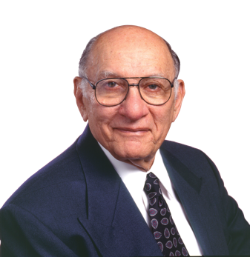


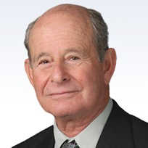




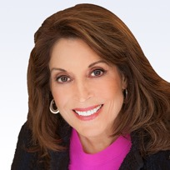
RICH SCIENTIFIC HERITAGE
SCIENTIFIC ADVISORY BOARD
World Renowned Scientists & Nutrition Experts
Active, Published, Respected
Founding Member Emeritus
Dr. Arthur Furst
Pioneer in Cancer
Research & Toxicology
John R. Miller
Fred G. Hooper
Laszlo P. Somogyi
Arianna Carughi
SAB Director, Product Technologist, Researcher
Ph.D. Biochemist, Nutritionist
Ph.D. Food Scientist, Nutritionist
Ph.D., C.N.S. Nutritional Scientist
David Shepherd
Diane Clayton
Mark Lowman
Liz Applegate
Ph.D. Microbial Biochemist
Ph.D., R.Nutr., Biochemist,
Health Practitioner
Biologist, Formulator, Quality Expert
Ph.D., Nutrition, Sports Nutritionist
Notes:
But knowledge is power and that’s why we’re so passionate about our time together and spreading the word about an exciting solution to this problem, developed by an elite, purpose-driven group of scientists.
These scientists serve on the Scientific Advisory Board of an international leader in the health and wellness industry, NeoLife International. Since 1958, NeoLife has pioneered nutrition supplementation, offering solutions to cellular nutrition long before most people even knew what a vitamin was. with a rich history of industry firsts and breakthrough discoveries that have paved the way for products like the first ever protein shakes, omega-3 supplements and antioxidant protection.

Slide 20
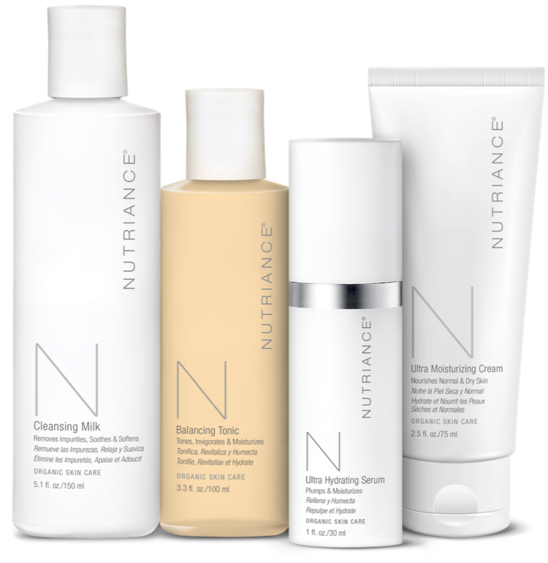
Thalassotherapy
\thə -,la-sō-’the-rə-pē\
From the Greek words “thalassa” meaning sea and “therapeia” meaning healing
Notes:
For more than a decade the NeoLife SAB searched the world over, and have now found the most unique source for biocompatibility and perfect harmony with the skin through marine-based nutrients, sourced from the birthplace of modern thalassotherapy.
“Thalassotherapy” is the term for the medical use of seawater, and marine ingredients such as seaweed extracts and marine minerals. It comes from the Greek words “Thalassa” meaning sea and “therapeia” meaning healing. Seawater and marine extract ingredients were used for their rich mineral and trace element content which were believed to enter the skin and clear the pores, detoxifying and balancing the body.

Slide 21

EXCLUSIVE MARINE ENVIRONMENT
ISLE DE
MOLÈNE
Island of Molène off the coast of Brittany, France
A haven of natural diversity and a rich marine ecosystem
Known for abundant seaweed resources and resource maintenance
Notes:
Nutriance Organic is a scientifically-formulated marine botanical based organic skin care line. Marine botanicals are sourced from a protected biosphere, the Molène Archipelago in Brittany, France, renowned for its exceptional wealth of seaweeds and purity of seawater. Formulated in collaboration with leading skin care experts and marine biologists, and clinically tested at prestigious research and dermatology centers based in France.

Slide 22

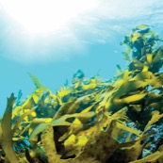

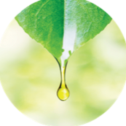
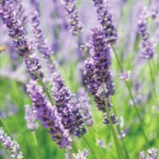
EXCLUSIVE
FORMULAS FEATURE
10
PURE
15
10
FRESH MARINE SEAWEED EXTRACTS
& PATENTED SEAWATER
ESSENTIAL OILS
BOTANICAL WATERS & BOTANICAL EXTRACTS
Notes:
Now the company has proven their commitment to ending the trend of poor wellness once again, by launching the first ever marine botanical-based Organic Skincare line in the Direct Selling Industry, Nutriance Organic.
10 Fresh Marine Seaweed Extracts
Using hand harvesting and gentle extraction techniques for quality and environmental sustainability
Extracted within 24 hours of harvest for potency
Pure & Patented Seawater
Biocompatible for perfect harmony with the epidermis
With more than 80 trace minerals
15 Essential Oils
10 Botanical Waters & Botanical Extracts
and Protective Antioxidants including carotenoids and polyphenols

Slide 23
NOT ANIMAL TESTED
NON-COMEDOGENIC
100% VEGAN
PARABEN FREE
Notes:
NOT ANIMAL TESTED
NON-COMEDOGENIC
100% VEGAN
PARABEN FREE

Slide 24


SELF-SPA
TREATMENT
Notes:
(Optional product testimony here)
Now its time to have some real fun and let the products speak for themselves, with the Self-Spa treatment.

Slide 25
AGE-DEFYING
CELL ACTIVIATING
SYSTEM
1
CLEANSE & DETOXIFY
2
BALANCE & INVIGORATE
3
ACTIVATE & NOURISH
Notes:
The Self-Spa Treatment is designed to guide you through a sensory experience, harnessing the synergistic properties of the line, using the Age-Defying Cell Activating System, in 3 steps. And with specific formulas to match your skin type: either Normal to Dry or Combination to Oily.

Slide 26
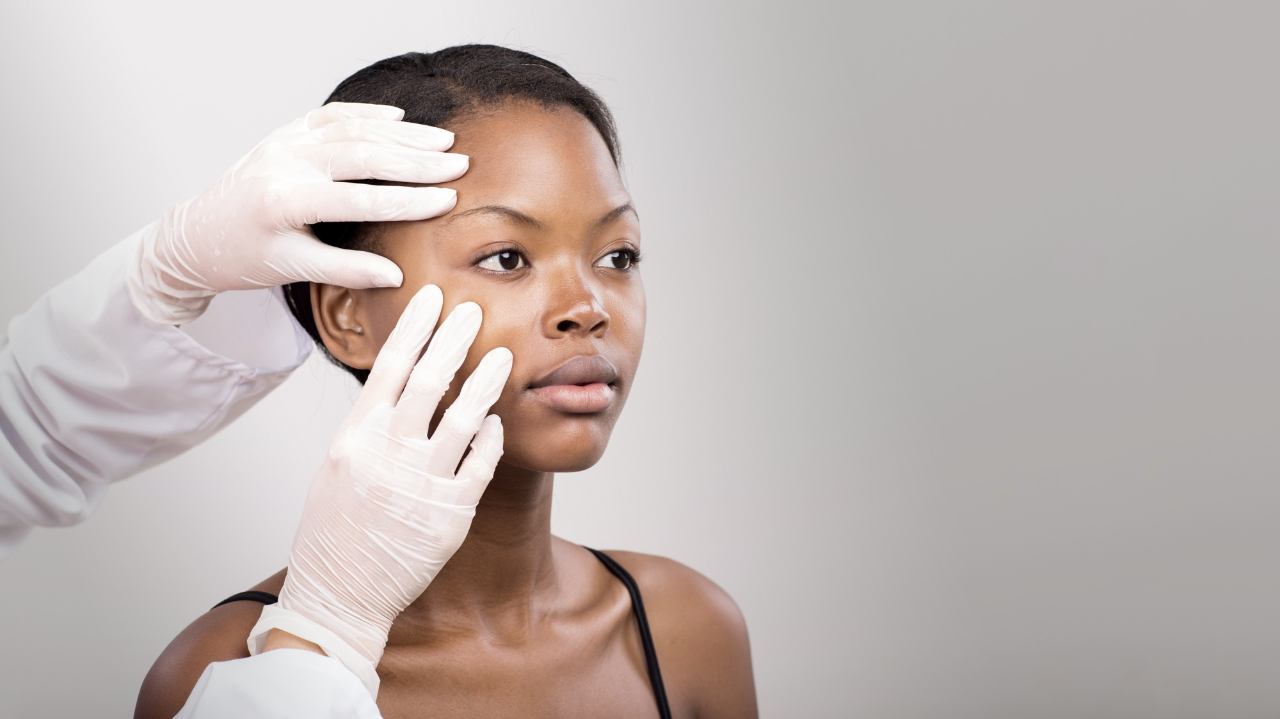
CLINICALLY
TESTED
Notes:
Clinically tested under dermatological control in a leading European skin care clinic
Tested performed included; Human clinical trials with Dermatologist supervision.
Over 100 participants to date.
Use Tests 4-Weeks of daily use
State of the art procedures
Full compliance with international regulations.

Slide 27
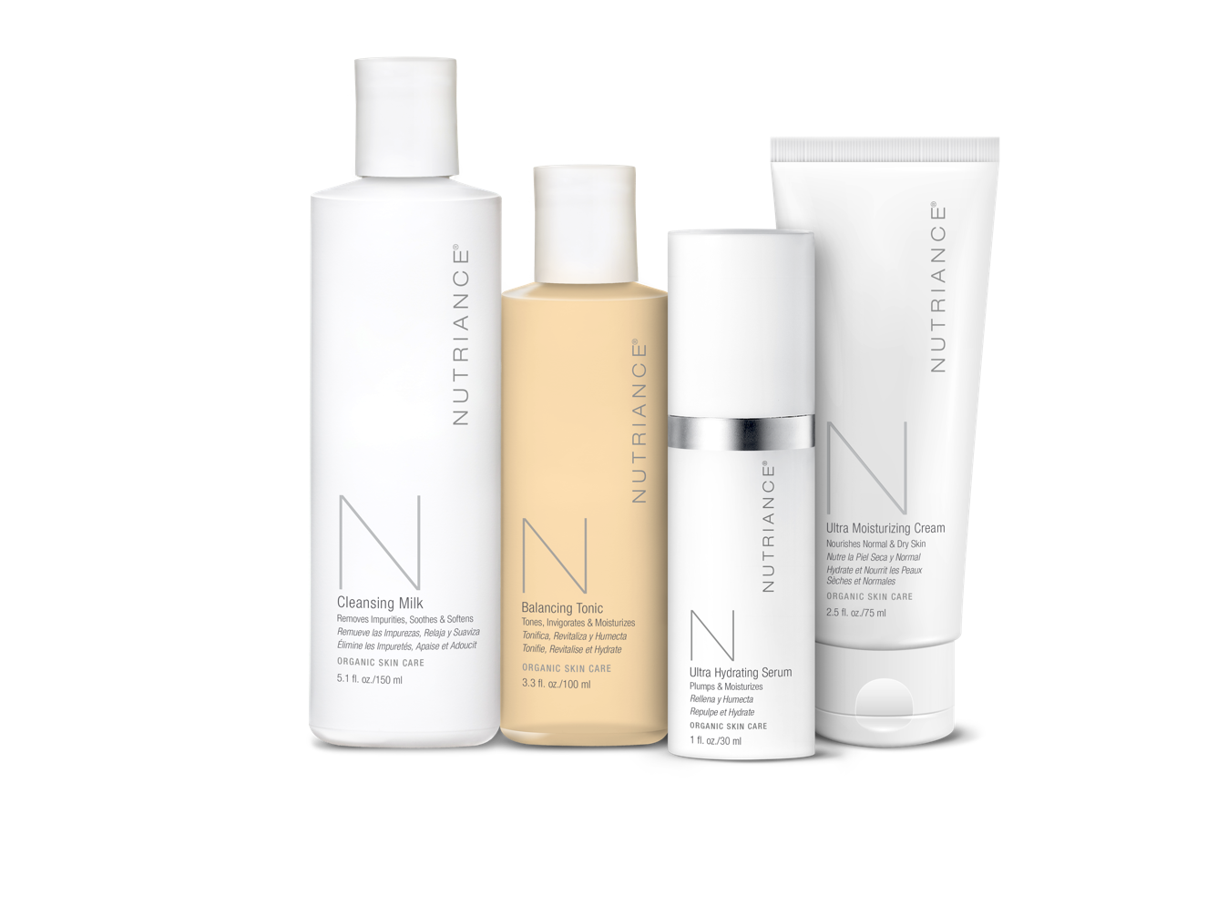



DESIGNED FOR YOU
Notes:
The range of products is available to suit the skin types Normal to Dry or Combination to Oily

Slide 28

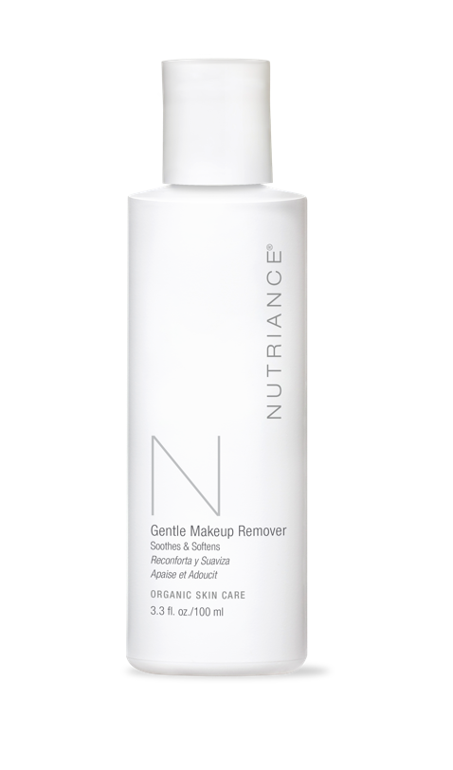
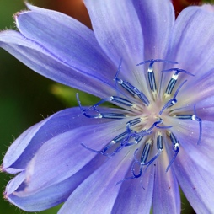
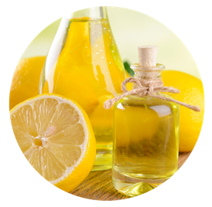
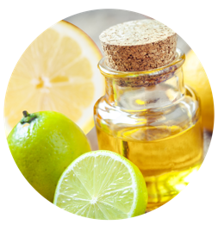
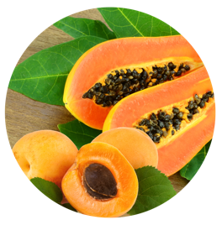
PRE-STEP
GENTLE MAKEUP
REMOVER
With Chamomile to soothe the skin.
Enriched with brown seaweed extracts and wheat peptides to protect and reinforce the skin’s natural barrier.
With nourishing and skin comforting essential oils to hydrate the skin.
Clinically proven to hydrate the skin.
Notes:
I actually like to use the Gentle Makeup Remover before I start the 3-step system. It’s a “pre-step”. I love this product. Especially because its gentle and alcohol-free, yet it’s even strong enough for my waterproof mascara.
A 2-in-1 skin care product suitable for all skin types, even sensitive skin. Formulated to gently remove makeup while also energizing, and reinforcing the natural film of protection.
Soothes, decongests & conditions the skin.
Rich in natural essential oils to create a lasting feeling of freshness. Lime and Lemon oils in synergy with Sea Fennel help gently soothe and exfoliate the skin while the oils of Papaya and Apricot kernel energize and soften the skin.

Slide 29
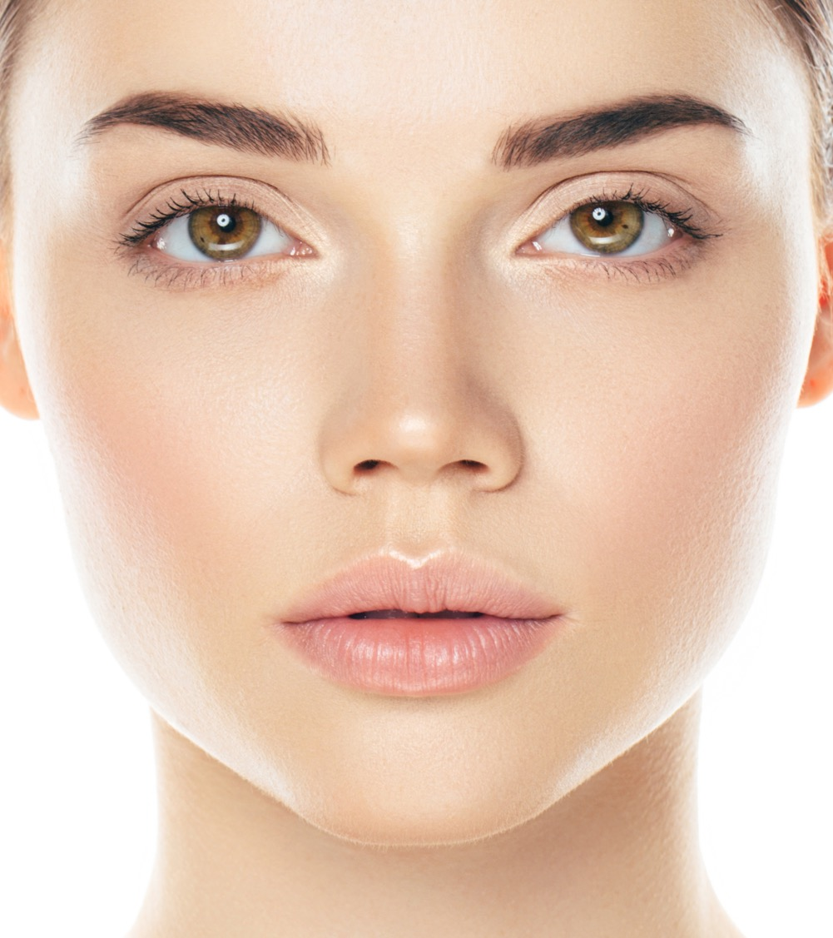
REMOVE
YOUR TURN TO…
MAKEUP
Place cotton pad over eye and hold for a few seconds.
Gently rub in circular motion over eye area.
Repeat on other eye.
Notes:
For those of us who are wearing make-up, we’ll start with a Pre-Step, using the Gentle Makeup Remover.
We’re following an “I DO, YOU DO” format. So first I’ll show you a demo, and then you can do the same.
For this product take we’re going to take a cotton pad or ball and saturate it. Then place the pad over one eye and hold it there for a few seconds. Begin to gently rub in a circular motion. Your eye area is one of the most delicate areas of your face, so its important to do this using soft strokes. Then Flip your cotton over for the other eye.
Continue with gentle strokes over your face and lips with the remaining solution. There is no need to rinse off this product, it actually has nourishing properties that are great for your eye lashes and skin.
Now you try…
Take your cotton pad or ball and saturate it with the solution, and then pass the bottle to the next person. Be sure to get enough so that you can use both sides of the cotton.

Slide 30
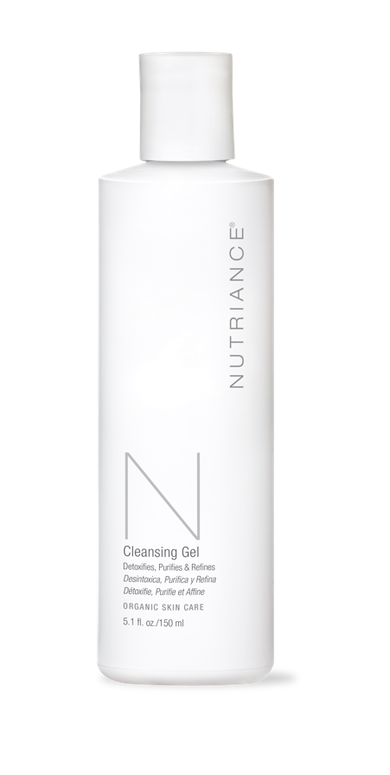
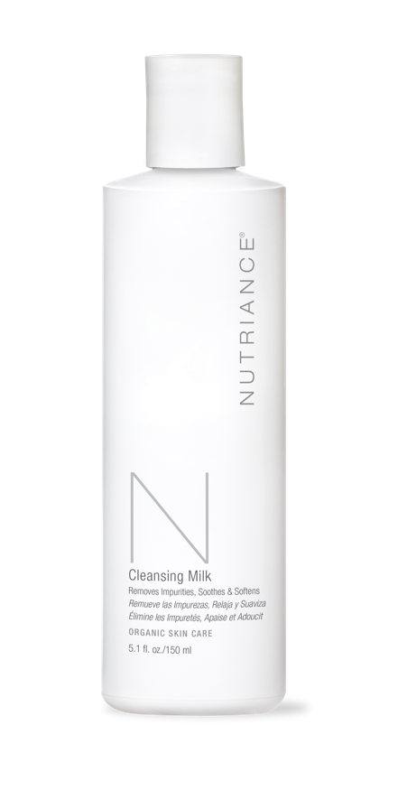


STEP 1
CLEANSE &
DETOXIFY
Notes:
The 3 step Age-Defying Cell Activating System begins with one of the most important factors affecting skin surface pH, skin cleansing.
Step 1 is designed to Cleanse & Detoxify
There are two products to choose from for your skin type, Cleansing Gel and Cleansing Milk.
Both of them are formulated with gently acting ingredients which naturally cleanse the skin surface and remove dead skin cells without dehydrating the skin. The range of botanicals ingredients work in synergy in a non–abrasive manner to preserve the integrity of the skin outer layer and pH.
Cleansing Milk for Normal to Dry skin.
Cleansing Gel for Combination to Oily skin

Slide 31
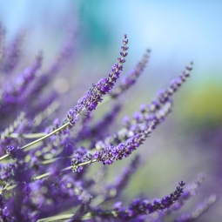
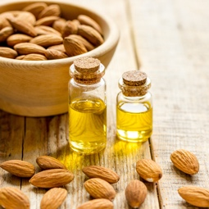
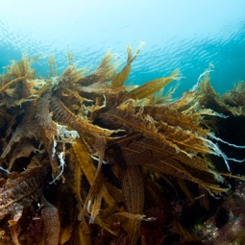
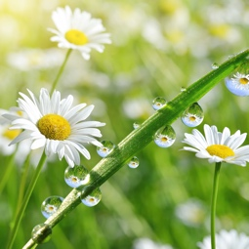

STEP 1
CLEANSE &
DETOXIFY
With Chamomile to soothe the skin.
Enriched with brown seaweed extracts and wheat peptides to protect and reinforce the skin’s natural barrier.
With nourishing and skin comforting essential oils to hydrate the skin.
Clinically proven to hydrate the skin.
Notes:
CLEANSING MILK
With Chamomile flower water to soothe the skin. Enriched with protective brown seaweed extracts and peptides to protect and reinforce the skin’s natural barrier. As well as nourishing and skin comforting essential oils, including sweet almond and English lavender, to hydrate the skin. A single application was found to increase skin hydration after 30 minutes and up to 4 hours after use. Nutriance Cleansing Milk cleanses perfectly and smoothly, leaving the skin soft and hydrated.

Slide 32
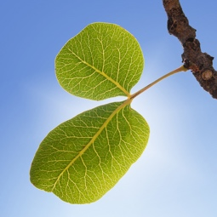

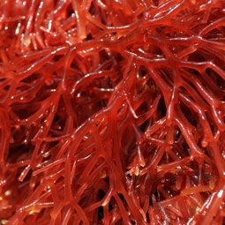
STEP 1
CLEANSE &
DETOXIFY
Pistacia lentiscus leaf extract renowned for its skin purification qualities
Hydrolyzed wheat proteins (wheat peptides) rich in essential amino acids
With red seaweed extract which reinforces the skin’s natural barrier
Dermatologically tested and found to be non-irritating
Notes:
CLEANSING GEL
Its unique isotonic formula delivers a high concentration of pure seawater with a rich natural diversity of minerals and trace elements to the epidermis to revitalize the cells. Pistacia leaf extract helps clear blocked pores through a natural decongestant. Red seaweed extract and peptides rich in essential amino acids, reinforce the skin’s natural barrier. Nutriance Cleansing Gel leaves the skin revitalized and rebalanced with a healthy glow.
• Pistacia lentiscus leaf extract renowned for its skin purification qualities.
• Hydrolyzed wheat proteins (wheat peptides) rich in essential amino acids which reinforces the skin’s natural barrier, nourishing, softening and soothing the skin.
• With red seaweed extract which reinforces the skin’s natural barrier.
• Dermatologically tested and found to be non-irritating.

Slide 33
CLEANSE
YOUR TURN TO…
Massage into face, using big circles on your cheeks and forehead, and smaller circles around your nose
Notes:
For this product we’re going to take a new cotton and saturate it. We apply the cleanser using gentle strokes, in a circular motion. Big circles on the cheeks and forehead, and smaller ones around the nose, really getting into those nooks and crannies. As you massage it into your face, the detoxifying action is removing dead skin cells and impurities.
Once you’ve cleansed your entire face, set your cotton aside, and now using the wet wash cloth at your station, gently blot your face. Don’t worry about excess product because the next step will take care of the rest.
Now you try…
Take your cotton pad or ball and saturate it with your cleanser of choice, and then pass the bottle to the next person. Be sure to get enough so that you can use both sides of the cotton, over your entire face.

Slide 34
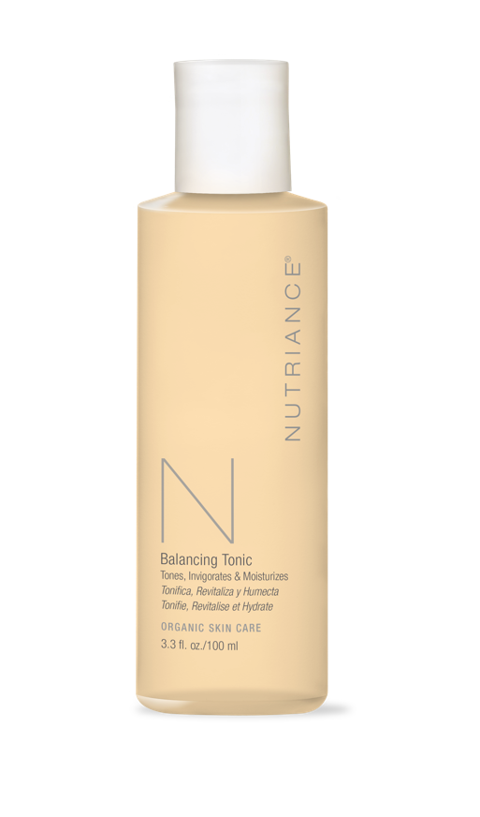
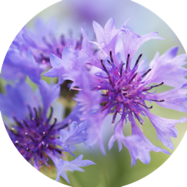
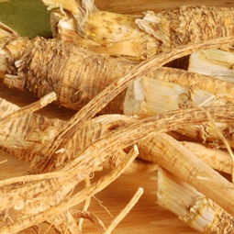
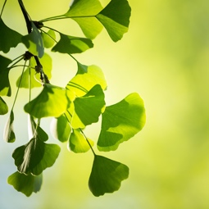
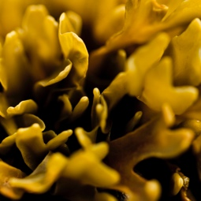
STEP 2
BALANCE &
INVIGORATE
With Cornflower water to soothe and soften the skin
With Panax ginseng and Ginkgo biloba with moisturizing and invigorating properties
With brown seaweed extract rich in iodine and magnesium which mineralize and balance the skin
Clinically proven to hydrate the skin
Notes:
Step 2: Step 2 is designed to Balance and Invigorate.
Restore normal pH and refine pores, texture & tone
Balancing Tonic
It is pH balanced and gentle enough for all skin types, with a clinically proven hydration effect lasting up to 4 hours. Organic Cornflower botanical water soothes and softens the skin. Ginseng and Ginkgo biloba plant extracts moisturize and invigorate the skin, and brown seaweed extract rich in iodine and magnesium mineralizes and balances the skin. Nutriance Balancing Tonic is light and refreshing.

Slide 35
BALANCE
YOUR TURN TO…
Apply using gentle strokes. Start from the center and glide outwards, over entire face.
Notes:
I find this product to be really light and refreshing. I especially love using it in the morning for its invigorating properties.
We’ll start by saturating a new cotton with the tonic. Apply it using gentle strokes. Start from top at the center of your forehead and glide outwards. Then we’ll move down to the middle of the face, from the nose, gliding outwards in either direction. And finally we’ll make our way down to the chin, gliding outwards in either direction and going back to any spots you may have missed or need extra attention.
Now you try…
Take your cotton pad or ball and saturate it with Tonic, and then pass it the bottle to the next person. Be sure to get enough so that you can use both sides of the cotton, over your entire face.

Slide 36
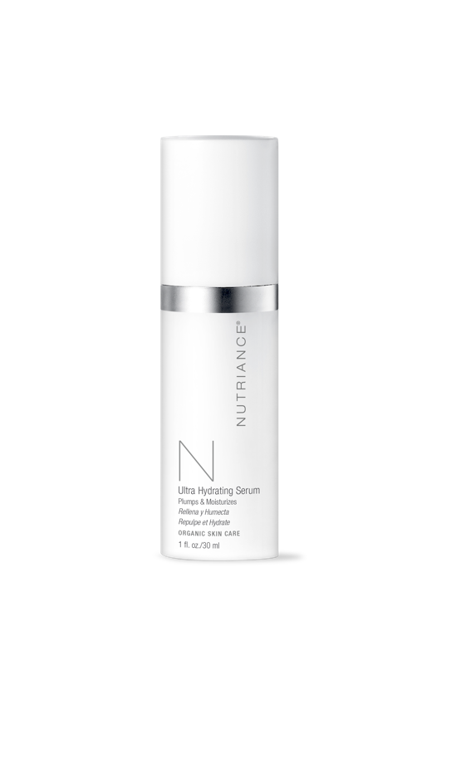

STEP 3a
ACTIVATE &
NOURISH
Notes:
Step 3 is designed to activate and nourish.
In this step you’ll revitalize stressed skin, reinforce natural defenses against aging, and renew cells to visibly restore skin’s youthful look
We’ll start with Part A, which features serums designed to penetrate the skin and deliver nutrients to activate your cells.
Combination to Oily - Hydrating serum
Normal to dry - Ultra hydrating serum

Slide 37
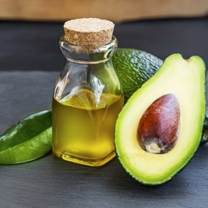
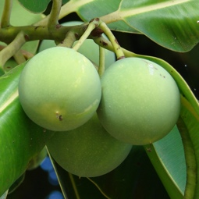
STEP 3a
ACTIVATE &
NOURISH
Essential oils from Avocado, Almond, Apricot, Tamanu and Jojoba
Hyaluronic acid, a powerful moisturizing agent, works in synergy with botanical extracts
Sea Fennel extract rich in polyphenols and essential oils and brown seaweed beta glucans
Clinically proven for visibly more moisturized and more radiant skin
Notes:
Ultra Hydrating Serum
Essential oils from Avocado, Almond, Apricot, Tamanu and Jojoba provide vitamins and essential fatty acids to nourish the skin. Hyaluronic acid, a powerful moisturizing agent, works in synergy with botanical extracts to plump the skin. Beta glucans from seaweed help strengthen the skin’s natural film of protection. A single application of Nutriance Ultra Hydrating Serum was clinically proven to dramatically boost skin hydration, an effect which lasted beyond 8 hours. Nutriance Ultra Hydrating Serum energizes and conditions the cells, preparing them for further nourishment.
• Nourishes – Essential oils from Avocado, Almond, Apricot, Tamanu and Jojoba provide vitamins and essential fatty acids to nourish the skin.
• Plumps - Hyaluronic acid, a powerful moisturizing agent, works in synergy with botanical extracts to plump and smooth the skin.
• Protects and Strengthens – With marine botanicals – Sea Fennel extract rich in polyphenols and essential oils and brown seaweed beta glucans to protect and reinforce the skin defenses.
• Clinically proven for visibly more moisturized and more radiant skin.

Slide 38
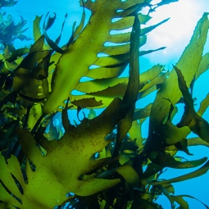
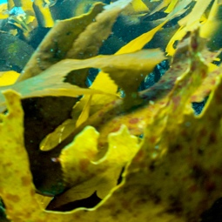
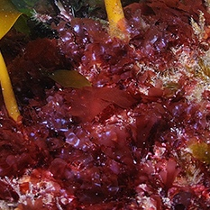
STEP 3a
ACTIVATE &
NOURISH
Sea Fennel extract, rich in natural essential oils.
Wrinkle-Fighting Complex of marine pentasaccharides (MPS) from green seaweed and galactomannan from the Tara tree
Red seaweeds alleviates any redness & bring radiance to the skin.
Clinically proven for a long-lasting soothing effect and visibly more moisturized skin.
Notes:
Nutriance Organic Hydrating Serum,
rich in marine botanicals formulated in a base containing the patented and pure Molène seawater.
Exclusive Wrinkle-Fighting Complex from marine pentasaccharides from green seaweed and the galactomannan from the Andean tree
Sea fennel extract, rich in natural essential oils, and Patented anti-inflammatory cucurbita pepo, pumpkin seed extract, soothes redness and alleviates stressed skin. Red seaweeds provide suppleness, brings radiance to the skin. The Hydrating Serum helps alleviate and rebalance stressed skin, creating a lasting feeling of freshness, and preparing it for further nourishment.
In a controlled trial, 100% of subjects reported that their skin felt more moisturized after just 1-week of daily applications with each of these exclusive creams.
• Contains Sea Fennel extract, rich in natural essential oils. Soothes redness and create a lasting feeling of freshness.
• With the Wrinkle-Fighting Complex of marine pentasaccharides (MPS) from green seaweed and galactomannan from the Tara tree, native tothe Andes.
• With red seaweeds to provide suppleness to the skin, to alleviate any redness and bring radiance to the skin.
• Clinically proven for a long-lasting soothing effect and visibly more moisturized skin.

Slide 39
ACTIVATE
YOUR TURN TO…
Gently apply using fingertips, first patting it on all over and then smoothing it out evenly.
Notes:
This time we’ll be using our hands. Pump the product into the palm of one hand, and now we’ll Gently apply the serum using our fingertips, first patting it on all over, and then smoothing it out evenly. It’s best to resist the urge to massage it in, and just let the active ingredients do their magic as they gradually absorb into the skin. Use any remaining product on your neck.
Really take note of how you feel, noticing the effects of the wrinkle fighting complex and plumping action.
Now you try…
Just pump into the palm of your hand and pass it to the next person. Get enough product to cover your face and neck.

Slide 40
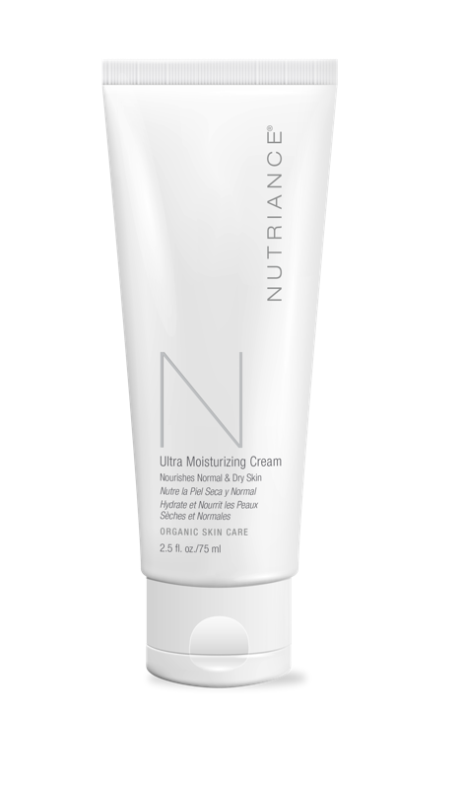

STEP 3b
ACTIVATE &
NOURISH
Notes:
Part B of Step 3 features moisturizers that nourish.
Combination to Oily - Moisturizing Cream
Normal to dry - Ultra-Moisturizing Cream

Slide 41
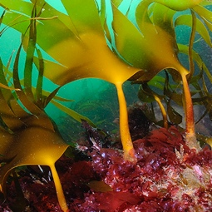
STEP 3b
ACTIVATE &
NOURISH
Marine botanicals from brown, green and red seaweed assist Active Cell Renewal processes
Contains the Wrinkle-Fighting Complex made from from green seaweed and the Tara tree, native to the Andes
Essential oils from Cranberry and Sunflower seeds
Clinically proven to provide a long-lasting 24-hour moisturizing effect
Notes:
Nutriance Organic Ultra Moisturizing Cream
Rich, nourishing and soothing cream designed for optimal hydration. Exclusive marine botanical red, green and brown seaweeds deliver a host of protective nutrients vital to your skin’s defense systems. This includes helping to assist skin cell renewal and the elimination of toxins, reducing skin inflammatory factors, protecting and strengthening the skin and working to help prevent wrinkle formation by stimulating collagen production. Peptides from wheat, renowned for their ability to provide a firming effect, improve the skin’s overall elasticity. Essential oils from Cranberry, Sunflower, and Arnica nourish and provide extra support for the skin’s protective lipid barrier.
Clinically proven to give 95% of people visibly softer and more supple skin.
Also clinically proven for a long-lasting moisturizing effect. A single application was found to increase skin hydration in a highly significant manner after just 30 minutes, and lasting for a full 24 hours.
Nutriance Ultra Moisturizing Cream extends the skin’s youthfulness by preserving the skin barrier integrity and providing protective nutrients vital to your skin’s natural defense systems. • The natural active principles found in the marine botanicals from brown, green and red seaweed work in synergy to nourish, soothe and boost skin‘s vital functions, helping to assist Active Cell • Renewal processes and protecting and reinforcing the skin’s barrier
• Contains the Wrinkle-Fighting Complex of unique botanical polysaccharides from green seaweed and the Tara tree, native to the Andes
• With essential oils from Cranberry and Sunflower seeds to nourish the skin and provide extra support for the skin’s protective lipid barrier

Slide 42
CLINICALLY PROVEN RESULTS
100%
FELT SKIN
MORE
SUPPLE
90%
FELT
SKIN LESS
STRESSED
>80%
FELT SKIN
MORE
RADIANT
Notes:
Clinically Proven Results for the Ultra Moisturizing Cream:
100% felt skin more supple
90% felt skin less stressed
More than 80% felt skin less stressed
“Furthermore after just 4 weeks of daily applications 100% of test participants felt their skin was more supple, 90% felt their skin was less stressed and better protected against the environment. The vast majority of subjects (76-86%) also judged their skin to be firmer and more radiant”.

Slide 43

LONG LASTING MOISTURIZING
60
55
50
ELECTRICAL CAPACITANCE (A.U)
45
40
35
30
0
5
10
15
20
25
TIME
(Hours)
Treated
Untreated
Notes:
a single application of Ultra Moisturizing Cream was shown to provide a long lasting, 24-hour moisturizing effect”.
In a 4-week Use test study participants were judged by and expert dermatologist to have:-
“Skin visibly more moisturized” and
“Skin visibly more nourished”

Slide 44

STEP 3b
ACTIVATE &
NOURISH
Wrinkle-Fighting Complex green seaweed and galactomannan from the Tara tree
Essential oils and flower extracts from nourishing Sunflower seed and Cranberry and soothing Arnica flower extract
Chamomile and English Lavender oils as well as conditioning Mandarin peel oil
Clinically proven to provide an 8-hour moisturizing effect
Notes:
Nutriance Organic Moisturizing Cream rich in nutritive and mineralizing elements from red, brown and green seaweed extracts and essential oils in a base of organic Witch Hazel, ideal for hydrating, strengthening and protecting the skin. Exclusive brown and red seaweeds soothe and boost the skin’s vital functions, helping to assist skin cell renewal and the elimination of toxins. Excellent nutritive properties and biocompatible sea minerals deliver a wealth of minerals, trace elements and nutritive amino acids.
Exclusive Wrinkle-Fighting Complex from marine pentasaccharides from green seaweed and the galactomannan from the Andean tree
Essential oils including Cranberry, Sunflower seed, Arnica, Chamomile, English Lavender, and Mandarin peel, nourish, soothe, and condition the skin while helping to support the skin’s protective lipid barrier. A single application was clinically proven to dramatically boost skin hydration, an effect which lasted beyond 8 hours.
Nutriance Moisturizing Cream provides conditioning care and helps restore a healthy youthful glow.
• Contains the unique Wrinkle-Fighting Complex from green seaweed and galactomannan from the Tara tree, native to the Andes.
• Essential oils and flower extracts from nourishing Sunflower seed and Cranberry and soothing Arnica flower extract, Chamomile and English Lavender oils as well as conditioning Mandarin peel oil to help support the skin’s protective lipid barrier.
• Clinically proven for visibly more moisturized and nourished skin.

Slide 45
CLINICALLY PROVEN RESULTS
95%
FELT SKIN
MORE
RADIANT
95%
FELT SKIN
SOFTER &
MORE SUPPLE
95%
FELT SKIN
BETTER
PROTECTED
Notes:
Clinically Proven Results for the Moisturizing Cream:
95% felt skin more radiant
95% felt skin softer and more supple
And 95% felt skin better protected
“Furthermore after just 4 weeks of daily applications 95% of test participants felt their skin was more radiant, less stressed, softer, more supple, strengthened and better protected against the environment”.

Slide 46

Notes:
We mentioned earlier that Nutriance Organic is brought to you by a global leader in the health and wellness industry, NeoLife International.
Let’s take a look at what we’re all about.

Slide 47


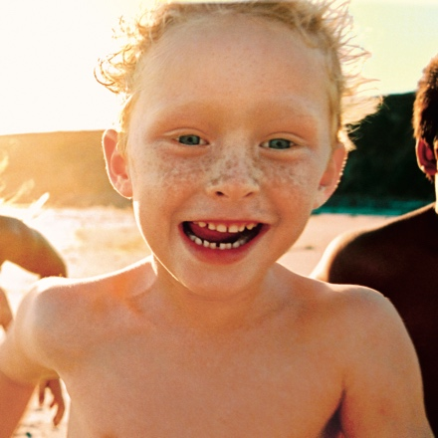


We are on a Mission to Make
the World a Healthier & Happier Place
Notes:
At NeoLife, <CLICK for NEXT SLIDE>

Slide 48



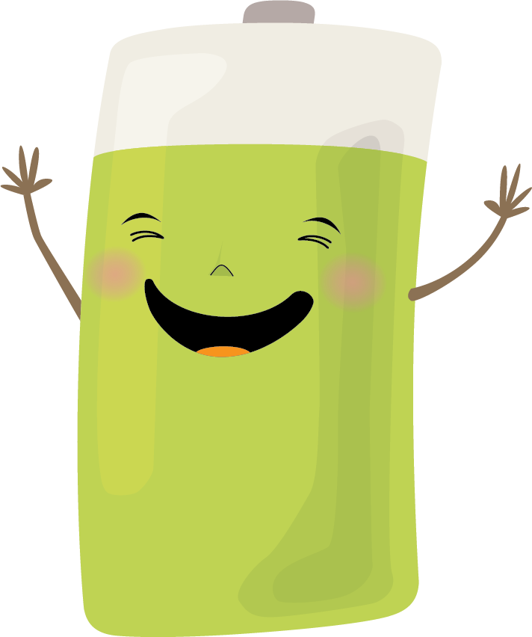


We are on a Mission to Make
the World a Healthier & Happier Place
Helping People Get Charged Up On Good Nutrition...
STARTING WITH YOU
Notes:
…we are on a mission to make the world a healthier and happier place. <CLICK for NEXT SLIDE>

Slide 49

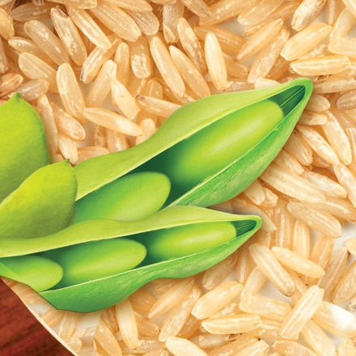
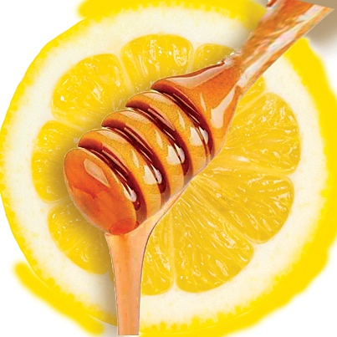
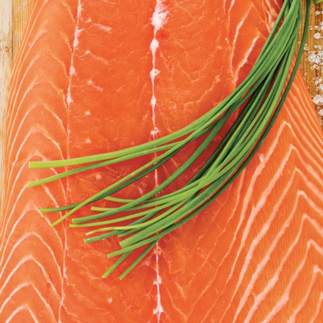


Helping People Get Charged Up On Good Nutrition...
STARTING WITH YOU
The finest whole food ingredients...
Products that are based in nature, and backed by leading edge science
Notes:
… helping people get charged up on good nutrition... starting with you. <CLICK for NEXT SLIDE>

Slide 50


Helping People Get Charged Up On Good Nutrition...
STARTING WITH YOU
The finest whole food ingredients...
Products that are based in nature, and backed by leading edge science
Founding Member Emeritus
Dr. Arthur Furst
RICH SCIENTIFIC HERITAGE
Pioneer in Cancer
Research & Toxicology
SCIENTIFIC ADVISORY BOARD
World Renowned Scientists & Nutrition Experts
Active, Published, Respected
John R. Miller
Laszlo P. Somogyi
Arianna Carughi
SAB Director, Product Technologist, Researcher
Ph.D. Food Scientist, Nutritionist
Fred G. Hooper
Ph.D., C.N.S. Nutritional Scientist
Ph.D. Biochemist, Nutritionist
David Shepherd
Mark Lowman
Liz Applegate
Diane Clayton
Biologist, Formulator, Quality Expert
Ph.D. Microbial Biochemist
Ph.D., Nutrition, Sports Nutritionist
Ph.D., R.Nutr., Biochemist,
Health Practitioner
Notes:
NeoLife’s superior quality nutrition products follow nature's blue print, using the finest whole food ingredients...
Products that are based in nature, and backed by leading edge science. <CLICK for NEXT SLIDE>

Slide 51




The finest whole food ingredients...
Products that are based in nature, and backed by leading edge science
RICH SCIENTIFIC HERITAGE
SCIENTIFIC ADVISORY BOARD
World Renowned Scientists & Nutrition Experts
Active, Published, Respected
Founding Member Emeritus
Dr. Arthur Furst
Pioneer in Cancer
Research & Toxicology
John R. Miller
Fred G. Hooper
Laszlo P. Somogyi
Arianna Carughi
SAB Director, Product Technologist, Researcher
Ph.D. Biochemist, Nutritionist
Ph.D. Food Scientist, Nutritionist
Ph.D., C.N.S. Nutritional Scientist
David Shepherd
Diane Clayton
Mark Lowman
Liz Applegate
Ph.D. Microbial Biochemist
Ph.D., R.Nutr., Biochemist,
Health Practitioner
Biologist, Formulator, Quality Expert
Ph.D., Nutrition, Sports Nutritionist
CORE
NUTRITION
Notes:
But knowledge is power and that’s why we’re so passionate about our time together and spreading the word about an exciting solution to this problem, developed by an elite, purpose-driven group of scientists.
These scientists serve on the Scientific Advisory Board of an international leader in the health and wellness industry, NeoLife International. Since 1958, NeoLife has pioneered nutrition supplementation, offering solutions to cellular nutrition long before most people even knew what a vitamin was. with a rich history of industry firsts and breakthrough discoveries that have paved the way for products like the first ever protein shakes, omega-3 supplements and antioxidant protection.

Slide 52




CORE
NUTRITION
Notes:
From core nutrition for a foundation of good health, <CLICK for NEXT SLIDE>

Slide 53




DIGESTIVE
HEALTH
Notes:
… to targeted solutions like heart health, immunity, <CLICK for NEXT SLIDE>

Slide 54





CHILDREN’S
NUTRITION
Notes:
… digestive health, children’s nutrition… <CLICK for NEXT SLIDE>

Slide 55












SPORT
NUTRITION
Notes:
… and sport nutrition to name just a few, NeoLife’s got you covered. <CLICK for NEXT SLIDE>

Slide 56
Notes:
But NeoLife really isn’t just a company, it’s a family of people like you and me who made the decision to take control of their health. <CLICK for NEXT SLIDE>

Slide 57

CLUB MEMBER BENEFITS
Free to Join
15% Discount
UNLOCK:
25%
off
30%
Whole Sale Discount
all Nutriance Organic when on Auto-Ship
NEOLIFE CLUB WEBSITE
Notes:
Becoming a Club Member is free, and all members automatically receive a 15% discount off retail. BUT if you have at least one product on auto-ship, you’ll unlock the full wholesale discount of 25% off all your orders!
And now, the company has decided to increase that discount to 30% off all Nutriance Organic products when you have an auto-ship.
You can choose to set up your Auto-ship with any product of your choice, from NeoLife. <<HOST NAME>> will make sure you get an application form to fill out before you leave.
Unlike a Promoter, you won’t earn income as a Club Member, but you’ll help your friends by sharing your club benefits with them through your free personalized <<CLICK for NEXT SLIDE>>>

Slide 58
NEOLIFE CLUB WEBSITE
WHY NEOLIFE
Notes:
… NeoLife club website. Your website is like a Costco or Sam’s Club membership that you can share with friends so they enjoy the same savings <<CLICK for NEXT SLIDE>>

Slide 59
NEOLIFE CLUB WEBSITE
WHY NEOLIFE
Notes:
Being a Promoter of the Club certainly isn’t for everyone, but if you enjoy helping others, there couldn’t be a better time to partner with us as we work together to end the trend. <<CLICK for NEXT SLIDE>>

Slide 60
INDUSTRY POTENTIAL
2018
2020
0
10
15
20
50
80
100
150
200
500
800
1,000
1,250
1,500
1,750
2,000
2,500 2,750 4,500 5,000
5,500 8,000
8,500
8,750
10,000
999,000,000,000
100,000,000,000
130,000,000,000
135,000,000,000
$139,000,000,000
Next trillion dollar
industry
Notes:
Skin care is a massive global industry and its expected to grow to more than $40 billion by 2020 (can you show a chart here that animates up to $40 billion in 2020?). Couple that with health and wellness, which is predicted to be the next trillion dollar industry, and that <<CLICK for NEXT SLIDE>>

Slide 61
INDUSTRY POTENTIAL
HUGE OPPORTUNITY
Notes:
… equals huge opportunity. <PAUSE for EFFECT> <<CLICK for NEXT SLIDE>>

Slide 62
















Promoters
Notes:
Other companies gain legitimacy and brand awareness with ads on TV and splash marketing campaigns.
But we do it through <<CLICK to REVEAL>>
Promoters. <<CLICK for NEXT SLIDE>>

Slide 63
Promoters
Real People.
=
Notes:
… Through People. <<CLICK for NEXT SLIDE>>

Slide 64
Because we believe in people.
Notes:
Because we believe in people. <<CLICK for NEXT SLIDE>>

Slide 65
With NeoLife,
you’re in business for yourself, but not by yourself.
Notes:
… So instead of paying advertisers, we pay you. And we have proven success systems and support so you’re in business for yourself, but not by yourself. <<CLICK for NEXT SLIDE>>

Slide 66


AGE-DEFYING
CELL ACTIVIATING
SYSTEM
Notes:
Now you’ve seen the benefits of joining NeoLife by becoming a Club Member or Promoter. But there’s one more thing we should mention before we say our goodbyes. In the midst of this exciting launch, the company has decided to offer unheard of savings, when you do one simple thing. And that’s Auto-Ship.
Auto-Ship is a convenient monthly home delivery, that can be changed or cancelled anytime with no penalty.
Becoming a Club Member is free, and all members automatically receive a 15% discount off retail. BUT if you have at least one product on auto-ship, you’ll unlock the full wholesale discount of 25% off all your orders!
And now, the company has decided to increase that discount to 30% off all Nutriance Organic products when you have an auto-ship.
You can choose to set up your Auto-ship with any product of your choice, from NeoLife. I will make sure you get an application form to fill out before you leave.
Unlike a Promoter, you won’t earn income as a Club Member, but you’ll help your friends by sharing your club benefits with them through your free personalized NeoLife club website. Your website is like a Costco or Sam’s Club membership that you can share with friends so they enjoy the same savings.
Being a Promoter of the Club certainly isn’t for everyone, but if you enjoy helping others, there couldn’t be a better time to partner with us as we work together to end the trend.
Skin care is a massive global industry and its expected to grow to more than $40 billion by 2020. Couple that with health and wellness, which is predicted to be the next trillion dollar industry, and that equals huge opportunity.
Other companies gain legitimacy and brand awareness with ads on TV and splash marketing campaigns.
But we do it through Promoters. Through People. Because we believe in people. So instead of paying advertisers, we pay you. And we have proven success systems and support so you’re in business for yourself, but not by yourself.
And with NeoLife’s 90-day Money-back guarantee, there’s really nothing to lose, except a few wrinkles.

Slide 67



LAUNCH PARTNER PACK
BUY FOUR 3-Step Systems
&
GET FREE
(1) Spa Hour Guide
Notes:
Launch Partner Pack: Get a free Spa Hour Guide with the purchase of four 3-Step Systems.

Slide 68
THANK YOU!
Notes:
Thanks for joining us for this Spa Hour. Be sure to let me know how I can best serve your needs and whether you want to become a Club Member or Promoter.

