Slide 1

SPEAKING OF MARKETS
You can’t predict the future, but you can prepare for it.
Presenter Name Victoria Verity, Regional Investment Consultant
Notes:
Investing can be one of the most rewarding and most challenging experiences in life. Fortunately, you don't have to do it alone. There are time-tested investment principles that work well amid market uncertainties. These principles—along with the guidance of a qualified financial professional—can help you achieve the investment outcomes that you and your family are counting on.
Today we are going to talk about:
What’s happening in markets right now
The themes T. Rowe Price is focused on in 2022
OPTIONAL: How to put current events in perspective (Navigating Uncertainty and Preparing for What’s Ahead sections)

Slide 2



What We’ll Talk About Today
Market Update
Navigating Uncertainty
Preparing for What’s Ahead
Notes:
OPTIONAL SLIDE IF COVERING ALL 3 TOPICS. Recommendation is to skip if only covering Market Update.
Today we are going to talk about:
What’s happening in markets right now
The themes T. Rowe Price is focused on in 2022
OPTIONAL: How to put current events in perspective (Navigating Uncertainty and Preparing for What’s Ahead sections)

Slide 3

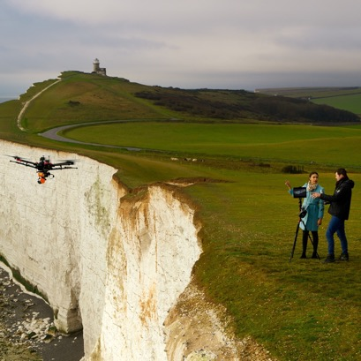



Transitioning to a New Paradigm
Navigating Challenging Currents
Fundamentals Matter
Flexible Fixed Income
Managing Through Geopolitical Risks
Notes:
Investors like yourselves have endured an extraordinary two years and entered 2022 hoping it would offer a return to normal. Instead, the markets have had to contend with inflationary pressures not seen in decades, fueled by the economic scars left by the pandemic and further aggravated by the war in Ukraine and China's zero-COVID policy. We are now at an inflection point in history; the world is likely going to change in ways that are difficult to predict, and this creates further complexity. Here are four key themes that T. Rowe Price investment leaders think could shape global capital markets:
Navigating Challenging Currents
Fundamentals Matter
Flexible Fixed Income
Managing Through Geopolitical Risks

Slide 4

Potential Investment Implications
As of June 30, 2022
Inflation and Central Banking Policy
Earnings Growth and Valuations
Fading Fiscal and Monetary Stimulus
Geopolitical Conflict
Impact of Virus Mutations and Pandemic Recovery
Environmental and Sustainability Targets
Notes:
There are wild cards with potential investment implications:
Inflation and Central Banking Policy
Earnings Growth and Valuations
Geopolitical Conflict
Fading Fiscal and Monetary Stimulus
Impact of Virus Mutations and Pandemic Recovery
Environmental and Sustainability Targets

Slide 5



The Price Is Not Right
As of September 2022
Rising Costs in 2022
Fuel Oil
69%
Used Cars
8%
Eggs
40%
Transportation
21%
Coffee
18%
Clothing
5%
Source: Bureau of Labor Statistics Consumer Price Index Report August 2022. All numbers are changes in inflation rate as a percentage change from August 2021 to August 2022.
Notes:
Inflation hit a 40-year high in 2021 and has not slowed in 2022 due to supply chain issues and commodity disruptions.

Slide 6


Global Interest Rate Cycle
As of September 30, 2022
Raising Rates, Dropping Stimulus: The Fine Balance
Too quick
Economic growth potentially falters,
and yield curves flatten
Too slow
Inflation continues to accelerate
⬤ Developed Countries
⬤ Developing Countries
START OF EASING:
RATES GOING DOWN
END OF EASING:
RATES BOTTOMING
START OF HIKING:
RATES GOING UP
END OF HIKING:
RATES PEAKING
Source: IMF; analysis by T. Rowe Price.
Country classifications in the chart are in line with IMF groupings as of the reporting date.
Notes:
With inflation in the headlines, many investors are concerned about rising interest rates. As the Federal Reserve chooses to raise interest rates in 2022, it will do so to keep the economy from growing too fast and causing sustained inflation. We have seen other countries go through the same cycle and have been through the cycle many times in our own history.

Slide 7
Curbing Our Enthusiasm
As of June 30, 2022
Global equity returns: We expect returns in many large markets to be restrained relative to recent history.¹
WHAT TO DO IN
YOUR PORTFOLIO:
Keep a long-term perspective
Stay diversified
Remember to rebalance
Cumulative Return (%)
Jul 2022
Past performance is not a reliable indicator of future performance.
Global equity returns are represented by MSCI All Country World Index. Total return in USD. It is not possible to invest directly in an index.
Source: FactSet. Financial data and analytics provider FactSet. Copyright 2021 FactSet. All Rights Reserved.
¹Based on T. Rowe Price Capital Market Assumptions. See Additional Disclosures at the end of the presentation.
Notes:
As supportive trends that have fueled the global economic rebound start to fade, it’s hard to envision equity markets expanding at the same record pace. We expect that growth will be off peak levels, monetary policy will continue to tighten, and fiscal stimulus will be at lower levels. Adding to these headwinds, equity markets are sitting at elevated valuations supported by low interest rates, input costs are rising, and earnings growth is expected to moderate. It’s best to keep a long-term perspective, stay diversified, and remember to rebalance.

Slide 8
Navigating uncertainty
Notes:
The current market environment certainly feels like no other.

Slide 9
How Have Geopolitical Crises Impacted Markets?
As of June 30, 2022
S&P 500 Index: Markets Have Eventually Recovered From Past Crises
Russia Invades Ukraine
U.S. Pulls Out
of Afghanistan
U.S./Iran Tensions
Escalate
Russia
Air Strikes
on Syria
Paris
Terrorist
Attacks
Putin Threatens War With Republic of Georgia
7/7 London Bombings
Russia Takeover
of Crimea
9/11 Terrorist Attacks
Russia Incursion Into Republic of Georgia
Start of
Iraq War
2000
2002
2004
2006
2008
2010
2012
2014
2016
2018
2020
2022
Past performance is no guarantee of future results.
Sources: T. Rowe Price, FactSet, Standard & Poor’s, and https://www.matteoiacoviello.com/gpr.htm. See Additional Disclosures on the back for more information about S&P data. It is not possible to invest directly in an index. Chart is for illustrative purposes only.
Notes:
Beyond the destruction and human suffering inflicted by the Russia-Ukraine conflict, the war has also had a major impact on financial markets. To better understand that impact, let’s look at other recent crises. Short-term market downturns may heighten anxiety among investors, but if the stock market’s historical trends hold true, a patient investor who absorbs short-term volatility may benefit over the long term.

Slide 10
How Have Pandemics Impacted Markets?
As of June 30, 2022
S&P 500 Index: Markets Have Eventually Recovered From Past Pandemics
Coronavirus (COVID-19)
Zika
MERS
Avian Flu (H5N1)
Swine Flu (H1N1)
SARS
2000
2002
2004
2006
2008
2010
2012
2014
2016
2018
2020
2021
Past performance is no guarantee of future results.
Source: T. Rowe Price analysis using data from FactSet and RIMES. It is not possible to invest directly in an index. Chart is for illustrative purposes only.
Notes:
Let’s also take a look at the impact that recent pandemics have had on markets. It is helpful to note that, when looking back at some of our darkest moments of the past, our society—including financial markets—collectively recovered and eventually came out stronger. Our hope is that the same will be true of this pandemic.

Slide 11
Looking at the Market Through a 15-Year Lens…
As of December 31, 2021
S&P 500 Index: Returns Tend to Stabilize Over the Longer Term
%
Past performance is not a reliable indicator of future performance.
Sources: T. Rowe Price, created with Morningstar Direct; S&P. See Additional Disclosures. Price return calculations include dividends and capital gains. Annual returns beginning in calendar year 1970. Rolling 15-year data beginning in 1970. It is not possible to invest directly in an index. Chart is for illustrative purposes only.
Notes:
OPTIONAL SLIDE
To illustrate this point further, let's take the last 50 years and look at one-year returns and rolling 15-year returns.
In 1970, the one-year return was 4%. But the average annual 15-year return ending in 1970 was 8%. In 1971, the one-year return was 14%; the 15-year return was 9%. One-year returns bounce around—a lot!
Taking a step back and looking at things from a broader perspective can help put the recent volatility into perspective.

Slide 12
Your Returns Are Likely Different From the Market
30 Years Ended December 31, 2021
Portfolio Performance
100
20/80
40/60
60/40
80/20
100
 | 100% Bonds | 20% Stocks 80% Bonds | 40% Stocks 60% Bonds | 60% Stocks 40% Bonds | 80% Stocks 20% Bonds | 100% Stocks
Return for Best Year | 18.5% | 22.1% | 25.8% | 29.7% | 33.6% | 37.6%
Return for Worst Year | -2.9% | -4.6% | -13.7% | -22.1% | -29.8% | -37.0%
Average Annual Nominal Return | 5.6% | 6.9% | 8.1% | 9.2% | 10.3% | 11.2%
Number of Down Years | 4 | 3 | 4 | 6 | 5 | 5
Average Loss (in Down Years) | -1.8% | -2.4% | -4.9% | -6.5% | -12.4% | -16.9%
These hypothetical portfolios combine stocks and bonds to represent a range of potential risk/reward profiles. For each allocation model, historical data are shown to represent how the portfolios would have fared in the past.
Figures include changes in principal value and reinvested dividends and assume the portfolios are rebalanced monthly. It is not possible to invest directly in an index. Past performance cannot guarantee future results.
Sources: T. Rowe Price, created with Zephyr StyleADVISOR; S&P; Bloomberg Index Ltd.; FTSE. See Additional Disclosures. Stocks, S&P 500 Index; Bonds, Bloomberg U.S. Aggregate Bond Index.
Notes:
It’s also important to recognize that your portfolio’s performance may look very different than general market returns, depending on your asset allocation. Your financial professional worked with you to develop your asset allocation based on your financial plan and goals. As the chart shows, portfolios with a higher percentage of stocks were more likely to experience dramatic short-term gains and losses than their bond-heavy counterparts. Over time, however, portfolios with a blend of stocks and bonds tended to offer higher returns than an all-bond portfolio with less volatility than an all-stock portfolio.
There isn’t a bulletproof investment that will safeguard your portfolio from market volatility and provide the growth potential needed to achieve your goals. An asset allocation strategy that aligns to your time horizon and your risk tolerance can help defend against market fluctuations.

Slide 13
Past Bear Markets Have Typically Been Followed by Longer-Term Bull Markets
 |  |  |  | % Cumulative Gain After Trough
Event | Duration | % Drop¹ | Recovery² | 1 Year | 5 Years
■ Tech Bubble Crash | 2.5 years | -48.77% | 5 years | 33.73% | 101.50%
■ Pre-Iraq War | 3.5 months | -14.71% | 2.5 months | 38.22% | 64.93%
■ Global Financial Crisis | 1.5 years | -56.39% | 4 years | 66.83% | 174.53%
■ Greek Debt Crisis/Flash Crash | 2.5 months | -15.61% | 4 months | 30.83% | 103.09%
■ Debt Ceiling Debates/S&P Downgrade | 5 months | -19.39% | 3 months | 32.00% | 96.61%
■ Post QE/China Growth Slowdown | 6 months | -13.07% | 4 months | 27.29% | N/A
■ January/February 2018 Correction | 0.5 months | -10.16% | 6.5 months | 4.92% | N/A
■ Q4 2018 Sell-Off | 2 months | -19.78% | 4 months | 37.10% | N/A
Coronavirus Shock | 1 month | -33.93% | 5 months | 74.78% | N/A
Bear Market
Correction
Past performance is not a reliable indicator of future performance. Index performance is for illustrative purposes only and is not indicative of any specific investment. Investors cannot invest directly in an index.
Sources: Standard & Poor’s, Morningstar; analysis by T. Rowe Price.
¹ Drop is based on the percentage drop from the highest market index value just prior to the correction to the lowest market index value.
² Recovery is defined as the length of time for the market to return to the previous highest market index value, rounded to the nearest number of months.
Notes:
Historically, bear markets have been temporary and were typically followed by longer-term bull markets.
When the market is volatile, it’s tempting to cash out and stop the bleeding. But that course of action misses a crucial aspect of how markets work: Prices instantly reflect investors’ expectations about the future. It is very difficult to predict the exact bottom or when sentiment will shift.
And that’s only half the battle. Those who manage to get out before another market drop must decide when to get back in, which is never clear. Market turns tend to be sudden. By the time it feels safe, the market is often sharply higher, leaving investors with regret about missing the bottom. In addition, an investor may be tempted to wait for the market to revisit its lows, an opportunity that may never come.
Preretirees and retirees may wonder if they even have time to wait for stocks to recover. If history is any guide, the answer is most likely yes. There have been 10 bear markets in the U.S. since 1948, excluding the most recent one, as measured by a 20% or greater decline in the S&P 500 Index. The average number of years from peak to recovery—that is, the time it took for the S&P 500 to climb back to its previous high—was 3.9 years, and the median was 2.7 years. On five of those occasions, the market recovered in two years or less. In other words, market downturns tend to feel a lot longer than they are.

Slide 14
Preparing for What's Ahead
Notes:
Why do people want to do something in the first place?
Activity reduces anxiety, but the wrong activity can make the situation worse!

Slide 15

In Stressful Situations, We Have a Bias for Action
Kick
Direction
Left 32%
Center 29%
Right 39%
Data do not add to 100% due to rounding. Source: Bar-Eli, Michael, et al., Action bias among elite soccer goalkeepers: The case of penalty kicks, Journal of Economic Psychology (28) 207, pg. 612.
Notes:
OPTIONAL SLIDE 15-16
Let's look at an example.
In the game of soccer, there's a situation where a player gets a chance to try to kick the ball into the goal with only the opposing goalkeeper playing defense—it's called a penalty kick. The player can kick the ball toward the left side of the goal, toward the middle, or toward the right side. And when someone looked at where players actually kicked the ball, they found that it was a pretty even distribution between those three options.
Now let's look at this from the goalkeeper's perspective. To try to block the shot, they have the choice of jumping to the left, jumping to the right, or staying in the center. You'd expect that they, too, would evenly distribute their jumps—with, perhaps, a slight bias toward staying in the center since their odds of actually blocking the shot there are a bit higher because even if they jump to a side, they still might not be able to reach the ball.

Slide 16

But That Doesn't Always Work in Our Favor
Kick Goalie
Direction Jumped
Left 32% 49%
Center 29% 6%
Right 39% 44%
Data do not add to 100% due to rounding. Source: Bar-Eli, Michael, et al., Action bias among elite soccer goalkeepers: The case of penalty kicks, Journal of Economic Psychology (28) 207, pg. 612.
Notes:
OPTIONAL SLIDE 15-16
Instead, goalkeepers almost always jump. In the same way, we're always tempted to change course because we think, “This time, it's different." But that may not be accurate.
As our economy has evolved from agrarian to knowledge-based, there have been many stressful situations. Even in the last several decades, we've seen stagflation and globalization in the 1970s, high interest rates in the '80s, booms and busts in the '90s and 2000s, and new technologies like cryptocurrency today. And there will be more disruptions in the future.
In times of stress, we feel the need to do something—even when the best course of action may be to stick with the plan we already have!

Slide 17
Fear of Loss Can Lead to Bad Decisions
In the past, investors who maintained their stock exposure through market downturns tended to fare better than investors who cashed out.
Outcomes for Different Styles of Investors
Both began investing $2,000 each quarter beginning 1990 through December 31, 2021
Investor 1—Steady
Balance as of 12/31/21
U.S. Dollars
Investor 2—Anxious
● Investor 2—In
● Investor 2—Out
Tech Bubble
Crash
Global
Financial
Crisis
Flash
Crash
U.S.
Credit Downgrade
2018 4Q
Sell-Off
Coronavirus Shock
IN
OUT
IN
OUT
IN
IN
OUT
IN
OUT
IN
OUT
Past performance is not a reliable indicator of future performance. Index performance is for illustrative purposes only and is not indicative of any specific investment. Investors cannot invest directly in an index.
Sources: Standard & Poor’s, Morningstar; analysis by T. Rowe Price.
The "anxious" style of investor is assumed to be invested in 3-month Treasury bills as a cash equivalent. The $2,000 contributed each quarter in this example assumes minimal interest earned. The anxious style of investor also assumes that cash is invested in Treasury bills during those periods when not invested in the stock market. The performance of stocks shown is that of the S&P 500 Index, which measures the performance of large-capitalization companies that represent a broad spectrum of the U.S. economy. This chart is for illustrative purposes only.
Notes:
There have been studies demonstrating that investors feel the pain of losses more than the positives of market gains. But what happens when investors act solely because of that negative feeling?
Let’s consider two hypothetical investors—the first sticks to their investment strategy despite market fluctuations, and the second becomes anxious during volatile markets and jumps in and out.
Both investors contributed $2,000 each quarter to their investment accounts in 1990. The steady investor (dark blue in the chart) kept their money and ongoing contributions invested, riding out the stock market’s ups and downs. The anxious investor (orange) moved their account balance and contributions to cash when stocks dropped 10% or more in a quarter and only jumped back in to equities after a fourth consecutive quarter of positive returns.
This behavior was repeated throughout several market cycles. While both investors saw their portfolio balances decline during downturns, they continued to contribute to their accounts. The steady investor took advantage of lower stock prices through their ongoing contributions and was rewarded as the market recovered. Ultimately, the anxious investor’s account value ($376,386) was less than one-quarter of the steady, long-term investor’s account ($1,787,135) at the end of the period.

Slide 18
Fear of Future Regret Is a Better Guide
As of December 31, 2021
Growth of $10,000
$271,660
Stocks
Bonds
Cash
60% Stocks, 40% Bonds
$155,010
$54,416
$21,361
Dec ’21
Sources: T. Rowe Price, created with Zephyr StyleADVISOR; S&P; Bloomberg Index Services Ltd. and FTSE. See Additional Disclosures. Past performance cannot guarantee future results. It is not possible to invest directly in an index. Chart is shown for illustrative purposes only. Stocks: S&P 500 Index, Bonds: Bloomberg U.S. Aggregate Bond Index, and Cash: FTSE 3 Month US T-Bill Index.
Notes:
Instead of acting on a fear of loss, ask yourself, “What will I regret in the future?” What I have experienced over the long term is that investors regret not buying great assets in times of crisis. In the short term, anything can happen, but history tells us that in the long term, stay invested to take advantage of the stock market’s growth potential.
Although the stock market has experienced several major downturns since 2000, history shows that stock markets eventually recover—though past performance cannot guarantee future results. The chart demonstrates how the market has fluctuated over past decades. While stocks saw some drastic dips, they also rallied periodically for strong gains.
Over a long-term time horizon, stocks provide a higher return potential when compared with bonds or cash. The red line represents a 60/40 allocation of stocks and bonds, which has generated significantly higher returns than an all-bond portfolio with less volatility than an all-stock portfolio.

Slide 19
Strike the Right Balance
As of December 31, 2021
Annualized Return | Risk¹
6.6% | 9.1%
Regular rebalancing can help keep your asset allocation on
track and aligned with your long-term investment objectives.
$408,435
$384,237
Annualized Return | Risk¹
6.3% | 8.2%
Annual Rebalancing Contributed $24,199 More Value
Technology Bubble
Financial
Crisis
2000 | 2002 | 2004 | 2006 | 2008 | 2010 | 2012 | 2014 | 2016 | 2018 | 2020 | 2021
Past performance is not a reliable indicator of future performance. Index performance is for illustrative purposes only and is not indicative of any specific investment. Investors cannot invest directly in an index.
Sources: Russell, MSCI, Bloomberg Index Services Ltd. See Additional Disclosures for more details.
Hypothetical portfolio assuming an investment on December 31, 1996, in a balanced portfolio: 36% large-cap U.S. stocks (Russell 1000 Index), 6% small-cap stocks (Russell 2000 Index), 18% international stocks (MSCI EAFE Index), and 40% U.S. investment-grade bonds (Bloomberg U.S. Aggregate Bond Index). In one scenario, the portfolio is never rebalanced; in the other scenario, the portfolio is rebalanced annually to maintain the original target asset allocation.
¹Risk is measured by standard deviation. Standard deviation is a measure of volatility that indicates the range of possible outcomes for a portfolio—positive or negative—over a given period of time. The higher the standard deviation, the greater the volatility or market risk.
Notes:
In terms of potential actions you can take, consider rebalancing. Market volatility can unintentionally alter your asset allocation. Regular rebalancing is designed to keep your portfolio on track to meeting your long-term investment objectives.

Slide 20

Review your financial plan with your financial professional, and consider these potential actions.
Notes:
In addition to rebalancing, consider these potential actions.
First, think about your financial goals and whether they have changed over the last few months.
You can also talk to your financial professional about your concerns and determine if you need to make adjustments to your financial plan.

Slide 21
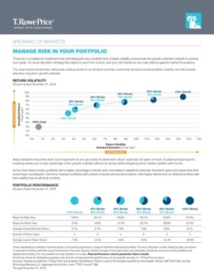
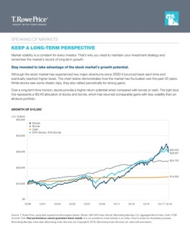
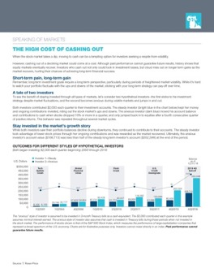
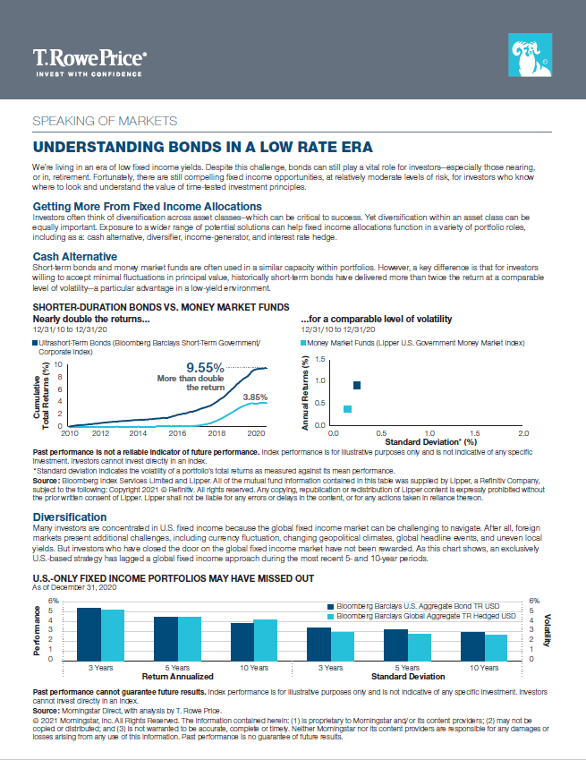
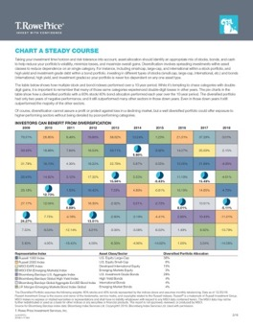
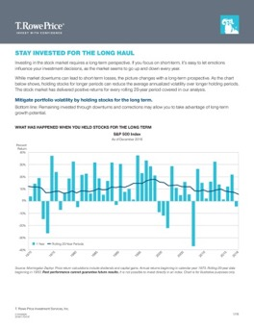
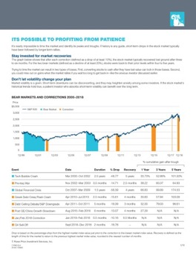
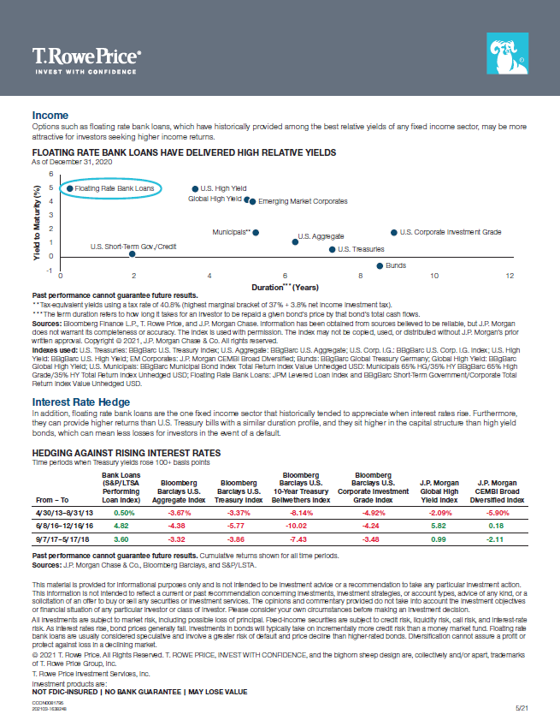
Speaking of Markets Resources
Better investment outcomes are possible. Understanding the current market and how to respond can help you achieve them.
Keep a long-term perspective
Stay
diversified
Remember to rebalance
Understand the role of fixed income
For illustrative purposes only.
Notes:
Ultimately, a better understanding of the market, and how you can respond to changing conditions, could lead to better investment outcomes for you.
Schedule an appointment with your financial professional to keep the conversation going and discuss your options for navigating an uncertain market.

Slide 22
Additional Disclosures
“Bloomberg®” and Bloomberg Indices are service marks of Bloomberg Finance L.P. and its affiliates, including Bloomberg Index Services Limited (“BISL”), the administrator of the index (collectively, “Bloomberg”) and have been licensed for use for certain purposes by T. Rowe Price. Bloomberg is not affiliated with T. Rowe Price, and Bloomberg does not approve, endorse, review, or recommend this product. Bloomberg does not guarantee the timeliness, accurateness, or completeness of any data or information relating to this product.
Copyright © 2022, S&P Global Market Intelligence (and its affiliates, as applicable). Reproduction of any information, data or material, including ratings (“Content”) in any form is prohibited except with the prior written permission of the relevant party. Such party, its affiliates and suppliers (“Content Providers”) do not guarantee the accuracy, adequacy, completeness, timeliness or availability of any Content and are not responsible for any errors or omissions (negligent or otherwise), regardless of the cause, or for the results obtained from the use of such Content. In no event shall Content Providers be liable for any damages, costs, expenses, legal fees, or losses (including lost income or lost profit and opportunity costs) in connection with any use of the Content. A reference to a particular investment or security, a rating or any observation concerning an investment that is part of the Content is not a recommendation to buy, sell or hold such investment or security, does not address the suitability of an investment or security and should not be relied on as investment advice. Credit ratings are statements of opinions and are not statements of fact.
London Stock Exchange Group plc and its group undertakings (collectively, the “LSE Group”). © LSE Group 2021. FTSE Russell is a trading name of certain of the LSE Group companies. Russell® is a trademark of the relevant LSE Group companies and is used by any other LSE Group company under license. All rights in the FTSE Russell indexes or data vest in the relevant LSE Group company which owns the index or the data. Neither LSE Group nor its licensors accept any liability for any errors or omissions in the indexes or data and no party may rely on any indexes or data contained in this communication. No further distribution of data from the LSE Group is permitted without the relevant LSE Group company’s express written consent. The LSE Group does not promote, sponsor or endorse the content of this communication. The LSE Group is not responsible for the formatting or configuration of this material or for any inaccuracy in T. Rowe Price Associates’ presentation thereof.
© 2021 Morningstar, Inc. All rights reserved. The information contained herein: (1) is proprietary to Morningstar and/or its content providers; (2) may not be copied or distributed; and (3) is not warranted to be accurate, complete, or timely. Neither Morningstar nor its content providers are responsible for any damages or losses arising from any use of this information. Past performance is no guarantee of future results.
MSCI and its affiliates and third party sources and providers (collectively, “MSCI”) makes no express or implied warranties or representations and shall have no liability whatsoever with respect to any MSCI data contained herein. The MSCI data may not be further redistributed or used as a basis for other indices or any securities or financial products. This report is not approved, reviewed, or produced by MSCI. Historical MSCI data and analysis should not be taken as an indication or guarantee of any future performance analysis, forecast or prediction. None of the MSCI data is intended to constitute investment advice or a recommendation to make (or refrain from making) any kind of investment decision and may not be relied on as such.
Haver Analytics—(Ministry of Health, Labour & Welfare, Statistical Office of the European Communities, Bureau of Labor Statistics, US Bureau of Labor Statistics, US Bureau of Economic Analysis, European Central Bank, Standard & Poor’s Bureau of Economic Analysis, Federal Reserve Board, Tax Policy Center and Citizens for Tax Justice, China National Bureau of Statistics, Bank of Korea)/Haver.
Copyright © 2021 IHS Markit. All rights reserved.
J.P. Morgan Chase—Information has been obtained from sources believed to be reliable but J.P. Morgan does not warrant its completeness or accuracy. The index is used with permission. The Index may not be copied, used, or distributed without J.P. Morgan’s prior written approval. Copyright © 2021, J.P. Morgan Chase & Co. All rights reserved.
Financial data and analytics provider FactSet. Copyright © 2022 FactSet. All Rights Reserved.
Notes:
Please see the Important Information

Slide 23
Glossary of Indices
Additional Disclosures
T. Rowe Price Capital Market Assumptions
T. Rowe Price Capital Market Assumptions are published annually and are best understood as forecasts for the central tendency of forward returns. We do not seek to predict actual or realized returns. Our baseline forecasts incorporate the insights of senior portfolio managers and analysts across our equity, fixed income, and multi-asset divisions. The foundation of our capital market assumptions is a survey provided to a wide range of senior T. Rowe Price portfolio managers, economists, and analysts across our equity, fixed income, and multi-asset divisions. The survey requests forecasts for many inputs: GDP growth, inflation, commodity prices, equity valuations, earnings growth, fixed income yields, slopes of yield curves, and spread levels. After all surveys are collected, baseline forecasts are developed for each asset class. The Capital Market Assumptions Governance and Investment Committee then reviews the results for internal consistency and reasonableness.
MSCI All Country World Index: The MSCI ACWI is a market capitalization-weighted index designed to provide a broad measure of equity market performance throughout the world.
The index is composed of stocks from both developed and emerging markets and contains stocks from 46 different countries. There are 23 countries classified as developed markets and 23 countries considered emerging markets.
Russell 3000 Index: The Russell 3000 Index tracks the 3,000 largest U.S. companies, as determined by market capitalization.
MSCI Emerging Markets Index: The MSCI Emerging Markets Index is an index designed to measure equity market performance in global emerging markets. It is a float-adjusted market capitalization index that consists of indices in 23 emerging economies: Brazil, Chile, China, Colombia, Czech Republic, Egypt, Greece, Hungary, India, Indonesia, South Korea, Malaysia, Mexico, Peru, Philippines, Poland, Qatar, Russia, South Africa, Taiwan, Thailand, Turkey, and the United Arab Emirates.
Bloomberg Global Aggregate Bond Index (Hdg): The index is a market-weighted index of global government, government-related agencies, corporate, and securitized fixed income investments. The index is hedged to the U.S. dollar.
J.P. Morgan EMBI Global Diversified: A comprehensive emerging market debt benchmark. It is denominated in U.S. dollars and is uniquely weighted to allow for a more equal distribution of countries included in the index.
S&P 500 Index: The Standard & Poor's 500, often abbreviated as the S&P 500, is an American stock market index based on the market capitalizations of 500 large companies having common stock listed on the NYSE or NASDAQ.
Notes:
Please see the Important Information

Slide 24
Important Information
This material is provided for general and educational purposes only, and is not intended to provide legal, tax or investment advice. This material does not provide recommendations concerning investments, investment strategies, or account types; it is not individualized to the needs of any specific investor and not intended to suggest any particular investment action is appropriate for you. Please consider your own circumstances before making an investment decision.
Under no circumstances should this material, in whole or in part, be copied, redistributed, or shown to any person without prior consent from T. Rowe Price. This material does not constitute a distribution, offer, invitation, recommendation, or solicitation to sell or buy any securities in any jurisdiction. The views contained herein are those of the authors as of the date noted and are subject to change without notice. These views may differ from those of other T. Rowe Price associates. Information and opinions, including forecasts and forward-looking statements, are derived from proprietary and nonproprietary sources deemed to be reliable; the accuracy of those sources is not guaranteed, and actual results may differ materially from expectations.
Past performance is not a reliable indicator of future performance. Index performance is for illustrative purposes only and is not indicative of any specific investment. Investors cannot invest directly in an index. All investments are subject to market risk, including the possible loss of principal.
Fixed income securities are subject to credit risk, liquidity risk, call risk, and interest rate risk. As interest rates rise, bond prices generally fall. Floating rate bank loans are usually considered speculative and involve a greater risk of default and price decline than higher-rated bonds.
International investments can be riskier than U.S. investments due to the adverse effects of currency exchange rates, differences in market structure and liquidity, as well as specific country, regional, and economic developments. These risks are generally greater for investments in emerging markets.
All charts and tables are shown for illustrative purposes only.
T. Rowe Price Investment Services, Inc., Distributor.
T. Rowe Price Retirement Plan Services, Inc.
© 2022 T. Rowe Price. All rights reserved. T. Rowe Price, INVEST WITH CONFIDENCE, and the bighorn sheep design are, collectively and/or apart, trademarks of T. Rowe Price Group, Inc.
Investment products are:
NOT FDIC-INSURED | NO BANK GUARANTEE | MAY LOSE VALUE
Notes:
Please see the Important Information

Slide 25
CCON0104387
202206-2252076
1/22
Notes:
Thank you

