Slide 1




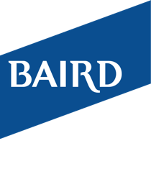
Discover the Difference
THE PERRINI CAIN GROUP
Can Make

Slide 2
Our Difference - We Build, Preserve & Transfer Wealth
Our Firm
Baird's private employee ownership delivers a cultural difference.
At all levels, we expect the client to immediately feel the compassion we have for our clients, the care that goes into the results we deliver and the passion we have for the work we do. As shareholders of a client first company, our interests are perfectly aligned, and we understand that the company will succeed only if the client does.
We pride ourselves in our responsiveness and accountability. When you call the office, you will almost always be answered by one of The Perrini Cain Group members who will do our best to address your need or concern immediately. Both our Operations and Customer Service teams are based in the US Midwest and have the same passion to deliver timely results.
Our Practice
Wealth Preservation is not an accident and Wealth Transitions don't happen spontaneously. Both are planned.
The Perrini Cain Group has the knowledge and experience to help prepare our clients for the transition from early wealth creation needs to sustained accumulation strategies and ultimately multi-generational wealth preservation.
We are a Family Wealth Services Team. This exclusive designation allows us to partner with the necessary scope of experts to meet the needs of families with multi-generational wealth preservation. We see this process as an opportunity to not only fulfill your vision but also your legacy.
Our Relationship
Considerable wealth precipitates complexity - you need a Wealth Champion
We build relationships rooted in trust and expertise, so you become confident with us advising on the distinctive issues and objectives of your family. This deep understanding of the family, positions us at the center of your advisory network.
We tailor our approach to each individual situation. We Build, Preserve and Transfer Wealth by managing the assets, developing the plan and maneuvering with change. Thus, we are beyond consulting and fully accountable. As the actual Discretionary Portfolio Manager, we are in a unique position to bring total accountability and extensive investment experience directly to the client by constructing proprietary, quality driven, time-tested portfolios.

Slide 3





What We Can Do for You
Investment Consulting | Advanced Planning | Family Wealth Services | Business Solutions
Management of all investment elements to maximize the probability of clients achieving all that is important to them Portfolio Performance Analysis Risk Evaluation Asset Allocation Assessment of Costs Assessment of Taxes Investment Policy Statement | Individualized Financial Planning Retirement & Income Planning Estate Planning Strategy Tax Efficiency Strategy Risk Management & Insurance Legacy & Charitable Giving Education Funding | Trust, Legacy Planning & Fiduciary Services Family Meetings & Preparation of Rising Generation Philanthropy Tax Planning Risk & Liability Management Cyber Security Partner Provided: Tax and Accounting Services for both corporate and personal Estate, Legal and Advisory Documentation Services | Business Owner Planning/Transaction Solutions Global Investment Banking Baird Private Equity Capital Executive Compensation

Slide 4


Baird Family Wealth
Family · Business · Legacy Wealth
We recognize that high net worth families need a deeper and broader spectrum of services that go beyond investment consulting and advanced planning. Our Team offers a bespoke wealth management experience that supports the preservation and growth of multi-generational wealth.
In partnership with Baird Family Wealth, we take the time to understand your needs and complex legacy considerations, developing meaningful relationships with you and your family along the way.
Our approach focuses on the “why” behind your financial and legacy goals, as we concentrate on what makes your family unique, and how we can best support you across generations.
Once we’ve reached this understanding, we formulate a plan built specifically for you and your family.

Slide 5
Private Investment Management Overview
Beyond Consulting & Fully Accountable
The Perrini Cain Wealth Management Group goes beyond the typical investment consulting approach of simply using third party managers which often results in an additional layer of fees and low accountability. Our credentials, experience and wisdom provides the client significant depth in their investment management and holds us to the front line of accountability.
Key Highlights
Quality Portfolios Easy to Understand Ongoing Portfolio Management Risk Management Tax Efficiency Direct Access to Portfolio Managers Individual Investment Policy Statement Transparent Business Philosophy
What is Private Investment Management (PIM)
PIM is a fully discretionary portfolio platform managed by the Perrini Cain Group. PIM portfolios are constructed of investments (primarily individual stocks and bonds) designed to manage risk and achieve the specific objectives according to a formal investment policy statement. PIM Managers are highly credentialed undergoing rigorous scrutiny and due diligence to ensure they employ best practices and comply with stringent industry regulations. PIM Managers have access to Baird's own industry-leading equity and fixed income research analysts, plus outside research from many leading providers and can coordinate account management with you other professional advisors to facilitate more integrated tax, financial and estate planning strategies.
“As your wealth management partner, we are accountable to one person – you. Nobody wins unless you win.” – Michael Perrini, Managing Director PIM Portfolio Manager

Slide 6
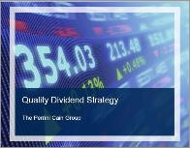
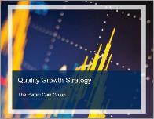

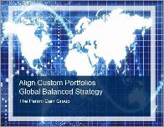
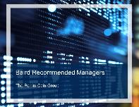
Private Investment Management Strategies
^{QUALITY DIVIDEND}
This pure-equity strategy invests in quality, primarily US companies offering attractive dividend income and capital appreciation potential. We attempt to maintain a diversified blend of dividend-yielding stocks across multiple US sectors, while adhering to critical and carefully researched risk parameters.
^{QUALITY GROWTH}
This portfolio is comprised primarily of common stocks of large U.S. companies that have the potential for above-average earnings growth and are well-established in their respective industries. The portfolio offers the potential for long-term capital appreciation by investing in leading companies in industries we believe are poised for long-term growth. It gives investors a convenient way to invest in "blue chip" growth companies that enjoy strong market positions, season management teams, solid financial conditions, and above-average earnings growth and profitability potential.
^{FIXED INCOME}
Our Fixed Income Core Plus approach seeks to balance preservation of principal with income production and allows for modest capital appreciation by strategically adapting to changing market environments. We pursue these investment objectives through a two-component allocation strategy. The core bond component, the larger of the two, is comprised of individual bonds. The satellite component is implemented using funds selected based on the relative attractiveness of other income producing asset classes.
^{GLOBAL BALANCED}
The Global Balanced Strategy is largely funds based and offers clients a convenient and cost-effective way to participate in a highly diversified, global strategy in equity, fixed income and alternative asset classes. All security selections are screened, research covered and monitored by Baird’s Align platform investment management team.
^{BAIRD RECOMMENDED MANAGERS}
Baird's Recommended Manager program is appropriate for clients who wish to own underlying stocks or bonds and have professional management by a research recommended third party money manager. The managers are selected from the Recommended Managers List, a carefully vetted group of approximately 30 money managers and 60 investment options that meet stringent criteria set by Baird's Asset Manager Research group. The independent money managers utilize Separately Managed Accounts (SMAs) to create an investment portfolio on behalf of the client. The manager has full discretion in making investment decisions on behalf of the client.

Slide 7


The Perrini Cain Group
Experienced · Trusted · Accountable
The Perrini Cain Group is a team highly credentialed in our expertise and complimentary in our skillset. We are in a UNIQUE position with a PIM Manager to bring total accountability DIRECTLY to our clients by constructing proprietary, quality driven, time-tested portfolios as a discretionary portfolio manager. Working with full families, across their multiple generations and needs, we help them build, preserve, and transfer wealth throughout the many turns of a lifetime. We build relationships rooted in trust, so you become confident with us advising on the distinctive issues and objectives of your family. This deep understanding of the family, positions us at the center of your advisory network allowing us to shoulder your worries, save you time and provide you the security in knowing that your wealth is being preserved for the future of your family.
Experienced – The team principals have extensive industry experience, educational backgrounds and specialized designations.
Trusted – The team considers the trust of their clients as the primary contributor to a successful relationship. The team has an admirable record of client retention and compliance.
Knowledgeable – Because of its industry knowledge, the team utilizes propriety investment strategies as the core of its investment management solutions.
Manage substantial financial assets – As a testament to the team’s process and success, we manage a substantial amount of financial assets.
Accountable – Because the team utilizes many proprietary strategies, it recognizes and welcomes the associated accountability.

Slide 8
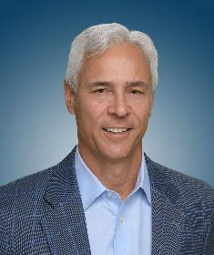
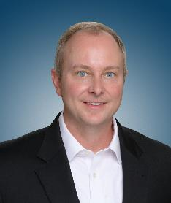
Our Principals
Michael Perrini is a Managing Director of Private Wealth Management and joined Baird in 1999. He has over 30 years experience in the industry having held positions in private client investments, portfolio management, consulting and institutional sales. Michael has been recognized by FORBES as a Best In State Wealth Advisor for 5 consecutive years.
Michael earned his BA in Finance from the University of Notre Dame. He received his MBA from Northwestern University’s Kellogg Graduate School of Management. He also completed the Investment Consultants Program sponsored by Baird at the University of Chicago Graduate School of Business. Currently Michael resides in Columbus, Ohio, where he has spent most of his life and is active in numerous community organizations. Michael is married and has three children.
2023 Forbes/SHOOK Research Best-In-State Wealth Advisors published 4/4/23, based on data as of 6/30/22
Michael Perrini
Managing Director
614.629.6970
mperrini@rwbaird.com
Jim Cain is a Director of Private Wealth Management and joined Baird in 2001. He has over 20 years experience in the industry. Jim holds an Ohio State Life, Fixed and Variable Annuity License. Jim is a CERTIFIED FINANCIAL PLANNER™ professional as well as a CERTIFIED PRIVATE WEALTH ADVISOR®. He considers the financial security of his client to be his top priority.
Jim holds a BS in Financial Management from the Ohio State University. He is married with two children, lives in Galena and is part of the Financial Planning Association, Investment Management Consultants Association and the Ohio State Alumni Association. He has been named as a Five Star Wealth Manager for 9 years in a row.
2022 Five Star Professional published 9/1/22, based on data as of 6/24/22
James Cain, CPWA®, CFP®
Director
614.629.6926
jcain@rwbaird.com

Slide 9
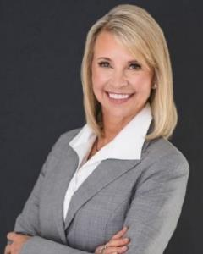
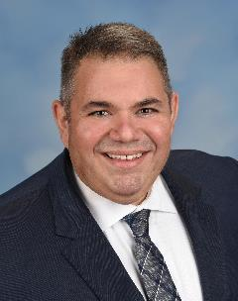
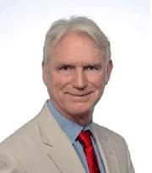
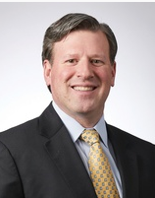
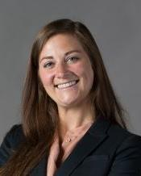
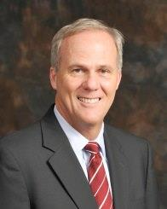
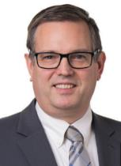
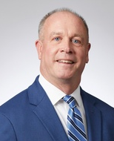
Team of Experts
Jaleigh White
Managing Director
Baird Family Wealth
Robert Robes, JD, LLM
Director
Wealth Strategist
Willis Hobson, JD*
Senior Vice President
Baird Trust Strategist
Scott Grenier CFP®, AEP
Senior Vice President
Manager, Tax & Estate Planning
Kelsey Clair, CPA
Vice President
Senior Tax Strategist
Andy McKay, JD
Managing Director
Business Owner Solutions
Jonathan Raymon
Senior Vice President
Charitable Solutions Strategist
Laurence Kluth
Senior Vice President
Equity Compensation Planning Manager
*Baird Trust Company, a Kentucky state-chartered trust company, is owned by Baird Financial Corporation ("BFC") and is affiliated with Robert W. Baird & Co. Incorporated (an SEC-registered broker-dealer and investment adviser), and other operating businesses owned by BFC. Not all trust services offered by Baird Trust are available in every state and/or location. Baird Trust does not provide legal advice.

Slide 10
About Baird
We are a full-service, diversified financial services company providing private wealth management, asset management and public finance services across the United States, as well as investment banking, private equity and institutional research, sales and trading services globally.
HISTORY
Founded in 1919; headquartered in Milwaukee, Wisconsin
Member of the New York Stock Exchange since 1948
GEOGRAPHY
More than 200 offices globally, including 33 states and three continents.
ECONOMICS
The Securities Investor Protection Corporation (SIPC) covers most types of investments up to a value of $500,000¹
Baird clients are further protected by a policy in excess of SIPC limits that provides additional coverage beyond the $500,000 SIPC limit²
The Federal Deposit Insurance Corporation (FDIC) covers client funds swept into bank accounts – up to $250,000 for each account per depositor
Employee-owned and fully independent
Client assets over $415 billion as of December 31, 2021
Conservatively leveraged and well-capitalized, with total capital well in excess of the minimum net capital requirement
Asset protection in excess of SIPC limits through Lloyd’s of London
¹Securities in client cash accounts are segregated from Baird’s assets. Assets held at Baird Trust Company are not covered by SIPC.
²Aggregate coverage limit of $250 million for all claims of Baird customers eligible for distributions under the Securities Investor Protection Act of 1970.
The policy has a sublimit of $1.9 million per customer for cash awaiting reinvestment.

Slide 11
Structured for Success
Baird’s unique balance of complementary businesses diversifies our revenues across market cycles and helps protect from cyclical volatility or unexpected environmental shocks in any one area. This gives us the financial strength to reinvest in our capabilities for clients like you in both good and challenging times.
Private Wealth Management | Asset Management | Fixed Income Capital Markets | Investment Banking/ Equity Capital Markets | Private Equity
Baird Private Wealth Management Baird Trust | Baird Advisors Baird Equity Asset Management | Fixed Income Sales & Trading Public Finance | Advisory & Financing Services Equity Research, Sales, Trading | Global Private Equity (U.S., U.K., Asia) U.S. Venture Capital
1,300 Financial Advisors averaging 20 years of industry experience and serving clients coast-to-coast 140+ specialized experts providing advice on all aspects of wealth management – complex portfolio strategies, financial, tax and estate planning, liquidity, insurance solutions, charitable giving, technology, and more Baird Trust, with approximately $20 billion in assets, provides clients the ability to grow, protect and transfer their wealth in a way that holds true to their values | $121 billion in fixed income investments managed by Baird Advisors¹ $9 billion in equity investments managed by our U.S. and International and Global Growth teams and our Specialized Asset Management team in Baird Equity Asset Management¹ Minority interests in RiverFront Investment Group and Greenhouse Funds LLLP • A Best Place to Work in Money Management for 11 consecutive years among firms our size according to Pensions & Investments | Approximately 140+ institutional sales, trading and analytics professionals More than 75 Public Finance bankers and analysts Ranked as the No. 1 lead managing underwriter and No. 5 municipal advisor nationally based on number of issues collectively since 2009, according to MuniAnalytics | Approximately 425 banking professionals serving clients globally Completed more than 150 financing and advisory transactions in 2022 with a total value of $68 billion More than 700 companies under research coverage Arranged more than 20,000 investor/company connections in 2022 Strategas, a Baird Company provides award-winning macro research to institutional investors and corporate executives | 40 investment, operating and support professionals across our global footprint Over three decades of investment experience Portfolio companies have combined annual revenues of $1.9 billion and more than 15,000 employees
275
130
No.1
No.1
1.3
$
billion+
in PWM client assets¹
$
billion +
in assets under management¹
Municipal bond underwriter nationwide²
Important small/mid-cap research advisory firm³
$
billion
Raised and managed¹
¹Assets as of June 30, 2023.
² Based on number of issues each year since 2009, according to Ipreo MuniAnalytics and Thomson Reuters.
³Robert W. Baird & Co. Incorporated. Visit rwbaird.com for important information and disclosures. “Baird” is the marketing name for Robert W. Baird & Co. Incorporated and several of its subsidiaries and affiliates worldwide. Robert W. Baird Limited (RWBL) and Baird Capital Partners Europe Limited (BCPE) are authorized and reg-ulated in the U.K. by the Financial Conduct Authority (registered numbers are 124308 and 150154, respectively). RWBL and BCPE have approved this information for distribution in the U.K. and Europe.

Slide 12


Let’s Connect
Numbers are not on the agenda for our first meeting.
Our ideal introduction is over coffee or lunch where we can talk freely and get to know each other. It is a casual conversation but one where we will try to get deep fast. We want to learn not only about your dreams and goals, but also what keeps you up at night and where you want to go.
At the conclusion of our meeting you will know how The Perrini Cain Group can add value to achieving your goals and helping to solve your greatest worries.
The Perrini Cain Group
4215 Worth Ave. Suite 200
Columbus, OH 43219
614.629.6926
theperrinicaingroup@rwbaird.com
Team Website: https://perrinicaingroup.bairdwealth.com/
RB2023-0912

Slide 13



Thank you
Robert W. Baird & Co. Incorporated
Notes:
Thank you

