Slide 1

The presentation will begin shortly.
Notes:
The presentation will begin shortly…

Slide 2

Guide To Financial Planning:
Strategies For Your
30s, 40s, & 50s
Notes:
Hello everyone and welcome to today’s presentation! We’ll be discussing your guide to financial planning: strategies for ages 30s, 40s, and 50s. We have a wonderful presentation in store for you today, so let’s go ahead and get started.

Slide 3


Michael Kincaid, CRPC®
Wealth Advisor, OneAZ Wealth Management
MKincaid@oneazcu.com
Notes:
I am your host today, and if we haven’t met before, welcome! My name is Michael Kincaid and I am a wealth advisor here at OneAZ Wealth Management.
Michael Kincaid Self bio:
Michael joined OneAZ Wealth Management in 2021 and has been affiliated with LPL Financial since 2008. He has worked in the investment management business since 1995, offering his clients a wide array of wealth management services including retirement and education planning, insurance analysis, wealth transfer techniques, and investment strategies. He completed extensive training to earn the Chartered Retirement Planning Counselor (CRPC®) designation conferred by the College For Financial Planning. Born and raised in Ohio, Michael and his family now call Arizona home. Michael is an active leader in his community, serving in many civic and charitable organizations and on numerous committees with his local church. In the summer, you can find him volunteering as a summer baseball coach and spending time with his wife, their two daughters and son.
Mr. Kincaid holds his Arizona Life and Health Insurance License and is registered with LPL Financial with his Series 7, 24, 63, and 65 securities registrations.

Slide 4



Connect With Us!
Website: OneAZWealth.com
Email: OneAZWealth@OneAZCU.com
24/7 Online Appointment Scheduler:
OneAZWealth.com
Phone: (877) 566-0517
Call Monday-Friday, 9:00 am – 5:00 pm
Scan to visit OneAZWealth.com
Your Credit Union (“Financial Institution”) provides referrals to financial professionals of LPL Financial LLC (“LPL”) pursuant to an agreement that allows LPL to pay the Financial Institution for these referrals. This creates an incentive for the Financial Institution to make these referrals, resulting in a conflict of interest. The Financial Institution is not a current client of LPL for brokerage or advisory services.
Please visit https://www.lpl.com/disclosures/is-lpl-relationship-disclosure.html for more detailed information.
This presentation was created for educational and informational purposes only and is not intended as ERISA, tax, legal or investment advice. If you are seeking investment advice specific to your needs, such advice services must be obtained on your own separate from this educational presentation.
Securities and advisory services are offered through LPL Financial (LPL), a registered investment advisor and broker-dealer (member FINRA/SIPC). Insurance products are offered through LPL or its licensed affiliates. OneAZ Credit Union (OneAZ CU) and OneAZ Wealth Management are not registered as a broker-dealer or investment advisor. Registered representatives of LPL offer products and services using OneAZ Wealth Management, and may also be employees of OneAZ CU. These products and services are being offered through LPL or its affiliates, which are separate entities from, and not affiliates of, OneAZ CU nor OneAZ Wealth Management. Securities and insurance offered through LPL or its affiliates are:
Not Insured by NCUA or Any Other Government Agency | Not Credit Union Guaranteed | Not Credit Union Deposits or Obligations | May Lose Value
OneAZ Wealth Management | (877) 566-0517 | www.OneAZWealth.com | Safe For Public Distribution.
Notes:
Here is our information page for your convenience which contains our required legal disclosures. Our team of wealth advisors assist clients and members of OneAZ Credit Union all over the great state of Arizona! For more information, you can connect with us on social media or scan the QR Code that will take you to our website, OneAZWealth.com.
Today’s webinar will be in “listen-only mode” and we will be fielding your questions at the end of the webinar with a Q&A session. At any point during the webinar, you can email your questions to: oneazwealth@oneazcu.com. We will be compiling your questions and will answer them at the end of today’s presentation.

Slide 5
Agenda
Planning Retirement
Investing Long-Term
Your Risk Tolerance
Financial Goals for 30s/40s
Financial Goals for 50s and Beyond
Closing Thoughts
Notes:
Let’s get started! Here is the agenda for today, we’ll begin by breaking down general planning for retirement at all ages, investing in the long-term, and identifying your risk tolerance. Then, we’ll walk through specific strategies for those in their 30s, 40s, & 50s, respectively. Lastly, we’ll close with implementing this roadmap into your finances.

Slide 6
Why Save For Your Retirement?
Longer life spans, people are living longer
People are enjoying healthier and more active lifestyles
Rising costs of healthcare
Social Security benefits are starting later
Notes:
So, Why Save for Retirement?
Planning for your retirement today is vital for a successful retirement. Nowadays, with longer life spans, people are living longer with medical advancements. There are also natural rising costs with our healthcare, and it’s important to educate and prepare ahead of time. Next, future financial solvency of Social Security that is in the news has talks of extending retirement age qualifications. This requires everyone to look again at their retirement income streams and how to supplement it with personal savings. Another important factor for you to consider are rising costs with changing lifestyles and goals. Retirement in the future will also likely cost more than it does today, and your individual retirement planning must take these facts into consideration. Take time to sit down with a pen and paper and dream, what do you want your retirement to look like/

Slide 7

Timelining Retirement
Decide when you’re going to retire
Estimate adequate income needs
At least 10% of monthly income go towards retirement savings
Set a retirement savings goal
Have an investment plan to outpace inflation
Consider annual increase in pay raises
Notes:
Sadly, most people do not adequately prepare for retirement. So, let’s walk through a timeline of planning for retirement.
First, you’ll need to consider when you’re thinking about retiring. If you have a partner, do you both want to retire at a certain age? Maybe that is 50, 60, or 70. But get specific about when you want to.
Next is projecting and estimating your annual retirement income need. Experts indicate you will need 60% to 80% of your final working year’s salary each year during retirement. A good benchmark for savings towards that goal is saving 10% (or more) of your income during your working years. Budgeting tools, worksheets, and monthly financial checks can help you estimate your current savings situation.
Third, what is your retirement savings goal? Investing for retirement should be one of your top financial priorities even though you may be 30 years or more away from retiring. You also need to estimate how much you’ll need in retirement savings. According to research done by the Employee Benefits Research Institute, individuals who take the time to establish a savings goal are also likely to have more set aside for retirement over time.
Next, outpacing inflation is particularly important when setting this goal since, over time, the purchasing power of your assets may be eroded. We can’t control inflation, but we can adequately prepare and take it into consideration when saving.
Lastly, and this is more of a savings tip, a very easy way to increase your annual saving rate is to divert a portion of your annual pay raises into your retirement savings. All important things to consider when timelining out your retirement.

Slide 8
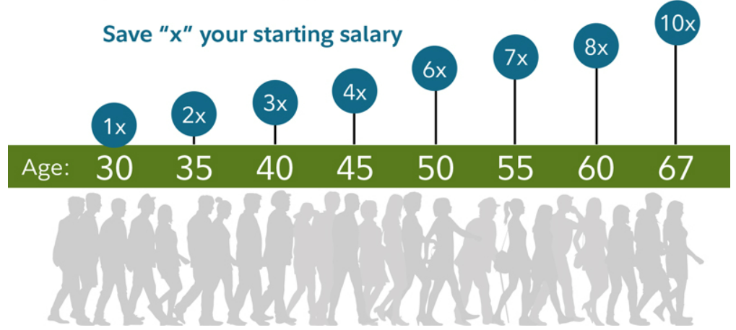
Retirement Savings Benchmarks By Age
Source: https://www.fidelity.com/viewpoints/retirement/how-much-do-i-need-to-retire
Notes:
As a helpful savings benchmark for everyone on our webinar today, here is an analysis that was conducted by Fidelity. It estimates what someone’s retirement accounts should total at the different life ages as they grow closer to retirement. How do you measure up with your current savings put away?

Slide 9

Meeting The Retirement Challenge
401(k) Contribution Limits for 2025:
Standard Limit: You can contribute up to $23,500 in employee salary deferrals.
Catch-up Contributions:
Age 50 and older: Can contribute an additional $7,500, bringing the total to $31,000.
Ages 60-63: Can contribute an additional $11,250, bringing the total to $34,750, if your plan allows.
Total Contribution Limit: The combined employee and employer contributions cannot exceed $70,000.
IRA Contribution Limits for 2025:
Standard Limit: You can contribute up to $7,000 to a Traditional or Roth IRA.
Catch-up Contributions:
Age 50 and older: Can contribute an additional $1,000, bringing the total to $8,000.
*Withdrawals from qualified retirement accounts prior to age 59 ½ may result in a 10% IRS penalty tax. Future tax laws can change at any time and may impact the benefits and tax treatment of Roth IRAs.
Notes:
Now, once you have clarified your retirement plan and savings goal amount, the good news is that you have time on your side to save for retirement. There are many ways to do this. If your employer has a retirement savings plan (like a 401k) it can help you pursue your goal. With a traditional 401k plan, the money you contribute is deducted from your pay before income taxes are taken out. That means that saving on taxes today it will also grow tax-deferred, and then when you take out retirement distributions, they will act as taxable income. As you see here, there are contribution limits for 401(k) plans, depending on your age. Feel free to take a screenshot of this information for your reference, it’s helpful information to know when working on your 401(k) plan.
On the other half of the slide, you’ll see that we mention a second retirement option which include IRAs, or Individual Retirement Accounts. You may have also heard of Roth IRAs, as well. With Roth IRAs, qualified contributions are after tax, and the retirement distributions are tax free. But for ease’s sake, we’re showing you a typical IRA and it’s contribution limits right now in 2025.
To create a retirement plan that is appropriate for you and your goals, consulting a wealth advisor will help ensure you are considering all retirement plan options to help achieve your dream retirement.

Slide 10
Investing For Long-Term Growth
High
Investors:
Stocks
Value potentially higher returns in the long-term
Understand their account balance can go up and down
Work with a Wealth Advisor to take an active role in monitoring the market and investments
Develop a financial plan and strategy for investing long-term
Bonds
Risk/Return Potential
Money Market Instruments
Low
*Asset allocation does not ensure a profit or protect against a loss
Notes:
Now that we’ve done planning, let’s approach investing and choosing our investment mix.
With investing in the stock market, there are (3) basic asset classes: stocks, bonds, and money market instruments. Stocks typically have the highest risk/return potential, bonds in the middle, and money market instruments with a low risk/return potential. Each asset class has different risk/return options and most retirement plans utilize mutual funds to help with diversification & choices. An important term to define here is something you’ve probably heard before- Asset Allocation. Asset Allocation is the process of diversifying your money in different asset classes to help you pursue returns while managing risk.
When approaching investing as opposed to only saving, it’s important to remember that investors typically value potentially higher returns in the long-term, and they understand their account balance can go up and down. They also usually work with a Wealth Advisor to take an active role in monitoring the market and investments. Lastly, investors develop a financial plan and strategy for investing long-term, and they revisit their goals frequently to adjust their strategy accordingly. Investing doesn’t have to be daunting, and to begin investing, you should identify what level of risk you are comfortable in.

Slide 11
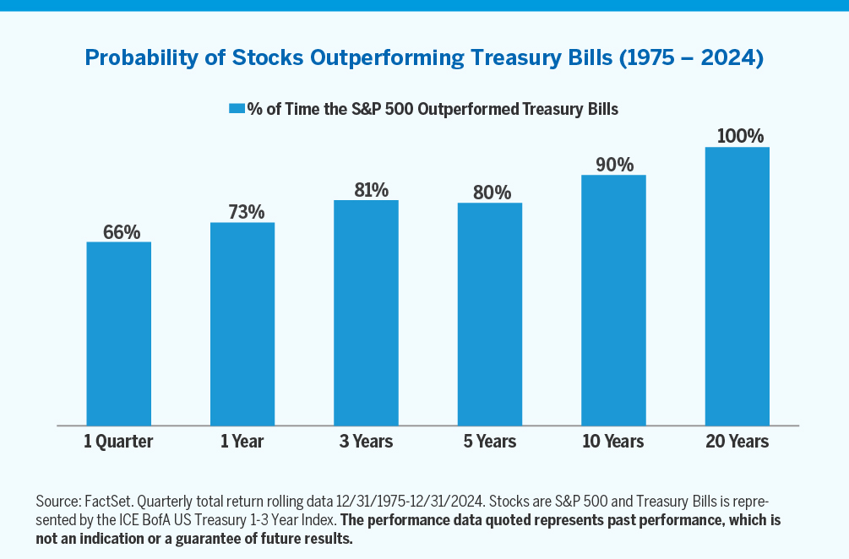
The Power of Patience
Source: Alger.com The Power of Patience
Notes:
Recently, equity market volatility has increased due to heightened uncertainty around fiscal, monetary, and trade policy. During such periods, investors often become risk averse and are tempted to make short-term asset allocation decisions. However, we believe individuals may be better served by taking the long view during times of market volatility and practicing patience with their investments.
While it may be tempting to turn to “safe havens” such as cash or Treasury Bills in times of volatility, history shows that the probability of equities underperforming these assets decreases significantly over longer holding periods. Although past performance is not indicative of future returns, we can see here that data over the past half century shows that equities have outperformed Treasury Bills 66% of the time over rolling quarters, 73% of the time over one-year periods, 90% of the time over 10-year periods, and 100% of the time over 20-year periods.
We believe it is very beneficial adopting a long-term view when looking at your investments, and we encourage investors to ride out the inevitable volatility of the equity market. While market drawdowns can be difficult to endure, our work supports the adage: it’s time in the market, not timing the market.

Slide 12
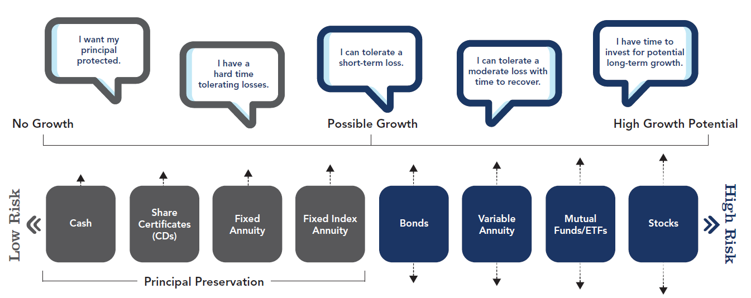

Assess Your Risk Tolerance
Notes:
This is called your risk tolerance. How do you choose which asset allocation is appropriate for you? You begin by understanding your personal tolerance for investment risk and how it can work in conjunction with your time horizon. The illustration here shows a spectrum of asset class types. Your tolerance for risk is determined by your investment time frame and your personal feelings about risk.
As I’ve mentioned, stocks involve the highest short-term risk of price fluctuations, but over the long term they have historically outperformed other types of investments. But past performance can’t guarantee future results, and there is always the chance that you will lose money in the stock market -- and maybe even the bond market. Consider, however, that your time horizon can help you be more or less tolerant toward investment risk.

Slide 13
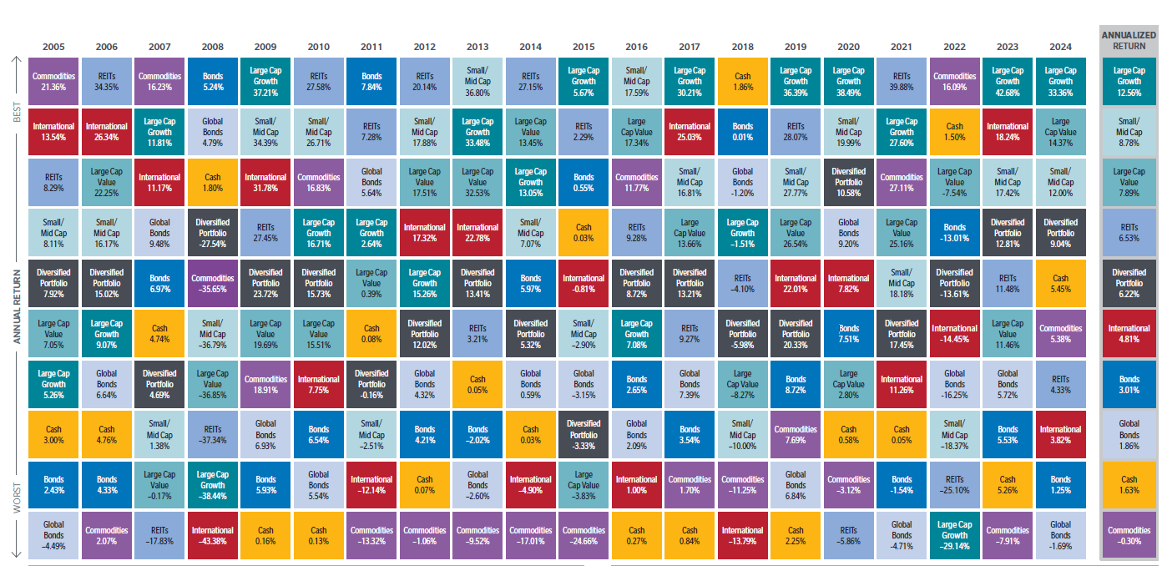
Asset Allocation Diversification: 20 Years of the Best and Worst
Source: FactSet SPAR. Returns are in USD, and net for MSCI EAFE and gross for all other asset classes. Annualized return and standard deviation (annualized) is for the 20-year period ending December 31, 2024. The diversified portfolio is rebalanced quarterly to maintain the equal allocations throughout the period. Standard deviation reflects a portfolio’s total return volatility, which is based on a minimum of 36 monthly returns. The larger the portfolio’s standard deviation, the greater the portfolio’s volatility. Asset allocation and diversification do not guarantee a profit or protect against a loss.
Notes:
We are often asked as advisors what is the best investment to buy. Well, it is nearly impossible to pick or guess what is going to be the best investment category next. But, we can estimate and review options carefully. Take a look at this chart… I call it the Jelly Bean chart, because it has so many colors, each color illustrating a different investment category. They are ranked by their actual performance during the given year, and you can see there is a lot of volatility or change in their percentages from one year to the next with these individual investment categories.
One prudent method of investing is asset allocating your investment portfolio across multiple categories, so you can possibly generate a solid average with less major volatility. The Dark Gray box here is what a Diversified Portfolio would have returned year over year. Because the dark grey boxes pan out higher up in the chart with better annual return, we can see it has performed with less volatility over the last 20 years. This poses a great question when investing, how diversified is your portfolio?

Slide 14
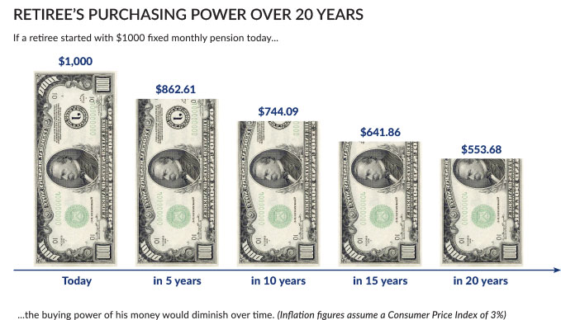
A Look At Performance
Source: “Inflation and Cost-of-Living Increases.” TCDRS, https://www.tcdrs.org/library/inflation-and-colas/.
Notes:
As we talked about before, one of the big negative forces working against all savers and investors is inflation!
Take a look here at how a simple 3% inflation rate can impact your income. Starting at $1,000 a month, it can erode to $553.68 a month in just 20 years!
While the inflation rate has recently been low, in the 2% and 3% range, history shows that it has varied considerably through the years.
So, why is this important for you as you save? Well, the further away you are from retirement, the more inflation can reduce your future purchasing power. So, this is why it is most important for you to choose investments that can potentially help you stay ahead of inflation.

Slide 15
Keeping You On Track
Review your asset allocation at least once a year
Modify and make changes as your needs change
Consult your financial professional
Notes:
So far we’ve covered a lot. We’ve discussed how to create a timeline for retirement, factors to consider when saving and investing, different investment options based on your risk tolerance, and the power of patience. Don’t forget to review & repeat the following process in your financial journey:
Continue to review your asset allocation at least once a year
Modify and make changes as needed
And work with a professional that can provide guidance to your goals and financial objectives.

Slide 16

30s & 40s
Notes:
Now, let’s dive into what specific financial goals to focus on in your 30s and 40s.

Slide 17

Planning for College Costs
College costs continue to rise faster than inflation
Financial Options
Loans
Scholarships
Grants
College savings vehicles
Education Savings Accounts
Penalty-free IRA withdrawals
Prepaid tuition plans
529 savings plans
Notes:
For many young and growing families, saving for future college expenses is the biggest financial hurdle after retirement savings. So let’s take a look at ways to help plan for college costs.
It’s important to note that there are many options to help with college expenses, such as: Loans, Scholarships, and Grants. You can also consider other college savings vehicles that help prepare you over time, such as tax-advantaged plans. These include a Coverdell Education Savings Account, Penalty-Free IRA Withdrawals, or Prepaid Tuition Plans. One of the most popular college savings plans are Section 529 Plans. These offer tax-free growth for qualified expenses and flexibility depending on your situation and goals.

Slide 18
Protecting Yourself and Loved Ones
Do you need life or disability income insurance?
Setting up life insurance based on your needs
Policy types
Whole life vs Term insurance
Mortgage insurance
Do you need an estate plan?
Substantial assets
An inheritance or windfall
Charitable giving
Generational planning
Notes:
In your 30s and 40s, many people consider their loved ones and how to protect them throughout their age. With this, it’s important to consider protection strategies. This involves asking difficult questions, such as how will your family cope financially if you unexpectedly become disabled or pass way?
Life & Disability Income Insurance cover this instance, and most employers have some coverage options available. It’s always a good idea to have coverage outside of the employer too. There are many type of plans available, so we suggest having a meeting with your financial advisor to determine the type of life insurance you need.
If you don’t have one already, an estate plan may include strategies for selecting beneficiaries, the creation of trusts, plans for charitable giving, and your will. Consider establishing are a Power of Attorney, Healthcare Power of Attorney, a Will, and a Trust.

Slide 19

Having a Valid Will
A will provides for the distribution of your assets
Deferring distributions to minors
You can name guardians for your children
Choosing the Executor
Making Specific Bequests to Individuals
Authorizing the Continuation of a Business
Peace of Mind
Notes:
What does a living will entail? Everyone needs a will, and if you pass away without one, your assets will be distributed by the court through a process known as probate, according to state laws. Probate can cost money and take time, so establishing a will is vital to your early life-stage planning.
Within a will is the established executor of an estate, but the duties of the executor of an estate can be very time consuming and frustrating, especially to someone who has just lost his or her loved one. In the will, a qualified individual and/or a corporate trust company can be chosen to handle these responsibilities.
In your valid will, an individual may bequeath specific items of jewelry, heirlooms and furniture, or make cash bequests, and be certain that they will pass to the proper persons. Without a will, written or oral instructions may not be followed.
When parents die leaving minor children alive, each child’s share of the estate must be held in a guardianship account until he or she attains the age of 18 (or 21), at which time the entire remaining share is distributed outright. Trust provisions can be placed in the will to defer these distributions until a more mature age.
Although this advantage cannot be measured in dollars and cents, it is a large emotional burden lifted when the estate is in order for the person who is concerned for his or her family’s well being.

Slide 20

50 & Up
Notes:
Now that we’ve established early life-stage financial goals appropriate for your 30s and 40s, let’s take a look at some goals applicable for those approaching 50 or older.

Slide 21

When You Leave Your Job
In the homestretch to retirement
Begin retirement income strategy planning
Maximizing savings, reducing risk
401(k) Retirement Plan options
Leave your assets in your company’s plan
Transfer to new employer’s plan
Roll over to an IRA
Lump-sum distributions
Create your personally-owned pension solution
Notes:
During the 7th inning stretch in baseball, the game is coming to an end. Usually by then, you will have a good idea of who may win the game by looking at the scoreboard. Similarly, as you approach your 50’s, you also will know how well you have accumulated your financial assets for your retirement and in what ways you could potentially improve in your preparation.
Leaving your job and pursuing retirement is an exciting time, and you need to begin educating yourself on retirement income strategies so you can maximize your income streams to meet your retirement goals. When you change jobs or retire, you’ll need to decide what to do with your retirement savings. You have many options to do this, including: keep your savings in your former employer’s plan, transfer the balance to your new employer’s plan, rollover your savings to your personal IRA, or take a lump-sum distribution.
If you choose to transfer your assets to an IRA, you pay no taxes on the distribution. To avoid a mandatory 20% withholding on the account balance — which you would have to make up from your own pocket in order to avoid having the withholding treated as a distribution — you may want to choose a direct rollover. In the direct rollover option, the funds are transferred directly from your plan to your new IRA.
Now, if you choose to roll your assets into a Roth IRA, you will pay taxes on the amount “converted” to the Roth IRA. But, subsequent withdrawals from the Roth IRA will be tax free if you are over age 59½ and have held the account for five years.
The last point I want to make on this slide that is worth considering is how to best manage your de-accumulation stage of retirement monies. Many find value and comfort in creating their own personal pension income solution strategy, but carefully consider which of these options is best for you.

Slide 22
A Retirement Action Plan
Savings goals are important
Make regular contributions to your retirement accounts
If you are over age 50, plan to make additional contributions
Watch your savings and invest to outpace inflation
Review your asset allocation with your advisor regularly and make adjustments, as needed
Notes:
What is your retirement action plan? Your savings goals are still important, so take advantage of opportunities to contribute to tax-deferred retirement accounts. Try to contribute the maximum possible. If you are over age 50, plan to make catch-up contributions to potentially benefit from additional tax-deferred growth.
With investing over the age of 50, choose a mix of investments to help pursue growth while potentially reducing risk. Including stocks in your asset allocation may help you stay ahead of inflation long-term. Make sure to review your asset allocation regularly — perhaps annually — to make sure that you are still on track with your goals.

Slide 23
Considerations For Caregivers
There are fewer opportunities for individual job advancement
Possible reduced pension and Social Security benefits
Out-of-pocket, unpaid expenses
Less money to put in savings and investments
Notes:
Let’s discuss considerations for caregivers. If you potentially need to provide care for a family member, it’s important to weigh all your options. Make sure to investigate local community resources as well as state and national associations that may be able to assist you. Sometimes, being a caregiver can take a substantial toll on your wellbeing financially, physically and emotionally, and individuals will provide unpaid care to their loved ones without knowing the financial effects.
With this, it is important to consider that the long-term economic effects of reduced wages due to lost job opportunities, lost retirement benefits from Social Security and pensions, and out-of-pocket expenses can take a significant toll over a caregiver’s lifetime, not including the opportunity cost of having less money to save and invest. If you choose to provide care as a caregiver, make sure you are aware of all the factors that can affect quality of life and finances. These are just a few things to consider when making a decision that best supports yourself and your loved one, so please be proactive and investigate options while you are healthy and strong.

Slide 24

Know Changing Tax Laws
Tax Avoidance vs. Tax Evasion
We want: Tax-Free, Taxable, Tax-Deferred, and Tax-Advantaged Methods!
Managing Tax Liabilities
Tax Diversification
Taxes on estates
Inherited IRA assets
Consult your tax advisor to gauge your situation
Notes:
As the old saying goes… only two things are for sure in life… Death and Taxes… Now, while that may be true, we can all be more proactive and prepared in our tax planning. First off, do you know the difference between Tax Avoidance vs Tax Evasion? Tax avoidance is legal and tax evasion gets you jail time. Not good! So, let’s make that distinguishment outright and say that is absolutely OK to proactively plan your taxes. You CAN use viable strategies that help manage your taxes! You do this by having investments and income that are: Tax–Free, Taxable Federal and/or State, Tax-deferred and Tax-Advantaged (long-term gains).
A number of tax law continue to be changed in recent years, so it’s important to consult with your CPA and financial advisor on current distribution rules and the tax ramifications that may affect you.

Slide 25
Closing Thoughts
Quick Tips For Building A Strong Financial Future
If you haven’t yet, focus on building a nest egg for retirement. It’s never too late to start.
Take advantage of opportunities to defer taxes on investment earnings, you can save a sizeable sum.
Plan ahead, you can put compounding interest to work for you.
Invest in your savings appropriately, based on your time horizon and tolerance for risk.
If you have dependents, providing for their future security can help give you confidence.
Review your insurance needs and make sure you have a valid will.
Notes:
Closing Thoughts…we want you all to have a strong financial future! If you haven’t yet, focus on building a nest egg for retirement, start now. It is never too late to start. By taking advantage of opportunities to defer taxes on investment earnings, you can save a sizeable sum. Plan ahead, you can put compounding interest to work for you. Invest your savings appropriately, based on your time horizon and tolerance for risk, to increase your chances of meeting your goals. If you have dependents, providing for their future security can help give you confidence. Review your insurance needs and make sure you have a valid will.
Your financial future is up to you, and there are many tools and resources available that can help you meet the challenge.

Slide 26
Question & Answers
Website: OneAZWealth.com
Email: OneAZWealth@OneAZCU.com
24/7 Online Appointment Scheduler:
OneAZWealth.com
Phone: (877) 566-0517
Call Monday-Friday, 9:00 am – 5:00 pm
Scan to visit OneAZWealth.com
OneAZ Wealth Management | (877) 566-0517 | www.OneAZWealth.com | Safe For Public Distribution.
Notes:
That concludes the information portion of our presentation, and we have a number of questions coming in now that I’ll answer. Please feel free to send any questions you have to OneAZWealth@oneazcu.com and we will be sure to address them.
So, our first question is: (TBD)

Slide 27
Thank you!
Website: OneAZWealth.com
Email: OneAZWealth@OneAZCU.com
24/7 Online Appointment Scheduler:
OneAZWealth.com
Phone: (877) 566-0517
Call Monday-Friday, 9:00 am – 5:00 pm
Scan to visit OneAZWealth.com
OneAZ Wealth Management | (877) 566-0517 | www.OneAZWealth.com | Safe For Public Distribution.
Notes:
Thank you for joining today and we hope our presentation has provided some helpful information and guidance. We at OneAZ Wealth Management welcome your feedback and comments, so please email us any suggestions you have for future webinar topics. As always, our entire OneAZ Wealth team of advisors stands ready to assist you in reviewing your current financial plan and portfolio in light of today’s economy. There is no better time than the present for a 2nd opinion on your current plan. We welcome your call!
Please feel free to call us at 877-566-0517 with any questions, or visit our website at OneAZWealth.com for more information in creating your personal financial and retirement plan. Have a great rest of your day!

