Slide 1
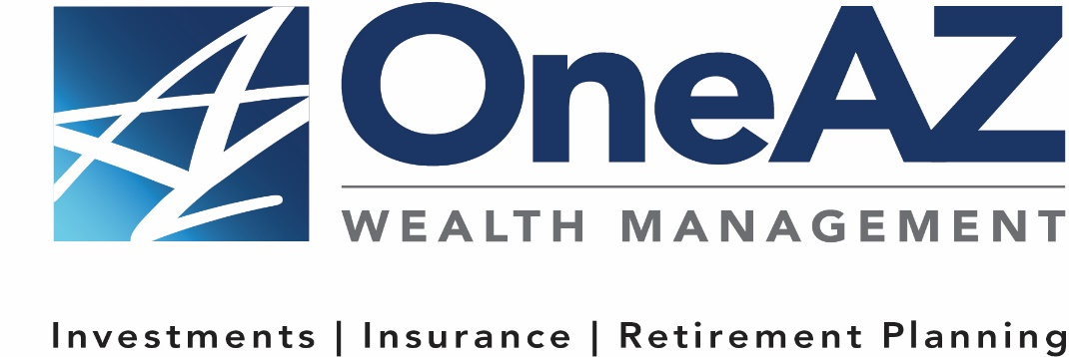
The presentation will begin shortly.
Your Credit Union (“Financial Institution”) provides referrals to financial professionals of LPL Financial LLC (“LPL”) pursuant to an agreement that allows LPL to pay the Financial Institution for these referrals. This creates an incentive for the Financial Institution to make these referrals, resulting in a conflict of interest. The Financial Institution is not a current client of LPL for brokerage or advisory services.
Please visit https://www.lpl.com/disclosures/is-lpl-relationship-disclosure.html for more detailed information.
This presentation was created for educational and informational purposes only and is not intended as ERISA, tax, legal or investment advice. If you are seeking investment advice specific to your needs, such advice services must be obtained on your own separate from this educational presentation.
Securities and advisory services are offered through LPL Financial (LPL), a registered investment advisor and broker-dealer (member FINRA/SIPC). Insurance products are offered through LPL or its licensed affiliates. OneAZ Credit Union (OneAZ CU) and OneAZ Wealth Management are not registered as a broker-dealer or investment advisor. Registered representatives of LPL offer products and services using OneAZ Wealth Management, and may also be employees of OneAZ CU. These products and services are being offered through LPL or its affiliates, which are separate entities from, and not affiliates of, OneAZ CU nor OneAZ Wealth Management. Securities and insurance offered through LPL or its affiliates are:
Not Insured by NCUA or Any Other Government Agency | Not Credit Union Guaranteed | Not Credit Union Deposits or Obligations | May Lose Value
OneAZ Wealth Management | (877) 566-0517 | www.OneAZWealth.com | Safe For Public Distribution.
Notes:
The presentation will begin shortly…

Slide 2
Succession Planning For Business Owners
Notes:
Hello, Welcome to the OneAZ Wealth webinar on, Succession Planning for Small and Family-Owned Businesses

Slide 3


Host
Thomas E. Mitchell, CFP®
Senior Vice President
TMitchell@OneAZcu.com
Notes:
My name is, Tom Mitchell and I have the honor of leading the OneAZ Wealth Management team of Wealth Advisors, located here at the OneAZ Credit Union. Our fulltime professional financial advisors, we are assisting clients and members of the OneAZ Credit Union all over the great state of Arizona!
We are very excited to bring these educational topics directly to you and we are planning many exciting webinars in 2024. Keep an eye out on our website for our 2024 webinar schedule available in the upcoming weeks.
As a heads up, our last webinar will be on December 14th, 2023, where we will be addressing Building A Strong Financial Future: Understanding Social Security!

Slide 4

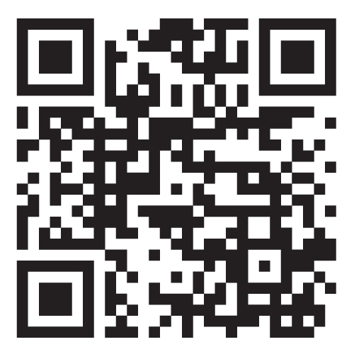


Website: OneAZWealth.com
Email: OneAZWealth@OneAZCU.com
24/7 Online Appointment Scheduler:
OneAZWealth.com
Phone: (877) 566-0517
Call Monday-Friday, 9:00 am – 5:00 pm
Scan to visit OneAZWealth.com
Your Credit Union (“Financial Institution”) provides referrals to financial professionals of LPL Financial LLC (“LPL”) pursuant to an agreement that allows LPL to pay the Financial Institution for these referrals. This creates an incentive for the Financial Institution to make these referrals, resulting in a conflict of interest. The Financial Institution is not a current client of LPL for brokerage or advisory services.
Please visit https://www.lpl.com/disclosures/is-lpl-relationship-disclosure.html for more detailed information.
This presentation was created for educational and informational purposes only and is not intended as ERISA, tax, legal or investment advice. If you are seeking investment advice specific to your needs, such advice services must be obtained on your own separate from this educational presentation.
Securities and advisory services are offered through LPL Financial (LPL), a registered investment advisor and broker-dealer (member FINRA/SIPC). Insurance products are offered through LPL or its licensed affiliates. OneAZ Credit Union (OneAZ CU) and OneAZ Wealth Management are not registered as a broker-dealer or investment advisor. Registered representatives of LPL offer products and services using OneAZ Wealth Management, and may also be employees of OneAZ CU. These products and services are being offered through LPL or its affiliates, which are separate entities from, and not affiliates of, OneAZ CU nor OneAZ Wealth Management. Securities and insurance offered through LPL or its affiliates are:
Not Insured by NCUA or Any Other Government Agency | Not Credit Union Guaranteed | Not Credit Union Deposits or Obligations | May Lose Value
OneAZ Wealth Management | (877) 566-0517 | www.OneAZWealth.com | Safe For Public Distribution.
Notes:
First, here is our Information page, it contains our required legal disclosures for your convenience.
Please always check out our OneAZWealth.com website for upcoming webinar events.

Slide 5
Connect With Us!
Website: OneAZWealth.com
Email: OneAZWealth@OneAZCU.com
24/7 Online Appointment Scheduler:
OneAZWealth.com
Phone: (877) 566-0517
Call Monday-Friday, 9:00 am – 5:00 pm
Scan to visit OneAZWealth.com
OneAZ Wealth Management | (877) 566-0517 | www.OneAZWealth.com | Safe For Public Distribution.
Notes:
For better audio, the webinar will be in “listen-only mode”…
We will be fielding your questions at the end of the webinar. Please, email any questions to: oneazwealth@oneazcu.com. We will be compiling your questions and will answer them at the end of today’s presentation. If we do not get to your question, I promise we will respond to you directly.
Last, for more information about OneAZ Wealth Management and our team of wealth advisors, visit OneAZWealth.com or use your mobile device to scan the QR Code on the screen now.
You can also connect with us on social media on Facebook, LinkedIn, and YouTube for more exciting resources and helpful information.

Slide 6
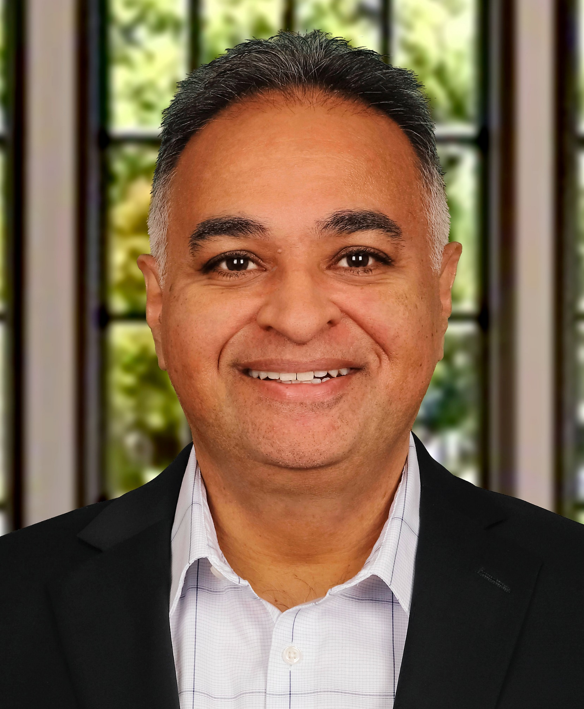
Guest Speaker
Neil P. Patel, CPA
Founder, Patel Advisory Group
Neil@PatelAdvisory.com
**Neil P. Patel, Patel Advisory Group PC, is not affiliated with or endorsed by LPL Financial and OneAZ Wealth Management.
Notes:
So, let’s get started…
Our OneAZ Wealth topic today: Succession Planning For Business Owners
Neil Patel bio:
Neil’s interest in the mechanics of business started early and was influenced by his entrepreneurial family of operators and investors. After graduating from Chicago’s esteemed Loyola University, Neil worked for public and private enterprises affording him invaluable insight and experience into the finance, operations and management functions of businesses in multiple industries.
Neil launched his practice in 1999. And for nearly 25 years, he has advised hundreds of diverse businesses providing him with a uniquely wide scope of real-world, hands-on experience. As a result, he understands firsthand the challenges and opportunities business leaders face today.
His professional mission has been focused on helping clients navigate today’s complex business environment, improve visibility and grow. Neil is best known for his perspectives on financial leadership. In this capacity Neil is able to help accounting and finance teams align with operational targets and strategic objectives. In doing so, Neil is able to help business leaders achieve their goals, reduce stress and find professional and personal fulfillment.
Outside of the office, Neil enjoys hiking, camping, traveling, spending time with friends and family and spoiling his chocolate lab, Lily.

Slide 7






Welcome
Notes:
Welcome, and thank you for joining us today.
[INTRODUCE YOURSELF AND ORGANIZATION*]
Today we will be covering some myths, realities and strategies we use in Succession Planning for Small and Family-Owned Businesses.
There are millions of “small businesses” in the U.S. These businesses range from self-employed professionals to medium-sized firms to larger manufacturing concerns. Small businesses employ 55% of all U.S. workers across all geographic areas. Their success drives America’s success.
More than half of today’s small business owners are 50 and older. 23% of small business owners plan to sell or transfer the business in the next 3-5 years. However, only 38% have a formal business succession plan, and those tend to be the younger business owners. And only 40% of that group has funded the purchase obligations in those plans. So today, let’s talk about that. What is a succession plan? What things should you consider? And how to get started?

Slide 8
Agenda
Facts & Stats: clearing up common misconceptions
Key Questions to help you design your plan
  The “why’s” of exiting/selling your business
  Succession Plan vs. Emergency Plan
What are your options? What strategies can you use?
Are there tax consequences?
What is my business value or worth?
Steps to take today
Notes:
Here’s our Agenda for today’s discussion.
First, let’s go over some Facts, Stats, and common misconceptions about succession planning that we see every day.
Then we will review various key questions to ask yourself to help you design your plan. Every business situation is different, and you have some goals and expectations that may be unique to your situation. A Succession Plan vs. Emergency Plan, understanding the difference.
Once you’ve gained clarity as to what’s most important to you, then we will dive into some options and strategies that business owners use to accomplish their goals and objectives.
With each decision or indecision comes tax consequences, so we’ll do a high-level review of the tax impact from various strategies.
Knowing the true value of one's business is critical to proper business planning and achieving personal goals.
Lastly, we’ll end the program with some clear steps that you can take now. We will also have time for some Q&A at the end of the program.

Slide 9
Privately Held Businesses In The U.S.
5,996,000
Source: Corporate Value Metrics, LLC. 2021
Notes:
Review the contents of the chart… There are millions of small businesses that drive our economy.

Slide 10





According To The 2021 Census:
51%
of privately held companies are owned by baby boomers2
Baby Boomers are between
59–77
years old today1
By 2030, all Baby Boomers will be
65
or older1
Average boomer thinks about the next phase of life at
63
years old2
46%
of privately held companies are owned by people ages 36-56 years old2
1 Source: United States Census, 2021
2 Source: Delaware M&A Market Survey, 2022
Notes:
Review the contents of the chart… There are millions of small businesses that drive our economy.

Slide 11
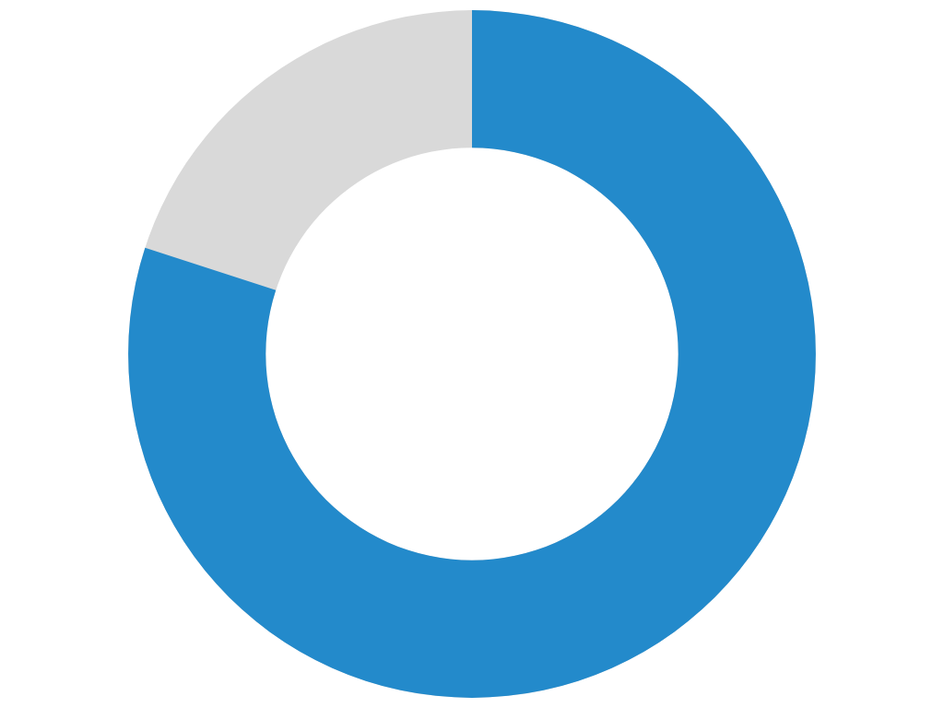
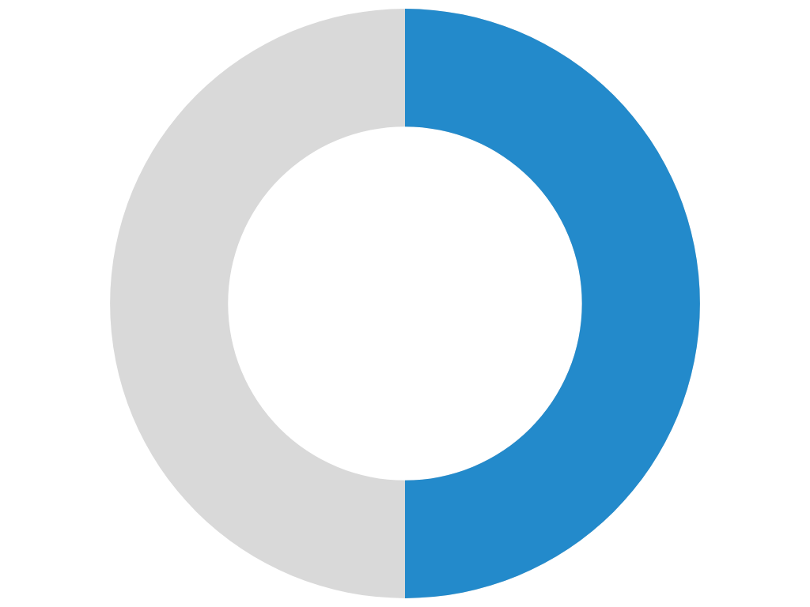
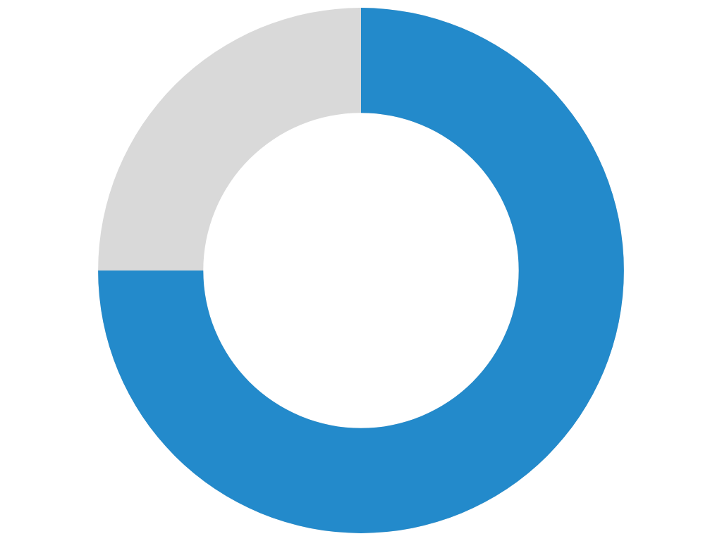
State of Owner Readiness Survey:
80%
of an owner’s wealth is locked in their business
50%
of business transitions in the U.S. are involuntary
75%
of owners regret selling after one year
Involuntary Exits Caused By:
Death
Disability
Divorce
Distress
Disagreement
*Nearly 60% of owners indicated through the State of Owner Readiness that they had no contingency plans in their company or in their personal lives.
Source: Exit Planning Institute, State of Owner Readiness Survey, 2022 & 2023
Notes:
Review the contents of the chart…

Slide 12

5 Common Misconceptions
Myth #1 – There’s plenty of time to plan
Myth #2 – It’s easier to just sell it
Myth #3 – A successor or my kids will be ready and willing when I’m ready
Myth #4 – Equal is synonymous with “fair”
Myth #5 – Giving up ownership means losing control and/or income
Notes:
Let’s start with reviewing some of the common misconceptions around Business Succession Planning.
#1 – We have plenty of time to plan. There is a common thought among business owners that the planning can wait until they are ready to exit. That puts the financial well-being of the business owner, the family and the business itself in jeopardy. (provide example)
#2 – It’s easier to just sell the business. While that sounds like the easy solution, it is often difficult to find a willing buyer for the business. And since many business owners tie emotions to the “baby” that they have built from the ground up, they may overestimate its value to someone else. It depends a great deal on timing, the health of the business, how dependent its success is on the current owner’s involvement, and the particular industry.
#3 – My successor or my kids will be ready when I’m ready. Handing the business to someone else to run is always difficult, but the odds of success go up exponentially with preparing the successor management team ahead of time. Having a plan to strategically hand over the torch makes it seamless to the business, the employees and the customers. If family members could be involved, you must have clear and open discussions in advance and truly recognize strengths and weaknesses.
#4 – Fair means “equal” when passing my business. This is probably one of the most common misconceptions. It is also one of the biggest causes of family disharmony. (give example)
#5 – Giving up ownership means that I will lose control and/or my income. Another common fear that prevents business owners from taking action. Ownership can easily be separated from control and also from cash flow. In addition, we may be able to implement strategies to recharacterize the nature of income to the business owner – taking it from ordinary income to capital gain income (taxed at much lower rates).

Slide 13
Every Business Needs a Plan
Proactive Proper Planning can:
Enable an orderly transition of both ownership and responsibility
Minimize conflict between heirs and partners
Provide economic support for all relevant parties involved
Maximize business value for higher cash payouts
Notes:
For most business owners, the business is not only the primary source of household income, it is also the single largest asset owned. Planning for something so important is critical.
What is a Succession Plan?
Put simply, it is the process of determining how you are going to transfer your business ownership and transition out of the business management role, while seeking to maximize your personal financial security. But like most things that are important, it is not always easy to put a good plan in place.
Why bother with business succession planning? There are several reasons. . .
Creates an orderly transition plan, both for ownership as well as management. A poor management transition plan can have a negative impact on business results, and in some cases can result in business failure.
It minimizes potential conflicts between heirs and other business partners. If you hope to have your business continued by one or more family members, you will need to coordinate your succession plan with your estate plan. It will also be important to consider the tax consequences. Or perhaps your plan involves a new or existing business partner. It is best to solve potential problems now while everyone is agreeable and not in distress.
Provide economic support for you and your family. The value of your business may represent a substantial source of income in retirement. But that needs to be balanced with the goal of a smooth and orderly transition. What about your spouse or loved ones who are dependent on that income if something happens to you? We need to consider a variety of contingencies.
Important steps can be taken now, years before the transition to better maximize the potential business value.
An event such as the death or disability of you or a business partner could lead to business chaos without proper planning and financial protection. Advance planning can help ensure that you, your family, and your business are all properly protected.

Slide 14
Every Business Needs a Plan
Proactive Proper Planning can:
Recognize industry norms and unique differences
Identify and address areas of risk that will impact values
Understand both sides of the transaction:
  Buyer vs. Seller needs and desires
Help to minimize tax liability and erosion of value
Notes:
Proactive Planning can also:
Recognize the industry norms or unique qualities of your business
Identifying any risks that can impact your values. Like seasonality sales demands, special pricing contracts with vendors or customers, labor agreements, etc.
Fully understand both sides of the transaction – to have a Win/Win transition, both the buyer and seller need to feel they won. It is key to take into account everyone’s needs and desires.
Last but not least, let’s try to minimize tax liability and erosion of business value. With proper planning, such tax costs may be greatly reduced. We’ll cover those strategies later in the discussion.
An event such as the death or disability of you or a business partner could lead to business chaos without proper planning and financial protection. Advance planning can help ensure that you, your family, and your business are all properly protected.

Slide 15

Key Questions To Ask
  What is my business worth?
  Do I have a written buy/sell agreement in place?
    If yes, when was it last reviewed?
  When do I plan to exit my business?
  What if I am forced to leave due to injury or illness?
  Do I have someone identified who could successfully step in?
  If there are multiple owners, have I discussed it with my partners?
  What does my family want or need if something happens to me?
  What and how much do I need when I exit?
  What is my motivation and why?
Notes:
We’ve covered WHY a business needs a succession plan, and we’ve discussed some of the common misconceptions that stop business owners from creating a plan. Now let’s cover some key questions for you to ask yourself. This will help you create your roadmap -- that is specific to you and your goals – as well some strategies to work toward it.
The most important place to start is “What is my business worth?” That will set the stage for all of the planning we do. I find that business owners either vastly underestimate or overestimate the true value of their business. Value should be determined objectively – what would a willing unrelated buyer pay for your business?
The next question is “Do I have a written plan in place now?” If so, what does it require? Sometimes such language is embedded in your business operating agreement, which you likely haven’t seen since you created it years ago.
The next question to consider is “When do I plan to exit?” There is no one right answer to this, only what is right for you. But that will give the timeline. As I mentioned earlier, 1 in 4 business owners plan to exit their business in the next 3-5 years. But only a few have actually planned for that event.
All business owners will exit their business someday. . . Either voluntarily or involuntarily. So what if you are forced to exit because of a disability? What impact would that have on the day-to-day success of the business?
If something were to happen today – death or disability – have you identified the person who could successfully step in to keep things going? What would they need?
What do your business partners (if any) think? Is everyone on the same page? Do you each want the same things?
What do you need for your family if something happens to you? Do you want to pass the business itself to your heirs? Or do you simply want your family to inherit the value you have built? Do you even have the type of business that can be passed on, or is it completely dependent on your expertise?
Advance thinking and planning around, how much do you really need after I exit?
Lastly, what was your real motivation and why? Does the plan address these personal questions?

Slide 16
How? When? Who?
Ways To Transfer Your Business
Family Transfers
  Gifts during lifetime
  Transfers at death
  Sale (or partial sale)
Non-family Transfers
  Co-owners
  Key employee(s)
  Competitor
  3rd party buyer
Notes:
Once you have a good idea of your own situation, your wants and needs, then it’s time to consider the various ways to accomplish your goals. This relates to How, When, and Who.
If you plan to pass the business itself to one or more family members, then you will need to coordinate the succession plan with your estate plan. After all, your business is just one of your assets to pass to family – although it is often the largest or most lucrative asset you will own. How and When you transfer the business to family depends on a host of factors that are unique to your situation. We will cover the tax impacts of those decisions in our next section.
Often we see the business interests pass at death, just like all other assets, by the terms of a Will or Revocable Trust. You can also pass some or all of the business interests while you are alive, done with a Gift to family. It’s important to remember that sometimes the best outcome is achieved with a combination of these strategies. For example, you may want to pass the torch to your children who work in the business. But gifting it to them outright means you would no longer receive the income you get as the owner.
For example, consider selling some portion in exchange for a note receivable. Now they use their ownership profits to pay off the note to you, providing you with the income you need. Any remaining interests can pass at your death.
If you transfer the business at death, the plan should consider how to do this equitably. Perhaps you have some children who are actively engaged in the business and others who aren’t. Without a plan, the business would pass equally to all children regardless of their involvement.
One of our more common scenarios involves succession planning for non-family business transfers. In many of those cases, we see multiple owners of the business. How do you ensure that your partner gets your portion of the business, and vice versa? With a written buy/sell agreement. That is when parties agree ahead of time what rights and obligations each has when a “triggering event” takes place – usually death, disability, or departure (i.e. retirement).
Sometimes there is only 1 owner, but the goal is for the business to end up in the hands of one or more key employees. The agreement would lay out the terms of that arrangement. This is known as a “one-way buy/sell” since the ownership sits with only 1 person today. If a triggering event happens, the key employee would then be required to buy out the business from the owner’s family. Funding such an arrangement takes planning well in advance, as most of the time key employees do not have those resources.
Sometimes the business is best transferred by selling to a local competitor. For example, a dentist’s office or a small accounting practice. The agreement between competitors works in much the same way as between business partners. Rights and responsibilities are clearly spelled out to protect both parties.
Lastly, sometimes the plan is to offer the business for sale in the marketplace when the owner is ready to depart. Every day I work with business owners who were approached by a potential buyer with an offer to purchase the business. Of all the strategies for transferring your business, this is the least predictable and mostly out of your control. It’s a combination of luck and timing.

Slide 17

Tax and Financial Consequences
Capital gains tax – sale during lifetime
  Basis
  Tax reduction strategies
Gift tax issues – transfer to family
  Lifetime exemption
Estate and income tax issues – transfer at death
Income shifting with change in ownership
  Strategies to shift ownership while keeping control
Be proactive in your tax planning
Notes:
It’s important to remember that every strategy has tax or financial consequences. The key is to focus on the strategies that accomplish your desired results, and then look for ways to minimize the tax cost where possible.
If you sell your business to anyone during your lifetime, you will likely recognize a capital gain. If you owned the business for longer than 1 year, that is known as a long-term capital gain. Your basis in the business is the money you have invested in it over time. That portion is not taxable to you, as you are merely recouping what you paid. But most of the time a business has a very low basis (mostly your own efforts were invested) and therefore most of the sales price is capital gain. In many cases, the capital gain is substantial and we look at ways to minimize that tax burden by deferring when the gain is recognized. Two common strategies are --
Sell the business with installment obligation – defer recognizing the gain until each payment is received.
Use a technique called a Charitable Remainder Trust (CRT) as a way to sell your business but spread the gain out over many years or your lifetime while the CRT pays you an income stream. This strategy also provides a sizeable upfront income tax deduction, but the income stream is taxable to you. The CRT is a very popular technique for selling any highly appreciated business and it’s been done for decades. We would generally explore this option for most clients who are selling a business.
If you are gifting business interests to your heirs during your lifetime, you will not have to recognize any taxable gain. The “basis” that you have in the business would be transferred over with the gift. However, gifts of large amounts are taxable to the person making the gift. This is considered a “transfer tax” that applies whenever assets move from one person to another. We currently have a very large lifetime exemption to cover such taxable transfers -- $12.92 million per person this year. Utilizing your lifetime exemption for such gifts is a critical part of one’s estate plan and is usually coupled with a variety of other planning strategies.
So what if you plan to transfer a business and other assets that are worth far more than your current exemption? The federal transfer tax is currently 40% on any transferred amount beyond your lifetime exemption. That is known as the Estate & Gift Tax, and it is the highest tax that we currently have in the law. But it is also the most avoidable tax, through careful planning well in advance.
Earlier I dispelled a common misconception that changing ownership of a business interest does not mean that you necessarily have to give up your control or your income. In many plans, we want to shift most of the “value” of a business to get it and future growth out of our taxable estate to avoid that 40% tax at death. But while that helps us with estate taxes down the road, most business owners don’t want to give up control over the business they have built. They also want to keep the income from the business. So we utilize various trust or entity strategies to accomplish that objective. In many cases, we can re-design the business interests so that most of the interests have no control over business decisions and keep a small portion of interests that have full control. Splitting up such rights among the interests allows one to make gifts or sales of the non-controlling interest values while keeping all of the controlling interests in place. This is fairly complex estate planning but something we often explore for successful business owners.

Slide 18
Steps You Can Take Now
Determine your goals and what outcome you desire
Determine value:
  Appraisal, formula, or stated amount
Implement any strategies to enhance the value, now
Finalize the strategy and put your plan in writing
Craft the right buy-sell arrangement for your situation
  Include “triggers” for Death, Disability, or Departure of an owner
  May include Divorce, Bankruptcy, Loss of license, etc.
  Include all the parties (and spouses?)
  Work out details now when everyone is happy
Notes:
This program is not designed to answer all your questions, but rather help you start asking the right questions to put the right succession plan in place. So what steps should you start to take now?
First, get real clarity on your own goals and what outcome you want to see. If you have other owners involved, get everyone together to plan. No plan should be put in place without first recognizing what is the most important outcome to you.
Second, get clarity on the value of your business. Take the emotion out and get an independent informal valuation. That will give you an excellent framework for the plan.
Third, consider implementing any strategies that could help to enhance the value. Be proactive…
After you have finalized the Succession strategy, it’s crucial to put your plan in writing. Best-laid plans do not happen without putting them down on paper and getting all of the parties involved to agree and sign.
There are several different types of succession agreements, and you’ll need to determine which is right for your situation. However, any agreement should include the important “triggers” to initiate action when an event occurs. The most common are – death, disability, and departure. But many agreements may also include Divorce or even Bankruptcy. Some include things like loss of professional license as a trigger. Regardless of the details, you’ll want to get all of the parties on the same page now.
The last step and one that is often missed is the funding of the agreement. Let’s go through an example. Let’s say you and a partner own your business 50% each. You have signed an agreement that says if something happens to one partner, the other will purchase their business interests from the family. Everyone is happy because the plan is in place. But suppose that next year something happens to you. Your family needs the business partner to pay them what is due. And the business partner – who now owns the entire business – might not have enough cash flow to pay off the obligation. That leaves your family in a bad situation that can be avoided if we plan ahead for funding.

Slide 19
Steps You Can Take Now
Fund the buy-sell agreement
  Life insurance, disability insurance
  Installment payments
What is your post-sale life plan?
Seek professional advice and guidance
Notes:
The last step and one that is often missed is the funding of the agreement. Let’s go through an example. Let’s say you and a partner own your business 50% each. You have signed an agreement that says if something happens to one partner, the other will purchase their business interests from the family. Everyone is happy because the plan is in place. But suppose that next year something happens to you. Your family needs the business partner to pay them what is due. And the business partner – who now owns the entire business – might not have enough cash flow to pay off the obligation. That leaves your family in a bad situation that can be avoided if we plan ahead for funding.
Don’t forget about your Post-Sale Life Plan – what are going to do?
As always, please seek professional advice from advisors that best understand business succession planning.

Slide 20

Creation of a Team
YOU
Financial Wealth Advisor
Business Banker
Business Advisor/CPA
Legal Advisor
  Estate planning
  Business planning
Notes:
We’ve covered a lot in a short period of time. And it may seem a bit overwhelming – how do you put all of these pieces together? That is why you want to work with a team.
As part of a client’s team, we work with other professionals to bring a variety of solutions and expertise all together. We always say that true planning is a team sport. You’ll want to choose a financial professional to quarterback that team and help you keep the ball moving down the field. But you’ll also need other professionals on your team to help you create the best succession plan for your unique situation.

Slide 21
Business Valuation – A Great Start
Top 12 Reasons For Business Valuation
98% of business owners don’t know their value. You can’t grow your value and optimize it without knowing where you are today.
Better understand your business and its potential.
Know the value of your largest asset so you can plan for retirement.
Ensure the business and your family are properly protected.
Create a Succession Plan.
Pay the right amount when you buy a business.
Source: www.BizEquity.com
Notes:
Knowing what your business is really worth, is using a Great Start in your Business Succession planning process.
Here are the top reasons for knowing your Business Valuation….
(Simply read off the list… 1, 2, 3, 4, 5, 6)

Slide 22
Business Valuation – A Great Start
Top 12 Reasons For Business Valuation
7. Get what it is worth upon sale.
Create Buy/Sell Agreements with business partners.
Explore funding opportunities.
Establish a trust or create an estate plan.
Prepare for taxable events such as gifting or grants.
82% of all business owners that knew their value at least 18 months before their sale increased their sale price by at least 14%.
Source: www.BizEquity.com
Notes:
(Simply read off the list… 7, 8, 9, 10, 11, 12)

Slide 23
The First Step Is Now…
OneAZ Wealth Management, as part of our overall financial planning review, is now offering a complimentary Business Valuation Estimation for business owners, using the BIZEQUITY calculation tool
Knowing the true value of one's business is critical to proper business planning and pursuing personal goals
This valuable service opens the door to conversations around financial health, while also working toward securing the future of business owners’ families and key employees
**Business Valuation Estimations through BizEquity are informal and for financial planning-related purposes only. The resulting valuation is intended to provide an illustrative estimation and cannot be relied upon in lieu of a formal business appraisal in connection with the purchase or sale of a business, extensions of credit, or otherwise by third parties.
Notes:
To help you move to the first step, OneAZ Wealth Management, as part of our overall financial planning review, is now offering a Complementary Business Value Estimation for business owners. We have access to an estimation calculator, called BIZEQUITY.
Knowing the value of one's business is critical to proper business planning and pursuing personal goals
This valuable service opens the door to conversations around financial health, while also working toward securing the future of business owners’ families and key employees.
As we wrap up now…
We hope you’ve found a lot of valuable information in today’s presentation. These are complex problems with equally complex solutions, so I’m sure you have questions. We can set up a time to meet individually to discuss the particulars of your situation.
Now, Let’s take some time to answer some of the questions already submitted . . . .

Slide 24
Question & Answers
Website: OneAZWealth.com
Email: OneAZWealth@OneAZCU.com
24/7 Online Appointment Scheduler:
OneAZWealth.com
Phone: (877) 566-0517
Call Monday-Friday, 9:00 am – 5:00 pm
Scan to visit OneAZWealth.com
OneAZ Wealth Management | (877) 566-0517 | www.OneAZWealth.com | Safe For Public Distribution.
Notes:
Please email any questions you have to OneAZWealth@oneazcu.com ... And we will be sure to address them…
So, our first question is: (TBD)
If we do not get to your question, I promise we will respond to you directly.

Slide 25
Thank you!
Website: OneAZWealth.com
Email: OneAZWealth@OneAZCU.com
24/7 Online Appointment Scheduler:
OneAZWealth.com
Phone: (877) 566-0517
Call Monday-Friday, 9:00 am – 5:00 pm
Scan to visit OneAZWealth.com
OneAZ Wealth Management | (877) 566-0517 | www.OneAZWealth.com | Safe For Public Distribution.
Notes:
As a wrap-up, Thank you, Neil for your help in today’s presentation and insights.
For those watching and listening, Thank you for joining, we hope our discussion today has helped to provide you some ideas on Succession Planning for Business Owners.
We all here at OneAZ Wealth Management welcome your feedback and comments. So, Please email us any suggestions you have for future webinar topics.
As always, our entire OneAZ Wealth team of Advisors stands ready to assist you in reviewing your current financial plan and portfolio in light of today’s economy. There is no better time than the present for a 2nd opinion on your current plan. Many of our clients had other advisors when they first come to us, and they learned and discovered new ideas and new strategies. We welcome your call!
Please call our toll-free number: 877-566-0517 and visit our OneAZWealth.com website for more information in creating your personal financial and retirement plan.
Again, Thank you for joining us… From all of us at OneAZ Wealth, we wish you the best 2023 for your Safety, Health and Wealth!

