Slide 1

The presentation will begin shortly.
OneAZ Wealth Management, OneAZ Credit Union and LPL Financial are not affiliated with any other referenced entity.
Your Credit Union (“Financial Institution”) provides referrals to financial professionals of LPL Financial LLC (“LPL”) pursuant to an agreement that allows LPL to pay the Financial Institution for these referrals. This creates an incentive for the Financial Institution to make these referrals, resulting in a conflict of interest. The Financial Institution is not a current client of LPL for brokerage or advisory services. Please visit https://www.lpl.com/disclosures/is-lpl-relationship-disclosure.html for more detailed information.
This presentation was created for educational and informational purposes only and is not intended as ERISA, tax, legal or investment advice. If you are seeking investment advice specific to your needs, such advice services must be obtained on your own separate from this educational presentation.
Securities and advisory services are offered through LPL Financial (LPL), a registered investment advisor and broker-dealer (member FINRA/SIPC). Insurance products are offered through LPL or its licensed affiliates. OneAZ Credit Union (OneAZ CU) and OneAZ Wealth Management are not registered as a broker-dealer or investment advisor. Registered representatives of LPL offer products and services using OneAZ Wealth Management, and may also be employees of OneAZ CU. These products and services are being offered through LPL or its affiliates, which are separate entities from, and not affiliates of, OneAZ CU nor OneAZ Wealth Management. Securities and insurance offered through LPL or its affiliates are:
Not Insured by NCUA or Any Other Government Agency | Not Credit Union Guaranteed | Not Credit Union Deposits or Obligations | May Lose Value
OneAZ Wealth Management | (877) 566-0517 | www.OneAZWealth.com | Safe For Public Distribution.
Notes:
The presentation will begin shortly…

Slide 2
Leveraging Secure Act 2.0 To Grow Your Business
Notes:
Hello, Welcome to the OneAZ Wealth webinar on: Leveraging Secure Act 2.0 To Grow Your Business

Slide 3
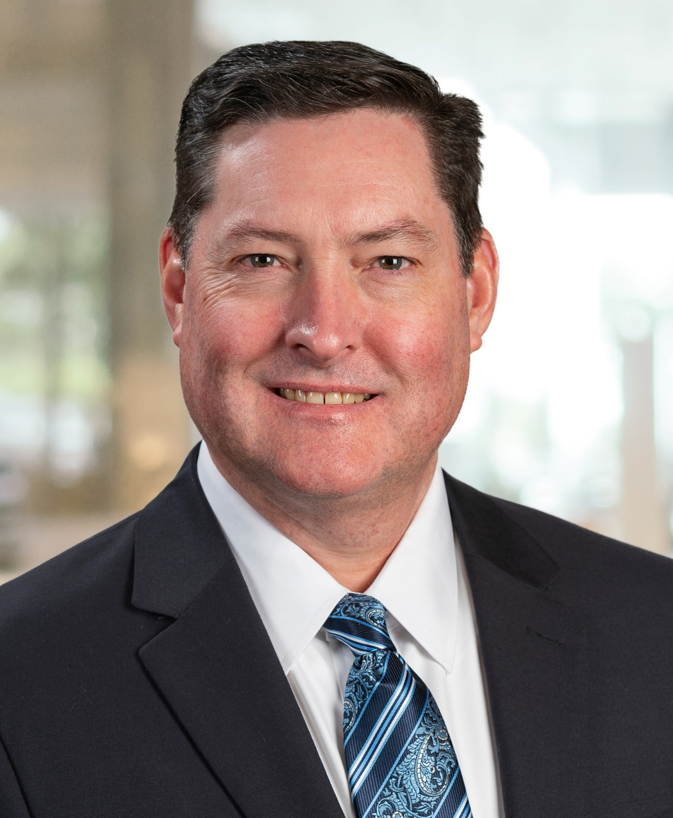

Presented By
Robert E. Nichols, AIF®, CPFA™
Wealth Advisor
OneAZ Wealth Management
RNichols@OneAZcu.com
Notes:
My name is Robert Nichols, I am a Wealth Advisor located in the Northern Arizona Region at OneAZ Wealth Management here at OneAZ Credit Union. [INCLUDE SELF BIO OR INTRODUCTION]
Our full-time professional financial advisors, assist clients and members of the OneAZ Credit Union all over the great state of Arizona! We are very excited to bring these educational topics directly to you and we are planning more in 2024.

Slide 4


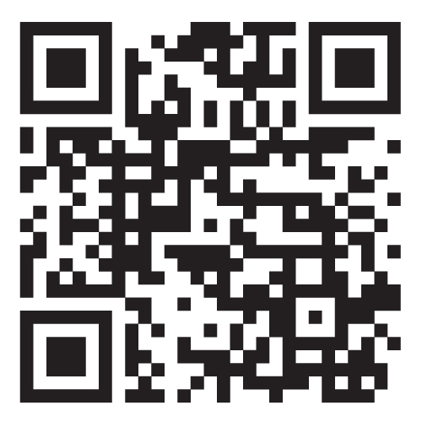
Connect With Us!
Website: OneAZWealth.com
Email: OneAZWealth@OneAZCU.com
24/7 Online Appointment Scheduler:
OneAZWealth.com
Phone: (877) 566-0517
Call Monday-Friday, 9:00 am – 5:00 pm
Scan to visit OneAZWealth.com
OneAZ Wealth Management, OneAZ Credit Union and LPL Financial are not affiliated with any other referenced entity.
Your Credit Union (“Financial Institution”) provides referrals to financial professionals of LPL Financial LLC (“LPL”) pursuant to an agreement that allows LPL to pay the Financial Institution for these referrals. This creates an incentive for the Financial Institution to make these referrals, resulting in a conflict of interest. The Financial Institution is not a current client of LPL for brokerage or advisory services. Please visit https://www.lpl.com/disclosures/is-lpl-relationship-disclosure.html for more detailed information.
This presentation was created for educational and informational purposes only and is not intended as ERISA, tax, legal or investment advice. If you are seeking investment advice specific to your needs, such advice services must be obtained on your own separate from this educational presentation.
Securities and advisory services are offered through LPL Financial (LPL), a registered investment advisor and broker-dealer (member FINRA/SIPC). Insurance products are offered through LPL or its licensed affiliates. OneAZ Credit Union (OneAZ CU) and OneAZ Wealth Management are not registered as a broker-dealer or investment advisor. Registered representatives of LPL offer products and services using OneAZ Wealth Management, and may also be employees of OneAZ CU. These products and services are being offered through LPL or its affiliates, which are separate entities from, and not affiliates of, OneAZ CU nor OneAZ Wealth Management. Securities and insurance offered through LPL or its affiliates are:
Not Insured by NCUA or Any Other Government Agency | Not Credit Union Guaranteed | Not Credit Union Deposits or Obligations | May Lose Value
OneAZ Wealth Management | (877) 566-0517 | www.OneAZWealth.com | Safe For Public Distribution.
Notes:
First, here is our Information page, it contains our required legal disclosures for your convenience.
Please always check out our OneAZWealth.com website for upcoming webinar events.
For better audio, the webinar will be in “listen-only mode”…
We will be fielding your questions at the end of the webinar. Please, email any questions to: oneazwealth@oneazcu.com. We will be compiling your questions and will answer them at the end of today’s presentation. If we do not get to your question, I promise we will respond to you directly.
Last, for more information about OneAZ Wealth Management and our team of wealth advisors, visit OneAZWealth.com or use your mobile device to scan the QR Code on the screen now.
You can also connect with us on social media on Facebook, LinkedIn, and YouTube for more exciting resources and helpful information.

Slide 5
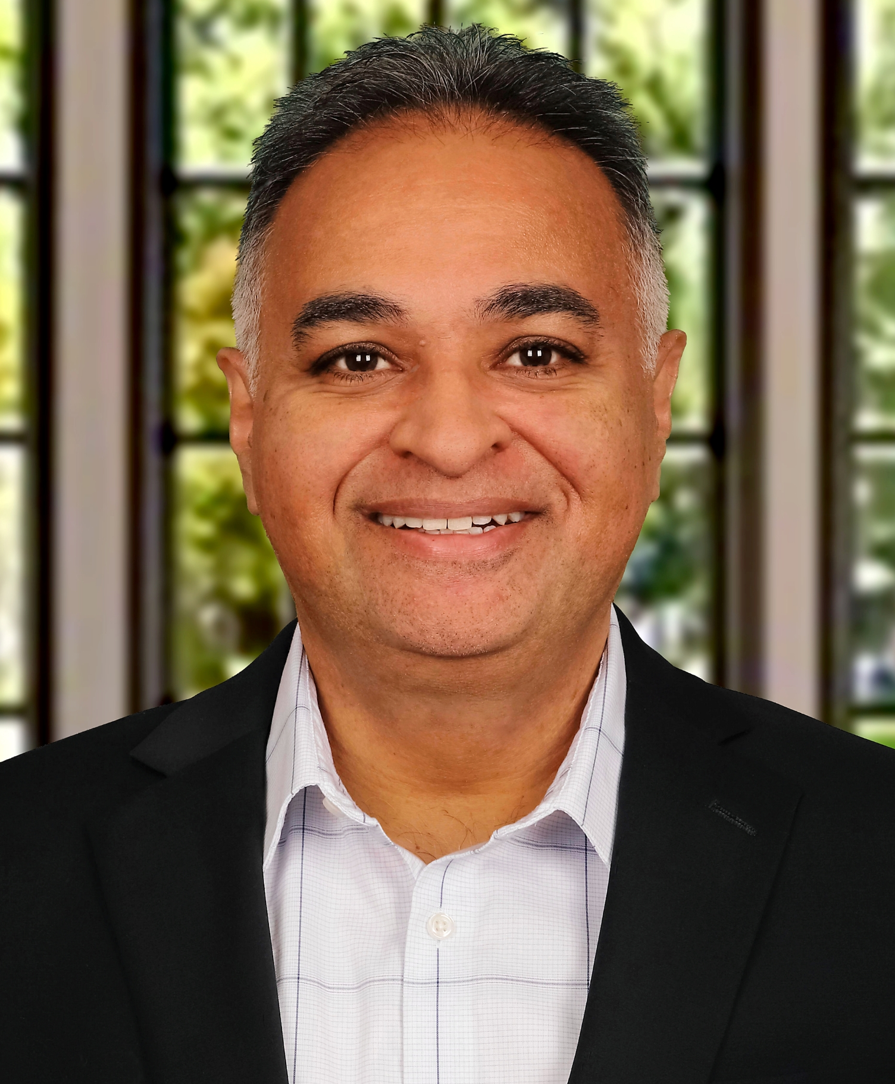
Guest Speaker
Neil P. Patel, CPA
Founder, Patel Advisory Group
Neil@PatelAdvisory.com
(480) 626-9270
**Neil P. Patel, Patel Advisory Group PC, is not affiliated with or endorsed by LPL Financial and OneAZ Wealth Management.
Notes:
So, let’s get started…
Our Guest Speaker today is Neil Patel of Patel Advisory Group
Neil’s interest in the mechanics of business started early and was influenced by his entrepreneurial family of operators and investors. After graduating from Chicago’s esteemed Loyola University, Neil worked for public and private enterprises affording him invaluable insight and experience into the finance, operations and management functions of businesses in multiple industries.
Neil launched his practice in 1999. And for nearly 25 years, he has advised hundreds of diverse businesses providing him with a uniquely wide scope of real-world, hands-on experience. As a result, he understands firsthand the challenges and opportunities business leaders face today.
His professional mission has been focused on helping clients navigate today’s complex business environment, improve visibility and grow. Neil is best known for his perspectives on financial leadership. In this capacity Neil is able to help accounting and finance teams align with operational targets and strategic objectives. In doing so, Neil is able to help business leaders achieve their goals, reduce stress and find professional and personal fulfillment.
Outside of the office, Neil enjoys hiking, camping, traveling, spending time with friends and family and spoiling his chocolate lab, Lily.

Slide 6

Secure Act 2.0
Revised in 2022
Reduces IRS penalty for taking out less than full RMD from 50% not underpayment to 25%
Beginning date of RMDs changed from 72 to 73 years old
Notes:
The SECURE Act 2.0, officially known as the "Setting Every Community Up for Retirement Enhancement Act 2.0," aims to enhance retirement savings opportunities and provide various benefits to small business owners. Here are some of the key benefits for small business owners
*In 2023, the SECURE Act 2.0. reduces the IRS penalty for taking out less than your full RMD from 50% of the underpayment to 25% (10% if corrected in a timely manner). You should consult your investment professional or tax advisor about your specific situation.
**Under the “Setting Every Community Up for Retirement Enhancement Act” of 2019, as revised in 2022 (“the SECURE Act 2.0”), the required beginning date of RMDs is raised from age 72 to 73 for any person who attains age 72 after December 31, 2022. There is no change to RMDs for people who turned age 72 prior to January 1, 2023.

Slide 7
Enhanced Tax Credits for Starting Retirement Plans
Increased Startup Credit:
Increases small business startup credit for retirement plans from 50% to 100% of the costs for employers
Up to 50 employees, capped at $5,000 per year for first 3 years
Additional Credit for Employer Contributions:
Additional credit provided for employer contributions to retirement plan, up to $1,000 per employee for first 5 years
Notes:
Enhanced Tax Credits for Starting Retirement Plans
Increased Startup Credit: The act increases the small business startup credit for retirement plans from 50% to 100% of the costs for employers with up to 50 employees, capped at $5,000 per year for the first three years.
Additional Credit for Employer Contributions: An additional credit is provided for employer contributions to the retirement plan, up to $1,000 per employee for the first five years.

Slide 8

Simplified Plan Administration
Reduced Administrative Burden:
Provisions allowing certain corrections of plan errors without incurring penalties
Auto-Enrollment Requirement:
Auto-enrollment can lead to higher participation rates and improved employee satisfaction without significant administrative burden due to simplified processes
Notes:
Simplified Plan Administration
Reduced Administrative Burden: Various provisions in SECURE Act 2.0 are designed to simplify plan administration, such as allowing certain corrections of plan errors without incurring penalties.
Auto-Enrollment Requirement: While auto-enrollment may initially seem like an additional responsibility, it can lead to higher participation rates and improved employee satisfaction without significant administrative burden due to simplified processes.

Slide 9

Enhanced Retirement Savings for Employees
Higher Contribution Limits:
Increases catch-up contribution limits for employees aged 60 to 63
Attract and retain more experienced employees by allowing them to save more as they near retirement
Student Loan Matching Contributions:
Employers can treat student loan payments as elective deferrals for purposes of matching contribution
Will help employees with student debt to receive retirement benefits
Notes:
Enhanced Retirement Savings for Employees
Higher Contribution Limits: The act increases catch-up contribution limits for employees aged 60 to 63, which can attract and retain more experienced employees by allowing them to save more as they near retirement.
Student Loan Matching Contributions: Employers can treat student loan payments as elective deferrals for purposes of matching contributions, helping employees with student debt to still receive retirement benefits.

Slide 10
Incentives for Employee Retention
Flexible Plan Options:
More flexibility in plan designs, including pooled employer plans (PEPs)
Reduce costs & administrative duties by sharing them with other employers
Roth Matching Contributions:
Allows employers to offer Roth matching contributions
Provide tax benefits to employees and make retirement plans more attractive
Notes:
Incentives for Employee Retention
Flexible Plan Options: The act offers more flexibility in plan designs, including pooled employer plans (PEPs), which can reduce costs and administrative duties by sharing them with other employers.
Roth Matching Contributions: The act allows employers to offer Roth matching contributions, providing tax benefits to employees and potentially making the retirement plan more attractive.

Slide 11

Encouragement of Long-Term Savings
Emergency Savings Accounts:
Allows for creation of emergency savings accounts
Pursue financial security for employees and potentially reduce turnover due to financial stress
Lifetime Income Solutions:
Provisions encouraging use of lifetime income products (such as annuities) within retirement plans
Provide employees with more stable income in retirement, increasing the perceived value of the plan
Notes:
Encouragement of Long-Term Savings
Emergency Savings Accounts: The act allows for the creation of emergency savings accounts within retirement plans, which can potentially improve overall financial security for employees and potentially reduce turnover due to financial stress.
Lifetime Income Solutions: Provisions encouraging the use of lifetime income products (such as annuities) within retirement plans can provide employees with more stable income in retirement, increasing the perceived value of the plan.

Slide 12
Improved Compliance and Protection
Improved Retirement Plan Access:
Make retirement plans more accessible & easier to maintain
Help your small business comply with regulations without undue burden
Increased IRS Support:
Enhanced IRS guidance & resources for plan sponsors can help small business owners better navigate complexities of retirement plan management
Notes:
Improved Compliance and Protection
Improved Retirement Plan Access: The act includes provisions to make retirement plans more accessible and easier to maintain, which can help small businesses comply with regulations without undue burden.
Increased IRS Support: Enhanced IRS guidance and resources for plan sponsors can help small business owners better navigate the complexities of retirement plan management.

Slide 13

Financial Wellness Programs
Incorporating Financial Wellness:
Encourages integration of financial wellness programs with retirement plans
Employees can better manage their financial health and improve their ability to save for retirement
Notes:
Financial Wellness Programs
Incorporating Financial Wellness: The act encourages the integration of financial wellness programs with retirement plans, which can help employees better manage their overall financial health and improve their ability to save for retirement.

Slide 14
Conclusion: 7 Takeaways
SECURE Act 2.0 provides significant benefits to small business owners by making it easier and more cost-effective to maintain retirement plans
You can enhance the attractiveness of these plans to your employees and ultimately aid in employee retention and satisfaction
Increased Tax Credits
Simplified Plan Administration
Enhanced Retirement Savings Options
Employee Retention Incentives
Encouragement of Long-Term Savings
Improved Compliance and Protection
Financial Wellness Programs
Notes:
Overall, the SECURE Act 2.0 provides significant benefits to small business owners by making it easier and more cost-effective to establish and maintain retirement plans, enhancing the attractiveness of these plans to employees, and ultimately aiding in employee retention and satisfaction.
Increased Tax Credits
Startup Credit Expansion: 100% of retirement plan startup costs covered (up to $5,000 per year) for businesses with up to 50 employees.
Employer Contribution Credit: Additional tax credit for employer contributions, up to $1,000 per employee for the first five years.
Simplified Plan Administration
Reduced Administrative Burden: Simplified correction of plan errors and streamlined processes.
Auto-Enrollment: Encourages higher participation rates and employee satisfaction with minimal additional administrative effort.
Enhanced Retirement Savings Options
Higher Contribution Limits: Increased catch-up contributions for employees aged 60-63.
Student Loan Matching: Allows student loan payments to be treated as elective deferrals for matching contributions, aiding employees with student debt.
Employee Retention Incentives
Flexible Plan Options: Introduction of pooled employer plans (PEPs) to share costs and administrative duties.
Roth Matching Contributions: Provides tax benefits to employees, enhancing the plan's attractiveness.
Encouragement of Long-Term Savings
Emergency Savings Accounts: Facilitates creation of emergency savings within retirement plans, improving financial security and reducing turnover.
Lifetime Income Solutions: Promotes use of annuities for stable retirement income, increasing the plan’s value to employees.
Improved Compliance and Protection
Accessible Retirement Plans: Provisions to make plans easier to maintain and comply with regulations.
Enhanced IRS Support: More guidance and resources for plan sponsors, aiding in compliance and management.
Financial Wellness Programs
Integration with Retirement Plans: Encourages financial wellness programs to help employees manage finances and improve savings rates.

Slide 15
Business Valuation – A Great Start
Top 12 Reasons For Business Valuation
98% of business owners don’t know their value! You can’t grow your value & optimize it without knowing where you are today
Better understand your business and its potential.
Know the value of your largest asset so you can plan for retirement.
Ensure the business and your family are properly protected.
Create a Succession Plan.
Pay the right amount when you buy a business.
Source: www.BizEquity.com
Notes:
Knowing what your business is really worth, is using a Great Start in your Business Succession planning process.
Here are the top reasons for knowing your Business Valuation….
(Simply read off the list… 1, 2, 3, 4, 5, 6)

Slide 16
Business Valuation – A Great Start
Top 12 Reasons For Business Valuation
7. Get what it is worth upon sale.
Create Buy/Sell Agreements with business partners.
Explore funding opportunities.
Establish a trust or create an estate plan.
Prepare for taxable events such as gifting or grants.
82% of all business owners that knew their value at least 18 months before their sale increased their sale price by at least 14%.
Source: www.BizEquity.com
Notes:
(Simply read off the list… 7, 8, 9, 10, 11, 12)

Slide 17
The First Step Is Now…
OneAZ Wealth Management, as part of our overall financial planning review, is now offering a complimentary Business Valuation Estimation for business owners, using the BIZEQUITY calculation tool
Knowing the true value of one's business is critical to proper business planning and pursuing personal goals
This valuable service opens the door to conversations around financial health, while also working toward securing the future of business owners’ families and key employees
**Business Valuation Estimations through BizEquity are informal and for financial planning-related purposes only. The resulting valuation is intended to provide an illustrative estimation and cannot be relied upon in lieu of a formal business appraisal in connection with the purchase or sale of a business, extensions of credit, or otherwise by third parties.
Notes:
To help you move to the first step, OneAZ Wealth Management, as part of our overall financial planning review, is now offering a Complementary Business Value Estimation for business owners. We have access to an estimation calculator, called BIZEQUITY.
Knowing the value of one's business is critical to proper business planning and pursuing personal goals
This valuable service opens the door to conversations around financial health, while also working toward securing the future of business owners’ families and key employees.
As we wrap up now…
We hope you’ve found a lot of valuable information in today’s presentation. These are complex problems with equally complex solutions, so I’m sure you have questions. We can set up a time to meet individually to discuss the particulars of your situation.
Now, Let’s take some time to answer some of the questions already submitted . . . .

Slide 18
Question & Answers
Website: OneAZWealth.com
Email: OneAZWealth@OneAZCU.com
24/7 Online Appointment Scheduler:
OneAZWealth.com
Phone: (877) 566-0517
Call Monday-Friday, 9:00 am – 5:00 pm
Scan to visit OneAZWealth.com
OneAZ Wealth Management | (877) 566-0517 | www.OneAZWealth.com | Safe For Public Distribution.
Notes:
We have a number of questions coming in now. Please email any questions you have to OneAZWealth@oneazcu.com ... And we will be sure to address them…
So, our first question is: (TBD)
If we do not get to your question, I promise we will respond to you directly.

Slide 19
Thank you!
Website: OneAZWealth.com
Email: OneAZWealth@OneAZCU.com
24/7 Online Appointment Scheduler:
OneAZWealth.com
Phone: (877) 566-0517
Call Monday-Friday, 9:00 am – 5:00 pm
Scan to visit OneAZWealth.com
OneAZ Wealth Management | (877) 566-0517 | www.OneAZWealth.com | Safe For Public Distribution.
Notes:
As a wrap-up, thank you, Neil for your presentation and insights.
For those watching and listening, Thank you for joining, we hope our discussion today has helped to provide you some ideas on Leveraging Secure Act 2.0 To Grow Your Business. We all here at OneAZ Wealth Management welcome your feedback and comments. So, Please email us any suggestions you have for future webinar topics. As always, our entire OneAZ Wealth team of Advisors stands ready to assist you in reviewing your current financial plan and portfolio in light of today’s economy. There is no better time than the present for a 2nd opinion on your current plan. Many of our clients had other advisors when they first come to us, and they learned and discovered new ideas and new strategies that are better suited to their needs. We welcome your call! Please call our toll-free number: 877-566-0517 and visit our OneAZWealth.com website for more information in creating your personal financial and retirement plan.
Again, Thank you for joining us… From all of us at OneAZ Wealth, we wish you the best for your Safety, Health and Wealth!

