Slide 1
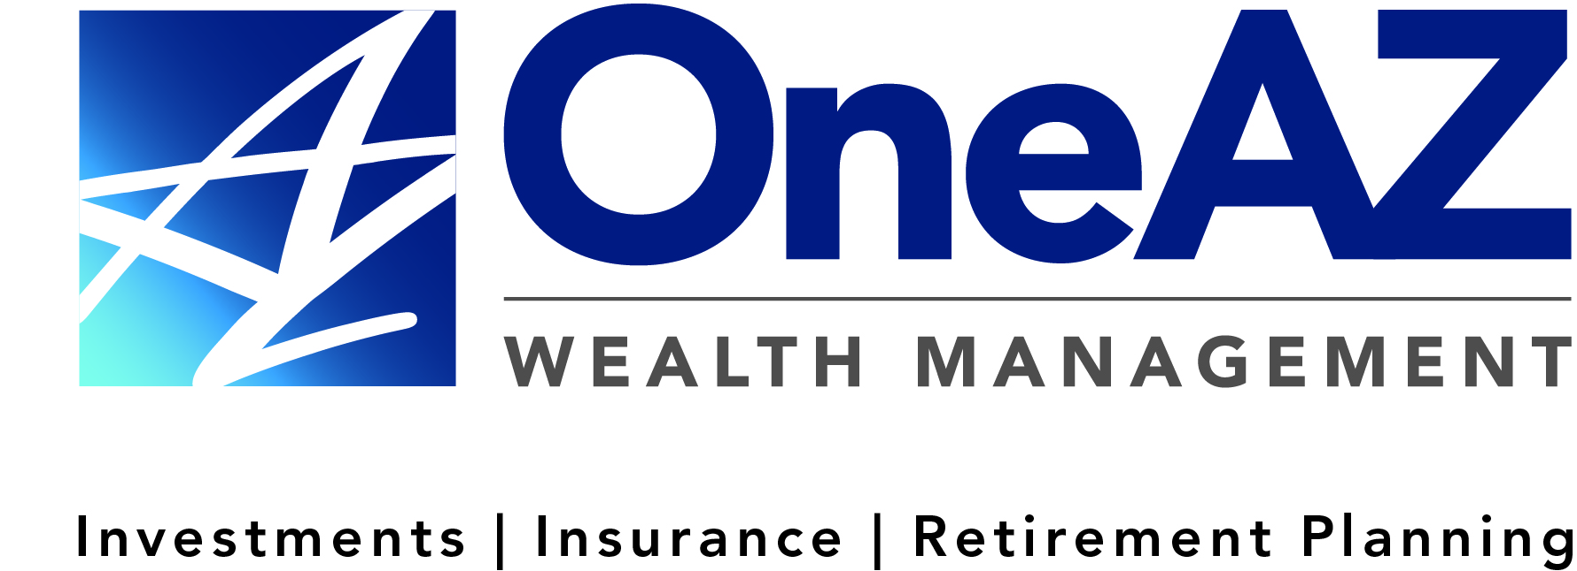
The presentation will begin shortly.
Your Credit Union (“Financial Institution”) provides referrals to financial professionals of LPL Financial LLC (“LPL”) pursuant to an agreement that allows LPL to pay the Financial Institution for these referrals. This creates an incentive for the Financial Institution to make these referrals, resulting in a conflict of interest. The Financial Institution is not a current client of LPL for brokerage or advisory services.
Please visit https://www.lpl.com/disclosures/is-lpl-relationship-disclosure.html for more detailed information.
This presentation was created for educational and informational purposes only and is not intended as ERISA, tax, legal or investment advice. If you are seeking investment advice specific to your needs, such advice services must be obtained on your own separate from this educational presentation.
Securities and advisory services are offered through LPL Financial (LPL), a registered investment advisor and broker-dealer (member FINRA/SIPC). Insurance products are offered through LPL or its licensed affiliates. OneAZ Credit Union (OneAZ CU) and OneAZ Wealth Management are not registered as a broker-dealer or investment advisor. Registered representatives of LPL offer products and services using OneAZ Wealth Management, and may also be employees of OneAZ CU. These products and services are being offered through LPL or its affiliates, which are separate entities from, and not affiliates of, OneAZ CU nor OneAZ Wealth Management. Securities and insurance offered through LPL or its affiliates are:
Not Insured by NCUA or Any Other Government Agency | Not Credit Union Guaranteed | Not Credit Union Deposits or Obligations | May Lose Value
OneAZ Wealth Management | (877) 566-0517 | www.OneAZWealth.com | Safe For Public Distribution.

Slide 2




Website: OneAZWealth.com
Email: OneAZWealth@OneAZCU.com
24/7 Online Appointment Scheduler:
OneAZWealth.com
Phone: (877) 566-0517
Call Monday-Friday, 9:00 am – 5:00 pm
Scan to visit OneAZWealth.com
Your Credit Union (“Financial Institution”) provides referrals to financial professionals of LPL Financial LLC (“LPL”) pursuant to an agreement that allows LPL to pay the Financial Institution for these referrals. This creates an incentive for the Financial Institution to make these referrals, resulting in a conflict of interest. The Financial Institution is not a current client of LPL for brokerage or advisory services.
Please visit https://www.lpl.com/disclosures/is-lpl-relationship-disclosure.html for more detailed information.
This presentation was created for educational and informational purposes only and is not intended as ERISA, tax, legal or investment advice. If you are seeking investment advice specific to your needs, such advice services must be obtained on your own separate from this educational presentation.
Securities and advisory services are offered through LPL Financial (LPL), a registered investment advisor and broker-dealer (member FINRA/SIPC). Insurance products are offered through LPL or its licensed affiliates. OneAZ Credit Union (OneAZ CU) and OneAZ Wealth Management are not registered as a broker-dealer or investment advisor. Registered representatives of LPL offer products and services using OneAZ Wealth Management, and may also be employees of OneAZ CU. These products and services are being offered through LPL or its affiliates, which are separate entities from, and not affiliates of, OneAZ CU nor OneAZ Wealth Management. Securities and insurance offered through LPL or its affiliates are:
Not Insured by NCUA or Any Other Government Agency | Not Credit Union Guaranteed | Not Credit Union Deposits or Obligations | May Lose Value
OneAZ Wealth Management | (877) 566-0517 | www.OneAZWealth.com | Safe For Public Distribution.

Slide 3
Connect With Us!
Website: OneAZWealth.com
Email: OneAZWealth@OneAZCU.com
24/7 Online Appointment Scheduler:
OneAZWealth.com
Phone: (877) 566-0517
Call Monday-Friday, 9:00 am – 5:00 pm
Scan to visit OneAZWealth.com
OneAZ Wealth Management | (877) 566-0517 | www.OneAZWealth.com | Safe For Public Distribution.
Notes:
For better audio, the webinar will be in “listen-only mode”…
We will be fielding your questions at the end of the webinar. Please, email any questions to: oneazwealth@oneazcu.com. We will be compiling your questions and will answer them at the end of today’s presentation. If we do not get to your question, I promise we will respond to you directly.
Please send your webinar questions to OneAZWealth@OneAZCU.com.
Last, for more information about OneAZ Wealth Management and our team of wealth advisors, visit OneAZWealth.com or use your mobile device to scan the QR Code on the screen now.
You can also connect with us on social media on Facebook, LinkedIn, and YouTube for more exciting resources and helpful information.
Now, let’s get started!

Slide 4
2023 Market Outlook

Slide 5

Guest Speaker
Thomas E. Mitchell, CFP®
Senior Vice President
TMitchell@OneAZcu.com

Slide 6
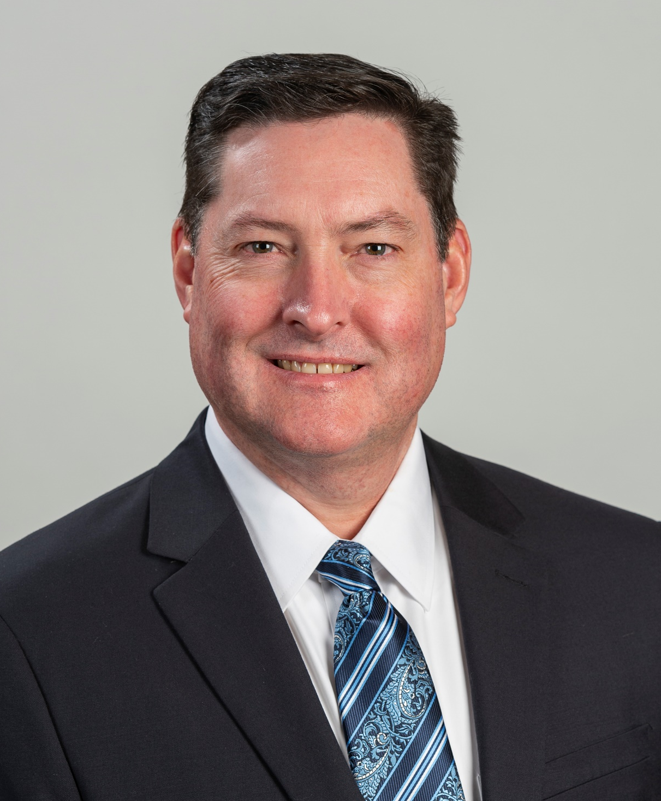
Guest Speaker
Robert Nichols, AIF®, CPFA™
Wealth Advisor
RNichols@OneAZcu.com

Slide 7
Agenda
Introduction
2022 Market Recap
  Stocks and Bonds
U.S. Economy Overview
Interest Rates & Inflation
Recession – how deep?
2023 Outlook
Q & A

Slide 8
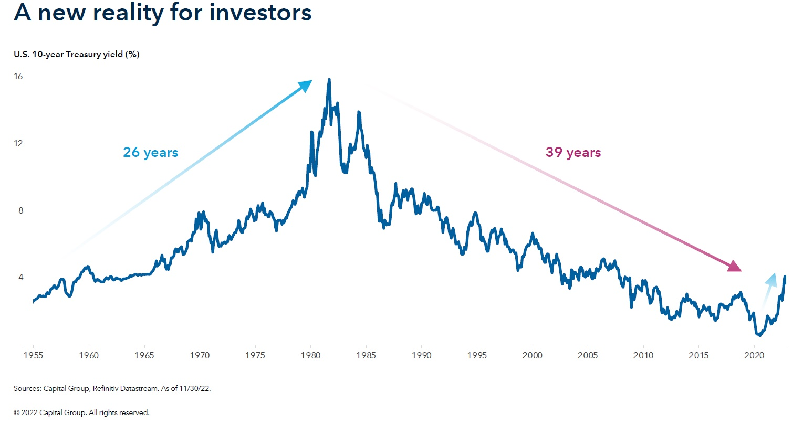

Notes:
Prior to 2022, Treasury yield had been consistently trending lower from the mid 1980’s
Recently, we’re seeing a significant rise in both short and long-maturity treasuries
10yr Treasury
12/31/21 at 1.63%
12/31/22 at 3.88%
‘18 – ’20 drop 2.69% to 0.93%

Slide 9
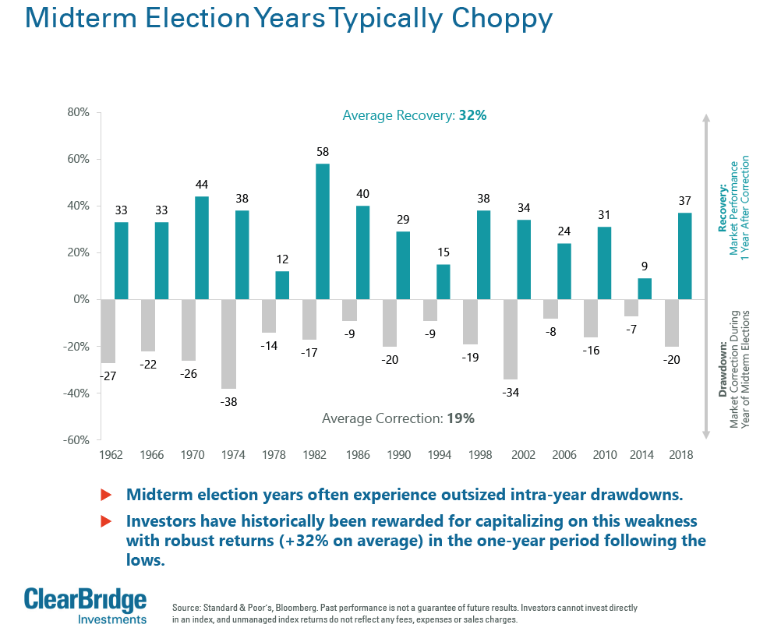
Notes:
We discussed last year that Mid-Term Election years are traditionally very volatile
We certainly saw that in ‘22
Stocks fell from near all-time highs at the beginning of 2022 and hit lows just before the election
The fourth quarter was positive for stocks but a far cry from the usual rally post-election

Slide 10
Forecasts By The Numbers
Forecasts for where the S&P 500 will finish in 2023 vary greatly. Below is a roundup of estimates made by five major banks, reported in notes and year-end reports. You can see that they’re largely hovering around 4,000
Barclays: 3,725
Citi: 3,900
Bank of America: 4,000
Goldman Sachs: 4,000
JPMorgan: 4,200
The bottom line: Take these predictions with a grain of salt.
Source: https://www.cnn.com/2022/12/28/investing/premarket-stocks-trading/index.html#:~:text=What's%20happening%3A%20Last%20year%2C%20Goldman,closed%20on%20Tuesday%20at%203%2C829
Notes:
Over the previous 20 years (2002 – 2021), the average difference between the target price estimates by industry insiders at the beginning of the year and the final price for the index for that same year has been 8.3%, according to a FactSet report.
Analysts overestimated the final value (that is, the final value finished below the estimate) in 13 of the 20 years and underestimated the final value (the final value finished above the estimate) in the other 7 years.
Source: https://www.cnn.com/2022/12/28/investing/premarket-stocks-trading/index.html#:~:text=What's%20happening%3A%20Last%20year%2C%20Goldman,closed%20on%20Tuesday%20at%203%2C829

Slide 11
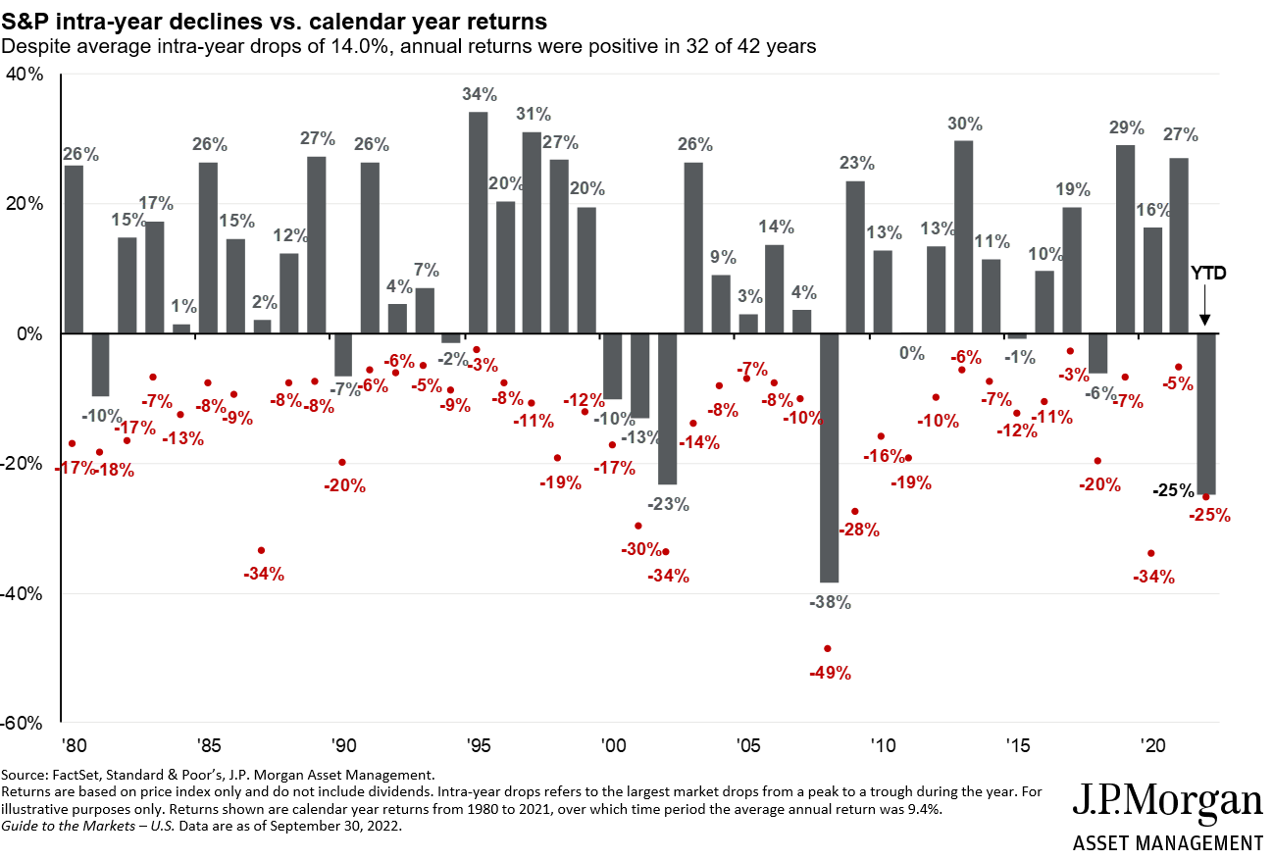













Annual returns and intra-year declines
Notes:
We can see that the majority of years the markets are positive with Intra-year declines or corrections
With the exception of ‘20 and COVID, we had been experiencing a lengthy period of growth with few large declines

Slide 12
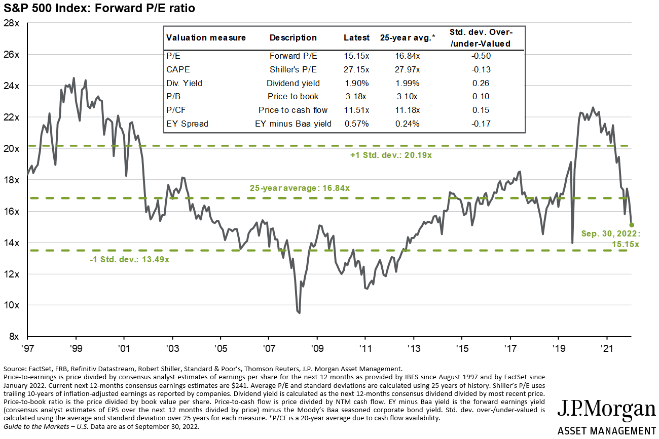

S&P 500 valuation measures
Notes:
This chart illustrates when valuations are above or below the historical average, that the S&P 500 stocks are measured by the average price-to-earnings ratio - or P/E.
We will be making the comparison between SBUX (Starbucks) to MSFT (Microsoft) with their publicly-known P/E values.
The long-term average is about 16.5x. Anything higher is expensive. Anything lower is at a lower price.
“Everything reverts to the mean”.

Slide 13
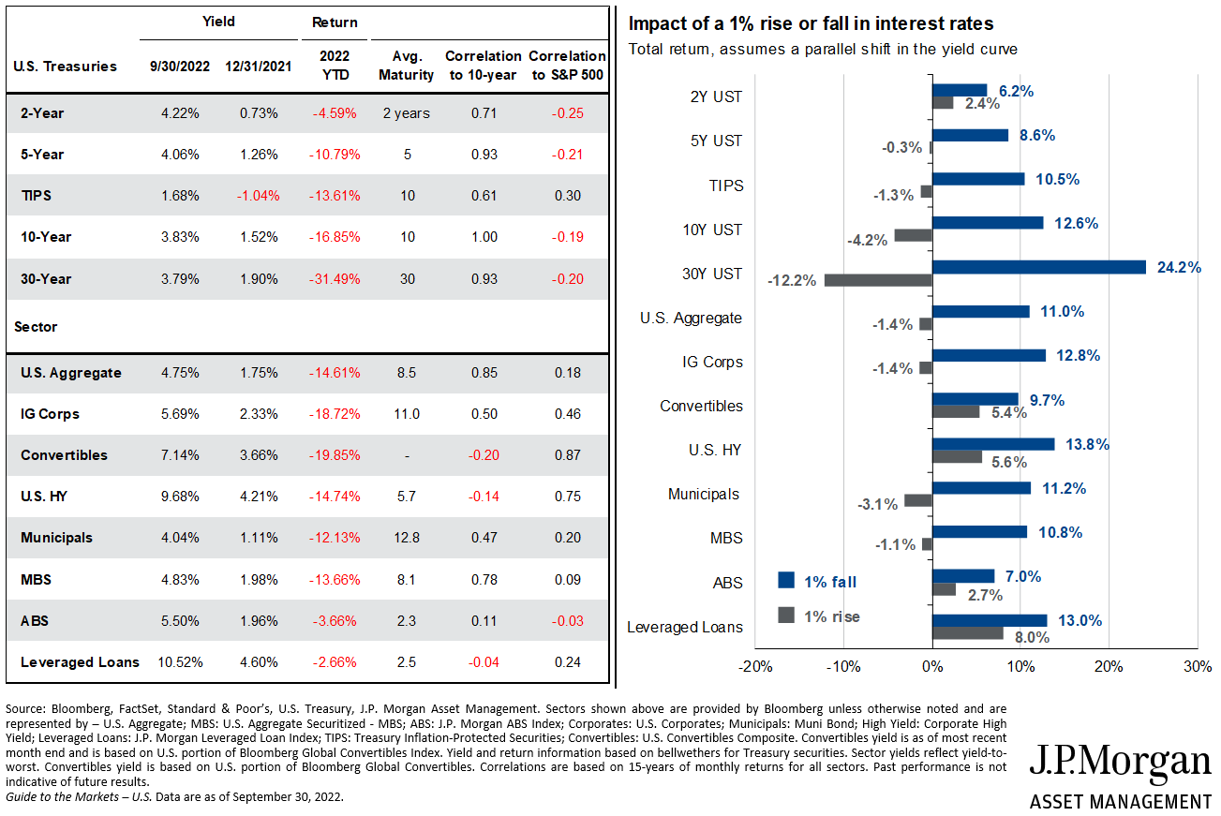




















Fixed income market dynamics
Notes:
Bonds last year were not their typical “safe harbor”
Bonds averages last year, in some areas, rivaled the drops in stocks
This decline & loss was felt by “conservative” investors that generally invest more in bonds for lower loss potential with higher amounts of income

Slide 14
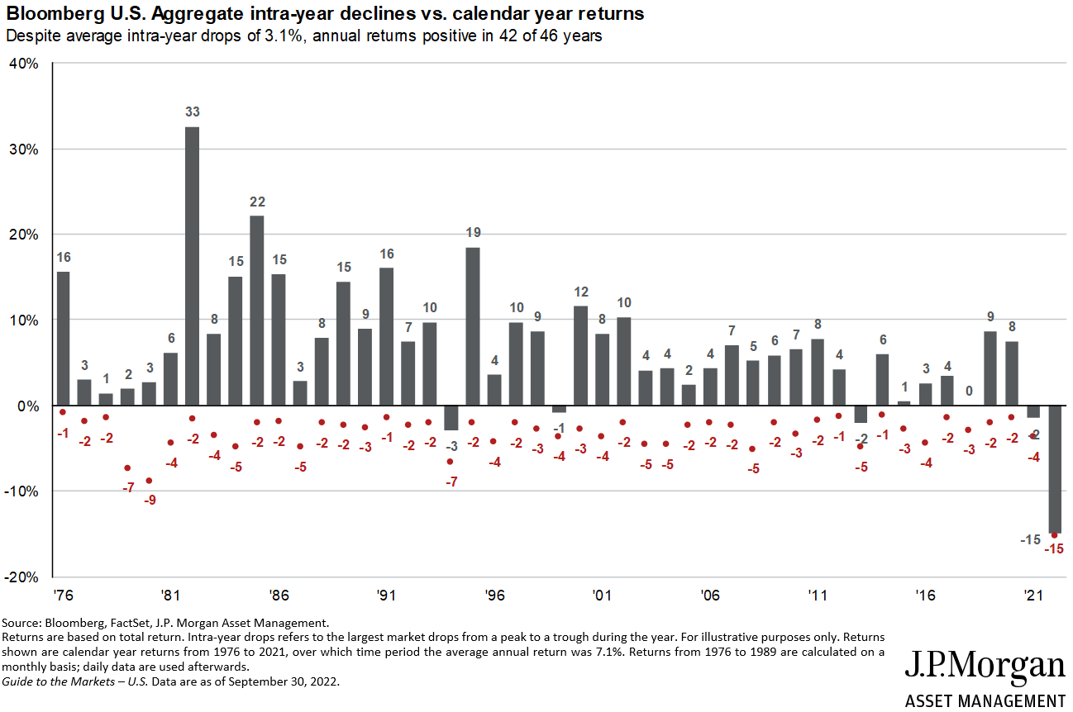




Bloomberg U.S. Agg. annual returns and intra-year declines
Notes:
This illustrates further how bad the average bond fund or index performed
Not since before President Reagan was elected had we seen inter or full year drops like this year
That was over 40 years ago and this downturn was more than 2x as bad

Slide 15
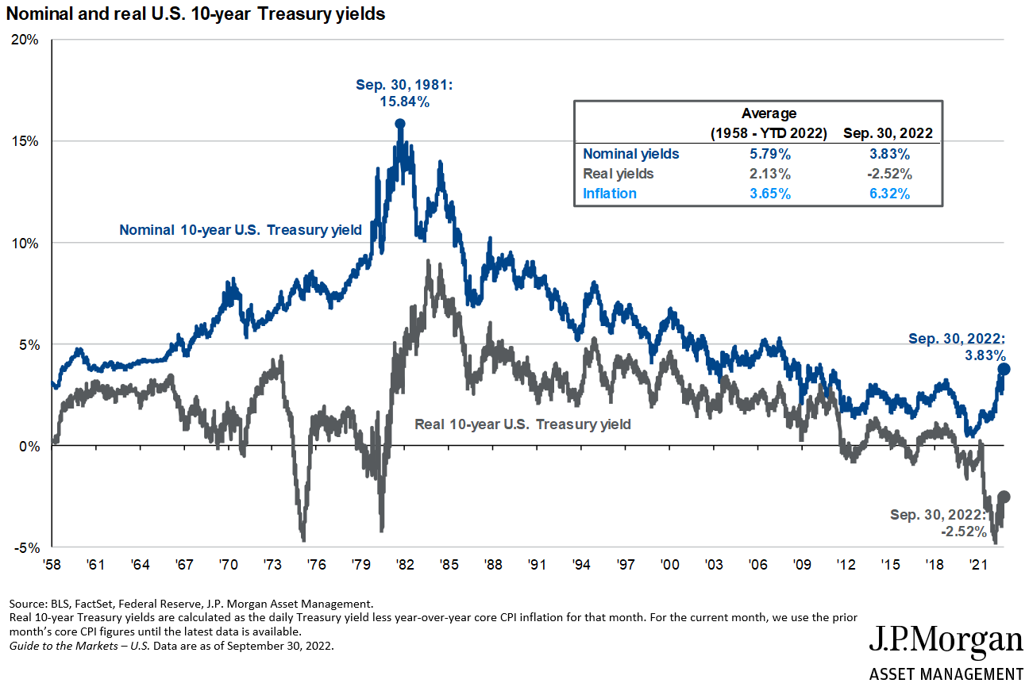







Interest rates and inflation
Notes:
Interest rates and yields had been falling since the early ’80s
Inflation has a dynamic impact on real yields
Note the grey line shows what you really earned, net of inflation
People remember back then getting upwards of +15% or more for savings/money market and CD’s
But after taxes (50% marginal) and inflation, their “value” still was dropping by 5% per year
It is worse now even with savings rates rising

Slide 16
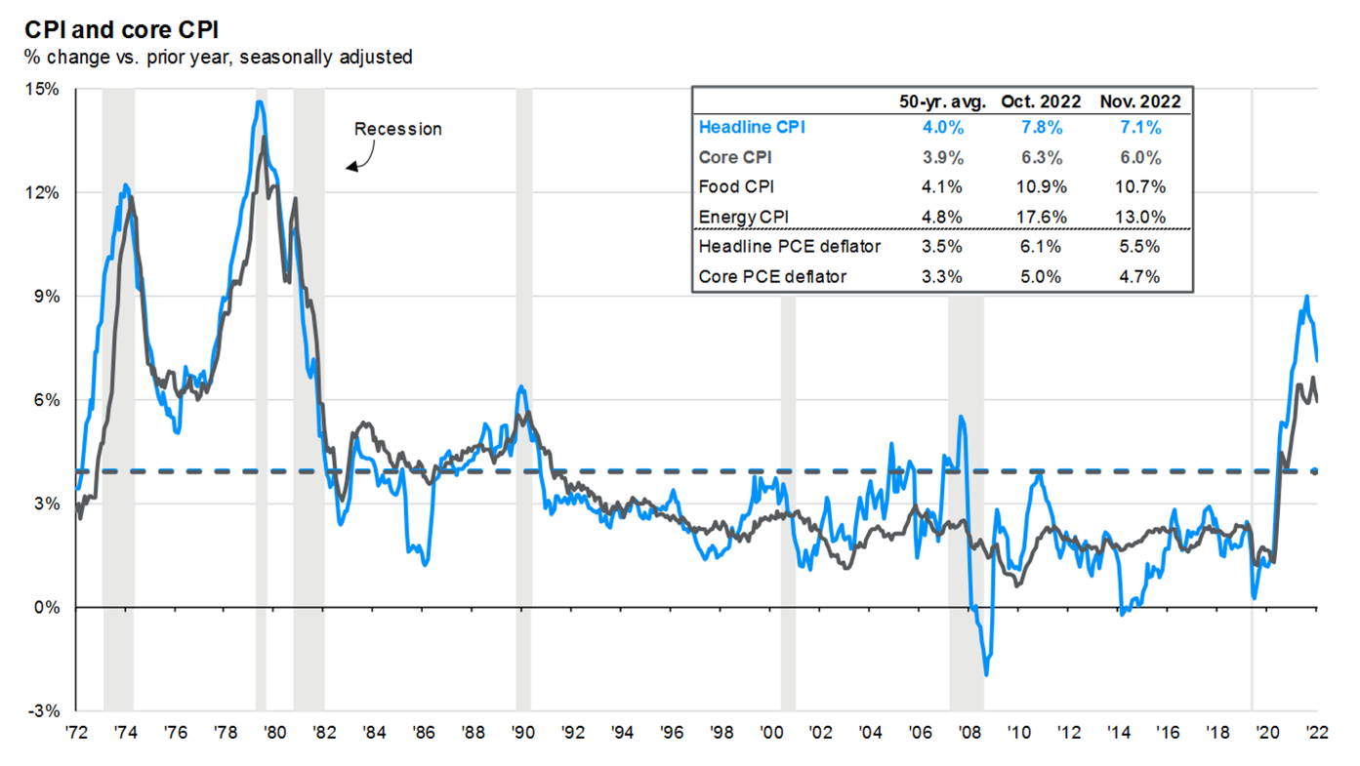

Inflation
Notes:
Headline CPI (inflation) excludes more volatile data such as energy, food, and housing. But try living without those
They track closely except in price dislocations like real estate in ‘08
AZ because of real estate and gas prices soaring in recent past have been affected more than most

Slide 17
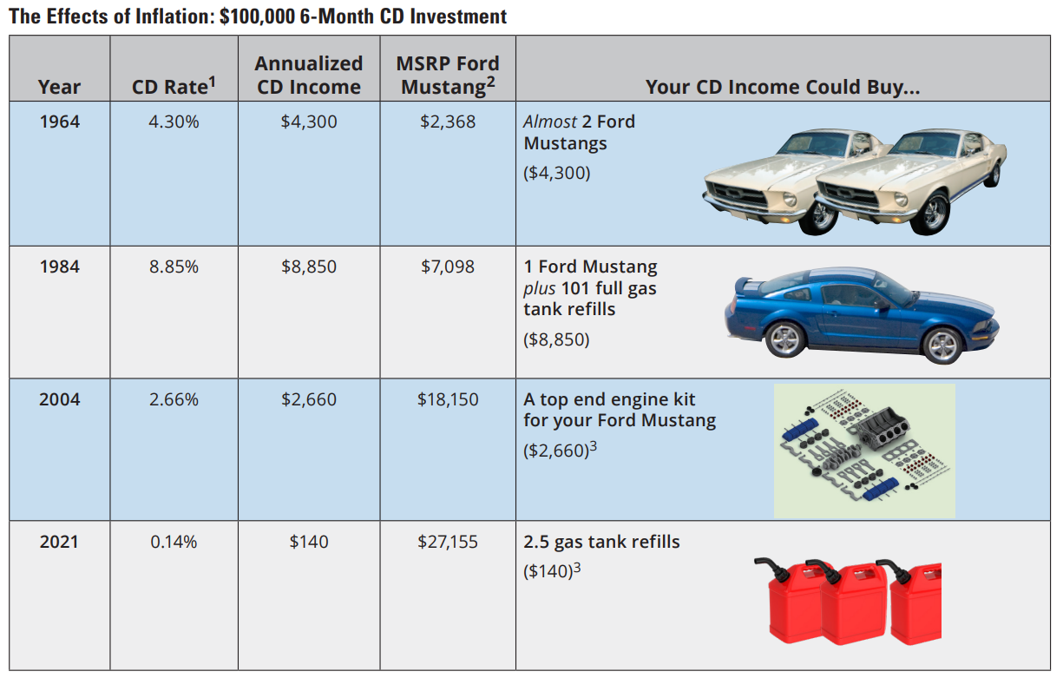
CDs are insured by the FDIC, offer a fixed rate of return, and are generally designed for short-term savings needs. The principal value and investment return of investment securities (including mutual funds) are subject to risk, will fluctuate with changes in market conditions, are generally considered long-term investments, and may not be in the best interest of all investors.
1 Data Sources: Federal Reserve, BankRate.com, and Hartford Funds, 2/22. CD rate for 2021 as of 12/31/21.
2 Sources: cjponyparts.com and USnews.com, retrieved 5/21.
3 Data Source: aaa.com, retrieved 5/25/21. Hartford Funds Distributors, LLC. CCWP012_0222 227403
Notes:
This chart is an illustrated way to look at the negative effects of inflation
Warren Buffet Quote: “Today people who hold cash equivalents feel comfortable. They shouldn’t. They have opted for a terrible long-term asset, one that pays virtually nothing and is certain to depreciate in value.”
The downside of “playing it safe” is that actually may cost you in the future by decreasing the buying power of your money

Slide 18
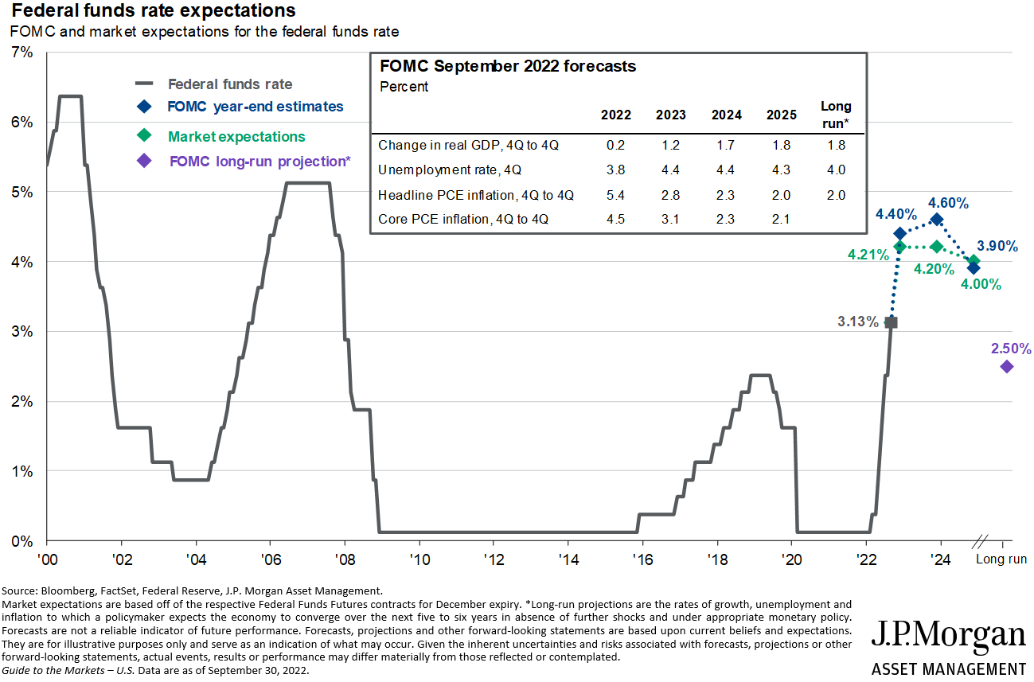
The Fed and interest rates
Notes:
Currently, the Fed Funds rate is 4.25% to 4.50%
This is only the interest rate the Fed pays to retail banks on their deposits
It affects rates on credit cards, HELOC and auto loans
The other way to battle inflation is the Fed’s balance sheet – think of it as their bond portfolio
These numbers, found at the source of FederalReserve.gov, are the Federal Reserve’s Balance Sheet Holdings:
3/16/22 at 8.954 Trillion dollars
12/28/22 at 8.551 Trillion dollars
4.5% Reduction – very small

Slide 19
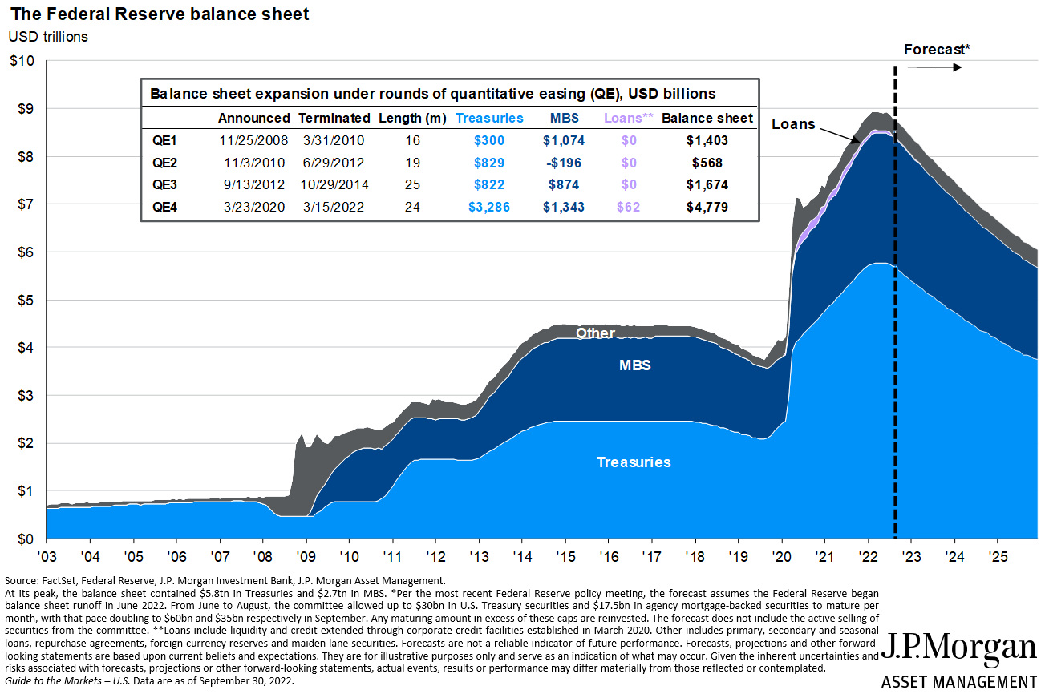


The Federal Reserve balance sheet
Notes:
So what was the major cause of inflation?
Huge amount of money added during and after COVID. $5T
Breakdown in the supply chain
People home spending
ECON 101
More $
More demand
Less supply
Prices Go Higher

Slide 20
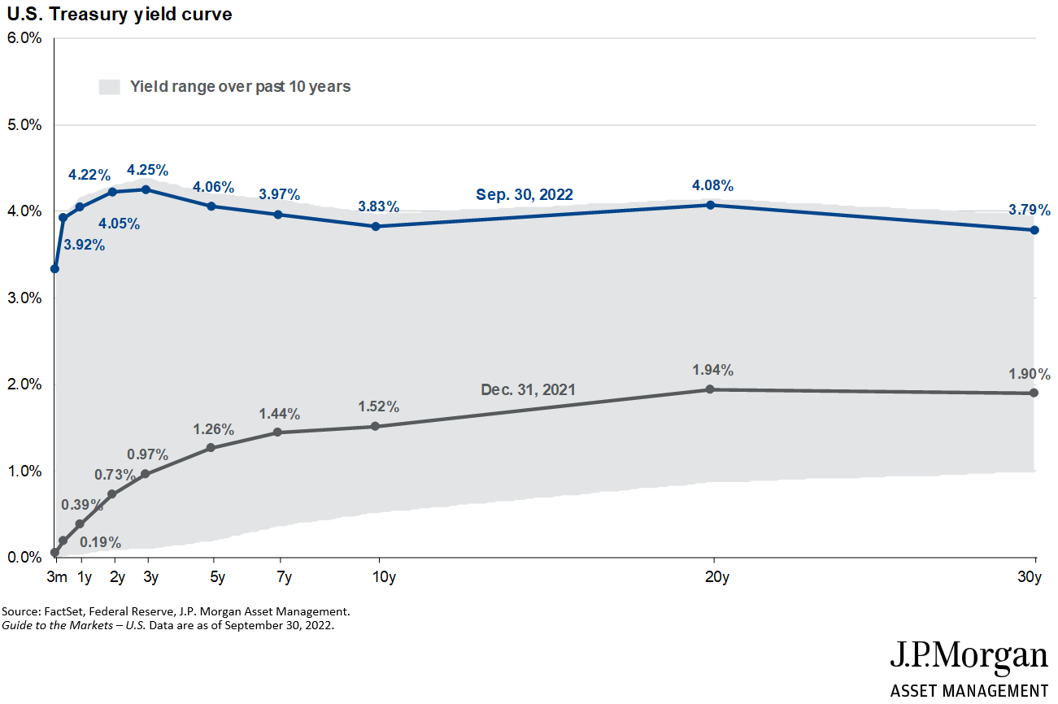
Yield curve
Notes:
Now let’s begin to talk about the ugly “R” word – Recession
So predictors of a coming recession
2 consecutive Qtr. of negative GDP
1st and 2nd qtrs. of 2022
Inverted yield curve
See above
Stock market sell off

Slide 21
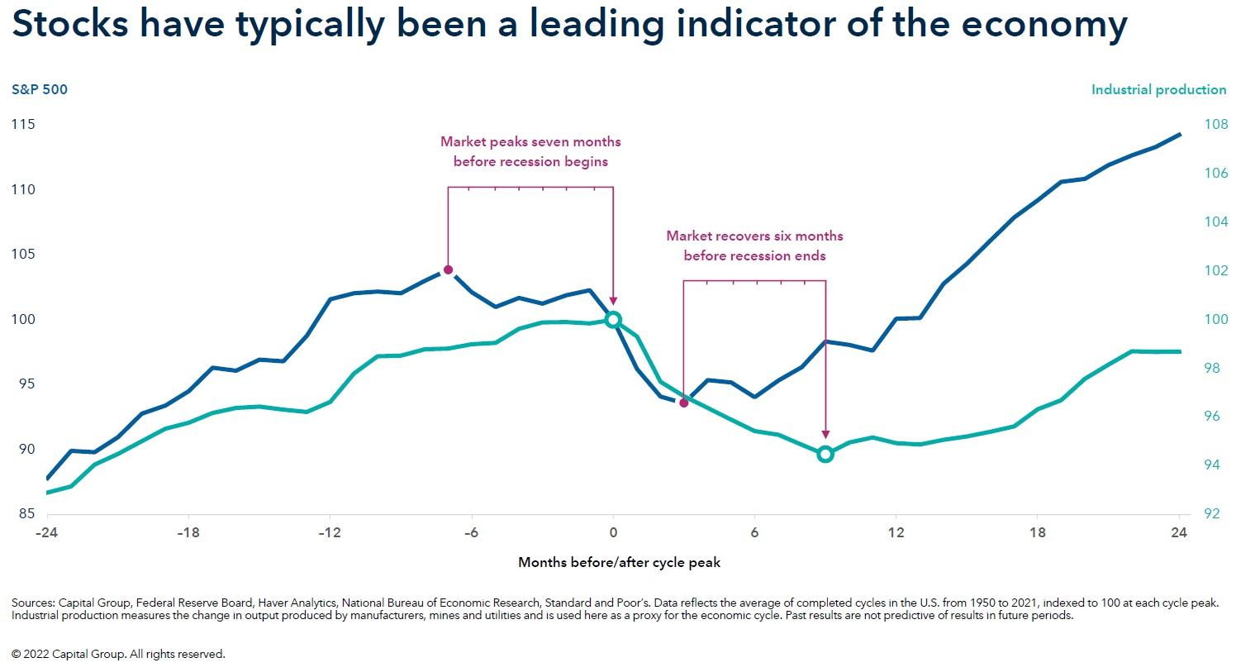
Notes:
The stock market on average sells off 6-9 months before the recession “officially” starts
The market also begins to recover 6-9 months prior to the recession officially ending
The “official” begin and end is declared by the National Bureau of Economic Research
This determination generally comes well after the event is over

Slide 22
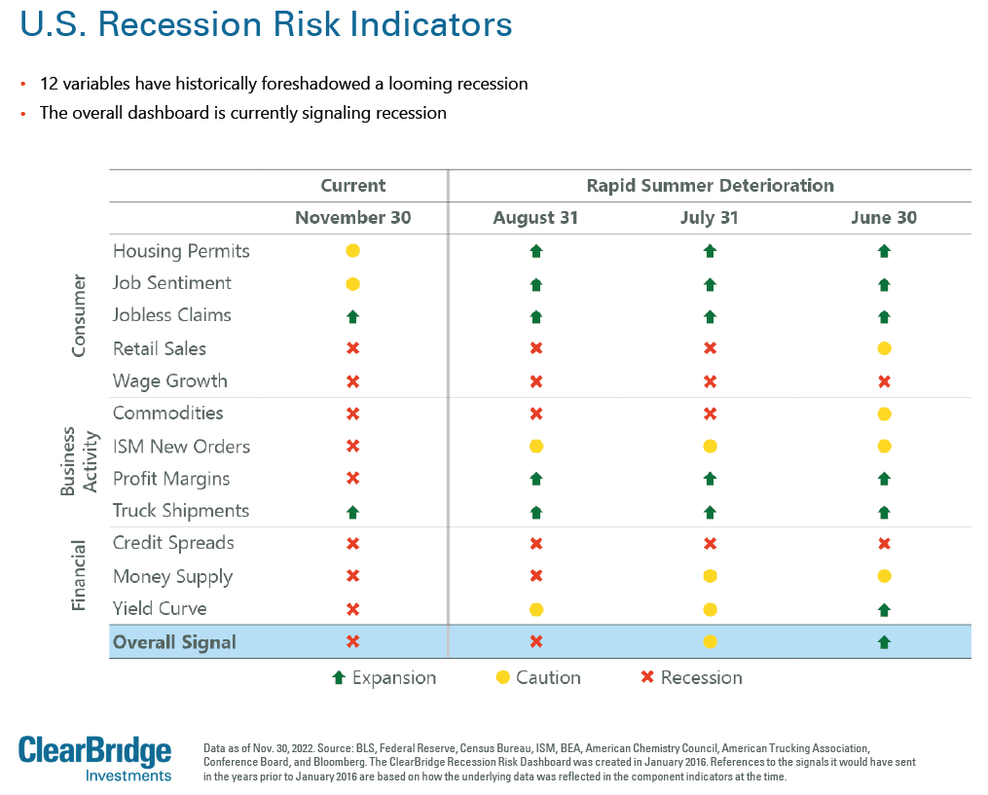








Notes:
These next 2 slides are from ClearBridge Investments
Slide one shows the rapid and significant decline in most sectors of our economy
A chart where green is good, yellow is warning, and red is negative
By November 2022, mainly red with little yellow or green
Only jobs & trucking positive

Slide 23
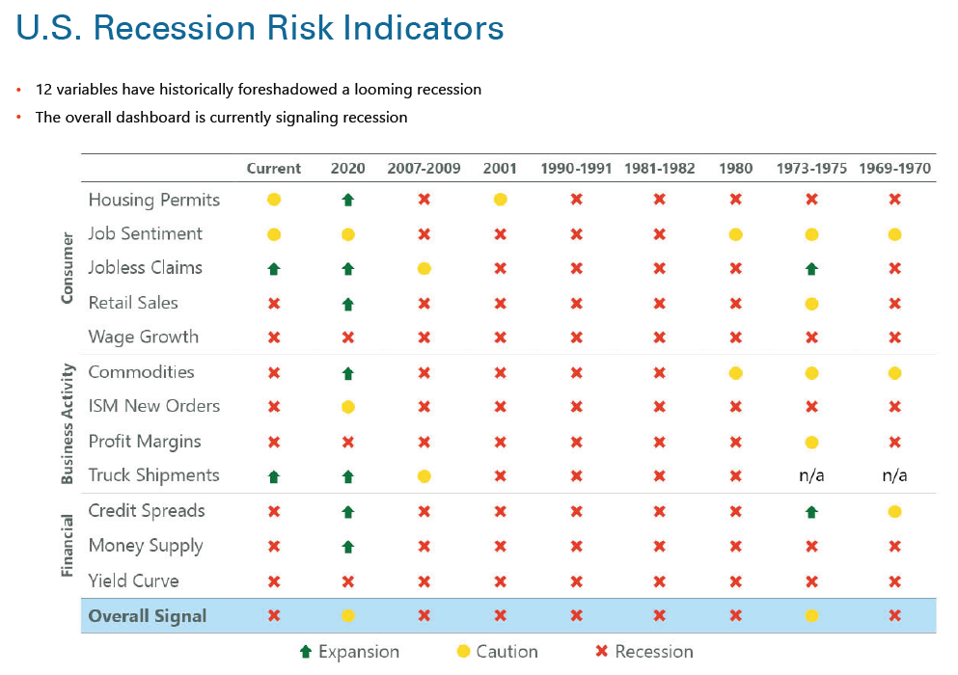
Notes:
This shows where indicators were before previous recessions
With the exception of the 2020 COVID recession, we currently look very similar to the start of previous recessions
Jeremy Siegel Quote: “Some people say that this is the most anticipated recession going into next year ever, because so many people are forecasting it. And when too many people forecast something, my feeling is that often, that drives the market below its fundamental values.”

Slide 24
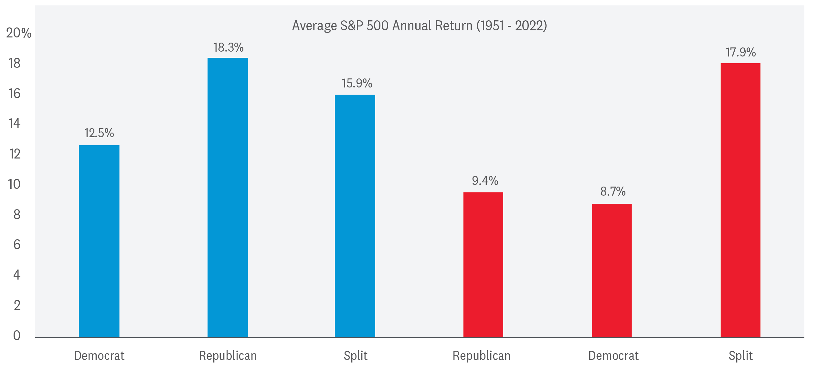


DEMOCRATIC President with a Republican or Split Congress Has Been a Strong Combination for Stocks
Democratic President
Republican President
Source: LPL Research, FactSet 11/13/22
All indexes are unmanaged and cannot be invested into directly.
Past performance is no guarantee of future results. The modern design of the S&P 500 Index was first launched in 1957.
Performance before then incorporates the performance of its predecessor index, the S&P 90.
Notes:
The other major takeaway from the election is that we now have a “mixed government” with Democrats holding the Oval Office and a majority in the Senate, while Republicans have a majority in the House. Markets have tended to favor a mixed government, since neither party is able to give in to its worst excesses and any legislation that does get passed is subject to compromise. It may also be that the government that governs best is sometimes the one that governs least, and mixed government has a tendency to create gridlock.

Slide 25
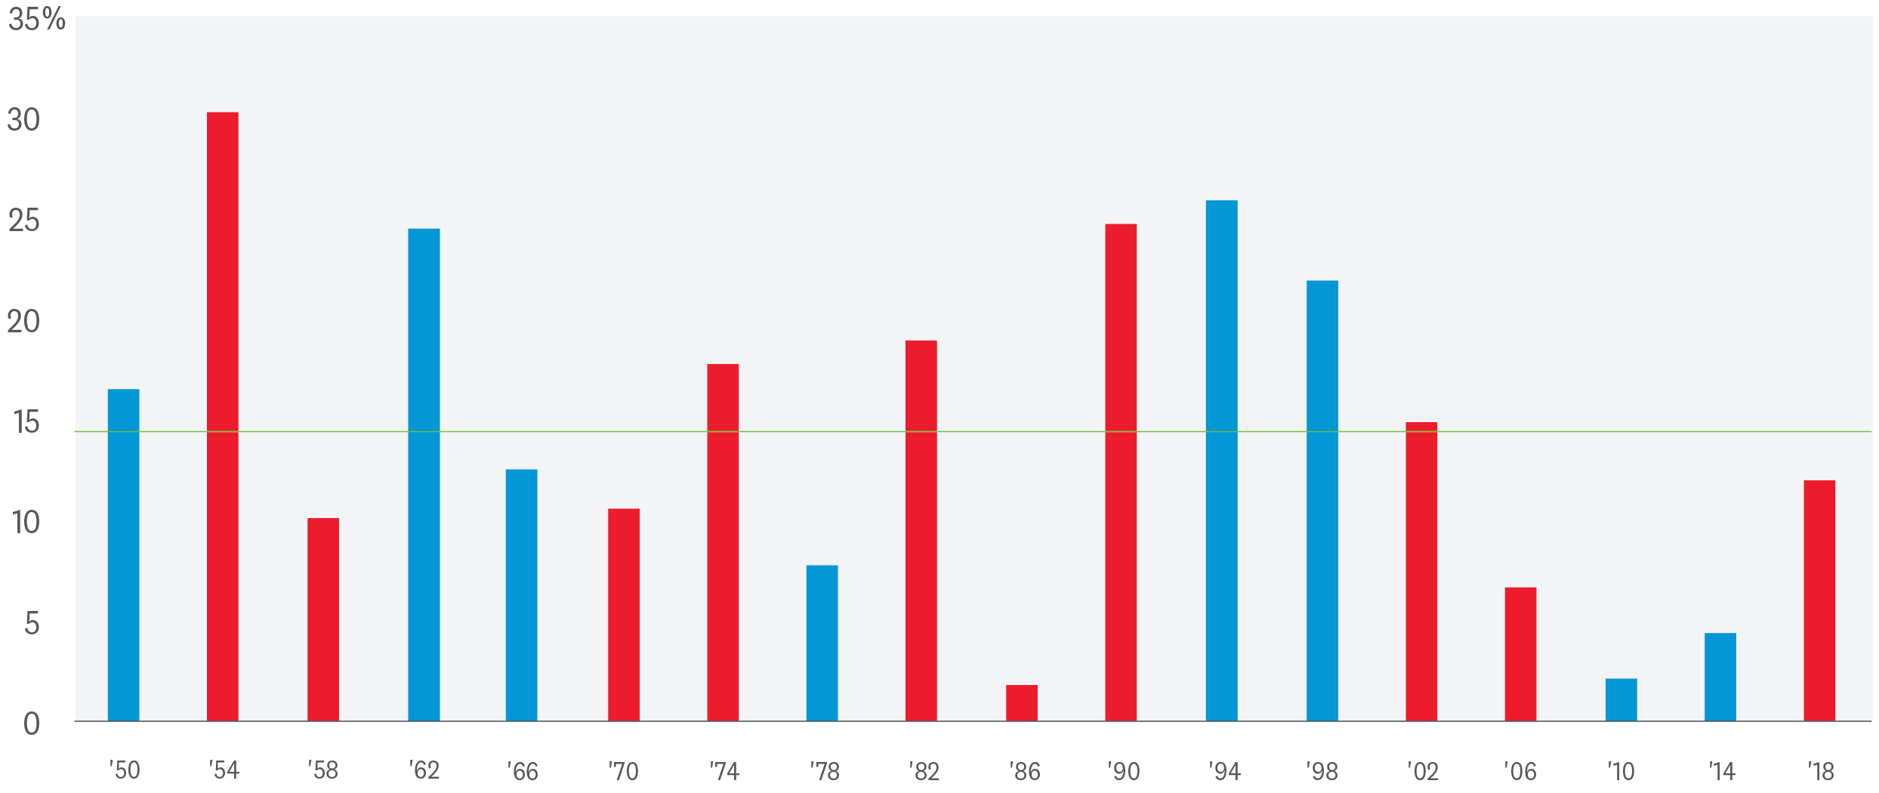
Stocks Have Always Gained a Year After
Midterms (No Matter Who's in Office)
S&P 500 Index Returns 1 Year After Midterm Elections (1950 to Current)
Average if Democratic President: 14.5%
Average if Republican President: 14.8%
Average Gain: 14.7%
Source: LPL Research, Brookings Institute 11/15/22
Past performance is no guarantee of future results. Indexes are unmanaged and cannot be invested into directly.
The modern design of the S&P 500 Index was first launched in 1957. Performance before then incorporates the
performance of its predecessor index, the S&P 90.
Notes:
Perhaps the most important outcome of the election is simply that we have it behind us. Historically, midterm years have been volatile for markets, and 2022 has been no exception. But the third year of the presidential cycle has historically been the strongest and a weak 2022 may help set up that pattern again. We would add a note of caution, though, that increased fiscal stimulus in anticipation of the presidential election has often supported returns in the third year of the cycle and we are unlikely to see that added tailwind next year.

Slide 26
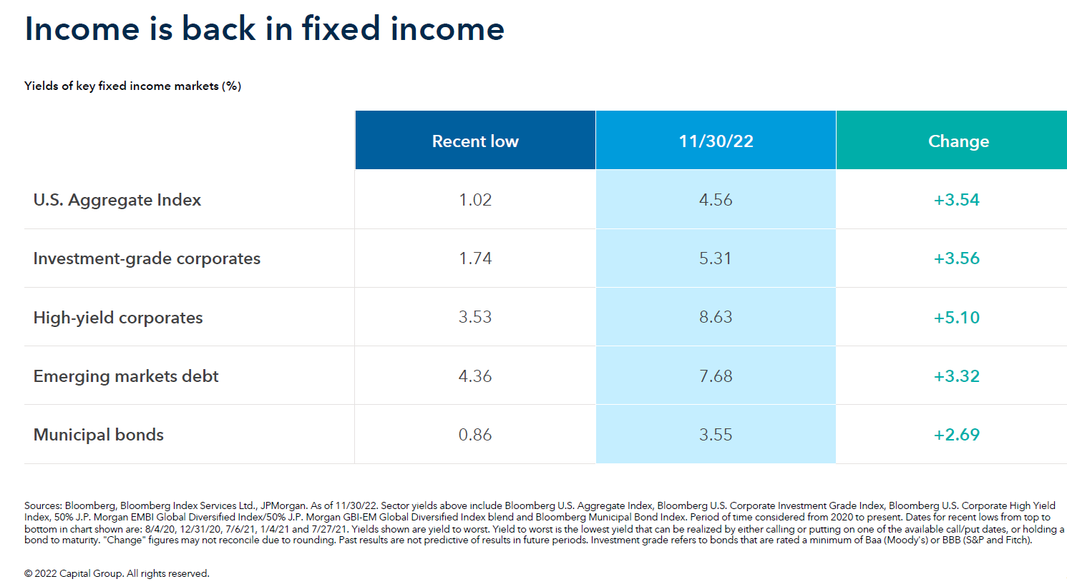

Notes:
Now for some potentially good news
Bond yields on new issued debt is much higher
The inverse relationship to current bond prices and interest rates make bonds very attractive for longer-term investors

Slide 27
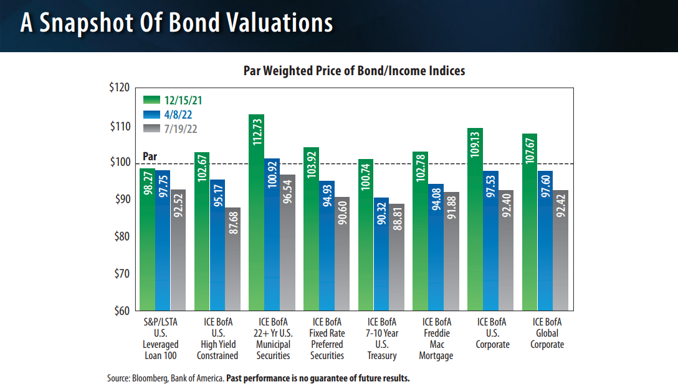
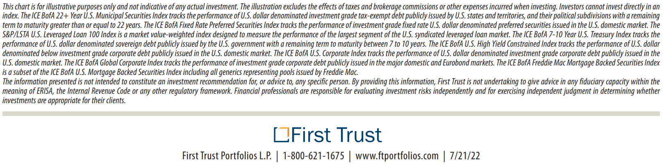








Notes:
Bond prices have dropped as interest rates have climbed
Most bonds held by MFs/ETF are discounted from this time last year
This drop in bond prices was sharp and rapid. One reason why “conservative” investors felt this bond market worse than in previous downturns
This may have created a good opportunity to buy in

Slide 28
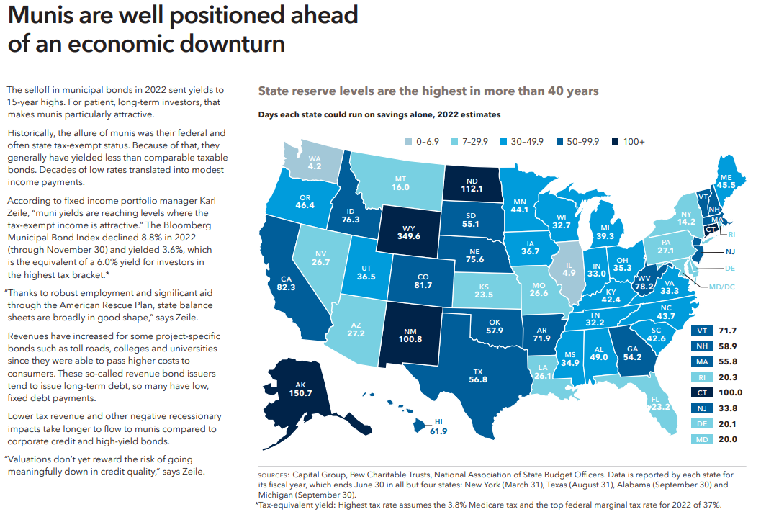
Notes:
Munis are attractive solutions for some investors
In AZ we tend to focus on National funds for most investors
2 reasons:
AZ tax rate very low, so difference is minimal for most tax brackets
Football draft/recruiting

Slide 29
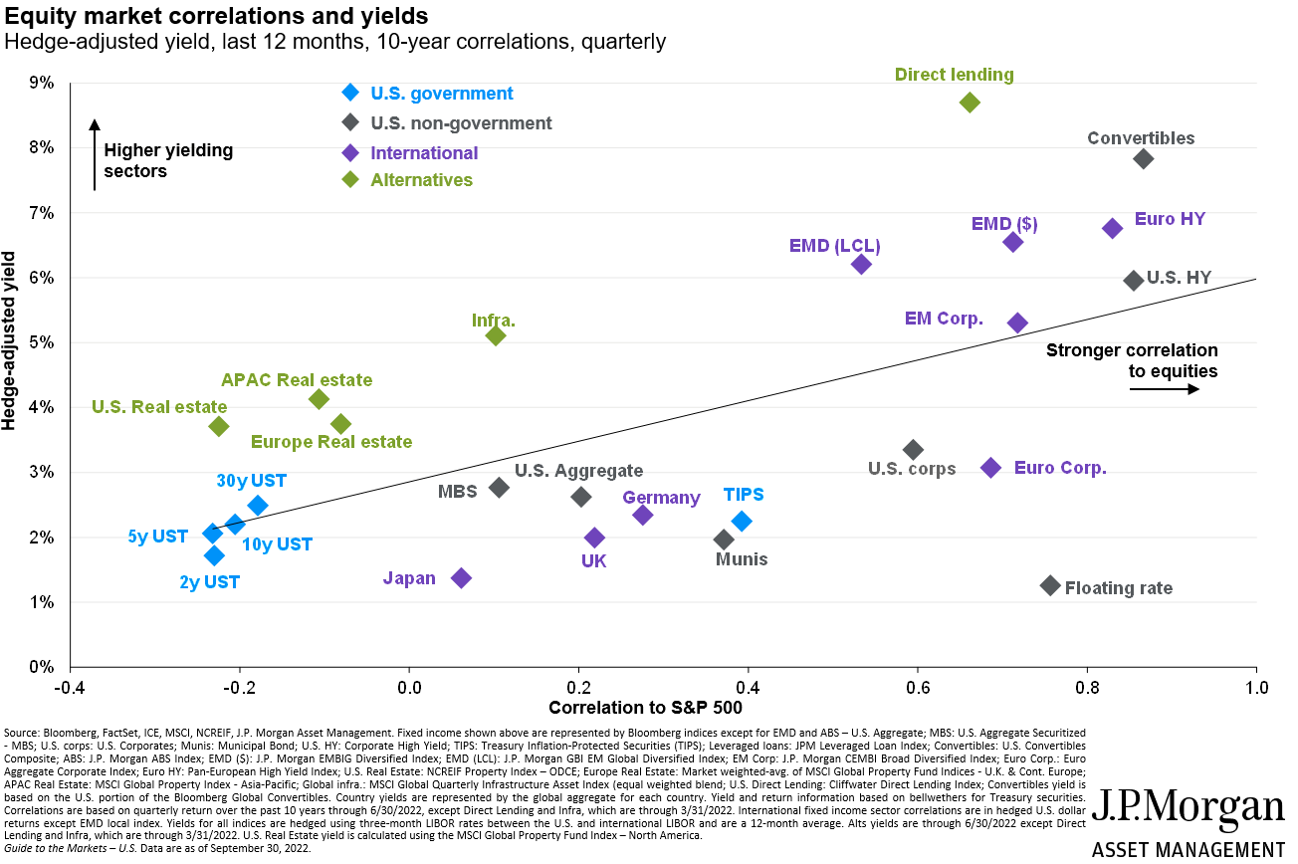




Equity market correlations and yields
Notes:
- Here are bond sectors with greater past total returns than other sectors and how they trade relative to the stock market

Slide 30
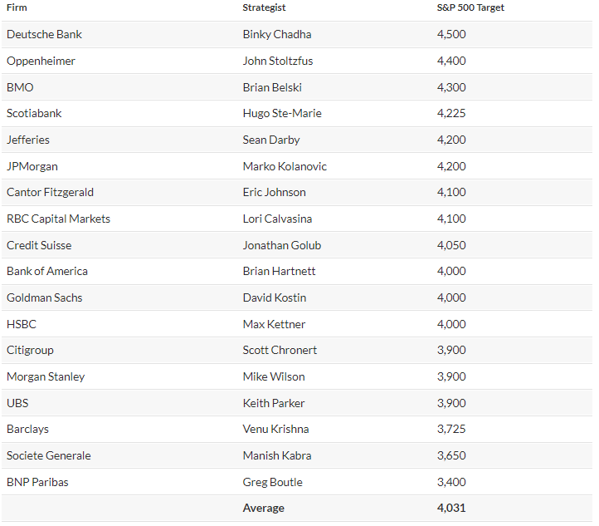
2023 Forecasts
S&P 500 Estimates
A recent survey of top Wall Street forecasters by MarketWatch put the average S&P 500 estimate at 4,031 for the end of 2023, an advance of only about 6% from Tuesday’s close of 3,821.62.
Source: https://www.marketwatch.com/story/wall-streets-stock-market-forecasts-for-2022-were-off-by-the-widest-margin-since-2008-will-next-year-be-any-different-11671583416
Notes:
S&P 500 Estimates
To get to that average (see chart), MarketWatch collected estimates from 18 investment banks and brokers.
Source: https://www.marketwatch.com/story/wall-streets-stock-market-forecasts-for-2022-were-off-by-the-widest-margin-since-2008-will-next-year-be-any-different-11671583416

Slide 31
Closing Thoughts
What are your 2023 Financial Resolutions?
5 Key Takeaways
1. Based on our research, we believe that the first half of 2023 could be choppy and corporate earnings could drop
2. In our opinion, the worst of the bond market losses have been realized
3. Hopes of a soft landing may disappoint
4. Fixed-rate insurance solutions can avoid market risk
5. Silver-lining: We anticipate things to be better in the second half of 2023
Notes:
What Financial Resolutions did you make and did you keep them?
Difference between “Resolve” (I pledge to, want to, etc.) and “Resolute” (How resolved you are, the stand you take, final)
Very choppy for stock with expected earnings to drop
Worst for bonds may be factored in
Fed has never gotten it right
Forecasts look better by the end of the year

Slide 32
Question & Answers
Website: OneAZWealth.com
Email: OneAZWealth@OneAZCU.com
24/7 Online Appointment Scheduler:
OneAZWealth.com
Phone: (877) 566-0517
Call Monday-Friday, 9:00 am – 5:00 pm
Scan to visit OneAZWealth.com
OneAZ Wealth Management | (877) 566-0517 | www.OneAZWealth.com | Safe For Public Distribution.
Notes:
For better audio, the webinar will be in “listen-only mode”…
We will be fielding your questions at the end of the webinar. Please, email any questions to: oneazwealth@oneazcu.com. We will be compiling your questions and will answer them at the end of today’s presentation. If we do not get to your question, I promise we will respond to you directly.
Please send your webinar questions to OneAZWealth@OneAZCU.com.
Last, for more information about OneAZ Wealth Management and our team of wealth advisors, visit OneAZWealth.com or use your mobile device to scan the QR Code on the screen now.
You can also connect with us on social media on Facebook, LinkedIn, and YouTube for more exciting resources and helpful information.

Slide 33
Thank you!
Website: OneAZWealth.com
Email: OneAZWealth@OneAZCU.com
24/7 Online Appointment Scheduler:
OneAZWealth.com
Phone: (877) 566-0517
Call Monday-Friday, 9:00 am – 5:00 pm
Scan to visit OneAZWealth.com
OneAZ Wealth Management | (877) 566-0517 | www.OneAZWealth.com | Safe For Public Distribution.
Notes:
For better audio, the webinar will be in “listen-only mode”…
We will be fielding your questions at the end of the webinar. Please, email any questions to: oneazwealth@oneazcu.com. We will be compiling your questions and will answer them at the end of today’s presentation. If we do not get to your question, I promise we will respond to you directly.
Please send your webinar questions to OneAZWealth@OneAZCU.com.
Last, for more information about OneAZ Wealth Management and our team of wealth advisors, visit OneAZWealth.com or use your mobile device to scan the QR Code on the screen now.
You can also connect with us on social media on Facebook, LinkedIn, and YouTube for more exciting resources and helpful information.

Slide 34
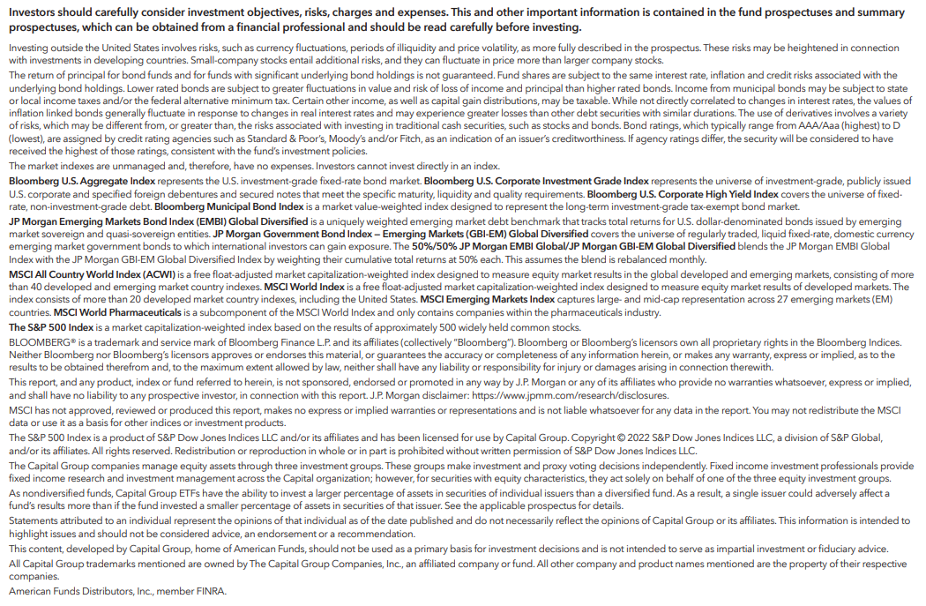
Important Disclosures

Slide 35
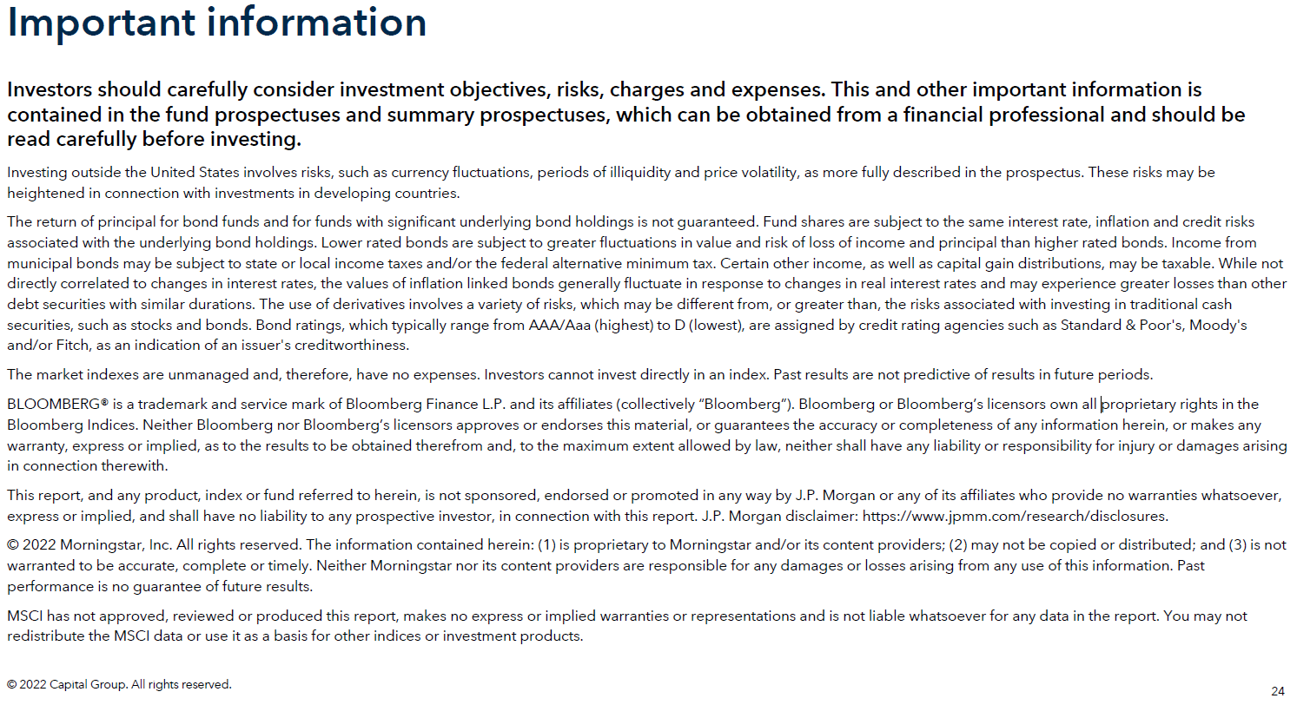

Slide 36
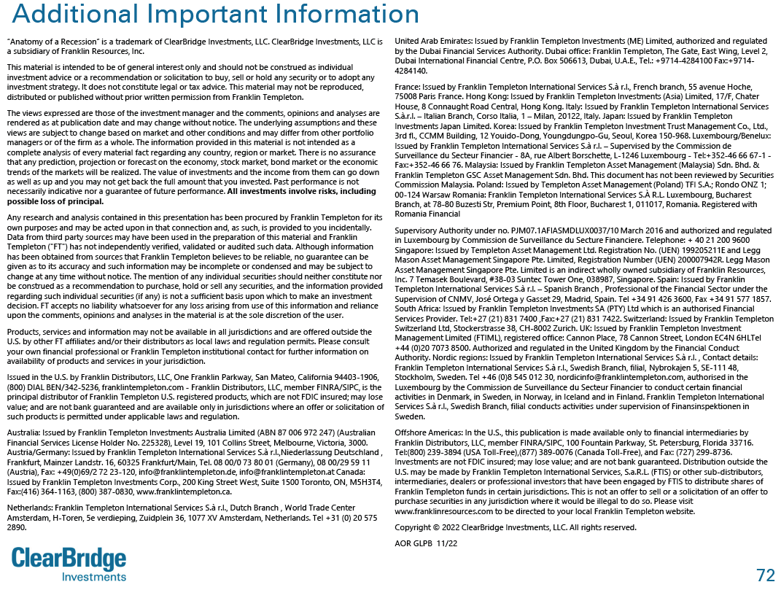

Slide 37
Important Disclosures
The PE ratio (price-to-earnings ratio) is a measure of the price paid for a share relative to the annual net income or profit earned by the firm per share. It is a financial ratio used for valuation: a higher PE ratio means that investors are paying more for each unit of net income, so the stock is more expensive compared to one with lower PE ratio.
Earnings per share (EPS) is the portion of a company’s profit allocated to each outstanding share of common stock. EPS serves as an indicator of a company’s profitability. Earnings per share is generally considered to be the single most important variable in determining a share’s price. It is also a major component used to calculate the price-to-earnings valuation ratio.
The Standard & Poor’s 500 Index is a capitalization-weighted index of 500 stocks designed to measure performance of the broad domestic economy through changes in the aggregate market value of 500 stocks representing all major industries.
The Bloomberg U.S. Aggregate Bond Index is an index of the U.S. investment-grade fixed-rate bond market, including both government and corporate bonds.
Equity Risk:
Investing in stock includes numerous specific risks including the fluctuation of dividend, loss of principal and potential illiquidity of the investment in a falling market. Because of their narrow focus, sector investing will be subject to greater volatility than investing more broadly across many sectors and companies. Value investments can perform differently from the market as a whole. They can remain undervalued by the market for long periods of time. The prices of small and mid-cap stocks are generally more volatile than large
cap stocks.
Equity Definitions:
Cyclical stocks typically relate to equity securities of companies whose price is affected by ups and downs in the overall economy and that sell discretionary items that consumers may buy more of during an economic expansion but cut back on during a recession. Counter-cyclical stocks tend to move in the opposite direction from the overall economy and with consumer staples which people continue to demand even during a downturn.
A growth stock is a share in a company that is anticipated to grow at a rate significantly above the average for the market due to capital appreciation.
A Value stock is anticipated to grow above the average for the market due to trading at a lower price relative to its fundamentals, such as dividends, earnings, or sales.
Large-cap stocks are issued by corporations with a market capitalization of $10 billion or more, and small-cap stocks are issued by corporations with a market capitalization between $250 million and $2 billion.

Slide 38
Important Disclosures
Fixed Income Risks:
Bonds are subject to market and interest rate risk if sold prior to maturity. Bond values will decline as interest rates rise and bonds are subject to availability and change in price. Bond yields are subject to change. Certain call or special redemption features may exist which could impact yield. Government bonds and Treasury bills are guaranteed by the US government as to the timely payment of principal and interest and, if held to maturity, offer a fixed rate of return and fixed principal value. Corporate bonds are considered higher risk than government bonds but normally offer a higher yield and are subject to market, interest rate, and credit risk, as well as additional risks based on the quality of issuer coupon rate, price, yield, maturity, and redemption features. Mortgage-backed securities are subject to credit, default, prepayment, extension, market and interest rate risk.
Fixed Income definitions:
Credit Quality is one of the principal criteria for judging the investment quality of a bond or bond mutual fund. As the term implies, credit quality informs investors of a bond or bond portfolio’s credit worthiness, or risk of default. Credit ratings are published rankings based on detailed financial analyses by a credit bureau specifically as it relates to the bond issue’s ability to meet debt obligations. The highest rating is AAA, and the lowest is D. Securities with credit ratings of BBB and above are considered investment grade. The credit spread is the yield the corporate bonds less the yield on comparable maturity Treasury debt. This is a market-based estimate of the amount of fear in the bond market. Base-rated bonds are the lowest quality bonds that are considered investment-grade, rather than high-yield. They best reflect the stresses across the quality spectrum.
The Bloomberg Aggregate U.S. Bond Index represents securities that are SEC-registered, taxable, and dollar denominated. The index covers the U.S. investment-grade fixed rate bond market, with index components for government and corporate securities, mortgage pass-through securities, and asset-backed securities.
High yield/junk bonds (grade BB or below) are not investment grade securities, and are subject to higher interest rate, credit, and liquidity risks than those graded BBB and above. They generally should be part of a diversified portfolio for sophisticated investors.
Municipal bonds are subject to availability and change in price. They are subject to market and interest rate risk if sold prior to maturity. Bond values will decline as interest rates rise. Interest income may be subject to the alternative minimum tax. Municipal bonds are federally tax-free but other state and local taxes may apply. If sold prior to maturity, capital gains tax could apply.

Slide 39
Important Disclosures
For a list of descriptions of the indexes and economic terms referenced in this publication, please visit our website at lplresearch.com/definitions.
This research material has been prepared by LPL Financial LLC.
Securities and advisory services offered through LPL Financial (LPL), a registered investment advisor and broker-dealer (member FINRA/SIPC). Insurance products are offered through LPL or its licensed affiliates. To the extent you are receiving investment advice from a separately registered independent investment advisor that is not an LPL affiliate, please note LPL makes no representation with respect to such entity.
Not Insured by FDIC/NCUA or Any Other Government Agency | Not Bank/Credit Union Guaranteed | Not Bank/Credit Union Deposits or Obligations | May Lose Value

