Slide 1
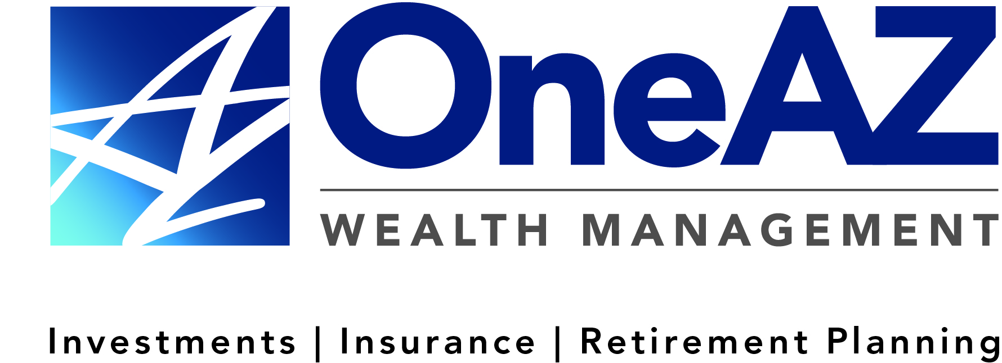
The presentation will begin shortly.
OneAZ Wealth Management | (877) 566-0517 | www.OneAZWealth.com | Safe For Public Distribution.
This presentation was created for educational and informational purposes only and is not intended as ERISA, tax, legal or investment advice. If you are seeking investment advice specific to your needs, such advice services must be obtained on your own separate from this educational presentation.
Securities and advisory services are offered through LPL Financial (LPL), a registered investment advisor and broker-dealer (member FINRA/SIPC). Insurance products are offered through LPL or its licensed affiliates. OneAZ Credit Union (OneAZ CU) and OneAZ Wealth Management are not registered as a broker-dealer or investment advisor. Registered representatives of LPL offer products and services using OneAZ Wealth Management, and may also be employees of OneAZ CU. These products and services are being offered through LPL or its affiliates, which are separate entities from, and not affiliates of, OneAZ CU nor OneAZ Wealth Management. Securities and insurance offered through LPL or its affiliates are:
Not Insured by NCUA or Any Other Government Agency | Not Credit Union Guaranteed | Not Credit Union Deposits or Obligations | May Lose Value
Your Credit Union (“Financial Institution”) provides referrals to financial professionals of LPL Financial LLC (“LPL”) pursuant to an agreement that allows LPL to pay the Financial Institution for these referrals. This creates an incentive for the Financial Institution to make these referrals, resulting in a conflict of interest. The Financial Institution is not a current client of LPL for brokerage or advisory services. Please visit https://www.lpl.com/disclosures/is-lpl-relationship-disclosure.html for more detailed information.
Notes:
Welcome slide on display at opening of meeting.

Slide 2




Website: OneAZWealth.com
Email: OneAZWealth@OneAZCU.com
24/7 Online Appointment Scheduler:
OneAZWealth.com
Phone: (877) 566-0517
Call Monday-Friday, 9:00 am – 5:00 pm
Scan to visit OneAZWealth.com
OneAZ Wealth Management | (877) 566-0517 | www.OneAZWealth.com | Safe For Public Distribution.
This presentation was created for educational and informational purposes only and is not intended as ERISA, tax, legal or investment advice. If you are seeking investment advice specific to your needs, such advice services must be obtained on your own separate from this educational presentation.
Securities and advisory services are offered through LPL Financial (LPL), a registered investment advisor and broker-dealer (member FINRA/SIPC). Insurance products are offered through LPL or its licensed affiliates. OneAZ Credit Union (OneAZ CU) and OneAZ Wealth Management are not registered as a broker-dealer or investment advisor. Registered representatives of LPL offer products and services using OneAZ Wealth Management, and may also be employees of OneAZ CU. These products and services are being offered through LPL or its affiliates, which are separate entities from, and not affiliates of, OneAZ CU nor OneAZ Wealth Management. Securities and insurance offered through LPL or its affiliates are:
Not Insured by NCUA or Any Other Government Agency | Not Credit Union Guaranteed | Not Credit Union Deposits or Obligations | May Lose Value
Your Credit Union (“Financial Institution”) provides referrals to financial professionals of LPL Financial LLC (“LPL”) pursuant to an agreement that allows LPL to pay the Financial Institution for these referrals. This creates an incentive for the Financial Institution to make these referrals, resulting in a conflict of interest. The Financial Institution is not a current client of LPL for brokerage or advisory services. Please visit https://www.lpl.com/disclosures/is-lpl-relationship-disclosure.html for more detailed information.
Notes:
Review the items listed: Website, Email, Appt. scheduler and Office phone number with hours.
Also, reference and review our presentation disclosure at the bottom of the slide.

Slide 3
Connect With Us!
Website: OneAZWealth.com
Email: OneAZWealth@OneAZCU.com
24/7 Online Appointment Scheduler:
OneAZWealth.com
Phone: (877) 566-0517
Call Monday-Friday, 9:00 am – 5:00 pm
Scan to visit OneAZWealth.com
OneAZ Wealth Management | (877) 566-0517 | www.OneAZWealth.com | Safe For Public Distribution.
Notes:
For better audio, the webinar will be in “listen-only mode”…
We will be fielding your questions at the end of the webinar. Please, email any questions to: oneazwealth@oneazcu.com. We will be compiling your questions and will answer them at the end of today’s presentation. If we do not get to your question, I promise we will respond to you directly.
Please send your webinar questions to OneAZWealth@OneAZCU.com.
Last, for more information about OneAZ Wealth Management and our team of wealth advisors, visit OneAZWealth.com or use your mobile device to scan the QR Code on the screen now.
You can also connect with us on social media on Facebook, LinkedIn, and YouTube for more exciting resources and helpful information.
Now, let’s get started!

Slide 4
How to Build Your Own Wealth Plan
Notes:
The title of today’s presentation is titled: How to Build Your Own Wealth Plan.

Slide 5

Guest Speaker
Thomas E. Mitchell, CFP®
Senior Vice President
TMitchell@OneAZcu.com
Notes:
Our speaker for today’s presentation is: Tom Mitchell, SVP of OneAZ Wealth Management, located at the OneAZ Credit Union. Please reach out to me by email or connect with me on LinkedIn.

Slide 6
Agenda
Start with Your O.P.M. Path
5 Key Components of a Wealth Plan
Capital Accumulation
Risk Management
Retirement Planning
Tax Planning
Legacy Planning
How do you measure up?
Key Take Aways
Notes:
With today’s presentation, we are going to cover the following topics.
Start with Your O.P.M. Path
5 Key Components of a Wealth Plan
Capital Accumulation
Risk Management
Retirement Planning
Tax Planning
Legacy Planning
How do you measure up?
Key Take Aways

Slide 7
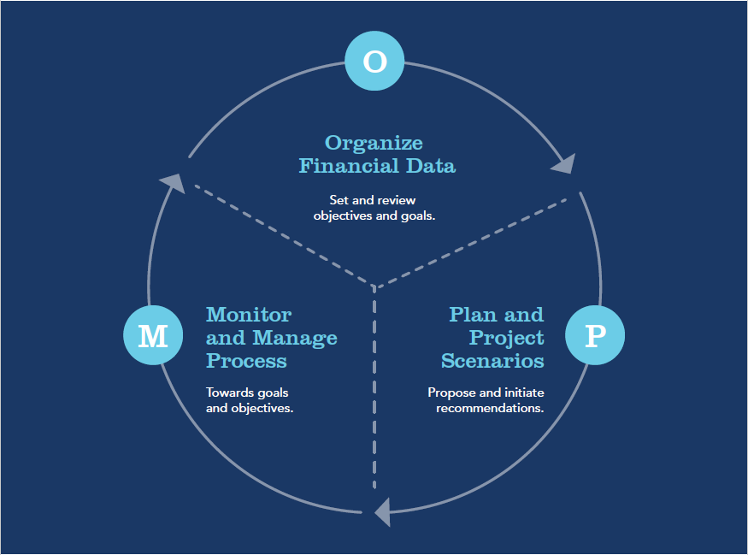

Wealth Management
O.P.M. Path
Notes:
Let’s get started with the O.P.M Path.
It starts with O – Organizing your financial data and your goals and objectives. Once we together gather and learn those, we move to the P.
With the P – we want to Plan and Project Scenarios using your personal goals and financial data. We will also offer up alternatives and possible strategies to better help in your planning process.
The M part of the path relates to the ongoing Monitoring and Managing the process going forward over time with you. Your goals are important and we like to track, monitor, and review your progress on an annual or semi-annual process. As you can see, the process is an ongoing cycle… periodically reviewing and refreshing your O, reviewing and update the P, providing us new strategies to carry out in the M process.

Slide 8
Financial Pyramid
Speculative
Conservative
Foundation
Growth
Art, Metals, Gemstones, Options, Commodities, Oil Exploration, Venture Capital
Equity Partnerships, Investment Real Estate, Growth Stocks and Mutual Funds, Variable Life Insurance and Annuities
Conservative Equities (Utility Stocks, Convertible Bonds, Balanced Funds); Residence; Retirement Plans; Corporate, Municipal, U.S. Government Notes, and Bonds.
Savings, Treasury Bills, Annuities, Money Market Funds, Life Insurance
Notes:
We like to review the importance of the basic Financial Pyramid. This financial planning concept has been around for a long time and illustrates how someone can build a strong wealth plan and allocate their assets accordingly. Starting with a strong foundation – which is made up of safe and most conservative savings and investment assets.
As you move up the pyramid, it is similar to the risk spectrum going from conservative to aggressive investment vehicles and styles. It is important to note, as the risk level does increase with the possible loss of your principal, however, the potential rate of return may also increase. The first step up the pyramid in building your wealth plan is the Conservative category. They are listed here…
Depending on your risk tolerance, and time horizon, having assets in the next tier up is the Growth category. The common vehicles used here are…
And lastly, if you have a solid plan and plenty of assets to cover your basic needs and your common goals, you may want to consider the most risky category level of the pyramid, the Speculative. Note, not all investors have their assets in all levels, it is a personal decision and subject to what your risk tolerance level is.

Slide 9
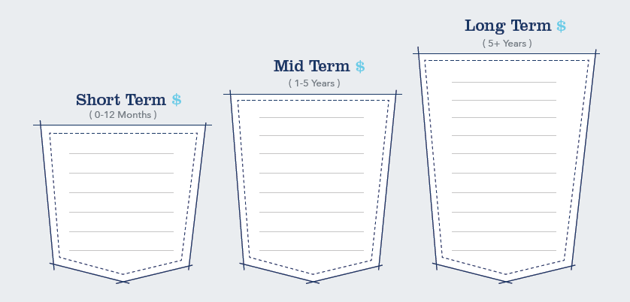
3 Pocket Analysis
Notes:
As we gather information on the client’s needs, desires and financial resources, we like to illustrate it using these three pockets… What are financial needs/desires along with assets needed for each of these three time periods.

Slide 10
3 Pocket Analysis
Casey
New Roof
Parker’s College Fund
Family Reunion
Retirement Accounts
New Car
Birthday Party
Kitchen Remodeling
Dental Work
Notes:
Let look at Casey for example. Here is Casey’s needs and desires. Once we know theses, it is important to align up the financial assets to these three pockets.
It is great way to see visually when you need something, and where the financial dollars come from to meet those needs and desires.

Slide 11
5 Key Components of a Wealth Plan
Notes:
Let review the 5 key components of a good Wealth Plan…

Slide 12

5 Key Components of a Wealth Plan
Capital Accumulation
Risk Management
Retirement Planning
Tax Planning
Legacy Planning
Notes:
The five areas are:
Capital Accumulation
Risk Management
Retirement Planning
Tax Planning
And Legacy Planning

Slide 13

Capital Accumulation
Investment Strategies and Selection
Asset Allocation and Risk Tolerance
Monitoring and Rebalancing
*Asset allocation does not ensure a profit or protect against a loss.
*There is no guarantee that a diversified portfolio will enhance overall returns or outperform a non-diversified portfolio. Diversification does not protect against market risk.
Notes:
First, let’s do highlight Capital Accumulation… it is a fancy phrase for investing.
You need to consider the following as you begin your investing plans:
Investment Strategies and Selection
Asset Allocation and Risk Tolerance
Monitoring and Rebalancing

Slide 14
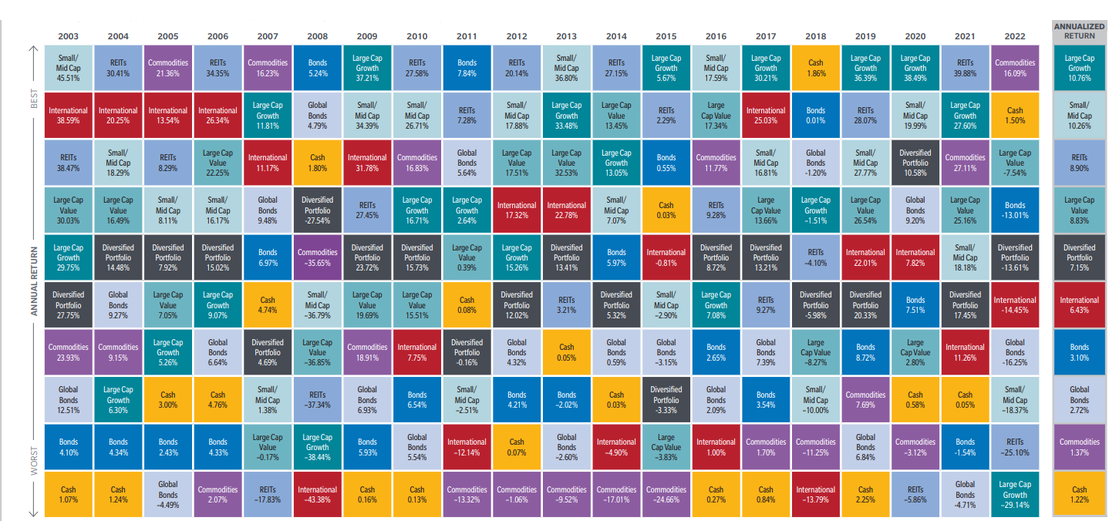
Asset Allocation Diversification: 20 Years of the Best and Worst
Source: FactSet SPAR. Returns are in USD, and net for MSCI EAFE and gross for all other asset classes. Annualized return and standard deviation (annualized) is for the 20-year period ending December 31, 2022. The diversified portfolio is rebalanced quarterly to maintain the equal allocations throughout the period. Standard deviation reflects a portfolio’s total return volatility, which is based on a minimum of 36 monthly returns. The larger the portfolio’s standard deviation, the greater the portfolio’s volatility. Asset allocation and diversification do not guarantee a profit or protect against a loss.
Notes:
We are often asked what is the best investment to buy… Well, it is nearly impossible to pick or guess what is going to be the best investment category next.
Take a look at this chart… I call it the Jelly Bean chart, because it has so many colors, each color illustrating an investment category.
They are ranked by their actual performance during the given year. And you can see there is a lot of volatility or change from one year to the next with these individual categories.
One prudent method of investing is asset allocating your investment portfolio across multiple categories, so you can possibly generate a solid average with less major volatility. The Dark Gray box is what a Diversified Portfolio would have returned year over year. You can see it has performed with less volatility over the last 20 years. So how diversified is your portfolio?

Slide 15
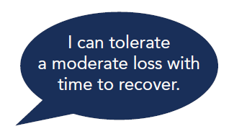
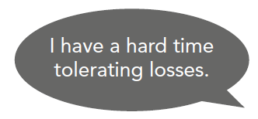
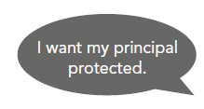
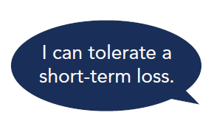
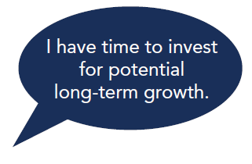
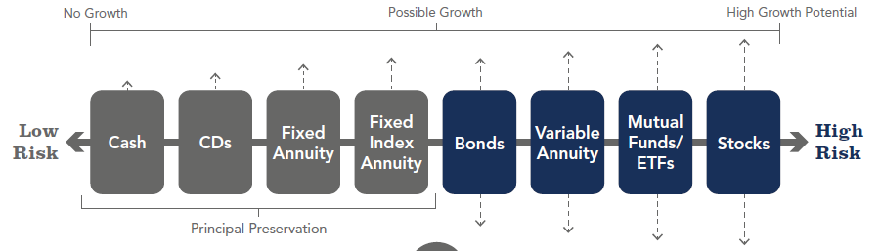
What’s your investment risk level?
Notes:
This chart is a nice illustration of risk tolerance and aligning it with some investment categories.
<READ the call out bubbles>
Review the chart from the Left --no growth, most conservative-- to the right, being the high growth with high risk.

Slide 16
Savers vs. Investors
Notes:
Using the prior chart… are you more inclined to be a Saver or an Investor?

Slide 17
Investment Choices Have Their Own
S.T.Y.L.E.
S
Safety of Principal
T
Tax Treatment
Y
Yield and Growth Potential
L
Liquidity Features
E
Estate Plan Impacts
Notes:
Here is another great easy way to compare the different investment choices you may be considering… Every investment can have its own “STYLE”… or S. T. Y. L. E.
When you evaluate your investment choices and vehicles, think about and compare them using the STYLE overview.
Each letter stands for a characteristic or feature…
S – Safety level
T – Taxation concerns and levels
Y – Yield or growth potential
L – Liquidity options
E – How will or can it affect my Estate plan and desires

Slide 18




Risk Management
Disability Risks
Premature Death Risks
Property Losses
Health & Long-Term Care Risks
Notes:
The second area of a Wealth Plan need to address Risk Management. Not talking about investment risk, but real-life risks.
Have you prepared yourself and your family if one or more of these four life risk categories occurred…
The four are:
Disability Risks
Premature Death Risks
Property Losses
Health & Long-Term Care Risks

Slide 19
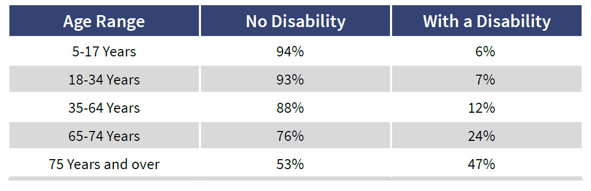
Individuals with Disabilities by Age
Source: U.S. Census Bureau, 2019 American Community Survey 1-Year Estimates, Sex-by-Age-by Disability Status for the civilian non-institutionalized population, male and female. Table B18101.
Notes:
Here is some data on just the risk of becoming disabled….
<review chart>

Slide 20

Retirement Planning
Retirement Income Strategies
Managing Pension and Social Security Options
Healthcare Expenses
Plan Options:
401k
457 and 403b
IRAs: Traditional vs. Roth
Notes:
The third area of a good Wealth Plan is: Retirement Planning
Most have their hopes and dreams set on a successful and enjoyable Retirement… but have you done the planning and forecasting yet?
Stop the worry and fear by sitting down and investing in the areas in greater detail…
Retirement Income Strategies
Managing Pension and Social Security Options
Healthcare Expenses
Plan Options:
401k
457 and 403b
IRAs: Traditional vs. Roth

Slide 21
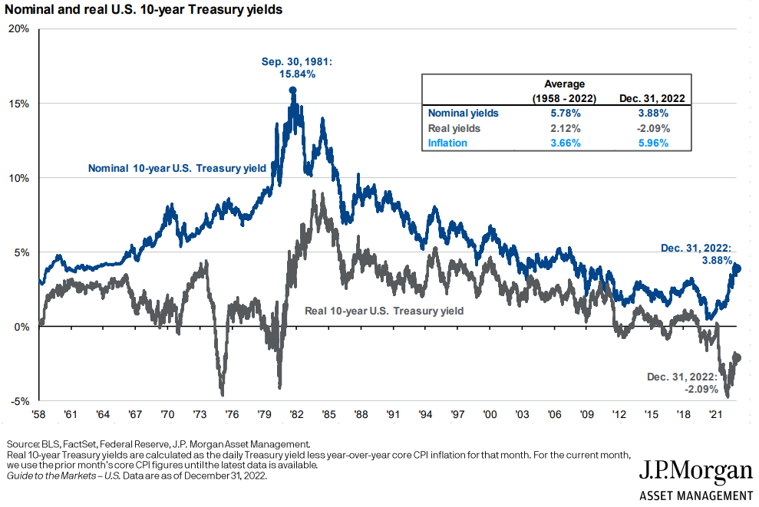

Interest Rates and Inflation
Notes:
A big part of retirement planning is understanding how inflation and taxes can impact your life.
This chart goes back to 1958 and illustrates the gross yield on 10-year US Treasury notes over time and how inflation if deducted or offsetting the yield, what the Real Yields would have been. The dark grey line shows with the real inflation-adjusted yield really would have been. Inflation can be a cost or expense that we just do not see directly each day, but over time it can really impact our lives.

Slide 22
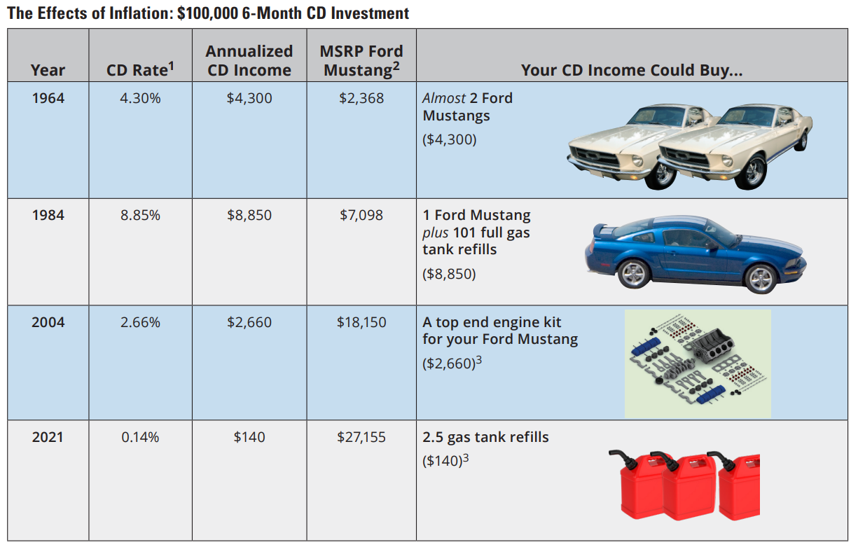
The Effects of Inflation: $100,000 6-month CD Investment
CDs are insured by the FDIC, offer a fixed rate of return, and are generally designed for short-term savings needs. The principal value and investment return of investment securities (including mutual funds) are subject to risk, will fluctuate with changes in market conditions, are generally considered long-term investments, and may not be in the best interest of all investors.
1 Data Sources: Federal Reserve, BankRate.com, and Hartford Funds, 2/22. CD rate for 2021 as of 12/31/21.
2 Sources: cjponyparts.com and USnews.com, retrieved 5/21.
3 Data Source: aaa.com, retrieved 5/25/21. Hartford Funds Distributors, LLC. CCWP012_0222 227403
Notes:
Here is a better example of how inflation has impacted someone starting in 1964. To show the effects of inflation on our purchasing power over time, let’s review this chart.
<Review the data for each line>

Slide 23
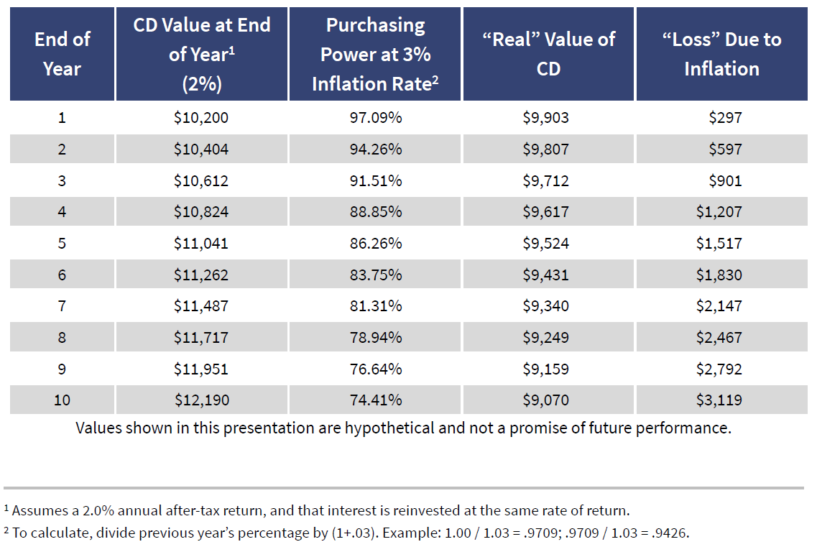
“Real” Value of CD After Inflation
Notes:
Here is another chart illustrating a sample $10,000 CD paying a 2% yield, purchased in year 1 and going to year 10; and how a simple annual inflation factor of 3% can erode the investment purchasing power over time.

Slide 24

Tax Planning
Tax Avoidance vs. Tax Evasion
Tax-Free, Taxable, Tax-Deferred Methods
Managing Tax Liabilities
Tax Diversification
Notes:
The fourth area of a Wealth Plan that everyone needs to address is Tax Planning. It is important to understand all of these terms and what makes them different.
Tax Avoidance vs. Tax Evasion
Tax-Free, Taxable, Tax-Deferred Methods
Managing Tax Liabilities
Tax Diversification

Slide 25
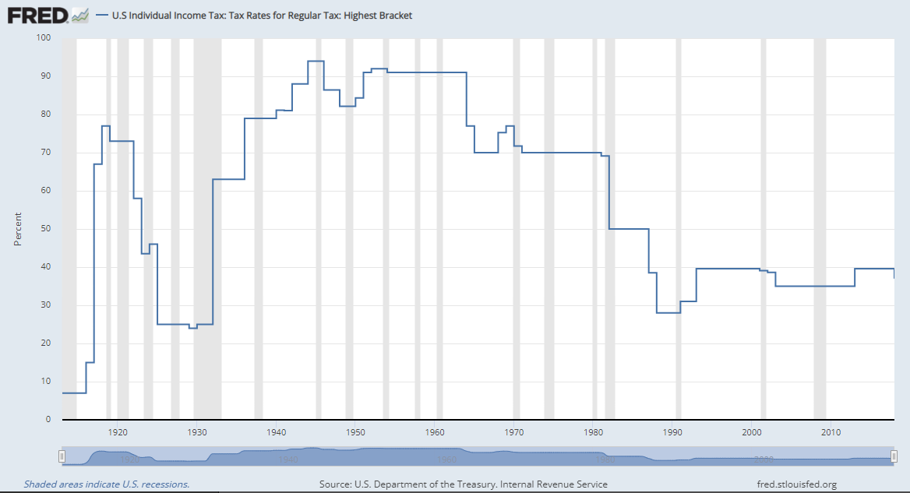
Income Tax Rates (1913-2018)
Notes:
Many times, we hear clients complain about how taxes are high and how they make life unbearable. I thought I would show this historic chart. It illustrates what the highest tax brackets were in any given year, since before 1920. Over the last 100 years, our current tax rates are relatively low! So, you may want to consider this in your tax planning decisions.

Slide 26

Legacy Planning
Succession Plans
Personal
Business
Charitable Donation Plans
Wills & Trusts
Power of Attorney (P.O.A.)*
*OneAZ Wealth Management and LPL Financial do not provide legal advice or services. Please consult your legal advisor regarding your specific situation.
Notes:
The last or 5th area of a good wealth plan will address your Legacy Planning. Do you have a Will or Trust in place, is it current? If you own a business, do you have a real Succession Plan? And for the living issues of life, do you have a viable P.O.A.? Please make sure you have this area of your plan addressed, otherwise you could be leaving a lot of open issues and confusion for your heirs.

Slide 27
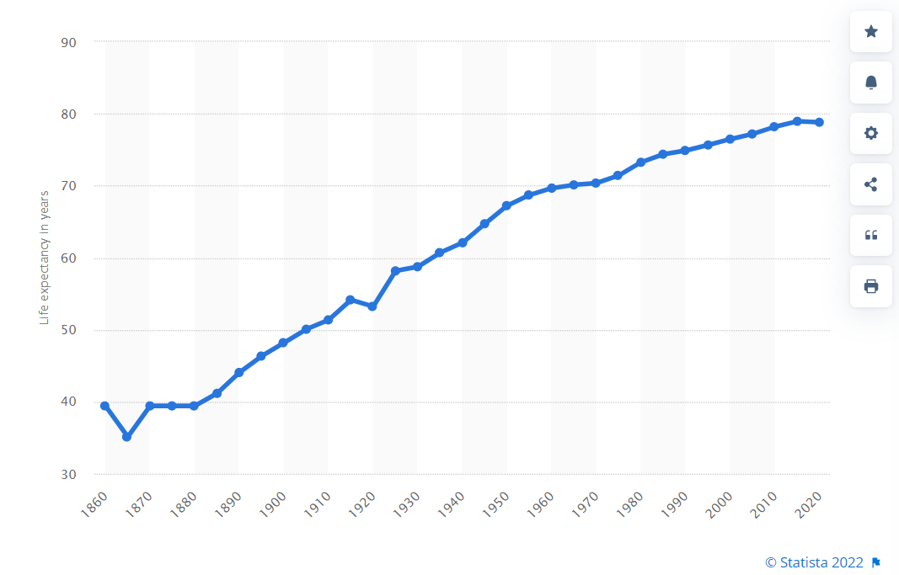
Life Expectancy from birth in the U.S. (1860-2020)
Notes:
Speaking of living… Wow look at this. This shows what the average life expectancy age has done over the last 150 years. I major reason for our longevity today is our great health care and breakthroughs… We are all living longer and it is expected to increase more.

Slide 28

How do you measure up?
3 Stages of Life
Life Events
Reality Check-In
401k Balance
Age 30, 40, 50, 60, 67
Notes:
As we wrap up… we are often asked, How Do We Measure Up to others? Are we prepared for retirement properly?
I like to talk about the 3 main stages of life. The first 30 years is the Learning stage… you are learning who you are and what you are going to do. You are establishing your career and basic life needs. Once you turn 30, you enter the 2nd stage, for 30-60 years… I call the Earning years. These years are very important because you are earning money and you need to manage it wisely and invest for the future. If you do not use this time wisely, then your last 30 years will not be enjoyable. The last stage, Age 60-90, I call the Burning years, It all depends on how well you have saved and invested up, which will determine what you can Burn or use to enjoy your retirement!

Slide 29
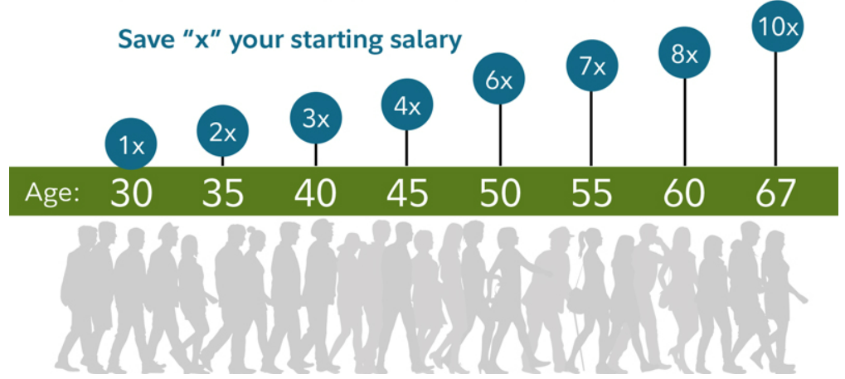
Savings factors to help you on your journey to retirement
Source: https://www.fidelity.com/viewpoints/retirement/how-much-do-i-need-to-retire
Notes:
I like this analysis that was conducted by Fidelity. It estimates what someone’s retirement accounts should total at the different ages as they grow closer to retirement. How do you measure up?

Slide 30
Take Aways
Start with Your O.P.M. Path
5 Key Components of a Wealth Plan
Know Your Investment Risk Tolerance Level
Compare Investment Options Using S.T.Y.L.E.
Manage Your Life Risks
Start Planning and Act Now!
Notes:
As a wrap-up, here are the Take Aways, I hope you will take from my presentation today…
Start with Your O.P.M. Path
5 Key Components of a Wealth Plan
Know Your Investment Risk Tolerance Level
Compare Investment Options Using S.T.Y.L.E.
Manage Your Life Risks
Start Planning and Act Now!

Slide 31
Question & Answers
Website: OneAZWealth.com
Email: OneAZWealth@OneAZCU.com
24/7 Online Appointment Scheduler:
OneAZWealth.com
Phone: (877) 566-0517
Call Monday-Friday, 9:00 am – 5:00 pm
Scan to visit OneAZWealth.com
OneAZ Wealth Management | (877) 566-0517 | www.OneAZWealth.com | Safe For Public Distribution.
Notes:
I am open for questions now… Please, email any questions to: oneazwealth@oneazcu.com. We will be compiling your questions and will answer them now. If we do not get to your question, I promise we will respond to you directly.
Please send your webinar questions to OneAZWealth@OneAZCU.com.
Last, for more information about OneAZ Wealth Management and our team of wealth advisors, visit OneAZWealth.com or use your mobile device to scan the QR Code on the screen now.
You can also connect with us on social media on Facebook, LinkedIn, and YouTube for more exciting resources and helpful information.
Now, let’s get started with questions!

Slide 32
Thank you!
Website: OneAZWealth.com
Email: OneAZWealth@OneAZCU.com
24/7 Online Appointment Scheduler:
OneAZWealth.com
Phone: (877) 566-0517
Call Monday-Friday, 9:00 am – 5:00 pm
Scan to visit OneAZWealth.com
OneAZ Wealth Management | (877) 566-0517 | www.OneAZWealth.com | Safe For Public Distribution.
Notes:
Again, thank you for attending and I hope you have found this information of value.
I wish you all, a Safe, Healthy and Wealthy year ahead.

