Slide 1
Market Outlook September 2023
Kara Murphy, CFA
Chief Investment Officer
Kestra Investment Management

Slide 2
Disclosure
Kestra Investment Management, LLC (Kestra IM) is an SEC registered investment adviser. Registration does not imply a certain level of skill or training. Kestra IM provides market commentary, research, model management, and other investment advice to its affiliated broker-dealers, dually registered broker-dealers and registered investment advisers.
This material is intended for information purposes only, and does not constitute investment advice, a recommendation or an offer or solicitation to purchase or sell any securities to any person in any jurisdiction in which an offer, solicitation, purchase or sale would be unlawful under the securities laws of such jurisdiction. Reliance upon information in this material is at the sole discretion of the reader. Investing involves risks. Asset allocation does not assure a profit or protect against a loss in declining financial markets. Different asset classes present different risks. Past performance is no guarantee of future results.
The opinions expressed in this commentary are as of September 30, 2023, and are those of the author and may not necessarily reflect those held by Kestra Advisor Services Holdings C, Inc., d/b/a Kestra Holdings, and its subsidiaries, including, but not limited to, Kestra Advisory Services, LLC, Kestra Private Wealth Services, LLC, Kestra Investment Services, LLC, Kestra Investment Management, LLC, and Bluespring Wealth Partners, LLC. The material is for informational purposes only. It represents an assessment of the market environment at a specific point in time and is not intended to be a forecast of future events, or a guarantee of future results. It is not guaranteed by any entity for accuracy, does not purport to be complete and is not intended to be used as a primary basis for investment decisions. It should also not be construed as advice meeting the particular investment needs of any investor. Neither the information presented, nor any opinion expressed constitutes a solicitation for the purchase or sale of any security. This material was created to provide accurate and reliable information on the subjects covered but should not be regarded as a complete analysis of these subjects. It is not intended to provide specific legal, tax or other professional advice. The services of an appropriate professional should be sought regarding your individual situation. Kestra Advisor Services Holdings C, Inc., d/b/a Kestra Holdings, and its subsidiaries, including, but not limited to, Kestra Advisory Services, LLC, Kestra Private Wealth Services, LLC, Kestra Investment Services, LLC, Kestra Investment Management, LLC, and Bluespring Wealth Partners, LLC does not offer tax or legal advice.
This communication does not take into account the investment objectives, risk profile or financial situation of any particular person and as such, investments mentioned in this document may not be suitable for all investors. Kestra Investment Management, LLC (“Kestra IM”) is not acting as an investment or other advisor, fiduciary or agent. The information contained herein is not intended to be an exhaustive discussion of the strategies or concepts mentioned herein or tax or legal advice. Recipients of this communication should obtain advice based on their own individual circumstances from their own tax, financial, legal and other advisors about the risks and merits of any transaction before making an investment decision, and only make such decisions on the basis of their own objectives, experience, risk profile and resources.
The information contained in this communication is based on generally available information and, although obtained from sources believed to be reliable, its accuracy and completeness cannot be assured, and such information may be incomplete or condensed. Any assumptions or information contained in this communication constitute a judgment only as of the date of this document or on any specified dates and is subject to change without notice. Insofar as this communication may contain historical and forward looking information, past performance is neither a guarantee nor an indication of future results, and future results may not meet expectations due to a variety of economic, market and other factors. Further, any projections of potential risk or return are illustrative and should not be taken as limitations of the maximum possible loss or gain. Any prices, values or estimates provided in this communication (other than those that are identified as being historical) are indicative only and may change without notice.
Kestra IM is under no duty to update this document and accepts no liability for any loss (whether direct, indirect or consequential) that may arise from any use of the information contained in or derived from this communication. Investments in financial instruments or other products carry significant risk, including the possible loss of the principal amount invested. Financial instruments or other products denominated in a foreign currency are subject to exchange rate fluctuations, which may have an adverse effect on the price or value of an investment in such products. This communication does not purport to identify all risks or material considerations which may be associated with entering into any transaction.
© 2023 Kestra Investment Management, LLC. All Rights Reserved.

Slide 3
Table of Contents:
Market Review
Economic Overview
Stocks and Bonds

Slide 4
Market Review

Slide 5
Market Review
Q3’ 23 Returns, %
Equities |  |  | Fixed Income |  |  | Real Assets
U.S. | Dev. Ex-U.S. | Emerging Markets | U.S. AGG | Investment Grade Corporate | U.S. High Yield | U.S. Real Estate | Commodities
Past performance is not a reliable indicator of current or future results. Indexes are unmanaged and not subject to fees. It is not possible to invest directly in an index. Note: views are from a U.S. dollar perspective. This material represents an assessment of the market environment at a specific time and is not intended to be a forecast or guarantee of future results. Source: Kestra Investment Management with data from FactSet. Index proxies: Bloomberg U.S. AGG Bond Index, ICE BofA U.S. Corporate, ICE BofA U.S. High Yield, S&P 500, MSCI EM, MSCI World ex US Index, Dow Jones U.S. Select REIT, and Bloomberg Commodity Index. Data as of September 30, 2023.

Slide 6
US Equity Sector Returns
Q3’ 23 Returns, %
Utilities and Real Estate dropped substantially. Those sectors’ dividend yields are much less attractive given the increase in bond yields
Energy rallied in Q3 after struggling throughout much of 2023
… and Technology declined after starting the year off strong
Past performance is not a reliable indicator of current or future results. Indexes are unmanaged and not subject to fees. It is not possible to invest directly in an index. Note: views are from a U.S. dollar perspective. This material represents an assessment of the market environment at a specific time and is not intended to be a forecast or guarantee of future results. Source: S&P and FactSet. Index proxies: S&P 500 Index sectors. Data as of September 30, 2023.

Slide 7
Economic Overview

Slide 8

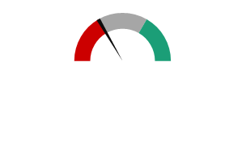


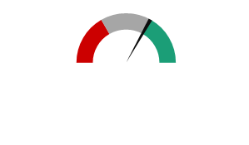



Economic Dashboard
Even though many leading economic indicators point to tougher conditions ahead, economic growth remains resilient. Weakness on the manufacturing side is being offset by a strong consumer and labor market.
The Federal Reserve is nearing the end of its interest rate increases, though future rate cuts have been pushed out even further
Monetary Policy
Manufacturing indicators remain in negative territory, though appear to be bottoming
Manufacturing
Consumer
Consumer balance sheets remain relatively healthy and spending continues. Confidence has waned a bit as gas prices rise
Housing
While mortgage rates remain high and affordability low, home activity has reaccelerated.
Labor
Jobs remain plentiful. Despite an increase in job losses, the newly unemployed are tending to find new positions quickly.
Negative
Neutral
Positive
Source: Kestra Investment Management

Slide 9
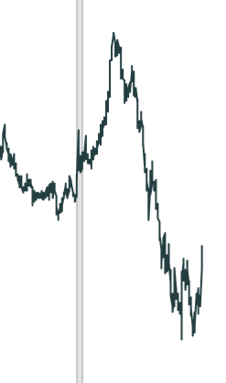
Treasury Yield Curve Flashing a Warning Signal, Still
Yields on the 10-year Treasury bond have dropped below 2-year yields. In previous periods when this has happened, a recession has typically followed within 6 months to 2 years.
The Treasury yield curve has been inverted since May 2022, though the level of inversion has lessened in recent months
Forward looking projections may not come to pass. Source: Kestra Investment Management, Federal Reserve System and FactSet​. Index proxies: 2 Year and 10 Year Treasury Indexes. Data as of October 12, 2023.

Slide 10
Higher Interest Rates for Longer
Fed Funds Futures as of 4/28/2023 and 9/30/2023
At the end of April, markets expected the Fed funds rate to reach a peak of 4.9% and then drop to 4.5% by the end of the year
But then by the end of September, the Fed Funds rate was expected to reach 5.5% and remain there through the end of the year
Effective Rate (bps)
Source: Kestra Investment Management, Fed Funds Futures data from Bloomberg. Data as of September 30, 2023.

Slide 11
Inflation Falling But Some Prices Remain Sticky
Consumer Price Index 12-Month Percent Change
Goods price increases are already well below the Federal Reserve’s target of 2%, but services price increases remain well above.
12-Month Change (%)
Source: Kestra Investment Management, Bureau of Labor Statistics with data from FactSet. Data as of September 30, 2023.

Slide 12
Manufacturing Activity Bottoming
ISM Manufacturing and Services Indexes
Index
ISM Manufacturing Index remains below 50, which indicates contraction. Its companion index, ISM Services, has also weakened, but remains in expansion territory.
Forward looking projections may not come to pass. Source: Kestra Investment Management, Institute For Supply Management and FactSet​. Data as of September 30, 2023.

Slide 13
Consumers: Feeling the Pinch of Higher Rates
Household Debt Balance, Credit Cards
Average Interest Rate for All Credit Card Accounts, 1994 to Present
Interest Rate (%)
Trillions ($)
After dropping in 2020 and 2021, credit usage is back to new highs as Americans ramp up spending and cope with higher prices
Interest rates on credit cards have increased substantially, leading to higher delinquency rates
Source: Kestra Investment Management, U.S. Bureau of Economic Analysis, Conference Board U.S. with data from FactSet and Federal Reserve monthly G.19 report on consumer credit. Data as of September 30, 2023.

Slide 14
Housing Market Remains Tight Despite Higher Interest Rates
U.S. 30-Year Fixed Rate Mortgage Average
Rate (%)
The average rate on a 30-year fixed mortgage crossed above 7%. The last time rates were this high was in December 2000.
Source: Kestra Investment Management, Freddie Mac with data from Federal Reserve Bank of St. Louis. Data as of October 5, 2023.

Slide 15
Labor Market Remains Tight
Non-Farm Payrolls, Month-Over-Month Growth
Payrolls had been softening, providing the Federal Reserve cover to end its rate hiking spree. But the latest report suggests the labor market may be running hotter than hoped.
Thousands of Persons
Source: Kestra Investment Management, US Bureau of Labor Statistics with data from FactSet. Data as of September 30, 2023.

Slide 16
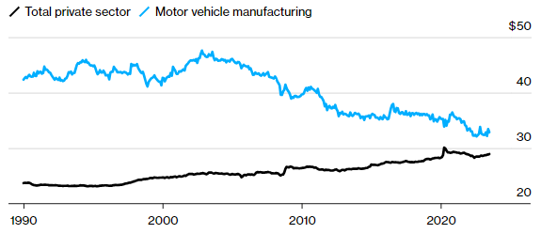
Labor Market: UAW Strike Impacts
Auto worker wages, adjusted for inflation, have declined by 30% since 2003, though they remain higher than other private sector workers
Real wages for all private sector workers, on average, peaked in 2020
Real Wages ($)
Source: Bloomberg, Department of Labor. Data as of September 2023.

Slide 17
Stocks and Bonds

Slide 18
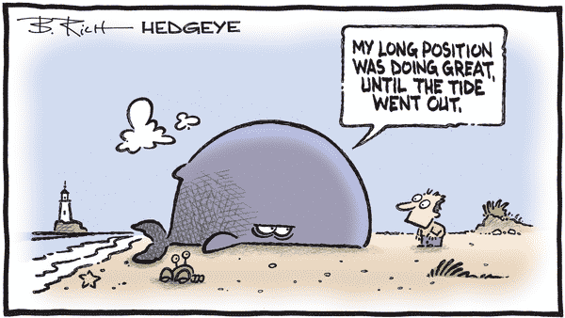

Slide 19
Stock Market Run Fueled by Technology Innovations
Apple Q3 Earnings,
August 3
Nvidia Q1 Earnings,
May 24
Indexed
Bard unveil, February 6
Microsoft Q1 Earnings,
April 24
Chat GPT-4 released,
March 13
NOTE: Values are indexed to 100. Past performance is not a reliable indicator of current or future results. Indexes are unmanaged and not subject to fees. It is not possible to invest directly in an index. Note: views are from a U.S. dollar perspective. This material represents an assessment of the market environment at a specific time and is not intended to be a forecast or guarantee of future results. Source: Kestra Investment Management with data from FactSet. Index proxies: S&P 500, Russell 2000, and The Big 7 ( Apple, Amazon, Alphabet, Microsoft, Meta, Nvidia and Tesla). Data as of September 30, 2023.

Slide 20
Few Stocks Have Been Spared
Percentage of Stocks Above their 50-Day Moving Average
Only about 15% of stocks in the S&P 500 and Nasdaq are above their average price of the last 50 trading days
Low percentage can correlate to positive forward returns
Percent (%)
Past performance is not a reliable indicator of current or future results. Indexes are unmanaged and not subject to fees. It is not possible to invest directly in an index. Source: Kestra Investment Management with data from FactSet. Index proxies: S&P 500 Index. Data as of September 30, 2023.

Slide 21
The Largest Companies Have Benefited from Stronger Profits
S&P 500 Index Dominated by a Few Names
Largest Companies Have Raised Profit Margins More than Smaller Ones
Percent (%)
Past performance is not a reliable indicator of current or future results. Indexes are unmanaged and not subject to fees. It is not possible to invest directly in an index. Note: views are from a U.S. dollar perspective. This material represents an assessment of the market environment at a specific time and is not intended to be a forecast or guarantee of future results. Source: Kestra Investment Management with data from FactSet. Index proxies: S&P 500, S&P 100, and S&P 600. Data as of September 30, 2023.

Slide 22
Returns for Some Sectors Driven by Largest Stocks
S&P 500, S&P 500 Equal-Weighted and S&P 600 Index Returns by Sector, Year to Date
Year to Date (%)
Past performance is not a reliable indicator of current or future results. Indexes are unmanaged and not subject to fees. It is not possible to invest directly in an index. Note: views are from a U.S. dollar perspective. This material represents an assessment of the market environment at a specific time and is not intended to be a forecast or guarantee of future results. Source: Kestra Investment Management with data from FactSet. Index proxies: S&P 500, S&P 500 Equally Weighted and S&P 600 Index. Data as of September 30, 2023.

Slide 23
Corporate Earnings Have Stabilized
S&P 500 Calendar Year Bottom-Up EPS
Actuals & Estimates
After moderating significantly over the last six months, earnings estimates have stabilized
Analysts currently expect 12% increase in earnings in 2024 versus 2023
+12%
Actuals
*Estimates
*Estimates. Forward looking estimates may not come to pass. Source: Kestra Investment Management and FactSet. Index: S&P 500. Data as of September 30, 2023.

Slide 24
Valuations Rebounded in Early 2023
S&P 500 Price to Forward Earnings (Next Twelve Months)
Price-to-forward-earnings average since 2000
Past performance is not a reliable indicator of current or future results. Forward looking estimates may not come to pass. Indexes are unmanaged and not subject to fees. It is not possible to invest directly in an index. Index proxy: S&P 500 Index. Source: Kestra Investment Management, S&P and FactSet. Data as of September 30, 2023.
​

Slide 25
Valuations by Sector
S&P 500 Sectors Price-to-Forward Earnings (Next Twelve Months)
Technology above 10-year average
Energy below 10-year average
Past performance is not a reliable indicator of current or future results. Indexes are unmanaged and not subject to fees. It is not possible to invest directly in an index. Note: views are from a U.S. dollar perspective. This material represents an assessment of the market environment at a specific time and is not intended to be a forecast or guarantee of future results. Source: Kestra Investment Management with data from FactSet. Index proxies: S&P 500. Data as of September 30, 2023.

Slide 26
Moderate Signs of Stress in Corporates
U.S. Bankruptcy Filings By Year
U.S. High Yield Option-Adjusted Spread
Number of Bankruptcies
Percent (%)
While bankruptcies have begun to increase, stress has not appeared in the high yield market as spreads have remained near historic lows
Past performance is not a reliable indicator of current or future results. Indexes are unmanaged and not subject to fees. It is not possible to invest directly in an index. Source: Kestra Investment Management, S&P Global, ICE BoFa with data from FactSet and Federal Reserve Bank of St. Louis. Index proxies ICE BoFa U.S. High Yield Option-Adjusted Spread. Data as of September 30, 2023.

Slide 27
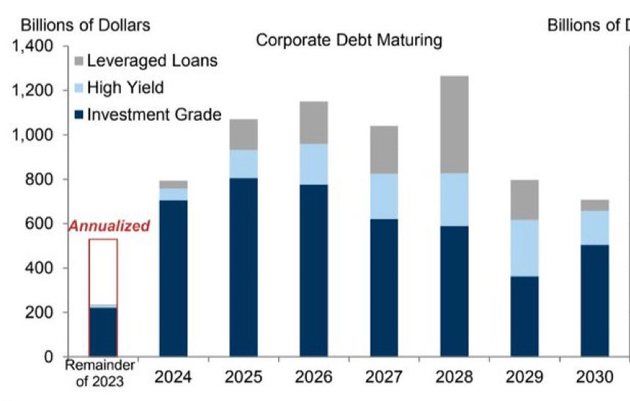
Corporate Refinancings Begin to Ramp Up
Source: Goldman Sachs Investment Research, Bloomberg

Slide 28
Stocks for the Long Run
Annualized Real Returns
January 1802 – December 2022
Stocks 6.7%
Bonds 3.5%
Bills 2.5%
Gold 0.6%
Dollar -1.4%
1941
1811
1931
1821
1831
1841
1851
1921
1861
1871
1881
1891
1911
1802
1901
2021
1971
2011
1981
2001
1961
1991
1951
“Stocks are the most volatile asset class in the short run, but the most stable in the long run.”
Professor Jeremy Siegel
NOTE: Values are indexed to 1, log scale. Past performance is not a reliable indicator of current or future results. Indexes are unmanaged and not subject to fees. It is not possible to invest directly in an index. Source: Siegel, Jeremy, Stocks for the Long Run (2022), 6th edition.

Slide 29
Invest Wisely,
Live Richly

