Slide 1

The presentation will begin shortly.
OneAZ Wealth Management, OneAZ Credit Union and LPL Financial are not affiliated with any other referenced entity.
Your Credit Union (“Financial Institution”) provides referrals to financial professionals of LPL Financial LLC (“LPL”) pursuant to an agreement that allows LPL to pay the Financial Institution for these referrals. This creates an incentive for the Financial Institution to make these referrals, resulting in a conflict of interest. The Financial Institution is not a current client of LPL for brokerage or advisory services.
Please visit https://www.lpl.com/disclosures/is-lpl-relationship-disclosure.html for more detailed information.
This presentation was created for educational and informational purposes only and is not intended as ERISA, tax, legal or investment advice. If you are seeking investment advice specific to your needs, such advice services must be obtained on your own separate from this educational presentation.
Securities and advisory services are offered through LPL Financial (LPL), a registered investment advisor and broker-dealer (member FINRA/SIPC). Insurance products are offered through LPL or its licensed affiliates. OneAZ Credit Union (OneAZ CU) and OneAZ Wealth Management are not registered as a broker-dealer or investment advisor. Registered representatives of LPL offer products and services using OneAZ Wealth Management, and may also be employees of OneAZ CU. These products and services are being offered through LPL or its affiliates, which are separate entities from, and not affiliates of, OneAZ CU nor OneAZ Wealth Management. Securities and insurance offered through LPL or its affiliates are:
Not Insured by NCUA or Any Other Government Agency | Not Credit Union Guaranteed | Not Credit Union Deposits or Obligations | May Lose Value
OneAZ Wealth Management | (877) 566-0517 | www.OneAZWealth.com | Safe For Public Distribution.
Notes:
The presentation will begin shortly…

Slide 2
2024 Market Outlook and Investing In An Election Year
OneAZ Wealth Management, OneAZ Credit Union and LPL Financial are not affiliated with any other referenced entity.
Your Credit Union (“Financial Institution”) provides referrals to financial professionals of LPL Financial LLC (“LPL”) pursuant to an agreement that allows LPL to pay the Financial Institution for these referrals. This creates an incentive for the Financial Institution to make these referrals, resulting in a conflict of interest. The Financial Institution is not a current client of LPL for brokerage or advisory services.
Please visit https://www.lpl.com/disclosures/is-lpl-relationship-disclosure.html for more detailed information.
This presentation was created for educational and informational purposes only and is not intended as ERISA, tax, legal or investment advice. If you are seeking investment advice specific to your needs, such advice services must be obtained on your own separate from this educational presentation.
Securities and advisory services are offered through LPL Financial (LPL), a registered investment advisor and broker-dealer (member FINRA/SIPC). Insurance products are offered through LPL or its licensed affiliates. OneAZ Credit Union (OneAZ CU) and OneAZ Wealth Management are not registered as a broker-dealer or investment advisor. Registered representatives of LPL offer products and services using OneAZ Wealth Management, and may also be employees of OneAZ CU. These products and services are being offered through LPL or its affiliates, which are separate entities from, and not affiliates of, OneAZ CU nor OneAZ Wealth Management. Securities and insurance offered through LPL or its affiliates are:
Not Insured by NCUA or Any Other Government Agency | Not Credit Union Guaranteed | Not Credit Union Deposits or Obligations | May Lose Value
OneAZ Wealth Management | (877) 566-0517 | www.OneAZWealth.com | Safe For Public Distribution.
Notes:
Hello, Welcome to the OneAZ Wealth Webinar on: 2024 Market Outlook and Investing In An Election Year

Slide 3


Presented By
Thomas E. Mitchell, CFP®
Senior Vice President
OneAZ Wealth Management
TMitchell@OneAZcu.com
Notes:
My name is, Tom Mitchell and I have the honor of leading the OneAZ Wealth Management team of Wealth Advisors, located here at the OneAZ Credit Union. Our full-time professional financial advisors are assisting clients and members of the OneAZ Credit Union all over the great state of Arizona! We are very excited to bring these educational topics directly to you in 2024.

Slide 4



Connect With Us!
Website: OneAZWealth.com
Email: OneAZWealth@OneAZCU.com
24/7 Online Appointment Scheduler:
OneAZWealth.com
Phone: (877) 566-0517
Call Monday-Friday, 9:00 am – 5:00 pm
Scan to visit OneAZWealth.com
OneAZ Wealth Management, OneAZ Credit Union and LPL Financial are not affiliated with any other referenced entity.
Your Credit Union (“Financial Institution”) provides referrals to financial professionals of LPL Financial LLC (“LPL”) pursuant to an agreement that allows LPL to pay the Financial Institution for these referrals. This creates an incentive for the Financial Institution to make these referrals, resulting in a conflict of interest. The Financial Institution is not a current client of LPL for brokerage or advisory services.
Please visit https://www.lpl.com/disclosures/is-lpl-relationship-disclosure.html for more detailed information.
This presentation was created for educational and informational purposes only and is not intended as ERISA, tax, legal or investment advice. If you are seeking investment advice specific to your needs, such advice services must be obtained on your own separate from this educational presentation.
Securities and advisory services are offered through LPL Financial (LPL), a registered investment advisor and broker-dealer (member FINRA/SIPC). Insurance products are offered through LPL or its licensed affiliates. OneAZ Credit Union (OneAZ CU) and OneAZ Wealth Management are not registered as a broker-dealer or investment advisor. Registered representatives of LPL offer products and services using OneAZ Wealth Management, and may also be employees of OneAZ CU. These products and services are being offered through LPL or its affiliates, which are separate entities from, and not affiliates of, OneAZ CU nor OneAZ Wealth Management. Securities and insurance offered through LPL or its affiliates are:
Not Insured by NCUA or Any Other Government Agency | Not Credit Union Guaranteed | Not Credit Union Deposits or Obligations | May Lose Value
OneAZ Wealth Management | (877) 566-0517 | www.OneAZWealth.com | Safe For Public Distribution.
Notes:
First, here is our Information page, it contains our required legal disclosures for your convenience. For better audio, the webinar will be in “listen-only mode”…
We will be fielding your questions at the end of the webinar. Please, email any questions to: oneazwealth@oneazcu.com. We will be compiling your questions and will answer them at the end of today’s presentation. If we do not get to your question, I promise we will respond to you directly.
Last, for more information about OneAZ Wealth Management and our team of wealth advisors, visit OneAZWealth.com or use your mobile device to scan the QR Code on the screen now.
You can also connect with us on social media on Facebook, LinkedIn, and YouTube for more exciting resources and helpful information.

Slide 5

Guest Speaker
Zach Holly, CFP®, CRPC®
Centralized Wealth Advisor
OneAZ Wealth Management
ZHolly@oneazcu.com
Notes:
So, let’s get started… Our OneAZ Wealth topic today: 2024 Market Outlook and Investing In An Election Year
Zach Holly bio:
For more than 10 years, Zach has worked as a financial advisor and focuses on retirement planning for credit union members at all life stages. Mr. Holly began his financial career with MassMutual, and has since worked for Edward Jones and Financial Engines before joining OneAZ Wealth Management in 2019. Zach takes the time to get to know each of his clients and helps them address their financial goals. He completed extensive training to earn the Chartered Retirement Planning Counselor (CRPC®) and Certified Financial Planning (CFP®) designations conferred by the College For Financial Planning. Zach also holds his Bachelor's Degree in Psychology from Arizona State University. In his free time, he enjoys golfing, bicycling, and spending time outdoors. Mr. Holly has his Arizona Life and Health Insurance License and is registered with his SIE, Series 7, 63, and 66 securities registrations through LPL Financial.

Slide 6
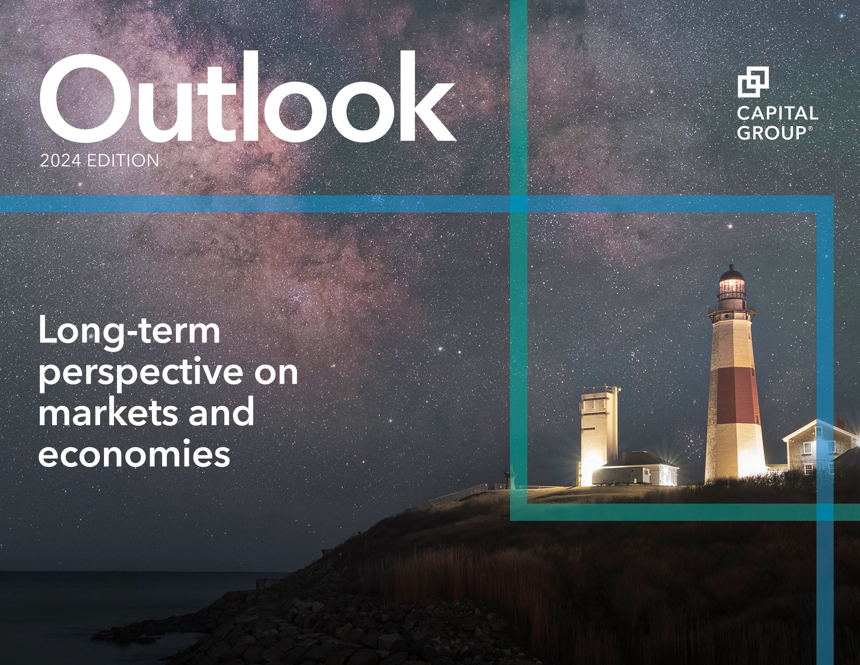

Slide 7

Back to the “old normal?” A return to higher rates
MACRO PERSPECTIVES
U.S. long-term rates today are within the range of historical norms
U.S. long-term government bond yield (%)
1
4%
2%
0%
%
%
%
%
%
10-Year Treasury
Fed funds rate (lower bound)
0.93%
5.25%
4.37%
1
1
8
0.00%
2021 2022 2023
Yields were in 3%-6% range in 61% of all periods
6
4
2
0
1870
1880
1890
1900
1910
1920
1930
1940
1950
1960
1970
1980
1990
2000
2010
2020
*Capital Group, Bloomberg Index Services Ltd., Standard & Poor’s, U.S. Federal Reserve. Returns shown from December 31, 1976 to November 30, 2023.
Sources: Federal Reserve, Robert Shiller. Data for 1871–1961 represents average monthly U.S. long-term government bond yields compiled by Robert Shiller. Data for 1962–2022 represents 10-year Treasury yields, as of December 31 each year within the period. Data for 2023 is as of November 30, 2023. Past results are not predictive of results in future periods.
Notes:
The Federal Reserve’s mission to tame inflation without widespread economic pain just got trickier. The U.S.10-year Treasury yield, which underpins borrowing costs for much of the economy, has risen sharply.
Will high rates stick around or will growth deteriorate, forcing the Fed to slash borrowing costs? I’m optimistic that consumers will continue to carry the economy, even as rates remain higher for an extended period. That’s partly because wages and home values remain above pre-pandemic levels, which has helped support consumer spending. Federal spending has also buffeted the economy, the flip side of which has been a rising deficit now close to 8% of GDP.
While the run-up in rates could weigh on markets, investors will likely adjust. When 10-year rates were 4.0% to 6.0%, the median annualized return since 1976 for the S&P 500 Index was 14.20%, while the Bloomberg U.S. Aggregate Index returned 6.99%.*

Slide 8



Rolling recessions may limit likelihood of broad downturn
MACRO PERSPECTIVES
Mini-recessions, and recoveries, have rolled across different industries and sectors
Travel
Travelers through TSA checkpoints (millions)
Oil
WTI crude oil spot price (USD per barrel)
3
120
2
80
1
40
0
0
2019
2020
2021
2022
2023
2019
2020
2021
2022
2023
Housing
S&P CoreLogic Case-Shiller 20-City Composite Home Price
Index (month-over-month % change)
2.5
Semiconductors
Philadelphia Stock Exchange Semiconductor Index
cumulative return (%)
200
250
1.5
150
0.5
100
-0.5
50
-1.5
2019
0
2020
2021
2022
2023
2019
2020
2021
2022
2023
Sources: Travel: Transportation Security Agency (TSA), U.S. Department of Homeland Security. Data is a 30-day moving average. As of November 30, 2023. Oil: Refinitiv. As of November 30, 2023. Housing: Standard & Poor’s. Latest available monthly data is September 2023, as of November 30, 2023. Semiconductors: Philadelphia Stock Exchange. As of November 30, 2023. Data represents cumulative price return since January 1, 2019. Past results are not predictive of results in future periods.
Notes:
Why didn’t the U.S. fall into recession in 2023, as so many pundits predicted?
The recession did happen, just not all at once. Over the past year and a half, different economic sectors experienced downturns at different times — a phenomenon economists call a “rolling recession.” Thanks to this rare event, it’s possible the U.S. won’t experience a traditional recession before the end of this year or even the next, despite the burden of high inflation and rising interest rates.
For example, residential housing contracted sharply after the Federal Reserve started aggressively raising interest rates. At one point in 2022, existing home sales tumbled nearly 40%. Now there are signs that the housing market is recovering. The chart illustrates several sector-based examples.
If these contractions and recoveries continue, the U.S. could avoid the most widely predicted recession in history. Citing a strong labor market and resilient consumer spending, the U.S. economy could grow at an annualized rate of roughly 2% in 2024.

Slide 9
Look for corporate earnings to rebound in 2024
MACRO PERSPECTIVES
Solid earnings growth expected across major markets
Estimated annual earnings growth
But economic indicators offer a mixed outlook
The Conference Board Leading Economic Index®
Positive Neutral Negative
United States
Developed international
Emerging markets
2023 2024
2023 2024
2023 2024
17.9%
.... New unemployment claims | .... New residential building permits
Average manufacturing hours worked | .... S&P 500 Index
.... Manufacturers’ new orders (consumer goods) | T Leading Credit Index
Manufacturers’ new orders (producers) | T Interest rate spread
_{T} ISM New Orders Index (from customers) | T Consumer expectations
11.4%
6.1%
0.8%
1.7%
-10.2%
Sources (left chart): Capital Group, FactSet, MSCI, Standard & Poor’s. Estimated annual earnings growth is represented by the mean consensus earnings per share estimates for the years ending December 2023 and December 2024, respectively, across the S&P 500 Index (U.S.), MSCI EAFE Index (developed international) and MSCI Emerging Markets Index (emerging markets). Estimates are as of November 30, 2023. Source (right chart): The Conference Board. The table shows the 10 components of The Conference Board Leading Economic Index and indicates if each is expected to have a positive, neutral, or negative impact on U.S. economic growth, based on current levels and six-month trends, as of October 31, 2023.
Notes:
Investors are getting mixed signals about the direction of the economy. But when it comes to stock prices, one of the metrics that matters most is corporate earnings.
In the U.S., Wall Street analysts expect earnings for companies in the S&P 500 Index to rise more than 11% in 2024, based on consensus data compiled by FactSet. That’s along with an expected 6.1% earnings boost in international markets and a robust 18% gain in emerging markets.
Given that 2023 was a difficult year, it’s logical to expect an earnings rebound in 2024, which could provide a runway for stocks to head higher. But there are several risks that could result in substantial earnings revisions, including sluggish consumer spending in the face of persistent inflation, slowing economic growth in Europe and China, and rising geopolitical risk from the wars in Ukraine and Israel.
What’s the risk that earnings expectations are too high?

Slide 10
A window of opportunity for moving cash off the sidelines
MACRO PERSPECTIVES
After Fed hikes ended, stocks and bonds have historically outpaced cash
Average annual return (%)
Cash equivalents
Core bonds
U.S. stocks
60/40 blend
16.2
One year following final Fed hike
14.2
Five years
10.1
9.0
following final Fed hike
7.1
8.4
4.7
3.2
*Based on an average of the four most recent cycles, which began on March 1, 1995, June 1, 2000, July 1, 2006, and January 1, 2019, respectively.
Sources: Capital Group, Morningstar. Chart represents the average returns across respective sector proxies in a forward extending window starting in the month of the last Fed hike in the last four transition cycles from 1995 to 2018 with data through June 30, 2023. Benchmarks represent U.S. 3-month T-bill (cash), Bloomberg U.S. Aggregate Index (core bonds), S&P 500 Index (U.S. stocks)
and a blend of 60% of the S&P 500 Index and 40% of the Bloomberg U.S. Aggregate Index (60/40 blend). Past results are not predictive of results in future periods.
Notes:
The investor exodus from stock and bond markets into cash over the last few years is understandable. However, investors who are still on the sidelines may miss out on a historic window of opportunity to position portfolios for long-term success.
With the Federal Reserve in the midst of an aggressive rate-hiking cycle, yields on money market funds and cash equivalents rose to attractive levels. What’s more, the speed of the rate increases at times rattled stock and bond markets.
But with inflation easing more quickly than anticipated, the Fed paused further hikes for the second consecutive meeting in October, signaling the central bank may be near the end of its tightening cycle. Historically this has provided a favorable time for investors to redeploy cash into stock and bond investments.
Following the last four tightening cycles, stocks, bonds and a blended hypothetical 60/40 portfolio (60% stocks, 40% bonds) sharply outpaced U.S. 3-month Treasury bill returns in the first year after the last Fed hike. Conversely, the 3-month Treasury yield, widely regarded as a proxy for cash-equivalent investments, rapidly declined an average 2.5% in the 18 months* after the last Fed hike.

Slide 11




With artificial intelligence, separate hype from real opportunity
EQUITY OPPORTUNITIES
AI’s impact will be felt across sectors and industries
Semiconductor chips & equipment
Cloud computing/ AI software
AI
applications
ASML
Applied Materials NVIDIA
TSMC
Broadcom
Microsoft Amazon Google
Tech and telecom Financial services Health care/pharma
Legal/professional services Automotive and assembly
Source: Capital Group. TSMC refers to Taiwan Semiconductor Manufacturing Company. As of November 30, 2023.
Notes:
Major advancements in artificial intelligence (AI) captured the market’s attention in 2023, driving up stock prices for a handful of Big Tech companies. But the beneficiaries of AI’s ascent aren’t only to be found in the tech world.
AI-driven applications are spawning innovation across many industries, including pharmaceuticals, banking and even fast food. McDonald’s is using AI to make its drive-through order systems faster. Pfizer is employing AI to accelerate the development of new drugs. And JPMorgan Chase is unleashing AI bots to detect identity theft.
These companies join more obvious beneficiaries, such as NVIDIA, which designs powerful computer chips needed to run AI applications, and Microsoft, co-owner of the popular AI app ChatGPT.
The challenge for investors will be to separate the hype from reality amid the expected exponential growth of AI systems over the next decade.

Slide 12

Made in America: Capital spending
boom could spark a manufacturing revival
EQUITY OPPORTUNITIES
After years of underinvestment, capital spending is set to recover
Capital expenditures as a percent of gross domestic product (%)
1
4%
3%
2%
1%
0%
%
%
%
1
POTENTIAL CATALYST FOR HIGHER CAPEX
1
2021
7.5%
$1.4
trillion
1
Historic low 7.3%
1
Estimated fiscal stimulus 2023-2030
9
8
7
1980
1990
2000
2010
2020
2030
Sources: Capital Group, St. Louis Federal Reserve. Data from January 1, 1980 to June 30, 2023. Capital expenditures include private nonresidential equipment and structures and excludes energy.
Notes:
A tidal wave of cash is headed directly at American industry, with the potential to galvanize the capital investment cycle and reshape U.S. manufacturing and energy industries. Seeking to support local supply chains, expand clean energy and boost the U.S. semiconductor industry, the U.S. government has committed $1.4 trillion over the next seven years for capital projects.
This investment translates into revenue and earnings growth potential for companies with the capacity and flexibility to undertake these expansive projects, including upgrading the U.S. power grid and building manufacturing facilities. Many industrial firms have been in a figurative desert for year, this level of investment can potentially transform them from sleepy cyclicals to growth businesses.
The stimulus will also likely have a multiplier effect throughout the economy as new facilities will create job prospects and other potential benefits. While much of the money has yet to be spent, the trend toward energy efficiency, localizing supply chains and infrastructure improvements is already generating opportunity. Air conditioning maker Carrier Global saw demand for its energy-efficient systems surge in 2023 as many countries experienced periods of record-high temperatures.
Among capital equipment companies, Caterpillar reported robust orders in the second quarter of 2023 for its construction equipment, partly driven by federal infrastructure spending.

Slide 13

Out-of-favor dividend payers poised to offer diversification, income
EQUITY OPPORTUNITIES
Valuations for high dividend payers are far below the market average
P/E of high dividend stocks vs. S&P 500 Index (%)
0
-5
-10
–12.9% average
-15
-20
-25
–25.9%
-30
-35
1980
1984
1988
1992
1996
2000
2004
2008
2012
2016
2020
Sources: Capital Group, Goldman Sachs. As of November 28, 2023. High dividend stocks refer to the cohort of stocks in the S&P 500 Index with the highest quintile dividend yield (sector-neutral) within the index. Line represents smoothed six-month average.
OUTLOOK 2024 · 10
P/E ratio = price-to-earnings ratio. Past results are not predictive of results in future periods.
Notes:
With investors swept up in the artificial intelligence fervor, valuations for dividend-paying stocks have quietly drifted toward multi-decade lows compared to the broader market.
With economic growth expected to moderate in 2024, and the potential for recession lingering, dividends may take a more prominent role in driving total returns for investors.
Select dividend payers across a variety of industries are adopting strategies to drive demand for their offerings. For example, retail pharmacy CVS Health is launching a new division that will work with drugmakers to produce biosimilar versions of leading therapies that will make them more affordable. Beverage maker Keurig Dr Pepper has a history of relatively stable demand through business cycles for brands like Canada Dry and Snapple. Within the more challenged tobacco industry, Philip Morris International has acquired Swedish Match to tap into demand for smokeless tobacco offerings.
For investors concerned about the risks of concentrating their portfolios in a handful of tech giants with similar businesses, dividend payers can offer diversification as well as income.

Slide 14


Will corporate reform in Japan unlock value for investors?
EQUITY OPPORTUNITIES
Japan Inc. is flush with cash
Percentage of index constituents with positive net cash positions
49%
17%
11%
TOPIX 500 Index
S&P 500 Index
STOXX Europe 600 Index
Sources: Capital Group, FactSet, Standard & Poor’s, STOXX, TOPIX. As of November 30, 2023. Net cash reflects the difference between the cash and short-term securities reported on a company’s balance sheet and its outstanding debt. Price-to-book value
OUTLOOK 2024 · 12
is a financial metric used to compare the book value of a company with its market capitalization.
Notes:
In Japan, the prospect of real corporate reforms and a renewed focus on shareholders have long seemed just beyond the horizon. After many false starts, will this time be different?
Japanese companies have been known for hoarding cash and subpar governance. To accelerate reforms, the government and Tokyo Stock Exchange are urging firms to improve profitability and boost stock valuations by reducing cash on balance sheets and shedding underperforming businesses. About half of Japanese companies have positive net cash positions, while a third have price-to-book values lower than the value of their underlying assets.
Investors have noticed. In 2023, Japanese equities rose to highs not seen since the late 1980s.
Many Japanese companies are prominent innovators in factory automation and niche technologies. For instance, SMC is a leader in robotic equipment components and semiconductor production, while TDK is among the largest manufacturers of high-end electric vehicle batteries. Sustained reforms could unlock opportunities across industries.

Slide 15
Emerging markets:
Coming out of China’s shadow
EQUITY OPPORTUNITIES
Returns among large EMs have diverged post-COVID
Cumulative total return (%)
60
India 50%
40
Mexico 43%
20
0
-20
China –28%
-40
-60
2018
2019
2020
2021
2022
2023
Sources: MSCI, RIMES. Returns reflect MSCI India Index, MSCI Mexico Index and MSCI China Index in U.S. dollars. Five-year time period shown to reflect returns pre- and post-COVID. Data as of November 30, 2023. Past results are not predictive of
OUTLOOK 2024 · 13
results in future periods.
Notes:
Is it time for emerging markets other than China to grab more of the spotlight? The setup looks attractive, and opportunities are growing in countries such as India, Indonesia and Mexico. Why? Infrastructure growth is accelerating, government balance sheets are stronger, and supply chain shifts are boosting regional economies.
Take India. New roads, housing developments and industrial parks have left parts of the country unrecognizable from just a few years ago. Indonesia is attracting foreign investment to build out the electric vehicle supply chain. And Mexico is becoming a reshoring hub.
Investment opportunities range from banks to airplane component makers to real estate developers to mining and consumer-related companies. Meanwhile, the rapid expansion of mobile-based technology platforms is tapping into demand for consumer services.
And don’t discount China as a whole. A deep selloff has created select opportunities to invest in innovative companies that have dominant market share in their home country, generate copious cash flows and trade at appealing valuations.

Slide 16

Corporate and mortgage bonds
offer compelling income opportunities
FIXED INCOME OPPORTUNITIES
Yields are near 20-year highs
Latest yield, as a percent of 20-year range
Yield as of 11/30/23
84th percentile
U.S. mortgage- backed securities
5.26%
83rd percentile
U.S. investment
grade
5.60%
86th percentile
Global investment
grade
5.23%
Sources: Capital Group, Bloomberg Index Services Ltd. Indexes used are the Bloomberg U.S. MBS: Agency Fixed Rate MBS Index (U.S. mortgage-backed securities), Bloomberg U.S. Corporate Investment Grade Index (U.S. investment grade) and the Bloomberg Global Aggregate Corporate Index (global investment grade). Includes daily yields for the 20-year period ending November 30,
2023. Past results are not predictive of results in future periods.
OUTLOOK 2024 · 14
Notes:
Despite an uncertain economic outlook creating potential headwinds, high starting yields combined with a confluence of supportive factors currently underpin agency mortgage- backed securities (MBS) and investment-grade corporate bonds (rated BBB/Baa and above).
Higher coupon MBS look appealing as the expected conclusion of the Fed’s hiking cycle looms. Volatility is likely to decline, and valuations today are at levels not seen since April 2020.
Housing inventory and affordability are approaching all-time lows, which should dampen MBS supply and support near-term valuations.
Investment-grade corporate bonds are supported by strong balance sheets and low refinancing needs. In a modest growth environment, investors could earn the coupon without too much downside risk. If the economy slows and Treasury yields rally, the sector’s longer duration would mean potential price appreciation, which could offset any widening in spreads.

Slide 17



Member FINRA/SIPC

Slide 18
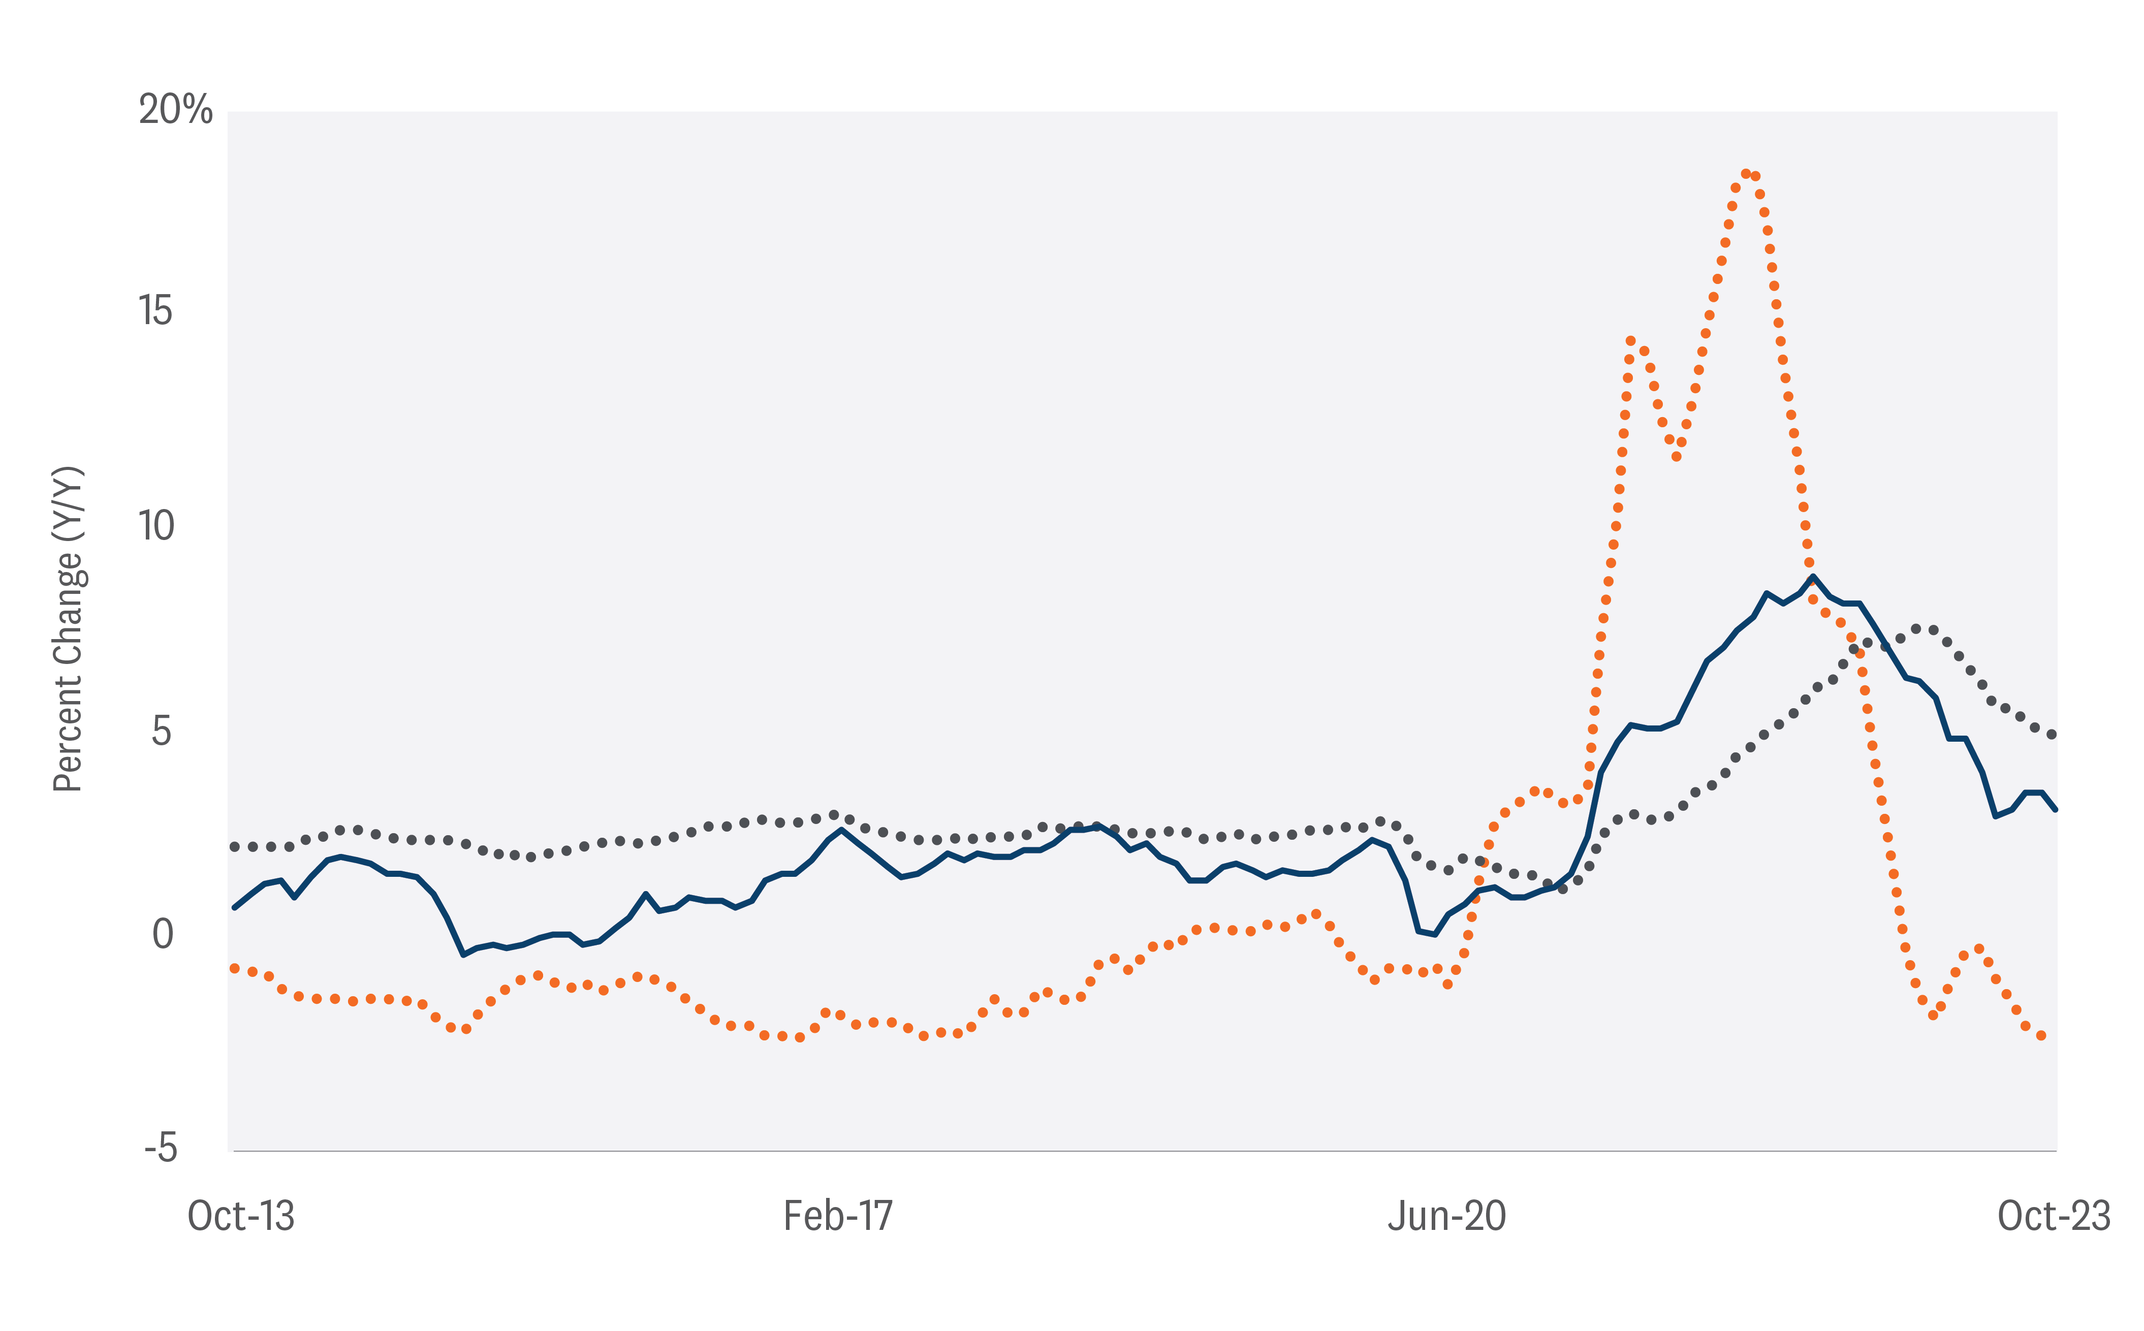
Markets Are Seeing a Downward TREND in Services Prices
And Durable Prices Keep Falling
CPI Y/Y %
CPI: Durables Y/Y%
CPI: Services Y/Y%
Source: LPL Research, U.S. Bureau of Labor Statistics 11/27/23
Notes:
We believe a recession is likely to emerge in 2024 as consumers, under increasing debt burdens, deplete their excess savings and are no longer able to keep up with debt payments. Leading indicators that we’re watching include an increase in serious delinquencies in credit cards and auto loans. We expect the spending splurge to end, with consumers reverting to trend. In 2024, the consumer will no longer be willing to spend, as they did in 2023.

Slide 19
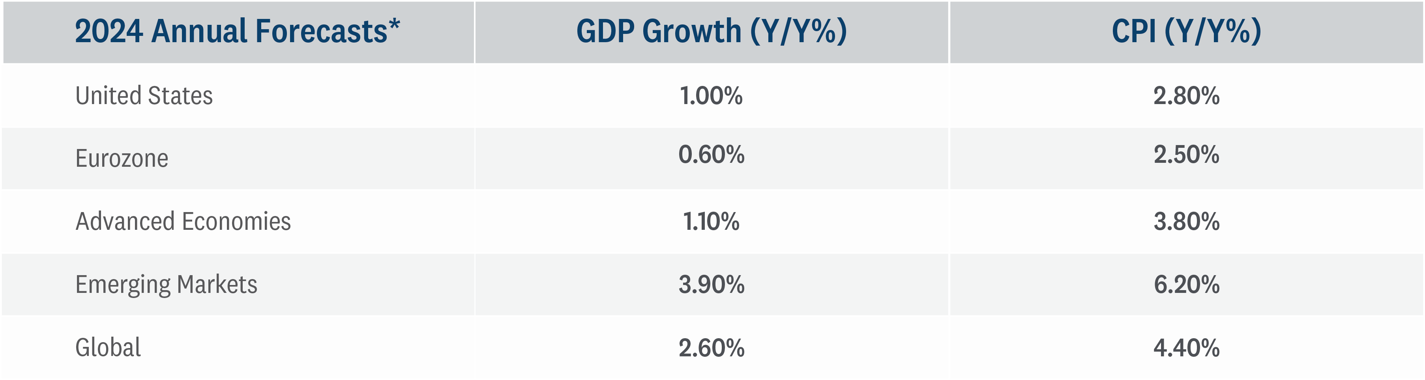
DOMESTIC GROWTH LIKELY CONCENTRATED IN LATTER HALF OF 2024
Inflation Should Moderate as Growth Slows
Source: LPL Research, Bloomberg 11/27/23
*Annual Average
The economic forecasts set forth in this material may not develop as predicted.
Notes:
LPL Research forecasts for economic growth and consumer inflation across regions in 2024.

Slide 20
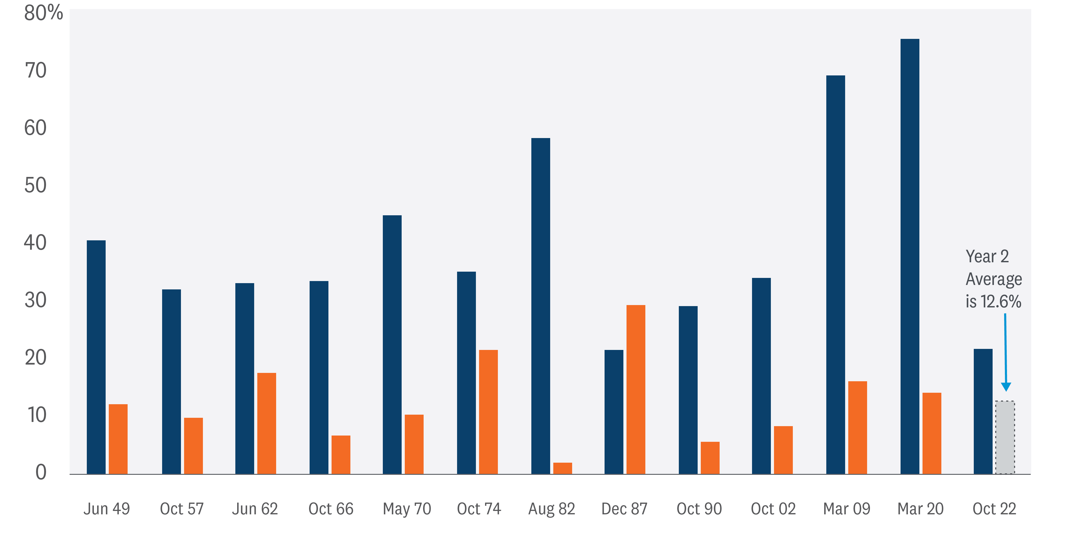
S&P 500 Bull Markets Have Historically Enjoyed Solid Year Two Returns
S&P 500 Performance: Bull Market Year 1
S&P 500 Performance: Bull Market Year 2
Source: LPL Research, FactSet 11/27/23
All indexes are unmanaged and cannot be invested into directly. Past performance is no guarantee of future results.
Notes:
As the next 12 months of the bull gets underway, market history tells us solid gains may lie ahead. Of the 12 such periods since 1950, the S&P 500 has gained an average of 12.6% and was positive every time. A gain of this magnitude seems reasonable given the potential for support from the Fed as inflation falls.

Slide 21
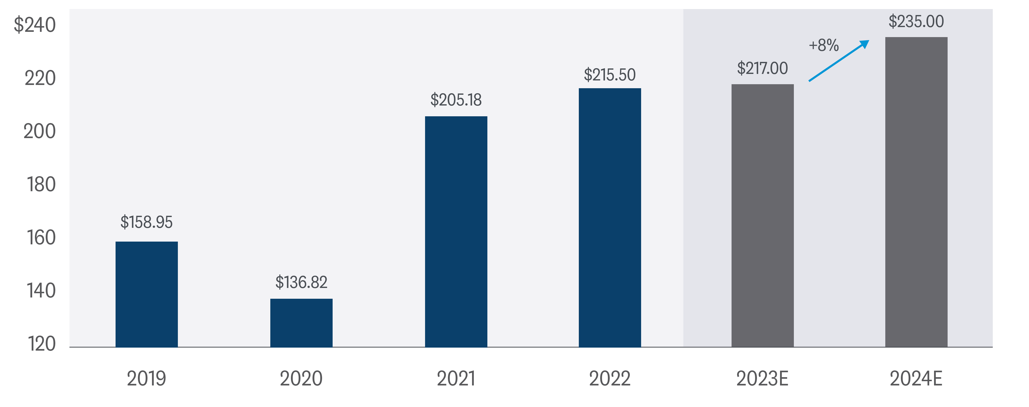
EXPECT EARNINGS GROWTH TO ACCELERATE IN 2024 AND SUPPORT STOCK PRICES
S&P 500 Earnings Per Share
Source: LPL Research, FactSet 11/27/23
Indexes are unmanaged and cannot be invested in directly. Past performance is no guarantee of future results.
Estimates may not materialize as predicted and are subject to change.
Notes:
Our 2024 S&P 500 earnings per share (EPS) forecast is $235 per share, up from our prior estimate of $230. The new estimate represents only about 7% earnings growth from the current 2023 consensus S&P 500 EPS estimate of $219. Beyond economic growth, how companies manage waning pricing power as inflation falls is key to the earnings outlook. Reversals of 2023 earnings declines by the healthcare and the natural resource sectors, along with increased earnings growth in the technology sector, will help drive a turnaround in overall earnings.

Slide 22
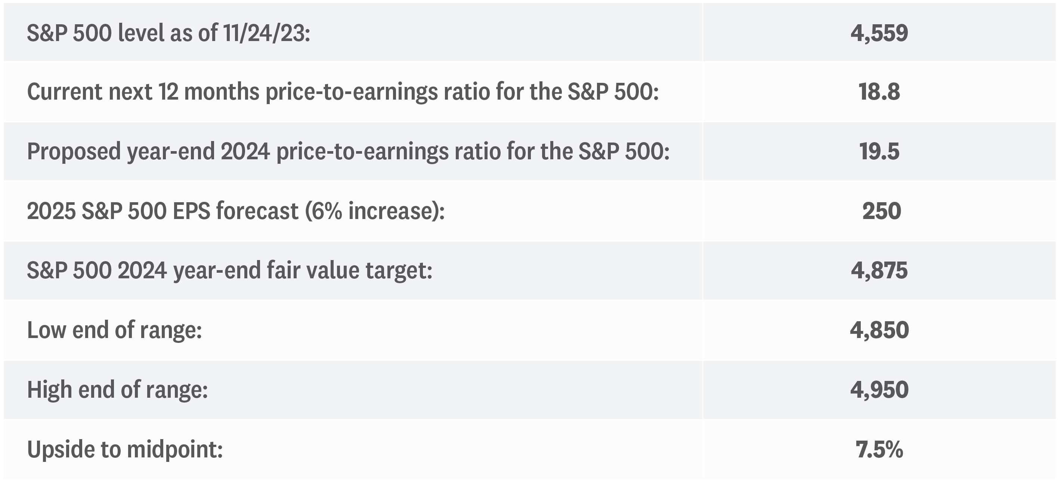
S&P 500 year-end fair value target for 2024
Source: LPL Research
Any economic forecasts set forth may not develop as predicted and are subject to change.
Notes:
While earnings growth will likely help push stocks higher in 2024, the contribution from valuations may be more limited. Stocks appreciate in value primarily in two ways—either earnings grow or valuations become richer. The good news is that stocks can move higher in the coming year without much help from valuations—a different story from the past two years. A price-to-earnings ratio of 19.5, in line with the five-year average, represents only a slight improvement in valuations from the 18.8 level in mid-November. Based on a P/E ratio of 19.5 times our projected 2025 S&P 500 earnings per share (EPS) of $250, we estimate a fair-value range for the S&P 500 at the end of 2024 to be between 4,850 and 4,950. This suggests potential high-single-digit gains at the midpoint.

Slide 23
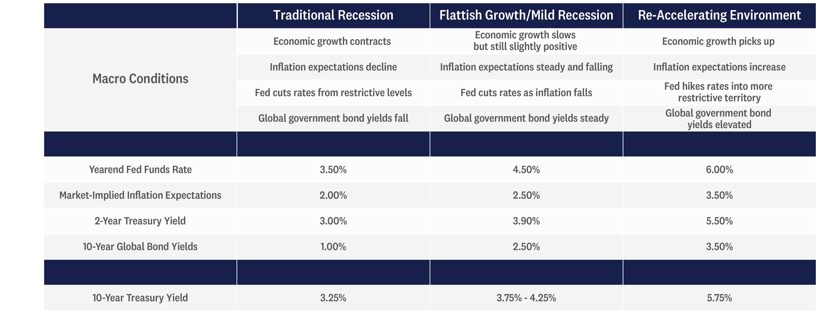
Treasury Yield Forecasts
Source: LPL Research, 11/27/23
Notes:
With the economic data (so far) continuing to reflect a more resilient economy than originally expected, we think Treasury yields are likely going to stay higher for longer as well. As such, we think the 10-year Treasury yield could stay in the 3.75% and 4.25% range with risks roughly balanced. However, while we think the economic data softens in 2024, which should allow the Fed to gradually adjust monetary policy lower, we can’t entirely rule out two other scenarios either: traditional recession or a re-accelerating economic environment.

Slide 24

Investing In An Election Year
How to survive the uncertainty and invest with confidence

Slide 25











Red, blue and you: Investing through election uncertainty
MACRO PERSPECTIVES
Long-term returns have been similar whether a Democrat or Republican won
10-year growth of hypothetical $10k investment made in the S&P 500 Index at start of election year (USD)
60
AVERAGE 10-YEAR ANNUALIZED RETURN
50k
40
11.2%
Democrat
10.5%
Republican
30
20
10
0
1936
1940
1944
1948
1952
1956
1960
1964
1968
1972
1976
1980
1984
1988
1992
1996
2000
2004
2008
2012
Sources: Capital Group, Standard & Poor’s. Each 10-year period begins on January 1 of the first year shown and ends on December 31 of the tenth year. For example, the first period listed (1936)
covers January 1, 1936 to December 31, 1945. Figures shown are past results and are not predictive of results in future periods.
Notes:
With the U.S. presidential election less than a year away, investors are feeling anxious about how markets will react.

Slide 26
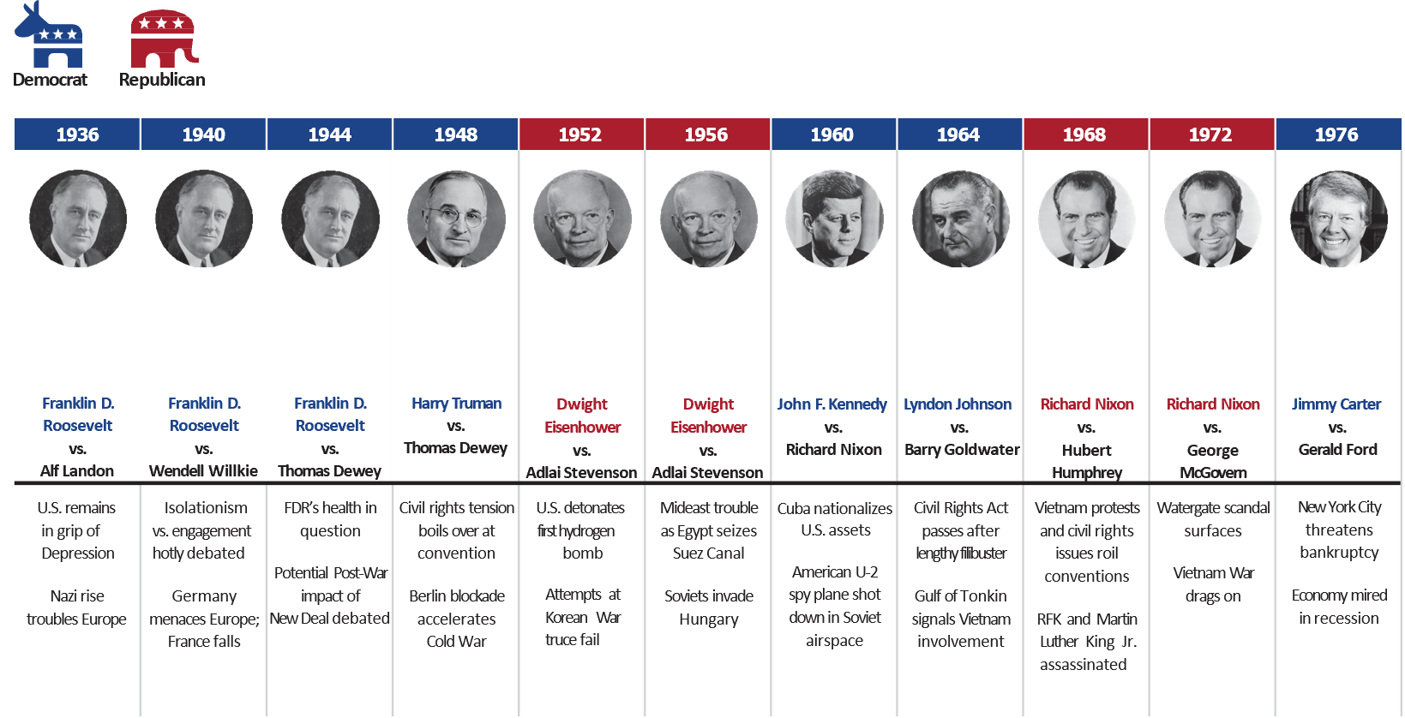
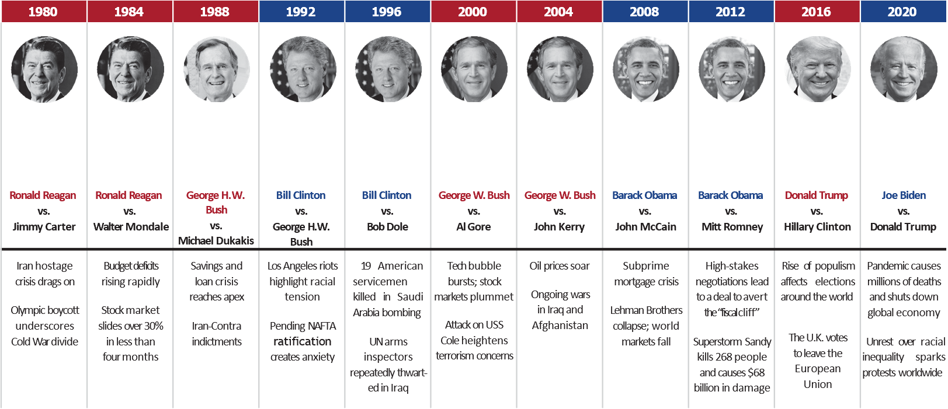
Investments are not FDIC-insured, nor are they deposits of or guaranteed by a bank or any other entity, so they may lose value.
Notes:
While markets can be volatile in election years, which political party takes the White House has had little impact for long-term investors. Since 1936, the 10-year annualized return of U.S. stocks (as measured by the S&P 500 Index) made at the start of an election year was 11.2% when a Democrat won and 10.5% in years a Republican prevailed.

Slide 27


“The only limit to our realization of
tomorrow will be our doubts of today.”
— Franklin D. Roosevelt
Market declines and recessions
Set your sights on the long-term
Investor doubts may seem especially prevalent during presidential election years when campaigns spotlight the country’s challenges. Yet even with election year rhetoric amplifying the negative, it’s important to focus on your vision for the future.
There have always been tumultuous events.
The current economic and political challenges may seem unprecedented, but a look back shows that controversy and uncertainty
have surrounded every campaign.
Geopolitical conflicts and war
Pandemics and other outbreaks
Keep in mind the following:
Successful long-term investors stay the course and rely on time rather than timing.
Investment success has depended more on the strength and resilience of the American economy than on which candidate or party holds office.
Civil unrest and protest
Weather-related calamities
Labor market struggles
The experience and time-tested process of your investment manager can be an important contributor to your long-term investment success.
Investments are not FDIC-insured, nor are they deposits of or guaranteed by a bank or any other entity, so they may lose value.
Notes:
Setting your sights on the long-term
Investor doubts may seem especially prevalent during presidential election years when campaigns spotlight the country’s challenges. Yet even with election year rhetoric amplifying the negative, it’s important to focus on your vision for the future.
Keep in mind the following:
Successful long-term investors stay the course and rely on time rather than timing.
Investment success has depended more on the strength and resilience of the American economy than on which candidate or party holds office.
The experience and time-tested process of your investment manager can be an important contributor to your long-term investment success.

Slide 28




The Investment Company of America®
22 elections and counting
$500,000,000
200,000,000
1964
Lyndon Johnson
1968
Richard Nixon
100,000,000
80,000,000
1960
John F.
60,000,000
1956
Dwight Eisenhower
Kennedy
40,000,000
$10,000 investment 10 years later
1952
Dwight Eisenhower
$23,598
$17,232
20,000,000
Dividends reinvested during period
1948
Harry Truman
$28,002
$5,076
$4,314
1944
Franklin Roosevelt
$33,264
$4,353
Average annual return:
9.0%
Average annual return:
5.6%
10,000,000
$46,825
Average annual return:
10.8%
Massacres in Cambodia
8,000,000
$4,190
New York City threatens bankruptcy
6,000,000
1936¹
Franklin Roosevelt
$33,980
$6,492
Average annual return:
12.8%
North Korea captures USS Pueblo
U.S. invades Cambodia
Wage-price freeze
Energy crisis
4,000,000
1940
Franklin Roosevelt
Average annual return:
16.7%
Civil rights marches
Vietnam War escalates
Money tightens; market falls
Watergate
Oil embargo
Nixon resigns
U.S. withdraws from Vietnam
2,000,000
$29,570
$6,942
Castro seizes power in Cuba
Soviets down U-2 plane
Berlin Wall is erected
Cuban Missile Crisis
Kennedy assassination
Newark riots
$27,723
$7,416
Average annual return:
13.0%
Dow tops 300 — market “too high”
Soviets launch Sputnik
Gulf of Tonkin
1,000,000
800,000
$4,156
Average annual return:
Soviets detonate H-bomb
Eisenhower illness
Value added by reinvestment of dividends
600,000
Average annual return:
10.7%
$25,991
11.5%
U.S. seizes steel mills
Suez Crisis
Recession
1972
Richard Nixon
1976
Jimmy Carter
400,000
$6,565
Soviets detonate A-bomb
Excess proﬁts tax
200,000
Average annual return:
10.0%
Consumer goods shortages
Post-war recession predicted
Dow tops 200 — market “too high”
Cold War begins
Berlin blockade
Korean War
Economy still struggling
$49,044
100,000
War clouds gather
Wartime price controls
Industry mobilizes
$22,958
$9,300
80,000
War in Europe
France falls
Pearl Harbor
$5,596
60,000
Civil war in Spain
Recession
Average annual return:
8.7%
Average annual return:
17.2%
40,000
Depression
20,000
10,000
8,000
Year ended Dec. 31
1934 1935 1936 1937 1938 1939 1940 1941 1942 1943 1944 1945 1946 1947 1948 1949 1950 1951 1952 1953 1954 1955 1956 1957 1958 1959 1960 1961 1962 1963 1964 1965 1966 1967 1968 1969 1970 1971 1972 1973 1974 1975 1976 1977 1978
Capital value ($ in thousands)
Dividends excluded: — —
Value at year-end: $12.6 23.0
$0.5
33.0
1.1
19.5
0.2
24.7
0.6
24.3
0.9
22.9
1.2
20.0
1.1
22.3
1.0
28.6
1.1
34.2
1.0
45.7
1.4
43.3
1.8
41.9
2.0
40.2
1.9
42.0
2.1
48.2
2.2
54.5
2.2
58.9
2.3
56.9
2.4
86.1
2.9
105.1
3.1
113.4
3.3
97.0
3.4
136.6
3.6
152.4
4.0
155.4
4.1
187.2
4.3
158.2
4.5
189.8
4.9
216.0
5.4
268.6
6.7
264.9
7.8
333.8
9.4 10.2
380.9 330.8
10.5
328.5
10.8
373.7
11.0
421.8
11.8 17.4
339.8 262.5
15.8
339.6
14.3
425.6
14.8
400.2
16.0
443.2
Total value ($ in thousands)
Dividends reinvested: — — $0.5 1.1 0.2 0.6 1.0 1.4 1.3 1.2 1.4 1.4 2.0 2.7 3.0 3.0 3.6 3.8 4.0 4.5 4.7 5.9 6.5 7.2 7.6 8.2 9.5 9.9 10.7 11.4 12.7 14.5 18.4 21.8 26.9 29.9 32.0 33.9 35.8 39.5 60.6 58.3 55.1 59.1 66.5
Value at year-end: $12.6 23.0 33.6 20.7 26.5 26.8 26.2 24.3 28.4 37.8 46.7 63.9 62.5 63.2 63.5 69.6 83.5 98.6 110.8 111.5 174.3 218.9 242.9 214.4 310.8 355.5 372.2 458.8 398.7 490.8 571.4 726.6 734.9 948.7 1,111.4 994.3 1,022.0 1,197.9 1,390.0 1,158.1 951.9 1,290.7 1,675.3 1,634.8 1,878.0
Total return (%) +25.6 +83.4 +46.0 –38.3 +27.8 +1.0 –2.3 –7.2 +16.9 +33.0 +23.5 +37.0 –2.2 +1.1 +0.5 +9.6 +20.0 +18.0 +12.4 +0.6 +56.4 +25.6 +10.9 –11.7 +45.0 +14.4 +4.7 +23.3 –13.1 +23.1 +16.4 +27.1 +1.1 +29.1 +17.2 –10.5 +2.8 +17.2 +16.0 –16.7 –17.8 +35.6 +29.8 –2.4 +14.9
Sources: Capital Group, Standard & Poor’s. Dividend calculations sourced from Refinitiv InvestmentView+.
Class F-2 shares were first offered on August 1, 2008. Class F-2 share results prior to the date of first sale are hypothetical based on Class A share results without a sales charge, adjusted for estimated annual expenses. The results shown are before taxes on fund distributions and sale of fund shares. Past results are not predictive of results in future periods. Results for other share classes may differ.
Notes:
As you can see in the mountain chart below, a hypothetical $10,000 investment in The Investment Company of America has grown steadily and significantly over the fund’s 89-year history.
Additionally, a hypothetical $10,000 investment in ICA made at the beginning of an election year was always larger 10 years down the road.
Here are ICA’s average annual total returns on a $1,000 investment with all distributions reinvested for periods ended June 30, 2023:
Class F-2 shares:
1 year- 21.61%
5 years-10.05%
10 years-11.48%

Slide 29




The Investment Company of America®
22 elections and counting
Federal Reserve/global central banks raise interest rates to ﬁght inﬂation
ICA with dividends reinvested
$255,998,120¹
Average annual return: 12.1%
Stock market with dividends reinvested
$94,852,057
Average annual return: 10.8%
ICA with dividends excluded
$18,029,599²
Average annual return: 8.8%
Stock market with dividends excluded
$3,801,482
Average annual return: 6.9%
Year ﬁve of federal government’s quantitative easing policy
U.S. drawn into Syrian conﬂict
Wave of populism affects elections around world
Hurricanes pummel the
U.S. and Caribbean
U.S. trade war with China
U.S.-China trade war; global rate cuts
COVID-19 pandemic
Inﬂation rates surge around the world
Subprime credit crisis
U.S. unemployment tops 10%
European sovereign debt crisis
U.S. faces “ﬁscal cliff”
Greek debt crisis; China growth slows
Global economic turmoil
Fears of Y2K computer problems
Internet bubble bursts
Terrorist attacks in U.S.
Corporate accounting scandals
Hurricanes devastate southern U.S.
Dow Jones tops 12,000 for ﬁrst time
U.S. recession
Gulf of Mexico oil spill
Dow tops 4,000, then 5,000 — market “too high”
Technology stocks stumble
Chaos in Asian markets
U.S. invades Iraq
Oil prices soar
Recession in U.S.; Soviet Union dissolves
Midwestern U.S. ﬂoods
Fed raises interest rates six times
Three Mile Island nuclear accident
Iraq invades Kuwait
Los Angeles riots
Soviets shoot down Korean airliner
Iran-Iraq war escalates
U.S. bombs Libya
Record-setting market decline
Bank failures peak
Problems with junk bonds
Reagan and the pope are shot
Worst recession in 40 years
U.S. becomes a debtor nation
Abscam scandal rocks Congress
1980
Ronald Reagan
1984
Ronald Reagan
1988
George H.W. Bush
1992
Bill Clinton
1996
Bill Clinton
2000
George W. Bush
2004
George W. Bush
2008
Barack Obama
2012
Barack Obama
$53,508
Consumer Price Index (Inﬂation)
$224,846
Average annual return: 3.6%
$10,170
$41,411
$45,955
$34,912
$39,431
$7,656
$28,319
$13,025
$20,333
$21,404
$5,669
$4,072
$3,671
$2,391
$2,905
$2,665
$4,053
Average annual return:
18.3%
Average annual return:
15.3%
Average annual return:
16.5%
Average annual return:
13.3%
Average annual return:
11.0%
Average annual return:
2.7%
Average annual return:
7.4%
Average annual return:
7.9%
Average annual return:
14.7%
Original investment
$10,000
1979 1980 1981 1982 1983 1984 1985 1986 1987 1988 1989 1990 1991 1992 1993 1994 1995 1996 1997 1998 1999 2000 2001 2002 2003 2004 2005 2006 2007 2008 2009 2010 2011 2012 2013 2014 2015 2016 2017 2018 2019 2020 2021 2022
19.3
24.1
590.7
29.1
567.9
34.7
717.5
33.6
828.8
35.1 36.9
847.5 1,089.5
41.8
1,285.1
52.9
1,307.2
60.4
1,421.2
67.6
1,769.8
71.2
1,712.2
55.2
2,109.7
60.0
2,198.0
61.4
2,393.1
65.0
2,335.9
70.3
2,977.9
74.0
3,479.7
78.1
4,438.8
88.1
5,366.7
97.4
6,160.7
109.3
6,297.2
115.2
5,903.3
116.1
4,949.0
118.0
6,125.0
120.0
6,607.4
156.6
6,911.7
174.6
7,841.4
166.9
8,151.6
179.3
5,186.6
154.7
6,421.4
153.1
6,965.8
158.2
6,701.0
194.7
7,564.5
175.4
9,842.9
215.2
10,833.0
201.3
10,494.9
236.8
11,797.4
243.5
13,889.7
280.9
12,749.3
314.6
15,568.1
276.6
17,525.8
285.5
21,643.3
297.7
508.7
18,029.6
Average annual total return for 89 years:
+12.1%
82.8
107.9
136.7
171.9
175.1
190.9
209.5
245.9
321.9
382.2 446.7 489.4 394.2 440.8 463.4 503.8 559.8 604.2 651.1 748.4 842.1 961.6 1,032.1 1,060.8 1,102.9 1,144.7 1,524.8 1,739.1 1,700.6 1,867.6 1,660.7 1,687.2 1,784.4 2,249.5 2,076.7 2,597.8 2,478.7 2,973.7 3,119.8 3,667.5 4,195.6 3,768.6 3,953.7 4,184.2
9,253.0 11,993.0 12,094.2 15,328.8 16,426.2 18,363.8 18,421.7 24,102.1 28,812.0 37,459.6 46,125.3 53,847.6 56,003.0 53,519.3 45,847.5 58,000.6 63,776.6 68,266.4 79,273.9 84,120.2 55,010.2 70,138.5 77,900.8 76,697.0 88,863.1 117,918.7 132,438.8 130,768.7 150,098.7 180,027.6 168,662.6 210,413.0 241,401.3 302,379.5 255,998.1
2,241.5 2,721.8 2,750.1 3,684.7 4,434.7 4,738.0 6,330.1 7,718.5 8,151.2
+19.4 +21.4 +1.0 +34.0 +20.4 +6.8 +33.6 +21.9 +5.6 +13.5 +29.6 +0.8 +26.7 +7.2 +11.8 +0.3 +30.8 +19.5 +30.0 +23.1 +16.7 +4.0 –4.4 –14.3 +26.5 +10.0 +7.0 +16.1 +6.1 –34.6 +27.5 +11.1 –1.5 +15.9 +32.7 +12.3 –1.3 +14.8 +19.9 –6.3 +24.8 +14.7 +25.3
–15.3
Expense ratio was 0.38% as of the fund’s prospectus available at the time of publication.
When applicable, investment results reflect fee waivers and/or expense reimbursements, without which results would be lower. Refer to capitalgroup.com for more information.
The stock market is represented by the S&P 500 Index, a market capitalization-weighted index based on the results of approximately 500 widely held common stocks. The index is unmanaged and, therefore, has no expenses. Investors cannot invest directly in an index. There have been periods when the fund has lagged the index.
¹ Investment results shown are for 10-year periods beginning on January 1 of the year shown.
²Includes dividends of $61,384,311, and capital gain distributions totaling $133,379,215, reinvested in the years 1936–2022.
³Includes reinvested capital gains of $11,974,227, but does not reflect income dividends of $5,827,007 taken in cash.
Notes:
[Previous slide continued]

Slide 30



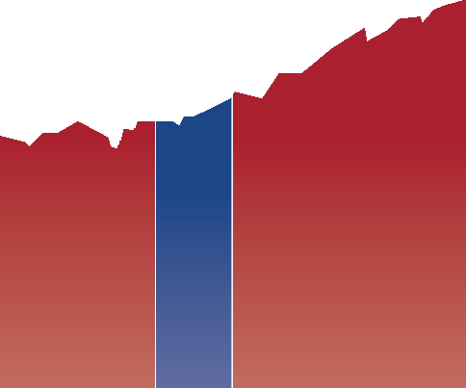



Which political party has been better for investors?
Growth of a hypothetical $1,000 investment in S&P 500 Index
$10,000,000
$1,000,000
Democratic presidency
Republican presidency
$100,000
$10,000
$1,000
1933 1938 1943 1948 1953 1958 1963 1968 1973 1978 1983 1988 1993 1998 2003 2008 2013 2018 2023
sources: Capital Group, rIMes, Standard & Poor‘s. Chart shows the growth of a hypothetical $1k investment made on March 4, 1933 (the date of Franklin D. Roosevelt’s first inauguration) through June 30, 2023. Dates of party control are based on inauguration dates. Values are based on total returns in USD. Shown on a logarithmic scale. Past results are not predictive of results in future periods.
GUIDE TO INVESTING IN AN ELECTION YEAR
– 3 –
Notes:
Investing during an election year can be tough on the nerves, and 2024 promises to be no different. Indeed, politics can elicit strong emotions and biases, but investors would be wise to tune out the noise and focus on the long term.
That’s because elections have, historically speaking, made essentially no difference when it comes to long-term investment returns.
What should matter more to investors is staying invested. A $1,000 investment in the S&P 500 made when Franklin D. Roosevelt took office would have been worth over $19 million as of June 30, 2023. During this time there have been eight Democratic and seven Republican presidents.
Current economic and political challenges may seem unprecedented but a look at past election cycles shows that controversy and uncertainty have surrounded every campaign. And in each case the market has continued to be resilient over time. Successful investors stay the course and rely on time in the market rather than timing the market.
Bottom line: U.S. stocks have trended up regardless of whether a Democrat or Republican won the White House.

Slide 31
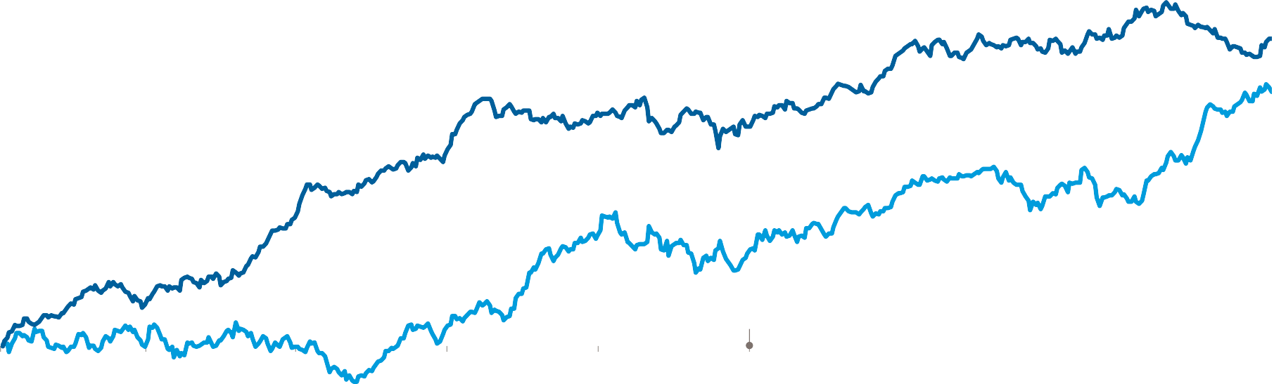

What typically happens to the stock market during election years?
S&P 500 Index average cumulative returns since 1932
15%
PRIMARIES
The ﬁrst ﬁve months of election years have had lower average
AFTER PRIMARIES
But markets have tended to bounce back and return to an upward trajectory after primaries end.
12
returns and higher volatility.
9
6
Non-election years
Election years
3
Election day
0
Jan
Mar
May
Jul
Sep
Nov
Jan
Mar
May
sources: Capital Group, RIMES, Standard & Poor‘s. Includes all daily price returns from January 1, 1932 through December 31, 2022. Non-election years exclude all years with either a presidential or midterm elections. Past results are not predictive of results in future periods.
GUIDE TO INVESTING IN AN ELECTION YEAR
– 4 –
Notes:
Markets hate uncertainty, and what’s more uncertain than primary season of an election year? With so many candidates on the campaign trail — 14 Republicans had announced their candidacy as of mid–2023 — the range of outcomes can feel daunting.
But the volatility is often short-lived. After the primaries are over and each party has selected its candidate, markets have tended to return to their normal upward trajectory.
Patient investors who stay the course have often been rewarded. Since 1932, stocks have gained an average of 11.3% in the 12 months following the conclusion of the primaries (using May 31 as a proxy) compared to just 5.8% in similar periods of non-election years.
But keep in mind, these are just averages. Investors shouldn’t try to time an entry point into the market. Instead, a long-term approach can help investors withstand volatility and feel confident that markets have tended to move higher over time, even in election years.
Bottom line: Primary season tends to be volatile, but markets have bounced back strongly thereafter.

Slide 32
Which sectors have done best in election years?
Range of one-year returns by S&P 500 sectors (1992–2022)
120% One year before election
100
One year after election Average
80
60
40
20
0
–20
–40
–60
Communication services
Consumer discretionary
Consumer staples
Energy
Financials
Health care
Industrials
Information technology
Materials
Utilities
S&P 500
sources: Capital Group, Refinitiv Datastream, Standard & Poor’s. October 31 used as proxy for each election date. Past results are not predictive of results in future periods.
GUIDE TO INVESTING IN AN ELECTION YEAR
– 5 –
Notes:
It‘d be great if there were go-to sectors to invest in every election year, but unfortunately investing isn’t that simple. Every election cycle brings its own parade of candidates with their own policy agendas, so market winners and losers are hard to predict.
The health care sector has been in the crosshairs for a number of election cycles. Heated rhetoric over drug pricing put pressure on many stocks in the pharmaceutical and managed care industries. Other sectors have had similar bouts of weakness prior to elections.
Does that mean you should avoid a particular sector altogether? Not necessarily.
Regardless of who wins, stocks with strong long-term fundamentals will often rally once the campaign spotlight fades. This pre-election market turbulence can create buying opportunities for investors with a contrarian point of view and the strength to tolerate short-term volatility.
Bottom line: Election year volatility can create buying opportunities for long-term investors.

Slide 33









What mistakes do investors often make in election years?
Average net fund flows by year of presidential term (1992–2022)
$250B Equity funds Money market funds
200
Presidential election year
150
100
50
0
Year 1
Year 2
Year 3
Year 4
source: Morningstar. Values based on USD. Funds include mutual funds and ETFs. Equity funds include funds within Morningstar’s International Equity and U.S. Equity categories. Money market funds include funds within Morningstar’s Money Market category.
GUIDE TO INVESTING IN AN ELECTION YEAR
– 6 –
Notes:
If you’re nervous about the markets heading into 2024, you’re not alone. Presidential candidates often draw attention to the country’s problems, and campaigns tend to amplify negative messages. So it’s no wonder that investors may start feeling a little pessimistic too. This can become a problem if they allow their mood to affect their money.
History shows that investors have poured into money market funds — traditionally one of the lowest risk investment vehicles — with greater frequency ahead of elections. By contrast, equity funds have seen the highest net inflows in the year immediately after an election. This trend holds true even for international funds.
This suggests that investors want to minimize risk during election years and wait for uncertainty to subside before revisiting riskier assets like stocks.
But market timing is rarely a winning long-term investment strategy and can pose a major problem for portfolio returns. On the next page, we’ll take a closer look at how it could negatively impact investor wealth.
Bottom line: Investors often get nervous and move to cash in election years, but that’s rarely a winning strategy.

Slide 34



What have been the best ways to invest in election years?
Three hypothetical $10K investment strategies during an election cycle
Analysis of 22 election cycles since 1932
Investor strategy Average ending value after four-year holding period
Best outcome
Worst outcome
FULLY INVESTED
This investor isn’t concerned about election uncertainty and invests the full
$10K on January 1 of the election year.
$10K $15,865
14/22
cycles
6/22
cycles
CONSISTENT CONTRIBUTIONS
Similar to a 401(k) retirement plan, this investor invests $1K in each of the ﬁrst 10 months of the election year.
$10K $15,738
5/22
cycles
0/22
cycles
SITTING ON THE SIDELINES
Nervous about how elections affect markets, this investor waits until January 1 after the election results to invest the full $10K.
$10K $14,936
3/22
cycles
16/22
cycles
sources: Capital Group, Board of Governors of the Federal Reserve System (US), RIMES, Standard & Poor’s. The three hypothetical investors each have $10K to invest during an election cycle and are invested in a combination of equities and cash at all times. fully invested is always fully invested in equities. consistent contributions starts with $1K in equity and $9K in cash. At the start of each of the next nine months, this investor reduces cash by $1K and makes a $1K contribution to equities, after which they will have made the full $10K contribution to equities. sitting on the sidelines is entirely invested in cash during the first year. At the start of the second year, this investor reduces cash by $10K and makes a $10K contribution to equities. S&P 500 Index used for equity returns, and returns reflect the reinvestment of dividends. 3-month Treasury Bills used as a proxy for cash returns, and returns reflect the reinvestment of interest. Returns and portfolio values are calculated monthly and in USD. Analysis starts on January 1 of each election year and reflects a four-year holding period. 2020 election is not included since there has not been a full four-year holding period to analyze, as of June 30, 2023. Past results are not predictive of results in future periods.
GUIDE TO INVESTING IN AN ELECTION YEAR
– 7 –
Notes:
Spoiler alert: The best way to invest in an election year has rarely been by staying on the sidelines.
To verify this, we looked at three hypothetical investors, each with a different investment approach. We then calculated the ending value of each of their portfolios over the last 22 election cycles, assuming a four-year holding period.
The investor who stayed on the sidelines had the worst outcome 16 times and only had the best outcome three times. Meanwhile, investors that were fully invested or made monthly contributions to a 401(k), for example, during election years came out on top. These investors had higher average portfolio balances over the full period and more frequently outpaced the investor who stayed in cash longer.
Sticking with a sound long-term investment plan based on individual investment objectives is usually the best course of action. Whether that strategy is to be fully invested throughout the year or to invest on a regular basis, the bottom line is that investors should avoid market timing around politics. As is often the case with investing, the key is to put aside short-term noise and focus on long-term goals.
Bottom line: Staying on the sidelines has rarely paid off. It’s time, not timing, that matters most.

Slide 35

Key Takeaways: How to invest with confidence in an election year
Here’s what we learned:
U.S. stocks have trended up regardless of whether a Republican or Democrat won the White House.
A $1,000 investment in the S&P 500 Index when FDR became president in 1933 would have been worth over
$19 million in 2023. During that time there have been seven Republican and eight Democratic presidents.
Primary season tends to be volatile, but markets have bounced back strongly afterward.
Stocks have returned 11.3% in the 12 months following primaries, compared to 5.8% in similar periods of non-election years.
Investors often get nervous and move into cash during election years.
Net asset flows into money market funds have been more than three times higher in election years than in the year after an election.
But staying on the sidelines has rarely paid off. It’s time, not timing, that matters most.
The S&P 500 Index had negative returns in only two of the last 20 election years (2000, 2008), and both declines were largely attributed to asset price bubbles rather than politics.
Investments are not FDIC-insured, nor are they deposits of or guaranteed by a bank or any other entity, so they may lose value.
Past results are not predictive of results in the future.
GUIDE TO INVESTING IN AN ELECTION YEAR
– 2 –
Notes:
Presidential elections can be divisive and unsettling. At times, the fate of the world seems to hang in the balance. But when it comes to investing, do elections really matter all that much?
U.S. voters will have their say in November 2024, but by maintaining a long-term focus, investors can position themselves for a brighter future regardless of the outcome at the voting booth. In fact, overreacting to short-term volatility during election cycles can be detrimental to investment returns.
Here’s what we learned:
U.S. stocks have trended up regardless of whether a Republican or Democrat won the White House. A $1,000 investment in the S&P 500 Index when FDR became president in 1933 would have been worth over $19 million in 2023. During that time there have been seven Republican and eight Democratic presidents.
Primary season tends to be volatile, but markets have bounced back strongly afterward. Stocks have returned 11.3% in the 12 months following primaries, compared to 5.8% in similar periods of non-election years.
Investors often get nervous and move into cash during election years. Net asset flows into money market funds have been more than three times higher in election years than in the year after an election.
But staying on the sidelines has rarely paid off. It’s time, not timing, that matters most. The S&P 500 Index had negative returns in only two of the last 20 election years (2000, 2008), and both declines were largely attributed to asset price bubbles rather than politics.

Slide 36
As nondiversified funds, Capital Group ETFs have the ability to invest a larger percentage of assets in securities of individual issuers than a diversified fund. As a result, a single issuer could adversely affect a fund’s results more than if the fund invested a smaller percentage of assets in securities of that issuer. See the applicable prospectus for details.
For CGGR, CGXU, CGCP, CGMS: Investing outside the United States involves risks, such as currency fluctuations, periods of illiquidity and price volatility, as more fully described in the prospectus. These risks may be heightened in connection with investments in developing countries.
For CGCP, CGMU, CGMS: The return of principal for bond funds and for funds with significant
underlying bond holdings is not guaranteed. Fund shares are subject to the same interest rate, inflation and credit risks associated with the underlying bond holdings. For CGCP, CGMS, CGMU: Lower rated bonds are subject to greater fluctuations in value and risk of loss of income and principal than higher rated bonds. For CGMU: Income from municipal bonds may be subject to state or local income taxes and/or the federal alternative minimum tax. Certain other income, as well as capital gain distributions, may be taxable. For CGCP, CGMS: The use of derivatives involves a variety of risks, which may be different from, or greater than, the risks associated with investing in traditional securities, such as stocks and bonds. For CGCP, CGMS: Investments in mortgage-related securities involve additional risks, such as prepayment risk, as more fully described in the prospectus.
Bond ratings, which typically range from AAA/Aaa (highest) to D (lowest), are assigned by credit rating agencies such as Standard & Poor’s, Moody’s and/or Fitch, as an indication of an issuer’s creditworthiness. If agency ratings differ, the security will be considered to have received the highest of those ratings, consistent with the fund’s investment policies. Small-company stocks entail additional risks, and they can fluctuate in price more than larger company stocks.
The market indexes are unmanaged and, therefore, have no expenses. Investors cannot invest directly in an index.
Bloomberg U.S. Aggregate Index represents the U.S. investment-grade fixed-rate bond market.
Bloomberg U.S. Corporate Investment Grade Index represents the universe of investment- grade, publicly issued U.S. corporate and specified foreign debentures and secured notes that meet the specific maturity, liquidity and quality requirements. Bloomberg U.S. Corporate High Yield 2% Issuer Capped Index covers the universe of fixed-rate, non-investment grade debt. The index limits the maximum exposure of any one issuer to 2%. Bloomberg Global Aggregate Corporate Index is a flagship measure of global investment-grade, fixed-rate corporate debt.
Bloomberg U.S. Mortgage Backed Securities Index is a market value-weighted index that covers
the mortgage-backed pass-through securities of Ginnie Mae (GNMA), Fannie Mae (FNMA) and Freddie Mac (FHLMC). Bloomberg Municipal Bond Index is a market value-weighted index designed to represent the long-term investment-grade tax-exempt bond market. JP Morgan Emerging Markets Bond Index (EMBI) Global Diversified is a uniquely weighted emerging market debt benchmark that tracks total returns for U.S. dollar-denominated bonds issued by emerging market sovereign and quasi-sovereign entities. JP Morgan Government Bond Index — Emerging Markets Global Diversified covers the universe of regularly traded, liquid fixed-rate, domestic currency emerging market government bonds to which international investors can gain exposure. The 50% EMBI Global Diversified/50% JP Morgan GBI-EM Global Diversified blend weighs the indexes cumulative total returns at 50% each. This assumes the blend is rebalanced monthly. MSCI China Index captures large- and mid-cap representation across China A shares, H shares, B shares, Red chips, P chips and foreign listings (e.g., ADRs). MSCI EAFE (Europe, Australasia, Far East) Index is a free float-adjusted market capitalization- weighted index designed to measure developed equity market results, excluding the United States and Canada. MSCI Emerging Markets Index captures large- and mid-cap representation across 27 emerging markets (EM) countries. MSCI Europe Index is designed to measure developed equity market results across 15 developed countries in Europe. MSCI India Index is designed to measure the performance of the large- and mid-cap segments of the Indian market. MSCI Mexico Index measures the performance of the large- and mid-cap segments of the Mexican market. S&P 500 Index is a market capitalization-weighted index based on the results of approximately 500 widely held common stocks. S&P Global Broad Market Index (BMI) is a market capitalization-weighted index maintained by Standard and Poor’s (S&P) providing a
broad measure of global equities markets. S&P CoreLogic Case-Shiller 20-City Composite Home Price Index seeks to measure the value of residential real estate in 20 major U.S. metropolitan areas. The Conference Board Leading Economic Index is an American economic leading indicator intended to forecast future economic activity. The ISM New Orders Index shows the number of new orders for manufacturing firms as reported by survey respondents. The Leading Economic Index provides an early indication of significant turning points in the business cycle and where the economy is heading in the near term. Philadelphia Stock Exchange Semiconductor Index is a Philadelphia Stock Exchange capitalization-weighted index composed of the 30 largest U.S. companies primarily involved in the design, distribution, manufacture and sale of semiconductors. STOXX Europe 600 Index is a market capitalization- weighted index consisting of 600 fixed components spanning large-, medium- and small-cap companies, and covers roughly 90% of the investable European stock market. TOPIX 500 Index is a market capitalization-weighted index consisting of the 500 largest and most liquid components of the Tokyo Stock Price Index (TOPIX).
BLOOMBERG® is a trademark and service mark of Bloomberg Finance L.P. and its affiliates (collectively “Bloomberg”). Bloomberg or Bloomberg’s licensors own all proprietary rights in the Bloomberg Indices. Neither Bloomberg nor Bloomberg’s licensors approves or endorses this material, or guarantees the accuracy or completeness of any information herein, or makes any warranty, express or implied, as to the results to be obtained therefrom and, to the maximum extent allowed by law, neither shall have any liability or responsibility for injury or damages arising in connection therewith.
This report, and any product, index or fund referred to herein, is not sponsored, endorsed or
promoted in any way by J.P. Morgan or any of its affiliates who provide no warranties whatsoever, express or implied, and shall have no liability to any prospective investor, in connection with this report. J.P. Morgan disclaimer: https://www.jpmm.com/research/disclosures
©2023 Morningstar, Inc. All rights reserved. The information contained herein: (1) is proprietary
to Morningstar and/or its content providers; (2) may not be copied or distributed; and (3) is not warranted to be accurate, complete or timely. Neither Morningstar nor its content providers are responsible for any damages or losses arising from any use of this information. Past performance is no guarantee of future results.
MSCI has not approved, reviewed or produced this report, makes no express or implied
warranties or representations and is not liable whatsoever for any data in the report. You may not redistribute the MSCI data or use it as a basis for other indices or investment products.
The S&P 500 Index, S&P Global Broad Market Index (BMI) and S&P CoreLogic Case-Shiller 20- City Composite Home Price Index are products of S&P Dow Jones Indices LLC and/or its affiliates and have been licensed for use by Capital Group. Copyright © 2023 S&P Dow Jones Indices LLC, a division of S&P Global, and/or its affiliates. All rights reserved. Redistribution or reproduction in whole or in part is prohibited without written permission of S&P Dow Jones Indices LLC.
The Capital Group companies manage equity assets through three investment groups. These groups make investment and proxy voting decisions independently. Fixed income investment professionals provide fixed income research and investment management across the Capital organization; however, for securities with equity characteristics, they act solely on behalf of one of the three equity investment groups.
Statements attributed to an individual represent the opinions of that individual as of the date published and do not necessarily reflect the opinions of Capital Group or its affiliates. This information is intended to highlight issues and should not be considered advice, an endorsement or a recommendation.
This content, developed by Capital Group, home of American Funds, should not be used as a primary basis for investment decisions and is not intended to serve as impartial investment or fiduciary advice.
All Capital Group trademarks mentioned are owned by The Capital Group Companies, Inc., an affiliated company or fund. All other company and product names mentioned are the property of their respective companies.

Slide 37
General Disclosures
The opinions, statements and forecasts presented herein are general information only and are not intended to provide specific investment advice or recommendations for any individual. It does not take into account the specific investment objectives, tax and financial condition, or particular needs of any specific person. There is no assurance that the strategies or techniques discussed are suitable for all investors or will be successful. To determine which investment(s) may be appropriate for you, please consult your financial professional prior to investing.
Any forward-looking statements including the economic forecasts herein may not develop as predicted and are subject to change based on future market and other conditions. All performance referenced is historical and is no guarantee of future results.
References to markets, asset classes, and sectors are generally regarding the corresponding market index. Indexes are unmanaged statistical composites and cannot be invested into directly. Index performance is not indicative of the performance of any investment and does not reflect fees, expenses, or sales charges. All performance referenced is historical and is no guarantee of future results.

Slide 38
General Risk Disclosures
Investing involves risk including the potential loss of principal.
Alternative investments may not be suitable for all investors and should be considered as an investment for the risk capital portion of the investor’s portfolio. The strategies employed in the management of alternative investments may accelerate the velocity of potential losses.
Investing in stock includes numerous specific risks including the fluctuation of dividend, loss of principal and potential illiquidity of the investment in a falling market. Because of their narrow focus, sector investing will be subject to greater volatility than investing more broadly across many sectors and companies. Value investments can perform differently from the market as a whole. They can remain undervalued by the market for long periods of time. The prices of small and mid-cap stocks are generally more volatile than large cap stocks.
Bonds are subject to market and interest rate risk if sold prior to maturity. Bond values will decline as interest rates rise and bonds are subject to availability and change in price. Bond yields are subject to change. Certain call or special redemption features may exist which could impact yield. Government bonds and Treasury bills are guaranteed by the U.S. government as to the timely payment of principal and interest and, if held to maturity, offer a fixed rate of return and fixed principal value. Corporate bonds are considered higher risk than government bonds but normally offer a higher yield and are subject to market, interest rate, and credit risk, as well as additional risks based on the quality of issuer coupon rate, price, yield, maturity, and redemption features. Mortgage-backed securities are subject to credit, default, prepayment, extension, market and interest rate risk. Floating rate bank loans are loans issues by below investment grade companies for short term funding purposes with higher yield than short term debt and involve risk.
Preferred stock dividends are paid at the discretion of the issuing company. Preferred stocks are subject to interest rate and credit risk. As interest rates rise, the price of the preferred falls (and vice versa). They may be subject to a call feature with changing interest rates or credit ratings. The majority of preferred stocks outstanding are concentrated in the financial sector.
International debt securities involve special additional risks. These risks include, but are not limited to, currency risk, geopolitical and regulatory risk, and risk associated with varying settlement standards. These risks are often heightened for investments in emerging markets.
High yield/junk bonds (grade BB or below) are not investment grade securities, and are subject to higher interest rate, credit, and liquidity risks than those graded BBB and above. They generally should be part of a diversified portfolio for sophisticated investors.
Municipal bonds are subject to availability and change in price. They are subject to market and interest rate risk if sold prior to maturity. Bond values will decline as interest rates rise. Interest income may be subject to the alternative minimum tax. Municipal bonds are federally tax-free but other state and local taxes may apply. If sold prior to maturity, capital gains tax could apply.

Slide 39
General Risk Disclosures
The fast price swings of commodities will result in significant volatility in an investor's holdings. Commodities include increased risks, such as political, economic, and currency instability, and may not be suitable for all investors. Precious metal investing is subject to substantial fluctuation and potential for loss.
Any company names noted herein are for educational purposes only and not an indication of trading intent or a solicitation of their products or services. LPL Financial doesn’t provide research on individual equities.
All index data from FactSet. International investing involves special risks such as currency fluctuation and political instability and may not be suitable for all investors. These risks are often heightened for investments in emerging markets.
All information is believed to be from reliable sources; however, LPL Financial makes no representation as to its completeness or accuracy.
Investing involves risks including possible loss of principal. No investment strategy or risk management technique can guarantee return or eliminate risk in all market environments. There is no guarantee that a diversified portfolio will enhance overall returns or outperform a non-diversified portfolio. Diversification does not protect against market risk. Investing in foreign and emerging markets debt or securities involves special additional risks. These risks include, but are not limited to, currency risk, geopolitical risk, and risk associated with varying accounting standards. Investing in emerging markets may accentuate these risks.
Asset allocation does not ensure a profit or protect against a loss.

Slide 40
General Definitions
Gross Domestic Product (GDP) is the monetary value of all the finished goods and services produced within a country’s borders in a specific time period, though GDP is usually calculated on an annual basis. It includes all of private and public consumption, government outlays, investments and exports less imports that occur within a defined territory.
The PE ratio (price-to-earnings ratio) is a measure of the price paid for a share relative to the annual net income or profit earned by the firm per share. It is a financial ratio used for valuation: a higher PE ratio means that investors are paying more for each unit of net income, so the stock is more expensive compared to one with lower PE ratio.
Earnings per share (EPS) is the portion of a company’s profit allocated to each outstanding share of common stock. EPS serves as an indicator of a company’s profitability. Earnings per share is generally considered to be the single most important variable in determining a share’s price. It is also a major component used to calculate the price-to-earnings valuation ratio.
The Standard & Poor’s 500 Index is a capitalization- weighted index of 500 stocks designed to measure performance of the broad domestic economy through changes in the aggregate market value of 500 stocks representing all major industries.
The Bloomberg U.S. Aggregate Bond Index is an index of the U.S. investment-grade fixed-rate bond market, including both government and corporate bonds.
The HFRI® Indices are broadly constructed indices designed to capture the breadth of hedge fund performance trends across all strategies and regions.
The HFRI Institutional Macro Index is a global, equal-weighted index of hedge funds with minimum assets under management of USD $500MM which report to the HFR Database and are open to new investments.
A company’s market capitalization is the market value of its outstanding shares. Market capitalization is calculated by multiplying the number of a company’s shares outstanding by its stock price per share. Classifications such as large-cap, mid-cap and small-cap are only approximations and may change over time.
Equity Definitions
Cyclical stocks typically relate to equity securities of companies whose price is affected by ups and downs in the overall economy and that sell discretionary items that consumers may buy more of during an economic expansion but cut back on during a recession. Counter-cyclical stocks tend to move in the opposite direction from the overall economy and with consumer staples which people continue to demand even during a downturn.
A Growth stock is a share in a company that is anticipated to grow at a rate significantly above the average for the market due to capital appreciation.
A Value stock is anticipated to grow above the average for the market due to trading at a lower price relative to its fundamentals, such as dividends, earnings, or sales.
Large cap stocks are issued by corporations with a market capitalization of $10 billion or more, and small cap stocks are issued by corporations with a market capitalization between $250 million and $2 billion.

Slide 41
General Definitions
Fixed Income Definitions
Credit Quality is one of the principal criteria for judging the investment quality of a bond or bond mutual fund. As the term implies, credit quality informs investors of a bond or bond portfolio’s credit worthiness, or risk of default. Credit ratings are published rankings based on detailed financial analyses by a credit bureau specifically as it relates to the bond issue’s ability to meet debt obligations. The highest rating is AAA, and the lowest is D. Securities with credit ratings of BBB and above are considered investment grade.
The credit spread is the yield the corporate bonds less the yield on comparable maturity Treasury debt. This is a market-based estimate of the amount of fear in the bond market. Base-rated bonds are the lowest quality bonds that are considered investment-grade, rather than high-yield. They best reflect the stresses across the quality spectrum.
The Bloomberg Aggregate U.S. Bond Index represents securities that are SEC-registered, taxable, and dollar denominated. The index covers the U.S. investment- grade fixed rate bond market, with index components for government and corporate securities, mortgage pass- through securities, and asset-backed securities.

Slide 42
This research material has been prepared by LPL Financial LLC.
Securities and advisory services offered through LPL Financial (LPL), a registered investment advisor and broker-dealer (member FINRA/SIPC). Insurance products are offered through LPL or its licensed affiliates. To the extent you are receiving investment advice from a separately registered independent investment advisor that is not an LPL affiliate, please note LPL makes no representation with respect to such entity.
RES-1675051-1023 | For Public Use | Tracking #514731 (Exp. 12/2024)
Not Insured by FDIC/NCUA or Any Other Government Agency | Not Bank/Credit Union Guaranteed | Not Bank/Credit Union Deposits or Obligations | May Lose Value

Slide 43
Questions & Answers
Website: OneAZWealth.com
Email: OneAZWealth@OneAZCU.com
24/7 Online Appointment Scheduler:
OneAZWealth.com
Phone: (877) 566-0517
Call Monday-Friday, 9:00 am – 5:00 pm
Scan to visit OneAZWealth.com
OneAZ Wealth Management, OneAZ Credit Union and LPL Financial are not affiliated with any other referenced entity.
Your Credit Union (“Financial Institution”) provides referrals to financial professionals of LPL Financial LLC (“LPL”) pursuant to an agreement that allows LPL to pay the Financial Institution for these referrals. This creates an incentive for the Financial Institution to make these referrals, resulting in a conflict of interest. The Financial Institution is not a current client of LPL for brokerage or advisory services.
Please visit https://www.lpl.com/disclosures/is-lpl-relationship-disclosure.html for more detailed information.
This presentation was created for educational and informational purposes only and is not intended as ERISA, tax, legal or investment advice. If you are seeking investment advice specific to your needs, such advice services must be obtained on your own separate from this educational presentation.
Securities and advisory services are offered through LPL Financial (LPL), a registered investment advisor and broker-dealer (member FINRA/SIPC). Insurance products are offered through LPL or its licensed affiliates. OneAZ Credit Union (OneAZ CU) and OneAZ Wealth Management are not registered as a broker-dealer or investment advisor. Registered representatives of LPL offer products and services using OneAZ Wealth Management, and may also be employees of OneAZ CU. These products and services are being offered through LPL or its affiliates, which are separate entities from, and not affiliates of, OneAZ CU nor OneAZ Wealth Management. Securities and insurance offered through LPL or its affiliates are:
Not Insured by NCUA or Any Other Government Agency | Not Credit Union Guaranteed | Not Credit Union Deposits or Obligations | May Lose Value
OneAZ Wealth Management | (877) 566-0517 | www.OneAZWealth.com | Safe For Public Distribution.
Notes:
We have a number of questions coming in now. Please email any questions you have to OneAZWealth@oneazcu.com... And we will be sure to address them…
So, our first question is: (TBD)
If we do not get to your question, I promise we will respond to you directly.

Slide 44
Thank You!
Website: OneAZWealth.com
Email: OneAZWealth@OneAZCU.com
24/7 Online Appointment Scheduler:
OneAZWealth.com
Phone: (877) 566-0517
Call Monday-Friday, 9:00 am – 5:00 pm
Scan to visit OneAZWealth.com
OneAZ Wealth Management, OneAZ Credit Union and LPL Financial are not affiliated with any other referenced entity.
Your Credit Union (“Financial Institution”) provides referrals to financial professionals of LPL Financial LLC (“LPL”) pursuant to an agreement that allows LPL to pay the Financial Institution for these referrals. This creates an incentive for the Financial Institution to make these referrals, resulting in a conflict of interest. The Financial Institution is not a current client of LPL for brokerage or advisory services.
Please visit https://www.lpl.com/disclosures/is-lpl-relationship-disclosure.html for more detailed information.
This presentation was created for educational and informational purposes only and is not intended as ERISA, tax, legal or investment advice. If you are seeking investment advice specific to your needs, such advice services must be obtained on your own separate from this educational presentation.
Securities and advisory services are offered through LPL Financial (LPL), a registered investment advisor and broker-dealer (member FINRA/SIPC). Insurance products are offered through LPL or its licensed affiliates. OneAZ Credit Union (OneAZ CU) and OneAZ Wealth Management are not registered as a broker-dealer or investment advisor. Registered representatives of LPL offer products and services using OneAZ Wealth Management, and may also be employees of OneAZ CU. These products and services are being offered through LPL or its affiliates, which are separate entities from, and not affiliates of, OneAZ CU nor OneAZ Wealth Management. Securities and insurance offered through LPL or its affiliates are:
Not Insured by NCUA or Any Other Government Agency | Not Credit Union Guaranteed | Not Credit Union Deposits or Obligations | May Lose Value
OneAZ Wealth Management | (877) 566-0517 | www.OneAZWealth.com | Safe For Public Distribution.
Notes:
As a wrap-up, thank you, Zach, for your presentation and insights.
For those watching and listening, thank you for joining, we hope our discussion today has helped to provide you some ideas on 2024 Outlook and Investing In An Election Year. We all here at OneAZ Wealth Management welcome your feedback and comments. So, Please email us any suggestions you have for future webinar topics. As always, our entire OneAZ Wealth team of Advisors stands ready to assist you in reviewing your current financial plan and portfolio in light of today’s economy. There is no better time than the present for a 2nd opinion on your current plan. Many of our clients had other advisors when they first come to us, and they learned and discovered new ideas and new strategies that are better suited to their needs. We welcome your call!
Please call our toll-free number: 877-566-0517 and visit our OneAZWealth.com website for more information in creating your personal financial and retirement plan.
Again, Thank you for joining us… From all of us at OneAZ Wealth, we wish you the best 2023 and start to 2024 for your Safety, Health, and Wealth!

