Slide 1
Economic & Market Update
Baird Trust
April 23, 2025
Source: Strategas Research Partners

Slide 2
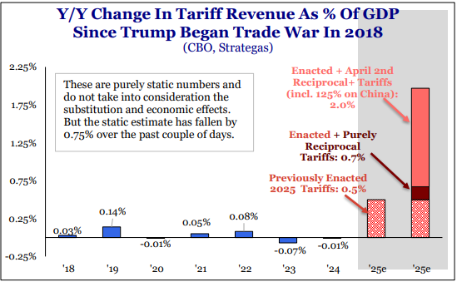
Tariffs in Perspective
Source: Strategas Research Partners

Slide 3
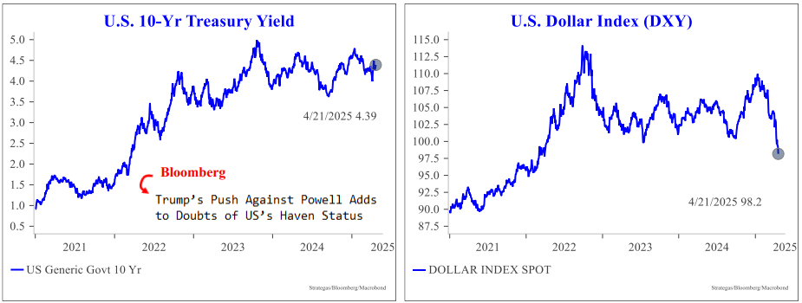
Treasuries and the Dollar
Source: Strategas Research Partners

Slide 4
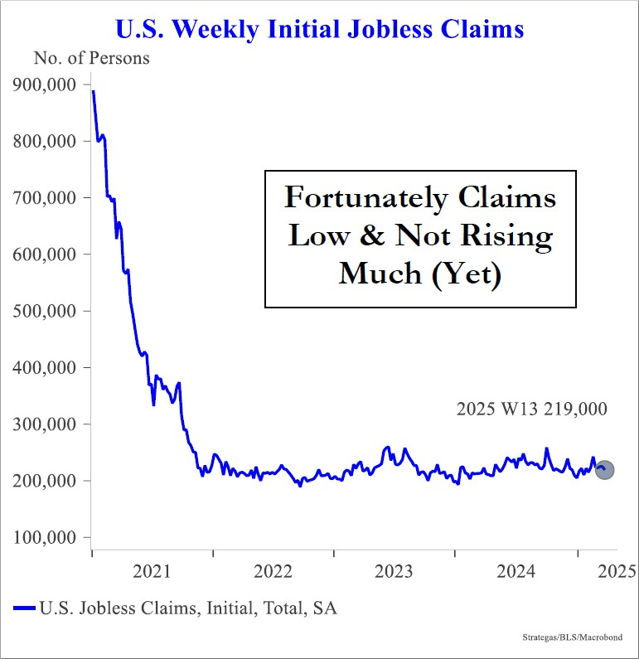
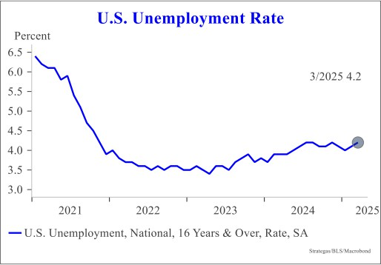
How is the Job Market?
Source: Strategas Research Partners

Slide 5
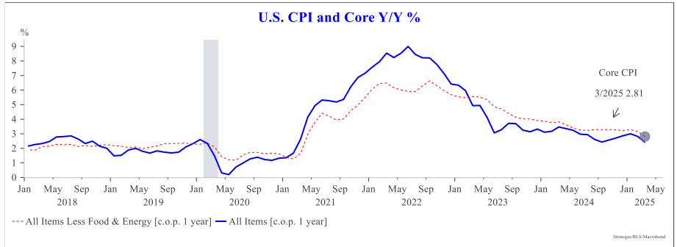
Inflation Continues to Moderate
Source: Strategas Research Partners

Slide 6
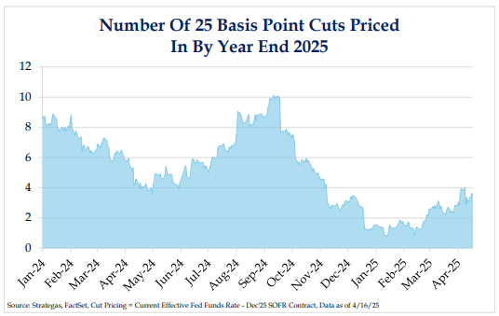
Will the Fed Cut Rates?
Source: Strategas Research Partners

Slide 7
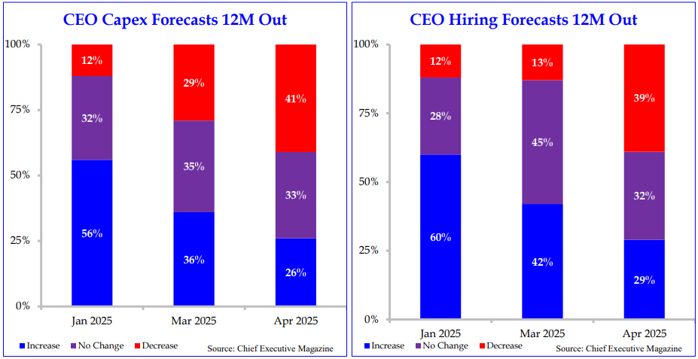
Are CEOs Tapping the Brakes?
Source: Strategas Research Partners

Slide 8
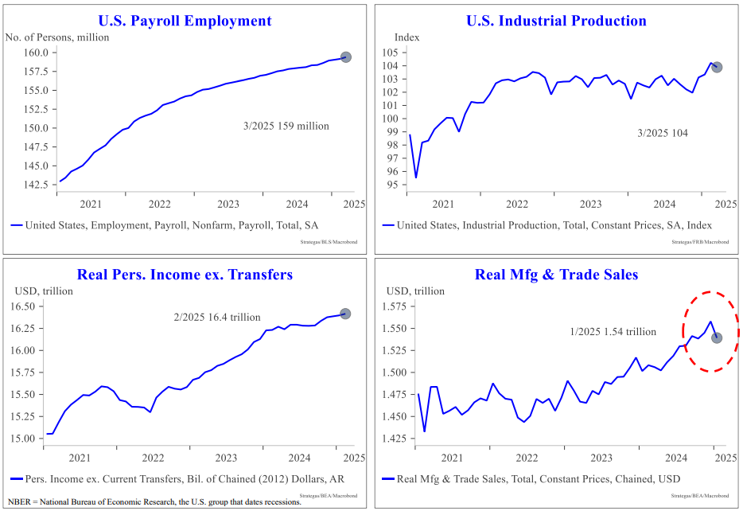
Recession Scorecard
Source: Strategas Research Partners

Slide 9
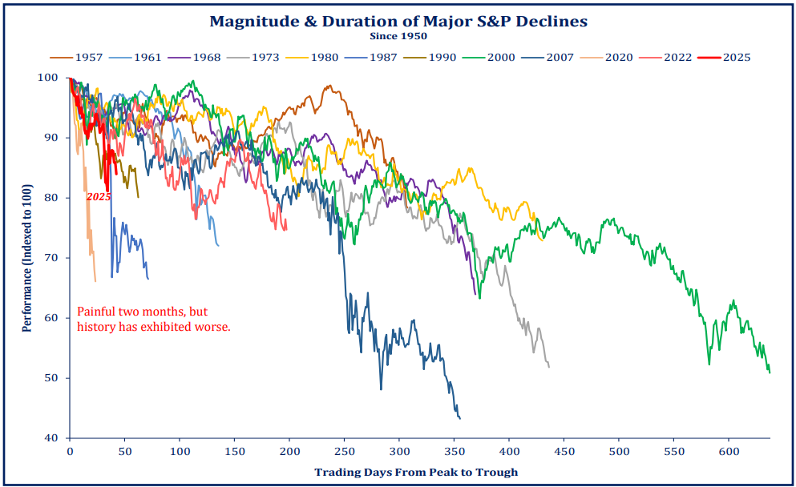
How does this Correction Compare?
Source: Strategas Research Partners

Slide 10
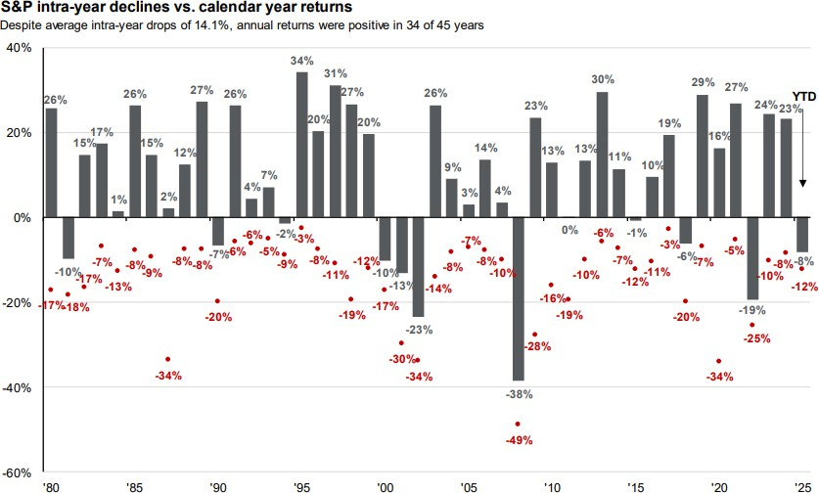
Intra-Year Declines & Calendar Year Returns
Source: J.P. Morgan Asset Management – April 3, 2025

Slide 11
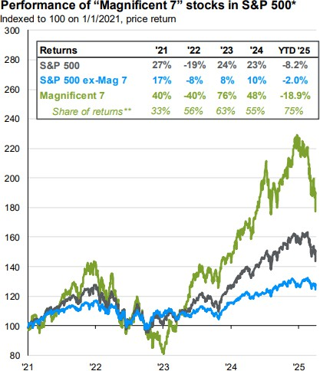
“Magnificent 7” Impact on the Market
Source: J.P. Morgan Asset Management – April 3, 2025

Slide 12
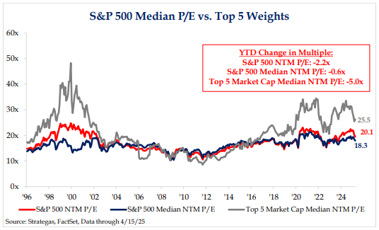
S&P 500 Valuation
Source: Strategas Research Partners

Slide 13
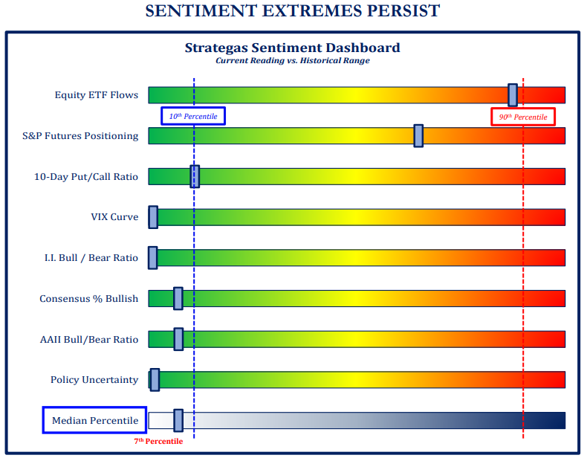

What is the Current Market Sentiment?

Slide 14
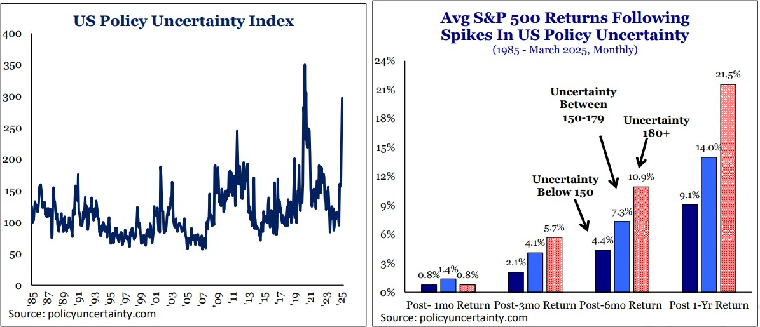
Uncertainty and Returns
Source: Strategas Research Partners

Slide 15
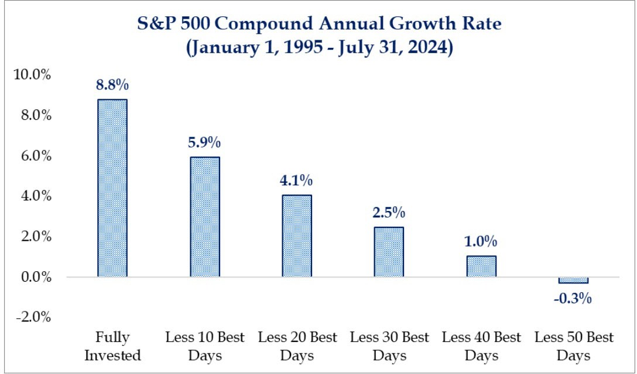
It’s More About Time in the Market than Timing the Market
Source: Strategas Research Partners

Slide 16
Trust Services Overview
Baird Trust
Source: Strategas Research Partners

Slide 17
Baird Trust – Corporate Trustee Services
  Professional trust administration and investment experience
  Objective decision-making based on the terms of the trust and applicable trust law
  Service that won’t be interrupted by disability or death, as can be the case with individual trustees
  Staff experienced in helping beneficiaries understand how their trusts affect them
  Impartiality when dealing with trust beneficiaries
While an individual trustee may be more familiar with family dynamics and the intent behind the trust, relying on a corporate trustee has significant advantages.

Slide 18
Baird Trust – Estate Settlement Capabilities
Estate Settlement is the legal process of settling the personal and financial affairs of someone who has passed away.
Collect assets held outside of Baird
Payment of bills
Secure valuables for safekeeping
Work with family on distribution and sale of personal property.
Trash and paperwork disposal
Engage attorney or CPA to prepare returns
(if applicable)
File final income tax returns
Real estate:
  Secure property (change locks if needed)
  Engage appraiser and obtain appraisal
  Sell real estate (engage realtor)
Special assets:
  Antique Car Collection
  Business interests (corporations, LLCs, partnerships)
  Farm (including livestock and crops)
  Gold Bars
  Native American Artifacts (including eagle feathers)
  Pledges
  Promissory Notes
  Publishing Contracts
  Racehorse
  Scholarly Papers
  Yacht

Slide 19
Important Disclosures
The Baird Trust Company is a Kentucky stated chartered trust company and is an affiliate of Robert W. Baird & Company.
Strategas Securities, LLC are affiliated with Baird although the firms conduct separate and distinct businesses.
Past performance is not indicative of future results and diversification does not ensure a profit or protect against loss. All investments carry some level of risk, including loss of principal. An investment cannot be made directly in an index.
Robert W. Baird & Co. Incorporated.

