Slide 1

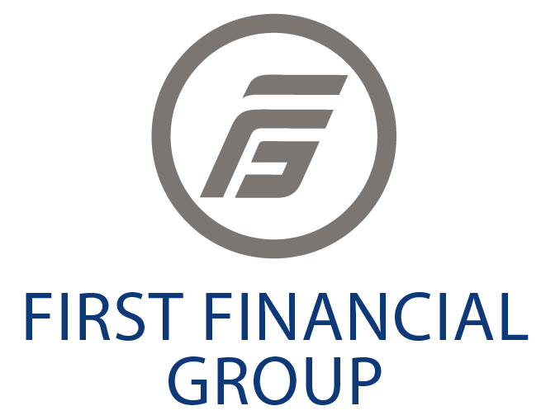
Creative Ways to Maximize Your Social Media Prospecting

Slide 2
14 LinkedIn Tips, Tricks & Hacks
Profile Photo- You have got to get this right. A few simple things: make sure you smile; it is a head shot (Not full body) and it is well lit.
LinkedIn Is Not A Resume Site Anymore- Your connections do not want to just see what you were doing 15 years ago. Focus on the relevant experience that falls within your current target audience. This boosts your credibility and authority.
Customized LinkedIn URL-(Go to Me > View Profile > Edit public profile & URL (top right corner))
Use A Dedicated Header Image- Use a nice professional or fun image. The dimensions of the image should be 1128 x 191px.Straight away your profile will start to pop!
Optimize Your Tagline- Most people just put their job title in this section. E.g., Financial Advisor. This is the most important part of your whole profile. Because when you send a connection request, a message or comment on a post, it is visible. E.g. I help Doctors in Virginia to take control of their retirement using holistic Financial Planning.
Use Grapevine and FMG Suite to Publish Articles On LinkedIn
Use A Professional Email Address
Tag Yourself- It is a great way of making it easy for viewers of your post to see your profile and connect/follow you. (To tag simply use @ and your profile name)
Hashtags- Pick 3-4 relevant keywords each time you post or publish an article or video. This will list your content into certain categories which LinkedIn can push to specific groups of people. Hopefully, people within your target audience E.g., #FinancialAdvisors #FinancialPlanners #WealthManagers.
Set Up Your ‘Featured’ Section- Profile visitors have short attention spans (2-6 seconds on average). Make it easy for them by highlighting recent articles, posts or videos in the featured section. They stand out nicely on your profile
Position Yourself As An Expert- Make your profile all about your audience. Key: Add value, build relationships.
Be Social- LinkedIn is a great for building warm relationships and learning more about the problems and challenges of your audience. Comment or like at least 5 posts per day.
Respond To People- If you get a comment or tagged in a post, respond to it. Be part of the conversation. This way, you build up a reputation for credibility and authority within your niche. (As well as being known as a friendly and social individual.) This action also helps boost your profile and name in the newsfeed.
Have FUN!

Slide 3
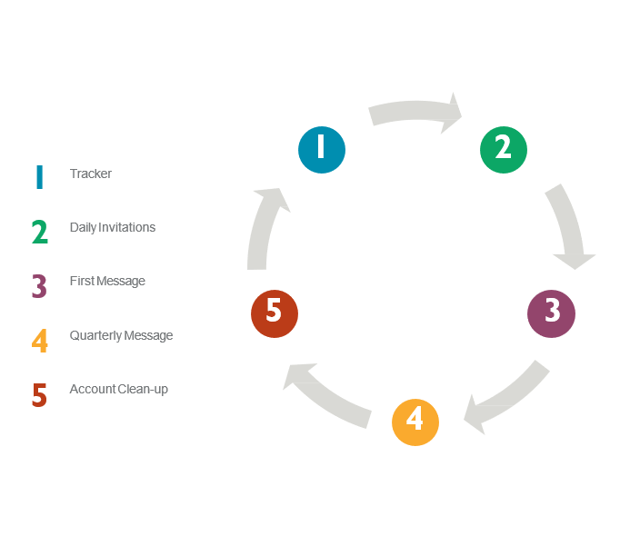
LinkedIn Prospecting-25x4 Strategy
OVERVIEW
Create a systematic process that allows you to connect with prospects you’re interested in working with.
Multiple touch points that will warm up your connections on LinkedIn.
Research has shown that it takes at least 7 contacts before a cold source prospect responds to you
The timing and message matters!

Slide 4

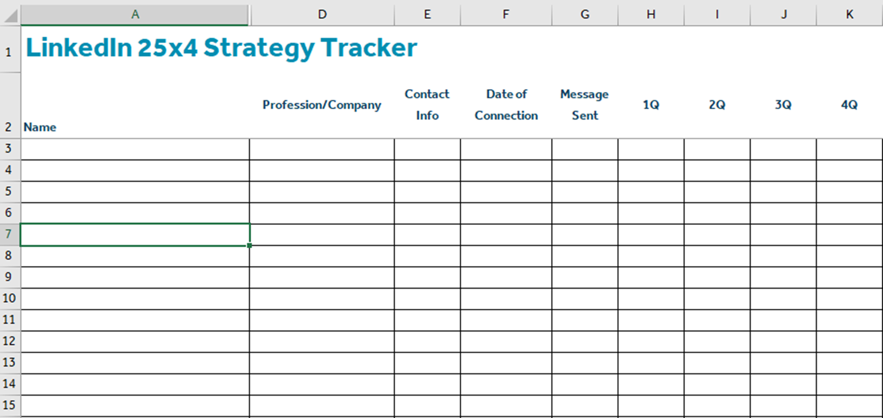
Step 1: Create a tracker
This will allow you to keep score and stay organized.
Click Here to Download a 25x4 Strategy Tracker

Slide 5

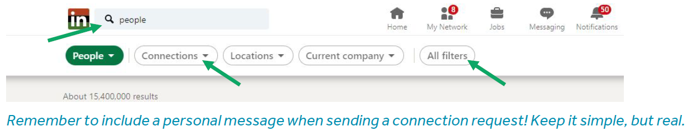
Step 2: Sending Connections
Using the LinkedIn app on your “phone,” invite 25 people to connect daily, 4 times per week.
First Way
Second Way
Press “Search” bar
Select “People”
Select “Connections,” 2nd
Select “Locations”
Select “Current Companies”
Scroll through the list of profiles and press “People” icon to the right to send an invite
Type the search criteria in the “Search” bar, for example, job title, name of school, company, etc.
Select “People”
Select “Connections,” 2nd AND 3rd
Select “Locations”
Select “All Filters” Scroll through the list of profiles and Press “People” icon to the right to send an invite

Slide 6

Find Ideal Connections- Who to Invite?
It’s easy to strike up a conversation with an ideal prospect based on commonalities. Attendance at the same educational institution, service in the same branch of the military, prior employers, location of upbringing, a common culture, language, or interests, are all easy conversation starters. LinkedIn’s advanced search capabilities enable us to quickly identify hundreds or thousands ideal prospects with whom we have several meaningful experiences in common.
Connection Level- For the purpose of identifying ideal prospects, searching for 2nd level connections is most effective. Whenever feasible, filter for individuals who are connected to at least one of your 1st level connections.
School- Many institutions of higher or otherwise specialized education deliberately encourage the maintenance (or formation) of strong mutually supportive bonds among their alumni. Financial advisors always benefit from making sure appropriate alumni of their own educational institution(s) connect with them.
Title- Searching for business owners, CEOs, CFOs, presidents, and vice presidents typically identifies hundreds or thousands of ideal prospects in one or more states in which you are licensed. Other effective filters can be built based on professional titles, such as architects, dentists, designers, engineers, lawyers, etc.
Industry- An industry that facilitates business ownership are ideal. Car dealers, construction companies, franchise owners, law firms, manufacturers, health care, real estate, and the hospitality industry are high value targets.
Current or Past Company- If you are a career changer, pursing prospects in your prior industry will produce impressive results. Even if you are not a career changer, target industries that facilitate the formation of small and medium sized businesses.

Slide 7
Find Ideal Connections- Who to Invite?
Connections Of (COIs)- You can build filters to identify appropriate individuals from among your existing connections. Let’s say you are connected with an influencer at a company, association, or industry. Look at their connections. Which subset of those would likely benefit from getting to know you? Existing connections help in another way. If you reach out to a prospect who is already connected to you, your prospect might reach out to your existing connection to inquire about you and what you do. Asking for and receiving introductions is one of the most effective ways to grow your business. Click here to watch an informative video that will teach you how to search for targeted prospects to build introduction lists.
Profile Language- If you speak a foreign language, you can differentiate yourself by reaching out to prospects in their native language.
Non-Profit Interests- LinkedIn allows you to filter for individuals who provide skilled volunteer services or agree to serve on corporate boards.
Schools- You can specify additional schools of interest. For example, if you went to two rival schools, you could filter for others with the same experiences, and maybe capture the attention of others who attended both schools, perhaps before a big rivalry sporting event.
Location- While it is relatively easy to get non-residence licenses in states in which you are not currently licensed, build your initial filters based on the states in which you are already authorized to do business.

Slide 8
Find Ideal Connections- Who to Invite?
Immerse Yourself in an Industry or Profession to Attract Prospects
An ideal industry or profession is one that facilitates the ownership of numerous closely held small and medium sized businesses. Consider the following trades to target:
Attorneys (law firms are ideal… think of partners as owners)
Auto dealers, repair shops, maintenance (e.g. Jiffy Lube franchise owners)
Building owners – commercial, strip malls, office buildings
Chiropractors
Construction companies
Contractors
Dentists
Hotel/motel owners
Manufacturers
Nurses - many are independent contractors
Optometrists
Orthodontists
Ophthalmologists
Physical therapists
Physicians (independents and various specialties who typically own specialist clinics)
Real estate agents (most are 1099)
Residents (recent medical graduates learning a specialty in a hospital setting)
Restaurant owners / high end boutiques to small, regional chains, fast food franchise owners
Retail store owners (those who own multiple stores and have a management team)
Veterinarians

Slide 9

Step 3: First Message
You will receive an email notifying they’ve accepted the invitation
Tips for writing messages that get responses
Update your tracker
Search for NEW connections name and click message
Keep message short, simple, and personalized
Write like you speak and avoid corporate jargon and cliches
You’re not trying to make an immediate sale; you’re trying to start a conversation
Read their profile first & find a way to customize your message specifically to recipient, and wherever possible, show them you've done your homework
Have your message typed out on a word document so you can copy and paste
The highest response rates result from messages delivered mid-morning on Tuesdays, Wednesdays, and Thursdays. The lowest response rates come from messages sent on Sundays.
Subject lines are the first impression and needs to be engaging
Example – Hello from a fellow (university) alumni
Promote your company LI page –people who follow your company are 81% more likely to respond
Write two messages using slightly different wording. Send each to prospects and measure the results. After a few days, you’ll likely notice a higher response rate to one of your messages. Select that as your primary message going forward.

Slide 10
LinkedIn Message Best Practices The GOAL of a message = Start a Conversation
For those who you choose to send a message to, consider the following best practices:
View their profile: Look for commonalities or topics to make e-small talk about. Read their summary, view their recent activity (what posts they have liked or shared), look at their experiences and education, mutual connections, etc.
Hi, Sally! A quick note to say that I loved the article you shared about first time home buying tips. Let’s grab coffee soon to catch up! How does Tuesday morning work for you?
Be authentic: write your message as if you were leaving that person a voice message.
​What’s your goal? For someone you don’t know well, your goal in sending them a message could be to get 15 minutes on the phone with them to mutually decide if it makes sense to potentially work together. For someone you know well, your goal could be to grab coffee and catch up. You decide!
Be specific: When you want to schedule time with someone, for a call or an in-person meeting, it’s a best practice to prompt your reader with a specific day/time. When you use vague phrases such as “at your earliest convenience,” or “whenever works best for you,” you’re giving them an easy way out of meeting with you.
Hey Joe, I see that you recently left Keller Williams and joined Sotheby’s – congrats!! I’d love to hear about the change and to catch up with you. Would you want to grab coffee soon? How does Thursday or Friday morning work for you? Looking forward to it, John
Provide them with valuable information:
Hi Kevin, I hope all is well. As a business owner, I thought you might find this article interesting. Let’s find 15 minutes at the end of the week to talk about how I could help improve your business planning. How does Friday at 3 work?
Follow-up: It’s common for messages to get overlooked; we all do it. That’s why it’s crucial to follow-up. Suggested: One week after you sent the initial message, send a follow-up message.
“Hey Joe, I hope you had a great weekend. I just wanted to make sure you saw my previous message. Looking forward to talking soon, John”

Slide 11
Targeted LinkedIn Message Examples
If Dentists were your target market, you'd develop custom messages to capture their immediate attention. You’d adjust your message based on the most common and relevant topics that likely preoccupy your targeted group of dentists. Let’s look at several possibilities.
Messaging Brand New Dentists- Dr. {Last Name}:I advise dentists fresh out of dental school on important financial strategies, including minimizing the cost of student loans, planning for their first independent practice, and a variety of tax-efficient risk mitigation strategies. Interested in learning more?
Messaging Growth-Oriented Dentists- I collaborate with growth-oriented dentists who wish to expand their practice by hiring associate dental practitioners. It’s a tight labor market! I offer a unique tax-efficient program that attracts, retains, and rewards associate dentists who commit to working with you for at least 10 years.
Messaging Dentists Approaching Retirement- I collaborate with dentists to maximize the value of their practice during their working years. When they are ready to retire, I assist them in transferring their practice to a successor. We convert the value of their practice into a secure, tax-efficient, lifetime retirement income stream.

Slide 12
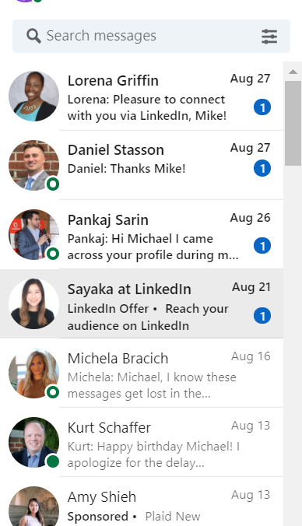
Step 4: Quarterly Message Send messages to your connections once per quarter, this will help you stay in front of them.
Reminder - update your tracker
Do NOT be concerned w/ their previous responses or lack of responses – All about timing!
Impromptu messages should be sent when situations arise (i.e., A job change or promotion, birth of a child etc.)

Slide 13
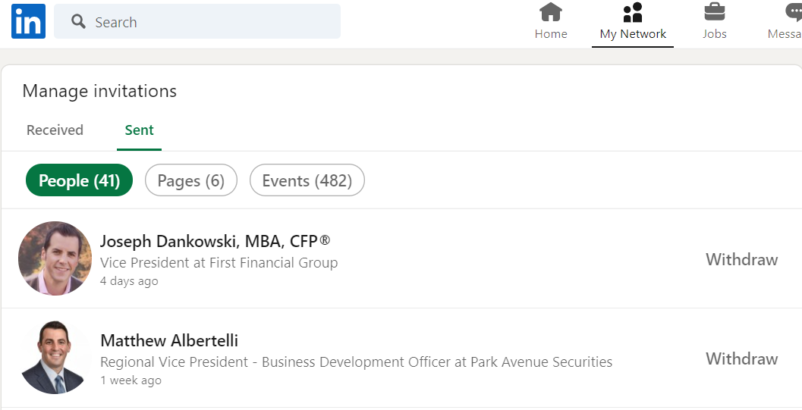
Step 5: Clean-up
LinkedIn will block your account if you have too many unaccepted invitations
Use the app on your Phone to delete all the invitations that are 3 months old:
Go to “My Network”
Click “Invitations”
Click “Sent”
Click “Withdraw”

Slide 14
Conclusion and Contact
For any follow up Inquiries please contact:
Useful Links:
Marketing Toolkit
Optimize the Power of LinkedIn
Immerse Yourself in an Industry or Profession to Attract Prospects
3 ways to master LinkedIn for prospecting
Top 5 Mistakes Financial Advisors Make On LinkedIn
Guardian’s Guide to LinkedIn
Your Guide to Grapevine6
20 LinkedIn Tips & Tricks For Financial Advisors
Drive Prospecting Activity with Your Free LinkedIn Account Video
LinkedIn - Building Introduction Lists Video
Schedule a Call with Guardian’s Social Media Team
Michael Dempsey
Marketing Coordinator
P 240.235.1333
michael.dempsey@ffgadvisors.com
Book a Meeting with Mike!

