Slide 1




Welcome to Boardwalk!
Ralph W. Sevelius, Jr., MBA, CFP®
Founder and Senior Wealth Advisor
Securities offered through LPL Financial, Member FINRA/SIPC. Investment advice offered through IHT Wealth Management, a registered investment advisor. IHT Wealth Management and Boardwalk Wealth Solutions are separate entities from LPL Financial.

Slide 2
Agenda
Introduction to Boardwalk Wealth Solutions
About the Wines
Estate Planning: Why does it matter?
Who should have an Estate Plan?
How do I get it done?
Estate Planning Attorney
Estate Guru
Conclusion
Securities offered through LPL Financial, Member FINRA/SIPC. Investment advice offered through IHT Wealth Management, a registered investment advisor. IHT Wealth Management and Boardwalk Wealth Solutions are separate entities from LPL Financial.

Slide 3
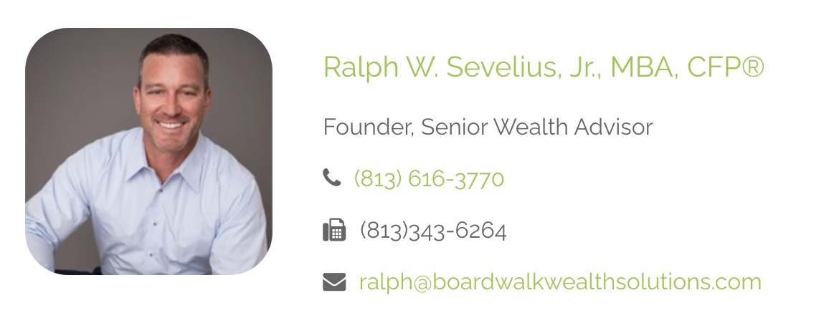
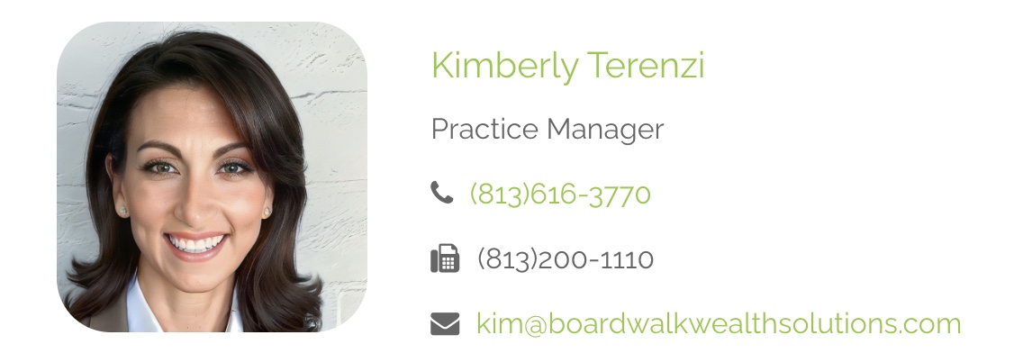
Meet the Team
Securities offered through LPL Financial, Member FINRA/SIPC. Investment advice offered through IHT Wealth Management, a registered investment advisor. IHT Wealth Management and Boardwalk Wealth Solutions are separate entities from LPL Financial.

Slide 4
Ralph W. Sevelius, Jr., MBA, CFP®
BA (Economics) - Wake Forest University – 1998
U.S. Army Officer – 1998-2002
MBA (Business) – University of Florida – 2005
Certified Financial Planner (CFP®) – 2012
17 years experience serving clients as their trusted Advisor
Community Involvement
Rotary Club of Tampa Foundation - Trustee
Academy at the Lakes – Trustee
Jackson in Action 83 Foundation - Trustee
Securities offered through LPL Financial, Member FINRA/SIPC. Investment advice offered through IHT Wealth Management, a registered investment advisor. IHT Wealth Management and Boardwalk Wealth Solutions are separate entities from LPL Financial.

Slide 5
Kimberly Terenzi
BS (Elementary Education) – University of South Florida
14 years service to our community as a Teacher
Practice Manager
Orchestrates and optimizes the various facets of operations
Guides a seamless onboarding process and ongoing communication
Primary point of contact on a daily basis for all of your immediate needs
Securities offered through LPL Financial, Member FINRA/SIPC. Investment advice offered through IHT Wealth Management, a registered investment advisor. IHT Wealth Management and Boardwalk Wealth Solutions are separate entities from LPL Financial.

Slide 6
How We Serve Our Clients
Personalized Financial Planning
Regular Updates, Reviews and Events
Transparent Communication
Access to the best Managers, Products and Services
Cutting-edge Financial Tools
Securities offered through LPL Financial, Member FINRA/SIPC. Investment advice offered through IHT Wealth Management, a registered investment advisor. IHT Wealth Management and Boardwalk Wealth Solutions are separate entities from LPL Financial.
Notes:
1. Personalized Financial Planning: We will work closely with you to create a comprehensive financial plan that addresses your short and long-term goals, to include an emphasis on both Estate and Tax Planning.
2. Regular Updates and Reviews: Your financial situation may evolve, and we are committed to regularly reviewing your plan to ensure it stays in line with your changing needs.
3. Transparent Communication: We believe in open and honest communication. Our team is always available to address your questions, concerns, and provide clarity on your financial matters.
4. Access to the best portfolio management, products, and services: We partner with top tier portfolio managers with proven track records, and stay up-to-date with all of the latest and best investment products and services available.
5. Cutting-edge Financial Tools: We leverage the latest technology to provide you with powerful financial tools that enhance your decision-making process.

Slide 7
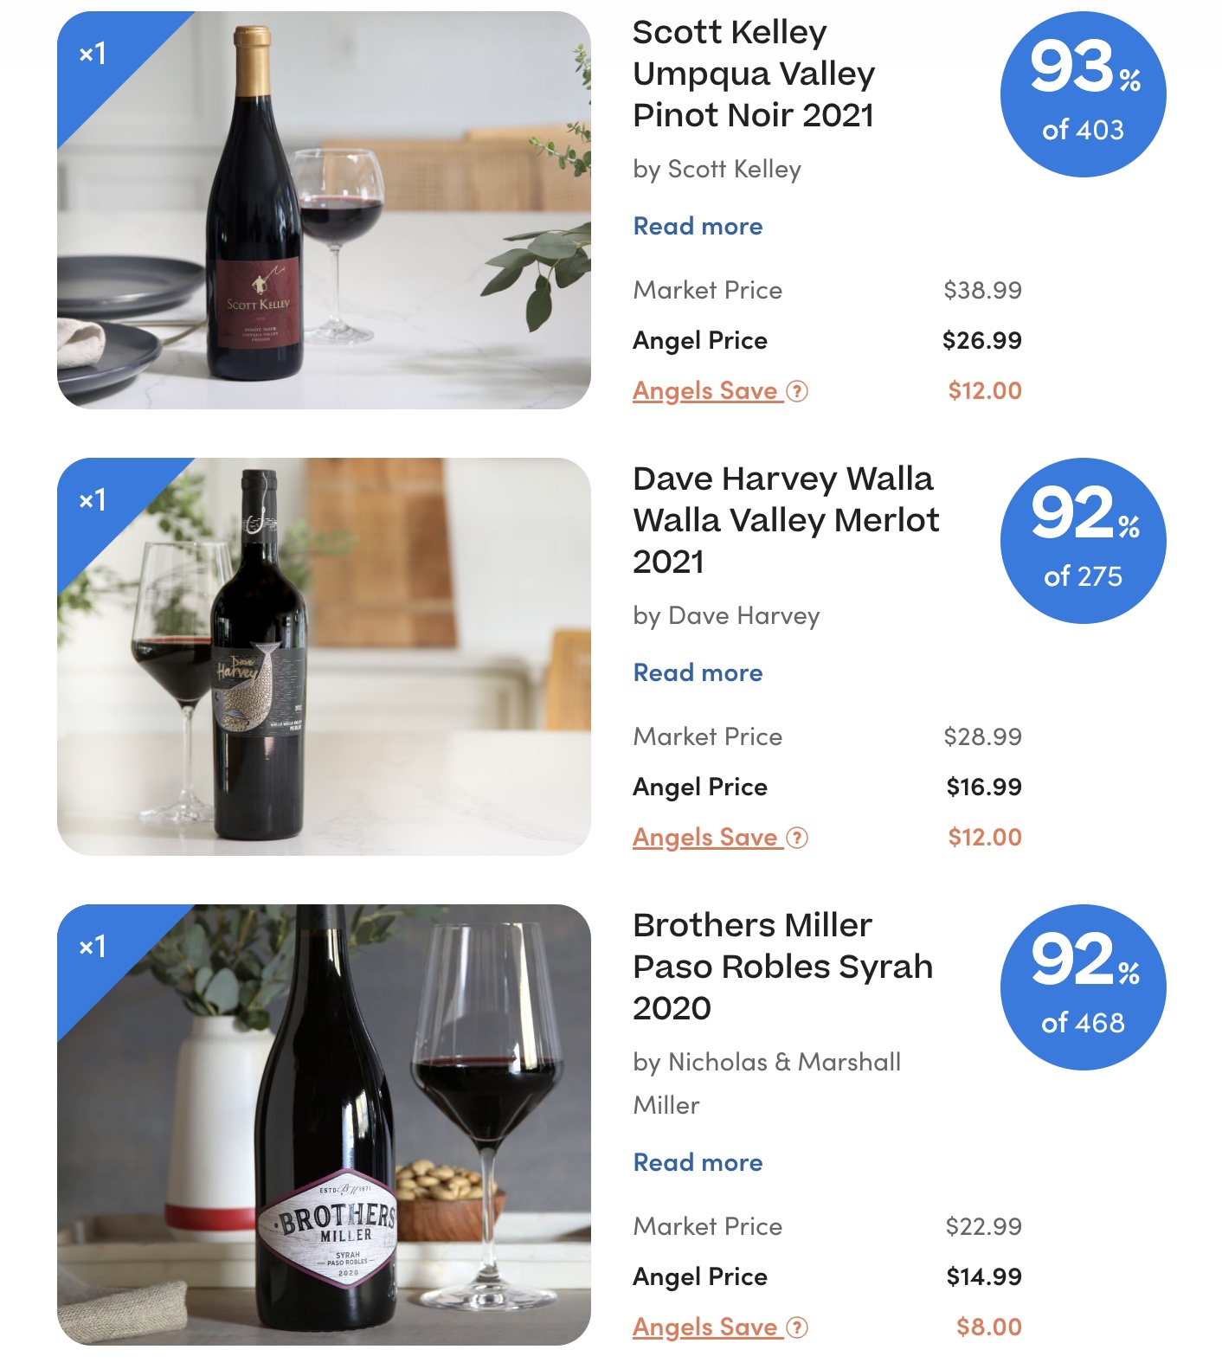
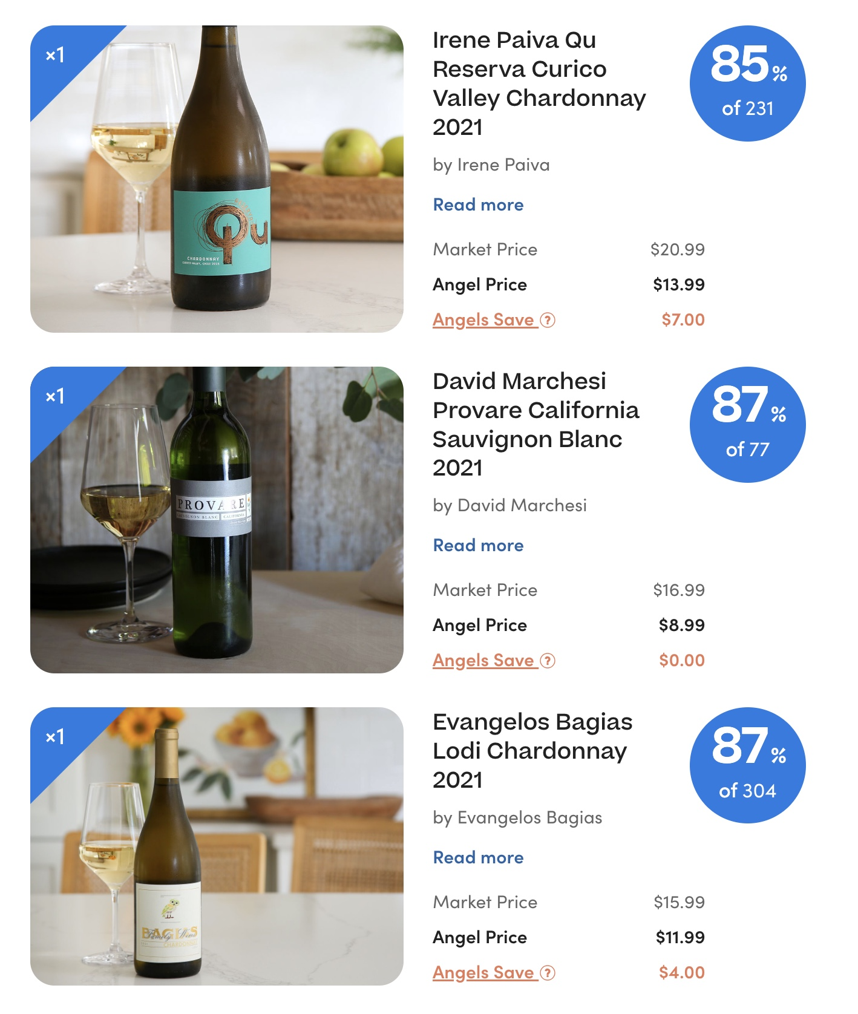
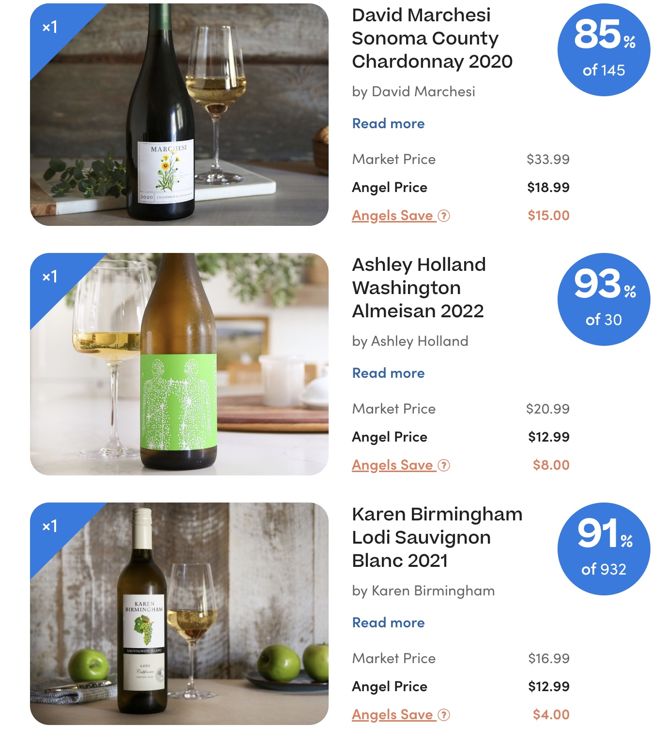
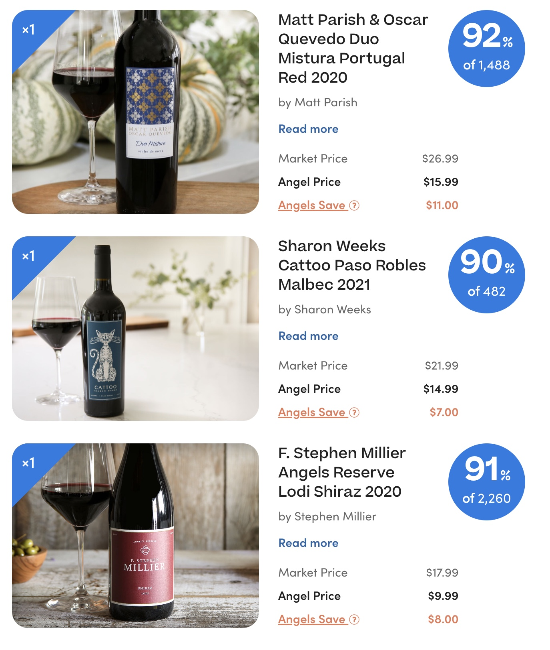
About the Wines
Securities offered through LPL Financial, Member FINRA/SIPC. Investment advice offered through IHT Wealth Management, a registered investment advisor. IHT Wealth Management and Boardwalk Wealth Solutions are separate entities from LPL Financial.

Slide 8
Estate Planning: Why Does It Matter?
Ensures your wishes are executed
Ensures loved ones are cared for
Ensures you are cared for
Ensures your finances and assets are cared for
Securities offered through LPL Financial, Member FINRA/SIPC. Investment advice offered through IHT Wealth Management, a registered investment advisor. IHT Wealth Management and Boardwalk Wealth Solutions are separate entities from LPL Financial.

Slide 9
Who should have an Estate Plan?
EVERYONE!!!
Securities offered through LPL Financial, Member FINRA/SIPC. Investment advice offered through IHT Wealth Management, a registered investment advisor. IHT Wealth Management and Boardwalk Wealth Solutions are separate entities from LPL Financial.

Slide 10
How do I get it done?
Estate Planning Attorney
Suitable for more complex Estate Plans
More costly, but necessary in complex situations
Estate Guru
Suitable for relatively simple situations
Cost-effective and Efficient
Securities offered through LPL Financial, Member FINRA/SIPC. Investment advice offered through IHT Wealth Management, a registered investment advisor. IHT Wealth Management and Boardwalk Wealth Solutions are separate entities from LPL Financial.

Slide 11
Estate Guru
https://www.estateguru.com/product
Securities offered through LPL Financial, Member FINRA/SIPC. Investment advice offered through IHT Wealth Management, a registered investment advisor. IHT Wealth Management and Boardwalk Wealth Solutions are separate entities from LPL Financial.

Slide 12
Questions?
Securities offered through LPL Financial, Member FINRA/SIPC. Investment advice offered through IHT Wealth Management, a registered investment advisor. IHT Wealth Management and Boardwalk Wealth Solutions are separate entities from LPL Financial.

