Slide 1
The
Road ahead
Navigating Inflation, Rising Rates, and Volatility
This presentation was prepared by First Trust Portfolios L.P. and reflects the current opinion of the authors. Opinions and forward-looking statements expressed are subject to change without notice. This information does not constitute a solicitation or an offer to buy or sell any security. Past performance is no guarantee of future results.
Not FDIC Insured | Not Bank Guaranteed | May Lose Value

Slide 2
INFLATION

Slide 3
M2 money SUPPLY YoY GROWTH IS A LEADING INDICATOR OF INFLATION
MONEY SUPPLY VS. INFLATION
Source: Bloomberg. Data from 1/31/59 – 6/30/2023 (latest data available). M2 Money Supply YoY Change tracks the year-over-year (YoY) change in the Federal Reserve United States Money Supply Index. M2 Money Supply is defined as all cash, checking deposits, savings deposits, money market securities, mutual funds and other time deposits. CPI 2-Yr Forward is the year-over-year change in the Consumer Price Index (CPI) 2 years after the date on the graph.
The information presented is not intended to constitute an investment recommendation for, or advice to, any specific person. By providing this information, First Trust is not undertaking to give advice in any fiduciary capacity within the meaning of ERISA, the Internal Revenue Code or any other regulatory framework. Financial professionals are responsible for evaluating investment risks independently and for exercising independent judgment in determining whether investments are appropriate for their clients.

Slide 4
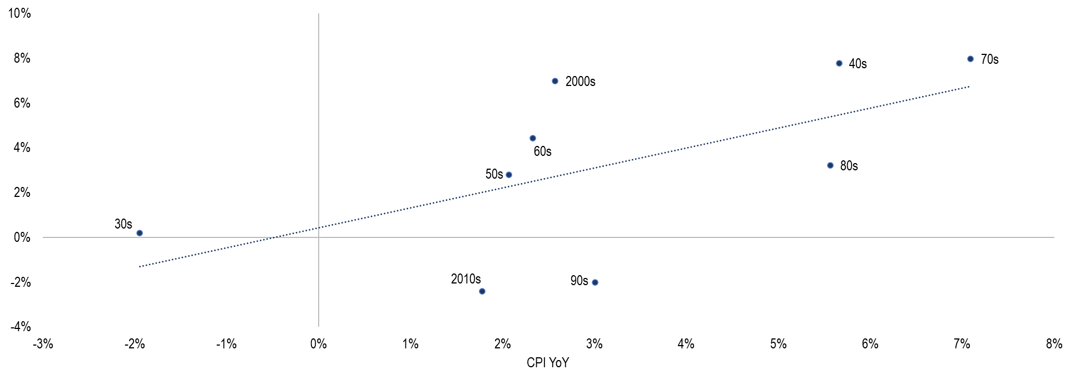
Value tends to outperform the market during Decades with higher cpi
ANNUALIZED VALUE RETURNS RELATIVE TO S&P 500 BY DECADE
Sources: Ken French Data Library, Bloomberg. As of 12/31/19. Past performance is no guarantee of future results. This example is for illustrative purposes and does not represent any actual investment. Value stocks include U.S. stocks in the lowest three deciles of Price to Book ratio in the Fama-French model universe. Value returns are equally-weighted. The S&P 500 Index is an unmanaged index of 500 companies used to measure large-cap U.S. stock market performance. The Consumer Price Index (CPI) is a measure that examines the weighted average of prices of a basket of consumer goods and services, such as transportation, food, and medical care. Investors cannot invest directly in an index.
The information presented is not intended to constitute an investment recommendation for, or advice to, any specific person. By providing this information, First Trust is not undertaking to give advice in any fiduciary capacity within the meaning of ERISA, the Internal Revenue Code or any other regulatory framework. Financial professionals are responsible for evaluating investment risks independently and for exercising independent judgment in determining whether investments are appropriate for their clients.

Slide 5
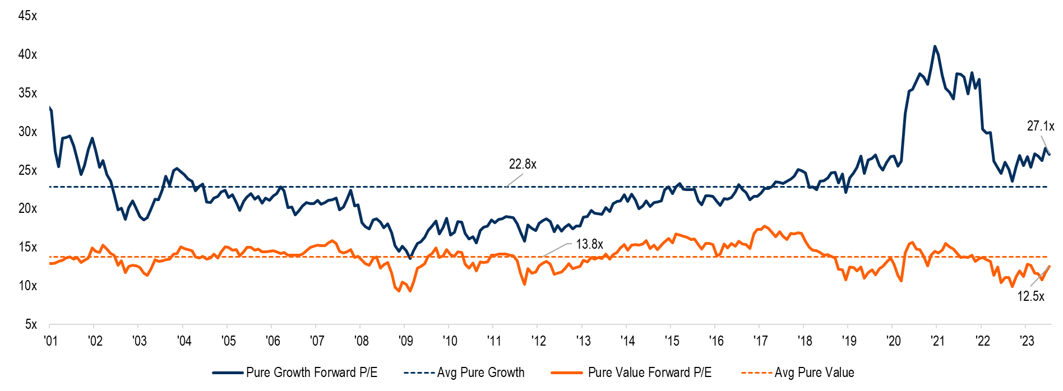
Value is extremely cheap relative to Historical average and growth
PURE GROWTH VS. PURE VALUE FORWARD P/E RATIOS
Source: Capital IQ. Monthly data is calculated from 12/29/2000-7/31/2023. Universe: largest 1,000 U.S. firms with $1 million in average daily volume over the last 3 months and 12 months of trading history. The median monthly forward price-to-earnings (P/E) ratio is used for the pure growth and pure value baskets. Only firms with positive earnings are used. Pure growth names are the 30% of names with the highest price-to-book versus the pure value basket of the 30% of names with the lowest price-to-book. For illustrative purposes only and not indicative of any investment.
The information presented is not intended to constitute an investment recommendation for, or advice to, any specific person. By providing this information, First Trust is not undertaking to give advice in any fiduciary capacity within the meaning of ERISA, the Internal Revenue Code or any other regulatory framework. Financial professionals are responsible for evaluating investment risks independently and for exercising independent judgment in determining whether investments are appropriate for their clients.

Slide 6
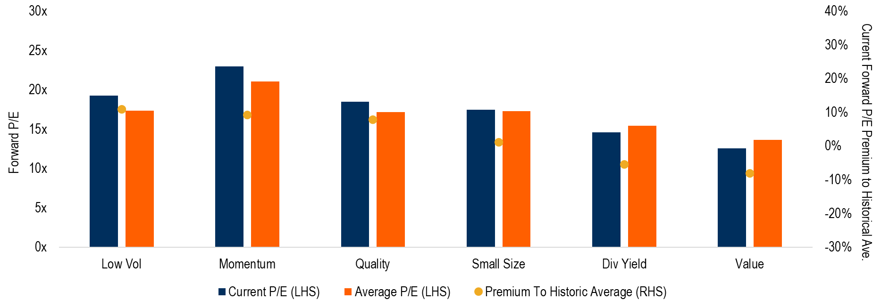
Factor valuations forward p/e ratio
factor valuations vs. history
Source: Bloomberg & Capital IQ. Monthly data is calculated from 12/31/1999 to 7/31/2023. For illustrative purposes and does not represent any actual investment. The median monthly forward price-to-earnings (P/E) ratio is used for each factor. Each factor is comprised of the top 30% of stocks from a universe of the largest 1,000 U.S. stocks with at least $1 million dollars in average daily volume over the last 3 months and 12 months of trading history. Value: Lowest price-to-book. Momentum: Highest 12-month price change. Quality: Highest return-on-equity. Size: Lowest market capitalization. Low Volatility: Lowest 1-year price variability. Dividend Yield: Highest dividend yield.
The information presented is not intended to constitute an investment recommendation for, or advice to, any specific person. By providing this information, First Trust is not undertaking to give advice in any fiduciary capacity within the meaning of ERISA, the Internal Revenue Code or any other regulatory framework. Financial professionals are responsible for evaluating investment risks independently and for exercising independent judgment in determining whether investments are appropriate for their clients.

Slide 7
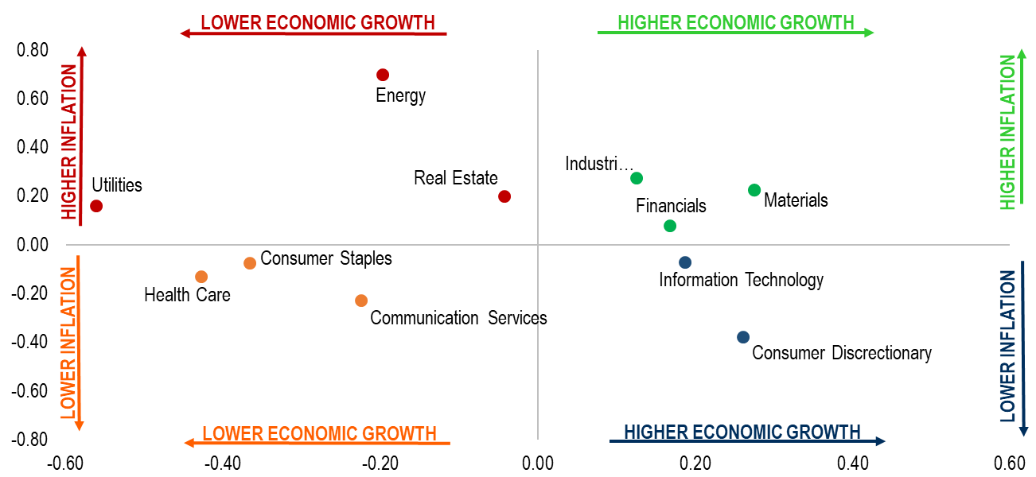
Sector correlation to Inflation & economic activity
Historical Correlation to economic growth & inflation by gics sector
Rising inflation / Rising growth
Rising inflation / falling growth
falling inflation / rising growth
Falling inflation / falling growth
Correlation of SECTOR to Ppi
Correlation of SECTOR to PMI
Source: Bloomberg. Data range 12/31/1991 to 6/30/2023 (latest data available). Past performance is no guarantee of future results. For illustrative purposes only and not indicative of any investment. The x axis is the correlation of the year-over-year return of the S&P 500 Sector Index minus the S&P 500 Index vs. the year-over year change in ISM Manufacturing PMI Index. The S&P 500 Sector Indexes represent U.S. large-cap stocks in each of the 11 sectors. They y axis is the correlation of the year-over-year return of the S&P 500 Sector Index minus the S&P 500 Index vs. the U.S. Producer Prices Index. The S&P 500 Index is an unmanaged index of 500 companies used to measure large-cap U.S. stock market performance. The ISM Manufacturing PMI Index is a survey of supply management professionals issued by the Institute for Supply Management. The US Producer Prices Index measures the change in the price of goods as they leave their place of production and is calculated by the Bureau of Labor Statistics. Indexes are unmanaged and an investor cannot invest directly in an index.
The information presented is not intended to constitute an investment recommendation for, or advice to, any specific person. By providing this information, First Trust is not undertaking to give advice in any fiduciary capacity within the meaning of ERISA, the Internal Revenue Code or any other regulatory framework. Financial professionals are responsible for evaluating investment risks independently and for exercising independent judgment in determining whether investments are appropriate for their clients.

Slide 8
Equity and fixed income returns in years with high inflation
Average real returns during years when inflation is greater than the median: 1927-2022
Sources: Ken French Data Library, Bloomberg. As of 12/31/22. Past performance is no guarantee of future results. This example is for illustrative purposes and does not represent any actual investment. Returns are average annual total real returns during years when inflation was higher than 2.6% at year-end. Returns are based on results from Kenneth R. French data library using the CRSP database. Universe includes all NYSE, AMEX & Nasdaq stocks. Value represents the lowest 30% of price-to-book (value stocks). Growth represents the highest 30% of price-to-book (Growth stocks). Small cap stocks are the smallest 30% of stocks while large cap stocks are the largest 30% of stocks in the universe, respectively. Industries represent the Standard Industrial Classification (SIC) industries for each company.
The information presented is not intended to constitute an investment recommendation for, or advice to, any specific person. By providing this information, First Trust is not undertaking to give advice in any fiduciary capacity within the meaning of ERISA, the Internal Revenue Code or any other regulatory framework. Financial professionals are responsible for evaluating investment risks independently and for exercising independent judgment in determining whether investments are appropriate for their clients.

Slide 9
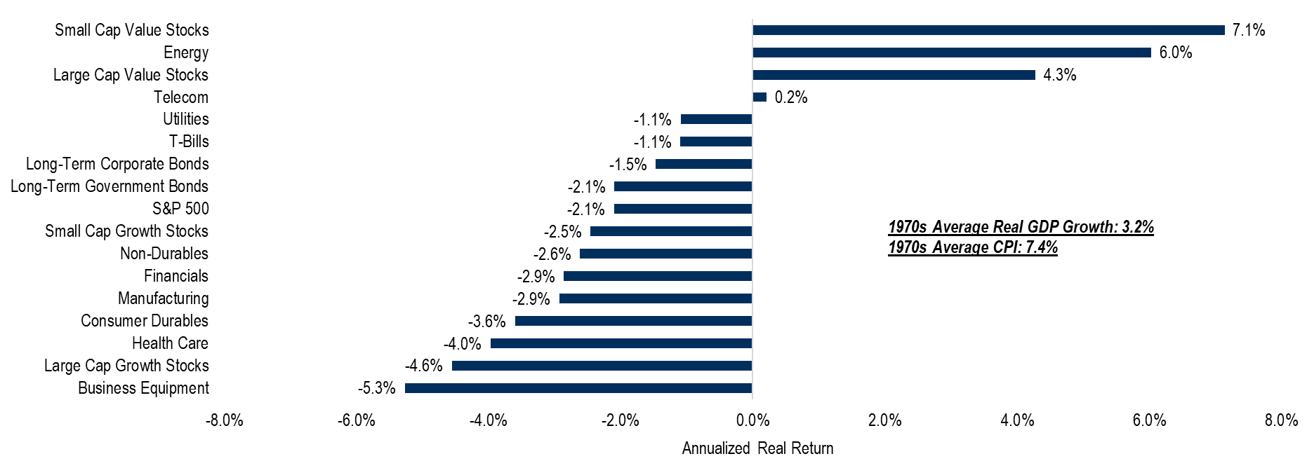
Equity and fixed income real returns during the 1970s
Asset class returns during the stagflation of the 1970s
Sources: Ken French Data Library, Bloomberg. Data from 1/1/1970-12/31/79. Past performance is no guarantee of future results. This example is for illustrative purposes and does not represent any actual investment. Returns are annualized total real returns during. Returns are based on results from Kenneth R. French data library using the CRSP database. Universe includes all NYSE, AMEX & Nasdaq stocks. Value represents the lowest 30% of price-to-book (value stocks). Growth represents the highest 30% of price-to-book (Growth stocks). Small cap stocks are the smallest 30% of stocks while large cap stocks are the largest 30% of stocks in the universe, respectively. Industries represent the Standard Industrial Classification (SIC) industries for each company.
The information presented is not intended to constitute an investment recommendation for, or advice to, any specific person. By providing this information, First Trust is not undertaking to give advice in any fiduciary capacity within the meaning of ERISA, the Internal Revenue Code or any other regulatory framework. Financial professionals are responsible for evaluating investment risks independently and for exercising independent judgment in determining whether investments are appropriate for their clients.

Slide 10
rising rates

Slide 11
INFLATION IS FIRMLY AHEAD OF INTEREST RATES
US 10-YEAR TREASURY YIELD VS YoY CPI
Source: Bloomberg. Data from 1/31/1962. 10-Year Yield is through 7/31/2023 and CPI is through 6/30/2023 (latest data available). This example is for illustrative purposes and does not represent any actual investment. Past performance is no guarantee of future results. US 10-Year Treasury yield is the yield-to-maturity on a 10-Year US Generic Government Bond. CPI measures the year-over-year (YoY) change in the Consumer Price Index which represents inflation in the US.
The information presented is not intended to constitute an investment recommendation for, or advice to, any specific person. By providing this information, First Trust is not undertaking to give advice in any fiduciary capacity within the meaning of ERISA, the Internal Revenue Code or any other regulatory framework. Financial professionals are responsible for evaluating investment risks independently and for exercising independent judgment in determining whether investments are appropriate for their clients.

Slide 12
Rolling correlation of bonds & equities
24-month rolling correlation of bonds & equities
Source: Bloomberg. Correlation is based on 24 month rolling correlation between monthly moves of the S&P 500 Index & the Bloomberg US Aggregate Bond Index from 9/30/1989 – 7/31/2023. The S&P 500 Index is an unmanaged index of 500 companies used to measure large-cap U.S. stock market performance. The Bloomberg US Aggregate Bond Index is a broad-based flagship benchmark that measures the investment grade, US dollar-denominated, fixed-rate taxable bond market. The index includes Treasuries, government-related and corporate securities, MBS (agency fixed-rate pass-throughs), ABS and CMBS (agency and non-agency). Past performance is no guarantee of future results. For illustrative purposes only and not indicative of any investment. Indexes are unmanaged and an investor cannot invest directly in an index.
The information presented is not intended to constitute an investment recommendation for, or advice to, any specific person. By providing this information, First Trust is not undertaking to give advice in any fiduciary capacity within the meaning of ERISA, the Internal Revenue Code or any other regulatory framework. Financial professionals are responsible for evaluating investment risks independently and for exercising independent judgment in determining whether investments are appropriate for their clients.

Slide 13
Stocks and Bonds Falling Together: What Happens Next?
In 2022, there were three consecutive quarters where both stocks and bonds were down. From 1976-Q2 2023 there were only 18 of 189 quarters in which stocks and bonds fell together. Below we take a closer look at this uncommon occurrence, how much stocks and bonds declined in those quarters and historically how they performed after.
Down Quarter | Mar 1977 | Dec 1977 | Dec 1978 | Mar 1980 | Jun 1981 | Sep 1981 | Jun 1984 | Mar 1990 | Mar 1992 | Mar 1994 | Mar 2005 | Jun 2006 | Jun 2008 | Sep 2008 | Mar 2018 | Mar 2022 | Jun 2022 | Sept 2022
Stocks | -7.45% | -0.11% | -4.93% | -4.12% | -2.30% | -10.23% | -2.57% | -3.02% | -2.53% | -3.79% | -2.15% | -1.44% | -2.73% | -8.37% | -0.76% | -4.60% | -16.10% | -4.89%
Bonds | -0.81% | -0.08% | -1.40% | -8.71% | -0.33% | -4.06% | -2.07% | -0.80% | -1.28% | -2.87% | -0.48% | -0.08% | -1.02% | -0.49% | -1.46% | -5.93% | -4.69% | -4.75%
Historical Returns For Periods After Quarters In Which Stocks And Bonds Fell Together
STOCKS
■ 6 Months Later
■ 1 Year Later
■ 3 Years Later
BONDS
■ 6 Months Later
■ 1 Year Later
■ 3 Years Later
 | Stocks (S&P 500 Index) |  |  | Bonds (Bloomberg U.S Aggregate Bond Index)
 | 6 Months Later | 1 Year Later | 3 Years Later | 6 Months Later | 1 Year Later | 3 Years Later
Average Return | +0.9% | +9.2% | +12.4% | +4.5% | +9.1% | +8.8%
Percent Positive | 67% | 71% | 93% | 78% | 88% | 93%
Source: Bloomberg. Data from 12/31/1975 – 6/30/2023. Past performance is no guarantee of future results. This chart is for illustrative purposes only and not indicative of any actual investment. The illustration excludes the effects of taxes and brokerage commissions, or other expenses incurred when investing. Stocks are represented by the S&P 500 Index, an unmanaged index of 500 companies used to measure large-cap U.S. stock market performance. Bonds are represented by the Bloomberg U.S. Aggregate Bond Index, a broad-based flagship benchmark that measures the investment grade, US dollar-denominated, fixed-rate taxable bond market. An index cannot be purchased directly by investors. The information presented is not intended to constitute an investment recommendation for, or advice to, any specific person. By providing this information, First Trust is not undertaking to give advice in any fiduciary capacity within the meaning of ERISA, the Internal Revenue Code or any other regulatory framework. Financial professionals are responsible for evaluating investment risks independently and for exercising independent judgment in determining whether investments are appropriate for their clients.
13

Slide 14
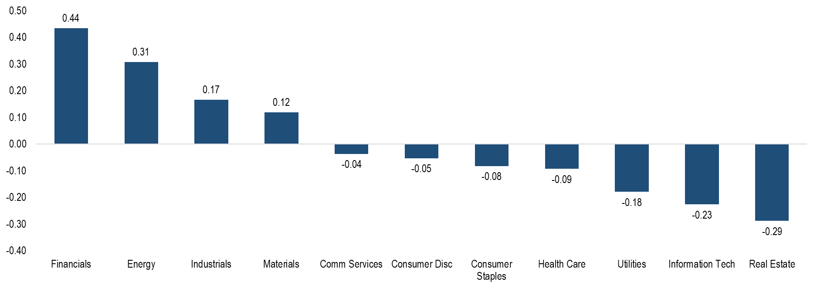
S&P 500 index Sector 3-yEAr weekly excess returns correlation to 10-YEAr treasury yield
3-YEAR WEEKLY CORRELATION OF SECTOR EXCESS RETURNS AND CHANGE IN 10-YEAR TREASURY YIELD
Source: Bloomberg. Data from 7/3/2020-7/31/2023. Excess returns are defined as the sector’s return relative to the S&P 500 Index’s returns. Returns are total returns. US 10-Year Treasury yield is the yield-to-maturity on a 10-Year US Generic Government Bond The S&P 500 Index is an unmanaged index of 500 companies used to measure large-cap U.S. stock market performance. For illustrative purposes only and not indicative of any investment. Past performance is no guarantee of future results. Indexes are unmanaged and an investor cannot invest directly in an index.
The information presented is not intended to constitute an investment recommendation for, or advice to, any specific person. By providing this information, First Trust is not undertaking to give advice in any fiduciary capacity within the meaning of ERISA, the Internal Revenue Code or any other regulatory framework. Financial professionals are responsible for evaluating investment risks independently and for exercising independent judgment in determining whether investments are appropriate for their clients.

Slide 15
The Effect of a 1% Rise in Interest Rates
Hypothetical Total Returns for 1-Year Period
Yield | Duration
4.14% | 5.47
3.95% | 8.32
5.30% | 5.45
7.95% | 5.15
8.31% | 3.88
5.28% | 5.35
9.59% | 0.25
3.02% | 4.46
4.22% | 10.75
4.51% | 2.79
4.17% | 4.57
3.95% | 8.32
4.00% | 17.89
Past performance is not a guarantee of future results. Source: Bloomberg, ICE BofA, S&P LSTA. Data as of 7/31/2023. The table illustrates hypothetical examples and does not represent the return on any particular investment. Effective duration is used for the preferred index and modified adjusted duration for all others. Duration is a measure of a bond’s sensitivity to interest rate changes that reflects the change in a bond’s price given a change in yield. Given that senior loans typically pay a floating rate of interest, they tend to have an effective duration of approximately zero. As such, we estimate the duration for senior loans to be approximately 0.25 years. Bloomberg US Treasury, 5-7 Year Index - Measures USD-denominated, fixed-rate, nominal debt issued by the US Treasury with 5-6.9999 years to maturity. Bloomberg US Treasury Bellwethers 10 Yr. Index - An unmanaged index representing the most recently issued U.S. Treasury bonds with 10 years’ maturity. Bloomberg US Corporate Bond Index - Measures the investment grade, fixed-rate, taxable corporate bond market. Bloomberg Emerging Markets (EM) USD Aggregate Bond Index, 5-7 Year - A flagship hard currency EM debt benchmark that includes fixed and floating-rate US dollar-denominated debt issued from sovereign, quasi-sovereign, and corporate EM issuers. Bloomberg US Corporate High Yield Bond Index - Measures the USD-denominated, high yield, fixed-rate corporate bond market. ICE BofA Fixed Rate Preferred Securities Index - Tracks the performance of fixed rate USD-denominated preferred securities issued in the US domestic market. S&P/LSTA US Leveraged Loan 100 Index - Designed to reflect the performance of the largest facilities in the leveraged loan market. Bloomberg U.S. Municipal Index - Covers the USD-denominated long-term tax-exempt bond market of the following maturities: 7 Year (6-8) and Long Bond (22+). 3-, 5-, 10- and 30-Year U.S. Treasuries - The most recently issued U.S. Treasury bonds or notes of a particular maturity. Indexes are unmanaged and an investor cannot invest directly in an index.

Slide 16
Rising rates and sector returns HISTORICAL IMPACT OF RISING RATES ON u.s. equity sectors
Rising Rate Period | Change In Rates | Consumer Staples | Utilities | Comm. Services* | Health Care | Information Technology | Financials | Industrials | Energy | Materials | Consumer Discretionary | S&P 500 Growth | S&P 500 Value | S&P 500 Index
11/7/01 – 4/1/02 | 1.25% | 8.78% | 0.90% | -14.47% | 0.25% | -3.42% | 5.58% | 5.17% | 11.78% | 14.12% | 9.99% | 2.31% | 4.15% | 3.32%
6/10/03 – 9/2/03 | 1.41% | 1.73% | -2.32% | -3.04% | -2.51% | 11.91% | 3.00% | 7.00% | 1.05% | 11.19% | 7.81% | 4.34% | 4.02% | 4.18%
3/8/04 – 6/14/04 | 1.10% | 0.50% | -4.19% | -5.44% | -1.74% | -0.10% | -5.45% | 3.73% | 0.94% | -4.45% | -1.08% | -0.24% | -2.65% | -1.47%
6/1/05 – 6/28/06 | 1.36% | 4.26% | 9.15% | 11.54% | -4.00% | -3.64% | 10.99% | 9.06% | 26.36% | 12.12% | -0.20% | 0.73% | 10.97% | 5.72%
12/18/08 – 6/10/09 | 1.87% | 0.46% | -2.76% | -3.64% | -1.80% | 26.95% | 1.23% | 4.54% | 10.33% | 21.62% | 12.96% | 12.49% | 2.38% | 7.56%
8/31/10 – 2/8/11 | 1.27% | 12.70% | 6.34% | 14.94% | 16.15% | 33.91% | 26.02% | 34.22% | 44.92% | 33.09% | 30.07% | 27.86% | 26.76% | 27.28%
7/24/12 – 12/31/13 | 1.64% | 29.03% | 9.08% | 14.08% | 52.77% | 32.90% | 58.26% | 55.70% | 33.12% | 39.37% | 60.20% | 39.76% | 46.13% | 42.60%
7/5/16 – 3/13/17 | 1.25% | 1.54% | -1.55% | -4.08% | 6.25% | 28.15% | 37.84% | 18.03% | 3.12% | 16.38% | 12.52% | 13.97% | 16.56% | 15.36%
9/5/17 – 11/8/18 | 1.18% | 6.48% | 4.17% | 3.58% | 17.81% | 25.99% | 15.53% | 8.95% | 11.85% | 4.20% | 25.96% | 21.15% | 12.17% | 16.78%
8/4/20 – 3/31/21 | 1.23% | 9.79% | 7.95% | 25.10% | 11.32% | 17.66% | 44.05% | 37.98% | 37.62% | 31.24% | 17.28% | 16.56% | 27.19% | 21.46%
8/2/21 – 6/14/22 | 2.30% | -0.16% | 2.05% | -32.44% | -7.91% | -17.43% | -13.25% | -13.40% | 78.69% | -4.94% | -25.16% | -21.15% | -5.94% | -13.73%
7/28/22 – 10/24/22 | 1.57% | -5.55% | -12.37% | -10.47% | -2.55% | -10.88% | -1.34% | -3.67% | 18.35% | -6.24% | -7.87% | -8.94% | -3.87% | -6.37%
Source: Bloomberg. As of 7/31/2023. Past performance is not a guarantee of future results. Source: Bloomberg. For illustrative purposes only and not indicative of any actual investment. Average total return for each period is shown. For each rising rate period, the returns are from the start of the period to the peak date of the 10-year yield before it fell at least 50 bps. The S&P 500 Index is an unmanaged index of 500 companies used to measure large-cap U.S. stock market performance. Investors cannot invest directly in an index. The S&P 500 Sector Indices are capitalization-weighted and comprised of S&P 500 constituents representing a specific sector. Index returns do not reflect any fees, expenses, or sales charges. These returns were the result of certain market factors and events which may not be repeated in the future.
*Comm. Services = Communication Services. As of 9/28/18, the Global Industry Classification Standard (GICS) was reconstituted, and the Telecommunications Services sector was renamed Communication Services. GICS sector information for periods prior to 9/28/18 may not necessarily be comparable to the reconstituted sectors.
The information presented is not intended to constitute an investment recommendation for, or advice to, any specific person. By providing this information, First Trust is not undertaking to give advice in any fiduciary capacity within the meaning of ERISA, the Internal Revenue Code or any other regulatory framework. Financial professionals are responsible for evaluating investment risks independently and for exercising independent judgment in determining whether investments are appropriate for their clients.

Slide 17
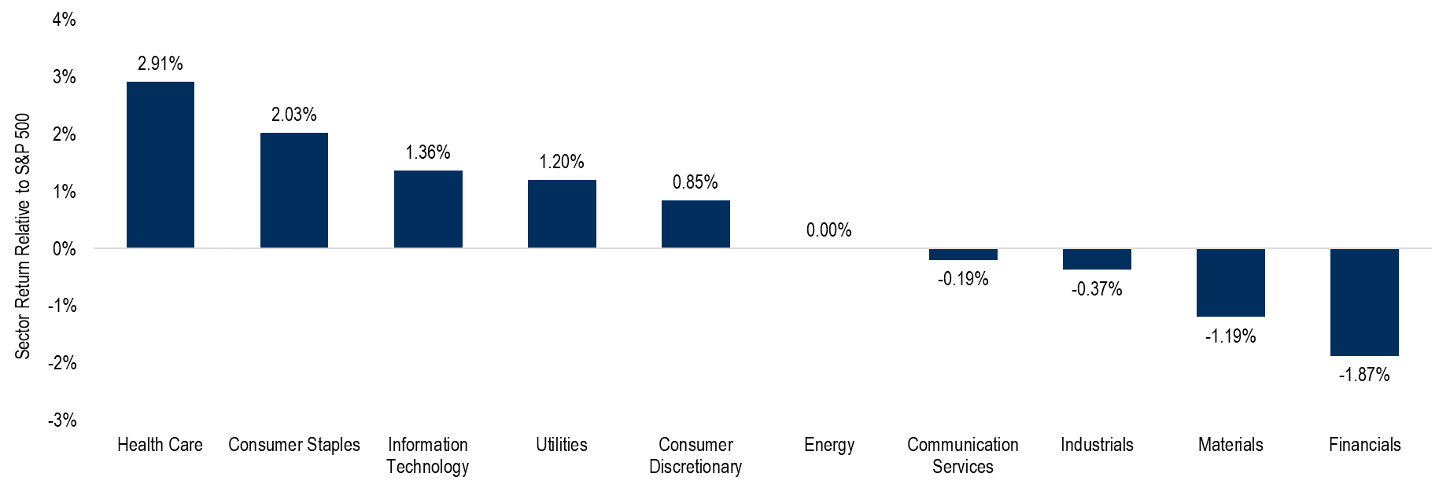
Defensive sectors outperform during volatility
AVERAGE EXCESS SECTOR RETURNS during most volatile quarters in stock market
Source: Bloomberg. Data from 12/31/1989 – 6/30/2023 (latest data available). Past performance is no guarantee of future results. For illustrative purposes only and not indicative of any investment. The S&P 500 Sector Indices are capitalization-weighted and comprised of S&P 500 constituents representing a specific sector. The Real Estate sector was excluded due to its shorter trading history. The chart shows the average excess return of each sector relative to the S&P 500 Index during the top quintile of volatile quarters in the S&P 500 Index. Volatility is calculated using 90-day standard deviation. The S&P 500 Index is an unmanaged index of 500 companies used to measure large-cap U.S. stock market performance. An index does not charge management fees or brokerage expenses, and no such fees or expenses were deducted from the performance shown. Indices are unmanaged and investors cannot invest directly in an index. On 9/28/18, the Global Industry Classification Standard (GICS) was reconstituted and the Telecommunications Services sector was renamed Communication Services. GICS sector information for periods prior to 9/28/18 may not necessarily be comparable to the reconstituted sectors. Defensive Sectors are defined as the health care, utilities, real estate, and communication services sectors excluding interactive media & services.
The information presented is not intended to constitute an investment recommendation for, or advice to, any specific person. By providing this information, First Trust is not undertaking to give advice in any fiduciary capacity within the meaning of ERISA, the Internal Revenue Code or any other regulatory framework. Financial professionals are responsible for evaluating investment risks independently and for exercising independent judgment in determining whether investments are appropriate for their clients.

Slide 18
Elevated volatility

Slide 19
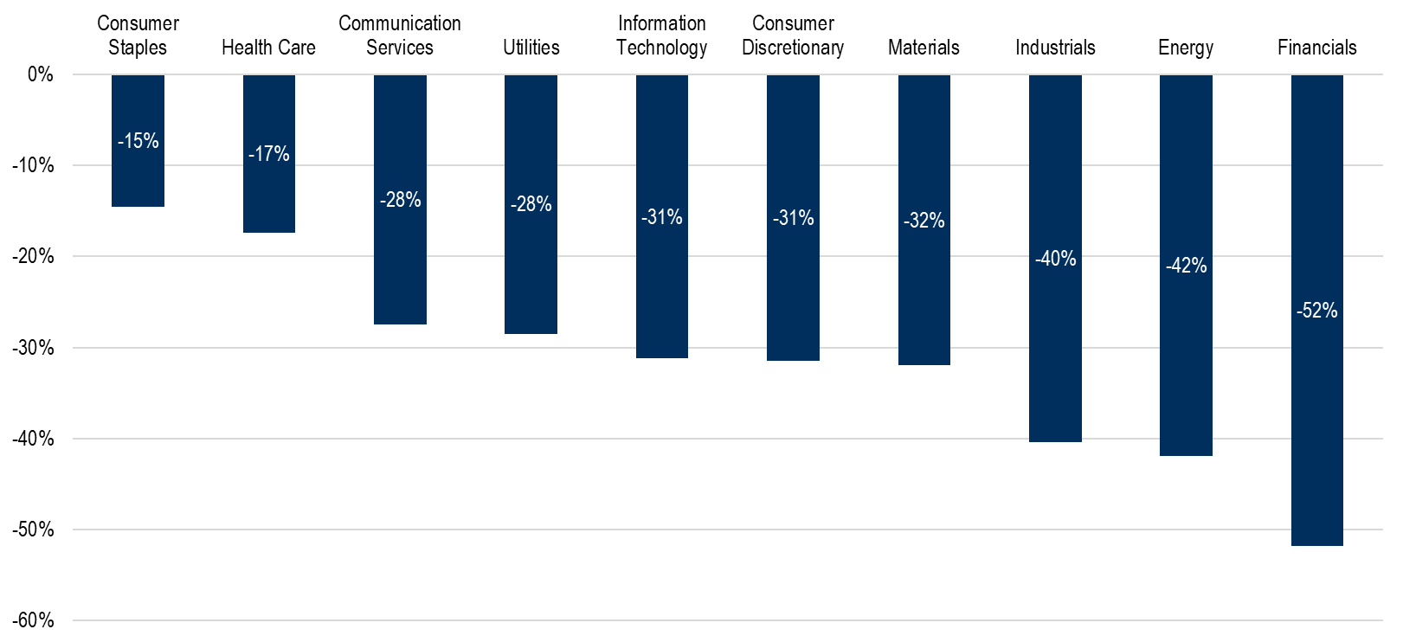
SECTOR PERFORMANCE during business cycles: early recession
Early recession
Data from 9/30/1989-10/31/21, most recent data available. Past performance is no guarantee of future results. For illustrative purposes only and not indicative of any investment. Source Bloomberg. Returns reflect the total annualized returns during each business cycle for each GICS sector in the S&P 500 Index. The Real Estate sector was excluded due to its shorter trading history. The S&P 500 Index is an unmanaged index of 500 companies used to measure large-cap U.S. stock market performance. Indexes are unmanaged and an investor cannot invest directly in an index. We define economic cycles as follows: Recovery – 18 months following the end of a recession. Expansion – time between recovery and late-expansion. Late expansion – last 18 months before peak economic growth. Early recession – start of a recessionary period until 3 months before it ends. Late recession – last 3 months before the economy bottoms. Business cycle dates were sourced from the National Bureau of Economic Research. Note, the recession in 2020 was a unique case and lasted only 3 months. The first 2 months of this recession were designated “Early Recession”, and the third month was designated “Late Recession”.
On 9/28/18, the Global Industry Classification Standard (GICS) was reconstituted, and the Telecommunications Services sector was renamed Communication Services. GICS sector information for periods prior to 9/28/18 may not necessarily be comparable to the reconstituted sectors.
The information presented is not intended to constitute an investment recommendation for, or advice to, any specific person. By providing this information, First Trust is not undertaking to give advice in any fiduciary capacity within the meaning of ERISA, the Internal Revenue Code or any other regulatory framework. Financial professionals are responsible for evaluating investment risks independently and for exercising independent judgment in determining whether investments are appropriate for their clients.

Slide 20
SECTOR PERFORMANCE during business cycles: late recession
Late Recession
Data from 9/30/1989-10/31/21, most recent data available. Past performance is no guarantee of future results. For illustrative purposes only and not indicative of any investment. Source Bloomberg. Returns reflect the total annualized returns during each business cycle for each GICS sector in the S&P 500 Index. The Real Estate sector was excluded due to its shorter trading history. The S&P 500 Index is an unmanaged index of 500 companies used to measure large-cap U.S. stock market performance. Indexes are unmanaged and an investor cannot invest directly in an index. We define economic cycles as follows: Recovery – 18 months following the end of a recession. Expansion – time between recovery and late-expansion. Late expansion – last 18 months before peak economic growth. Early recession – start of a recessionary period until 3 months before it ends. Late recession – last 3 months before the economy bottoms. Business cycle dates were sourced from the National Bureau of Economic Research. Note, the recession in 2020 was a unique case and lasted only 3 months. The first 2 months of this recession were designated “Early Recession”, and the third month was designated “Late Recession”.
On 9/28/18, the Global Industry Classification Standard (GICS) was reconstituted and the Telecommunications Services sector was renamed Communication Services. GICS sector information for periods prior to 9/28/18 may not necessarily be comparable to the reconstituted sectors.
The information presented is not intended to constitute an investment recommendation for, or advice to, any specific person. By providing this information, First Trust is not undertaking to give advice in any fiduciary capacity within the meaning of ERISA, the Internal Revenue Code or any other regulatory framework. Financial professionals are responsible for evaluating investment risks independently and for exercising independent judgment in determining whether investments are appropriate for their clients.

Slide 21
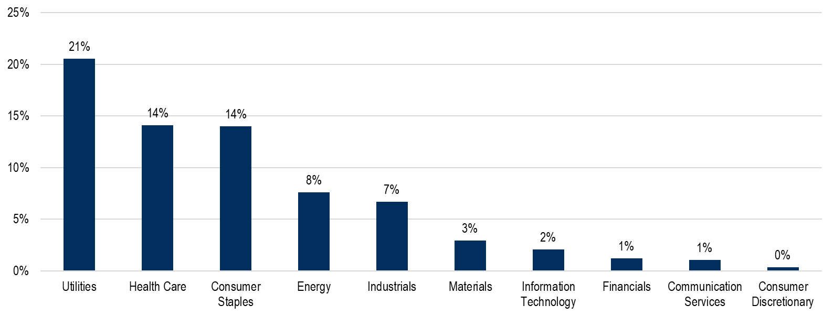
SECTOR PERFORMANCE during business cycles: Late expansion
Late expansion
Data from 9/30/1989-10/31/21, most recent data available. Past performance is no guarantee of future results. For illustrative purposes only and not indicative of any investment. Source Bloomberg. Returns reflect the total annualized returns during each business cycle for each GICS sector in the S&P 500 Index. The Real Estate sector was excluded due to its shorter trading history. The S&P 500 Index is an unmanaged index of 500 companies used to measure large-cap U.S. stock market performance. Indexes are unmanaged and an investor cannot invest directly in an index. We define economic cycles as follows: Recovery – 18 months following the end of a recession. Expansion – time between recovery and late-expansion. Late expansion – last 18 months before peak economic growth. Early recession – start of a recessionary period until 3 months before it ends. Late recession – last 3 months before the economy bottoms. Business cycle dates were sourced from the National Bureau of Economic Research. Note, the recession in 2020 was a unique case and lasted only 3 months. The first 2 months of this recession were designated “Early Recession”, and the third month was designated “Late Recession”.
On 9/28/18, the Global Industry Classification Standard (GICS) was reconstituted, and the Telecommunications Services sector was renamed Communication Services. GICS sector information for periods prior to 9/28/18 may not necessarily be comparable to the reconstituted sectors.
The information presented is not intended to constitute an investment recommendation for, or advice to, any specific person. By providing this information, First Trust is not undertaking to give advice in any fiduciary capacity within the meaning of ERISA, the Internal Revenue Code or any other regulatory framework. Financial professionals are responsible for evaluating investment risks independently and for exercising independent judgment in determining whether investments are appropriate for their clients.

Slide 22
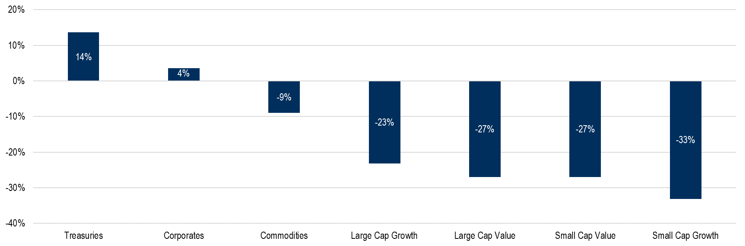
Asset Class PERFORMANCE during business cycles: early recession
Early recession
Data from 9/30/1989-10/31/21, most recent data available. Past performance is no guarantee of future results. For illustrative purposes only and not indicative of any investment. Source Bloomberg, Ken French Data Library. Returns reflect the total annualized returns during each business cycle for asset classes. Indexes are unmanaged and an investor cannot invest directly in an index. We define economic cycles as follows: Recovery – 18 months following the end of a recession. Expansion – time between recovery and late-expansion. Late expansion – last 18 months before peak economic growth. Early recession – start of a recessionary period until 3 months before it ends. Late recession – last 3 months before the economy bottoms. Business cycle dates were sourced from the National Bureau of Economic Research. Note, the recession in 2020 was a unique case and lasted only 3 months. The first 2 months of this recession were designated “Early Recession”, and the third month was designated “Late Recession”. Large cap and small cap stocks are defined as the largest and smallest 1/3 of U.S. stocks by market capitalization, respectively. Value and growth stocks are defined as the stocks with the highest and lowest 1/3 by book-to-price ratios, respectively. Treasuries returns are calculated using the Bloomberg U.S. Treasury Index which measures US dollar-denominated, fixed rate, nominal debt issued by the U.S. Treasury. Corporates returns are calculated using the U.S. Corporate Investment Grade Index which measures the investment grade, fixed-rate, taxable corporate bond market. Commodities returns are calculated using the Bloomberg Commodity Index which reflects commodity futures price movements for a broad range of commodities weighted by volume and world production caps.
The information presented is not intended to constitute an investment recommendation for, or advice to, any specific person. By providing this information, First Trust is not undertaking to give advice in any fiduciary capacity within the meaning of ERISA, the Internal Revenue Code or any other regulatory framework. Financial professionals are responsible for evaluating investment risks independently and for exercising independent judgment in determining whether investments are appropriate for their clients.

Slide 23
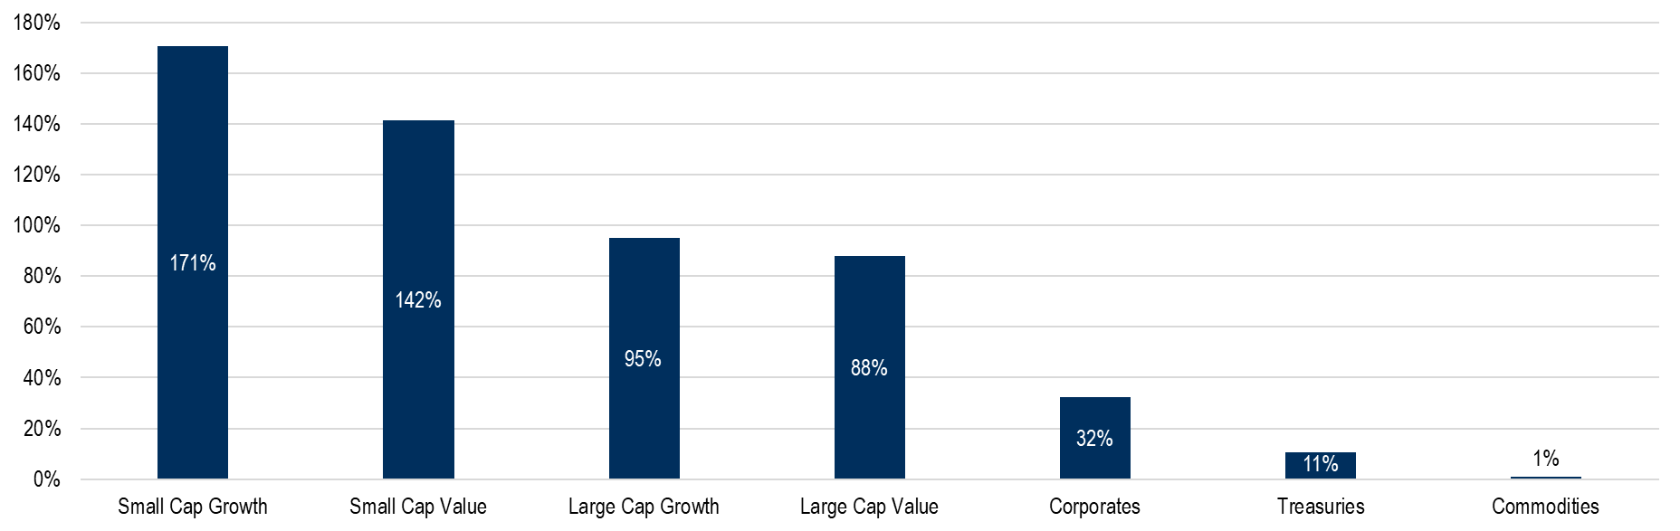
Asset class PERFORMANCE during business cycles: late recession
Late Recession
Data from 9/30/1989-10/31/21, most recent data available. Past performance is no guarantee of future results. For illustrative purposes only and not indicative of any investment. Source Bloomberg, Ken French Data Library. Returns reflect the total annualized returns during each business cycle for asset classes. Indexes are unmanaged and an investor cannot invest directly in an index. We define economic cycles as follows: Recovery – 18 months following the end of a recession. Expansion – time between recovery and late-expansion. Late expansion – last 18 months before peak economic growth. Early recession – start of a recessionary period until 3 months before it ends. Late recession – last 3 months before the economy bottoms. Business cycle dates were sourced from the National Bureau of Economic Research. Note, the recession in 2020 was a unique case and lasted only 3 months. The first 2 months of this recession were designated “Early Recession”, and the third month was designated “Late Recession”. Large cap and small cap stocks are defined as the largest and smallest 1/3 of U.S. stocks by market capitalization, respectively. Value and growth stocks are defined as the stocks with the highest and lowest 1/3 by book-to-price ratios, respectively. Treasuries returns are calculated using the Bloomberg U.S. Treasury Index which measures US dollar-denominated, fixed rate, nominal debt issued by the U.S. Treasury. Corporates returns are calculated using the U.S. Corporate Investment Grade Index which measures the investment grade, fixed-rate, taxable corporate bond market. Commodities returns are calculated using the Bloomberg Commodity Index which reflects commodity futures price movements for a broad range of commodities weighted by volume and world production caps.
The information presented is not intended to constitute an investment recommendation for, or advice to, any specific person. By providing this information, First Trust is not undertaking to give advice in any fiduciary capacity within the meaning of ERISA, the Internal Revenue Code or any other regulatory framework. Financial professionals are responsible for evaluating investment risks independently and for exercising independent judgment in determining whether investments are appropriate for their clients.

Slide 24
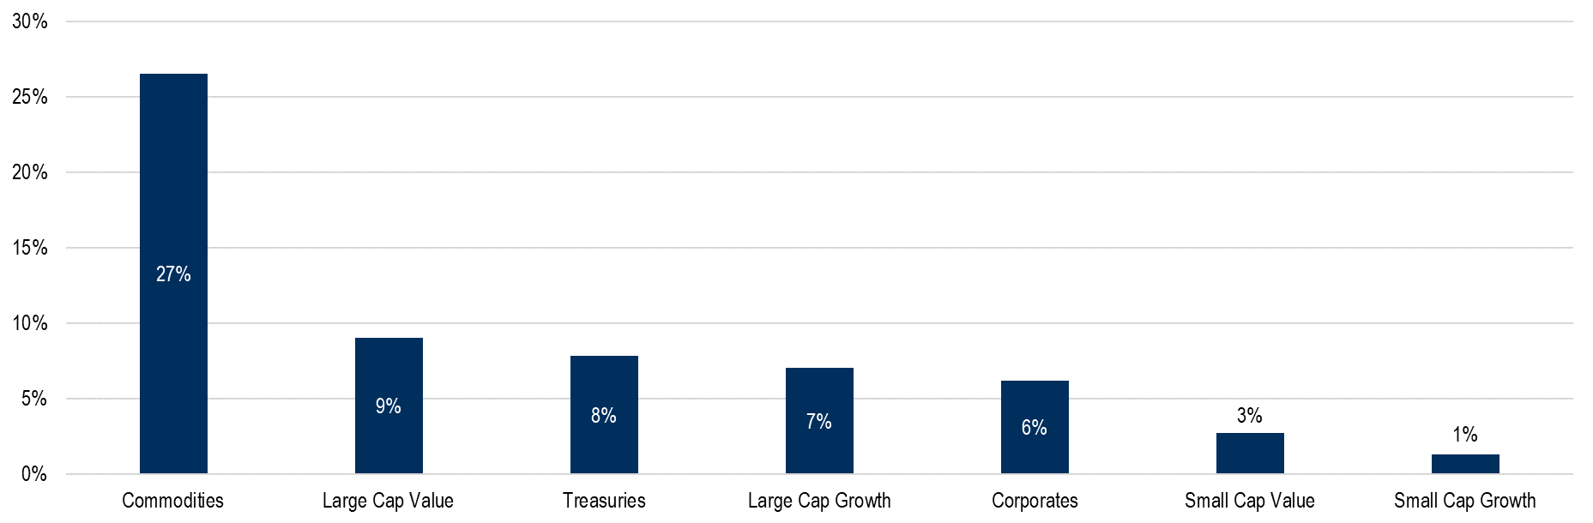
Asset Class PERFORMANCE during business cycles: Late expansion
Late expansion
Data from 9/30/1989-10/31/21, most recent data available. Past performance is no guarantee of future results. For illustrative purposes only and not indicative of any investment. Source Bloomberg, Ken French Data Library. Returns reflect the total annualized returns during each business cycle for asset classes. Indexes are unmanaged and an investor cannot invest directly in an index. We define economic cycles as follows: Recovery – 18 months following the end of a recession. Expansion – time between recovery and late-expansion. Late expansion – last 18 months before peak economic growth. Early recession – start of a recessionary period until 3 months before it ends. Late recession – last 3 months before the economy bottoms. Business cycle dates were sourced from the National Bureau of Economic Research. Note, the recession in 2020 was a unique case and lasted only 3 months. The first 2 months of this recession were designated “Early Recession”, and the third month was designated “Late Recession”. Large cap and small cap stocks are defined as the largest and smallest 1/3 of U.S. stocks by market capitalization, respectively. Value and growth stocks are defined as the stocks with the highest and lowest 1/3 by book-to-price ratios, respectively. Treasuries returns are calculated using the Bloomberg U.S. Treasury Index which measures US dollar-denominated, fixed rate, nominal debt issued by the U.S. Treasury. Corporates returns are calculated using the U.S. Corporate Investment Grade Index which measures the investment grade, fixed-rate, taxable corporate bond market. Commodities returns are calculated using the Bloomberg Commodity Index which reflects commodity futures price movements for a broad range of commodities weighted by volume and world production caps.
The information presented is not intended to constitute an investment recommendation for, or advice to, any specific person. By providing this information, First Trust is not undertaking to give advice in any fiduciary capacity within the meaning of ERISA, the Internal Revenue Code or any other regulatory framework. Financial professionals are responsible for evaluating investment risks independently and for exercising independent judgment in determining whether investments are appropriate for their clients.

Slide 25


1-800-621-1675 | www.ftportfolios.com
FIRST TRUST PORTFOLIOS L.P. | MEMBER SIPC | MEMBER FINRA

