Slide 1
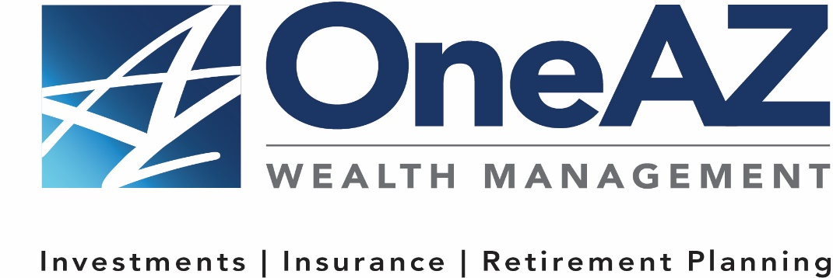
The presentation will begin shortly.
Your Credit Union (“Financial Institution”) provides referrals to financial professionals of LPL Financial LLC (“LPL”) pursuant to an agreement that allows LPL to pay the Financial Institution for these referrals. This creates an incentive for the Financial Institution to make these referrals, resulting in a conflict of interest. The Financial Institution is not a current client of LPL for brokerage or advisory services.
Please visit https://www.lpl.com/disclosures/is-lpl-relationship-disclosure.html for more detailed information.
This presentation was created for educational and informational purposes only and is not intended as ERISA, tax, legal or investment advice. If you are seeking investment advice specific to your needs, such advice services must be obtained on your own separate from this educational presentation.
Securities and advisory services are offered through LPL Financial (LPL), a registered investment advisor and broker-dealer (member FINRA/SIPC). Insurance products are offered through LPL or its licensed affiliates. OneAZ Credit Union (OneAZ CU) and OneAZ Wealth Management are not registered as a broker-dealer or investment advisor. Registered representatives of LPL offer products and services using OneAZ Wealth Management, and may also be employees of OneAZ CU. These products and services are being offered through LPL or its affiliates, which are separate entities from, and not affiliates of, OneAZ CU nor OneAZ Wealth Management. Securities and insurance offered through LPL or its affiliates are:
Not Insured by NCUA or Any Other Government Agency | Not Credit Union Guaranteed | Not Credit Union Deposits or Obligations | May Lose Value
Notes:
The presentation will begin shortly…

Slide 2
Understanding Rollover Options and Retirement Income Strategies
Notes:
Hello, Welcome to the OneAZ Wealth webinar on:
Understanding Rollover Options and Retirement Income Strategies

Slide 3


Presented By
Thomas E. Mitchell, CFP®
Senior Vice President
OneAZ Wealth Management
TMitchell@OneAZcu.com
Notes:
My name is, Tom Mitchell and I have the honor of leading the OneAZ Wealth Management team of Wealth Advisors, located here at the OneAZ Credit Union. Our full-time professional financial advisors, we are assisting clients and members of the OneAZ Credit Union all over the great state of Arizona!
We are very excited to bring these educational topics directly to you and we are planning more later in the year, with topics on Social Security, Medicare, Women in Investing, and more…
As a heads up, our next webinar will be on TBD WEBINAR DATE.

Slide 4




Website: OneAZWealth.com
Email: OneAZWealth@OneAZCU.com
24/7 Online Appointment Scheduler:
OneAZWealth.com
Phone: (877) 566-0517
Call Monday-Friday, 9:00 am – 5:00 pm
Scan to visit OneAZWealth.com
Your Credit Union (“Financial Institution”) provides referrals to financial professionals of LPL Financial LLC (“LPL”) pursuant to an agreement that allows LPL to pay the Financial Institution for these referrals. This creates an incentive for the Financial Institution to make these referrals, resulting in a conflict of interest. The Financial Institution is not a current client of LPL for brokerage or advisory services.
Please visit https://www.lpl.com/disclosures/is-lpl-relationship-disclosure.html for more detailed information.
This presentation was created for educational and informational purposes only and is not intended as ERISA, tax, legal or investment advice. If you are seeking investment advice specific to your needs, such advice services must be obtained on your own separate from this educational presentation.
Securities and advisory services are offered through LPL Financial (LPL), a registered investment advisor and broker-dealer (member FINRA/SIPC). Insurance products are offered through LPL or its licensed affiliates. OneAZ Credit Union (OneAZ CU) and OneAZ Wealth Management are not registered as a broker-dealer or investment advisor. Registered representatives of LPL offer products and services using OneAZ Wealth Management, and may also be employees of OneAZ CU. These products and services are being offered through LPL or its affiliates, which are separate entities from, and not affiliates of, OneAZ CU nor OneAZ Wealth Management. Securities and insurance offered through LPL or its affiliates are:
Not Insured by NCUA or Any Other Government Agency | Not Credit Union Guaranteed | Not Credit Union Deposits or Obligations | May Lose Value
Notes:
First, here is our Information page, it contains our required legal disclosures for your convenience.
Please always check out our OneAZWealth.com website for upcoming webinar events.

Slide 5
Connect With Us!
Website: OneAZWealth.com
Email: OneAZWealth@OneAZCU.com
24/7 Online Appointment Scheduler:
OneAZWealth.com
Phone: (877) 566-0517
Call Monday-Friday, 9:00 am – 5:00 pm
Scan to visit OneAZWealth.com
Notes:
For better audio, the webinar will be in “listen-only mode”…
We will be fielding your questions at the end of the webinar. Please, email any questions to: oneazwealth@oneazcu.com. We will be compiling your questions and will answer them at the end of today’s presentation. If we do not get to your question, I promise we will respond to you directly.
Last, for more information about OneAZ Wealth Management and our team of wealth advisors, visit OneAZWealth.com or use your mobile device to scan the QR Code on the screen now.
You can also connect with us on social media on Facebook, LinkedIn, and YouTube for more exciting resources and helpful information.

Slide 6

Guest Speaker
Michael Sammons, CRPC®
Wealth Advisor
OneAZ Wealth Management
MSammons@OneAZcu.com
Notes:
So, let’s get started…
Our OneAZ Wealth topic today: Understanding Rollover Options and Retirement Income Strategies
Mike Sammons bio:
For more than 27 years, Mike has been helping individuals and families pursue their long-term financial goals. Mike begins all meetings by listening and taking time to get to know his clients, their family and their personal needs and desires. Mr. Sammons began his financial career with Merrill Lynch in 1991 and joined OneAZ Credit Union in 2004. He completed extensive training to earn the Chartered Retirement Planning Counselor, (CRPC®) designation in 2011. Mike is originally from the Chicago area and earned a Bachelor’s Degree in Finance from the University of Iowa. He moved to Phoenix over 14 years ago and in his spare time enjoys spending time with his wife and two sons, watching sports and playing golf. Mr. Sammons also has his Arizona Life and Health Insurance License and is registered with LPL Financial with his SIE, Series 7, Series 63, and Series 65 securities registrations. CRPC conferred by College for Financial Planning.

Slide 7
Understanding Your Rollover Options
HOW THE CHOICES YOU MAKE TODAY CAN IMPACT YOUR FUTURE RETIREMENT SAVINGS
Presented by:
Thomas E. Mitchell, CFP®
CMGA-3475152.2-1222-0125
© CUNA Mutual Group
Notes:
Welcome! Thank you for joining us today to talk about your choices for retirement account rollovers, and the different consequences your decisions may have.

Slide 8
Important Notice
This workshop is educational only and is not investment advice. If you need advice regarding your financial goals and investment needs, contact a financial advisor.
Annuities are long-term insurance products designed for retirement purposes. Many annuities offer four main features: (1) a selection of investment options, (2) tax-deferred earnings accumulation, (3) guaranteed lifetime payout options, and (4) death benefit options. Before investing, you should consider the annuity’s investment objectives, risks, charges and expenses. The prospectus contains this and other information. You can obtain a prospectus from your financial advisor or insurance company. Please read it carefully.
All guarantees are backed by the claims-paying ability of the issuer and do not extend to the performance of the underlying accounts which can fluctuate with changes in market conditions.
Annuity contract values, death benefits and other values fluctuate based on the performance of the investment options and may be worth more or less than your total purchase payment when surrendered. Withdrawals may be subject to surrender charges, and may also be subject to a market value adjustment (MVA). Withdrawals of taxable amounts are subject to ordinary income tax, and if taken before age 59½ may be subject to a 10% federal tax penalty. If you are considering purchasing an annuity as an IRA or other tax-qualified plan, you should consider benefits other than tax deferral since those plans already provide tax-deferred status. The company does not provide tax or legal advice. Contact a licensed professional. Financial advisors are not tax advisors nor attorneys. For information regarding your specific tax situation, please consult a tax professional. For legal questions consult your attorney.
CUNA Mutual Group is the marketing name for CUNA Mutual Holding Company, a mutual insurance holding company, its subsidiaries and affiliates. Annuities are issued by CMFG Life Insurance Company (CMFG Life) and MEMBERS Life Insurance Company (MEMBERS Life) and distributed by their affiliate, CUNA Brokerage Services, Inc., member FINRA/SIPC, a registered broker/dealer, 2000 Heritage Way, Waverly, IA, 50677. CMFG Life and MEMBERS Life are stock insurance companies. MEMBERS® is a registered trademark of CMFG Life. Investment and insurance products are not federally insured, may involve investment risk, may lose value and are not obligations of or guaranteed by any depository or lending institution. All contracts and forms may vary by state, and may not be available in all states or through all broker/dealers.
There are distinct differences between annuities and certificates of deposit or other guaranteed fixed income instruments sold through a credit union or bank. Most certificates are considered short-term investments, while annuities are considered long-term investments. The investment in a certificate is insured by the federal government, either through the FDIC or NCUA. Any guarantees provided by an annuity are backed by an insurance company. Discuss with your advisor the benefits, costs and limitations of annuities.
8
Notes:
Before we begin, I want to highlight this disclosure for compliance purposes.

Slide 9

Our Commitment
In today’s session, we will:
Review the different options that employees have for their employer-based retirement plans when leaving or retiring
Compare pros and cons of the different options
Consider the impact of the choices you make now on reaching financial security later
9
Notes:
I want to highlight our commitment to you:
OneAZ Credit Union and OneAZ Wealth Management is committed to bring members and clients the financial education they need in their financial decision making process.
[CLICK FOR 3 GRAPHICS.]
Today’s session will provide some valuable education about your options for moving your retirement plan when leaving employment.
We will review the options you may have available to you.
We’ll compare the pros and cons of those different options.
And, we’ll discuss ways your choices can have a long-term impact on your retirement savings. A financial advisor can help you go deeper with your individual situation to make the best choice for you.
The next hour will be very important, and because we want to help you and others address these important financial issues, we want to continue to improve the presentation of this seminar. That’s why we’d like you to complete an evaluation form before you leave today.
[MAKE SURE EVALUATION FORMS ARE HANDED OUT.]

Slide 10


Changing jobs is a common experience
Median tenure among American employees age 55-64:
9.8 years
Median American employee tenure:
4.3 years for men, 3.8 years for women
10
SOURCE | Bureau of Labor Statistics, Employee Tenure in 2022, September 22, 2022.
Notes:
The path from your first job to retirement is rarely straightforward.
[CLICK TO BRING UP BULLETS]
If you consider that the median time on a job for older Americans is about ten years, and that the overall median job tenure is around 4 years, it’s clear that, in general, most of us are changing jobs at least a few times over the course of our working years.

Slide 11

Most full-time U.S. workers have access to retirement plan benefits
81% of full-time American workers in private industry and state and local governments have access to retirement benefits.
Of those, only 82% participate in their available retirement plans.
11
SOURCE | Bureau of Labor Statistics, Table 1. Retirement benefits: Access, participation, and take-up rates, Sept. 22, 2022.
Notes:
Access to retirement benefits is common, too.
So, given that many workers change jobs, and many workers access retirement benefits through their employers, the decision about what to do with your retirement plan is one that many people will need to make at least once in their lives.
If we assume there are about 130 million full-time workers in the U.S., 80% of that is more than 100 million, and 82% of that is just over 80 million covered and participating employees.

Slide 12


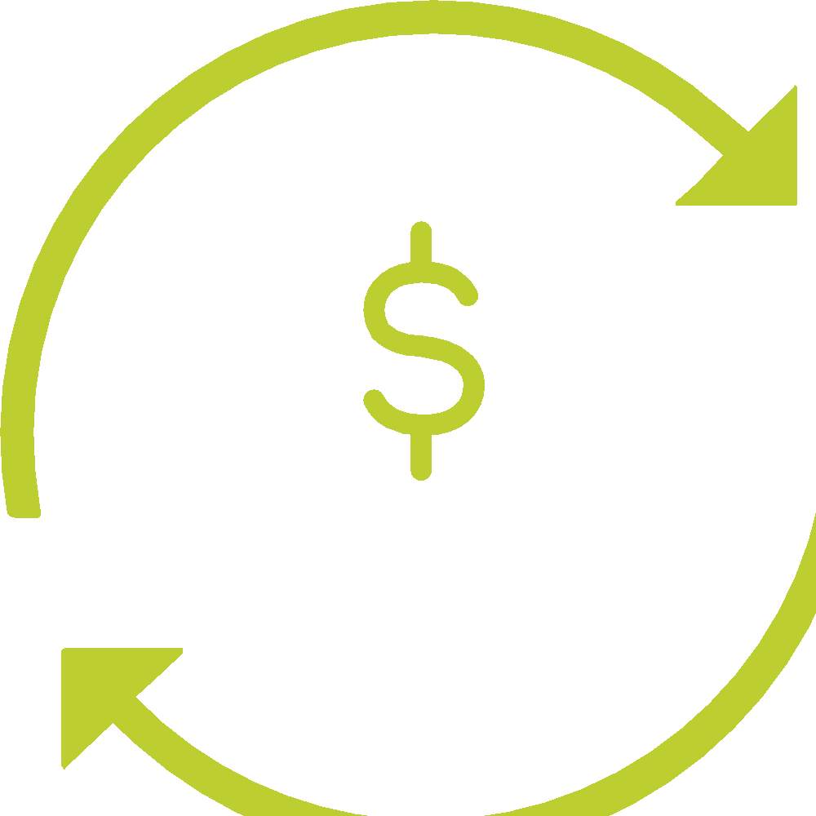

Available options for your previous employer- sponsored retirement plans
You can:
Leave it where it is
Move it to your new plan
Convert it to cash
Roll it over to an IRA
12
Notes:
Not everybody makes the same decision, but it’s important to know the consequences of your choices. You usually have four options. Let’s take a closer look at each of them.

Slide 13


Option 1: Leave your previous retirement plan with the old plan administrator
13
Notes:
[READ SLIDE]

Slide 14



No taxes or IRS withdrawal penalties
Tax-deferred compounding continues
Access to special investment options like company stock
Fees may be lower
IRS Rule of 55
Limited investment choices
Keeping track can be tough if you change jobs often
Your access is controlled by the plan
You may not be allowed to continue contributing or to take loans
Option 1: Leave your previous retirement plan with the old plan administrator
SOURCE | IRS.gov, Topic No. 558 Additional Tax on Early Distributions From Retirement Plans Other Than IRAs, Nov. 1, 2022.
14
Notes:
It may feel easiest to do nothing when you terminate employment and leave your assets in your old employer’s plan. This option also might involve much lower fees than some of your other options.
But it comes with its own downsides and limitations, as you can see here.
[CLICK TO BRING UP AND READ PROs]
[CLICK TO BRING UP AND READ CONs]

Slide 15

IRS “Rule of 55”
Rule of 55 states that if you leave your job—for any reason—career change, retirement, even fired
During the calendar year you turn 55 or any year after that, you can access your retirement funds without the 10% penalty
This ONLY applies to funds in the plan with your CURRENT employer, not previous employer plans
SOURCE | IRS.gov, Topic No. 558 Additional Tax on Early Distributions From Retirement Plans Other Than IRAs, Nov. 1, 2022.
15
Notes:
One important rule to keep in mind for those 55 and over is what’s referred to as the “Rule of 55.” It’s an exception to the IRS rules governing distributions that allows you to withdraw the funds from an employer’s plan IF you leave that employer during the calendar year you turn 55, or any year after that.

Slide 16

Employer-Sponsored Retirement Plan Fees
Many employees aren’t aware that their employer- sponsored retirement plans have fees. Typical fees associated with these plans may include:
Administration Fees
Investment Fees: sales charges, commissions, management fees, investment advisory fees, account maintenance fees
Individual Service Fees
Fees can vary widely, and they don’t necessarily correlate with better performance.
16
Notes:
Fees can have a significant impact on the final balance of your retirement account.
A difference of just 1% on an account starting at $100,000 and earning only 4% annually over 25 years could result in $32,000 in fees alone.
Do you know what your 401(k) fees add up to?

Slide 17


Option 2: Move your previous employer plan assets to your new employer’s plan
You may have the choice to roll over your retirement savings to your new employer’s retirement plan.
17
Notes:
Your new employer may allow you to move your retirement savings into their plan. If so, that’s an option for you to consider. Not all employers’ plans will accept rollovers from previous employers’ plans, so it’s not always possible.
You’d first need to contact your new employer’s plan administrator to find out whether it’s an option, and how to proceed.

Slide 18

Helps consolidate and keep your retirement assets in fewer places
Tax-deferred compounding of your assets
May offer access to special investment options like employer stock purchase programs, provisions for taking loans
New employer’s plan may limit your investment choices
New plan’s rules and provisions govern withdrawals
There may not be a new plan; if you plan to work part-time, freelance or start your own business
Option 2: Move your previous employer plan assets to your new employer’s plan
18
SOURCE | IRS.gov, Rollovers of Retirement Plan and IRA Distributions, June 16, 2022.
Notes:
Transferring your savings to a new employer’s plan allows your assets to continue compounding, tax-deferred. But there are some important details to be aware of.
If you choose a direct rollover, you avoid current income taxes and the 20% mandatory withholding.
If you choose an indirect rollover, you need to deposit your distribution, including the 20% withheld, within 60 days. That means you need to get the 20% from somewhere else, because the IRS is going to hold it against possible tax liabilities.
So again, there are pros and cons.
[CLICK TO BRING UP PROs]
Rolling assets into your new employer’s plan puts all your money in one place. Your new plan may have attractive investment options or loan features you want.
[CLICK TO BRING UP CONs]
At the same time, your investment choices are then limited to whatever the new plan offers. The same goes for withdrawals, exchanges among investments, and emergency access to your money: everything is subject to the rules of the new plan. And distribution options before 59-1/2 could come with a 10% penalty.
And that’s all IF you have access to a new plan. If you’re part-time or working independently, you may not have a new plan to consider.

Slide 19


Option 3: Convert your employer plan to cash
You can cash out your employer plan, but that’s RARELY the best choice when considering future financial security.
19
Notes:
Cashing out your plan puts the money in your pocket. No restrictions.
But there are a few MAJOR drawbacks to be aware of.

Slide 20

Immediate, unrestricted access to your money
Distribution may be subject to significant penalties and taxes
Distributed dollars can only be rolled over into another employer plan or IRA if done so within 60 days
Taking the cash and spending it now can throw your future retirement plans off course
Option 3: Convert your employer plan to cash
20
SOURCE | IRS.gov, Rollovers of Retirement Plan and IRA Distributions, June 16, 2022.
Notes:
A lump-sum distribution may seem like a simple and appealing option, especially if your account balance seems low to you. You may think it doesn’t make that big a difference in the long run.
[CLICK TO BRING UP PROs]
And all that cash can be enticing.
But cashing out can cost more than you might think.
[CLICK TO BRING UP AND READ CONs]

Slide 21
Distribution = income, so income taxes are due at the current rate
20% mandatory withholding
10% additional tax on early withdrawals (before age 59½)*
No longer tax-deferred
Possible state taxes
The costly side of cashing out:
Taxes and penalties
*Most distributions before age 59½ may be subject to an additional 10% tax.
SOURCE | IRS.gov, Rollovers of Retirement Plan and IRA Distributions, June 16, 2022.
21
Notes:
[CLICK TO BRING UP BULLETS]
Cashing out, or taking an early distribution, makes your money subject to penalties and taxes that take a big bite out of your total. Twenty percent of the distribution is required to be withheld to pay taxes; your distribution is subject to federal and state income tax at current rates.
That can add up to a big loss. Let’s take a look at an example that shows the immediate cost of cashing out.

Slide 22
The immediate costs of cashing out: Taxes & penalties*
 | Cash it out | Roll it over
Plan account balance | $40,000 | $40,000
Federal income tax (24%) (hypothetical, based on income bracket) | -$9,600 | -$0
Early withdrawal penalty (10%) | -$4,000 | -$0
Balance | $26,400 | $40,000
State income tax could make the final balance even lower.
*Hypothetical scenario: Consult a tax professional to determine individual impact.
22
Notes:
So, what happens when you cash out?
First, you can count on federal and state income taxes on your distribution. On top of that, lump-sum retirement plan distributions before age 59½ are often subject to an additional 10% tax penalty. Total taxes and penalties can add up to as much as half of your account balance.
Plus, after 60 days, the money withdrawn can no longer be moved into an employer plan or IRA. So that tax-deferred status is lost.
Lots to lose, right? Well, wait. Because there’s more. When you cash out, you opt out of allowing those assets to continue accumulating and growing your retirement savings. And those longer-term losses can be staggering.

Slide 23

Cashing out = Losing out
Taking an early distribution eliminates your assets’ potential for COMPOUNDING
It’s a mistake to underestimate the value of time, especially early in a career
Rule of 72
23
Notes:
When it comes to retirement investing, you want to keep time on your side.
Let’s take a look at the potential difference in outcomes between cashing out and staying invested by choosing a rollover option.

Slide 24
Can you make up for lost time?
Total invested
$40,000
ROLL IT OVER
This investor rolls over that $40,000 portfolio and earns 8% over 25 years
Total after 25 years
$295,497
CASH IT OUT
This investor takes the cash, then contributes $100,000 in monthly contributions over 25 years, also earning 8%
Total invested
$100,000
Total after 25 years
$320,547
ROLL IT OVER & KEEP INVESTING Here’s an investor who rolls over that $40,000 AND contributes an additional $100,000 over 25 years
Total invested
$140,000
Total after 25 years
$615,508
For illustrative purposes only.
24
SOURCE | Investor.gov, Compound interest calculator, January 24 2023.
Notes:
[CLICK TO BRING UP FIRST INVESTOR]
So, the first investor rolled over that $40,000 — and didn’t contribute another penny over the 25 years that followed.
[CLICK TO BRING UP BAR GRAPH – TOTAL INVESTED]
[CLICK TO BRING UP BAR GRAPH – TOTAL AFTER 25 YRS]
[CLICK TO BRING UP SECOND INVESTOR]
The second investor tried playing catch-up. He or she contributed $4,000 a year in monthly contributions over 25 years — and barely outperformed what they would have earned by investing just $40,000 initially.
[CLICK TO BRING UP BAR GRAPH – TOTAL INVESTED]
[CLICK TO BRING UP BAR GRAPH – TOTAL AFTER 25 YRS]
That’s right. The first investor contributed $40,000 and ended up with only a little less than the second investor who contributed $100,000.
[CLICK TO BRING UP THIRD INVESTOR] The third investor did both: rolled over $40,000 and contributed an additional $100,000 after 25 years.
[CLICK TO BRING UP BAR GRAPH – TOTAL INVESTED]
[CLICK TO BRING UP BAR GRAPH – TOTAL AFTER 25 YRS]
They about doubled what the other investors earned over time.

Slide 25

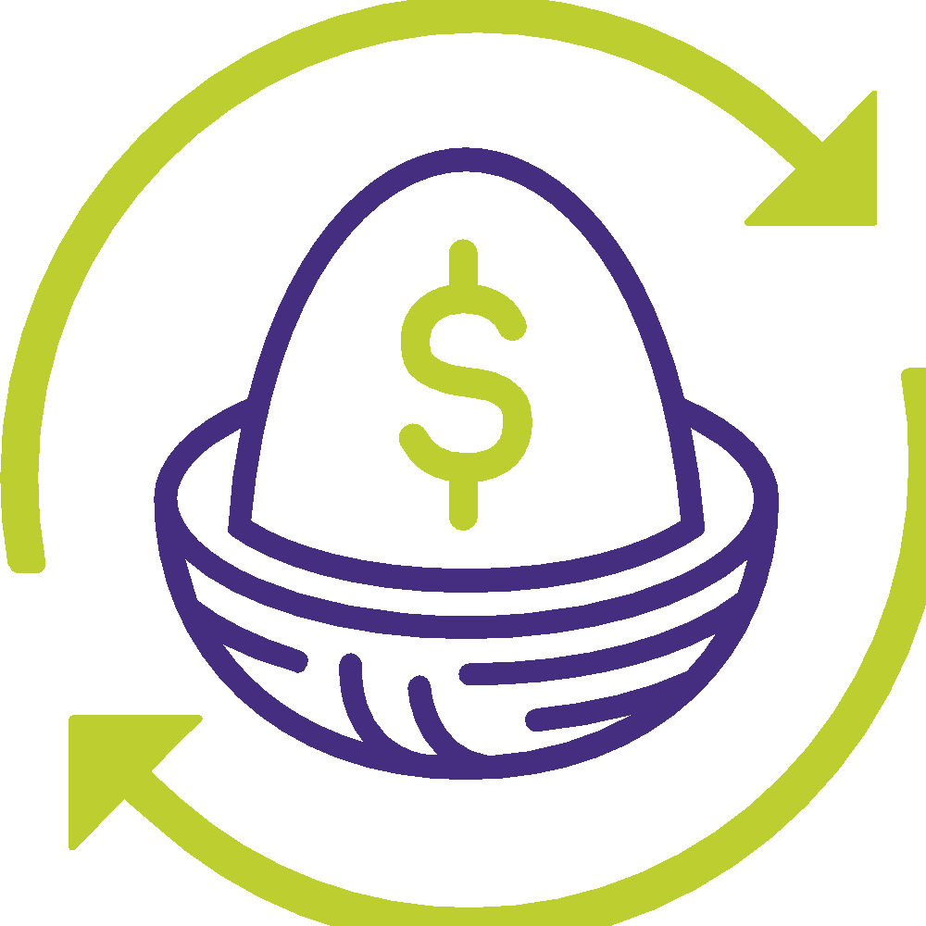
Option 4: Roll over your previous employer plans to an IRA
Even if your new employer doesn’t have a retirement savings plan, you don’t have to miss out on the opportunity to allow your retirement assets to KEEP GROWING.
You can work with an advisor to roll over your old plan into an IRA, avoiding TAXES and PENALTIES.
Most importantly, a rollover allows the savings you worked so hard for the ability to work hard for you!
25
Notes:
A Rollover IRA can allow you to consolidate your retirement assets.
Maybe you have multiple accounts from previous employers. You can work with an advisor to transfer your lines to one Rollover IRA.
Working with an advisor will help you avoid taxes, penalties, and keep you on track for your retirement. They can all be rolled over into one Rollover IRA.
Most importantly, a rollover allows the savings you worked so hard for the ability to work hard for you!
First, it keeps your assets invested, so they can continue earning and compounding over time. Second, it may give you greater control over your investment choices and retirement savings down the road.
But let’s consider the pros and cons.

Slide 26

Rolling over your previous retirement plan to your own personal IRA can help you stay on track
Option 4: Roll over your previous employer plans to an IRA
Easier to keep track and manage records
Greater range of choices among investments
Assets can be converted to Roth IRA
Option to withdraw before age 59½ without 10% penalties
26
SOURCE | IRS.gov, Rollovers of Retirement Plan and IRA Distributions, June 16, 2022.
Notes:
A popular choice for people changing jobs, and for retirees, is a direct rollover of employer plan assets to a Traditional IRA.
When you roll over your retirement plan distribution, you typically don’t pay tax on it. So you preserve that tax-deferred status and allow your assets to continue to grow.
[CLICK TO BRING UP PROs]
This type of rollover keeps those assets tax-deferred until you withdraw earnings when you’ve reached retirement, and keeps assets in one place for simplified management, tracking, and recordkeeping.
A Traditional IRA may offer a greater range of investment options than, for example, an average employer’s 401(k) plan.
IRAs can also provide an opportunity to withdraw funds penalty-free in the event of an early retirement—so, before age 59½—by taking substantially equal periodic payments. There are some qualified retirement plans that offer similar options for taking early distributions, but many do not.
So, a lot of pros. Let’s consider the downsides.

Slide 27

Range of investment options when working with an advisor
Money Market Accounts
Certificates of Deposit (CDs)
Bonds
Annuities
Mutual Funds
Managed Money Accounts
Individual Stock Purchases
A financial advisor will answer questions about “all-in” fees on any investment. They’ll review the features and benefits of any product you choose. They’ll also discuss your investment timeframe and your own personal temperament.
27
Notes:
Remember, fees have an effect on your eventual account balance, and the difference of just 1% can make a big impact over the course of a lifetime.
When you work with an advisor, he or she has a commitment to ensuring you understand the fees involved when you make investment decisions.
That clarity can help you feel more confident in your choices.

Slide 28
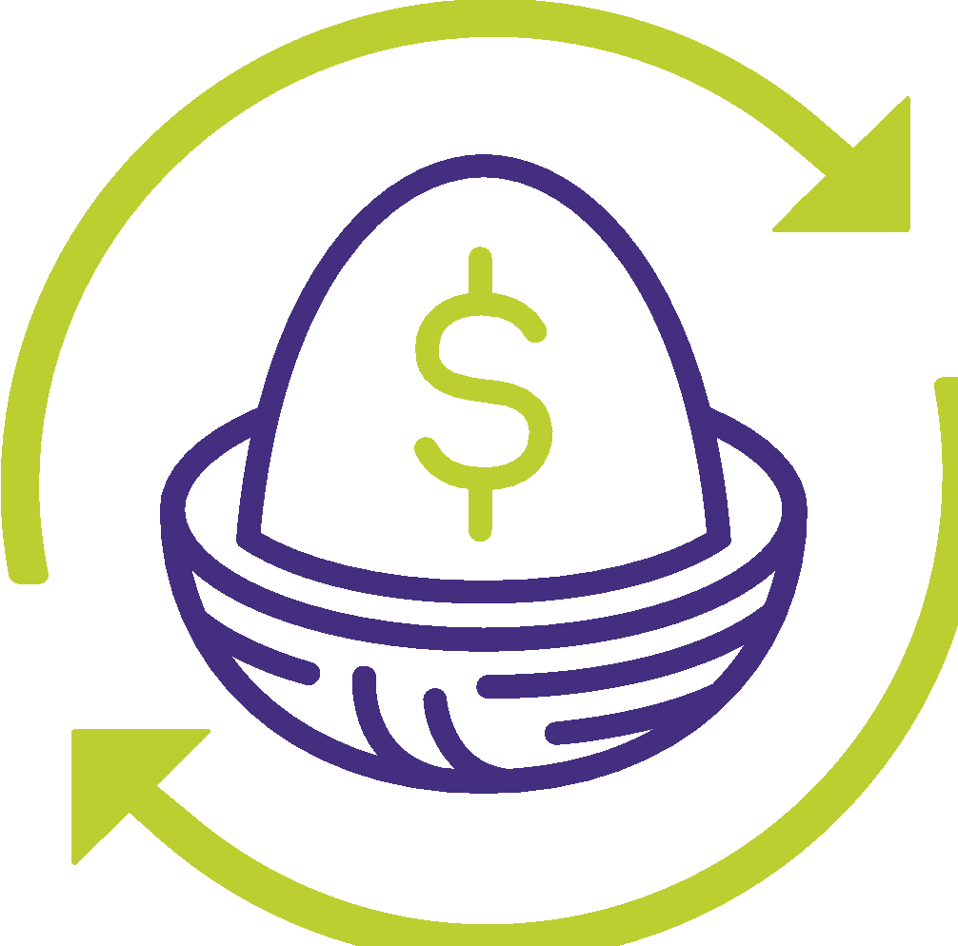
What can’t a Rollover IRA do?
Option 4: Roll over your previous employer plans to an IRA
Loans not available
Tax advantages for employer stock assets not available
May offer lower protection from creditors compared with employer plans
28
SOURCE | IRS.gov, Retirement Plans FAQs regarding Loans, April 27, 2022
Notes:
What can’t a Rollover IRA do?
[CLICK TO BRING UP CONs]
One downside is that you can’t borrow money from an IRA like you can with a 401(k) plan. And, there are special tax advantages, upon distribution, for assets held in employer stock that an IRA can’t offer.
And, while many state laws offer some protection from creditors when it comes to IRA assets, employer plans enjoy generally greater federal protections.

Slide 29

Withdrawals after 59½
Many, but not all, employer-sponsored retirement plans allow employees ages 59½ and older to take a distribution from their 401(k) account.
If this in-service withdrawal option is available to you, you may choose to use it to roll over funds to an IRA now and work with a financial advisor to determine a personal investment strategy.
An advisor can help you understand your investment options, compare them with your current investments in your 401(k), and determine the best choice for you.
29
SOURCE | IRS.gov, Topic No. 558 Additional Tax on Early Distributions From Retirement Plans Other Than IRAs, Nov. 1, 2022.
Notes:
You can dig into your 401(k) plan’s administrative and investment fees. You may determine that you have better options for investments, and you may get better clarity on costs, when you work with your advisor.
If that’s the case, you can consider taking advantage of In-Service Withdrawals after 59½, as an opportunity to move more of your funds into the investments you prefer, without incurring additional penalties.

Slide 30

Thinking of rolling over an old retirement plan?
Two ways to do it:
DIRECT
or
INDIRECT
(60-Day)
30
Notes:
If you’ve decided that you won’t be swayed by the temptation of cashing out, and you want a simpler way to keep track of your retirement assets, you might have decided a rollover is what you want.
Your next choice is whether you want to complete a direct rollover or an indirect rollover. This is also called a 60-day rollover. Talking with an advisor can help you decide which is best for you.

Slide 31



How does a DIRECT ROLLOVER work?
Your previous plan administrator makes a payment to your new or existing IRA or to your new employer’s plan.
No income tax due at time of rollover
No 20% withholding for income tax
No 10% early withdrawal penalty
Your previous plan administrator
Your new employer’s plan or rollover IRA
31
SOURCE | IRS.gov, Topic No. 558 Additional Tax on Early Distributions From Retirement Plans Other Than IRAs, Nov. 1, 2022.
Notes:
With a direct rollover, you don’t handle the funds. Your assets are instead transferred by your previous employer plan administrator to either your new plan or the Rollover IRA you chose.
Your previous plan administrator makes a payment to your new IRA or to your new employer’s plan
[CLICK TO SHOW MOVEMENT OF MONEY]
[CLICK TO BRING UP BULLETS]
In a direct rollover, there’s:
No income taxes due at time of rollover
No requirement to withhold 20% for taxes
No 10% penalty for early withdrawal
Your funds retain their tax-deferred status and may continue to grow in the new plan. You start the process by contacting the administrator of your former employer’s plan.

Slide 32



How does an INDIRECT ROLLOVER work?
Your previous plan administrator makes a payment directly to you, and you deposit the full amount into your new employer plan or IRA.
20% withheld for federal income tax
60 days to reinvest (including amount withheld) in a new employer’s plan or in an IRA
Previous plan administrator
New employer’s plan or rollover IRA
32
SOURCE | IRS.gov, Rollovers of Retirement Plan and IRA Distributions, June 16, 2022.
Notes:
Your “previous” plan administrator makes a payment to YOU
With an indirect rollover, YOU handle the funds.
[CLICK TO SHOW MOVEMENT OF MONEY]
Your previous plan administrator sends the check to you, with 20% withheld, in case you don’t make a full deposit into your new plan or IRA.
[CLICK TO SHOW MOVEMENT OF MONEY]
And you have just 60 days to execute the rollover.

Slide 33

What happens if you miss the 60-day deadline?
SEVERE IRS PENALTIES:
Income tax MUST be paid on the full distribution.
Tax-deferred status on previous plan dollars is lost – limited reinvestment choices available in tax-free or tax-deferred status moving forward.
10% ADDITIONAL TAX if the distribution occurs before age 59½.
May owe state taxes on distribution.
SOURCE | IRS.gov, Rollovers of Retirement Plan and IRA Distributions, June 16, 2022.
33
Notes:
The penalties for missing the 60-day reinvestment deadline are not minor.
Essentially, if you don’t roll it into something, the rollover becomes a cash distribution.
Income taxes are due for the year, the participant can no longer roll over that money to a tax-deferred account, and there’s an additional 10% tax on withdrawals made before age 59½.
So, miss the 60-day window on an indirect rollover, and it looks a lot like cashing out: lost opportunities and a lot of tax liability.

Slide 34
Remember, it’s YOUR choice to make:
Leave it where it is
Move it to your new plan
Convert it to cash
Roll it over to an IRA
Most important: Make an INFORMED CHOICE
34
Notes:
[READ SLIDE]

Slide 35
Cashing out can have immediate and long-term costs.
Compounding is an important tool to grow your retirement savings.
Rolling over a previous plan to an IRA may offer the right combination of flexibility and choices.
You don’t have to go it alone; the advisor located at your Credit Union is there to help guide you through your options.
All choices have consequences
35
Notes:
If there’s anything you need to remember from today, it’s this: Every one of these options has potential consequences.
Some options may be easier, like taking no action.
Some might be enticing in the moment, like cashing out.
But when you’re working on building your retirement savings, it’s important to remember the growth potential that compounding brings over time.
And when you need help rolling over your retirement plan assets, your financial advisor’s here for you.

Slide 36
OneAZ Pension Distribution Case – 5 Options
1. Rollover into OneAZ 401k plan (Active OneAZ Associates only)
2. Rollover the assets to new employer’s plan, if available and rollovers are permitted (Non-Active OneAZ Associates only)
3. Convert to Cash: Lump-sum distribution – Becomes taxable in year of receipt
4. Roll over the assets to a Personal IRA
5. Retain it as an Annuity distribution plan
- For Income Payouts
Notes:
To summarize the material for the presentation and have relate more to the situation with the OneAZ Pension Termination, I have outline these specific options for you to consider.
1. Roll over into OneAZ 401k plan – this is for Active current OneAZ Associates only.
2. Roll over the assets to new employer’s plan, if available and rollovers are permitted for the Non-Active OneAZ Associates only.
3. Convert to Cash: Lump-sum distribution, but keep in mind the immediate tax liability with this option.
4. Roll over the assets to a Personal IRA, can provide lots of flexibility and choices more tailored to your specific needs and desires.
5. Retain it as an Annuity distribution plan can provide you with the lifetime Income Payouts the pension was originally designed to do.

Slide 37

5. Retain it as an Annuity distribution plan - For Income Payouts
If your desire is to retain the guaranteed monthly payout income strategy, you can evaluate and consider the following:
A) Elect one of the Principal Group payout options
or
B) Rollover to another annuity provider for potentially different income options (current and deferred) designed to your needs and desires, plus beneficiary benefits
or
C) Plan to annuitize, and use the “Pension Maximizing” strategy
Notes:
If your desire is to retain the guaranteed monthly payout income strategy, you should carefully evaluate and consider the following options you have:
A. Leave it with Principal Group and accept their payout options.
or
B. Roll over to another annuity provider that may offer different income options and beneficiary benefits that you may desire.
or
C. Plan to Annuitize, and use the “Pension Maximizing” strategy

Slide 38
The “Pension Maximizing” strategy model example:
Standard Income options:
$1,000/mo. Single Life
or
$800/mo. Joint Life
Pension Maximizing:
$1,000/mo. Single Life
Minus $200/mo. to Pension Life Policy
Net - $800/mo.
Pension Maximizing:
Upon owner’s death, beneficiary(s) receive Pension Life Policy proceeds to generate the tax-free survivor joint life: $800/mo.*
The Pension Maximizing Strategy: Select Single Life option and purchase Pension Life Policy for the beneficiary(s) using the monthly payout difference between the Single and Joint life payout. The Pension Life policy can provide: Tax-Free benefits to beneficiary(s), and potentially more Income with Cash options.
Plus, if beneficiary(s) predeceases the owner, the owner may wish to cancel pension life policy and enjoy the balance of their higher single life payout and any cash values of pension life policy.
*This strategy requires careful planning and insurability of the owner. Consult with your advisor(s) for suitability and financial feasibility. The financial figures used in this example are for illustrative purposes only.
Notes:
The Pension Maximizing strategy concept has been around a long time, however it requires some careful understanding and planning of the process. With the Pension Max method, you are designing, managing and controlling your income and the benefits that may or may not be left to your beneficiaries. It actually can be very effective if your age and health are good, because you can use insurance to provide tax-free benefits to your beneficiaries, plus cash options.
Here is a simple example, suppose your income payout options are $1,000./mo for a single life or $800. for joint life that will provide an income to your designated beneficiary.
When you use the Pension Max method, you select the Single Life option and purchase a Pension Life Policy for the beneficiary(s) using the monthly payout difference ($200/mo) between the Single and Joint life payout. The Pension Life policy can provide: Tax-Free death benefits to beneficiary(s), and they can use the proceeds to generate their tax-free income as designed. They may not need all of the cash proceeds, so the excess can be enjoyed and passed to heirs.
If beneficiary(s) predeceases the owner, the owner may wish to cancel the pension life policy and enjoy the balance of their higher single life income ($1,000) payout and any cash values of pension life policy.
This strategy requires careful planning and insurability by the owner. Depending upon the difference between the ages of the owner and beneficiary, it may or may not be financially feasible to self-insure with the pension life policy strategy. Please consult with your advisor(s) for suitability and feasibility.

Slide 39
Question & Answers
Website: OneAZWealth.com
Email: OneAZWealth@OneAZCU.com
24/7 Online Appointment Scheduler:
OneAZWealth.com
Phone: (877) 566-0517
Call Monday-Friday, 9:00 am – 5:00 pm
Scan to visit OneAZWealth.com
OneAZ Wealth Management | (877) 566-0517 | www.OneAZWealth.com | Safe For Public Distribution.
Notes:
We have a number of questions coming in now. Please email any questions you have to OneAZWealth@oneazcu.com ... And we will be sure to address them…
So, our first question is: (TBD)
If we do not get to your question, I promise we will respond to you directly.

Slide 40
Thank you!
Website: OneAZWealth.com
Email: OneAZWealth@OneAZCU.com
24/7 Online Appointment Scheduler:
OneAZWealth.com
Phone: (877) 566-0517
Call Monday-Friday, 9:00 am – 5:00 pm
Scan to visit OneAZWealth.com
OneAZ Wealth Management | (877) 566-0517 | www.OneAZWealth.com | Safe For Public Distribution.
Notes:
As a wrap-up, you can see there are lots to consider when you make your pension election decisions.
The OneAZ Wealth team of Wealth Advisors can be your source for further education on any or all of the ideas, concepts and strategies outlined in today’s presentation. Please take advantage of our complimentary consultations for you and your family.
For those watching and listening, Thank you for joining, we hope our discussion today has helped to provide you some ideas on Understanding Rollover Options and Retirement Income Strategies. We all here at OneAZ Wealth Management welcome your feedback and comments. So, Please email us any suggestions you have for future webinar topics.
As always, our entire OneAZ Wealth team of Advisors stands ready to assist you in reviewing your current financial plan and portfolio in light of today’s economy. There is no better time than the present for a 2nd opinion on your current plan. Many of our clients had other advisors when they first come to us, and they learned and discovered new ideas and new strategies that are better suited to their needs. We welcome your call!
Please call our toll-free number: 877-566-0517 and visit our OneAZWealth.com website for more information in creating your personal financial and retirement plan.
Again, Thank you for joining us… From all of us at OneAZ Wealth, we wish you the best 2023 for your Safety, Health and Wealth!

