Slide 1

The presentation will begin shortly.
Your Credit Union (“Financial Institution”) provides referrals to financial professionals of LPL Financial LLC (“LPL”) pursuant to an agreement that allows LPL to pay the Financial Institution for these referrals. This creates an incentive for the Financial Institution to make these referrals, resulting in a conflict of interest. The Financial Institution is not a current client of LPL for brokerage or advisory services.
Please visit https://www.lpl.com/disclosures/is-lpl-relationship-disclosure.html for more detailed information.
This presentation was created for educational and informational purposes only and is not intended as ERISA, tax, legal or investment advice. If you are seeking investment advice specific to your needs, such advice services must be obtained on your own separate from this educational presentation.
Securities and advisory services are offered through LPL Financial (LPL), a registered investment advisor and broker-dealer (member FINRA/SIPC). Insurance products are offered through LPL or its licensed affiliates. OneAZ Credit Union (OneAZ CU) and OneAZ Wealth Management are not registered as a broker-dealer or investment advisor. Registered representatives of LPL offer products and services using OneAZ Wealth Management, and may also be employees of OneAZ CU. These products and services are being offered through LPL or its affiliates, which are separate entities from, and not affiliates of, OneAZ CU nor OneAZ Wealth Management. Securities and insurance offered through LPL or its affiliates are:
Not Insured by NCUA or Any Other Government Agency | Not Credit Union Guaranteed | Not Credit Union Deposits or Obligations | May Lose Value
OneAZ Wealth Management | (877) 566-0517 | www.OneAZWealth.com | Safe For Public Distribution.
Notes:
The presentation will begin shortly…

Slide 2
Cybersecurity and Defending Against Identity Theft
Notes:
Hello, Welcome to the OneAZ Wealth webinar on,
Identity Theft and Cybersecurity

Slide 3


Host
Thomas E. Mitchell, CFP®
Senior Vice President
TMitchell@OneAZcu.com
Notes:
My name is, Tom Mitchell and I have the honor of leading the OneAZ Wealth Management team of Wealth Advisors, located here at the OneAZ Credit Union. Our fulltime professional financial advisors, we are assisting clients and members of the OneAZ Credit Union all over the great state of Arizona!
We are very excited to bring these educational topics directly to you and we are planning more later in the year, with topics on Social Security, Medicare, Women in Investing, and more…
As a heads up, our next webinar will be on August 17th, 2023, where we will be addressing Understanding Your Rollover Options and Retirement Income Strategies. Visit our website to register!

Slide 4

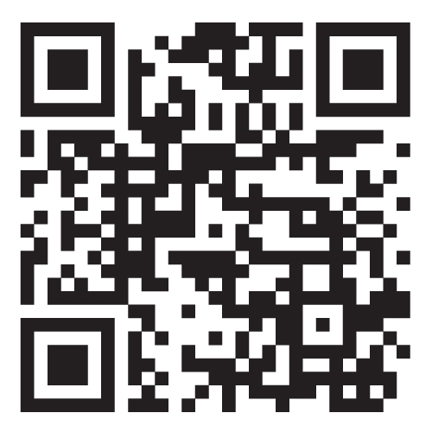


Website: OneAZWealth.com
Email: OneAZWealth@OneAZCU.com
24/7 Online Appointment Scheduler:
OneAZWealth.com
Phone: (877) 566-0517
Call Monday-Friday, 9:00 am – 5:00 pm
Scan to visit OneAZWealth.com
Your Credit Union (“Financial Institution”) provides referrals to financial professionals of LPL Financial LLC (“LPL”) pursuant to an agreement that allows LPL to pay the Financial Institution for these referrals. This creates an incentive for the Financial Institution to make these referrals, resulting in a conflict of interest. The Financial Institution is not a current client of LPL for brokerage or advisory services.
Please visit https://www.lpl.com/disclosures/is-lpl-relationship-disclosure.html for more detailed information.
This presentation was created for educational and informational purposes only and is not intended as ERISA, tax, legal or investment advice. If you are seeking investment advice specific to your needs, such advice services must be obtained on your own separate from this educational presentation.
Securities and advisory services are offered through LPL Financial (LPL), a registered investment advisor and broker-dealer (member FINRA/SIPC). Insurance products are offered through LPL or its licensed affiliates. OneAZ Credit Union (OneAZ CU) and OneAZ Wealth Management are not registered as a broker-dealer or investment advisor. Registered representatives of LPL offer products and services using OneAZ Wealth Management, and may also be employees of OneAZ CU. These products and services are being offered through LPL or its affiliates, which are separate entities from, and not affiliates of, OneAZ CU nor OneAZ Wealth Management. Securities and insurance offered through LPL or its affiliates are:
Not Insured by NCUA or Any Other Government Agency | Not Credit Union Guaranteed | Not Credit Union Deposits or Obligations | May Lose Value
OneAZ Wealth Management | (877) 566-0517 | www.OneAZWealth.com | Safe For Public Distribution.
Notes:
First, here is our Information page, it contains our required legal disclosures for your convenience.
Please always check out our OneAZWealth.com website for upcoming webinar events.

Slide 5
Connect With Us!
Website: OneAZWealth.com
Email: OneAZWealth@OneAZCU.com
24/7 Online Appointment Scheduler:
OneAZWealth.com
Phone: (877) 566-0517
Call Monday-Friday, 9:00 am – 5:00 pm
Scan to visit OneAZWealth.com
OneAZ Wealth Management | (877) 566-0517 | www.OneAZWealth.com | Safe For Public Distribution.
Notes:
For better audio, the webinar will be in “listen-only mode”…
We will be fielding your questions at the end of the webinar. Please, email any questions to: oneazwealth@oneazcu.com. We will be compiling your questions and will answer them at the end of today’s presentation. If we do not get to your question, I promise we will respond to you directly.
Last, for more information about OneAZ Wealth Management and our team of wealth advisors, visit OneAZWealth.com or use your mobile device to scan the QR Code on the screen now.
You can also connect with us on social media on Facebook, LinkedIn, and YouTube for more exciting resources and helpful information.

Slide 6
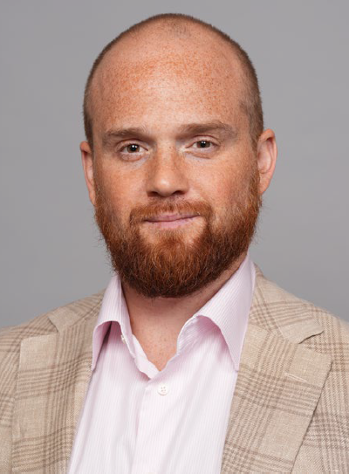
Guest Speaker
Timothy Cintolo
Vice President, Advanced Planning Field
Prudential Financial
**Timothy Cintolo, Prudential Financial is not affiliated with or endorsed by LPL Financial and OneAZ Wealth Management.
Notes:
So, let’s get started…
Our OneAZ Wealth topic today: Identity Theft and Cybersecurity
Tim Cintolo bio:
Tim Cintolo is the Director of Sales Technology for Prudential’s Advanced Planning Group. He provides value-added programs and in-market technology training to the sales organization, financial professionals, and the broker-dealers Prudential serves. His focus is helping financial professionals utilize technology solutions to better service clients and help grow their business. He delivers guidance on integrating best practices for broker-dealer systems and financial planning softwares, as well as: social media platforms, cybersecurity and technology trends in the Financial Services industry. Tim’s recommendations for financial professionals have been published in industry circulars such as WealthManagement Magazine.
Tim has made a career of working in partnership with financial professionals. He has been with Prudential Financial for over eight years, holding positions in both Sales and Marketing. Prior to this role, Tim worked extensively with financial professionals and their clients in both the Retirement Plan and Annuity markets. He joined Prudential from John Hancock where he spent four years as Sales Development Consultant and Advisor Experience Consultant, focused on the mid-market retirement plan business.
Tim graduated from Fairfield University in Fairfield, CT. He holds a designation as a Certified Digital Asset Advisor (CDAA) and has also earned a Certificate in Digital Media Marketing from NYU’s School of Continuing and Professional Studies. Outside of work, Tim can be found playing golf around the Boca Raton, FL area where he calls home.

Slide 8
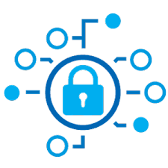
Agenda
State of The World
Cyber Breaches
Malware/Ransomware
Identity Theft
Protection Strategies
Know
Monitor
Defend
8
Notes:
Read slide.

Slide 9
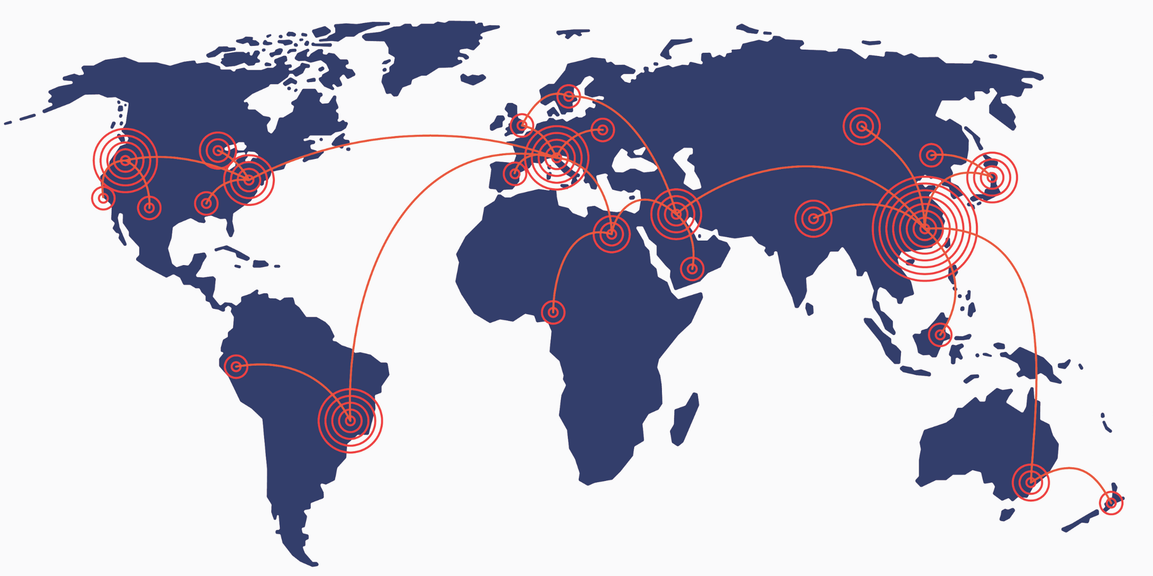
“If you can be hacked, you are hacked.”
- Kevin Mandia, CEO of cybersecurity firm FireEye
64% of companies across the globe have experienced some sort of hacking attack
Nearly 90% of all breaches occur due to human error.
https://www.axios.com/fireeye-kevin-mandia-cyberattacks-solarwinds-ea717ece-4839-4b7f-b966-c9c6f5ad9d03.html
9
Notes:
Over the past few years, we have seen high-profile cyber attacks steadily increase among national governments. The web has become the battlefield of choice for developed nations. Cybercrime technology is growing at a breakneck pace. International laws and regulations are no longer able to effectively keep up with and potentially sanction cyber attacks and cyber warfare.
Kevin Mandia, CEO of cybersecurity company FireEye says: “The next conflict where the gloves come off in cyber, the American citizen will be dragged into it, whether they want to be or not. Period.“ We're in an environment right now where we're playing goalie and there are slap shots coming at us every millisecond. And, by the way, blocking 99.99999999% of all the attacks means you're gonna get compromised everywhere.“
https://www.axios.com/fireeye-kevin-mandia-cyberattacks-solarwinds-ea717ece-4839-4b7f-b966-c9c6f5ad9d03.html
A cyber-attack is any type of internet attack designed by individuals or entire organizations that targets computer information systems, networks, or infrastructures. When they appear, they come from a seemingly anonymous source that will attempt to destroy its victim through hacking into its system.
There have been many, many worldwide cyber-attacks, and some are happening right now. The latest statistics say that security breaches have increased by 11% since 2018 and 67% since 2014. In fact, hackers attack every 39 seconds, so on average, 2,244 times a day.
Every 39 seconds, a cyber-attack occurs. While some of these are manually-targeted cyber-attacks, most of them are botnets steadfast on shutting down infrastructures and destroying computers and systems of major organizations.
https://norse-corp.com/map/
http://threatmap.fortiguard.com/

Slide 10
How and Why
Espionage
Ransomware
Phishing
What do they want?
1.
Three Types of Cyber Attacks:
Information
Money
Chaos
2.
3.
The FBI reports that since the start of the pandemic, cyberattacks have increased by 300%.
COVID-19 News: FBI Reports 300% Increase in Reported Cybercrimes - IMC Grupo
10
Notes:
What are cyber-attackers after? Information, Money or simply creating chaos for their victims, or victim’s nation. Here are the three most common types of cyber attacks.
25% of all cyber-attacks are espionage
Espionage is the theft of information or confidential data from either governments, companies or natural persons. The industries most affected are manufacturing, education, and public administration. https://safeatlast.co/blog/cyber-warfare-statistics/#gref
US cyber warfare statistics suggest that non-espionage-related cyber warfare constitutes 3.2% of all cybercrime activities in the country.
(Hackmageddon)
From DDoS attacks to acts of sabotage, cyberterrorists have a powerful arsenal of means of disrupting national internet security online. Cases like the 2015 Ukrainian power grid cyberattack pop to mind as some of the most definitive examples of cyberwarfare. The large-scale operation believed to be orchestrated by Russian-backed hackers left hundreds of thousands of homes without electricity for up to six hours. As for the United States, the much-debated 2016 fake news campaign also illustrates just how effective political hacking can be.
Ransomware statistics show that 24% of all cybersecurity incidents that include malware also come with a ransom note.
(Verizon)
The global infestation of the web with ransomware has made this particular niche of cybercrime so normalized that it’s only worthy of becoming information security news if it involves a high-profile target and multi-million dollar prey. On the other hand, cryptocurrency-related theft – which accounts for just 2% of malware activity – remains hyped. Most media outlets pay close attention to cryptocurrency heists as they are often related to North Korean cyber warfare.
https://dataprot.net/statistics/cyber-warfare-statistics/

Slide 11
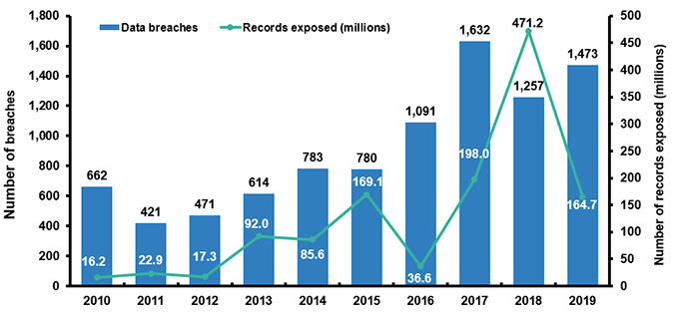
Data: From Accumulation to Monetization
Total breaches in 2020 were down 19% from 2019. Cyber criminals shift from collecting to using stolen data.
https://www.iii.org/fact-statistic/facts-statistics-identity-theft-and-cybercrime
11
Notes:
The scope of identity theft. Important to note, that data breaches are on the decline. Criminals are now shifting away from obtaining the records and data, to capitalizing on it and realizing a gain.

Slide 12
Three Key Breaches
Total US losses to Identity Theft are projected to hit $721.3 billion in 2021.
Equifax
2017
145M Americans’
Name
Address
DOB
SS#
Capital One
2019
100M customer records
SolarWinds
2020
18,000 government agencies
Undetected for months
Social Security Number: $4
Online banking logins: $40
Credit card details: $14-$30
A full range of documents and account details: $1,000
Hacked Facebook account: $35
On the Menu:
https://www.prnewswire.com/news-releases/you-are-worth-1-000-on-the-dark-web-new-study-by-privacy-affairs-finds-301286467.html
12
Notes:
In 2017 the largest U.S. credit bureau, Equifax Inc., suffered a breach that exposed the personal data, including Social Security numbers, of 145 million people. It was among the worst breaches on record because of the amount of sensitive information stolen.
In 2019, the Capital One Financial Corp. breach in July exposed 100 million records
In late 2020 criminals believed to originate outside the United States breached as many as 18,000 government agencies through software from SolarWinds, a software service company. The breach went undetected for months and was caused by changes made to a software program update. The information targeted appears to be corporate and government intellectual property rather than consumer information.
https://www.iii.org/fact-statistic/facts-statistics-identity-theft-and-cybercrime
A quick rundown on the information gathered by Privacy Affairs shows that:
Online banking logins cost an average of $40
Credit card details including associated data cost $14-$30
A full range of documents and account details can be obtained at $1,000
Hacked Facebook account: $35
https://www.prnewswire.com/news-releases/you-are-worth-1-000-on-the-dark-web-new-study-by-privacy-affairs-finds-301286467.html

Slide 13
ID Theft: By the Numbers
Identity fraud cost Americans a total of about $56 billion in 2020, with about 49 million consumers falling victim. – CNBC
Most Identity Theft occurs when victims interact with criminals or volunteer their sensitive information.
Robocalls
Phishing Scams
Social Media
https://www.cnbc.com/2021/03/23/consumers-lost-56-billion-dollars-to-identity-fraud-last-year.html
13
Notes:
Identity fraud cost Americans a total of about $56 billion last year, with about 49 million consumers falling victim.
That’s according to the 2021 Identity Fraud Study by Javelin Strategy & Research released Tuesday. About $13 billion in losses were due to what Javelin calls “traditional identity fraud,” where cybercriminals steal personally identifiable information and use it for their own gains, such as through data breaches.
But the bulk of the losses last year, $43 billion, stemmed from identity theft scams where criminals interact directly with consumers to steal their information through methods such as robocalls and phishing emails. Victims of these scams lost $1,100 on average, according to Javelin.
https://www.cnbc.com/2021/03/23/consumers-lost-56-billion-dollars-to-identity-fraud-last-year.html

Slide 14





A Lifetime of Fraud
Child identify Theft
New Account Creation
Synthetic Identity Theft
Credit Card Fraud
Wire Fraud
Tax Refund Fraud
Employment Fraud
Account Takeover
Elder Abuse
Family Impersonation
Phishing Scams
Senior Scams
Tax Refund Fraud
Social Security Fraud
14
Notes:
Read slide.
Note for Syntehtic ID Theft:
Synthetic identity theft is the fastest growing type of ID fraud and its occurrences have surpassed "true-name" identity fraud. The ID Analytics study states it currently accounts for 80 -85 percent of all identity fraud. This is when thieves combine real and fake information to create a brand new and different identity. For example; they use your Social Security number and combine it with a different name, address and phone number. They can then open new accounts, acquires credit cards, cell phones and other goods and services not in your name but because of your social security number. A problem is that synthetic ID theft creates a fragmented or sub-file to your main credit file. A fragmented file refers to additional credit report information tied to your Social Security number, but someone else's name and address. Negative information entered in the fragmented file that is then linked to you, but doesn't actually belong to you. If you have good credit but there is derogatory information is in the fragmented file, it could negatively impact your ability to get credit. Since this type of ID Theft does not effect your main credit file; it often doesn't hit your credit report nor will a fraud alert or credit freeze help. This means it takes longer to find out you've been victimized, making it harder for you to clear your name. When they run up 1000s of dollars of debt and disappear, the creditors will eventually back track to you.
https://www.ftc.gov/sites/default/files/documents/public_comments/credit-report-freezes-534030-00033/534030-00033.pdf

Slide 15

Protection Strategies: Know
Monitor
Defend
15
Notes:
Please read slide

Slide 16



Understanding Vulnerabilities
What information can they find? Where can they find it?
Mail
Paper Statements
Wallet/Purse
Email/Text
Social Media
Credit Cards
Smartphone
App Data
Online Accounts
Wi-Fi Network
No-Tech
Low-Tech
High-Tech
16
Notes:
Read slide.

Slide 17
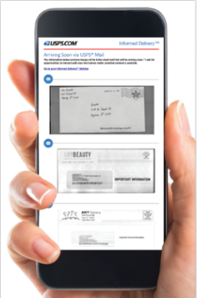
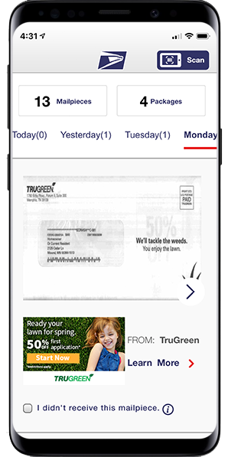
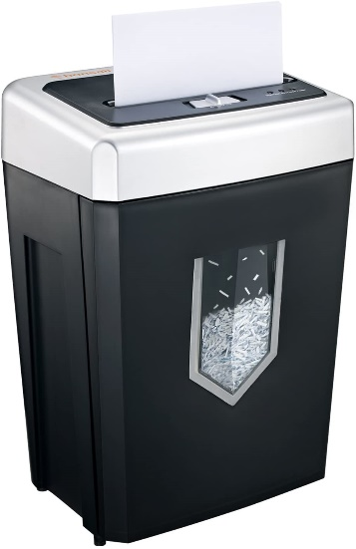
Paper is still a threat
‘Old-fashioned’ identity theft is still just as dangerous. Over half of all ID Theft originates non-digitally.
Minimize risk from physical documents:
Register for USPS Informed Delivery.
Invest in a shredder.
Reduce credit offers with: optoutprescreen.com
Go Paperless.
Clean out wallet/purse.
https://www.cnbc.com/2018/05/11/non-digital-identity-theft-can-be-as-damaging-as-breaches-from-hacking.html
17
Notes:
(Optional slide)
Read slide.
53% of all ID Theft originates non-digitally. – CNBC

Slide 18
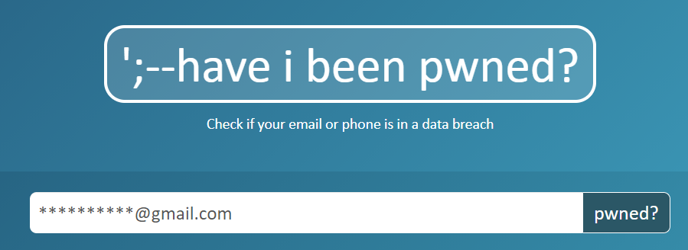
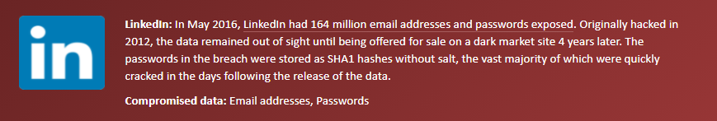
What’s already out there?
Haveibeenpwned.com
Check your email address and phone number for leaked information online.
The internet slang term "pwned" is used both online and offline as a gloating expression of dominance, control, or victory.
https://www.liveabout.com/what-is-pwned-2483497
18
Notes:
It's uncertain how the term pwned originated, but there are several theories. It may have sprung from the slang use of "owned," as in, "I owned you in that game." In the 1980s, hackers used the word "own" to describe the act of successfully hacking and taking control of a server or other computer.
If it originally began as "own" or "owned," pwned likely owes its etymological genesis to a keyboarding error in which a "p" was mistyped on a QWERTY keyboard instead of the adjacent "o," likely out of haste or excitement.
Pwned has also been attributed to a mistake in the online game Warcraft, in which the word "owned" was misspelled on a map.
Being pwned may also indicate that you're a victim of a data breach. A website called haveibeenpwned.com will help you determine if one of your accounts has been compromised.
https://www.liveabout.com/what-is-pwned-2483497

Slide 19
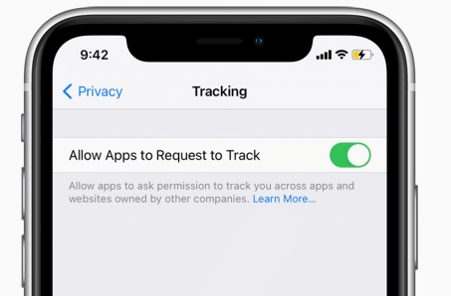
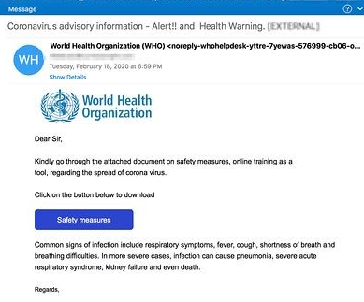
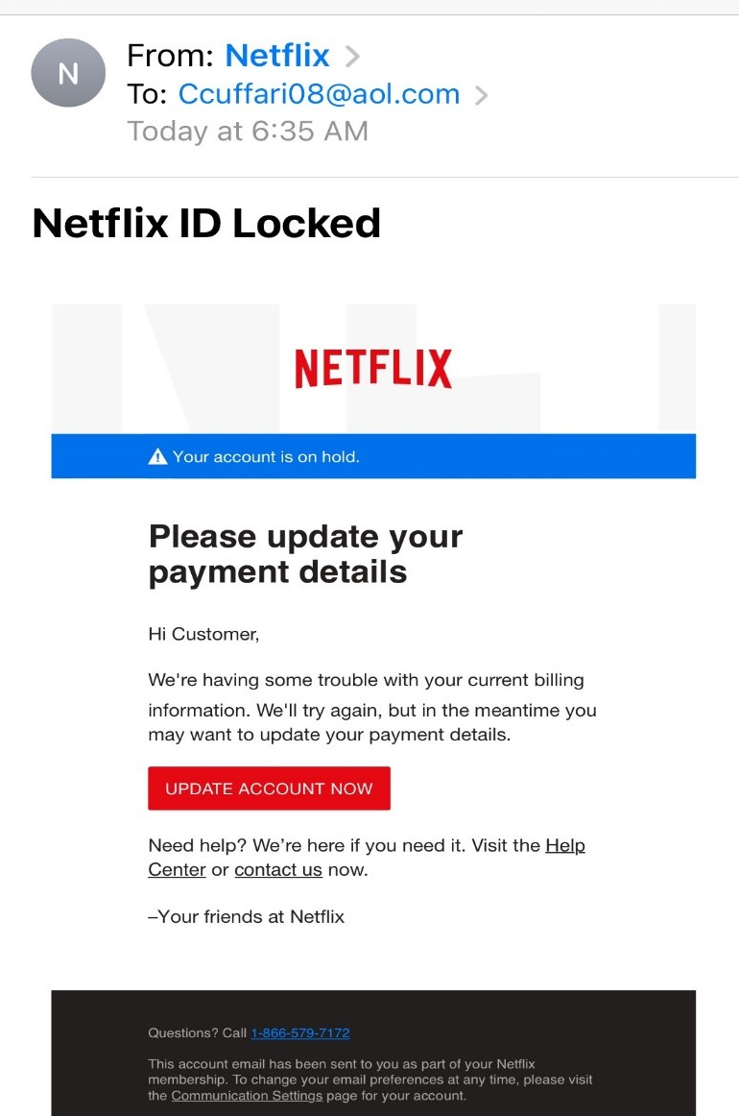
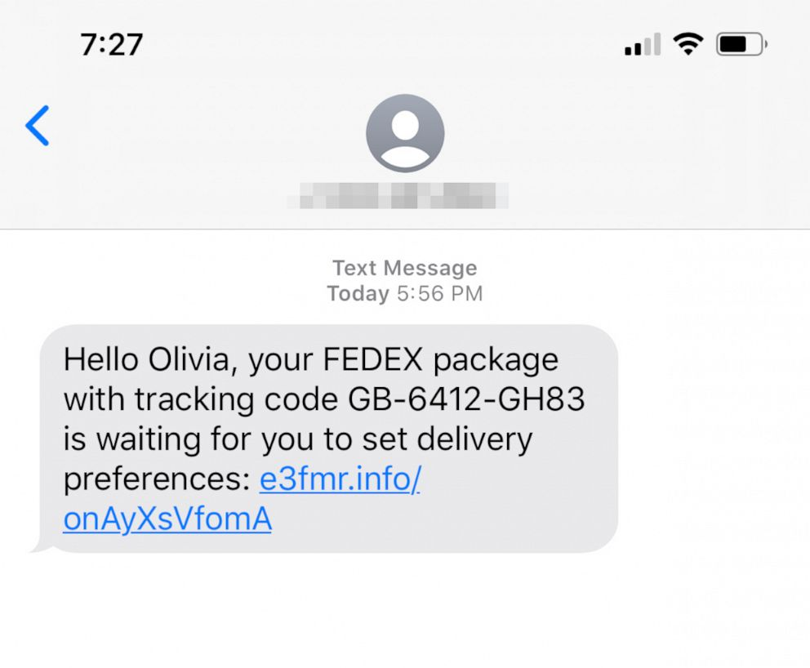
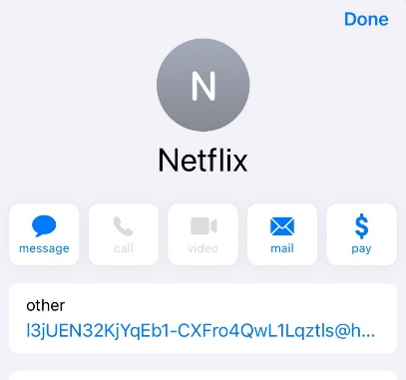
Phishing and Smishing
According to the FBI, phishing was the most common type of cybercrime in 2020 —phishing incidents nearly doubled in frequency, to 241,324 incidents.
Email:
Text Message:
https://www.tessian.com/blog/phishing-statistics-2020/#:~:text=According%20to%20the%20FBI%2C%20phishing,in%202020%20compared%20to%202016.
19
Notes:
Smishing
The most obvious example of a smishing attack is a text message containing a link to mobile malware. Mistakenly clicking on this type of link can lead to a malicious app being installed on your smartphone. Once installed, mobile malware can be used to log your keystrokes, steal your identity, or hold your valuable files for ransom. Many of the traditional dangers in opening emails and attachments from unknown senders are the same in smishing attacks, but many people are far less familiar with this type of attack and therefore less likely to be on guard against it.
Be skeptical of any text messages you receive from unknown senders and assume messages are risky until you are sure you know the sender or are expecting the message. Context is also very important. If a contact’s phone is lost or stolen, that contact can be impersonated. Make sure the message makes sense coming from that contact.
https://www.webroot.com/blog/2018/05/01/smishing-sms-phishing-scam-users-via-text-messages/

Slide 20
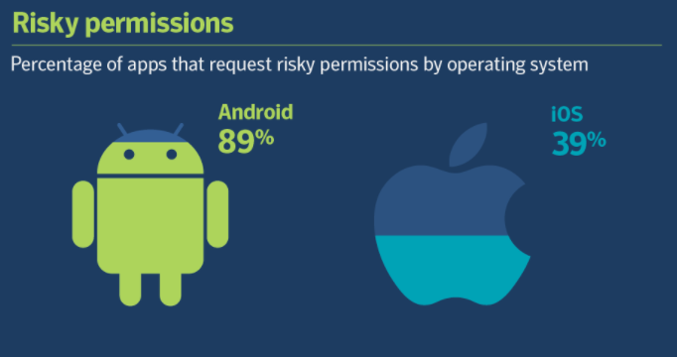
Smartphone Savvy
“Right now, your smartphone is likely filled with apps that are collecting details about you, including your age, gender, political leanings, GPS data or browsing habits.”
- Washington Post, July 2021
Pay close attention to apps that:
Access Camera
Track Location
Record Audio
Read Call Logs
Read Text Messages
https://www.washingtonpost.com/technology/2021/07/22/data-phones-leaks-church/
https://symantec-enterprise-blogs.security.com/blogs/threat-intelligence/mobile-privacy-apps
20
Notes:
Some of the most common sensors found in smartphones include the accelerometer, Bluetooth, GPS, light sensor, microphone, proximity sensor, and WiFi. Other types of smartphone data collected include call logs, short message service (SMS) logs, app-use logs, and battery-status logs.
Apps have long shared this kind of information with third-party data brokers, which exist in a largely unregulated sweet spot between websites, apps and advertisers. The brokers gather the data from apps, then sell it on the open market to parties that use it for ad targeting, political profiling or even research.
https://symantec-enterprise-blogs.security.com/blogs/threat-intelligence/mobile-privacy-apps
https://www.ncbi.nlm.nih.gov/pmc/articles/PMC5572675/
https://www.imore.com/stop-iphone-tracking-frequent-locations

Slide 21
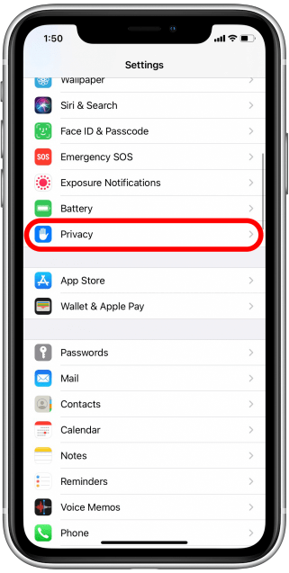
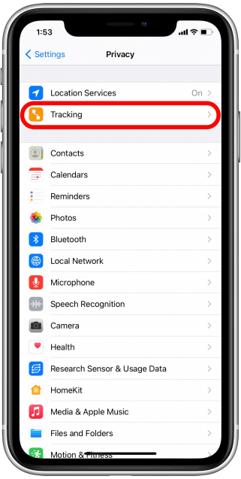
Disabling Data Tracking
How to Prevent Web & App Data Tracking on Your iPhone in iOS 14 (iphonelife.com)
21
Notes:
“Apps that you install on your phone can sometimes track your web and app activity outside of those particular apps—even when you’re not using them. This activity data is often sold to third parties to help them make advertising decisions. With iOS 14, they can’t track your data on the iPhone without your permission, but sometimes it’s easier to just stop apps from asking in the first place, so you never have to worry about allowing tracking by mistake. Let’s look at the simple way to stop apps from tracking your activity.”
It’s worth noting though that certain apps like Google, Facebook, and other account-based sites may be able to continue tracking your data as part of your user agreement for their platforms.
How to Prevent Web & App Data Tracking on Your iPhone in iOS 14 (iphonelife.com)

Slide 22
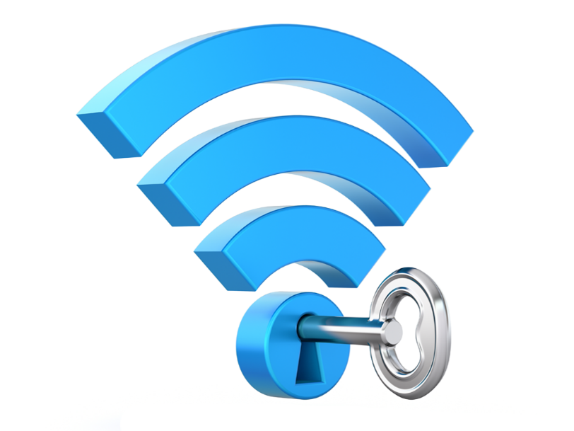
Wi-Fi Risks
Using Wi-Fi can be risky, especially in public settings.
Connect and browse safely:
At Home:
Always password-protect your network
Keep router and security software up to date
In Public:
Consider a VPN
Look for sites marked HTTPS
Avoid making financial transactions
https://www.metacompliance.com/blog/top-tips-to-stay-safe-on-public-wi-fi/
22
Notes:
(Optional Slide)
Read slide.
A VPN is one of the simplest ways to stay safe on a public Wi-Fi network. It allows you to create a secure connection to another network over the internet. It encrypts your data so that a hacker can’t tell what you are doing online or where you are located. It acts as a type of tunnel where the data is protected, and your activity can’t be viewed.

Slide 23
Know
Protection Strategies: Monitor
Defend
23
Notes:
Please read slide

Slide 24
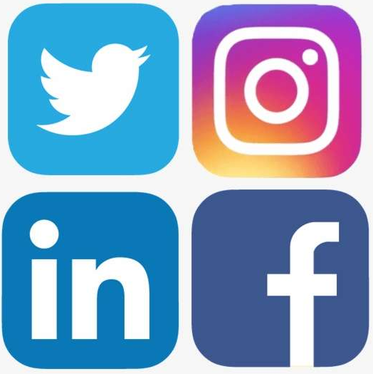
Social Media
Active social media users are 30% more likely to be affected by identity fraud; Snapchat, Facebook and Instagram users are at a 46% higher risk.
Volunteering Sensitive Information
Privacy Settings
Tagging Precise Locations
Knowing Your Network
Password Strength
Failed Log-in Attempts
Keep an eye on:
https://www.businessnewsdaily.com/4194-social-media-security-tips.html#:~:text=Active%20social%20media%20users%20are,with%20a%2046%25%20higher%20risk.
24
Notes:
68% of people with public social media profiles shared their birthday, with 45% of those users sharing their full birthdate; 63% shared the name of their high school; 18% shared their phone number; and 12% shared their pet's name
Scams to watch out for
Social media identity fraud can be difficult to recognize, because the most dangerous scams constantly change to reflect current events and take advantage of consumer patterns. Recent scams have shifted from email phishing to account fraud, leveraging fears about the COVID-19 pandemic. These fraudulent accounts pose as government agencies and post vaccine misinformation or dangle fake employment opportunities, enticing unsuspecting users to provide their contact or billing information in an effort to learn more.
These are some common schemes:
Impersonation: A hacker can message friends of the compromised account and ask for favors. Some messages may be innocuous, asking your friends about your weekend plans or work hours to learn when your home will be vacant. Others are more overt. These messages may claim that your friend is in some form of trouble and urgently needs money. Never consider sending money without verifying that the request is genuine.
Quizzes: These scams pose as fun games to post publicly and share with friends. Many quizzes ask questions about the street of your childhood home, the name of your first pet, or your favorite restaurants. These sound familiar because old password prompts asked the same questions. Posting your filled-out questionnaires offers potential hackers an easy opportunity to learn your passwords.
Business opportunities: When looking into employment opportunities, remember one golden rule: If you have to pay for anything, you are their customer, not their employee. These offers often come in the form of a pyramid scheme. The messaging party, who is almost always unsolicited, promises to send you a starter pack that you can sell. But first, of course, you need to provide your credit card information. Never, under any circumstances, provide credit information unless it is to make a purchase through a secured company page.
https://www.businessnewsdaily.com/4194-social-media-security-tips.html#:~:text=Active%20social%20media%20users%20are,with%20a%2046%25%20higher%20risk.

Slide 25
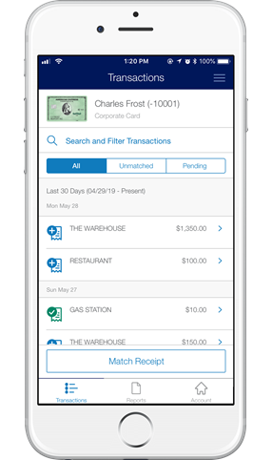
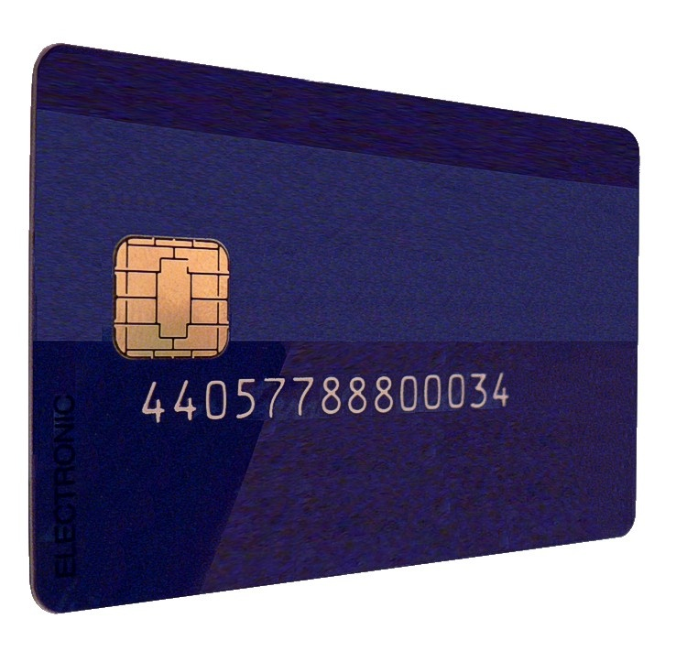
Credit Cards
Credit Card fraud has been on the decline thanks to EMV-chips. Still, be cautious when handing over your card!
Credit Card Tips:
Designate one card for online/risky purchases
Explore Virtual Account Numbers
Watch for skimmers
Use the app
Card Smartphone Apps Can:
View transactions in real time
Lock/pause/freeze your card
Set custom alerts
25
Notes:
Please read slide

Slide 26
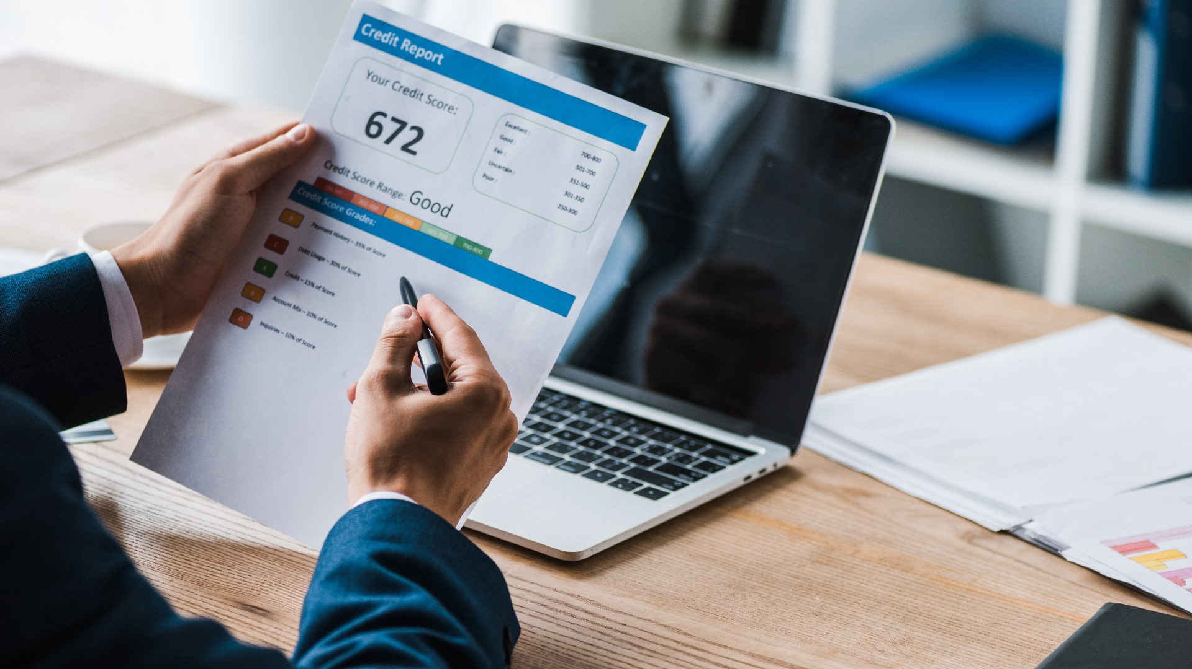
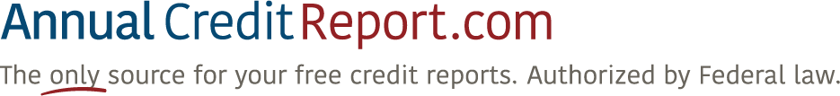
Credit Reports
Reviewing your credit reports can help spot identity theft.
Suspicious activity or accounts you don't recognize can be signs of identity theft. Review your credit reports to catch problems early.
SCORE can be checked as often as you want for free.
REPORT can be pulled for free once per year, per bureau.
26
Notes:
Read slide.

Slide 27
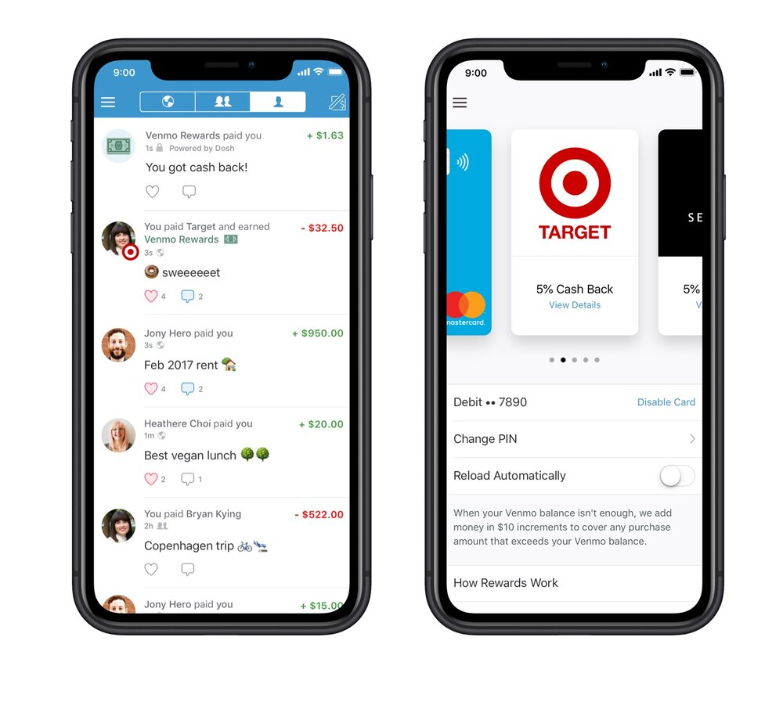
Peer-to-Peer Payments
Apple Pay, Cash App, Venmo, Zelle are great for moving money – but also pose a risk?
Make sure you know the recipient
Keep all transactions private
Secure your account with a strong password and MFA
Remember to sign out or close the app
Always password-protect your smartphone
27
Notes:
Read slide.

Slide 28
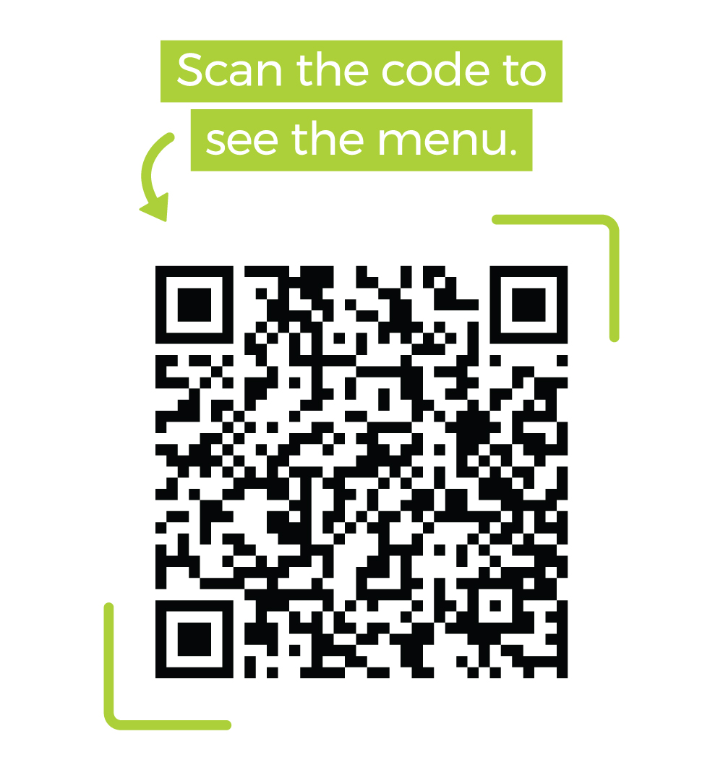
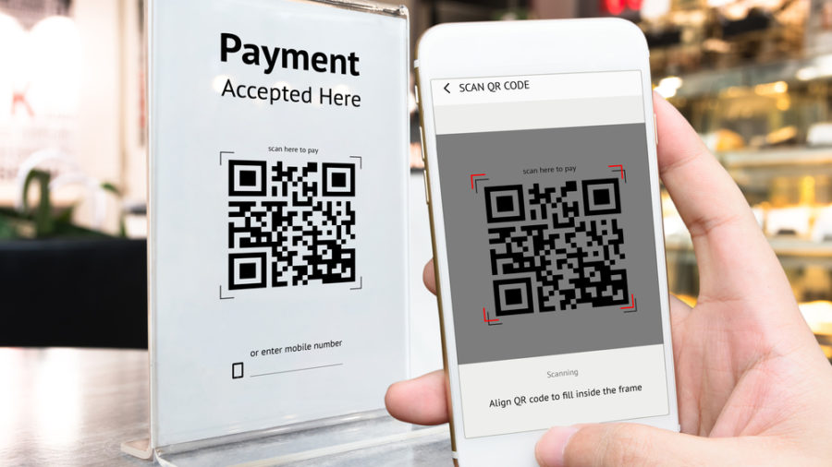
QR Codes
Fast adoption, and ease of producing and reading QR codes, make them a new favorite for bad actors.
Scanning a QR Code is just like clicking a link.
Be weary of scan-to-pay options and sites that ask for information.
28
Notes:
It is not uncommon for fraudsters to replace legitimate QR codes with their own codes, often simply by printing it on a sticker and placing it on top of the real one. Parking meters and ticket vending machines are common targets of this scheme.
When a consumer would scan this fake code, they would be taken to a website that might load malware onto their device or try to trick them into entering credit card information or other sensitive personal data. The advent of QR code payments has made it possible for fake codes to steal funds directly. While most QR code payment apps should prompt the consumer to verify the payment details after scanning the code, it’s easy for busy shoppers to approve a fraudulent payment because they weren’t paying close attention.
In markets where QR code payments are commonplace, some inventive scams have emerged, such as printing fake parking tickets that allow you to pay your “fine” via QR code, or offers to exchange QR codes payments for cash that overcharge the recipient by several orders of magnitude.
https://www.chargebackgurus.com/blog/qr-code-payments

Slide 29
Know
Monitor
Protection Strategies: Defend
29
Notes:
Please read slide

Slide 30
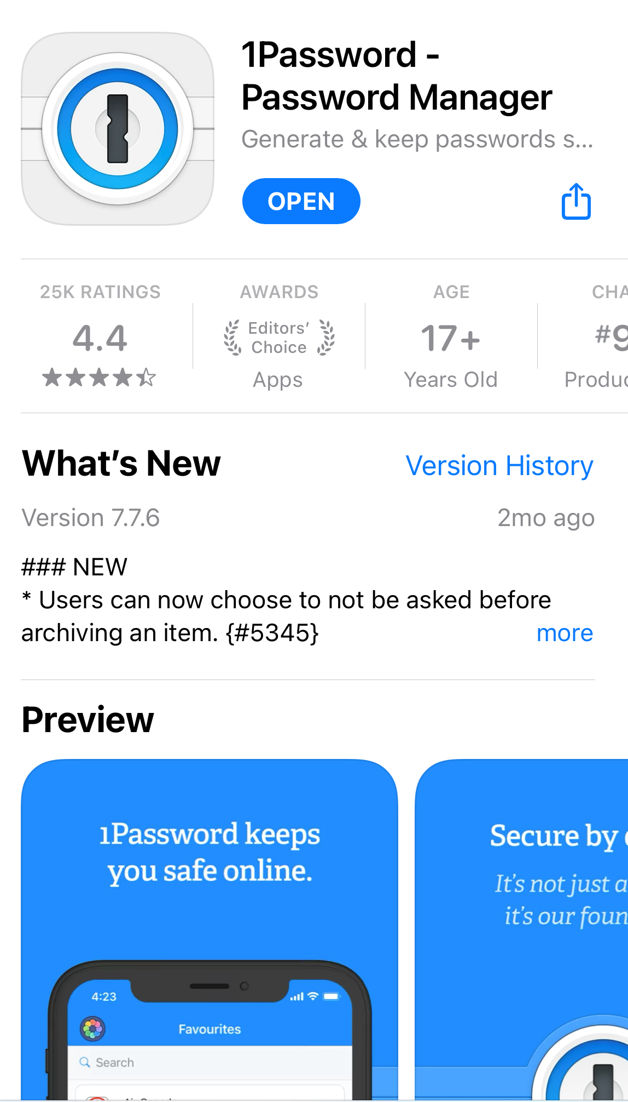
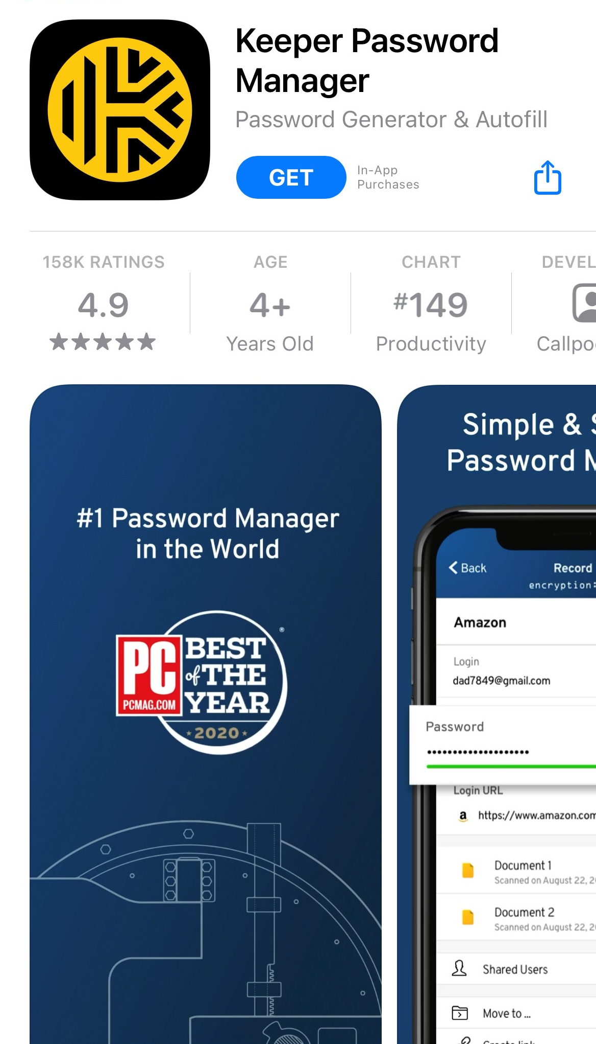
Passwords
Consider a Password Manager for security and ease.
Three keys for great “password etiquette”:
Secrecy: never shared, never exposed
Complexity: characters, symbols, phrases
Variety: always different, changed often
Sample Strong Password: Jelly22fi$h-10
30
Notes:
Switch to a passphrase
TRICK: substitute numbers and letters
TRICK: Use the site name somehow in the password
Use a password manager
Use a fingerprint reader
Lock your screen and log out
https://www.coolcatteacher.com/password-tips/
https://www.coolcatteacher.com/password-tips/

Slide 31
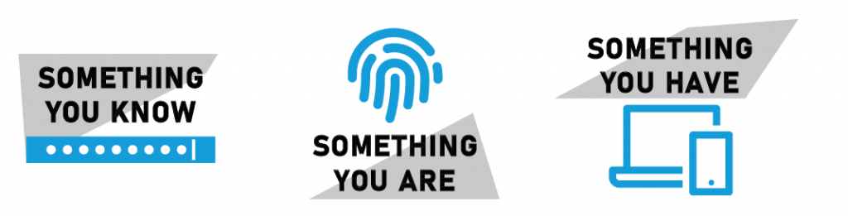
Multi-Factor Authentication (MFA)
Always review Account and Security settings and utilize options for MFA or 2FA.
Make Multi-Factor Authentication a priority for:
All Banking and Finance Accounts
Social Media Accounts
Google and Apple ID Accounts
Wireless Provider Account
MFA blocks 99.9% of automated attacks. - Microsoft
https://www.zdnet.com/article/microsoft-using-multi-factor-authentication-blocks-99-9-of-account-hacks/
31
Notes:
Read slide.

Slide 32
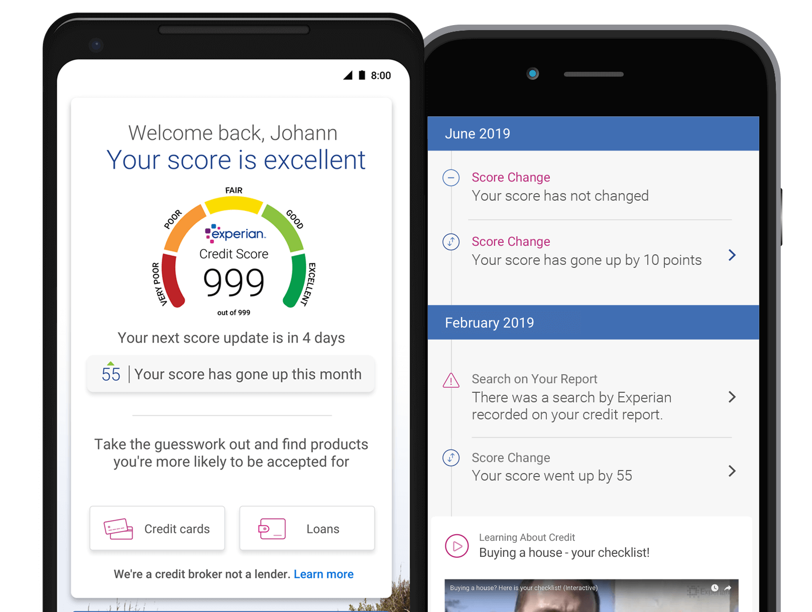
Credit Monitoring and ID Theft Protection Services
Consider services like Experian, CreditWise from Capital One, or LifeLock/Identity Guard
Authorizations and alerts
Features include:
Liability protection
Credit Scores and reports
Dark Web monitoring
Frequently offered free by employers
32
Notes:
https://www.cnbc.com/select/best-credit-monitoring-services/

Slide 33


Government Accounts
The SSA and IRS offer online access to review and protect your accounts.
Create accounts at SSA and IRS.
Verify all existing information.
Explore opportunities to set alerts/notifications.
Secure accounts with strong passwords.
33
Notes:
Read slide.

Slide 34
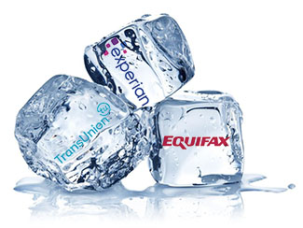
Freezing Credit
Placing a freeze on your credit is one of the best actions to prevent fraud.
Who can place one: Anyone
What it does: Restricts access to your credit report and prevents new lines of credit form being opened
Duration: Lasts until you remove it
Cost: Free
How to place: Contact each of the three credit bureaus, allow 24-48 hours
Be sure to save your PIN!
https://www.consumer.ftc.gov/articles/what-know-about-credit-freezes-and-fraud-alerts
34
Notes:
Read slide.

Slide 35
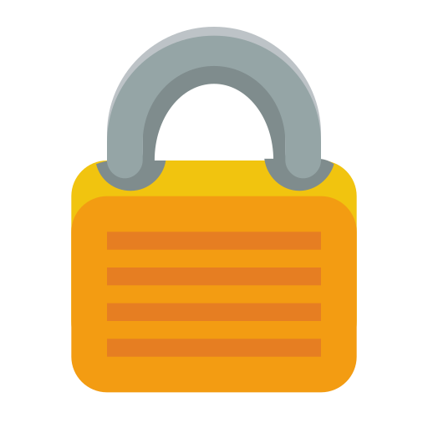
Take Action: Know, Monitor, Defend
Know: Use your resources to find out what is already online.
Monitor: Develop a system to regularly review accounts and data.
Defend: Take action to safeguard accounts. Implement strong passwords. Hire help.
Credit Monitoring / ID Theft Protection
IRS
SSA
Experian
Equifax
Transunion
Six Accounts for Safety:
35
Notes:
Read slide.

Slide 36
Disclosure
Issued by The Prudential Insurance Company of America, Newark, NJ, and its affiliates.
​This material is being provided for informational or educational purposes only and does not take into account the investment objectives or financial situation of any client or prospective clients. The information is not intended as investment advice and is not a recommendation about managing or investing your retirement savings. If you would like information about your particular investment needs, please contac​t a financial professional.
© 2022 Prudential Financial, Inc. and its related entities. Prudential, the Prudential logo, and the Rock symbol are service marks of Prudential Financial, Inc. and its related entities, registered in many jurisdictions worldwide.
36
Notes:
Please read slide

Slide 37

37
Notes:
Please read slide

Slide 38
Question & Answers
Website: OneAZWealth.com
Email: OneAZWealth@OneAZCU.com
24/7 Online Appointment Scheduler:
OneAZWealth.com
Phone: (877) 566-0517
Call Monday-Friday, 9:00 am – 5:00 pm
Scan to visit OneAZWealth.com
OneAZ Wealth Management | (877) 566-0517 | www.OneAZWealth.com | Safe For Public Distribution.
Notes:
We have a number of questions coming in now. Please email any questions you have to OneAZWealth@oneazcu.com ... And we will be sure to address them…
So, our first question is: (TBD)
If we do not get to your question, I promise we will respond to you directly.

Slide 39
Thank you!
Website: OneAZWealth.com
Email: OneAZWealth@OneAZCU.com
24/7 Online Appointment Scheduler:
OneAZWealth.com
Phone: (877) 566-0517
Call Monday-Friday, 9:00 am – 5:00 pm
Scan to visit OneAZWealth.com
OneAZ Wealth Management | (877) 566-0517 | www.OneAZWealth.com | Safe For Public Distribution.
Notes:
As a wrap-up,
Thank you, Tim for your presentation and insights.
For those watching and listening, Thank you for joining, we hope our discussion today has helped to provide you some ideas on Identity Theft and Cybersecurity.
We all here at OneAZ Wealth Management welcome your feedback and comments. So, Please email us any suggestions you have for future webinar topics.
As always, our entire OneAZ Wealth team of Advisors stands ready to assist you in reviewing your current financial plan and portfolio in light of today’s economy. There is no better time than the present for a 2nd opinion on your current plan. Many of our clients had other advisors when they first come to us, and they learned and discovered new ideas and new strategies that are better suited to their needs. We welcome your call!
Please call our toll-free number: 877-566-0517 and visit our OneAZWealth.com website for more information in creating your personal financial and retirement plan.
Again, Thank you for joining us… From all of us at OneAZ Wealth, we wish you the best 2023 for your Safety, Health and Wealth!

Slide 40
Important Disclosures
For a list of descriptions of the indexes and economic terms referenced in this publication, please visit our website at lplresearch.com/definitions.
This research material has been prepared by LPL Financial LLC.
Securities and advisory services offered through LPL Financial (LPL), a registered investment advisor and broker-dealer (member FINRA/SIPC). Insurance products are offered through LPL or its licensed affiliates. To the extent you are receiving investment advice from a separately registered independent investment advisor that is not an LPL affiliate, please note LPL makes no representation with respect to such entity.
Not Insured by FDIC/NCUA or Any Other Government Agency | Not Bank/Credit Union Guaranteed | Not Bank/Credit Union Deposits or Obligations | May Lose Value

