Slide 1
On-Track to Graduation:
The Chicago Story
National Title I Conference
February 4, 2014
Notes:
Good morning, President Vitale and Members of the Board. I’m honored to be representing hundreds of colleagues and partners throughout the city who have contributed their thoughts, ideas, and recommendations in the construction of the School Quality Rating Policy before you today for your consideration.
I want to recognize some key contributors before I begin my brief presentation. First, to the district’s director of Performance Data and Policy – Ryan Crosby – I owe a special debt of gratitude. Ryan knows the details of this work unlike anyone else and has built a team that shares his affinity for getting the specifics right. Broad Resident Vivian Lee was essential to the development of the framework you see today and was vital to our stakeholder engagement efforts. It took some convincing to get Vivian to work with me on this, but I hope she’s glad she said yes. To Denise Little who always is a great thought partner, I say a special thank you. To Jack Elsey and the Innovation and Incubation team, thank you for your strong partnership on this work throughout the process and going forward, as well.
Most of all, a special thanks to Dr. Byrd-Bennett who saw the need for a common accountability system and charged us to go out and make one. Doc, we hope we’ve met your expectations with the plan that I’ll give an overview of now.

Slide 2

The Next Generation: Chicago’s Children –
Our Framework for Success

Slide 3
A Legacy to Transform
In 2003, the five-year cohort graduation rate for Chicago Public Schools hovered at 50% - only half of the students who started in ninth grade had graduated five years later
In 2013, the five-year cohort graduation rate topped 65% and is positioned to break 70% for the Class of 2014
What happened?
Beginning in 2003, the district began using an on-track measure developed in partnership with the Consortium for Chicago School Research (CCSR) – the district dubbed this metric Freshman On-Track (FOT)
The FOT rate was defined as the number of first-time freshmen who earned at least 5.0 credits and did not fail more than 0.5 core course credits (numerator) divided by the number of first time freshmen (denominator)
Notes:
The district’s history on having what’s been known as a “performance policy” goes back to 1995, but our current work builds most off of recommendations made last year by a group known as the Accountability Task Force and the subsequent conversations with literally hundreds of stakeholders across the city.
The proposal before you today takes into account that the ISAT test – previously used in providing school ratings – is changing and then ultimately going away. And with the Partnership for Assessment of Readiness for College and Careers (PARCC) tests in beta testing mode for the 2014-15 school year at least, the district needs a stable, long-term plan to measure school quality.

Slide 4
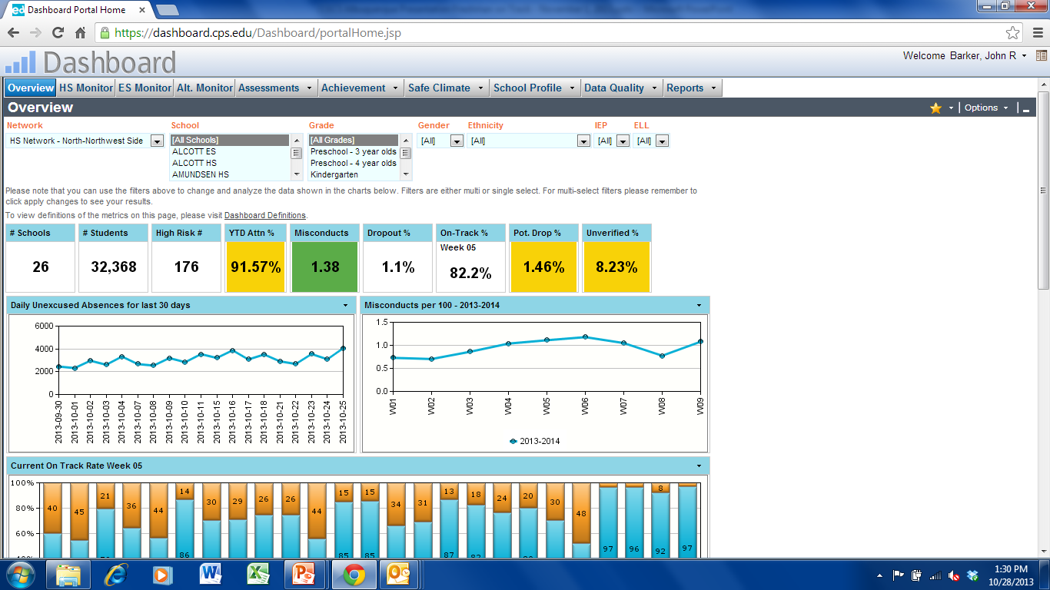
CPS Dashboard Allows 24/7 Review

Slide 5
FOT has Changed the Trajectory
Notes:
Throughout the development of this policy, we have engaged individuals from numerous organizations across the city. The discussions, emails, phone calls, texts, and interviews have been lively – as you might imagine given the participants listed – and in the end have always focused on one thing: improved learning opportunities for students.

Slide 6
What Lessons Have We Learned?
Develop and validate the metric – the variables included in the metric were found to be highly predictive of graduation
Provide actionable data reporting – implementation of the FOT early warning reporting system provide regular, actionable reports to schools allowing for early intervention with at-risk students and ongoing monitoring to ensure students stayed on track throughout the year. These reports included the Freshman Watchlist (incoming at-risk freshman), the Freshman Success Report (on-going monitoring beginning in 2nd quarter), and the Credit Recovery Report
Share best practices and provide support - “On-Track Labs” in several high schools developed promising practices around use of the reports and created opportunities for sharing effective practices
Hold schools accountable for their results – by demand from the field, FOT has become a part of the district’s accountability system
Notes:
To recap the changes you see in the policy as compared with what this Board has previously approved, there are a few issues to touch on here:
The metrics in the new School Quality Rating Policy are far more holistic than in prior policies, reflecting the broad-based support for moving away from a heavy reliance on student test scores as a disproportionate indicator of school quality.
The new policy adopts the use of five Tiers as compared with the former three Levels of school quality. The new five-category strategy allows for the recognition of excellence, as well as provides a clearer picture of the intervention and supports needed in lower-performing schools.
Possibly the first of its kind anywhere in the country, this policy includes a specific set of metrics for Option Schools, where students are served in alternative settings and school quality looks a bit different than a traditional model. Developed in close collaboration with key partners, the policy sets forth a rigorous set of performance metrics for this group of schools.
The Measures of Academic Progress (MAP) test from the Northwest Evaluation Association (NWEA) replaces ISAT in the new model, given the variable nature of ISAT over the past two years and coming year.
The new policy ties student performance to national benchmarks wherever possible including NWEA and EPAS results.
And the new policy expects schools to achieve at high levels for all students. The 95% participation rate metric says that schools can’t test a smaller proportion of high performers and declare victory. I’ve heard her say it many times and know she means it every time – under this CEO, all means all.

