Slide 1

Capacity Building Initiative
TEA Initiative for Title I, Part A and Title I, Part D
Notes:
The Title I Capacity Building Initiative is funded by the Texas Education Agency and produced by Region 10 Education Service Center.
This website serves as a central location for showcasing best practices in high achievement and closing the achievement gap between student groups.
The research, videos, and tools will assist schools striving for continuous improvement.

Slide 2
Introducing Our Team
Anita Villarreal, Texas Education Agency
  Texas State Coordinator for Title I, Part A
Toni Garrett, Capacity Building Initiative
  Region 10 Education Service Center
Rosemary Leal, Los Fresnos CISD
  Principal, Los Fresnos Elementary

Slide 3
Texas Education Agency
Anita Villarreal
State Coordinator for Title I, Part A

Slide 4
What’s the purpose of the initiative?
Provide tools and resources that integrate best practice strategies to improve student achievement
Provide tools and resources to assist LEAs with program compliance
State-wide initiative funded by TEA

Slide 5
Title I Capacity Building Initiative
Toni Garrett
Program Coordinator
Region 10 Education Service Center

Slide 6
Let’s explore!
http://www.region10.org/capacitybuilding
Look on the left side – Capacity Building Links
  Best Practice Resources
  Reward School Profiles
  Reward School Videos
  NCLB Publications
  Title I, Part D

Slide 7
Los Fresnos Elementary
Rosemary Leal
Principal
Los Fresnos CISD

Slide 8

Rosemary Leal
Principal, Los Fresnos Elementary

Slide 9
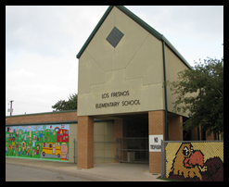
LFE - Demographics
659 students enrolled (PK- 5th)
32.02% Bilingual/LEP
80.27% Eco Dis
94% Hispanic
6% White
43.10% AT- Risk
6% SPED
5.92% GT
Professional staff-40
Para-professional staff-25

Slide 10
LFE – Mission Statement
District- Our mission is to provide a quality educational experience that results in the development of socially responsible life-long learners.
Campus- Our mission is to nurture the total development of each child: moral, intellectual, social, emotional, and physical to ensure they develop active and creative minds, a sense of understanding and compassion for others, and the courage to act on their beliefs.

Slide 11
LFE – Teach to STANDARDS
Texas Essential Knowledge and Skills
http://tea.texas.gov/curriculum/teks/
All pacing guides are written by teachers based on TEKS.
Lead4ward resources -TEKS snapshots, TEKS scaffolding, PLC instructional strategies are also used for lesson planning.

Slide 12
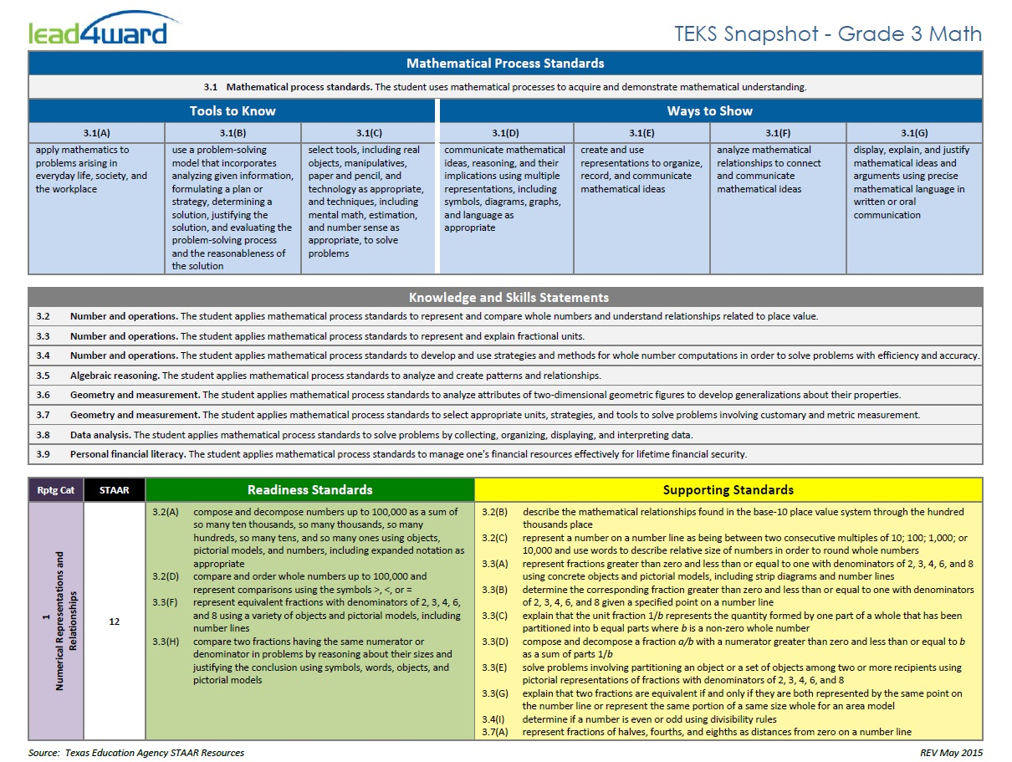

Slide 13
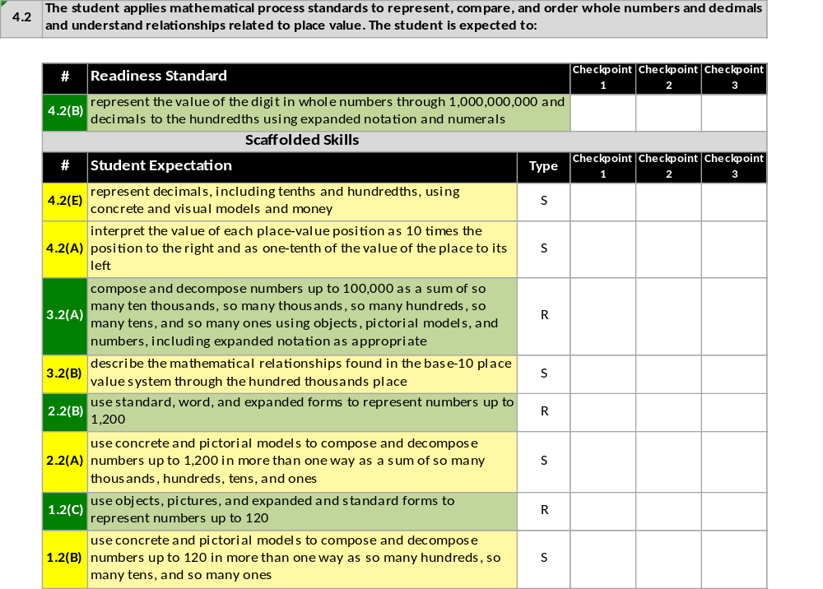
TEKS Scaffold: Math Grade 4

Slide 14
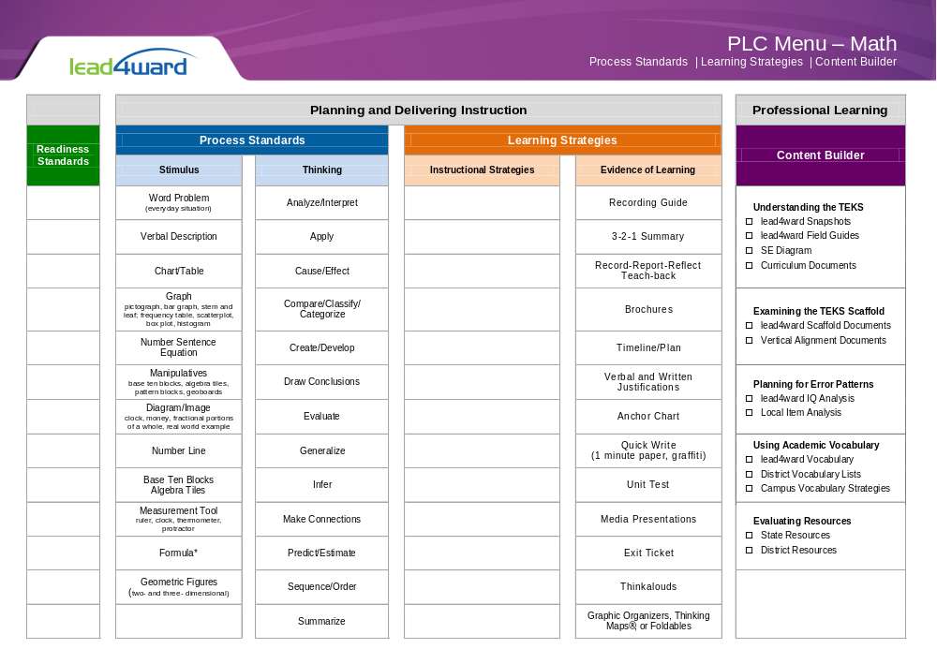
PLC - RIGOR

Slide 15
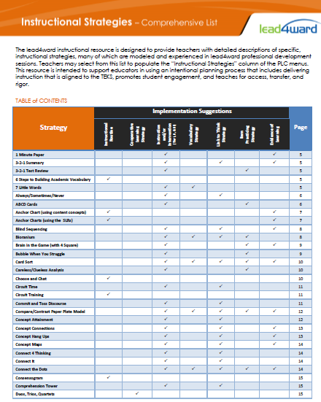
PLC
Instructional Strategies
*
Student engagement

Slide 16
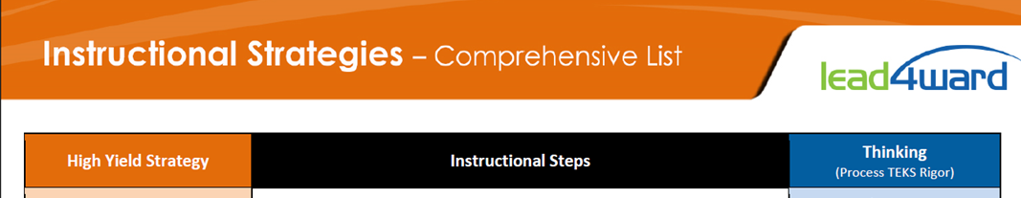
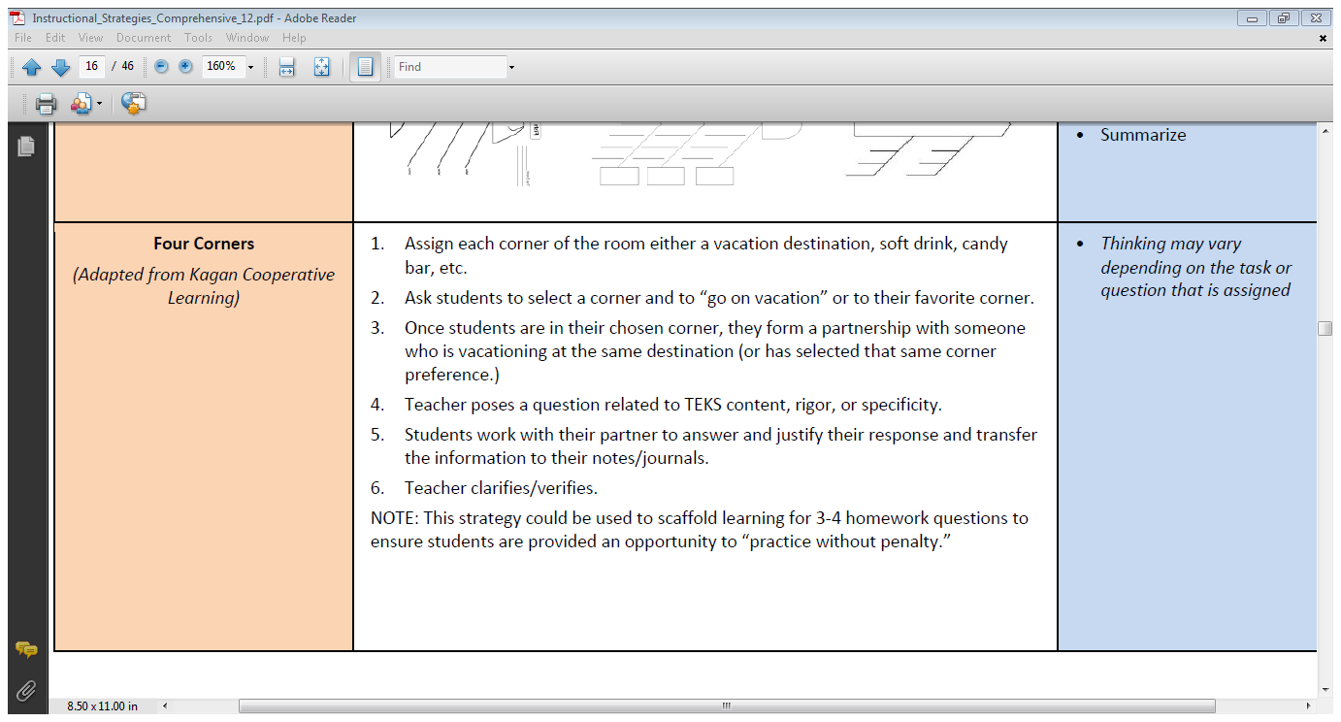

Slide 17
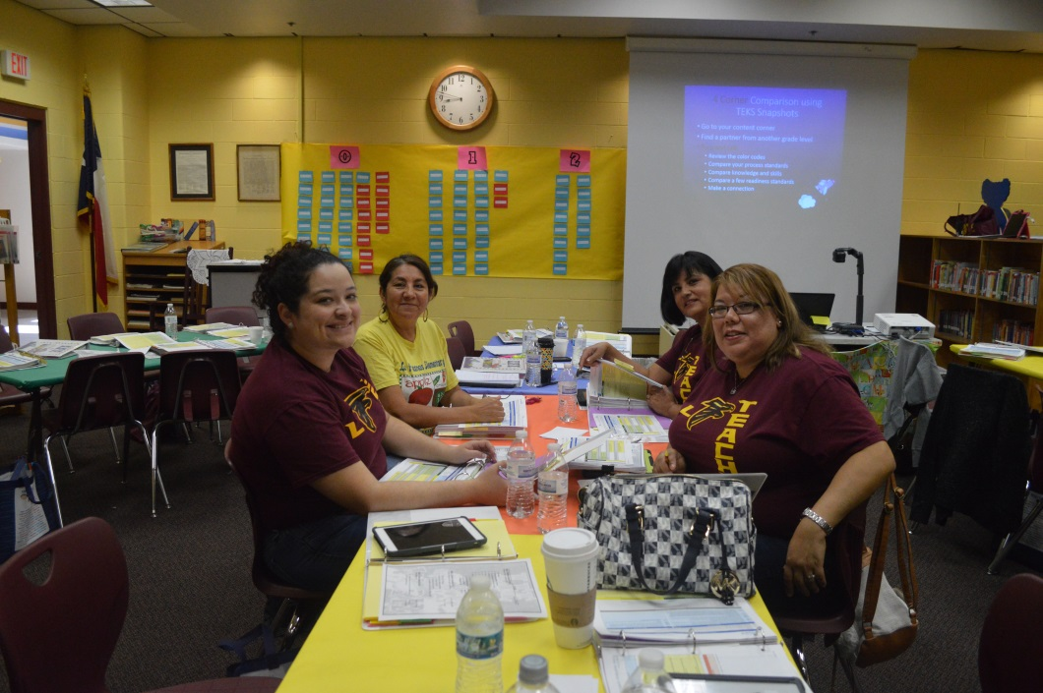
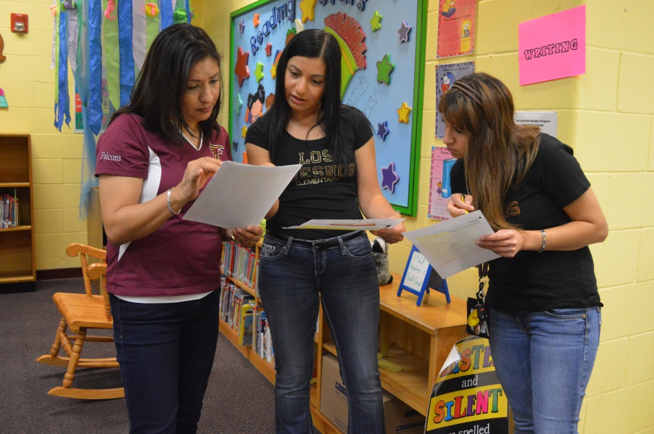
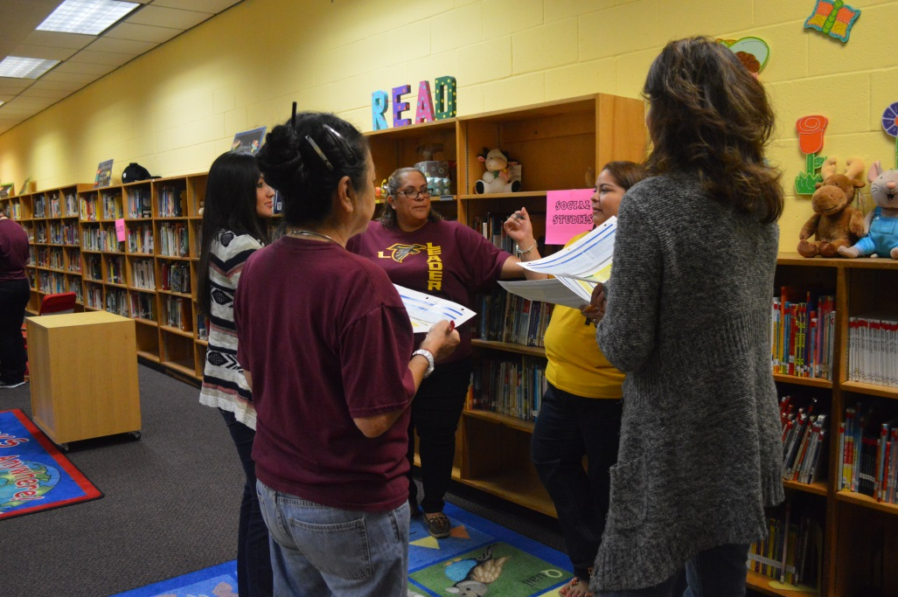
4 Corner Comparison using
TEKS Snapshots
1. Go to your content corner
2. Find a partner from another grade level
3. Turn and talk
TASK-
1. Review the color codes
2. Compare your process standards
3. Compare knowledge and skills
4. Compare a few readiness standards
5. Make a connection

Slide 18
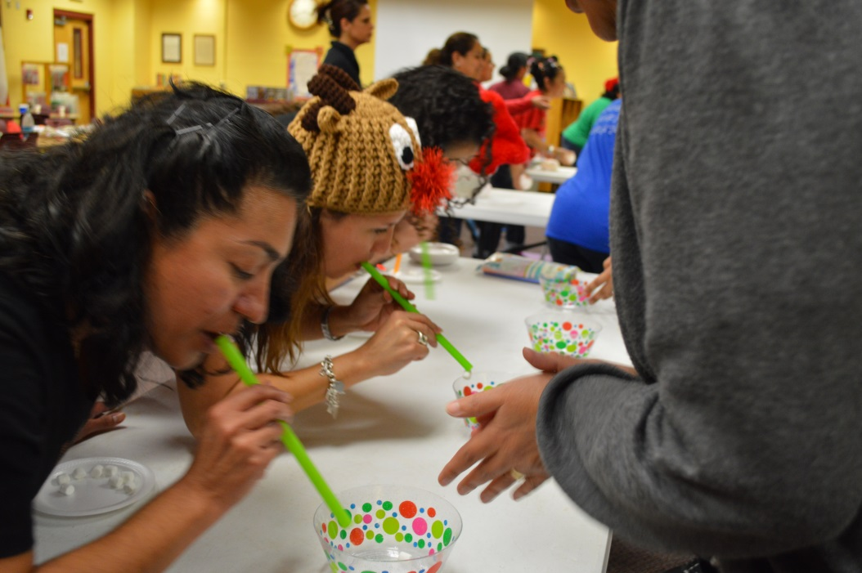
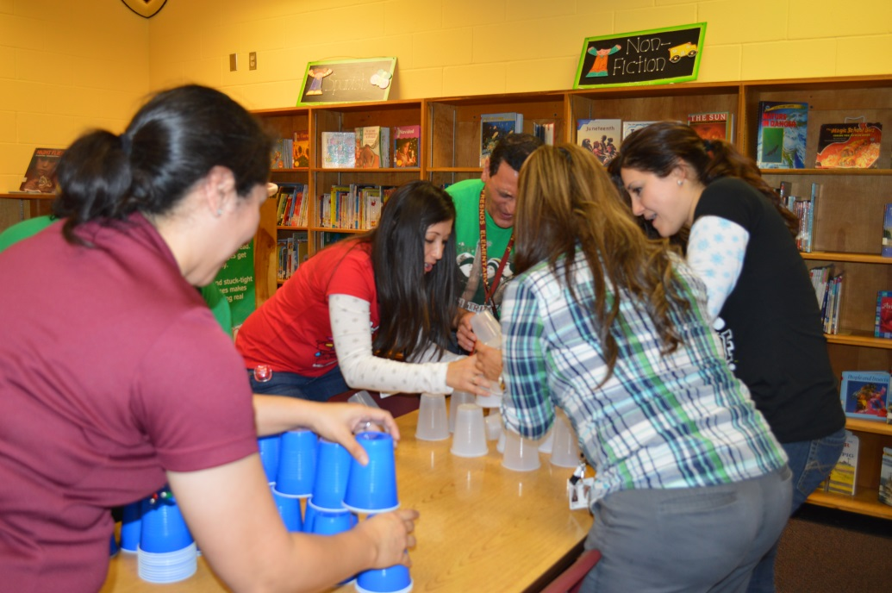
LFE – Campus Climate
Build relationships and trust through grade level meeting and team activities
Team points gained by Minute to Win It games and top scoring team wins prize.

Slide 19
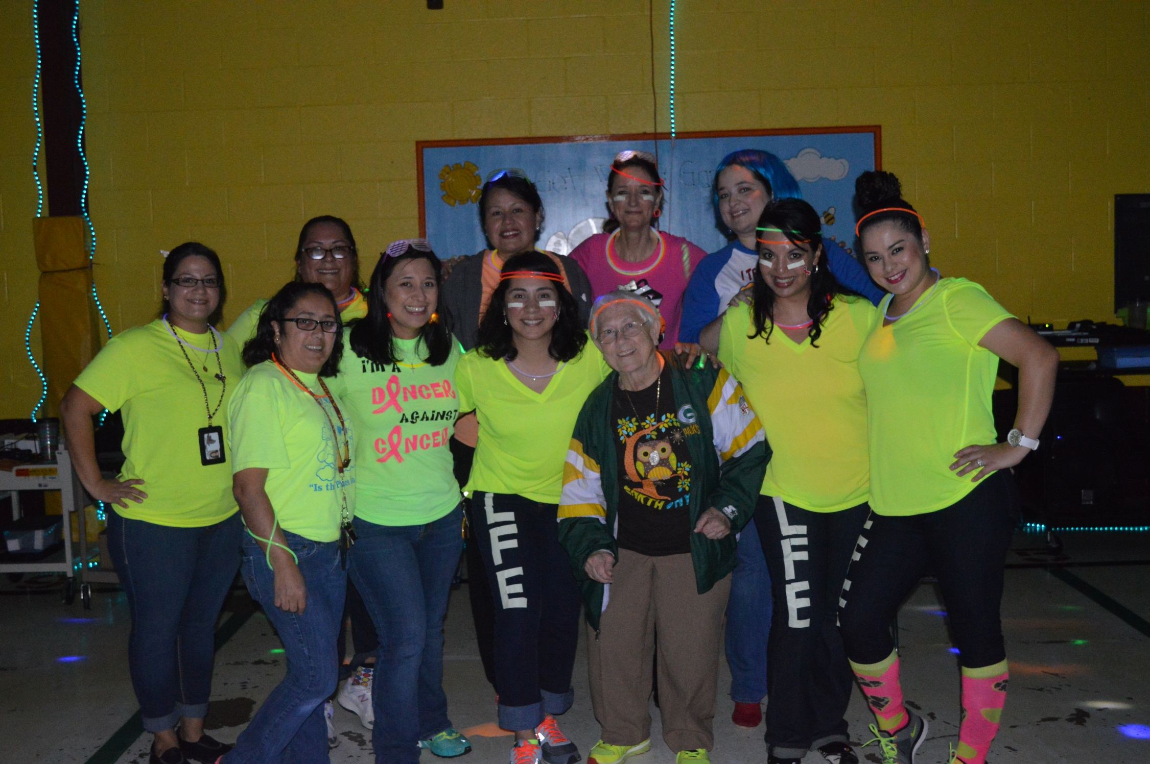

Slide 20
LFE – Building Teacher Capacity
Teachers write curriculum and lead district Best Teaching Practices meetings/vertical alignment.
Provide TTESS observation feedback with a reinforcement and a refinement
CAC – Campus Advisory Committee
PD360- Professional development program
Teacher to teacher observations
Implement data driven ideas developed by teachers

Slide 21
LFE- School Synergy to Reach Student Success
Look at data to drive instruction
Celebrate student progress (Reading Plus)
Know students (profile sheets)
Character building program
ACE afterschool program
CATCH program
Teacher ideas and taking risks
Change what is not working
RTI – what can we do to help?
Develop behavior plans
Develop interventions for students not making progress based on their needs.
Involving Community/Parents

Slide 22
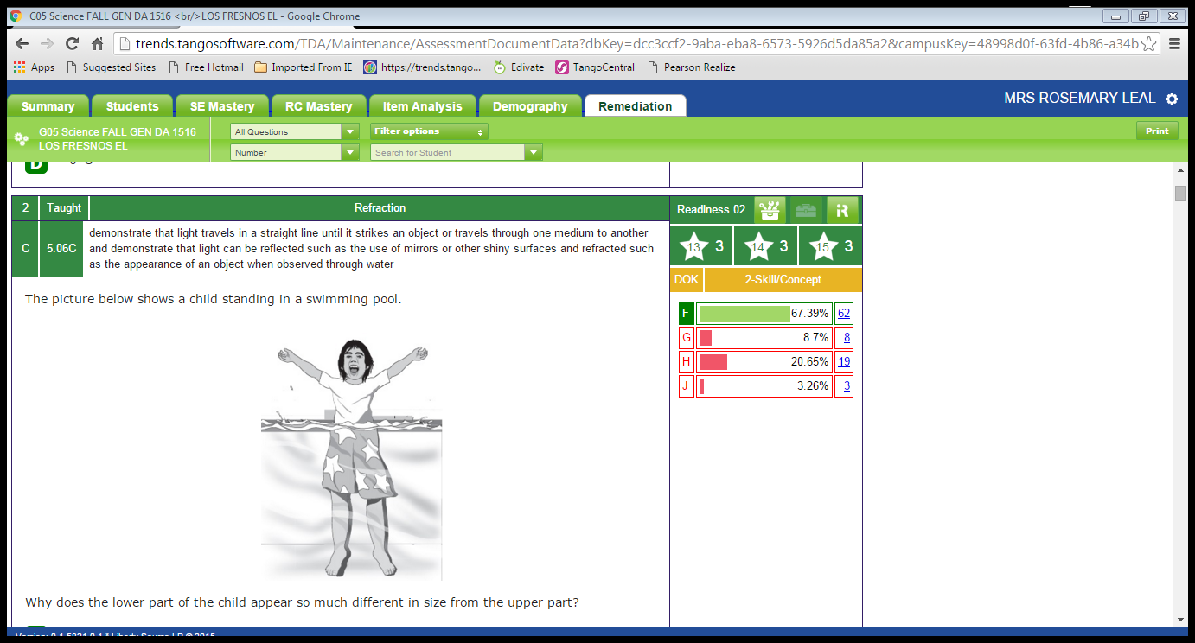
LFE- Data

Slide 23
LFE- Intervention
Hot spots (TEKS) are identified from District Assessments/STAAR
Grade level interventions are developed to closed instructional gaps.
All teachers take responsibility of all students not just those in classroom.
Example schedule:
Reading/Math intervention- 7:00 a.m. -7:55 a.m.
Power Hour 8:00a.m. – 9:00a.m.
Wednesday Success Academy 3:15 p.m. – 6:00 p.m.

Slide 24
LFE – Student Ownership

Slide 25
LFE- Student Data

Slide 26
For more information
Please contact:
Toni Garrett
Program Coordinator, Region 10 ESC
toni.garrett@region10.org
972-348-1488

