Slide 1

Response to Instruction
(RtI)
Calhoun County Schools
Mission
It is the mission of the Calhoun County School System to reach and promote the needs of every child in terms of their abilities, learning styles, interests, and diversities. Working in collaboration with all stakeholders, the Calhoun County School System challenges all students to reach their highest levels of achievement through rigorous, high-quality instruction while providing a safe and positive environment.

Slide 2
Graduation Rate Improvements System Wide
2010
58%
2011
79%
2012
81%
2013
86%

Slide 3

Response to Intervention is NOT:
Special Education initiative
Students with disabilities
A way of reducing costs or eliminating special education
A way to fix schools with weak core instruction
RtI is not…
“Instruction in a Box”

Slide 4
What is Response to Instruction?
Primary goal: Improving academic (and behavioral) outcomes for all students by eliminating discrepancies between actual and expected performance.
High Quality Instruction
Increasingly Intense Interventions
Making Instructional Decisions Based on Data
A Multi-tiered, Layered Instructional Approach

Slide 5


Slide 6
Core Principals of RtI:
High-quality, research based instruction
Early intervention for struggling learners
Waterford, Success Maker, SME, Multi Sensory Language Experience
CCRS-College and Career Readiness Standards
Data-driven decision making
STAR Enterprise Reading and Math, Formative Assessments and ACT Aspire
Universal screening and progress monitoring.
STAR Enterprise Reading and Math, Success Maker, SME and INAP
Notes:
•
•
•

Slide 7
Multi-tiered Layered Approach
Tier 3
Tier
2
Tier
1
Tier III- This should only be 1-5% of student population
Tier II- 5%-15%
Tier I- 80%-90%

Slide 8
PST
Classroom Teachers
Intervention Teachers
Instructional Coaches
SPED Teachers
School Counselor
Administration
Teams are ultimately based on school’s needs and personnel

Slide 9
PST Member Roles
Chairperson
Secretary
Timekeeper
Determine students to be reviewed
Invite teacher stakeholders to the meeting
Share student list with team members
Record decisions regarding students
Generate parent progress reports
Allocate time for discussion
Budgets team’ time effectively
Ensures meeting concludes on time
Data Manager
This role does not typically have fulltime classroom responsibilities
Presents and explains progress monitoring data
Gathers intervention documentation for meetings

Slide 10
PST Process
Analyze
Develop
Implement
Evaluate
Define

Slide 11
Define
What is the Problem?
Based on Universal Screener results, skill deficits are defined
Reading
Universal Screeners define deficits in the following areas:
Math
Behavioral

Slide 12
Analyze
What is the Probable Cause?
Based on the deficit skills defined, an analysis should reveal foundational weaknesses and established expectation for the student.
Expectations for the students are based:
College and Career Readiness Standards
Developmental/Behavioral Standards

Slide 13
Develop
How are We Going to Solve the Problem?
Locate resources that meet the identified need
Set Goal and Determine how often monitoring will take place
Create a plan that matches the identified student need(s)
Explicitly define the skill to be taught with focus on measurable benchmarks

Slide 14
Implement
Is the Plan Working?
Instruction
One student
Small group
Monitor
Progress Monitor
Record data points
Whole group
Schedule
Time
Frequency
Consistency
Review Data

Slide 15
Evaluate
Does the Plan Meet Student Need(s)?
Have students received quality instruction?
Did the instruction focus on the target skill?
Did the benchmark/progress monitoring show student growth?
Does the intervention or goal need to be modifed?

Slide 16
Reaching All Students
PASS (Promoting Academic Student Success)
ICU (High School)
Grades Don’t Matter (Elementary and Middle)

Slide 17
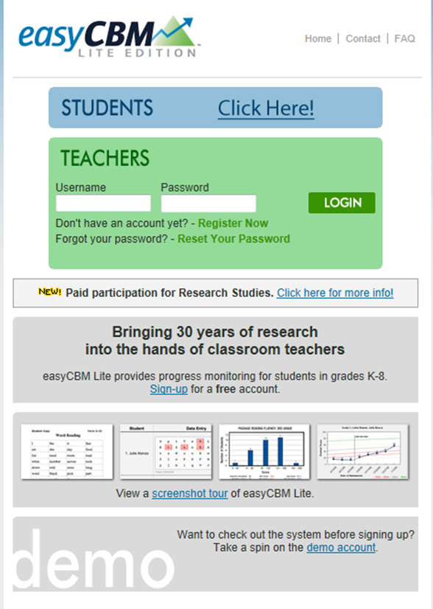
Resources
Easy CBM Lite Edition (free) – Provides Progress Monitoring for students in grades K-8 http://www.easycbm.com
Organizational chart that measures the effectiveness of progress monitoring tools http://www.intensiveintervention.org/chart/progress-monitoring

Slide 18
Free Apps
EDUCSCORE allows all students the ability to progress monitor and set goals.
User Friendly
Reusable Every Year
Today’s Target is a online service for teachers and students to set targets and use them.
Create an User Account or use Google login
Student Tracker centrally stores, manages and tracks student data.
Test results, support and interventions, activities and notes
See http://studenttracker.com.au for more information

Slide 19
Calhoun County Schools
Jenel Travis- IT Director
  jtravis@ccboe.us
Holly Box- PD Specialist
  hbox@ccboe.us
Tesha Crump – Principal - Alexandria Elementary
  tcrump.ae@ccboe.us
Jennifer Edwards – Assistant Principal – White Plains Elementary
  jedwards.wk@ccboe.us
Amber Ray – Assistant Principal – Weaver Elementary
  aray.we@ccboe.us

Slide 20
Sample Forms Online
Parent Letter
Consent for Vision and Hearing
Monthly Progress Report
Documentation Form
Intervention Form PST Plan
Alternate PST Plan
PST Meeting Log
Request for PST
Special Education Referral Checklist
Walk-through Forms for grade levels

Slide 21
Questions
Thoughts, Wonders, Ideas

