Slide 1
Changing School Climate in Philadelphia
Title I, National service & city year

Slide 2
  If you had a magic wand and could change one thing in your school building -or district- to improve school climate,
What would you change?

Slide 3
Agenda
Overview (30 minutes)
  Case Study: Thurgood Marshall School
  Partner Example: City Year
  District Perspective
Small Group Discussion (45 minutes)
Wrap Up (10 minutes)

Slide 4
Case Study
Thurgood Marshall School

Slide 5
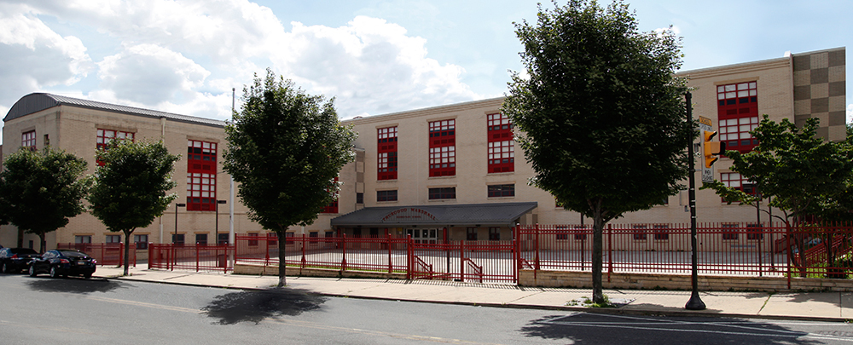
The vision of Thurgood Marshall School is for every child to become proficient in all academic areas.
At Thurgood Marshall, this will be an ongoing process that is based on feedback from formative, summative and classroom teacher assessments. Our vision can be sustained and quality professional development practices will be modified and monitored to provide the best education possible for every student in the Thurgood Marshall School. The vision is clear to all stakeholders including students, parents, teachers, administrators and the community as a whole.

Slide 6



Aligning School Improvement Goals & Partners like City Year
Academic Achievement
Behavior
Attendance

Slide 7

Partnership in Action: Academic Achievement
City Year AmeriCorps members work in 5th-8th grades,
providing math interventions for 46 scholars and literacy
interventions for 50 scholars
Math:
38% of students with D’s or F’s last year are up to a C or better in MP1
57% of students with C’s or better last year maintained a C or better in MP1
Literacy:
33% of students with D’s or F’s last year are up to a C or better in MP1
79% of students with C’s or better last year maintained a C or better in MP1

Slide 8

Partnership in Action: Extended Learning Time
46 students have participated in extended learning time since October
Clubs include: POWER, Myth Busters, Dancing, Cooking to Music, Art, Make a Music Video, Sports, Create, Get Active

Slide 9

Partnership in Action: Social Emotional Learning
City Year AmeriCorps members support initiatives such as Celebrating Hispanic Heritage Month
In only two months, 20% of scholars receiving social emotional learning coaching moved from “Needs Instruction” to “Typical”

Slide 10

Partnership in Action: Attendance
City Year AmeriCorps members lead attendance initiatives such as themed morning greetings and hot chocolate give aways
61% of students with an ADA below 90% last year are up to 90% or better in MP1

Slide 11
Partnership Example: City Year

Slide 12


Slide 13
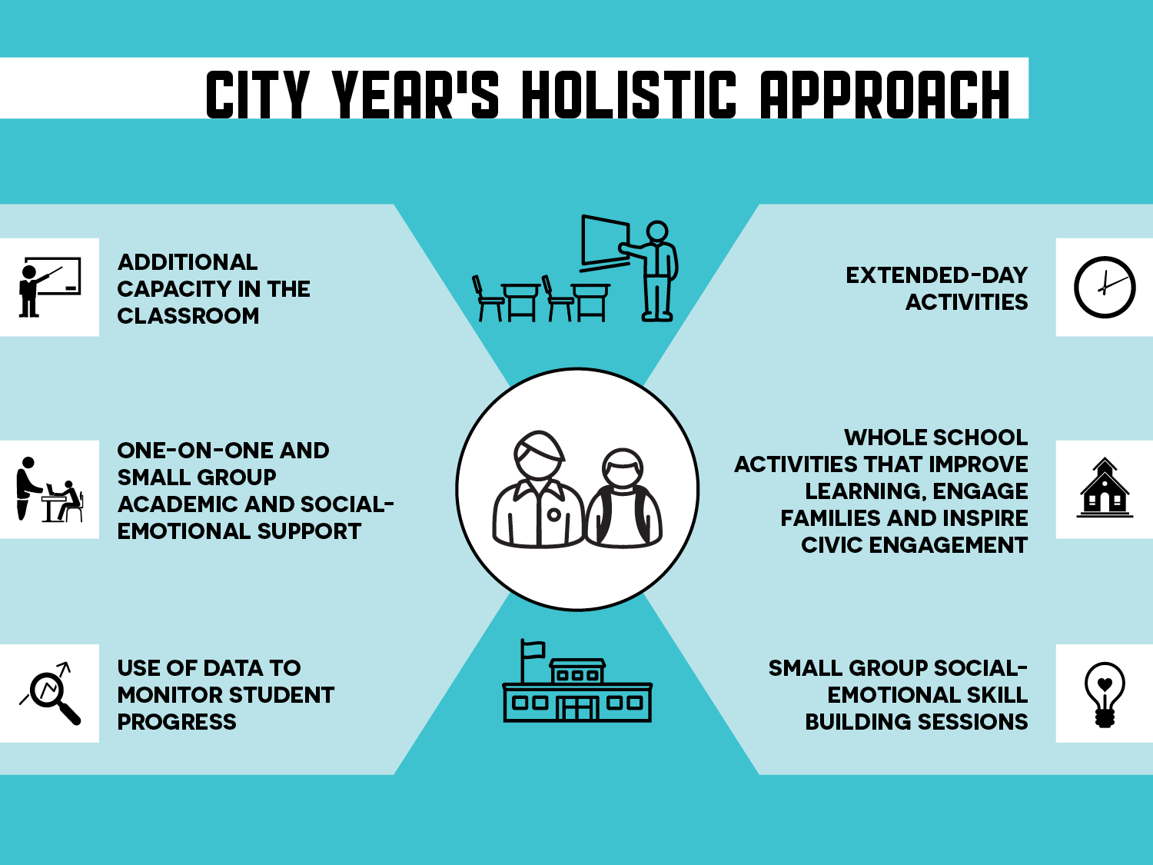

Slide 14


Many things will change in a student’s academic career, but
City Year will always be there, forging relationships built on trust and consistency, as an integral part of a student’s experience.
A student who makes it to 10th grade on track and on time is three times more likely to graduate than a student who falls behind.
– Johns Hopkins University study
Providing multiple years of support through critical transition years
Notes:
Source: Neild, R.C., Balfanz, R., & Herzog, L. (2007). An Early Warning System. Educational Leadership. 65(2), 28-33. Retrieved from http://new.every1graduates.org/wp-content/ uploads/2012/03/Early_Warning_System_Neild_Balfanz_Herzog.pdf pp. 2-3.)

Slide 15

8 to 12 City Year AmeriCorps members in one school
City Year teams are diverse: 56% people of color, 77% college grads, 54% are Pell Grant eligible
Serve as “near peer” mentors and receive professional development throughout service year
Notes:
Sources:
City Year recruitment and corps member survey data
Policy Studies Associates study (2007)

Slide 16
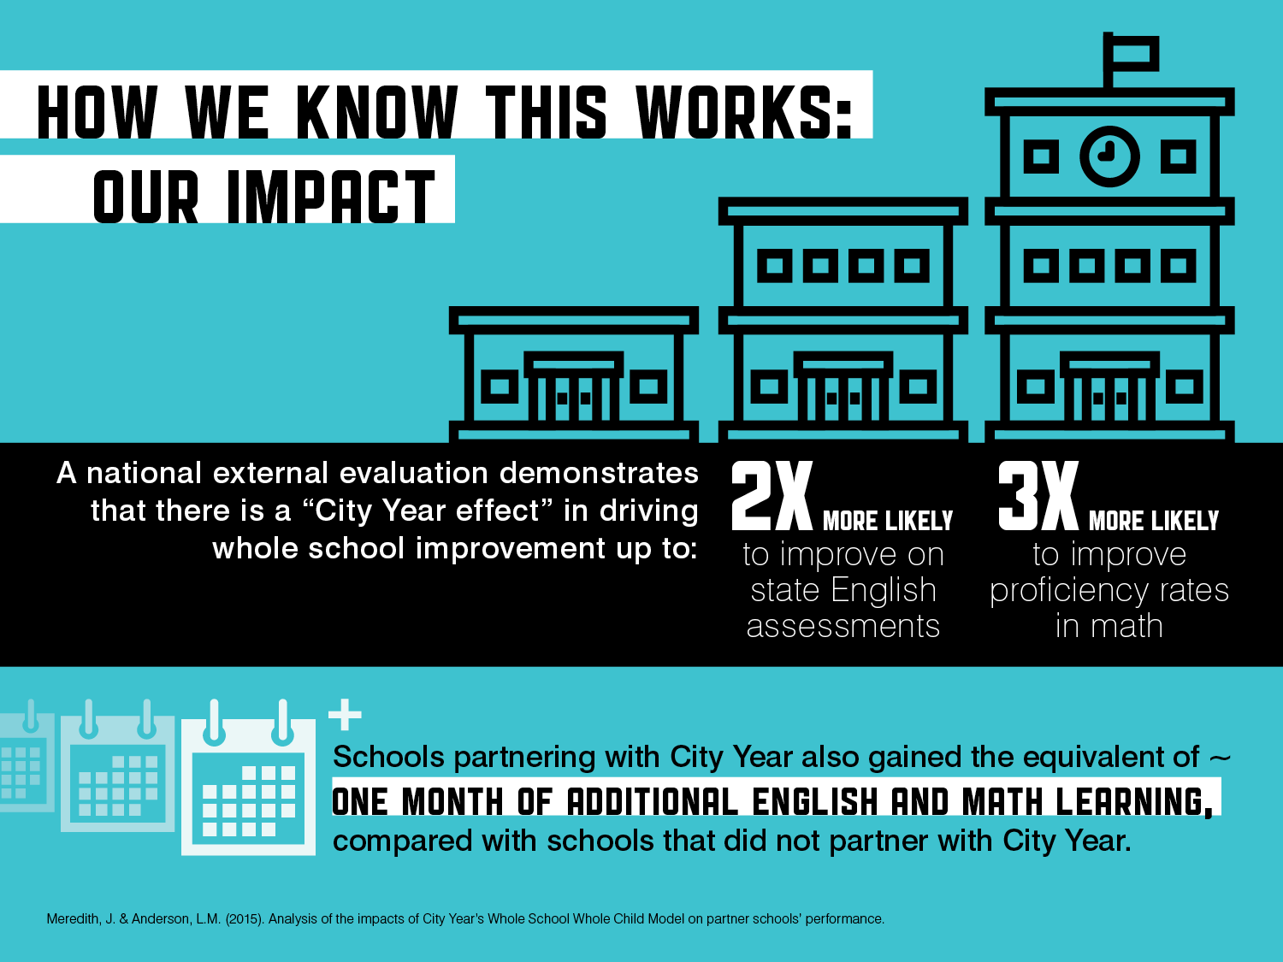

Slide 17

City Year Philadelphia
18 schools
199 City Year AmeriCorps members
Serve over 12,000 students and provide direct interventions to over 2,200 students
84% of Philadelphia teachers partnering with City Year agree or strongly agree that City Year AmeriCorps members improve the overall academic performance of their students*
When asked “To what extent do you believe City Year has had an overall positive impact this year on the overall school climate of your school?”, 78% of principals partnering with City Year Philadelphia responded “a great deal of impact.”**
*FY17 City Year Philadelphia Spring Teacher survey, n=119
**FY17 City Year Philadelphia Spring Principal Survey, n=21

Slide 18
District Perspective

Slide 19




The School District of Philadelphia’s Aspirational and Urgent Goals
100% of students will graduate ready for college or career
100% of 8-year-olds will read at grade level
100% of schools will have great principals and teachers
The District will have 100% of the funding we need for great schools and zero deficit

Slide 20

City Year Supports Progress in Neighborhood Schools
James G. Blaine Academies Plus School
William Cramp Elementary School
William D. Kelly School
Tanner Duckrey Elementary School
Bethune Elementary School
Alexander K. McClure School

Slide 21
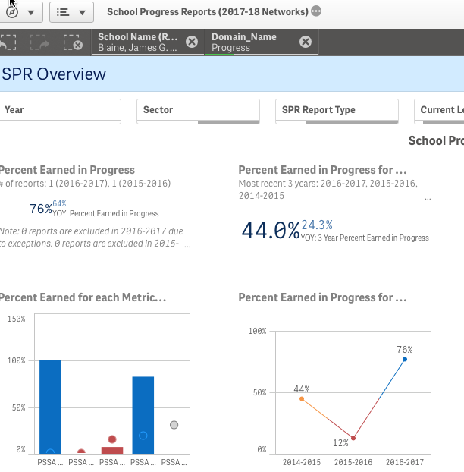
James G. Blaine Academies Plus School

Slide 22
“I love City Year because they are able to provide support and relate to our scholars in ways that no one else can in our building. Our scholars are supported both inside and outside the classroom with interventions that address reading, math, attendance, and behavior that are focused and aligned with the school goals. In addition, City Year facilitates an afterschool program which provides homework and enrichment activities that families enjoy.”
- Gianeen Powell, Principal, James G. Blaine Academics

Slide 23
“In their inaugural year at Cramp school, the City Year team has already proven themselves to be a tremendous asset. Our amazing City Year team is comprised of extraordinarily dedicated, enthusiastic, committed and hardworking leaders that have positively impacted our students both academically and socially. Our students, parents and staff feel very fortunate, indeed, to have them serving at our school.”
- Deanda Logan, Principal, William Cramp Elementary School

Slide 24

Teacher Pathways Opportunities

Slide 25
Small Group Discussion

Slide 26



Break into Four Discussion Groups
  Closer look at school level change - Keith Arrington
  Leveraging Title I for effective partnerships - John Tupponce
  Conditions for partnership success - Virgil Sheppard
  City Year’s Whole School Whole Child Model - Christina Patrick

Slide 27
What ideas from today’s workshop will you carry forward to your school/district?

Slide 28


