Slide 1

National Title I Association
Summer Membership Meeting
July 23, 2014

Slide 2
Our Mission
To enable disadvantaged children and youth to meet or exceed high academic state standards, the National Title I Association builds the capacity of state and local educators for leadership, support and advocacy in the design and effective implementation of programs under Title I of the Elementary and Secondary Education Act (ESEA).

Slide 3
Welcome & Introductions
Margaret MacKinnon (AK)
President
To ensure everyone can hear,
please wait to speak until a
microphone is brought to you
Notes:
Have everyone introduce themselves. Ask that they wait until they have a microphone, so everyone can hear.
Good idea to suggest that everyone wait to speak about anything during the day’s meetings until they have a microphone.

Slide 4
Legislative Updates
Rich Long
Government Relations Consultant
Education Policy Issues and Changes

Slide 5
Key Ideas in Today’s Presentation
Funding
USED
Authorizations & Reauthorizations in queue
  Higher Ed
  Perkins Career and Technical Education
  Child Care and Development Block Grant
  Charter Schools
  Education Research
  Three smaller Higher Ed bills
  Workforce Investment and Opportunity Act

Slide 6
Status of Appropriations
Senate
  Bills postponed
  Mini-buses
  Senate Subcommittee on Labor/HHS/ED – reported bill higher in ed spending – but with different assumptions
  Likely not done by Oct 1
  Continuing resolution, Lame Duck
House
  Several bills (of 12) have moved
  Education subcommittee (Labor/HHS/ED) – chair in run-off
  August recess – three weeks in September
  Continuing resolution
  Lame Duck

Slide 7
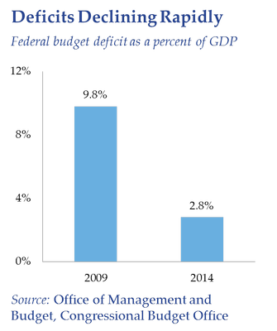
Deficits declining….

Slide 8
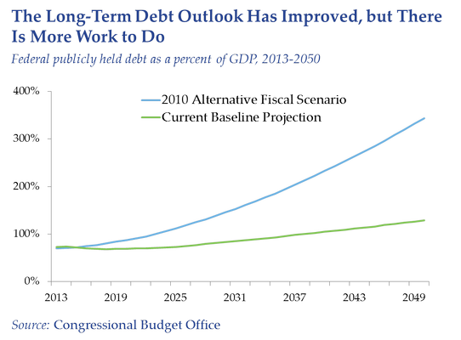
Long-term debt

Slide 9
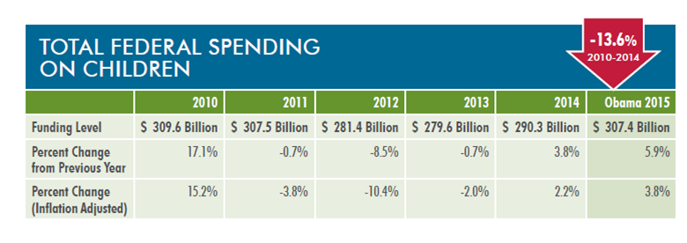
Children’s Budget
Request to create new category- Children

Slide 10
USED
Change in waivers status
Pre-school program – not rulemaking but guidance
New rules/regulations for SIG pending
  Draft by end of summer
  Take effect by end of the year
    State options
    School options
My Brother’s Keeper

Slide 11
Authorizations & Reauthorizations
7/23/2014

Slide 12
2017
ESEA Reauthorization
7/23/2014

Slide 13
Higher Ed
Big issue: change in funding pattern
Pell Grant from mandatory to discretionary – shortfalls expected in two years
Big issue: student loan interest rate
Big issue: teacher training and education
Hill moving bills on: information on completion rate, student debt and innovation
Senate asking for comments by August 31

Slide 14
Workforce Investment
Opportunity Act
Ten years in reauthorization
On President’s desk
Fewer programs
More state discretion
Accountability

Slide 15
Perkins
Links to progress in passing WOIA
New bi-partisan Senate bill
by Senators Kaine (D-VA) and Portman (R-OH)
Dems – education
Republicans – labor
Skills, jobs, education

Slide 16
Beyond 2015
Elementary and Secondary Education Act
IDEA
Big issue – competitive vs. formula
Big issue – focused vs. flexible
Big issue – accountability
Big issue – use of technology (beyond hand-held devices?)

Slide 17
Look Toward
Jack Jennings – new book in Spring of 2015
Chris Cross – new book (revised) August/September 2014
Center for American Progress
American Enterprise Institute – Frederick Hess
Others developing big ideas

Slide 18
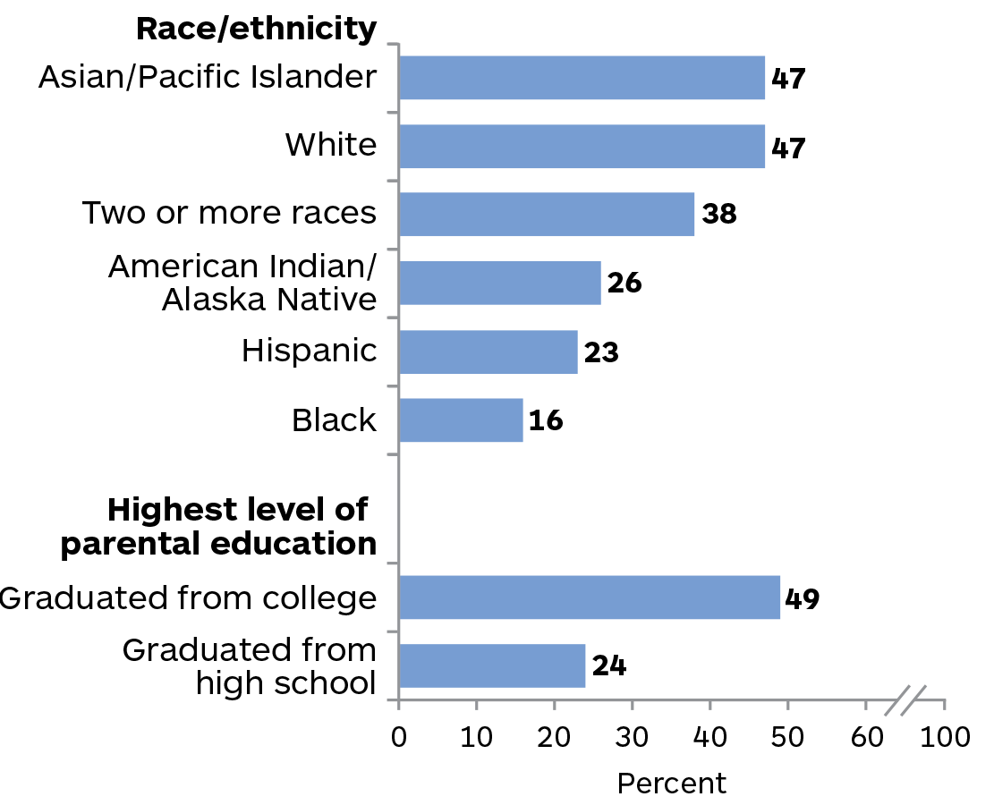
The Challenge: Reading
NAEP 2013

Slide 19
Legislative Update
Questions?

Slide 20
Business Meeting
Review & Approval of Minutes
Finance Report
State of the Association Report
2015 Conference Update
Leadership Elections
Committee Work
Notes:
ACTION: Need motion/second to approve the minutes as submitted. Then vote.

Slide 21
January – June finance reporT
Trish Boland (CO), Treasurer
Revenue | Year to Date | 2014 Budget | Remaining Balance
Conferences & Meetings | $215,747.10 | $245,000.00 | $29,252.90
Dues | $0.00 | $33,000.00 | $33,000.00
Grants | $0.00 | $10,000.00 | $10,000.00
Interest | $59.76 | $150.00 | $90.24
Services | $0.00 | $0.00 | $0.00
Sponsorships | $0.00 | $20,000.00 | $20,000.00
Subscriptions | $3,878.10 | $15,000.00 | $11,121.90
Total Revenue | $219,684.96 | $323,150.00 | $103,465.04
Notes:
Three-slide report in order of; Revenue, Expenses, and Bank Balances.
Action: No vote needed – informational only. Presented by Trish Boland, Treasurer

Slide 22
January – June Finance Report
Expenses | Year to Date | 2014 Budget | Remaining Balance
Awards & Gifts | $0.00 | $500.00 | $500.00
Bank Charges | $67.00 | $50.00 | ($17.00)
Conference & Meetings | $17,977.97 | $141,550.00 | $123,572.03
Contracted Services | $59,499.99 | $148,000.00 | $88,500.01
Dues & Subscriptions | $1,000.00 | $1,000.00 | $0.00
Insurance | $2,640.00 | $2,625.00 | ($15.00)
Legal & Professional | $825.00 | $1,500.00 | $675.00
Office Expenses | $600.00 | $1,600.00 | $1,000.00
Printing | $0.00 | $100.00 | $100.00
Supplies | $0.00 | $450.0 | $450.00
Taxes & Licenses | $25.00 | $50.00 | $25.00
Travel | $538.88 | $25,000.00 | $24,461.12
Total Expenses | $83,173.84 | $322,425.00 | $239,251.16

Slide 23
Bank balances
Bank Account | June 2014 Balance
United Timed Deposit | $151,127.90
Wells Fargo Checking | $55,029.47
Wells Fargo Money Market | $98,680.06
Total Assets | $304,837.43

Slide 24
STATE OF THE ASSOCIATION
Bob Harmon
Chief Executive Officer

Slide 25
2015 CONFERENCE UPDATE
Salt Lake City
Marcus Cheeks (MS)
Chairman

Slide 26
2015 CONFERENCE
Theme: Leading with Wonder
102 total sessions, including:
  5 keynotes
  97 concurrent sessions
Additional 36 sessions to be video taped for inclusion in Title I On Demand
Committee Reviewed top sessions yesterday and prioritized best proposals
Sessions will be finalized and posted in online schedule by September 1

Slide 27
2015 CONFERENCE Keynotes
Invited, not yet confirmed:
Secretary of Education, Arne Duncan
Panel, moderated by Gwen Ifill of PBS News Panelists: Arne Duncan, Doris Kearns Goodwin, Marian Wright Edelman
Stacey Bess: The School with No Name
James Johnson: Economics of Demographics
Chris Emdin: Training Teachers to Teach with “Magic”

Slide 28
2015 CONFERENCE Policies
NASTID Members have special exemptions:
Hotel blocks held at closest hotels until Dec 1
Hold registration & reservation until Jan 27
Cancel for full refund (less $75 fee) until Jan 27
Special NASTID Members section of website
For All Others:
30 day hold on registrations & reservations
Sliding scale cancellation & refund policy
Last date to cancel for refund: Dec XX

Slide 29
Vice President • Secretary • Regions 1 & 3 & 5
June 23- July 11 Nominations – 25 Received
Today Candidate Campaign Speeches
August 11 Special Elections Newsletter
August 11-17 Voting
August 25 Results Announced
Leadership elections
Margaret MacKinnon (AK)
President

Slide 30
Vice President Candidates
Karen Campbell (NJ)
Mike Radke (MI)

Slide 31
Secretary Candidates
Jennifer Davenport (GA)
BJ Granbery (MT)
Lynn Sodat (VA)

Slide 32
Region 1 Candidates
Karen Campbell (NJ)
Keshawn Golson (DC)
Tina McKnight (MD)

Slide 33
Region 3 Candidates
Cindy Hurst (IN)
Susan McCrone (PA)
Melina Wright (IL)

Slide 34
Region 5 Candidates
Marcia Beckman (ID)
Janie Lowe (NV)
Jack O’Connor (MT)
Gayle Pauley (WA)

Slide 35
15 minute break
Grand ballroom

Slide 36
Committee work…
Getting involved
Advocacy & Reauthorization
Effective Programs & Quality Outcomes
Professional Development
Supporting Student Achievement

Slide 37
Committee work…
Getting involved
Advocacy & Reauthorization
  Co-Chairs
  BJ Granbery (MT)
  Mike Radke (MI)
  Melina Wright (IL)

Slide 38
Committee work…
Getting involved
Effective Programs & Quality Outcomes
  Co-Chaired By
  Mary Earick (NH)
  Gayle Pauley (WA)

Slide 39
Committee work…
Getting involved
Professional Development
  Subcommittees & Chairs
  Communications: Diane Stuehmer (NE)
  Conference Planning: Marcus Cheeks (MS)
  Training: Veronica Tate (VA)

Slide 40
Committee work…
Getting involved
Supporting Student Achievement
  Subcommittees & Chairs
Early Childhood: Janie Lowe (NV)
English Learners: Charlie Geier (IN) & Anita Villarreal (TX)
Mathematics: Nancy Konitzer (AZ)
Reading: BJ Granbery (MT)
Special Education: Colleen Riley (KS)
Technology: Marcia Beckman (ID)

Slide 41
Committee ‘Round Robins’
Rotate through 4 committee stations
Starting With
Group 1: Advocacy & Reauthorization
Group 2: Effective Programs & Quality Outcomes
Group 3: Professional Development
Group 4: Supporting Student Achievement

Slide 42
Committee Work Time
Identify:
Which tasks are completed
Which tasks are in progress
Which items should remain
Which items should be deleted
Which items should be added

