Slide 1
From Silos to SWIFT:
Working Together to Positively Transform the Learning Outcomes for All Students
Wayne Sailor, The SWIFT Center
Amy McCart, The SWIFT Center
Carol Quirk, The SWIFT Center
Paul Dunford, Maryland State Department of Education

Slide 2
ALL means ALL
https://vimeo.com/97746142

Slide 3
SWIFT Panel
Wayne Sailor
  The SWIFT Center
Amy McCart
  The SWIFT Center
Carol Quirk
  The SWIFT Center
Paul Dunford
  Maryland State Department of Education

Slide 4
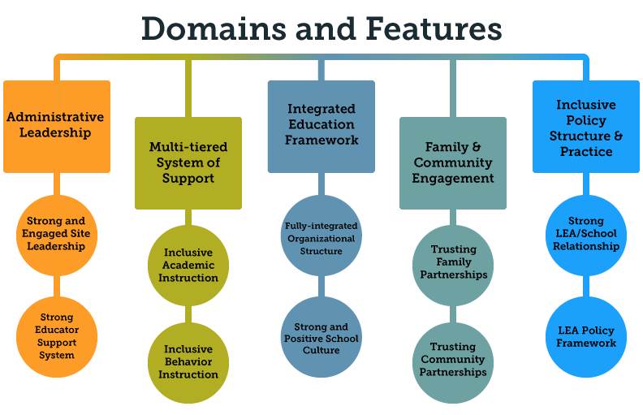

Slide 5
WHAT?
  Administrative Leadership
  Multi-Tiered System of Supports
  Integrated Educational Framework
  Family and Community Partnerships
  Inclusive Policy Structure and Practice

Slide 6
WHY?
Inequality in education hurts. We believe we can change this. We believe that, together, we can transform education so that it benefits each and every student, their families, and ultimately the communities in which they reside. The SWIFT Center community uses their talents, passion, and resources to ensure that every child is a valued member of their school and given the supports they need to achieve academic and social success.
What do we mean by “every child?” Students who are struggling readers, gifted, living in poverty, students with disabilities, high achievers, culturally and ethnically diverse students, and those with the most extensive needs.
The SWIFT Center is committed to eliminating the silos in education by bridging general and specialized education to create powerful learning opportunities for students and teachers and promote active, engaged partnerships among families and community members.

Slide 7
HOW?
Intensive Technical Assistance
Strength-based practice
Active Implementation Frameworks

Slide 8

SWIFT Technical Assistance
Shared Vision
  excellent, equitable, and unified teaching and learning environments that include all students.
Relationship Building
Tools to Guide
  Data Analysis
  Priority Setting
  Resource Alignment/Development

Slide 9
Keys to Effective Leadership
Know your strengths
Invest in others' strengths
Get people with the right strengths on your team
Focus on future strengths

Slide 10
Strength-based Approach
Builds and fosters hope
Works with past successes and present strengths
Moves all toward a shared vision of the future
Assumes that schools, LEAs and SEAs
  have strengths and resources
  can be resilient and resourceful
  are capable of learning new strategies.

Slide 11
SWIFT Technical Assistance
feedback and data on implementation efforts
Students
Families Staff
School Transformation
Team
District
Implementation
Team
State Implementation
Team
+
LEA Coordinator
+
School Coach
+
SEA Coordinator
Supports for effective practices implemented with fidelity
Notes:
Michael– review slide

Slide 12

Active Implementation Frameworks
Usable Intervention
Stages of Implementation
Implementation “Drivers”
Implementation Teams
Improvement Cycle process
http://implementation.fpg.unc.edu/resources/list

Slide 13
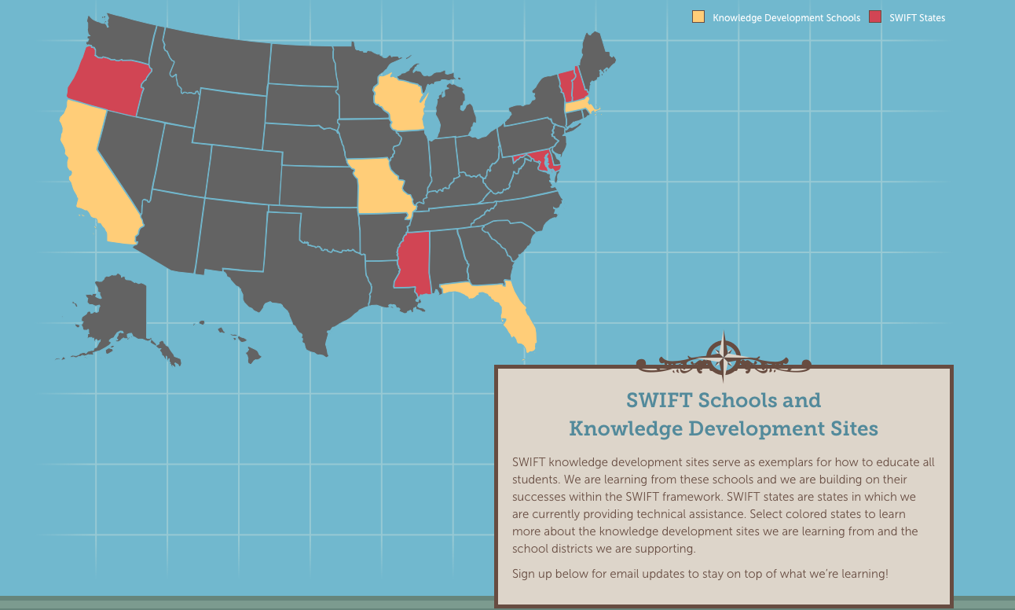
Who?

Slide 14
Select one of your schools
Write the name of the school on your Core Features form
Choose 1 strength
Choose 1 area for growth
Stand, introduce yourself to someone at another table and compare

Slide 15

People
The Right
Time
Services
The Right
The Right
Notes:
The Breakthrough Center’s goal is to support districts, schools, and the people who work in them to achieve breakthrough performances.
It was developed around the following beliefs:
People are a school’s greatest asset.
We must commit to finding people with the right skills and knowledge, or cultivate the right skills and knowledge in the people we have
We must create conditions that will allow them to do their best work: whether through policy, schedules, incentives, flexibility (with accountability
Schools and their communities are unique. What works for one will not necessarily work for another.
In the past, the services that a school or district received was consistent with their improvement status, not with the reasons that got them into improvement in the first place. Now, we work with districts to isolate the right services that are consistent with their specific and unique needs.
There is a sequence to improvement. A lot needs to happen, but not all at once.

Slide 16
District Conditions & Capacity Building
Supportive School Community
Principal & Teacher Development
Core Work
State Conditions to Accelerate Improvement
Increased Student Achievement

Slide 17
Breakthrough Center
Data Informed Decisions
Active Implementation Science
Successful Completion of the Goal(s)
Application of Change Theory
Data Informed Decisions

Slide 18
Data Informed Decisions
Active Implementation Science
Successful Completion of the Goal(s)
Application of Change Theory
Change Theory

Slide 19
Data Informed Decisions
Active Implementation Science
Successful Completion of the Goal(s)
Application of Change Theory
Active Implementation Science

Slide 20
Data Informed Decisions
Active Implementation Science
Successful Completion of the Goal(s)
Application of Change Theory
Successful Completion of the Goal(s)

Slide 21
The Foundation for Change
Leadership Team
Strengths-based approach
Assess current practices
School-wide engagement
LEA investment & participation

Slide 22
Assessment
Planning/Priorities
Action
Reflection
Revision
Action

Slide 23
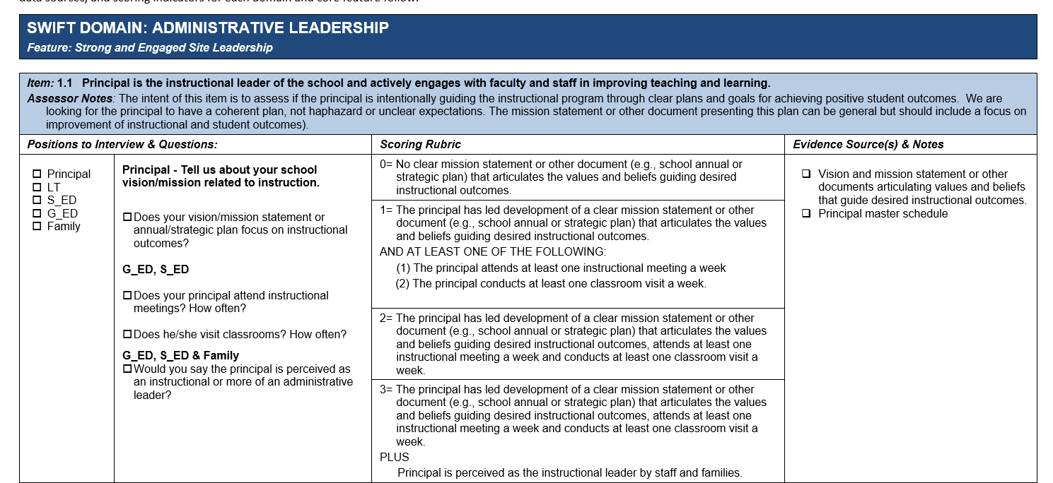
SWIFT-FIT
Fidelity of Implementation Tool

Slide 24
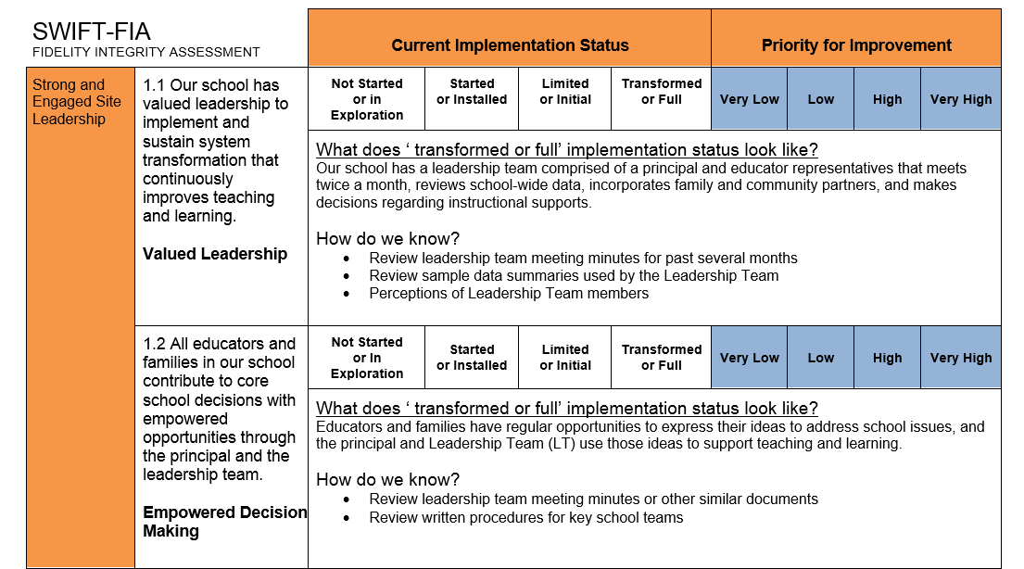
SWIFT-FIA
Fidelity Integrity Assessment

Slide 25
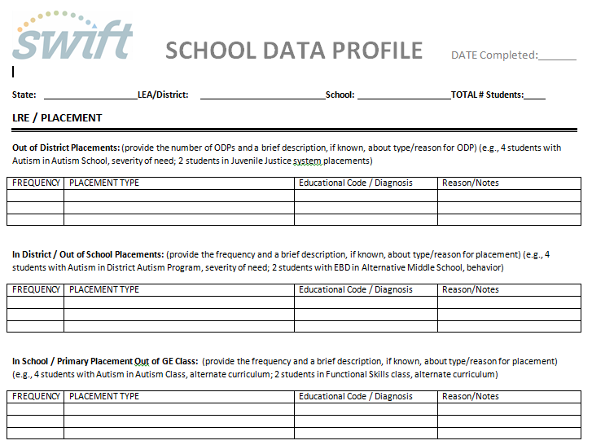
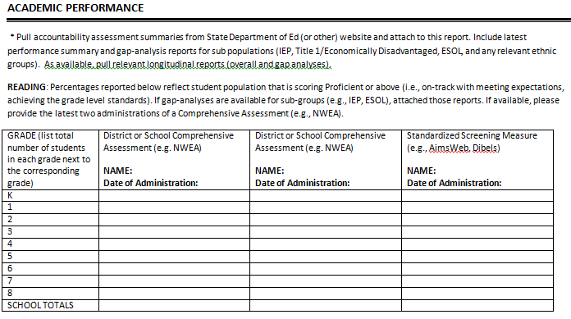
Student Outcome Data

Slide 26
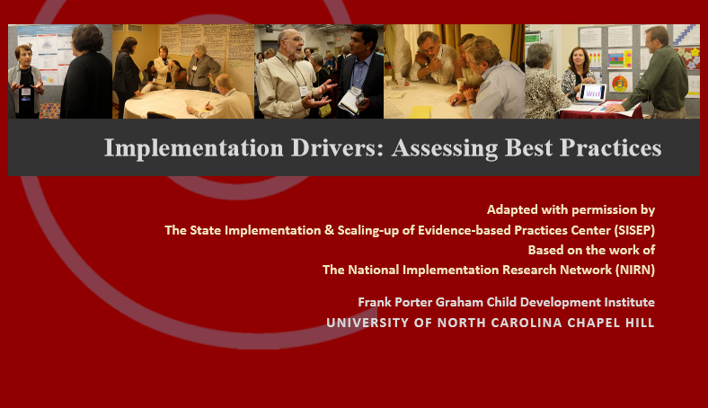
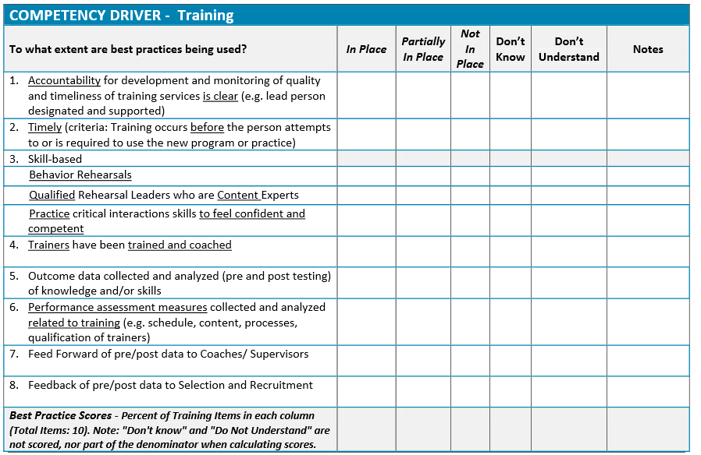
Implementation Drivers:
Assessing Best Practices

Slide 27
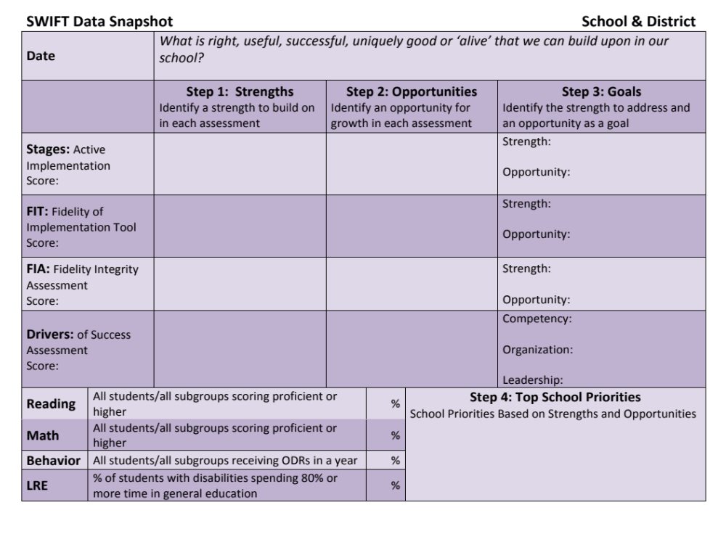

Slide 28
Assessing current practices
Teaching: student engagement
Learning: student performance
Collaborative team planning (leadership)
Data-based decision making
Culturally responsive practices (Equity Alliance)
Co-teaching
Parent partnerships (Flamboyan Foundation)
Curriculum alignment with CCR
SAMPLE
practices

Slide 29
Choose 1 strength
Choose 1 area for growth
Strong and Engaged Site Leadership

Slide 30
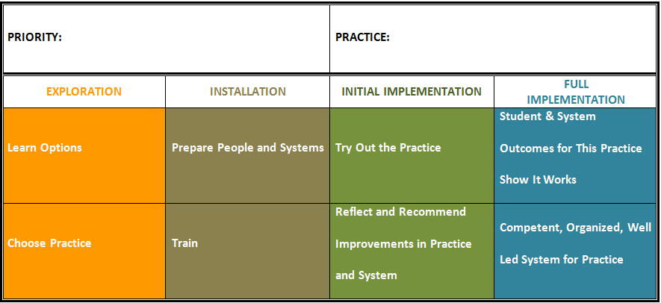
SWIFT
Priority Implementation Planning
Strong and Engaged Site Leadership
Effective Leadership Team Planning

Slide 31
Team Effectiveness Assessment
Write the name of the school you selected on your Team Assessment form
Complete either the even numbered items: assess your team’s effectiveness
Select the one practice that they do well
Select one practice that needs more growth.
Share and compare

Slide 32
SWIFT Resources
www.swiftschools.org

Slide 33

Questions/Comments?
Thank you!
This document was produced under U.S. Department of Education, Office of Special Education Programs Grant No. H326Y120005, University of Kansas, Beach Center on Disability. Grace Zamora Durán and Tina Diamond served as the OSEP project officers. The views expressed herein do not necessarily represent the positions or policies of the Department of Education. No official endorsement by the U.S. Department of Education of any product, commodity, service or enterprise mentioned in this publication is intended or should be inferred. This product is public domain. Authorization to reproduce it in whole or in part is granted.

