Slide 1

Planning Together to Improve Outcomes for All Students
U.S. Department of Education
Office of Elementary & Secondary Education (OESE)
Office of Special Education and Rehabilitative Services (OSERS) Implementation and Support Unit (ISU)

Slide 2
College and Career Readiness and English Learners
Kenji Hakuta (Stanford University)
Diane August (American Institutes for Research)
July 2014

Slide 3

Humans are information integration machines

Slide 4

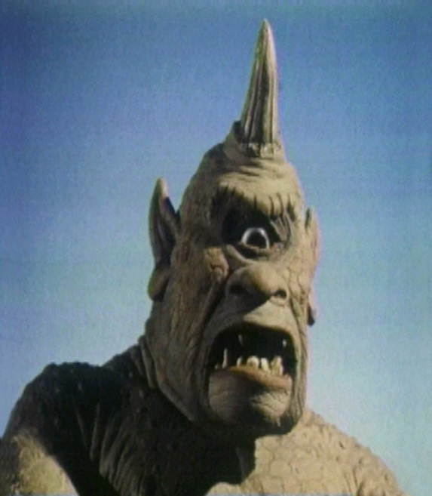
The Two Cyclops Problem

Slide 5
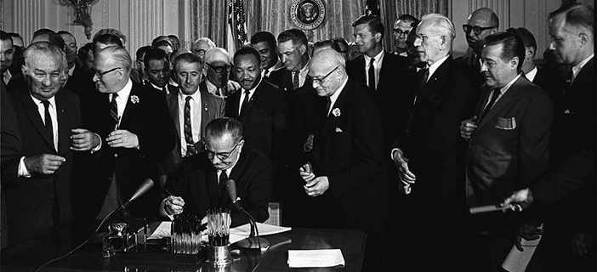
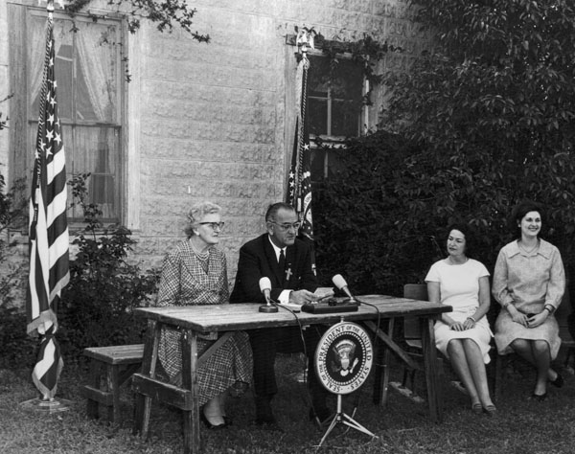
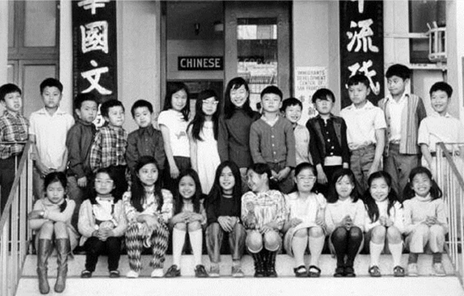
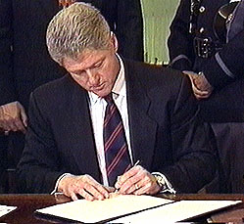
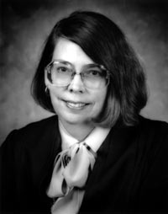
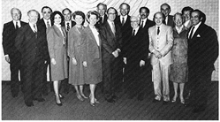
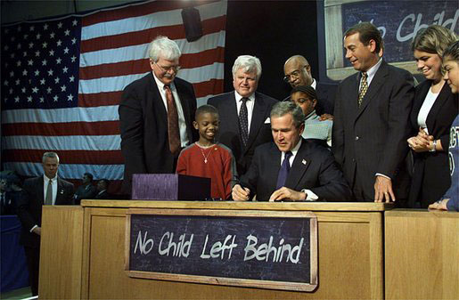
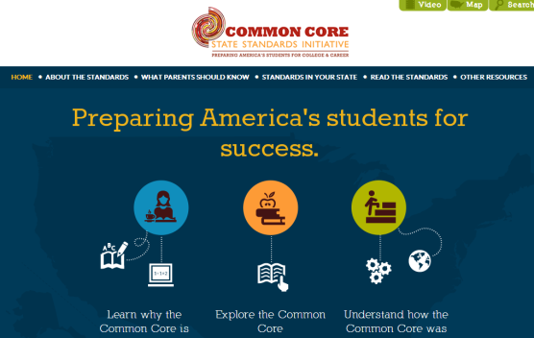

Slide 6
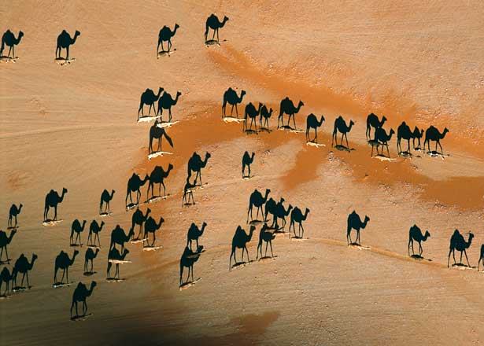

Slide 7


Slide 8
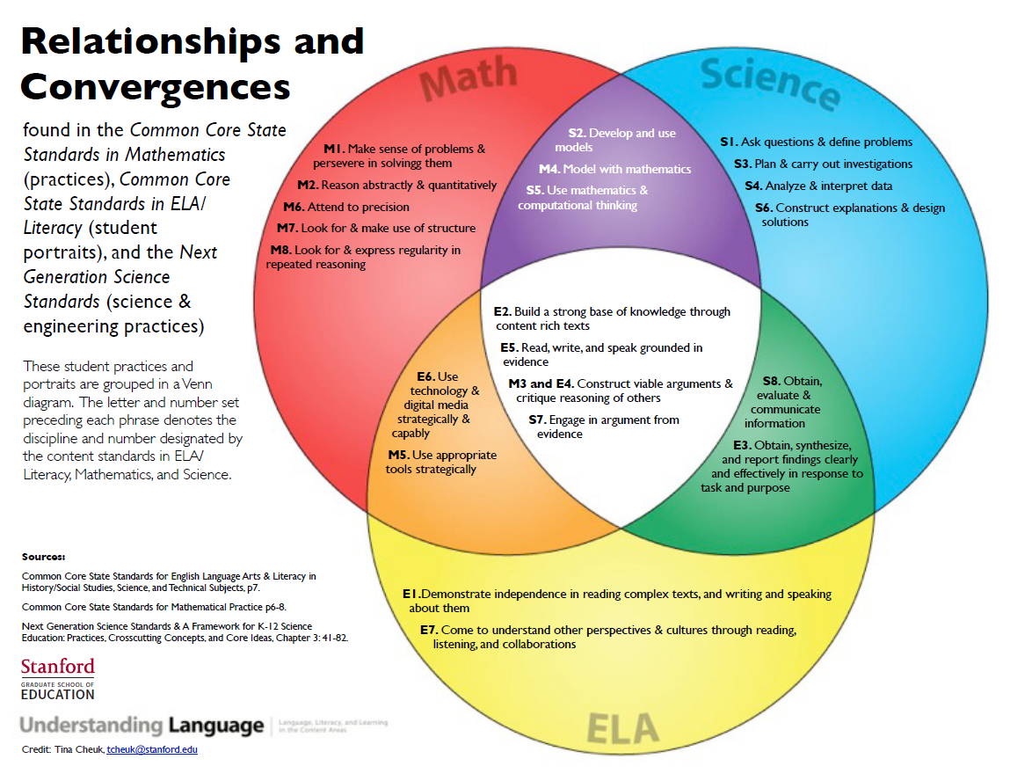

Slide 9
Implementing the Common Core State Standards for ELLs
Diane August
American Institutes for Research
Not to be used without prior permission
© 2013 Center for English Language Learners – American Institutes for Research © 2013 Language Learning Matters, LLC

Slide 10
Key Shifts in Instruction
SHIFT | BIG IDEA | EXPLANATION
1 | Balancing Informational & Literary Text | Students read a true balance of informational and literary texts
2 | Knowledge in the Disciplines | Students build knowledge about the world (domains/ content areas) through TEXT
3 | Staircase of Complexity | Students read the central, grade appropriate text around which instruction is centered. Teachers are patient, create more time and space and support in the curriculum for close reading.
4 | Reading Text Closely | Students engage in rich and rigorous evidence based conversations about text.
5 | Academic Vocabulary | Students constantly build the transferable vocabulary they need to access grade level complex texts. This can be done effectively by spiraling like content in increasingly complex texts.
6 | Writing from Sources | Writing emphasizes use of evidence from sources to inform or make an argument.
Notes:
The Common Core Standards entail six major shifts in instructional focus in ELA. I’m going to focus on two: reading text closely, and academic vocabulary, with a focus on how to make these aspects accessible to English language learners.

Slide 11

The Secret Garden by Frances H. Burnett
The Secret Garden book cover (1911), Project Gutenberg Archives
Notes:
Direct participants to the text in their handouts, pp 4-5.

Slide 12
Text: The Secret Garden
When Mary Lennox was sent to Misselthwaite Manor to live with her uncle everybody said she was the most disagreeable-looking child ever seen. It was true, too. She had a little thin face and a little thin body, thin light hair and a sour expression. Her hair was yellow, and her face was yellow because she had been born in India and had always been ill in one way or another. Her father had held a position under the English Government and had always been busy and ill himself, and her mother had been a great beauty who cared only to go to parties and amuse herself with gay people. She had not wanted a little girl at all, and when Mary was born she handed her over to the care of an Ayah, who was made to understand that if she wished to please the Mem Sahib she must keep the child out of sight as much as possible.

Slide 13
Reading Texts Closely
  It is through reading closely that students develop language and content area knowledge*
  → Make reading text(s) closely, examining textual evidence, and discerning deep meaning a central focus of instruction.
  On-going questions about the text and discussion related to these questions (instructional conversations) are an effective method for helping students comprehend text.**
  → Facilitate rigorous evidence-based discussions through a sequence of specific, thought-provoking, and text-dependent questions.
*Source: McKeown, M. G., Beck, I. L., & Blake, R. G. K. (2009). Rethinking comprehension instruction: Comparing strategies and content instructional approaches. Reading Research Quarterly, 44(3), 218-253.
**Source: Saunders, W., & Goldenberg, C. (1999). The effects of instructional conversations and literature logs on limited- and fluent-English proficient students' story comprehension and thematic understanding. The Elementary School Journal, 99 (4), 277-301.

Slide 14
Reading Texts Closely: All Students
Text-Dependent Questions
Requires the reader to go back to the text to find evidence.
Cannot be answered solely on personal opinion, background information, and/or imaginative speculation.
Non-Text-Dependent Questions
What is a time that you felt disagreeable?
What qualities make good parents?
Why did British people have native servants in India?
Text-Dependent Questions
What words in the first paragraph describe Mary’s appearance?
What does the reader learn about Mary’s parents?
Who was Mary’s Ayah, and what role did she play in Mary’s life?
Source: Pook, D. (2012). Implementing the CCSS: What teachers need to know and do. Manuscript.

Slide 15
Reading Texts Closely: ELLs
  Ask a guiding question for every portion of text that introduces a main idea.
  Align the questions with CCSS standards
  .
Cluster | Standard | Main Idea | The Secret Garden
Key Ideas and Details | Describe in depth a character, setting, or event in a story or drama, drawing on specific details in the text (e.g., a character’s thoughts, words, or actions). (RL.4.3) | The narrator describes Mary and her parents. [paragraph 1] | What does the reader learn about Mary’s parents?

Slide 16
Reading Texts Closely: ELLs
Supplementary Questions
ELLs may need additional, supplementary questions to help them answer guiding questions.
Supplementary questions can inquire about word meanings as well as larger sections of text.
Sequence supplementary questions to support ELLs’ understanding of the main idea.
Make it easier for ELLs to answer supplementary questions by
  Defining key words prior to asking the question
  Restating phrases or sentences that will help ELLs answer the question
Note that supplementary questions are text dependent!
Notes:
Appears in Part 2.
Supplementary questions are asked during the first reading to ensure students know what they are reading. You can reduce the level of scaffolding to align with proficiency levels (e.g., fewer words in the frame or no frame at all).

Slide 17
Reading Texts Closely: ELLs
Supplementary Questions
Guiding question: What does the reader learn about Mary’s parents?
Text dependent | Sequence to support understanding | Inquire about word meanings | What does it mean that Mary’s father “held a position” with the English government?
 |  | Restate phrases or sentences | Mary’s mother was a great beauty. What did Mary’s mother like to do?
 |  | Inquire about larger sequences of text | Did Mary’s mother want Mary? How do you know?
 |  | Define key words prior to asking the question | An Ayah is a maid who takes care of children. What did Mary’s mother want the Ayah to do?
Notes:
Appears in Part 2.

Slide 18
Reading Texts Closely: ELLs
Scaffold Questions at Different Levels of Proficiency
ELLs with lower levels of proficiency may need sentence starters, sentence frames, or word banks to help them answer all questions.
  Omitted words in sentence frames are words that carry most meaning in the sentence.
The level of scaffolding can and should be adjusted depending on ELL’s level of English proficiency.
  Emergent level proficiency: Sentence frames and word banks
  Intermediate level proficiency: Sentence starters
  Advanced level proficiency: Word banks

Slide 19
Reading Texts Closely: ELLs
amuse | out of sight | take care of
gave | parties | worked
Emergent
What does it mean that Mary’s father “held a position” with the English government?
  It means that Mary’s father _______ for the English government.
Mary’s mother was a great beauty. What did Mary’s mother like to do?
  Mary’s mother liked to go to ________ and ________ herself.
Did Mary’s mother want Mary? How do you know?
  Mary’s mother (did/did not)_________ want Mary. We know this because she ______ Mary to an Ayah to ____________ her.
An Ayah is a maid who takes care of children. What did Mary’s mother want the Ayah to do?
  Mary’s mother wanted the Ayah to keep Mary ____________ .
worked
parties
amuse
did not
gave
take care of
out of sight
Notes:
Supplementary questions are asked during the first reading to ensure students know what they are reading. You can reduce the level of scaffolding to align with proficiency levels (e.g. fewer words in the frame or no frame at all).

Slide 20
Reading Texts Closely: ELLs
Intermediate
What does it mean that Mary’s father “held a position” with the English government?
  It means that Mary’s father ___________________________________________________.
Mary’s mother was a great beauty. What did Mary’s mother like to do?
  Mary’s mother liked to ______________________________________________________.
Did Mary’s mother want Mary? How do you know?
  Mary’s mother ________________________________.
  We know this because ______________________________________________________.
An Ayah is a maid who takes care of children. What did Mary’s mother want the Ayah to do?
  Mary’s mother wanted the Ayah to _____________________________________________.
Notes:
Supplementary questions are asked during the first reading to ensure students know what they are reading. You can reduce the level of scaffolding to align with proficiency levels (e.g. fewer words in the frame or no frame at all).

Slide 21
Reading Texts Closely: ELLs
Advanced
amuse | out of sight | take care of
gave | parties | worked
What does it mean that Mary’s father “held a position” with the English government?
  ___________________________________________________________________.
Mary’s mother was a great beauty. What did Mary’s mother like to do?
  ___________________________________________________________________.
Did Mary’s mother want Mary? How do you know?
___________________________________________________________________.
An Ayah is a maid who takes care of children. What did Mary’s mother want the Ayah to do?
___________________________________________________________________.
Notes:
Supplementary questions are asked during the first reading to ensure students know what they are reading. You can reduce the level of scaffolding to align with proficiency levels (e.g. fewer words in the frame or no frame at all).

Slide 22
Academic Vocabulary
Vocabulary is a key determinant of reading comprehension.
Recent research indicates that ELLs typically exhibit vocabulary growth rates that are similar to or surpass those of native English speakers.
However, ELLs are often 2-3 years behind their English-speaking peers at any particular point in time, so a large vocabulary gap remains.
August, D., & Shanahan, T. (Eds.) (2006). Developing literacy in second-language learners:
Report of the National Literacy Panel
on Language-Minority Children and Youth. Mahwah, NJ: Erlbaum
Notes:
ELLs’ vocabulary growth rates are similar to and may even surpass those of native English speakers, they are typically two to three years behind native English-speaking students in vocabulary knowledge, and a large vocabulary gap remains (Mancilla-Martinez & Lesaux, 2011).
The 4K List: The words were selected from the most frequent words in The Educator’s Word Frequency Guide (Zeno et al. 1995) which overlaps with 4,000 word families of Hiebert’s Word Zones™ corpus (2005). The texts they are drawn from are K–14

Slide 23
Academic Vocabulary Selection: All Students
Frequency
  Use tools like the First 4000 Words List, Word Sift or the Academic Word List Highlighter to select frequently encountered English words.
Importance to Text
  Select words that will be critical for answering text-dependent questions.
Conceptual Complexity
  Select words to pre-teach that are not easily imageable, abstract, and/or have a high degree of relatedness.

Slide 24
Academic Vocabulary Selection: All Students
Conceptual Complexity
Words that are conceptually complex are more difficult to acquire.
Conceptually complex words may require more intensive instruction.
Conceptual complexity
  Imageability: A word is easily imageable if little effort is required to form an image of it in your mind
  Concreteness: A word is concrete (tangible) if its referent can be easily perceived through the senses.
  Relatedness: The degree to which understanding the word requires an understanding of related concepts is relatedness.

Slide 25
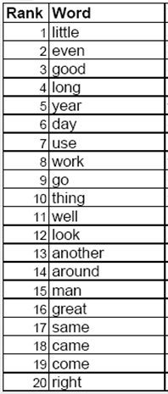
Academic Vocabulary Selection: ELLs
First 4000 Words List
1st Quartile | 2nd Quartile | 3rd Quartile | 4th Quartile
The child stared at him, but she stared most at her mother. She always did this when she had a chance to see her, because the Mem Sahib -- Mary used to call her that oftener than anything else -- was such a tall, slim, pretty person and wore such lovely clothes. Her hair was like curly silk and she had a delicate little nose which seemed to be disdaining things, and she had large laughing eyes. All her clothes were thin and floating, and Mary said they were “full of lace.” They looked fuller of lace than ever this morning, but her eyes were not laughing at all. They were large and scared and lifted imploringly to the fair boy officer's face.
Seward Reading Resources: http://www.sewardreadingresources.com/img/fourkw/4KW_Teaching_List.pdf
Notes:
The 4,000 most frequent English words account for about 80 percent of words that readers encounter in text.
The First 4000 words list: The words were selected from the most frequent words in The Educator’s Word Frequency Guide (Zeno et al. 1995) and the 4,000 word families of Hiebert’s Word Zones™ corpus (2005).
We have developed an online analyzer that returns words in the first, second, third, and fourth quartiles of the First 4000 Words list.
http://vocabularytool.airprojects.org/

Slide 26
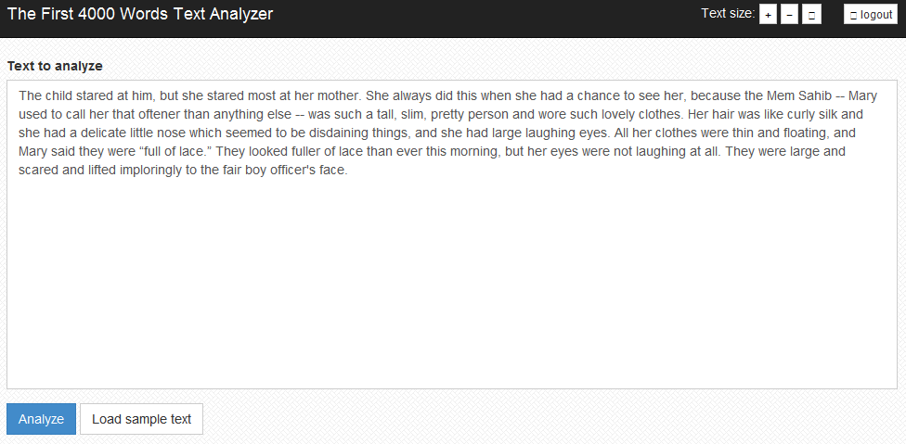
Academic Vocabulary Selection: ELLs
First 4000 Words Text Analyzer
http://vocabularytool.airprojects.org/

Slide 27
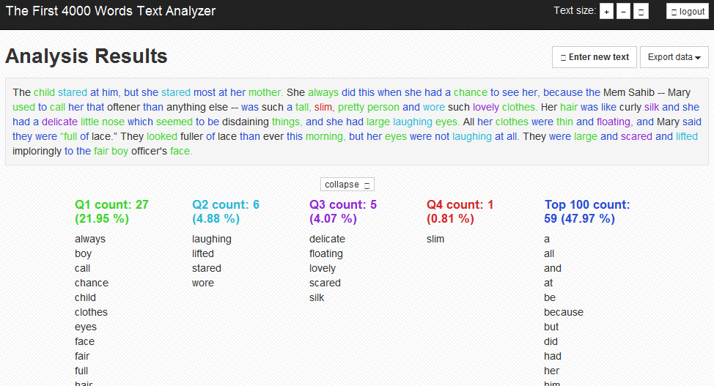
Academic Vocabulary Selection: ELLs
First 4000 Words Text Analyzer: Results
http://vocabularytool.airprojects.org/

Slide 28
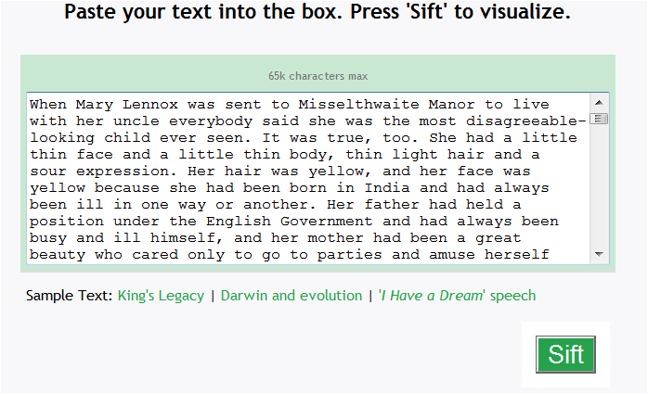
Academic Vocabulary Selection: ELLs
Word Sift
Accessible at: http://www.wordsift.com/
Notes:
WordSift was developed under a grant from the Council of Great City Schools to Kenji Hakuta. It was developed with the help and inspiration of middle school science teachers at the San Francisco Unified School District through a collaboration supported by the Strategic Education Research Partnership (SERP).
This is a potential tool for indicating which words are important within the text, because they are the words that the author uses frequently. Use this resources to find out more about these words (General Services List, AWL, Marzano, etc.)
These slides are based only on the first three paragraphs of the text, not the whole excerpt. For presentations where people have laptops, they could try it out with the rest of the excerpt.

Slide 29
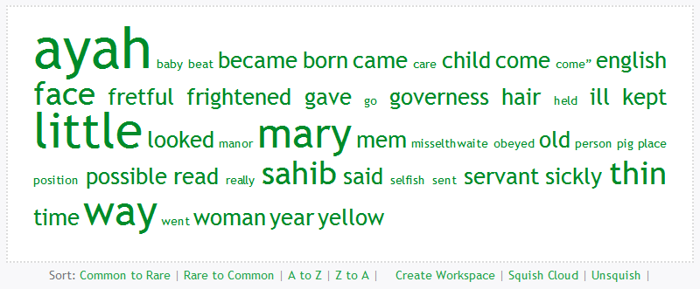
Academic Vocabulary Selection: ELLs
Word Sift: Default Results
Accessible at: http://www.wordsift.com/
Notes:
The Word Sift displays the most frequent words in this text (note: not necessarily the most frequent words found across texts), excluding function words. The words in the display are alphabetically ordered by default, and their relative frequency in the text is indicated by their size. So in this example, “Washington,” “Mall,” and “person” are the most frequent words, followed by “concert,” “crowd,” and “five,” then “great,” “long,” and “monument.” Singular and plural nouns are counted together. Other options for sorting are also available on the website.

Slide 30
Academic Vocabulary Selection: ELLs
Importance to Text
To be successful readers, ELLs need to know words that are frequent across multiple texts.
ELLs also need to know the meanings of words and phrases that are crucial to understanding the text at hand (as indexed by the text-dependent questions).
Text | Text-Dependent Questions | Key Vocabulary
When Mary Lennox was sent to Misselthwaite Manor to live with her uncle everybody said she was the most disagreeable-looking child ever seen. It was true, too. She had a little thin face and a little thin body, thin light hair and a sour expression. Her hair was yellow, and her face was yellow because she had been born in India and had always been ill in one way or another. | What do we learn in the first paragraph about Mary’s appearance? | disagreeable
 |  | thin
 |  | sour
 |  | expression
 |  | ill

Slide 31
Academic Vocabulary Instruction: ELLs
Teacher-directed instruction
  More intensive instruction for abstract words
    Provide the definition in context.
    Provide the home language definition and cognate status.
    Illustrate the word.
    Invite students to talk about the word.
  Less intensive instruction (i.e., English for Speakers of Other Languages [ESOL] techniques) for concrete words
    Define the word in situ.
    Use gestures to demonstrate the word.
    Show the word in illustrations from the text.
Student-directed learning
  Glossaries
  Word learning strategies

Slide 32
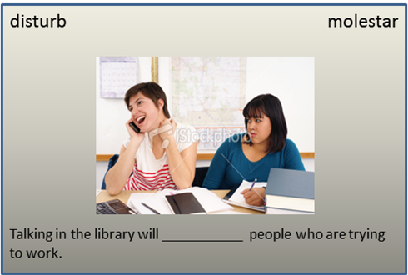

Academic Vocabulary Instruction: ELLs
Word Cards for More Complex Vocabulary
Students see:
The teacher says:
  Let’s talk about disturb. Look at the picture of the two girls. The girl on the phone is talking loudly. She is disturbing or bothering the girl who is trying to do her homework.
  Disturb means to bother someone. In the story, Mary’s mother does not want to be bothered or disturbed by Mary’s crying.
  Disturb in Spanish is molestar.
  Partner talk. Tell your partner about a time that someone disturbed you.
  Let’s spell disturb. [d,i,s,t,u,r,b]
  What word have we spelled? [disturb]
Notes:
Teacher-directed instruction prior to close reading.
General academic words and phrases that are abstract.
Characterized by “explicit teaching that includes both contextual and definitional information, multiple exposures to target words in varied contexts, and experiences that promote deep processing of word meanings”. Visuals are used. (Coyne, McCoach, & Kapp 2007, p. 74).

Slide 33
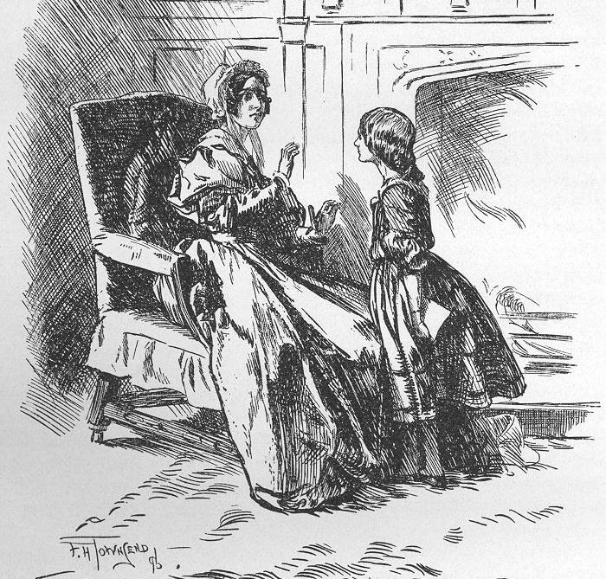
Academic Vocabulary Instruction: ELLs
ESOL Techniques for Less Complex Vocabulary
Word | ESOL Technique
sour | define in situ “In this sentence, sour means unhappy or in a bad mood. Do you know what else it can mean?”
expression | demonstration or gesture (e.g., make a happy or sad face)
governess | show a picture from the text*
*Governess picture not in this version of the text; shown as an example.
Notes:
Embedded instruction on the other hand takes much less time; it provides student with brief definitions of target words within the context or oral language or reading experiences (Penno, Wilkinson, & Moore, 2002). Some embedded instruction words are just glossed, such as words that are infrequent or not critical to understanding the text.
Reinforcement: Words generally need to be reinforced between 10-18 times for them to be learned. Words can be reinforced through games, songs, encounters in other texts where context supports meaning, etc.

Slide 34

Academic Vocabulary Instruction: ELLs
Encourage Student-Directed Learning
Teach students word learning strategies.
  Cognates, context clues, morphology, etc.
  Dictionaries and digital resources
    Online:
      English: wordsmyth.net
      Spanish.dictionary.com
    Smartphone apps:
      English: SnaPanda (Android)
      English: Dictionary! (Android & iPhone)
      Free Spanish-English Dictionary + (iPhone)
      English-Spanish dictionary (Android)
Glossary use
Notes:
All words appear in the glossary, whether teacher or student directed. Glossaries are listed as a student-directed learning technique because the glossary is an important resource for students to find and review word meanings.
We have not tested these smartphone apps, but they get good reviews online and appear to be something that would work.

Slide 35
Academic Vocabulary Instruction: ELLs
Word Learning Strategies
Word | Strategy
manor | context clues sent to live
disagreeable | cognate desagradable
expression | cognate expresión
fretful | context clues sickly, baby

Slide 36
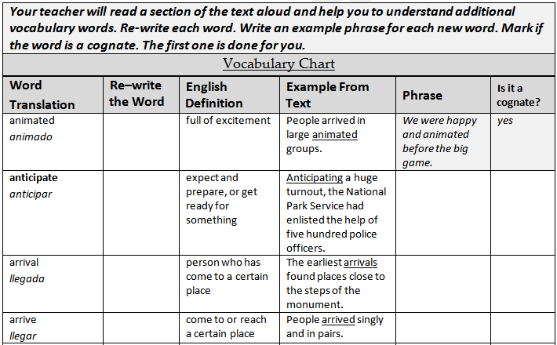
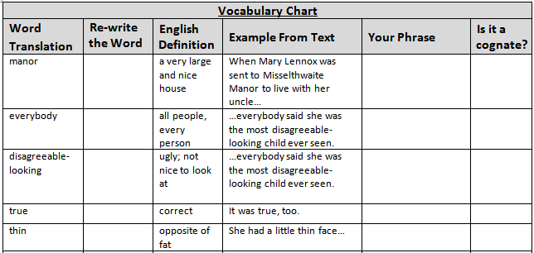
Academic Vocabulary Instruction: ELLs
Glossary

Slide 37
Writing to Sources: All Students
Writing Types
Elementary: 30% argument, 35% informative/explanatory, 35% narrative
Middle School: 35% argument, 35% informative/explanatory, 30% narrative
High School: 40% argument, 40% informative/explanatory, 20% narrative
Type | Example
Argument | Make a claim about the worth or meaning of a text Analyze evidence from multiple sources to support a claim
Informational/ Explanatory | Describe how a scientific process works Describe a historical event
Narrative

Slide 38
Writing to Sources: ELLs
Scaffolding for ELLs
Students respond to a mainstream lesson essay prompt re-written to make the writing assignment easier to understand.
Partner talk and a graphic organizer help ELLs put together the information they need to write
Paragraph frames and graphic organizers help ELLs write to different genres.
  Paragraph frames should align with the text type requirement of the prompt: argument, informative/explanatory, or narrative text.

Slide 39
Writing to Sources: ELLs
Mainstream essay prompt:
Related essay prompt:
What can the reader infer from the text about how to avoid falling ill from cholera?
Cholera is a terrible disease. In the story, Mary’s Ayah and many other people die from cholera. Based on what people in the story do and say, what can we infer, or understand, about how you can avoid or not get cholera?

Slide 40
Writing to Sources: ELLs
Graphic Organizer
Reread conversation between Mary’s mother and the soldier? What does the soldier say they should do?
Reread the last paragraph. What did the servants do?
Say what you would do to keep from getting cholera: | Say why you would do this:

Slide 41
Writing to Sources: ELLs
Paragraph Frame
What can the reader infer from the text about how to avoid falling ill from cholera?
Mary’s mother and the __________ talk about cholera. The __________ tells Mary’s mother she should have ____________________________________________________________. Then later, it says that all of the servants were gone. They had _________________________________________________________________________. From these two examples, the reader learns that the best way to avoid falling ill from cholera is to _____________________________________________________________________. If I were there, I would ________________________________________________________ because___________________________________________________________________.

Slide 42

The Center for English Language Learners

Slide 43
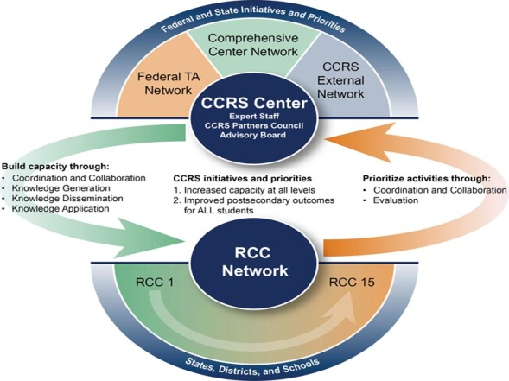
CCRS Center Technical Assistance Hub Task Areas
Coordination and Collaboration
  Regional Comprehensive and Content Centers
  Federal CCRS Technical Assistance Providers
  External CCRS Stakeholders and Resources
Knowledge Development and Application
  New CCRS Center Products and Tools
  CCRS Knowledge Database
  Webinars and Symposia
  CCRS Center Website and Social Media
  Responsive and Proactive Technical Assistance
  Networked Communities
Notes:
The College and Career Readiness and Success Center, which is housed at the American Institutes for Research, is part of a network of federally funded comprehensive centers that provide technical assistance and resources to our regional partners and the states they serve on key educational reform issues.
As a CCRS technical assistance hub, we also collaborate with federal and external centers and resource providers to promote knowledge development, dissemination and application. Our primary TA activities include developing and disseminating new CCRS products and tools, maintaining a searchable database of vetted resources, providing live and archived webinars on timely CCRS topics and issues, maintaining an up-to-date website and social media that are accessible by the general public, providing direct support to our regional and state clients, and building networked communities for peer-to-peer sharing. The goal of our TA hub is to provide information, resources and support to state, district, and school personnel seeking to ensure that their students are on a path to postsecondary success.

Slide 44
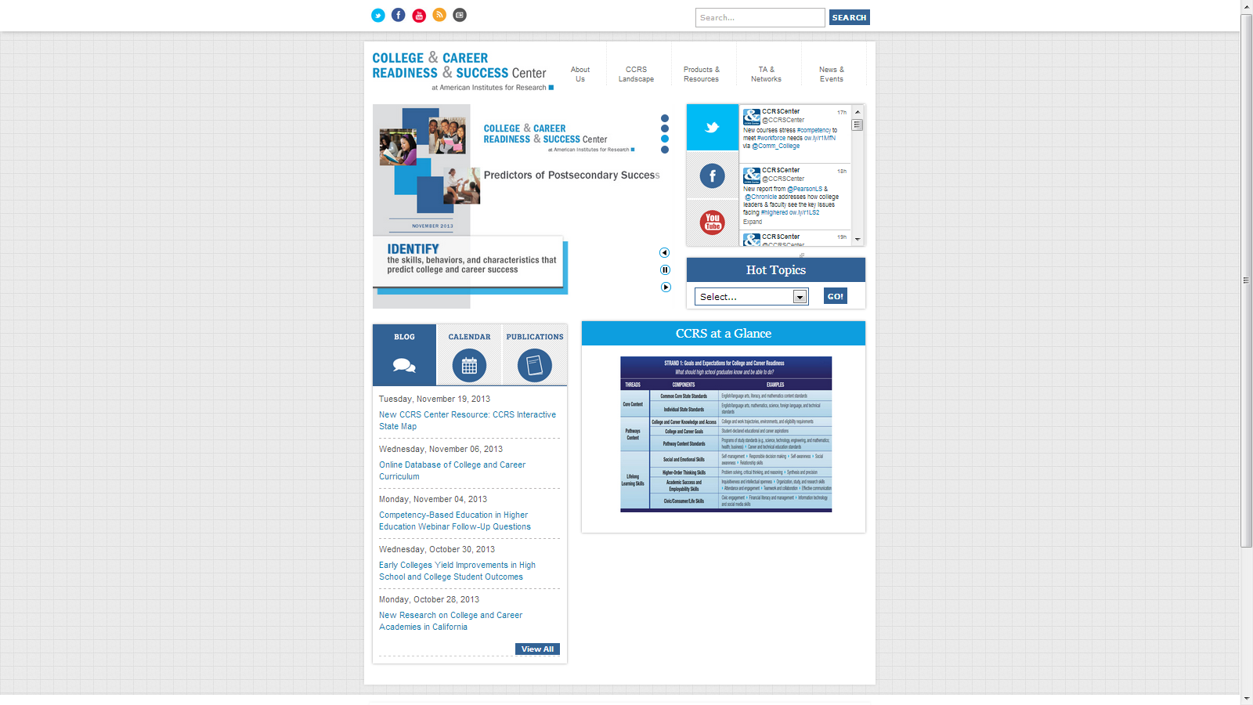
The College and Career Readiness Success
Center Website
#PredictSuccess
ccrscenter.org
Notes:
In closing, I invite you to visit the CCRS Center website to access these publications as well as an interactive version of the organizer and our other CCRS resources and activities that may be of interest to you and your colleagues.

Slide 45
Sample Resources Available from the
CCRS Center Website
The College and Career Readiness and Success Organizer
Predictors of Postsecondary Success
Improving College and Career Readiness by Incorporating Social and Emotional Learning
Improving College and Career Readiness for Students with Disabilities
How Career and Technical Education Can Help Students be College and Career Ready
Understanding Accelerated Learning Across Secondary and Postsecondary Education
College and Career Readiness and Success: Inventory of Policies, Programs, and Initiatives
College and Career Readiness and Success Interactive State Map
The District Role in Supporting College and Career Readiness for Students
Considerations for Collaborations to Support College and Career Readiness: A Facilitator’s Guide
Definitions of College and Career Readiness: An Analysis by State
Notes:
These are a listing or our most popular resources that are available from our website.

Slide 46

Questions

Slide 47

MOOCs from Understanding Language
Effective teachers facilitate rich student academic discourse that is supported by the tools of reading, writing, and visualization.
The Common Core State Standards (CCSS) and Next Generation Science Standards (NGSS), supported by the new English Language Proficiency Standards, have created a context for reform whose signature instructional moments include these uses of language.

Slide 48
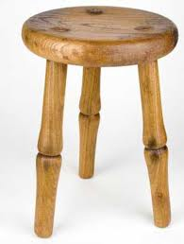
Three Legs of the Language Stool
Learning through discourse.
Transacting with text and images.
Writing about evidence, reasoning and argument.

Slide 49
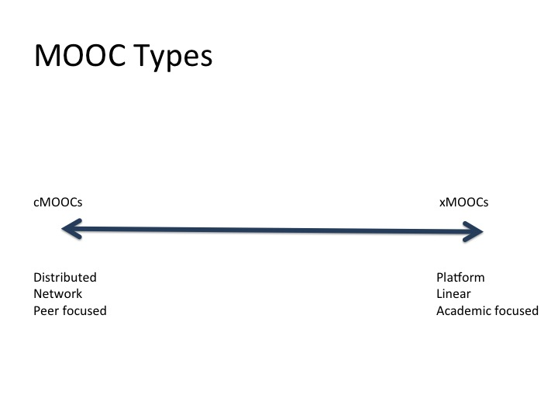
Continuum of MOOCs

Slide 50
c-MOOCs
“c” is for … connectivity, collaborative, constructivist, creative, collective…
Applied as…
…take a SCOOP of language and analyze, reflect, share, collaborate

Slide 51
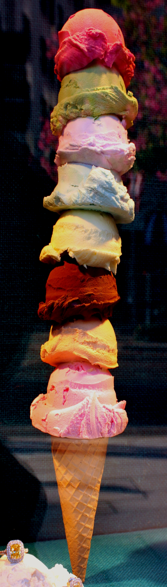
c-MOOCs
“c” is for … connectivity, collaborative, constructivist, creative, collective…
Applied as…
…take a SCOOP of language and
analyze, reflect, share, collaborate

Slide 52
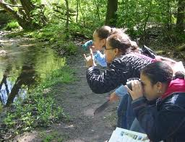
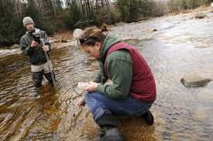
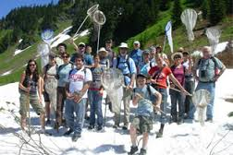
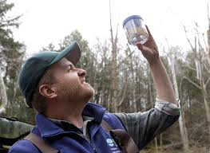
It is more like “Citizen Science” than it is a “MOOC”.

Slide 53



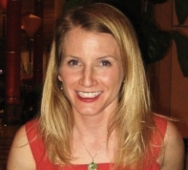
Learning from a Pilot MOOChttps://novoed.com/common-core(through support from OELA/NPD)
INSTRUCTORS
8,000 enrolled, plus 1,000 auditors
2,000 active participants joined 519 teams of 1-8 per team
1,560 fully completed first assignment
completion rate*: 26.2%
*with respect to those who turned in the 1st assignment
Addressed how to facilitate classroom discoursese as required by the new CCSS and NGSS
Targeted educators of English Language Learners
Required participants to listen closely, analyze, reflect, and act on student-to-student interactions
Kenji Hakuta
Jeff Zwiers
Sara Rutherford-Quach

Slide 54
MOOC as a Vehicle for Collaboration
IHEs
States and Districts
Stanford (Kenji Hakuta, Jeff Zwiers, Sara Rutherford)
Stanford (Jonathan Osborne, Bryan Brown, Helen Quinn, Guadalupe Valdes)
Stanford (Sam Wineburg)
Stanford (David Brazer)
Stanford (Rachel Lotan)
Oregon State (Karen Thompson)
UCSC (George Bunch, Judit Moschkovich)
UC Davis (Susan O’Hara, Harold Levine)
UCLA (Margaret Heritage), Alison Bailey
CSU Sacramento (Sue Baker, Adele Arellano, Stephanie Biagetti, Pia Wong)
U Virginia (Amanda Kibler)
U Wisconsin (Tim Boals, Margo Gottlieb, Gary Cook)
U Maryland (Melinda Beltran)
East Carolina University (Rob Lucas)
UNC Chapel Hill (Marta Civil)
New Mexico State University (Anita Hernandez)
University of New Mexico (Rebecca Blum Martinez)
UC Berkeley (David Pearson)
Seattle University (Robert Hughes)
North Carolina Department of Public Instruction (Nadja Trez) Topic: CCSS Implementation – ELA Middle School and Math Elementary
Oregon Department of Education (Timothy Blackburn and Martha Martinez) Topic: ELPA21 Standards
SFUSD (Angie Estonina), LAUSD (Hilda Maldonado) and OUSD (Nicole Knight) Topic: Student Discourse
Seattle Public Schools (Veronica Gallardo) Topic: Student Discourse
New York City Schools (in process)
New York State Education Department (in process)

Slide 55
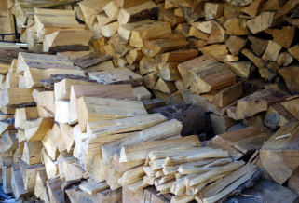

Understanding Language | Online
MOOCs
The Database

Slide 56
Understanding Language | Online
MOOCs
All MOOCs will be focused on SCOOPS of student work that display evidence from (1) discourse, (2) transaction with text, (3) writing about evidence, reasoning and argument that contributes to the Database.
MOOCs will be specialized by different content areas, grade levels, student subgroups, geographical region.
The MOOC COOP will be comprised of primarily faculty and LEAs, where the IHE will package and offer the MOOC, and the LEA will collaborate in capturing examples of student work and instruction that can become model content for the MOOC.
Members of the MOOC COOP will be part of an IP agreement that will allow reciprocal borrowing/lending of MOOC content with agreed-upon allowances and restrictions.
MOOC COOP membership will allow special access to the Database.

Slide 57
Understanding Language | Online
The Database
The Database will consist of MOOC SCOOPS , including all information about the SCOOPS gathered from the MOOC (description of setting, self-evaluations, peer evaluations, etc.) and will be searchable. The main uses of the Database are:
Evaluation and improvement of MOOCs
To support Formative Assessment Online, a service to allow users to enter new samples of student language (new SCOOPS) and to use the database as a reference point for formative assessment practice by finding “similar” and “informative” examples.
Basic research, such as mapping learning progressions for the language used around specific content topics.
Other activities to move the field, such as sponsoring Natural Language Processing contests to model expertise in evaluating student language.

Slide 58

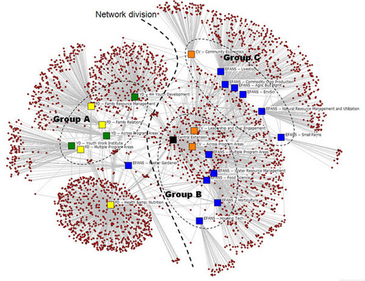
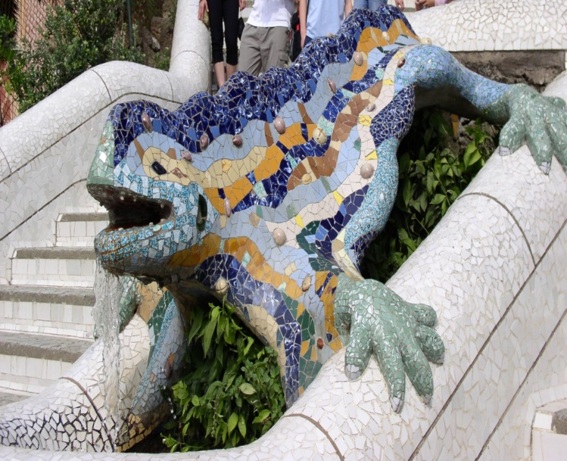
The “Vision”
Traffic patterns
District
Collaborations
Metadata
University
Collaborations
MOOC
Mosaic
Data
Formative
Assessment
NLP

Slide 59

Questions?

