Slide 1
The Power of Data:
Making Data Useable and Relevant to Drive School Achievement
National Title I Conference
Presented By Diplomas Now
Notes:
Kathy welcomes and introduces DN team.
Determines who is in the room

Slide 2
Agenda
Introductions
Diplomas Now Overview
Collecting & Using Data to Respond to Student Need
Data Activity 1 – Early Warning Indicator Mtg
Data Activity 2 – School-wide Data Review

Slide 3
Diplomas Now overview
Notes:
Kellie

Slide 4

Early Identification
Future Dropouts Can Be Identified as Early as 6th Grade
Research shows sixth-graders without one of these early warning signs (Poor attendance, sustained poor behavior and course failure in English or math) graduate at rates two to three times higher than students with an indicator¹
Diplomas Now identifies those students early, provides individualized support and helps them get on track
¹ Baltimore Education Research Consortium. (2011). “Destination Graduation: Sixth Grade Early Warning Indicators for Baltimore City Schools Their Prevalence and Impact.” Retrieved from: http://baltimore-berc.org/pdfs/SixthGradeEWIFullReport.pdf; Mac Iver, M.A., & Messel, M. (2012). “Predicting High School Outcomes in the Baltimore City Public Schools.” Retrieved from http://baltimoreberc.org/pdfs/PredictingHighSchoolOutcomes.pdf, p. 23.
Notes:
Kellie

Slide 5



Diplomas Now Partnership & Model
Partnership - Generate greater student outcomes through creating a new school improvement collaboration combining Talent Development’s whole school improvement practices with City Year’s Whole School Whole Child services and Communities In Schools’ integrated student supports to partner with the nation’s highest need secondary schools
Johns Hopkins University’s Talent Development Secondary provides curriculum/instruction support and early warning system
City Year’s “near peer” AmeriCorps members provide individualized, whole-class & whole school academic and social-emotional support
Communities In Schools provides case-managed support to students with the highest needs
City Year’s team of in-school, “near peer” AmeriCorps
student coaches.
Model Dissemination - Drive systemic change through validating and promoting the broad adoption of early warning indicator systems combined with evidence-based whole school improvement practices, academic and socio-emotional supports powered by national service and master level case management
Notes:
Kellie

Slide 6
Surrounding Teachers and Students with Support
Instructional Support
Double dose math & English
Extra help labs
Common college preparatory or high school readiness curricula
Organizational Support
Inter-disciplinary and subject focused common planning time
Bi-weekly EWI meetings
On-site school transformation facilitator
Teacher Team
Professional Development Support
Job-embedded coaching - Math & English instructional coaches
Professional learning community
Professional development linked to grade/subject instructional practice
Data Support
Easy access to student data on the Early Warning Indicators
Benchmarks tied to national and state standards
On-site facilitator to leverage EWI data
75-90 Students
Student Support
Multi Tiered Response to Intervention Model
  8 to 20 City Year AmeriCorps members: whole school and targeted academic and socio-emotional supports
  Communities In Schools site coordinator: case managed supports for highest need students
  Interventions to address early warning indicators of
  Attendance
  Behavior
  Course Performance
  Whole school attendance, positive behavior, college-going culture
  Strengthening student resiliency
Notes:
Kellie

Slide 7
Major National Research on Diplomas Now’s Evidence of Impact
The Diplomas Now collaboration had a positive, statistically significant increase in percentage of sixth- and ninth-graders with no early warning indicators (poor attendance, poor behavior and failing math and English) over the course of just one year
Diplomas Now also had a positive, statistically significant impact on increasing attendance and reducing chronic absenteeism in middle schools
Positive and statistically significant effects in the education field are rare: only 9% of randomized control trials commissioned by the U.S. Dept of Ed Institute of Education Sciences produce positive effects**
*Statistically significant at 95% confidence – What Works Clearinghouse level
** Coalition for Evidenced-Based Policy
Source: Addressing Early Warning Indicators: Interim Impact Findings from the Investing in Innovation (i3) Evaluation of Diplomas Now. MDRC. (June 2016)

Slide 8
Collecting & Using Data to respond to student need
Notes:
Laura

Slide 9



Data Driven Approach
In order to build the right support structures for students and schools, we need timely, accurate, and useable data, AND the know-how to make it actionable and to monitor progress over time
Notes:
Laura

Slide 10
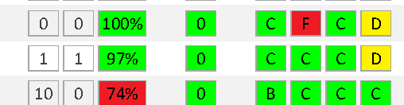
Early Warning System: Using Data to Provide the Right Supports to the Right Students at the Right Time
Using EWS, schools can be organized to apply school-wide preventative, targeted, and intensive interventions until students are on-track.
Indicators
Support and response system
Reliable, valid, and predictive
Each indicator adds information for action
Easily accessed and organized
Whole school/classroom, small group, and individual initiatives and interventions
System for monitoring/follow-up
Reflective processes
Facilitation and Teams
Notes:
Laura

Slide 11
School-Wide Data Reviews and the
Early Warning System
Tier 1 / Whole School Structures
Data Collection
Early Warning Indicator Meetings
Tiered Interventions
School-Wide Data Review
Notes:
Note – we’re using the word school-wide, but that could mean grade level in some instances

Slide 12
Goals of School-Wide Data Reviews
Monitor the progress of all students in the school
View student performance data side by side with intervention/support data
Determine data trends at the building, grade and classroom level
Ensure supports offered for struggling students are identified and match the scale of need
  Do we know what our resources are, do we have enough of them, and are they focused in the right places?
Notes:
Laura

Slide 13
Preparing for School-Wide Data Reviews
What you need:
All data tracked by the school, captured at the student level
Additional support and intervention data (by whom, for whom, why)
  To gather this, work with other partners and providers in the building
Notes:
Laura

Slide 14
Who’s Part of the School-Wide
Data Review?
Determining participants is partly context driven:
  Small schools will have different answers than larger, etc.
  Fit structure of existing meetings, if possible
Must have:
  School leader (either grade level or whole school, depending on data review focus)
  Grade level teacher teams
May also include:
  Other administrators
  Counselor
  Student support providers/partners
Notes:
Laura

Slide 15
During School-Wide Data Reviews
What to do:
Focus on trends…
  Large patterns
  How to be proactive in meeting student needs
    Identify any students who are newly off track and not getting any intervention
    Discuss whether interventions are happening at the right scale/tier.
      Ex. what tier is the best response to a trend? If 75% of students are off track in math, tutoring is not going to solve the larger issue
      Discuss whether interventions are appropriate and retool as necessary
  Matching needs to resources in the building
    Inform coordination of partners
What not to do:
Do not discuss individual students
Notes:
Laura

Slide 16
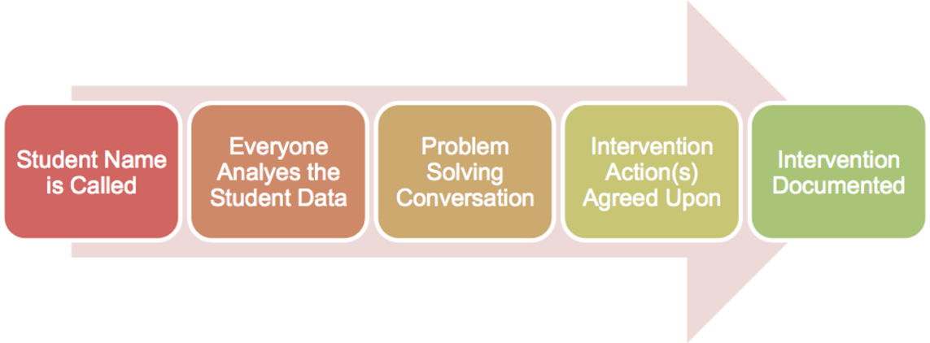
Early Warning Indicator Meetings
What’s an EWI Meeting?
A structure used to regularly monitor student progress and a collaborative effort to:
  Monitor student progress-rapidly flag students falling off track
  Identify students in need of intervention
  Looks for data trends to identify most strategic level of intervention (student, class, grade, school etc.)
  Monitor if intervention is improving student outcomes
What Happens during an EWI meeting?
  Examine relevant student data (attendance, behavior and coursework)
  Collaborate and problem-solve to identify reason for outcome
  Agree upon interventions to be taken and
  Identify “champion” and document each intervention
Process:
Notes:
Laura

Slide 17
Let’s Look at Data!
Hands On
Group Activity
Notes:
Laura

Slide 18
Activity #1
Early Warning Indicator Meeting
Each participant takes on a role, using one of the cards provided (need 6 people at each table to participate; others can be added if desired). These roles are the staff who would participate in an actual school-based EWI meeting.
Each card provides information about individual students that only that person (in a specific role) knows. As each student is discussed, each participant should share what they know (and feel free to add/embellish!)
The intervention protocol should be used for each of the four students.
Notes:
Laura

Slide 19
Activity #1
EWI Meeting Protocol
Identify the student (1 minute)
  Who are we discussing?
  Which off track behaviors is this student exhibiting (if any)?
  What data supports matching this student with an intervention?
Team shares information about student (2 minutes)
  Why is this student off track? What do we know?
  Be succinct and monitor your air time!
Team discusses intervention options (2 minutes)
  Consult intervention map
  Who will be the champion and follow up?
  When will we have a follow up conversation?
  What do we need to communicate to the student’s family? Other staff members?

Slide 20
Activity #1
Early Warning Indicator Meeting
Share Back
Notes:
Laura

Slide 21
Activity #2
School-Wide Data Review
What trends do you notice?
What supports/interventions/responses would you take at your school?
Which cross-sectional partners would you engage to execute this support?
Notes:
Kellie

Slide 22
Activity #2
School-Wide Data Review
Share Back
Notes:
Kellie

Slide 23
THANK YOU!
Laura Weeldreyer: weeldreyer@jhu.edu
Kellie Hinkle: khinkle@cityyear.org
To learn more about Diplomas Now, visit www.diplomasnow.org

