Slide 1
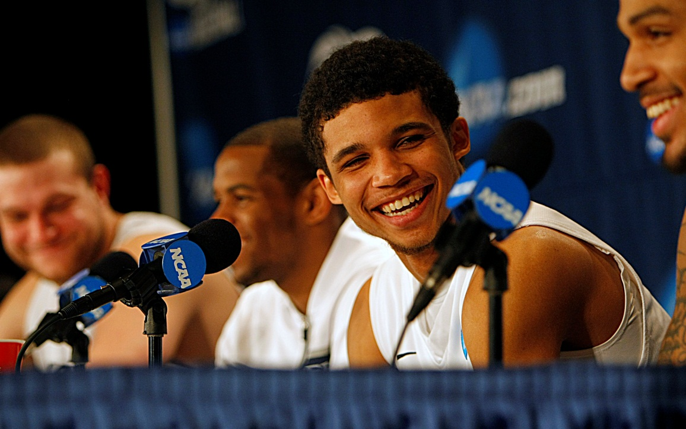
MEDIA & SOCIAL MEDIA TRAINING

Slide 2
Tom Eiser, Associate AD/Communications
Xavier University
eiser@xavier.edu
513-745-3124
@Eiser_XU_Sports

Slide 3
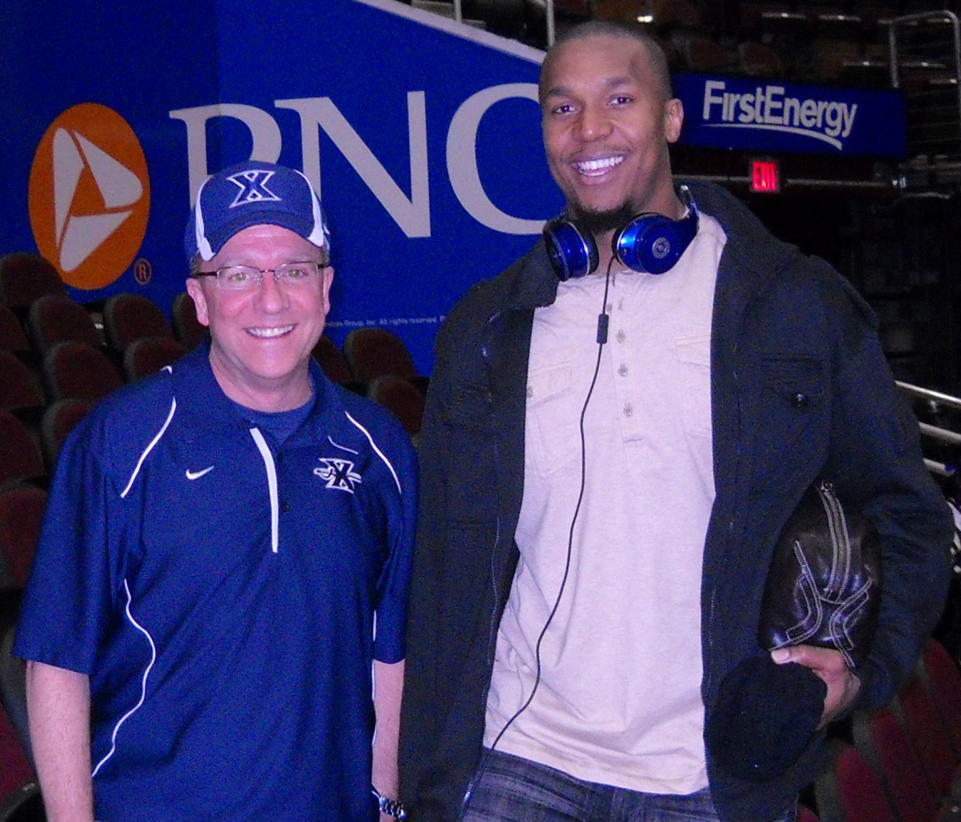
WHY IN-HOUSE?
Benefits:
- Direct contact with all student-athletes
- Cost savings and able to do all sports
Challenge:
- Time to customize
Must be on-going, not one and done

Slide 4
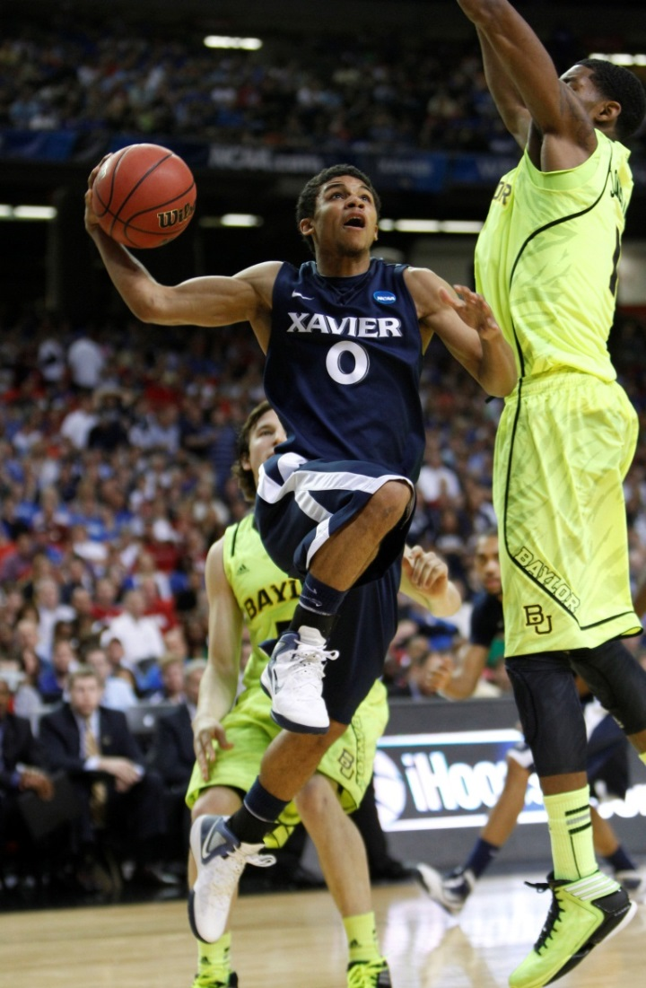
INTERVIEW BASICS
All interviews set up
through Tom Eiser
If you can’t be on time, be early.
Be courteous and say thank you.
Some Quick Tips
  No Gum
  Water Only
  Appropriate Attire (incl. gear,
  with no hats, headphones, etc.)
  Body Language
  (standing or sitting)
  Who do I look at?
  Hand Gestures

Slide 5
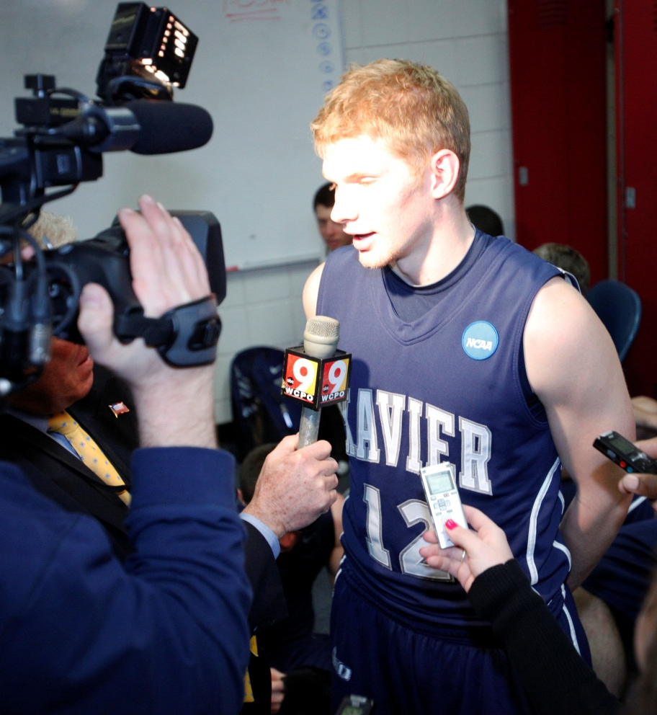
ACTIVE INVOLVEMENT
Show team specific student-athlete
examples – feedback
Practice the most used interview types:
- stand up (alone and with interviewer)
- press conference
- involve the students on both sides of the process

Slide 6
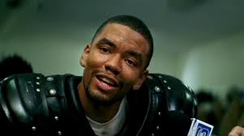
CONNECT WITH YOUR GROUP

Slide 7
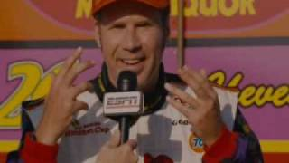
MAKE A POINT WITH HUMOR

Slide 8
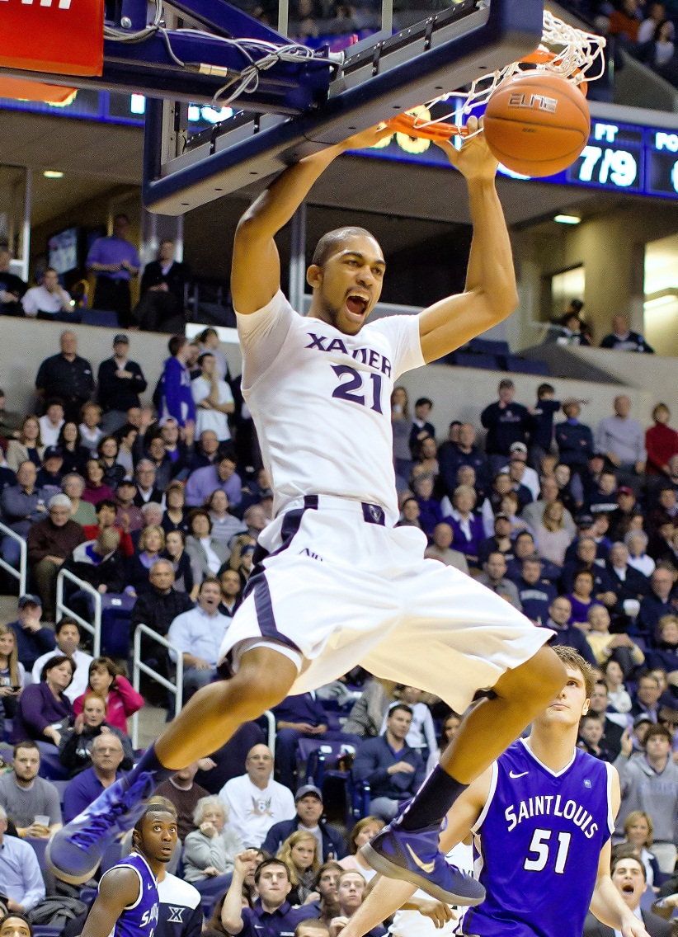
BRING YOUR GAME ENERGY
ENERGY….USE ENERGY IN YOUR ANSWERS!
HAVE FUN!

Slide 9
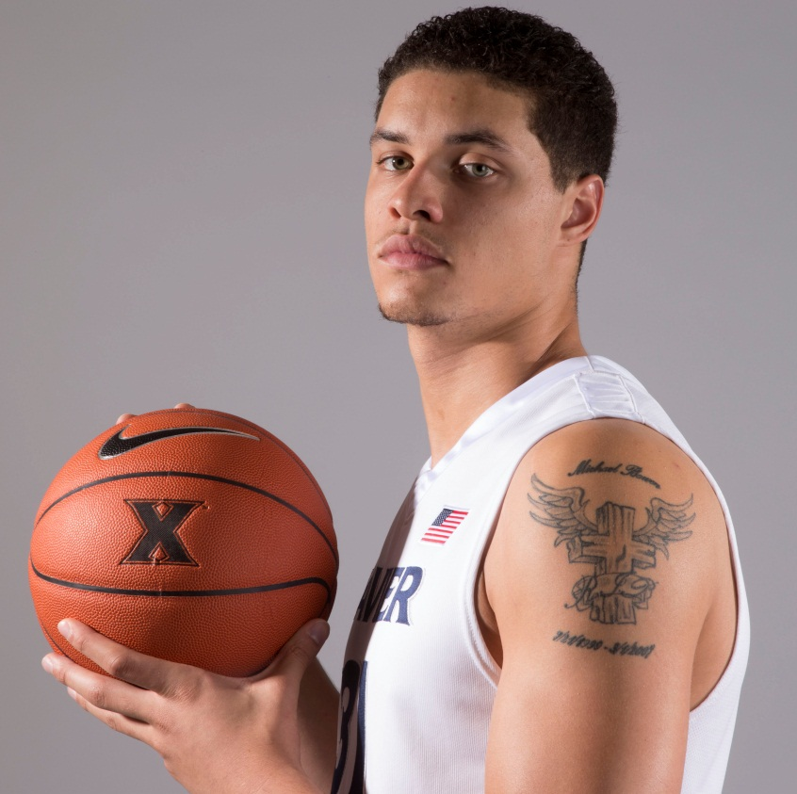
LOOK ME IN THE EYES
SLOW DOWN…Make eye contact, shake the interviewer’s hand and take time to introduce yourself. Also take time to think of your answer. Try to use the interviewer’s name.
Remember to say thank you

Slide 10
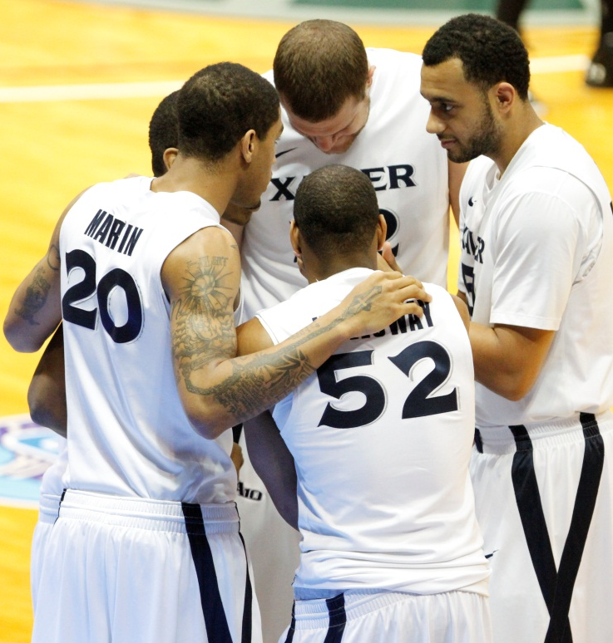
YOUR TEAM…YOUR MESSAGE
KNOW YOUR AUDIENCE…KNOW YOUR MESSAGE: FOCUS ON XAVIER
TALK ABOUT TEAMMATES AND BY NAME: Someone asks about your game-winning shot: “That pass from Dee Davis set me up perfectly.”

Slide 11
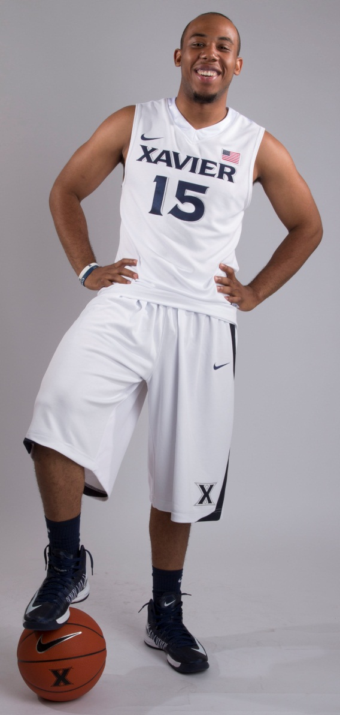
Be positive
ACCEPT VICTORY AND DEFEAT WITH CLASS…BE POSITIVE! NO SARCASM
YOU ARE THE EXPERT: The interviewer is asking you questions about you, your team, your sport, etc.
Answer the question your way. DON’T REPEAT NEGATIVES!

Slide 12
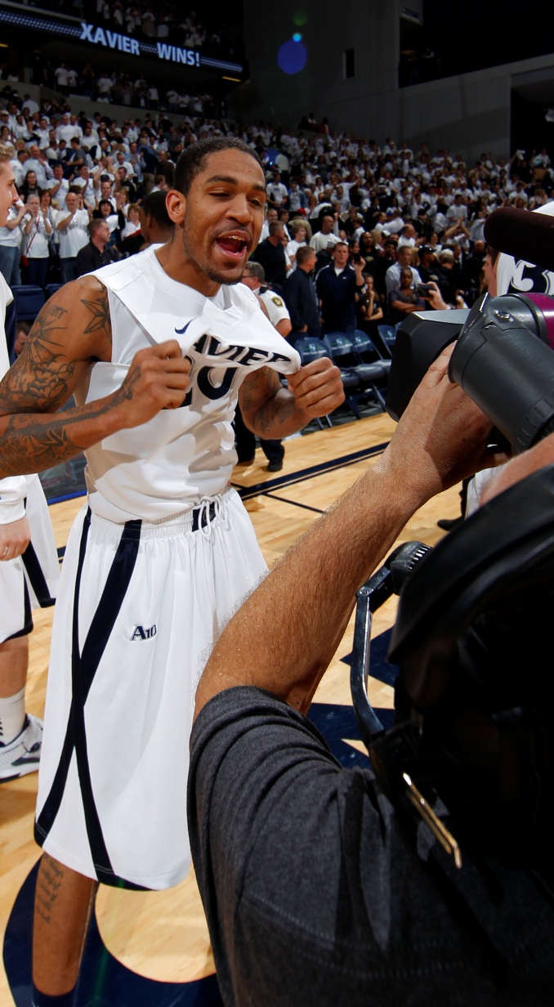
MAKE IT PERSONAL-ITY
PERSONALITY AND ANECDOTES: Tell stories. What do you find interesting when you see an interview on TV or the internet? Don’t be afraid to show personality.
USE COMMON SENSE – subject matter, language

Slide 13
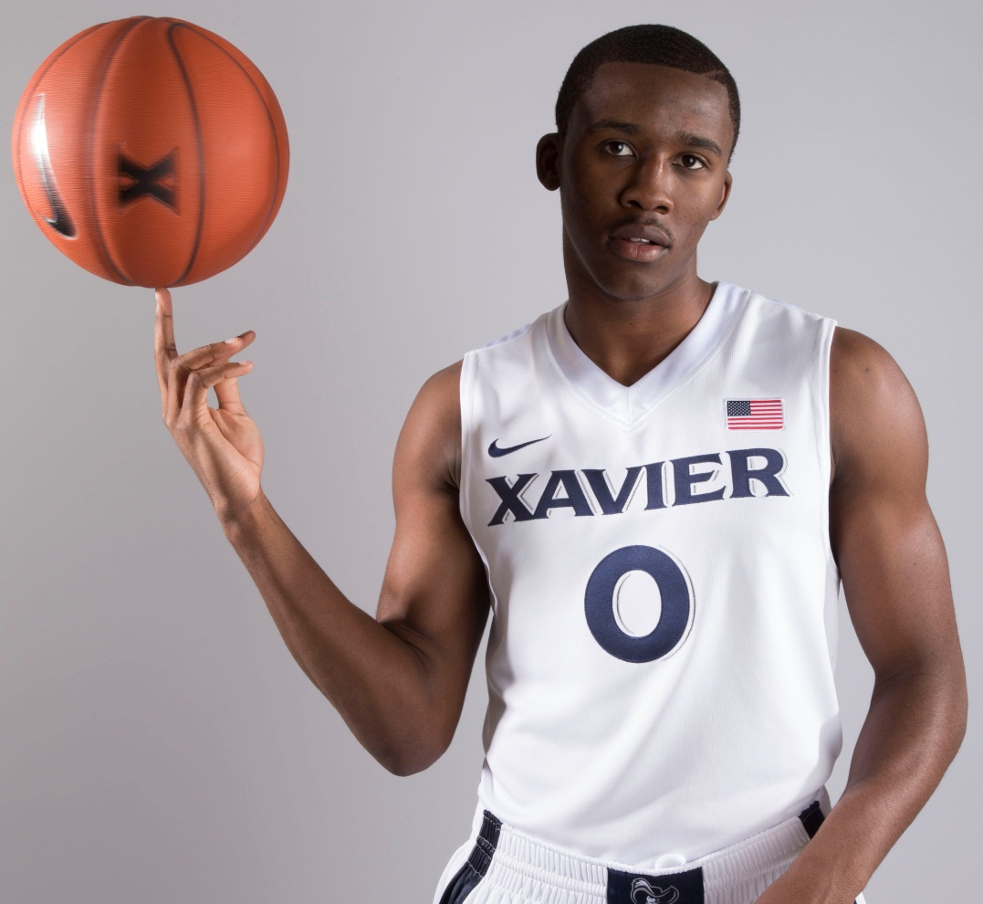
FILLER WORDS ARE NOT NECESSARY
AVOID SOME OF THE MOST COMMON “SPACE FILLERS” AS NATURAL PAUSES:
- Um
- Like
- Well…
- I mean
- You know
- Basically

Slide 14
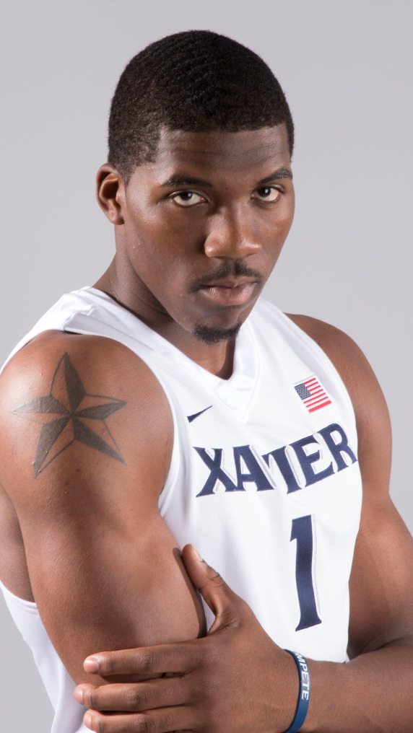
Choose your words wisely
Any curse words
Any racially-offensive words
“Come lay with me”
Ain’t
Yu, bra & text abbreviations
Former college football player describing his kick-off return for a touchdown:
“That was just instinct. Kind of like running from the cops.”

Slide 15
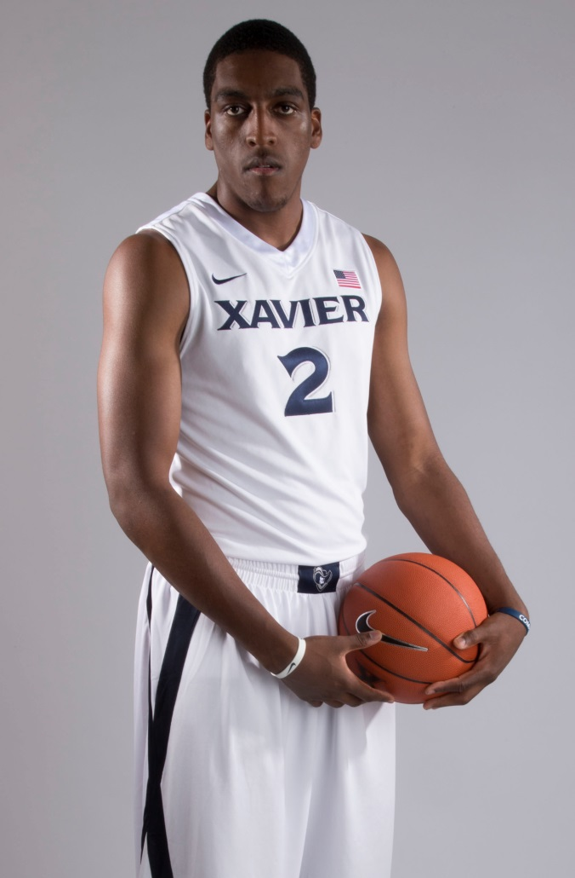
Practice Make Perfect…So Does Ongoing Feedback
FOR THE STUDENT-ATHLETE:
Practice, practice, practice.
FOR THE COMMUNICATIONS STAFF: Continuous feedback

Slide 16



SOCIAL MEDIA
We started our social media session with video: Social Media Revolution
Social Media Policy
Xavier Athletics Social Media Policy:
- if you don’t have one it’s time to write one

Slide 17
Twitter – the good
“Thanks everybody for your thoughts and prayers, mom just got out of surgery and is in recovery! #GODISGOOD” – @jmart202
“Finishing this paper for class… #collegelife” - @semaj2332
“Supporting my girls on the Xavier Volleyball Team!” (Tweeted with Photo) - @JamesFarr30
“’@jeremygrowe:.@B_RadXU12 looked like a young steve prefontaine out three w/ a 4:53 mile this morning’ haha got it done!!” - @B_RadXU12
Told my Moms she can have the Cap .. And my Grandma the Gown..I been thinking bout this Mother’s Day gift for 4 years ..Happy Mothers Day..” @TakeoffTrav

Slide 18
Pro stars you follow – good and bad
With training camp open, I’m working hard and my knee feels great. Looking forward to the new season! Go, Heat! ‏@DwyaneWade
Congrats to our Women's bball team, winning gold 5 times in a row!! Wow!! ‏@KDTrey5
Happy Birthday to the realest, most humble and God-fearing man that I've ever known...my DAD!!! Love You! @CP3
“Can someone please tell these fucking zebras foot locker called and they’re needed Back at work !!! #BreakingPoint” - @BrandonSpikes55

Slide 19
TWITTER – THE BAD
“RT @muskifan10: party in 2E #XavierNation @JalenReynolds @semaj2332 @jamesfarr30”
Keep my homeboys out da streets..keep my bad hoes on a leash! When I die burry me in a kneck full of rosary’s ..” – Retweet
“That shit is wackin like some dumb shit #preach”
“It’s almost my nigga @Big_Rob21 bday” – Retweeted from (•)(•) @BoobieFRESH
“How the eff has the chinese trampoline guy not thrown up his fried rice doing all those flips in a row #10minutes” – Academic All-Star Student Athlete (posted during the Olympics)

Slide 20
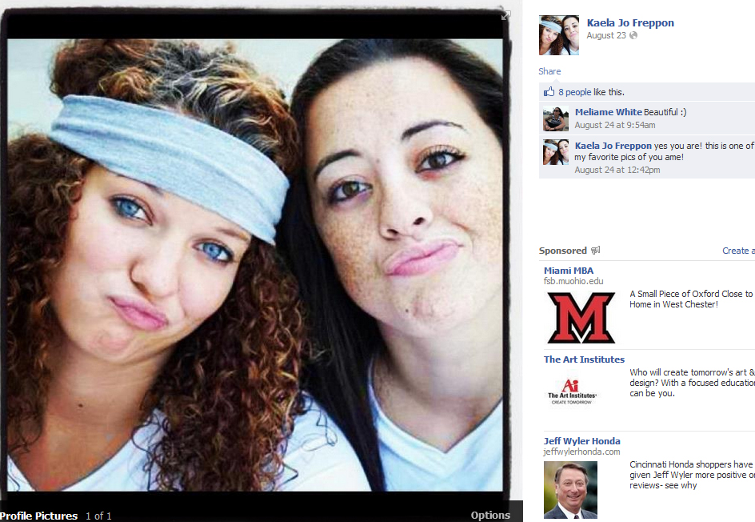
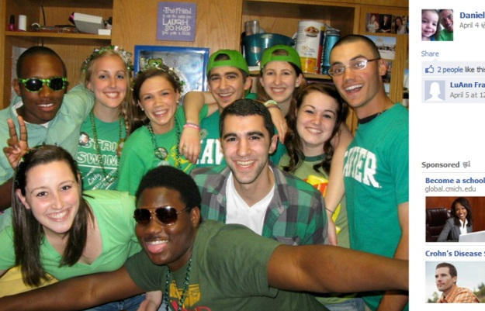
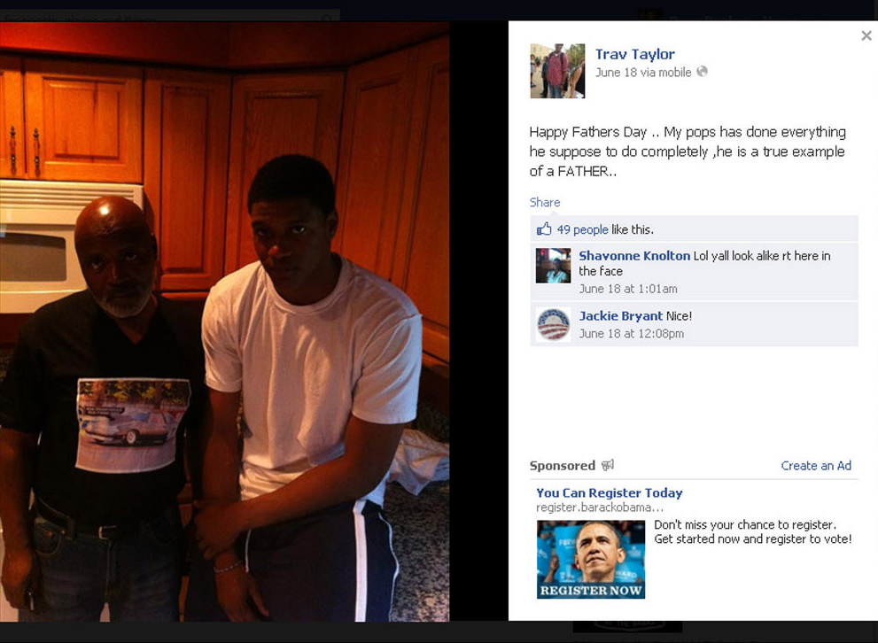
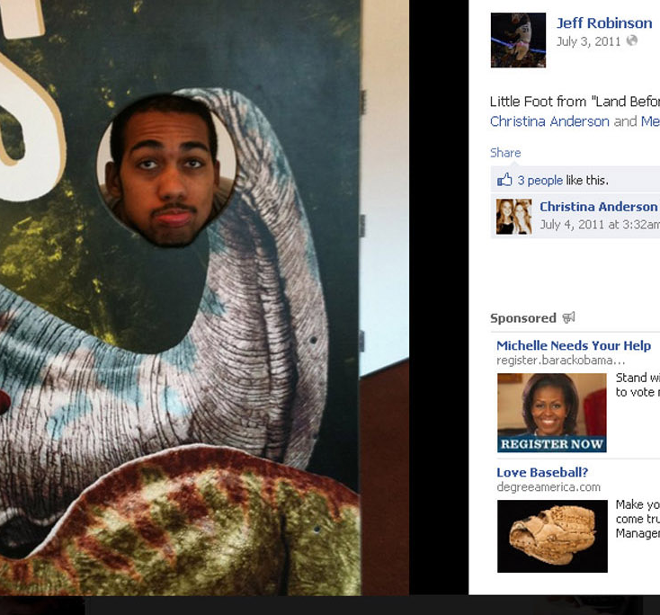
Facebook – the good

Slide 21
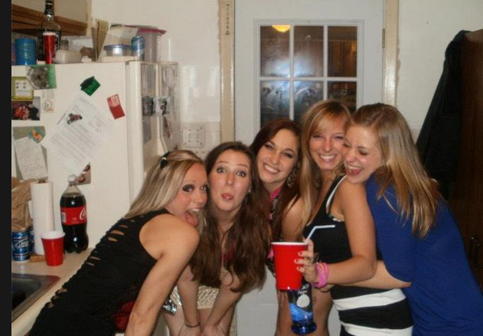
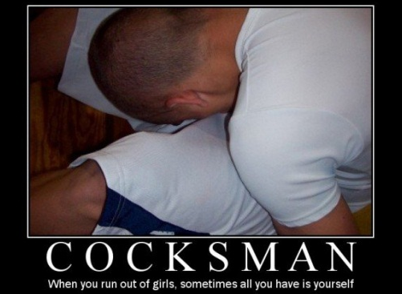
FACEBOOK – THE BAD

Slide 22

YEAR-LONG EDUCATION
No one-and-done approach
Regular follow-up: positive and constructive criticism for all media, including interviews and social media
Coaches don’t stop practicing and giving feedback in the pre-season; your pre-season session is exactly the same…a great starting point

Slide 23
John Lata, Assistant AD/Student Services
Florida State University
jlata@fsu.edu

Slide 24
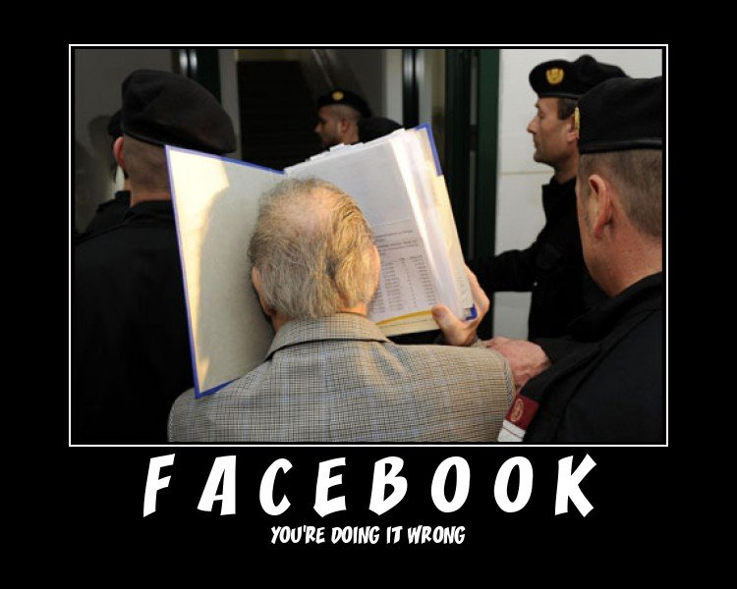
FSU’s Approach to Social Media
First FSU policy adopted in Summer 2006
Revised annually
  Last revision released: Summer, 2012
  Reviewed by university general counsel
  All SA’s sign agreement
Department philosophy:
  Educational
  Fun
  Not punitive in nature

Slide 25

Hazing Tie-in
Opportunity to touch on other hot topics
Many hazing situations were discovered through social-media downloads
Annual squad meetings

Slide 26
Squad Meetings
Coordinated by our Compliance Office
  Fall sports: held the day before practice starts
Mandatory for all teams and student-athletes
Attendance:
  All coaching staff
  All student athletes (if they do not attend, they can not practice)
Agenda:
  Signing paperwork to be able to compete, but now all are signed online, and we just use this meeting to emphasize certain issues within the student-athlete community
  Social media portion held in the middle, as a break between compliance and academics (typically 15 minutes: 5 minutes on hazing, 10 minutes on social media)

Slide 27
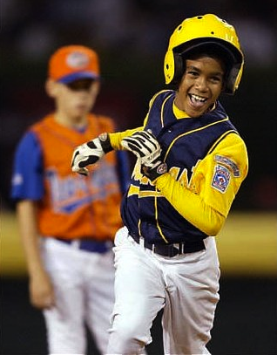
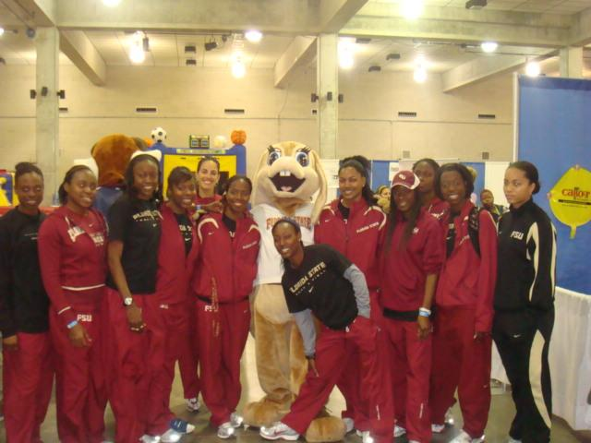
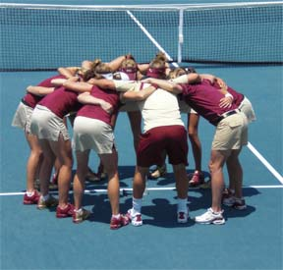
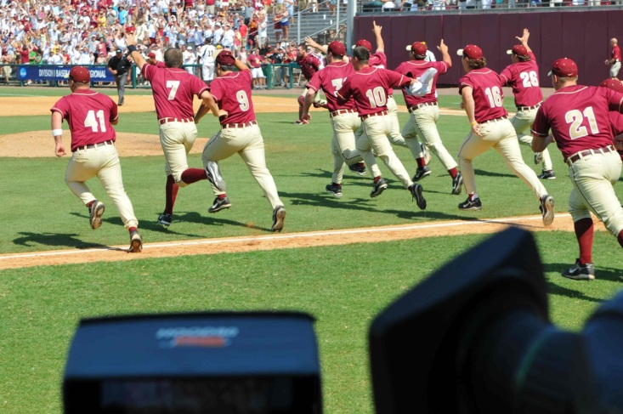
Why do they use social media?
Fun
Connections – family and friends
How many friends is too many?
  How many pictures are too many?!?

Slide 28
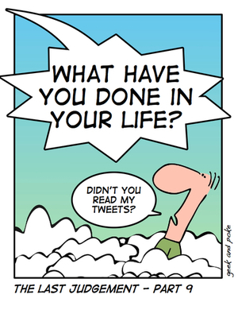
Appropriateness
Of discussions
Tweeting issues
Instagram/new platforms
Positive uses
  Thanking fans
  Talk about community service

Slide 29
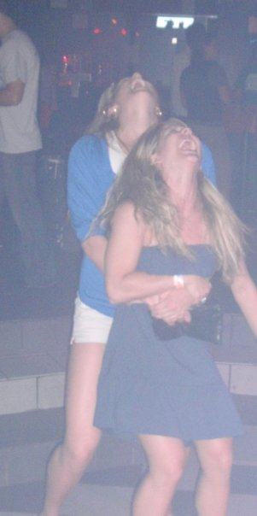
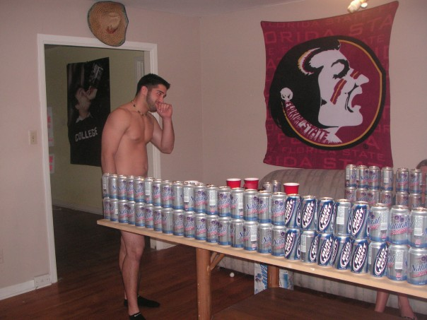
Uh-oh pics
Be careful of folks with cameras, especially in bars

Slide 30

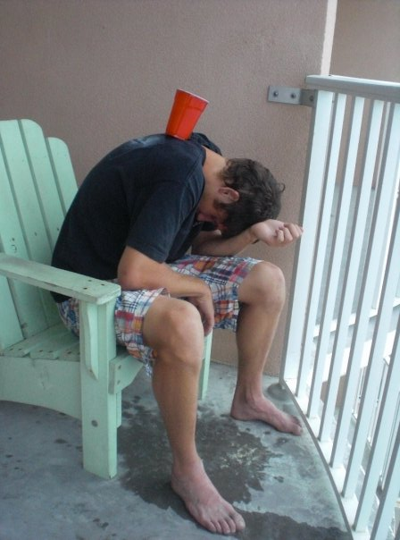

Bad pics/sayings
Don’t be president of your own fan club

Slide 31
Who disciplines?
Peer pressure
Pressure from coaching staff
I have little to no punitive powers
Were you waiting for your picture to go up on the big screen and I missed you?
  You know what picture I’m talking about, take it down

Slide 32
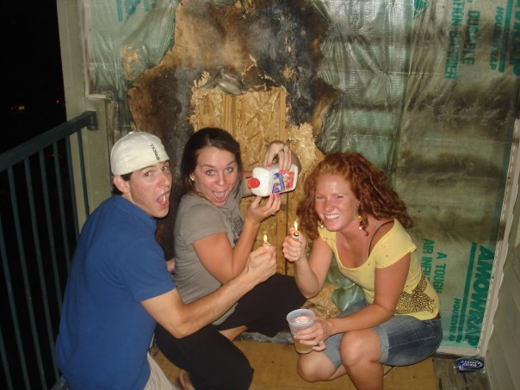
Once you post it, you don’t own it anymore!
Facebook policy – even after you delete it, they own it

Slide 33
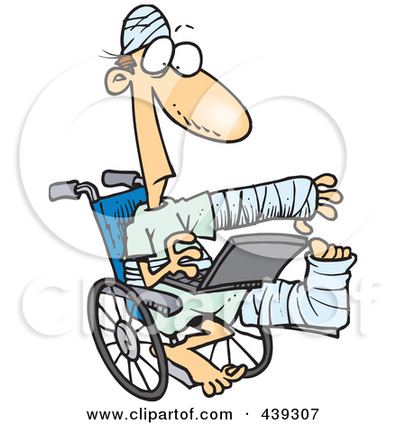
Other Issues
Don’t talk about team issues
Don’t talk about injuries, yours or others

Slide 34
Safety Issues
Point of emphasis
Don’t post personal contact info
Don’t post where you will be when
Your real friends know how to find you
Be careful what groups you belong to
  Guilty by association

Slide 35
Why my job gets harder every year:
Seniors know I’m coming
I utilize a “best of the past” presentation for the groups that don’t have issues
And yet, I’m still in business
No matter how much we talk about it, there are still a few folks who just don’t get it

Slide 36
Concluding Thoughts
Have fun
Don’t embarrass one person too much
If needed, pull a particular person aside before or after
Safety (and future employability) are key
Let the coaches set the team ground rules
  Expectations can vary

Slide 37
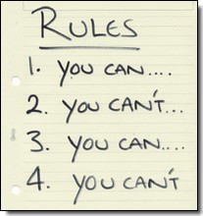
Concluding Thoughts
How do you handle violations?
  Obviously there are circumstances that are unacceptable regardless of team affiliation
  Handle them
Let the coaches set the team ground rules

Slide 38
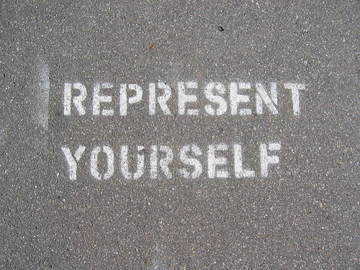
Represent!
Anything you post online represents:
  Yourself
  Your team
  Your athletic department
  Your school and conference
  And finally, your family

Slide 39
Chris Yandle, Director of Communications
University of Miami
c.yandle@miami.edu
305-284-3248
@ChrisYandle

Slide 40
R.A.I.S.E. Your Social media awareness
  Respectful
  Authentic
  Intentional
  Smart
  Engaging

Slide 41
Why do we do social media training in-house?

Slide 42
Your social media footprint is your digital résumé. Potential employers will look at what you’ve done online.

Slide 43
If athletics is the front porch of a University, then social media is the front lawn – keep it clean.

Slide 44
what you say online DOES represent your employer, your family, your church, etc.

Slide 45
your social media reputation says?
Google Yourself
Don’t rely on privacy settings
Remove every potentially-inappropriate post and picture
Keep language and grammar in mind
Emily Driscoll, FOXBusiness.com
“What Your Social Media Reputation Says to Employers” – June 3, 2013

Slide 46
10 SOCIAL MEDIA KEYS
Every day is a job interview. Dress/Act like the job you want, not the job you have.
Twitter/social media is a telephone, not a megaphone.
Take pride in who/what you represent.
If you can’t say it front of your mother, then don’t say it. (MOM RULE)
Have some common sense.

Slide 47
10 SOCIAL MEDIA KEYS
Don’t engage in Twitter arguments. No one wins.
What happens behind closed doors…stays behind closed doors.
Thank your teammates and fans every day.
Never criticize an opposing team, referee, coach or teammate.
Have fun.

Slide 48
QUESTIONS?

