Slide 1
Components of an Effective Program to Address Sexual Assault Involving Student Athletes
Lucy France, JD
Christine Fiore, Ph.D.
Amelia Lawless, CHES, ASW
Jessica Heskin, M.A.

Slide 2
Education and Collaboration
Jessica Heskin, M.A.
California State University, Sacramento

Slide 3

What Is “Good Education?”
Uniform—Everyone Gets The Same Information
Audience Specific– Information May Look Different For Different Audiences
Research Based
Resource and Empowerment Driven
Documented and Evaluated
Notes:
Sexual Assault and Domestic Violence education must be uniform across the campus in terms of information. It is counterproductive to have different education from different entities which are not collaborating. It must also be audience specific so that you would not be doing the same presentation for students as you would for staff, or for Greeks as you would for athletes. It should also be research-based whether through formal research or through climate surveys or other assessments of your own campus. Resources and empowerment models must also be provided so that the audience does not feel helpless at the end. These include bystander intervention strategies and experts on campus. Finally, you must be able to document and evaluate your trainings to make sure they are as effective as they can be. This will also cover your legal obligations under SaVE.

Slide 4
Health Promotion and Education
Health Promotion--Health promotion is the process of enabling people to increase control over, and to improve, their health. It moves beyond a focus on individual behaviour towards a wide range of social and environmental interventions.
Health Education--Health education is any combination of learning experiences designed to help individuals and communities improve their health, by increasing their knowledge or influencing their attitudes
--World Health Organization
Notes:
The terms are used interchangeably, but they really are different concepts. It is important to have both the social and individual intervention/education levels especially when talking about violence prevention. Each campus usually has some form of health promotion and/or health education department. Utilize them!

Slide 5

Types of Education
National Collegiate Health Assessment Survey (NCHA)
Online Tutorials
In-Person Orientations
Written and Web Material
Campus Events and Collaborations

Slide 6
National Collegiate Health Assessment
Conducted every two years
Ran subsets of data to isolate athlete responses
Prioritized types of education needed
Benchmarked
Notes:
NCHA supplies valuable data concerning what your students’ health habits are ranging from dietary habits to sleeping patterns to how often they exercise and see a dentist. In addition, the survey asks about what they would like to have more education about. You can also request (at a cost) subset data, for example a separate report regarding your athletes or your Greeks. This information can help shape how often you do education, and what type you do.

Slide 7

On-Line Tutorials
Advantages
Documented proof student compliance
Pre/Post test and attitudinal data collection
Uniform information and Benchmarking
Disadvantages
Costly
Must be managed if holds are placed
No “face-to-face” contact
Notes:
Can be easier to assure compliance if holds are placed on registration. The pre-post test data usually involves attitudinal data which can be valuable, in addition to ensuring that the students have some level of comprehension of material presented. Information and resources are consistent. They are costly, however. Different ways to cover the fee is a supplemental fee charged to the student, grants, and departmental budget collaboration. Also, someone must manage the holds. Not all companies offer this services. Finally, without face-to-face contact, especially with new students, there may not be an identification of the “person with the services”.

Slide 8
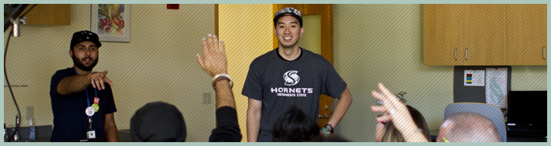
In Person Orientations
Done in conjunction, not in lieu of, online education
New Student Orientation, New Athlete Orientation, Greek New Member Ed orientation, RA training
Coaches and Athletic Staff
Notes:
Best done in conjunction with online education, as well as print material and web-based resources/education. These should also involve many different presenters if possible, although this can be uncomfortable for some staff due to the sensitive subject matter. Coaches, peer health educators, and health education staff can all participate. It is also important for sexual assault/domestic violence training to occur with new and existing athletic staff so that they know what the students are being told and feel comfortable with service-providing staff members should a student disclose.

Slide 9
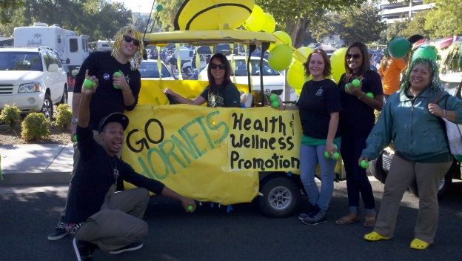




Successful Collaboration
Occurs throughout the academic year
*DV/SA Awareness Month
*VDay
Runs both ways
  *Attend athletic events
  *Tie-In of Athletes and DV/SA Awareness
  Coaches and Athletic Staff
  *Trainings
  *Assessment of staff knowledge
Notes:
The third piece of the puzzle is ongoing education through outreach. It is important for athletes to participate as members of the university athletic teams, as well as athletic coaches and staff to participate visibly. There has to be an infusion of education, not sporadic, isolated incidents. In addition, health education staff must participate with athletics for their big events. Going to homecoming, team games, honored or featured positions at DV/SA events for teams is just as important. Finally, assessing coaches and athletic support staff for their knowledge of the subject matter and then supplying training which is useful to them on an ongoing basis is essential. All of our DV/SA education staff should know coaches on a first name basis.

Slide 10

Victim Advocacy
Number one fear of female student athletes who are assaulted is being viewed as “weak”
Fear of coach finding out
Worried if alleged perpetrator is another athlete
Worried about team mates finding out
Worried process will interfere with trainings, etc.
Notes:
Victim advocates are not counselors, although we do crisis counseling. In most states, we do carry client confidentiality like a counselor. We are the “air traffic controllers” for the student. We explain their options and then let them choose. Then we make that happen to the best of our ability. It takes teamwork. This is why athletic-advocate collaboration is so very crucial so that when the crisis happens for the athlete the services are seamless and as coordinated as possible.

Slide 11
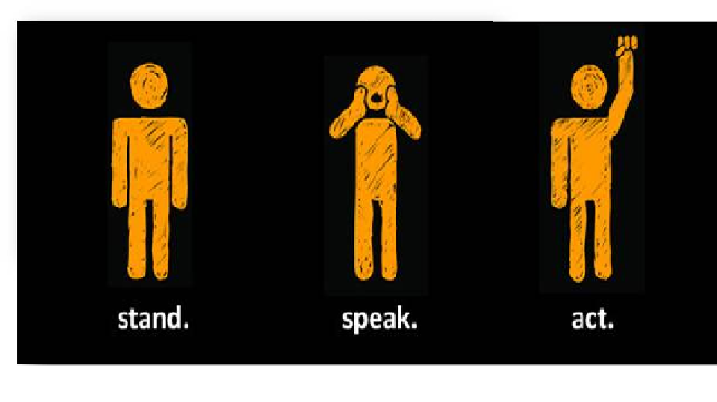
Bystander Intervention
Amelia Lawless, CHES, ASW
California State University, Sacramento

Slide 12
Bystander Effect/Apathy
Individuals not offering assistance to a victim when others are present
The probability of the victim receiving help exponentially decreases if more bystanders are present
Social psychology research
  First demonstrated in Darley and Latane’s lab in 1968 after the murder of Kitty Genovese in 1964
  Area continues to be researched
Factors
  Group cohesion
  Environment
  Diffusion of responsibility
Notes:
Kitty was approximately 100 feet from her apartment when she was attacked. She cried for help but neighbors did not intervene. One neighbor yelled out to the attacker to leave her alone. He left for ten minutes to stab her several more times. He then proceeded to rape her and stole money from her wallet. The entire attack lasted 30 minutes-more than enough time for neighbors to react and police to arrive.

Slide 13
Bystander Intervention
Strategy to prevention violent acts including, but not limited to, bullying, sexual harassment, sexual assault and intimate partner violence
Individuals choose to continue violent behaviors based on the reaction from those around them
Strategy discourages victim blaming, encourages changes in the social norms and shifts responsibility

Slide 14
How Bystander Intervention Works
Approach provides community members with the opportunity to intervene in safe and constructive ways
Provides information necessary for bystanders to be supportive allies to victims after incident has occurred
Research indicates that this approach is effective in prevention of violent incidents like sexual violence
Five steps toward taking action (Darley & Latane, 1968)
  1. Notice the event
  2. Consider whether the situation requires attention
  3. Decide if you have a responsibility to intervene
  4. Decide what form of assistance to use
  5. Understand how to implement the choice of safety

Slide 15

How Athletics Can Be Involved
Utilizing role model status within college community
Culture within team
Coaches and administrative support of bystander intervention
Social norms shift within campus

Slide 16


Solutions
Step Up!
  University of Arizona
Men Can Stop Rape Bystander Intervention Program
Bystander Intervention
  Mississippi Coalition Against Sexual Assault
Bringing in the Bystander & Know Your Power
  University of New Hampshire
Green Dot Campaign
Many more (list published on website)

Slide 17
Sacramento State Contact Information
Violence & Sexual Assault Support Services
  Jessica Heskin, M.A.
  heskin@csus.edu
  916-278-3799
Alcohol, Tobacco & Other Drug Education
  916-278-5422

Slide 18
Campus Climate
Christine Fiore, Ph.D.

Slide 19

Climate Surveys
White House Task Force to Protect Students from Sexual Assault-April 2014
“Best way to identify the Problem”
New toolkit: https://www.notalone.gov/assets/ovw-climate-survey.pdf. #page=24&zoom=auto,0,502
Campus Climate Surveys

Slide 20

Campus Climate Surveys
What are they?
How are they administered?
How can the information help you?

Slide 21
Campus Climate Surveys (CCS)
What are they?
Campus climate surveys are typically anonymous questionnaires about sexual violence experiences as well as assessment of perceptions of campus climate.
This can include: knowledge about campus policies, reporting and resources; opinions about barriers to reporting, seeking help, as well as effectiveness of campus programs and support services
Important to gather information on KNOWLEDGE, ATTITUDES and BEHAVIOR

Slide 22

What are they?
CCS are BEST method to assess:
  Incidence and prevalence rates
  Program effectiveness
  Barriers
  Explore possible patterns and concerns within different campus units
  Possible solutions
Notes:
Official channels are known to be under represent that actual prevalence of campus sexual violence

Slide 23
What are they?
May also gather campus climate information through focus groups –
  Provides for more focused and deeper questioning
  Gather student centered ideas on concerns, solutions and programming
  Opportunity to work with specific student subgroups such as female and male athletes to discover specific patterns and needs
Helpful to be done by someone outside your program for increased honesty and openness
Notes:
Focus groups last year on our campus suggested to us that coaches were the most likely person a student athlete would seek support from; that they expected coaches to know options and provide valued guidance. Female athletes also provided valuable information on their challenging position within this gendered arena. They described attitudes that created barriers to reporting as well as utilizing bystander intervention that were unique to their social group.

Slide 24

CCS-Knowledge
What do students know about campus sexual violence?
Typical surveys will assess students knowledge of:
  Rules of conduct and law (for all students and can be athletic codes of conduct as well)
  Reporting options
  Resource options
  Myths and Realities
Notes:
Clarifies if your efforts to educate are working

Slide 25
CCS-Attitudes
Campus Sexual Violence is believed to exist because of social attitudes about behavior that allow for its perpetuation
1 in 5 women and 1 in 6-9 men statistic establishes it as a social problem
Rape Myth Acceptance is correlated with sexual violence perpetration
Self-blame is correlated with less likelihood of reporting and poorer long term outcomes for victims/survivors

Slide 26

CCS-Attitudes
What are your campus attitudes that need to be addressed in programming?
  Attitudes are developed over a life time and are culture bound
  Colleges and Universities are known to change lives and attitudes through education
  Assessing guides programming and gives feedback on program effectiveness in impacting attitudes
  Attitudes are closely linked to behavior
  We need to know if how and if we are creating culture change

Slide 27

CCS-Behavior
What is the current of extent of the problem with sexual violence, stalking and intimate partner physical violence?
Do you know what percent of students are likely to report to campus authorities or police?
Do you know why or why not reporting is happening?
For those who have reported do you know anything about their satisfaction with the process?

Slide 28
CSS-Behavior
Offers an opportunity to sample your student population to discover the extent of the problem
Offers you the opportunity to know for those who have experienced campus violence, are your programs, processes and resources satisfactory and effective? Are they being utilized by those in need? Are certain subgroups not accessing resources and/or less satisfied?

Slide 29
How?
Administered typically through web-based surveys, anonymously, with incentive, to all students on campus
Need Institutional Review Board (IRB) approval
Select administration time with maximum possibility for best response
Must monitor and track process and data

Slide 30

How can CCS help you?
What can you do with the information?
Use it to guide you-Provide a roadmap for where you are and where you need to be!

Slide 31
Minimum Legal Requirements
Lucy France, JD

Slide 32
The Law
Clery Act
Title IX
Violence Against Women Act
Sub regulatory Guidance
  2001 and 2011 Dear Colleague Letters
  White House Task Force First Report
  Dept. of Education/OCR FAQ
  Resolution Agreements
Notes:
Clery is about crime and safety policy reporting in addition to timely warnings, emergency notifications, missing persons policies, etc.
VAWA is a 2013 Amendment to Clery.
Title IX prohibits sex discrimination in educational programs and activities- most guidance is from other sources

Slide 33

Compliance is Not an Option
DOE increased compliance reviews and investigations
Most importantly, compliance will help all students
Notes:
May 1, 2014 DOE released a list of higher education institutions under investigation for possible violations of federal law over handling of sexual violence and harassment complaints. There were 55 on the list.

Slide 34

Road Map
Reporting
Education and Programming
Helpful Tips

Slide 35
Reporting
Campus Security Authorities
  Campus police and security
  Employees/officials who have significant responsibility for student and campus activities, including, but not limited to student housing, student discipline, and campus judicial proceedings
  Pastoral and professional counselors are exempt
VAWA added reportable incidents
  Dating violence
  Domestic violence
  Stalking
Notes:
Do you know if you are a CSA? Do you know what and how to report? In athletics, it is likely that Athletic Director, associate and assistant directors, all coaches and trainers are CSAs. Clery requires reporting so statistics can be correctly counted and any need for timely warnings can be properly assessed.

Slide 36
Reporting
Responsible Employee
Has the authority to take action to redress sexual violence; who has been given the duty of reporting incidents of sexual violence or other misconduct by students to the Title IX coordinator or other appropriate school designee; or whom a student could reasonably believe has this authority or duty.
Notes:
This is a Title IX requirement from the 2001 DCL and reiterated in the 2014 FAQ. Who are your responsible employees? All CSAs; any more?

Slide 37

Reporting
Responsible Employee
When a responsible employee knows or reasonably should know of possible sexual violence, this knowledge is attributed to the institution. The school must take immediate and appropriate steps to investigate.

Slide 38
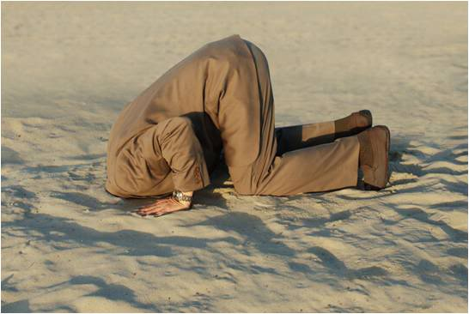
“Knows” or “Reasonably should know”

Slide 39
Reporting
Responsible Employee
A responsible employee must report to the Title IX Coordinator or other appropriate school designee, all relevant details about the alleged sexual violence. This includes the names of the alleged perpetrator and victim, other students involved, relevant facts, including date, time, and location.
Notes:
This clarification comes from the recent DOE/OCR FAQ.

Slide 40
Education and Programming
Employees
Special Training for Campus Security Authorities
Special Training for employees involved in implementing school’s grievance procedures
All employees likely to witness or receive reports of sexual violence
  How to prevent and identify sexual violence
  Behaviors that may lead to sexual violence
  Attitudes of bystanders
  Potential for revictimization by responders and effect on students
  Appropriate methods for responding to student report
  Impact of trauma on victims
  Where and how to report
  How to respond to student’s request for confidentiality
  Rights to file Title IX and criminal complaints
  Options for confidential reporting and resources
Notes:
Training includes identifying sexual harassment, retaliation, stalking, dating and domestic violence; information about the school’s processes; information about confidentiality.

Slide 41
Education and Programming
Students and Employees
On-going and sustainable
Objectively effective: methods used to offer prevention and awareness programs and campaigns must be based on solid foundations, either verified through existing research or based on assessment at the institution itself.
Notes:
Training and education must be constant and various

Slide 42
Education and Programming
Students and Employees
Policies and procedures
    Definitions, sanctions, confidentiality, reporting
Prevention programs- culturally relevant
Awareness programs- increase knowledge and share information and resources to prevent violence, promote safety, and reduce perpetration
Bystander intervention- recognition and safe and positive options
Risk reduction- options designed to decrease perpetration and bystander inaction, and increase empowerment for victims

Slide 43

Helpful Tip
Do Not Work in Isolation
Work closely with your Title IX Coordinator
Ask for information
Work on consistent and sustainable programming
Provide information in various ways
  Handbook
  Website
  Posters
  Coaches meetings
  Ongoing interactions
Notes:
Make it part of the culture. Figure out a way to ensure that student-athletes and employees are getting the same substantive information; but in a way that it is meaningful and relevant.

Slide 44
University of Montana
Contact Information
Lucy France, JD
  University of Montana Legal Counsel
  406-243-4742
  lucy.france@mso.umt.edu
Christine Fiore, Ph.D.
  Professor and Chair, Department of Psychology
  406-243-2081
  christine.fiore@mso.umt.edu

Slide 45
Questions?

