Slide 1
Concussions:
Initial Assessment
Mark Bajorek, MD
June 3, 2014
Director Health Services
Portland State University

Slide 2
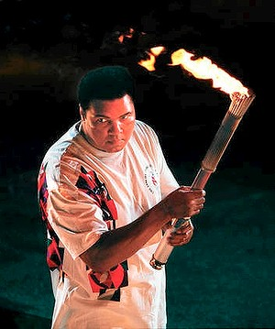
Epidemiology of traumatic brain injury (TBI) in the United States - CDC
Approximately 1.4-3.6 million people in United States with TBI per year
Contributing factor in 30.5% of injury-related deaths
Concussion or other mild TBI accounts for 75% of TBI
20% of TBI secondary to physical activity and sports
1.365 million people treated and released by the emergency room each year for TBI
275,000 people hospitalized for TBI each year
52,000 deaths from TBI each year
Most common in ages: 0-4, 15-19, and > 65 years
Direct medical costs and indirect costs (eg, lost productivity) of TBI totaled an estimated $60 billion in the United States in 2003
http://www.cdc.gov/traumaticbraininjury/get_the_facts.html

Slide 3
NCAA Definition
A concussion is a brain injury that may be caused by a blow to the head, face, neck, or elsewhere in the body with an “impulsive’ force transmitted to the head. Concussions can also result from hitting a hard surface such as the ground, ice, or floor, from players colliding with each other or being hit by a piece of equipment such as a bat, lacrosse stick or field hockey ball.

Slide 4

Case
Setting: Cycle Oregon X culminating of a 525 mile ride over the coastal range to the Oregon Coast at Yachats. Logging roads used for the ride. Rain and moss complicated the ride contributing some treacherous breaking on the descent.
Jason S is a 32 yo male helmeted cyclist whose bike hit a rock and he fell on an outstretched left arm and he hit his left temporal region on a rock. He reported no loss of consciousness, no loss of bowel or bladder control. No seizure like activity was observed. Pt was responsive to voice but was disoriented to day, date, and location. Pt reported pain in the left clavicle area and shoulder. Pt was not sure where he was going but wanted to get back on his bike.

Slide 5
Physical Exam
Patient sitting along side his bike
Vitals - pulse: palpable, respirations: 16/min regular
Pt oriented to name only, speech production fair, no sense of location
Extraocular muscles intact, pupils equal
Left clavicle observed through his jersey was bent caudad

Slide 6
Worst Case Scenarios
CT - scan of a epidural hematoma, subdural hematoma, and intracranial hematoma
Schematic views of
Brain edema
Chronic Traumatic Encephalopathy - l changes associated with neural connections and axons affecting mood, cognition and motor skills

Slide 7
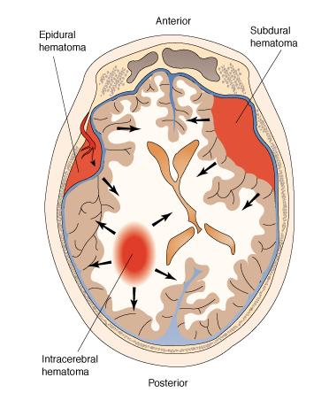

Slide 8
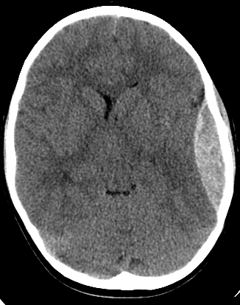

Slide 9
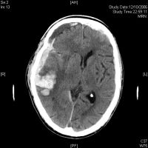

Slide 10
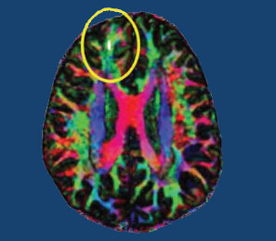
Diffusion Tensor Imaging

Slide 11
Red Flags
Decreasing level of consciousness
Increasing confusion
Increasing irritability
Loss of or fluctuating level of consciousness
Numbness in the arms or legs
Pupils becoming unequal in size
Repeated vomiting
Seizures
Slurred speech or inability to speak
Inability to recognize people or places
Worsening headache

Slide 12
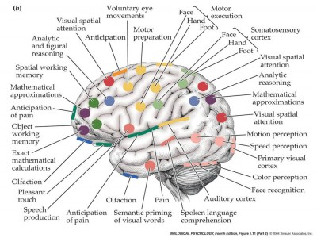
Looking for injuries based on function

Slide 13
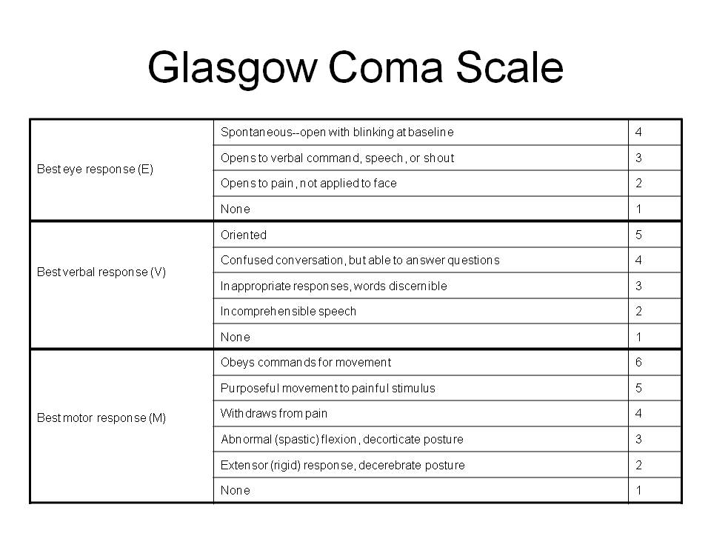

Slide 15
Maddocks Score
What venue are we at today?
Which half is it?
Who scored last in this match?
What team did you play last week/game?
Did your team win the last game?

Slide 16
Modified Assessment
What ride are you on?
Where are you headed ?
Where did you camp last night?
What type of bike do you have?
What is your rider number?

Slide 18
Evaluation of warning signs or Symptoms*
emotions
sensations
concentration
memory
Alertness
* More interpretation involved in scoring: none, mild, moderate, severe

Slide 19
Cognitive & Physical Evaluation
Orientation - day, date, month, year, time of day
Short term memory (words/digits) and concentration
Neck exam, balance, coordination
Re-check word recall

Slide 20
Chronic Traumatic Encephalopathy
A latent neurodegeneration clinically associated with behavioral changes, executive dysfunction, and cognitive impairments, and pathologically characterized by frontal and temporal lobe atrophy, neuronal and axonal loss and abnormal deposits of amyloid proteins.

Slide 21
“Return to Play” Guidelines
Baseline step of the "Return to Play Progression“:
  athlete needs to have completed physical and cognitive rest
  Athlete should not be experiencing concussion symptoms for a minimum of 24 hours
Keep in mind that the younger the athlete, the more conservative the treatment.
5 Steps for "Return to Play Progression“ (next slide)

Slide 22
NCAA Return to Play Progression
Step 1: Light aerobic exercise. The goal is only to increase the athlete's heart rate. Exercise time is 5-10 minutes and includes exercise bike, walking, or light jogging -- absolutely no weight lifting, jumping, or hard running.
Step 2: Moderate exercise. The goal is to limit body and head movement. Exercise time is reduced from a typical routine. Activities include moderate jogging, brief running, moderate-intensity stationary biking, and moderate-intensity weight lifting,
Step 3. Noncontact exercise. The goal is more intensity but without contact. Time should be close to the athlete's typical exercise routine, and activities can include running; high-intensity stationary biking; the player's regular weight lifting routine; and non-contact, sport-specific drills. This stage may add some cognitive component to practice in addition to the aerobic and movement components introduced in steps 1 and 2.
Step 4. Resume practice. The goal of this step is to reintegrate in full-contact practice.
Step 5. Return to play. The goal of this final step is to return to competition.
It is important to monitor symptoms and cognitive function carefully during each increase of exertion. Athletes should only progress to the next level of exertion if they are not experiencing symptoms at the current level. If symptoms return at any step, the athlete should be instructed to stop the activity, because this may be a sign that the athlete is pushing too hard. Only after additional rest, when the athlete is no longer experiencing symptoms, for a minimum of 24 hours, should the athlete begin again at the step during which symptoms were experienced.

Slide 23
NCAA Return to Play Progression
Step 1: Light aerobic exercise. The goal is only to increase the athlete's heart rate. Exercise time is 5-10 minutes and includes exercise bike, walking, or light jogging -- absolutely no weight lifting, jumping, or hard running.
Step 2: Moderate exercise. The goal is to limit body and head movement. Exercise time is reduced from a typical routine. Activities include moderate jogging, brief running, moderate-intensity stationary biking, and moderate-intensity weight lifting,
Step 3. Noncontact exercise. The goal is more intensity but without contact. Time should be close to the athlete's typical exercise routine, and activities can include running; high-intensity stationary biking; the player's regular weight lifting routine; and non-contact, sport-specific drills. This stage may add some cognitive component to practice in addition to the aerobic and movement components introduced in steps 1 and 2.
Step 4. Resume practice. The goal of this step is to reintegrate in full-contact practice.
Step 5. Return to play. The goal of this final step is to return to competition.
It is important to monitor symptoms and cognitive function carefully during each increase of exertion. Athletes should only progress to the next level of exertion if they are not experiencing symptoms at the current level. If symptoms return at any step, the athlete should be instructed to stop the activity, because this may be a sign that the athlete is pushing too hard. Only after additional rest, when the athlete is no longer experiencing symptoms, for a minimum of 24 hours, should the athlete begin again at the step during which symptoms were experienced.

