Slide 1
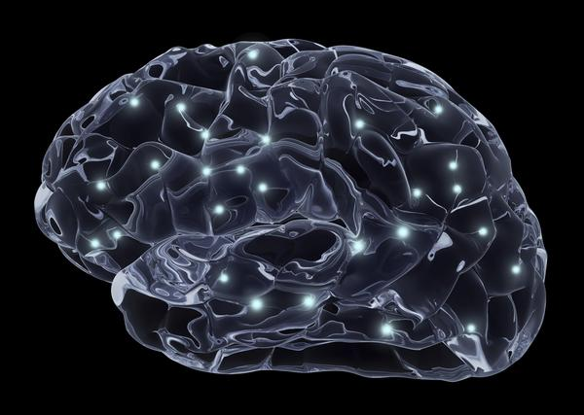

CONCUSSION
It Takes a Village to Manage a
Caroline Faure, EdD; ATC
Associate Professor & Director
Center for Sports Concussion
Idaho State University

Slide 2
“IT TAKES A VILLAGE TO MANAGE A SINGLE CONCUSSION…”
Athletic Trainers & Team Physicians
Coaches & Teammates
Family
Psychosocial Support Services
Academic Student Support Services
Equipment Support
Rule Changes

Slide 3
LONG TERM EFFECTS OF CONCUSSION
“It Takes a Village…”
Post-Concussion Syndrome (PCS)
80% of athletes recover from all concussion symptoms with time; 10-20% develop persistent PCS
Decreased Processing Speed
Short Term Memory Impairment
Concentration Deficit
Irritability/Depression
Fatigue/Sleep Disturbances
General Feeling of “Fogginess”
Academic Difficulties

Slide 4
LONG TERM EFFECTS OF CONCUSSION
“It Takes a Village…”
Psycho-Social Support Services
Underlying psychological conditions commonly associated with history of one or more concussions
  Headache, fatigue, academic & social functioning can be affected
  Emotions can run the gamut
Depression & anxiety common, especially in those reporting symptoms >10 days.
It’s subjective: Lack of physical markers (observable signs) can cause confusion and distrust
Loss of athlete identity
Pharmacological intervention may be necessary

Slide 5
LONG TERM EFFECTS OF CONCUSSION
“It Takes a Village…”
Psycho-Social Support Services
Clinical Depression & Suicidal Ideation
Study of retired NFL players revealed 11% reported previous diagnosis of clinical depression and those with history of 1-2s concussions were 1.5 times as likely to suffer from clinical depression, and those players with 3+ concussions were three times more likely to be diagnosed with depression.
Athletes with history of concussion 4.9 times more likely to experience suicidal ideation and 5.8 times more likely to abuse alcohol/elicit drugs

Slide 6
LONG TERM EFFECTS OF CONCUSSION
“It Takes a Village…”
Long Term Cognitive & Physical Impairments
Studies have shown that 35% of athletes with history of concussion suffer from cognitive impairments
In a study with former NFL players, the death rate from neurodegenerative diseases was three times greater than that of the general population (ALS = 2.1%)
Personality changes
Alzheimer’s & Dementia
ALS (Lou Gehrig’s Disease)
Epileptic Seizures

Slide 7
LONG TERM EFFECTS OF CONCUSSION
“It Takes a Village…”
Academic Student Support Services
Due to physical, cognitive, emotional and sleep-related effects of concussion, it may be necessary to make the following academic accommodations:
Depending on severity of symptoms, athlete may need to gradually return to the classroom
Once returning to class, encourage athlete to
  Utilize quiet, non-busy environments for studying
  Refrain from computers, video gaming, texting, loud and/or brightly lit environments

Slide 8
LONG TERM EFFECTS OF CONCUSSION
“It Takes a Village…”
Academic Student Support Services
Due to physical, cognitive, emotional and sleep-related effects of concussion, it may be necessary to make the following academic accommodations:
Encourage Faculty to
  Allow concussed athlete extra time to complete assignments / prioritize assignments
  Allow the concussed student-athlete to take frequent breaks, if needed
  Allow athlete to refrain from taking significant tests until symptoms resolve
  Provide written assignment instructions and allow for tape recording of class lectures

Slide 9
LONG TERM EFFECTS OF CONCUSSION
“It Takes a Village…”
Chronic Traumatic Encephalopathy (CTE)
Long-term degenerative brain damage caused by excessive presence of tau protein and cerebral atrophy
Most common symptoms are mood disorders (especially depression), paranoia, agitation, social withdrawal, poor judgment, and aggression. Cognitive impairment (loss of orientation, memory, language, attention, processing speed and executive functioning) typically emerges in the latter stages.
Evidence discovered in more than 50 deceased former athletes

Slide 10
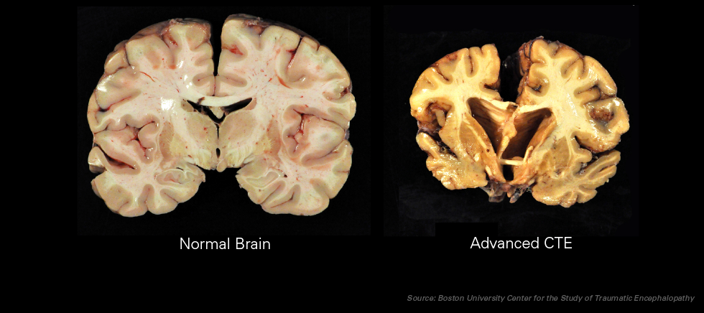
LONG TERM EFFECTS OF CONCUSSION
“It Takes a Village…”
Chronic Traumatic Encephalopathy (CTE)

Slide 11
MANAGING THE RISK OF CONCUSSION
“It Takes a Village…”
Equipment Considerations
NO helmet or product will prevent concussion
Avoid marketing gimmicks
Virginia Tech/Wake Forest STAR Rating System
NFL/NFLPA study (2010) tested 16 helmets and all meet/exceed safety standards but three were singled out as top-performers: Riddell Revolution, Revolution Speed and Schutt DNA Pro.
Important to have variety of helmet designs to fit different head sizes & shapes
Important to maintain helmets with air.

Slide 12
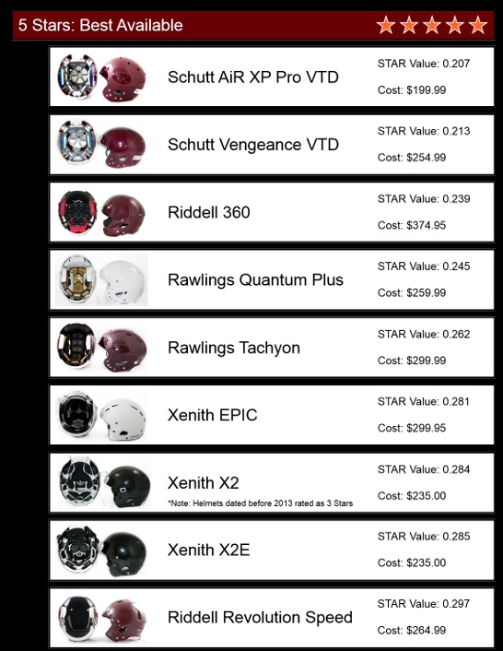

STAR Helmet Ratings

Slide 13
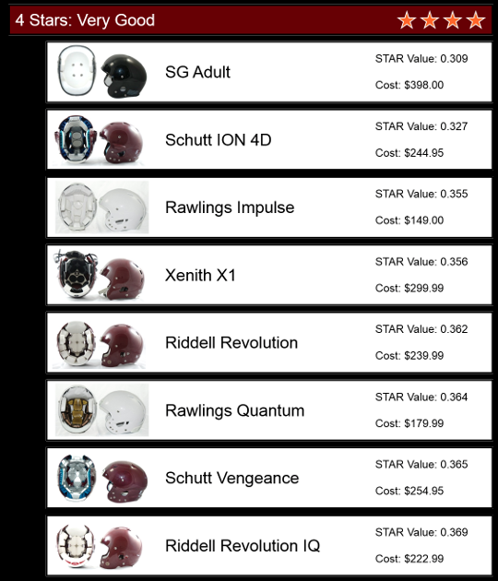
STAR Helmet Ratings

Slide 14
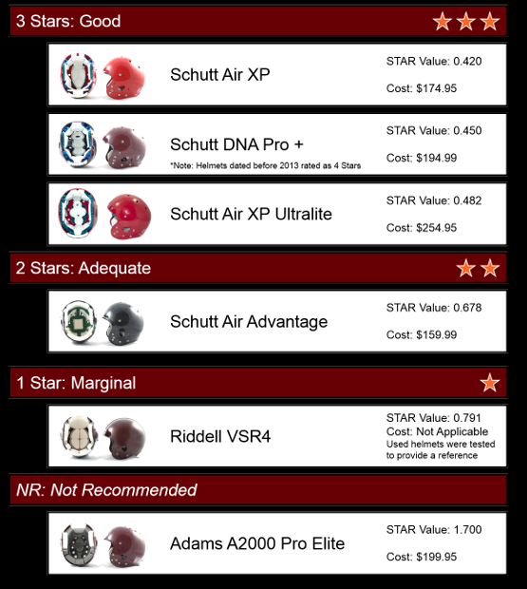
STAR Helmet Ratings

Slide 15
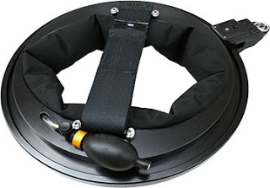
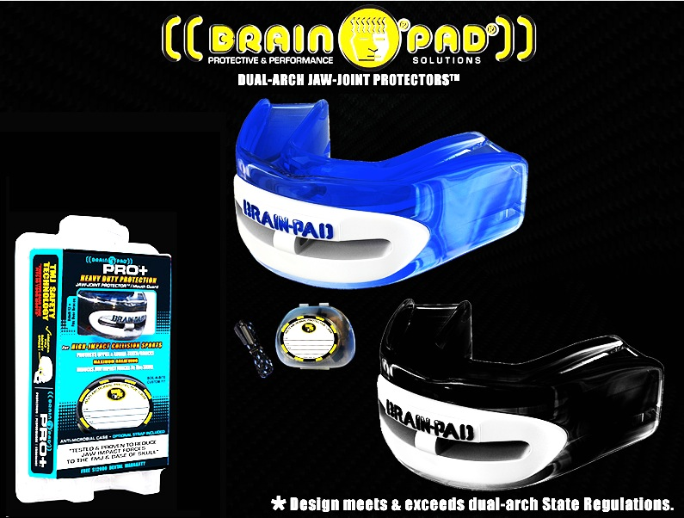

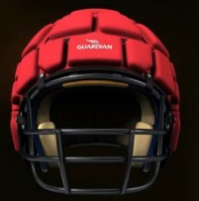
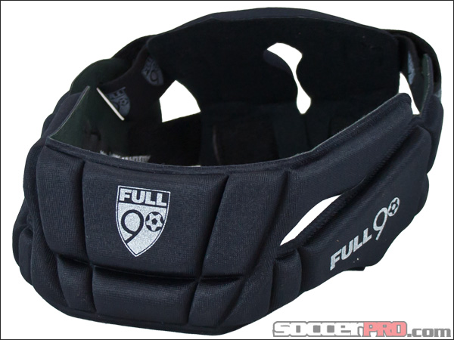
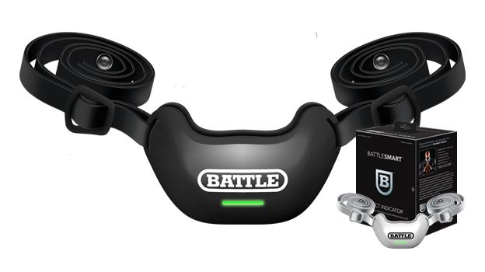
MANAGING THE RISK OF CONCUSSION
“It Takes a Village…”
Avoid Marketing Gimmicks…

Slide 16
MANAGING THE RISK OF CONCUSSION
“It Takes a Village…”
Implementing Change: The Future of Sport
Legislative Requirements / Laws
Football – penalties for spearing & hits to head; removed from game if helmet comes off; limit full contact practices; kick offs; 3-point stance;
Soccer – limit full contact & heading in practices
Additional athletic trainers???

Slide 17
MANAGING THE RISK OF CONCUSSION
“It Takes a Village…”
Implementing Change: The Future of Sport
Allow for adequate time to conduct on-field assessment
Enhance neck strength training programs, especially for women
Assessment and equipment modifications fueled by technology & research
Behavioral and cultural changes

Slide 18
MANAGING THE RISK OF CONCUSSION
“It Takes a Village…”
Implementing Change: The Future of Sport
NFL Class Action Lawsuit
  More than 4,800 ex-NFL players to be paid more than $765 million (pending - to date)
NCAA Lawsuits
  La Salle University player settled for $7.5 million in 2009
  Current class action case (filed in 2011) by former athletes claiming NCAA negligent (due to inaction) in handling of brain trauma.

Slide 19
MANAGING THE RISK OF CONCUSSION
“It Takes a Village…”
Implementing Change: The Future of Sport
NCAA Class Action Lawsuit (2011; still tbd… )
  NCAA failed to address and/or correct the coaching of tackling, checking, other playing methodologies that cause head injuries
  NCAA failed to educate coaches, trainers, and student-athletes as to the symptoms of concussion;
  NCAA failed to implement system-wide “return to play” guidelines for those who have sustained concussions;

Slide 20
MANAGING THE RISK OF CONCUSSION
“It Takes a Village…”
Implementing Change: The Future of Sport
NCAA Class Action Lawsuit (2011; still tbd… )
  NCAA failed to implement system-wide guidelines for screening and detection of head injuries;
  NCAA failed to implement regulations addressing the treatment and eligibility of student-athletes who have sustained multiple concussions while playing;
  NCAA failed to implement a support system for student-athletes who, after sustaining concussions, are left unable to either play their sport or lead a normal life.

Slide 21
MANAGING THE RISK OF CONCUSSION
“It Takes a Village…”
Implementing Change: The Future of Sport
The Need for Concussion Management Policy
  NCAA adopted guidelines in 2010 required physician clearance; Also advised each school to have written protocols; Athletes must sign acknowledgement form
  While the NCAA encourages educational outreach, the burden is on NCAA student athletes to recognize and report their concussive injuries…
  Policy Essentials: Education; Removal from play; Return to play; Referrals

Slide 22
MANAGING THE RISK OF CONCUSSION
“It Takes a Village…”
Implementing Change: The Future of Sport
Considerations for Other NCAA Rule Changes
  Academic Eligibility
  Continuing Eligibility
  Progress Toward Degree
  Medical Hardship

Slide 23
CONCUSSION
It Takes a Village to Manage a …
Through Sport, We All Have a Social Responsibility…

Slide 24
It Takes a Village to Manage a
CONCUSSION
Caroline E. Faure, EdD; ATC
Director, Center for Sports Concussion
Idaho State University
faurcaro@isu.edu
KnowConcussion.org

