Slide 1
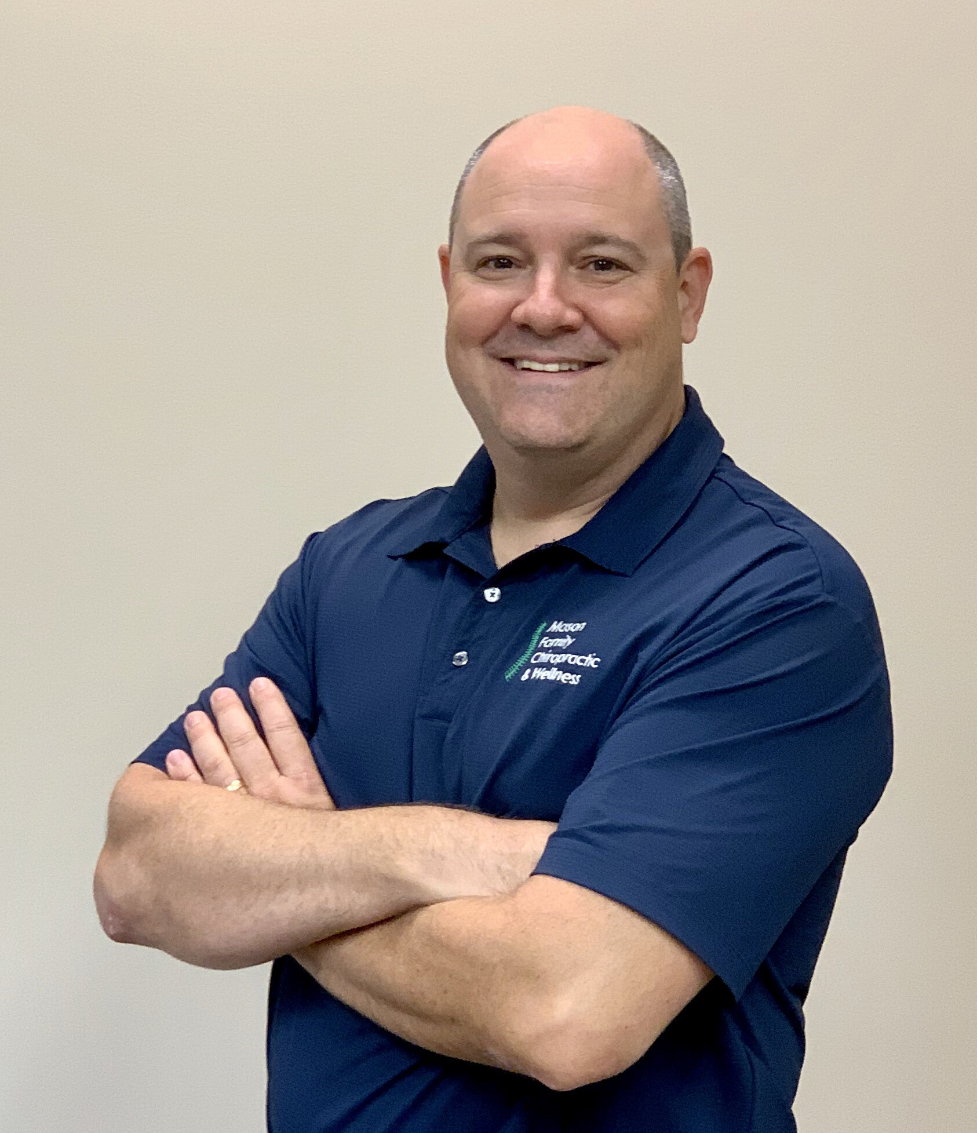
Richard Mason, MS, DC
Indiana Board of Chiropractic Examiners
Adjunct Professor, University of Campbellsville
NBCE exam question contributor
Member of the American College of Chiropractic Consultants
Peer Reviewer/IME specialist
28 years Private Practice experience
1997 Palmer College of Chiropractic (Iowa)

Slide 2
Diagnosis of CeAD & Stroke
Learning Objectives
Chiropractors need to be aware and vigilant to the following:
1. Symptoms of cervical artery dissection(CeAD)
2. Symptoms of stroke (brain ischemia)
3. VAD-induced radiculopathy
4. Case reports of chiropractic CeAD diagnosis
5. The 2019 Chaibi & Russell study

Slide 3
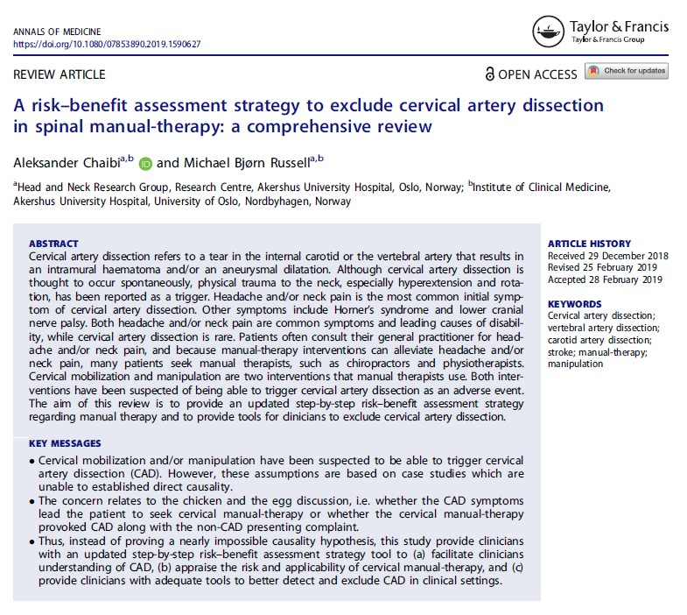
Diagnosis of CeAD & Stroke
The Subtle Symptoms of CeAD
Chaibi & Russell
“History taking, especially regarding the time of symptom onset, is the single most important factor for detecting subtle symptoms of CeAD; thus, primary care clinicians and, especially, manual therapists should dedicate enough time during the first consultation to allow for thorough history taking and physical examination.”

Slide 4
Diagnosis of CeAD
Diagnostic Assessment to Exclude CeAD
Chaibi & Russell
A risk-benefit assessment strategy to exclude cervical artery dissection in spinal manual-therapy: a comprehensive review
Annals of Medicine
2019

Slide 5

Diagnosis of CeAD
The “Subtle” Signs of CeAD
Once you know the signs & symptoms of CeAD, they are not subtle.

Slide 6
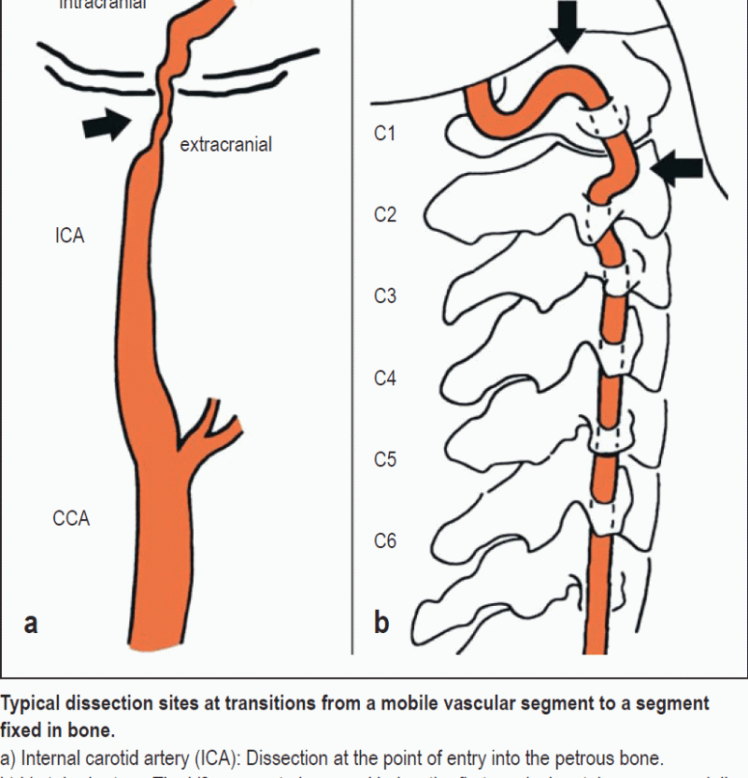
The Symptoms of CeAD and what Providers need to be aware of with every patient interaction
Make sure your approach to patients in a clinical setting allows time to ask questions when patients describe changes in symptoms on all encounters!
Ask about the nature of a patient’s neck pain or headache. Is it continuous, or not responding to medication? Has it been unremitting for 3 days or more?
Ask about recent falls/injuries/infections that could be causing these symptoms
Ask enough questions to formulate a differential diagnosis that leads away from CeAD, especially if it has been 2-6 months since the last encounter.
Has the patient had any unilateral moderate to severe neck pain or headaches that came and went over the last 6 months(healing dissection).

Slide 7
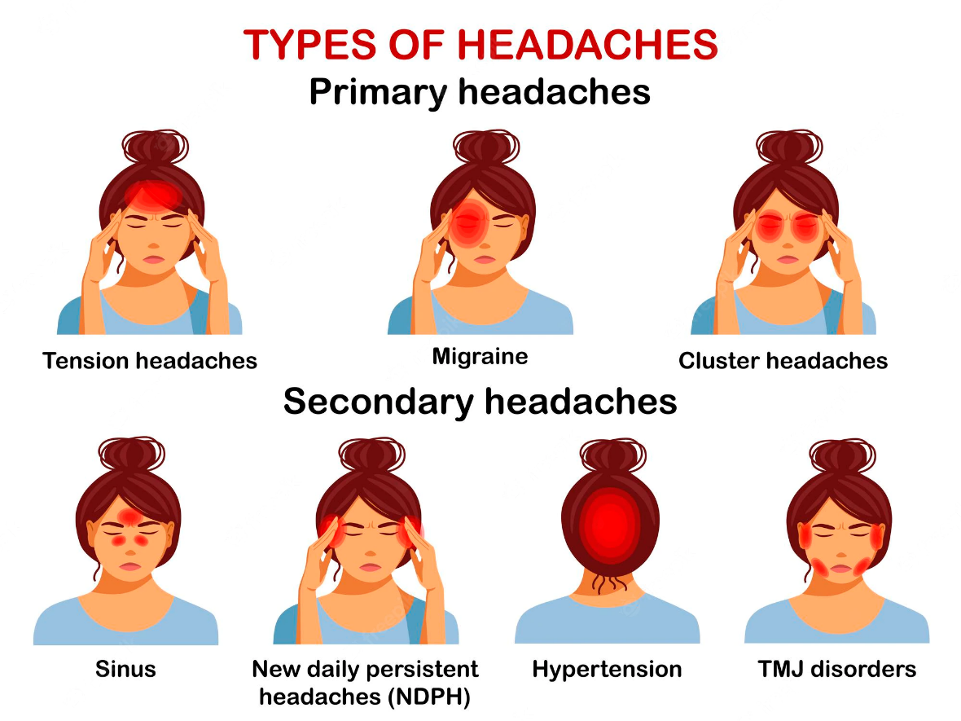
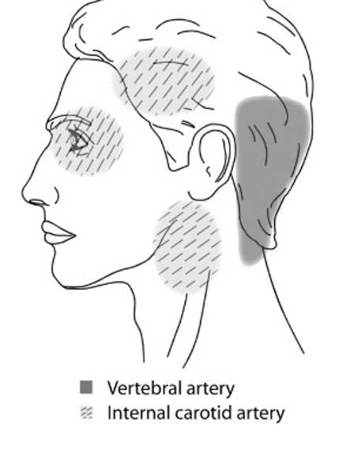
Location of Vertebral artery and Carotid artery pain during dissection

Slide 8
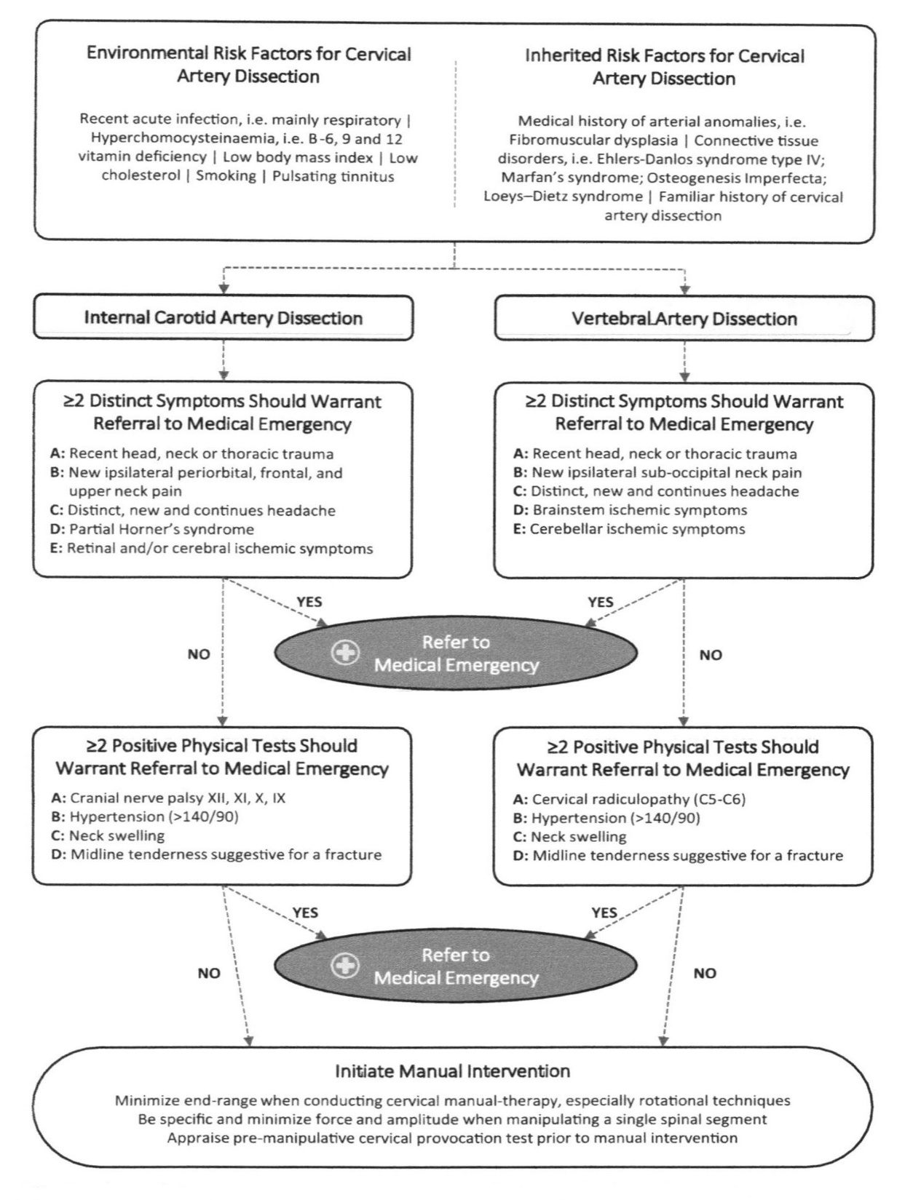
Diagnosis of CeAD
Diagnostic Assessment to Exclude CeAD
“…focus should be directed to the early detection and exclusion of CeAD, and questions should be raised on how to minimize the risk.”
Chaibi & Russell
A risk-benefit assessment strategy to exclude cervical artery dissection in spinal manual-therapy: a comprehensive review
Annals of Medicine
2019

Slide 9
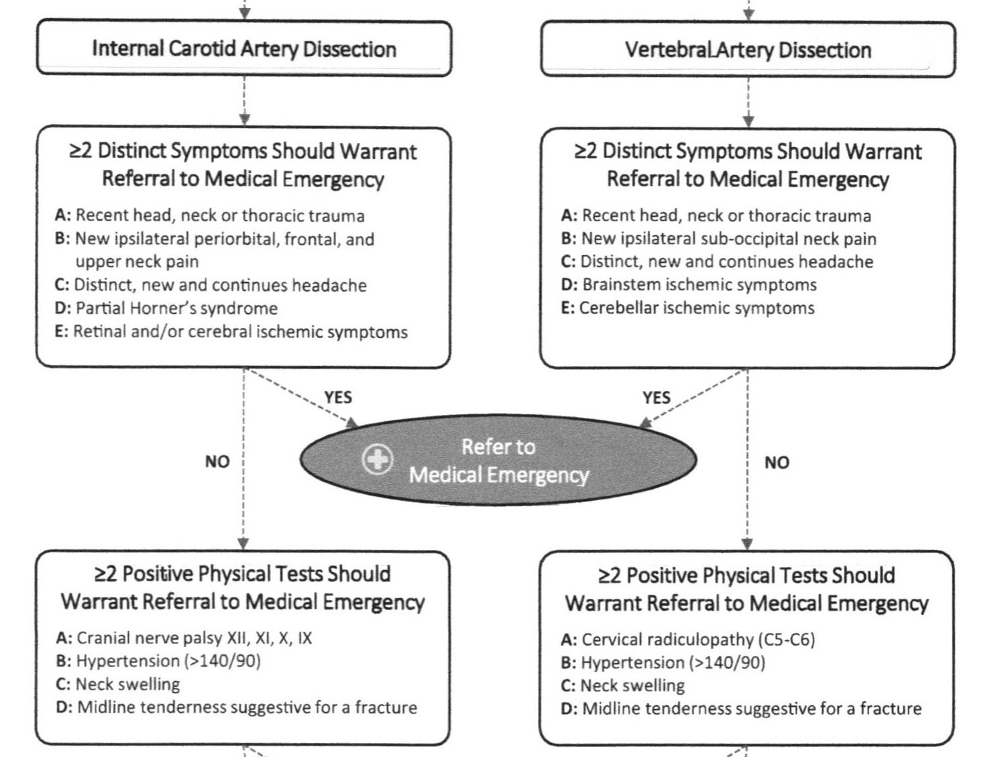

Slide 10
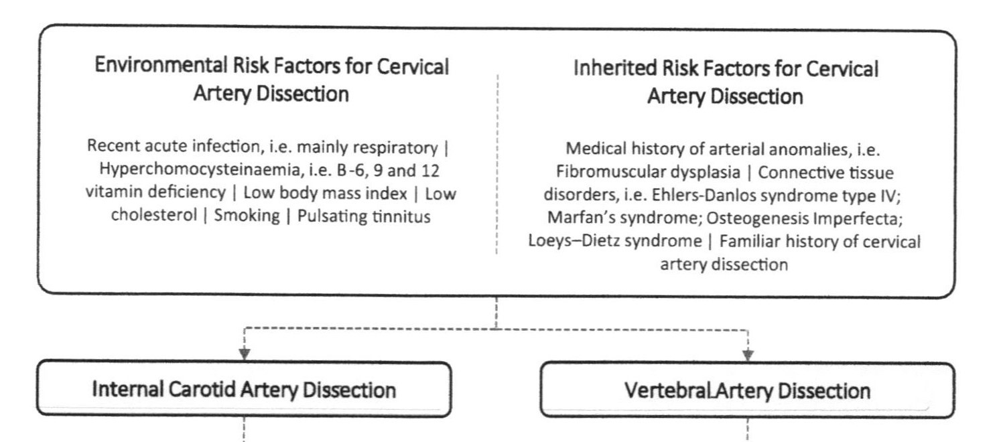
Diagnosis of CeAD
Diagnostic Assessment to Exclude CeAD

Slide 11
Diagnosis of CeAD
History Taking & Examination
In 2006, Lee reported 3 cases of CeAD that were asymptomatic at the time of imaging.
In 2024, Griffin reported 19 cases of CeAD that were asymptomatic at the time of imaging.
Lee and Griffin did not determine the time of onset and did not determine that the CeAD was asymptomatic at the time of onset. CeAD may become asymptomatic as the arterial wall heals, but it is unlikely that a CeAD would be asymptomatic at the time of onset-dissections hurt!

Slide 12
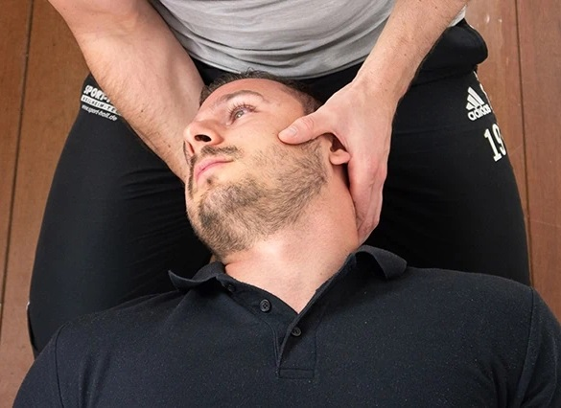
Diagnosis of CeAD
History Taking & Examination
There is no single objective screening test for CeAD.
In March 2004, US chiropractic colleges agreed to abandon the teaching and use of provocative testing-George’s test.
Therefore, the physician must have knowledge of the subjective symptoms of CeAD and a high index of clinical suspicion.

Slide 13
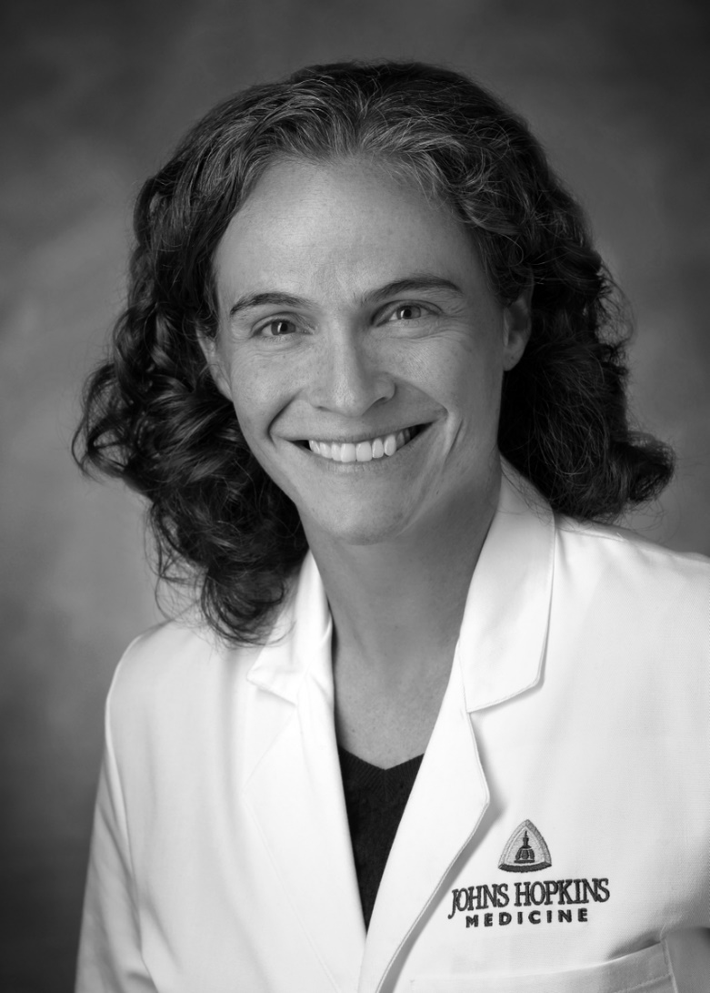
Diagnosis of CeAD
History Taking & Examination
Gottesman, et al.
Clinical characteristics of symptomatic vertebral artery dissection: a systematic review.
Neurologist. 2012.
Gottesman, et al.
Imaging characteristics of symptomatic vertebral artery dissection: a systematic review.
Neurologist. 2012.

Slide 14
Diagnosis of CeAD
History Taking & Examination
In this study, dizziness or vertigo was the most common symptom among individuals with vertebral artery dissection. Not neck pain and headache.
“Nearly one in four patients had no craniocervical pain either as an index symptom or evolving by the time of diagnosis.”
“VAD should be considered in the diagnostic assessment of patients presenting with dizziness or craniocervical pain, even in the absence of other risk factors.”

Slide 15

Diagnosis of CeAD
History Taking & Examination
“Our findings demonstrate that women have a twofold increased risk of spontaneous CeAD during pregnancy and the postpartum period compared to non-pregnant women.”
Trager, et al.
Pregnancy and spontaneous cervical artery dissection: A propensity-matched retrospective cohort study.
J Stroke Cerebrovasc Dis. 2023.

Slide 16
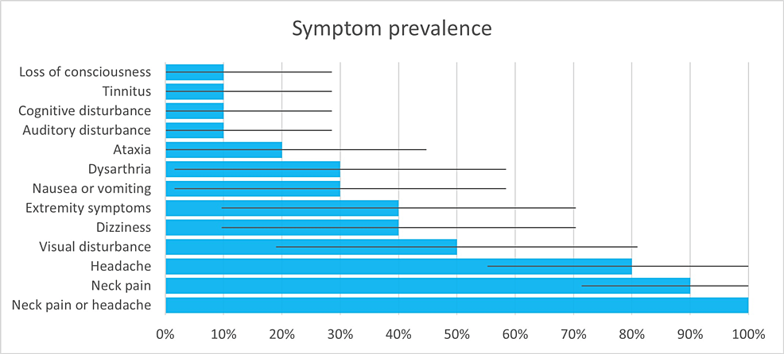
Diagnosis of CeAD
History Taking & Examination
Trager, et al. Symptoms of Patients With Vertebral Artery Dissection Presenting to Chiropractors: A Systematic Review and Meta-Analysis. Cureus. 2023.

Slide 17
Recent head, neck or thoracic trauma.
New ipsilateral sub-occipital neck pain.
Distinct, new and continued headache.
Brainstem ischemic symptoms:
  Ipsilateral loss of pain and contralateral temperature sensation in the body
  Ipsilateral hemiparesis (weakness on side of the body)
  Nausea (urge to vomit)
  Vomiting
  Vertigo (dizziness)
  Nystagmus (uncontrolled, repetitive eye movements)
  Diplopia (double vision)
  Dysphagia (difficulty swallowing)
  Dysarthria (difficulty speaking)
  Dysphonia (abnormal voice)
Cerebellar ischemic symptoms:
  Ataxia (lack of voluntary coordination of muscle movements)
  Vertigo (dizziness)
  Nystagmus (uncontrolled, repetitive eye movements)
VAD
VASCULAR/NMS SYMPTOMS
ISCHEMIC SYMPTOMS

Slide 18
Recent head, neck or thoracic trauma.
New ipsilateral periorbital, frontal, and upper neck pain.
Distinct, new and continued headache.
Partial Horner’s Syndrome:
Miosis (constricted pupil)
Partial ptosis (weak, droopy eyelid)
Apparent anhydrosis (decreased sweating)
Apparent enophthalmos (inset eyeball)
5) Retinal and/or cerebral ischemic symptoms:
  Hemiparesis (weakness on one side of body)
  Hemisensory loss (loss of sensation on one side of body)
  Neglect (vision difficulty in one eye)
  Aphasia (difficulty speaking)
  Gaze deviation
  Dysarthria (difficulty speaking)
  Monocular vision loss (vision difficulty in one eye)
ICAD
VASCULAR/NMS SYMPTOMS
ISCHEMIC SYMPTOMS

Slide 19
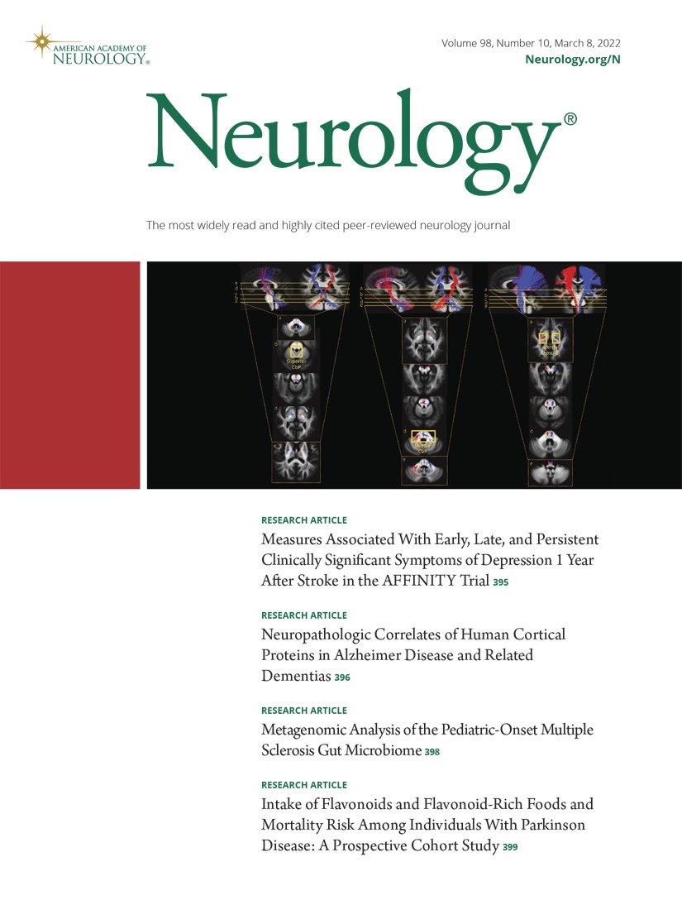
Diagnosis of CeAD
2013 Quinn: VAD & C5-C6 Radiculopathy
A 32-year-old mechanic developed severe left neck pain. Two days later, left arm weakness, two days later, left jaw numbness.
Exam revealed weakness in the C5 myotome & absent biceps reflex, but no facial or jaw numbness.
Quinn, Salameh
Vertebral artery dissection causing an acute C5 radiculopathy.
Neurology. 2013.

Slide 20
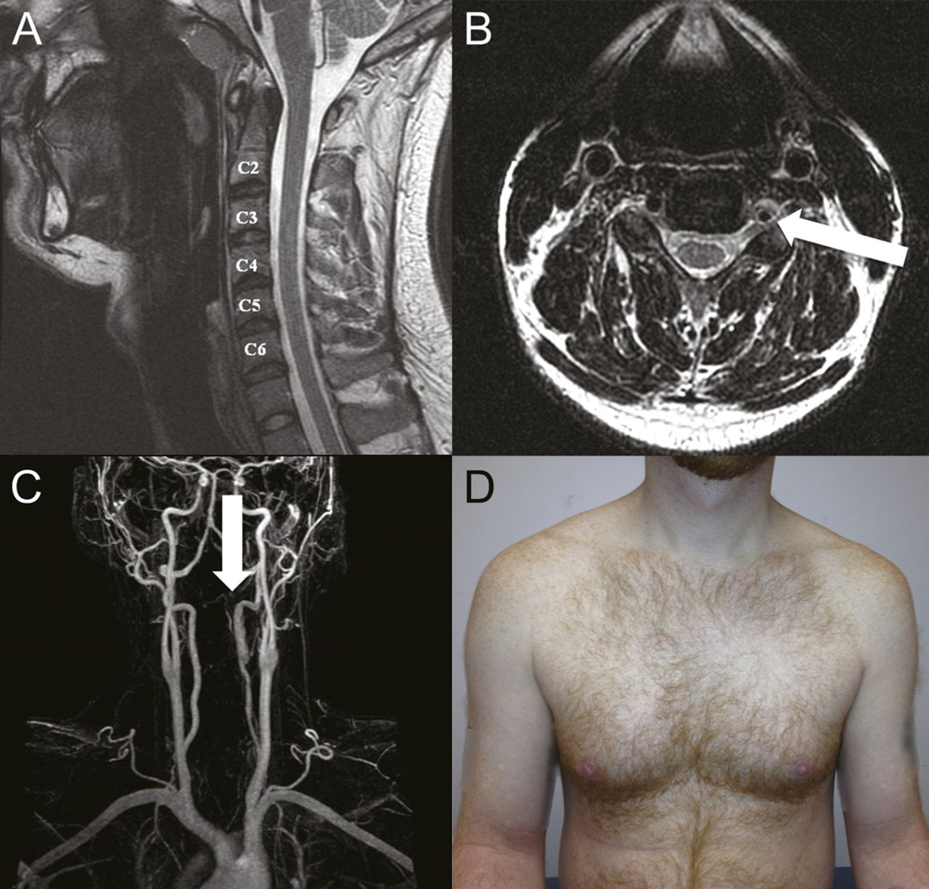
Diagnosis of CeAD
2013 Quinn: VAD & C5-C6 Radiculopathy
(A) No disc herniations.
(B) Large left V2 VAD compressing the C5 nerve root.
(C) MRA and CTA confirmed intramural hematoma with dissection flap from C2-C4.
(D) EMG & neuro-exam 1 month later, subacute C5 radiculopathy & atrophy in the C5 myotome.

Slide 21
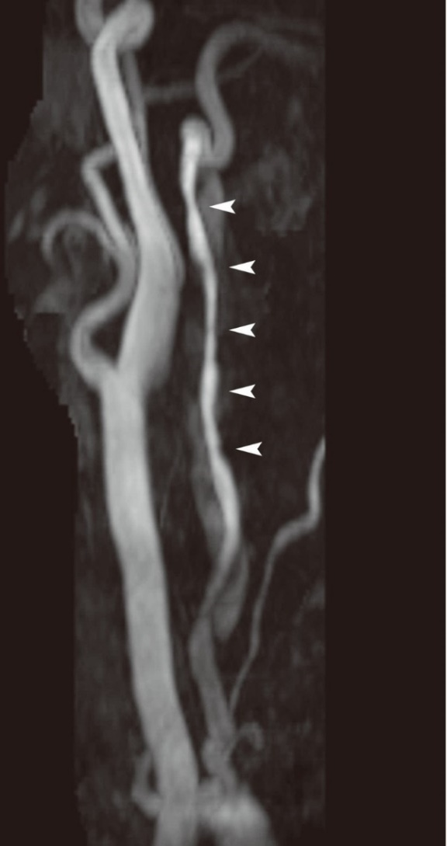
Diagnosis of CeAD
2013 Silbert: VAD & C5-C6 Radiculopathy
43-year-old woman with proximal left arm weakness and neck pain aggravated by movement.
Left VAD with intramural hematoma from C2-C7 compressing left C5 and C6 nerve roots.
Silbert, et al.
Vertebral artery dissection as a cause of cervical radiculopathy.
Asian Spine J. 2013.

Slide 22
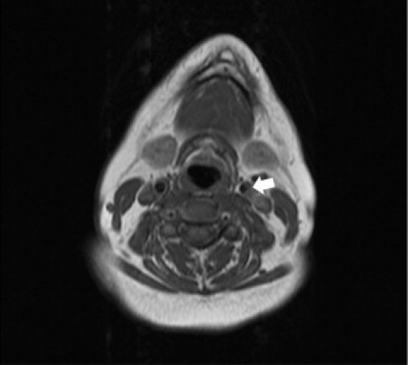
Diagnosis of CeAD
2011 Mosby Case Report
“This case suggests that careful history taking and awareness of the symptoms of VAD are necessary in cases of sudden head and neck pain.”
Mosby, et al.
Vertebral artery dissection in a patient practicing self-manipulation of the neck
Journal of Chiropractic Medicine
2011

Slide 23
Diagnosis of CeAD
2011 Mosby Case Report
42-year-old female with left shoulder pain and left lower neck pain.
Twelve days prior, she had “the worst headache of her life,” which began in her left lower cervical spine and extended to her left temporal region.
The pain was sudden and severe, described as sharp and burning, lasted 3 hours.
She reported nausea, vomiting & blurred vision.
History & examination suggested that the head and neck pain was not musculoskeletal in origin, but vascular.
She repeatedly requested that CSM be performed, but instead was referred to the local ED for further evaluation. MRA revealed left VAD from C6 to the C2-C3 interspace and a 3-mm dissecting pseudoaneurysm at the C3 level. She underwent angioplasty combined with antiplatelet therapy and experienced a good outcome.

Slide 24
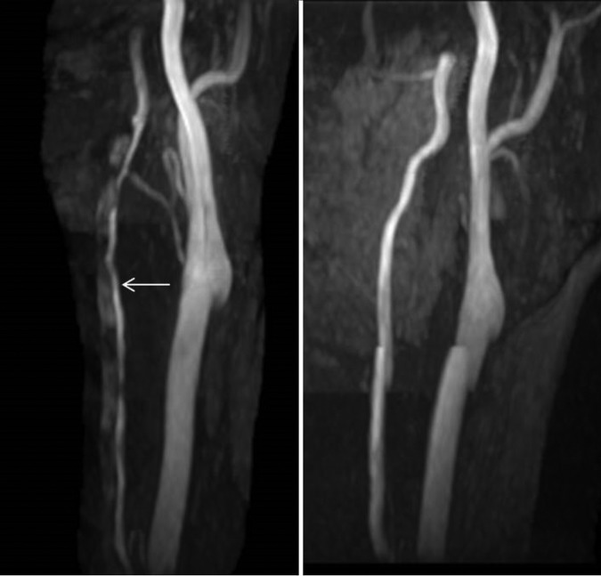
Diagnosis of CAD
2015 Futch Case Report
30-year-old woman with severe neck pain.
ER two days earlier for sudden onset transient loss of left peripheral vision.
No CSM. DC ordered MRA. Showed acute left VAD with early thrombus formation.
Treated with aspirin therapy.
Thrombus resolved. No stroke.
Futch, et al.
Vertebral artery dissection in evolution found during chiropractic examination.
BMJ Case Reports. 2015.

Slide 25
Diagnosis of CeAD
2015 Tarola Case Report
34-year-old woman, constant burning pain right suboccipital neck and upper shoulder, limited ability to turn her head from side to side.
Periods of blurred vision & muffled hearing.
Dizziness, visual & auditory disturbances, and balance difficulty abated within 1 hour of onset (lifting) and were not present at the evaluation.
Pins and needles sensation on the dorsal surface of both forearms.
Tarola, et al.
Chiropractic Response to a Spontaneous Vertebral Artery Dissection.
Journal of Chiropractic Medicine. 2015.

Slide 26
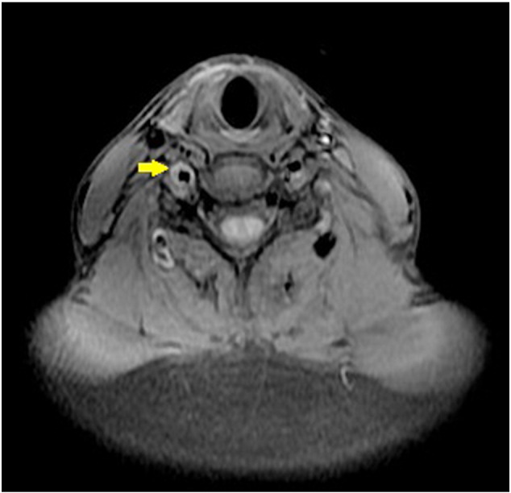
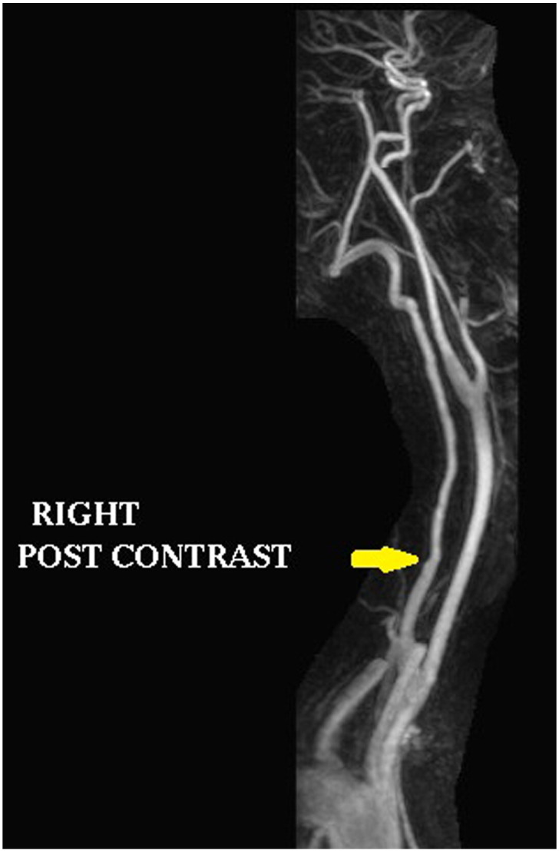
Diagnosis of CeAD
2015 Tarola Case Report
Patient advised of the possibility of CeAD; recommended to the ED. Patient declined.
Convinced by her DC (three days later) to present to the ED.
MRA showed the left VA was hypoplastic and appeared to terminate at the left PICA.
Abrupt moderately long segment of narrowing involving right VA beginning near the junction of V1 & V2 segments.
Radiologist noted right VAD.
Treated with aspirin; condition resolved.

Slide 27

Diagnosis of CeAD
2025 Demetrious Case Report
A 36-year-old woman with a history of mixed connective tissue disease presented to the emergency department five days postpartum with facial and peripheral edema, recent onset of hypertension, acute severe neck pain, headache, lightheadedness, confusion, and gait instability.

Slide 28
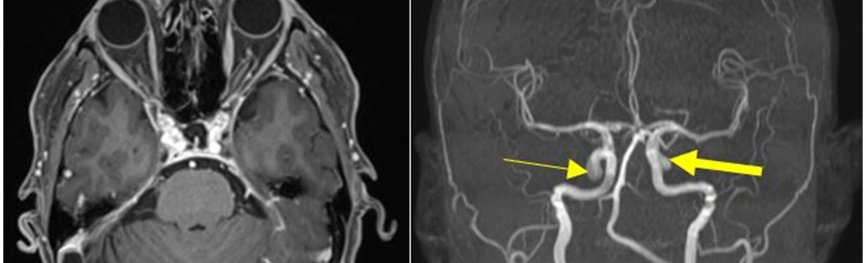
Diagnosis of CeAD
2025 Demetrious Case Report-continued
Magnetic resonance angiography (MRA) and magnetic resonance venography of the head were performed. Small, unruptured bilateral internal carotid artery aneurysms were visualized. The patient was admitted and treated for postpartum preeclampsia.
Although the patient improved with preeclampsia management, concerning neurologic symptoms persisted.

Slide 29
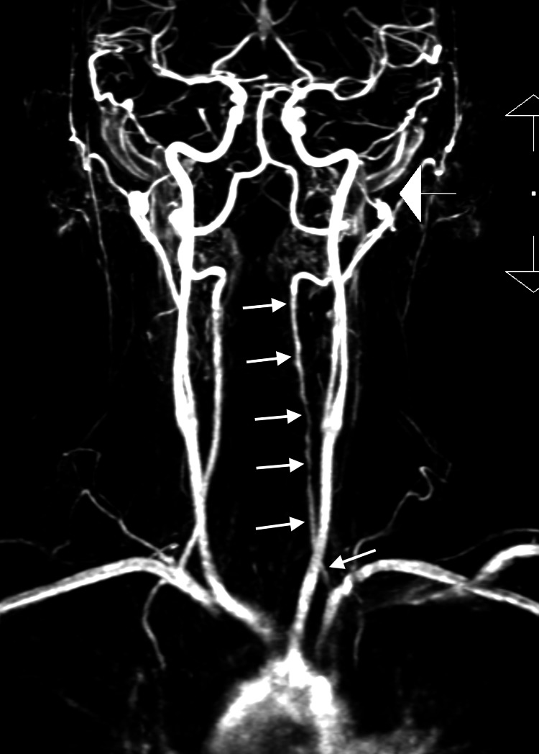
Diagnosis of CeAD
2025 Demetrious Case Report-continued
The patient later consulted a chiropractor, who suspected VAD. Emergent neck MRA was recommended and performed, confirming VAD 12 days after the initial emergency department visit.

Slide 30
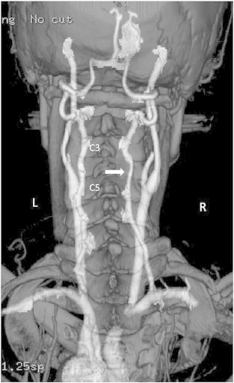
Diagnosis of CeAD
2014 Mattox: VAD & C5-C6 Radiculopathy
45-year-old woman with worsening neck pain, headache, & pain in the posterior portion of the right arm down to the elbow for three days.
Dissection right V2 from C3-C5 compressing nerve roots.
Mattox, et al.
Recognition of spontaneous vertebral artery dissection preempting spinal manipulative therapy: a patient presenting with neck pain and headache for chiropractic care.
Journal of Chiropractic Medicine. 2014.

Slide 31
2014 Mattox Case Report
Objective
“Physical examination revealed painful & limited active ROM in the cervical region.”
“Palpation was provocative for tenderness.”
No vital signs. No blood pressure.
No orthopedic or neurological testing.
No imaging considered or ordered.
Assessment/Diagnosis
Myofascial pain syndrome.

Slide 32
2014 Mattox Case Report
Procedure
Therapeutic ultrasound was applied (4 minutes) in the seated position over the suboccipital and posterior cervical musculature.
While still in the seated position, soft tissue treatment was performed by an LMT on the suboccipital and posterior cervical musculature.
The patient was shown to a treatment room and was supine when the clinician entered and asked how she felt.

Slide 33
2014 Mattox Case Report
Incident
The patient responded that her neck pain was much better, but she was more aware of her headache.
The patient was assisted to the seated posture, became dizzy, reported visual and cognitive disturbances, and had difficulty speaking. She proceeded to lose control of her right leg, which spontaneously assumed a flexion contracture.

Slide 34
2014 Mattox Case Report
Mattox, et al.
Recognition of symptoms of stroke after therapy treatments preempting SMT: Suspecting a vascular etiology, the DC called Paramedics, and a CT was performed, noting 50% stenosis of the right vertebral artery.
Journal of Chiropractic Medicine
2014

Slide 35

Diagnosis of CeAD
2025 Brown/Lehman Case Report
A 50-year-old female sought diagnosis and treatment from a chiropractor with complaints of constant, severe (7/10) left sub-occipital neck pain and constant, severe left occipital headache along with intermittent nausea and dizziness.
Onset of the left sub-occipital neck pain occurred 2 months prior, and the left occipital headaches started 2 days prior.

Slide 36
Diagnosis of CeAD
2025 Brown/Lehman Case Report-continued
Due to suspicion of VAD, cervical spine range-of-motion and orthopedic testing were contraindicated and were not performed.

Slide 37
Diagnosis of CeAD
2025 Brown/Lehman Case Report-continued
The differential diagnosis was:
1. Vertebral artery dissection
2. Internal carotid artery dissection
3. Cerebral artery aneurysm
4. Vasculitis affecting the vertebrobasilar circulation
5. Vertebrobasilar atherothrombotic disease
6. Migraine
7. Tension-type headache
8. Other intracranial abnormalities

Slide 38
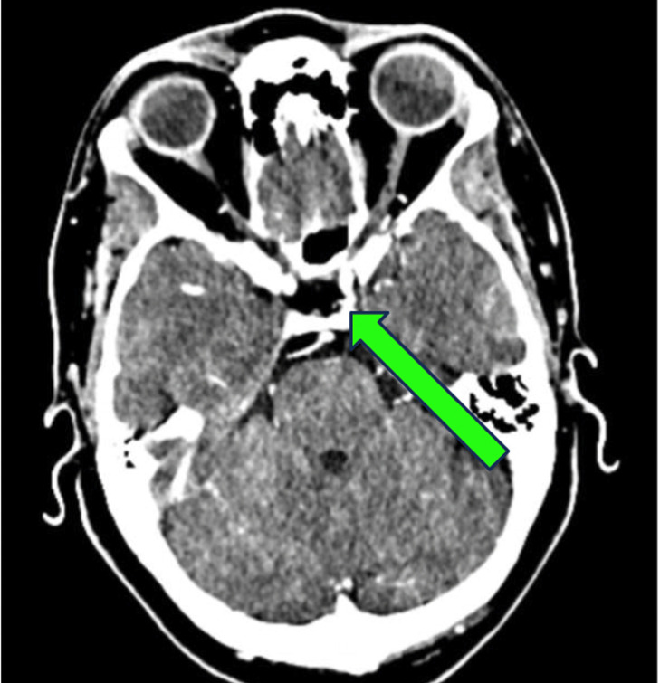
Diagnosis of CeAD
2025 Brown/Lehman Case Report-continued
Due to the presence of symptoms of potential VAD, the patient was referred to the emergency department for CTA examination
The neurosurgeon determined that the abnormal finding was an incidental infundibulum. The neurosurgeon concluded that the left-sided C3-C4 facet arthropathy was the etiology of the patient’s symptoms and prescribed physical therapy.

Slide 39

Diagnosis of CeAD
2025 Brown/Lehman Case Report-continued
What can we learn from this case report?
1. If a patient presents with symptoms similar to a CeAD, brain mass, or other cranial abnormality, refer out and err on the side of caution and patient safety
2. Patients will appreciate your thoroughness and attention to detail

Slide 40
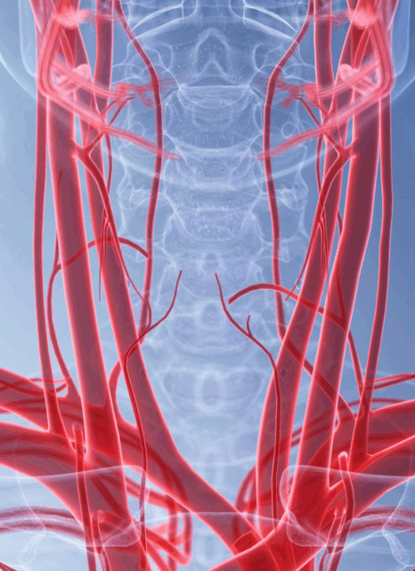
2008 Cassidy: VBA Stroke & CSM European Spine Journal
Cassidy et al. concluded that there was no increased risk of vertebrobasilar artery (VBA) stroke after chiropractic care compared to visits to primary care physicians. This suggests that patients who were later found to have cerebral ischemia (stroke) were likely already experiencing dissection-related symptoms, which prompted their chiropractic care.
Patients may present with a dissection; it’s our job to recognize the symptoms.
Notes:
Image source: Microsoft 365 content library
Cassidy et al. (2008) investigated the association between cervical artery dissection and cervical manipulation. The study found no increased risk of stroke following chiropractic care compared to visits to primary care physicians. Results suggested that patients seeking care for neck pain may already be at risk for dissection, independent of manipulation.

Slide 41
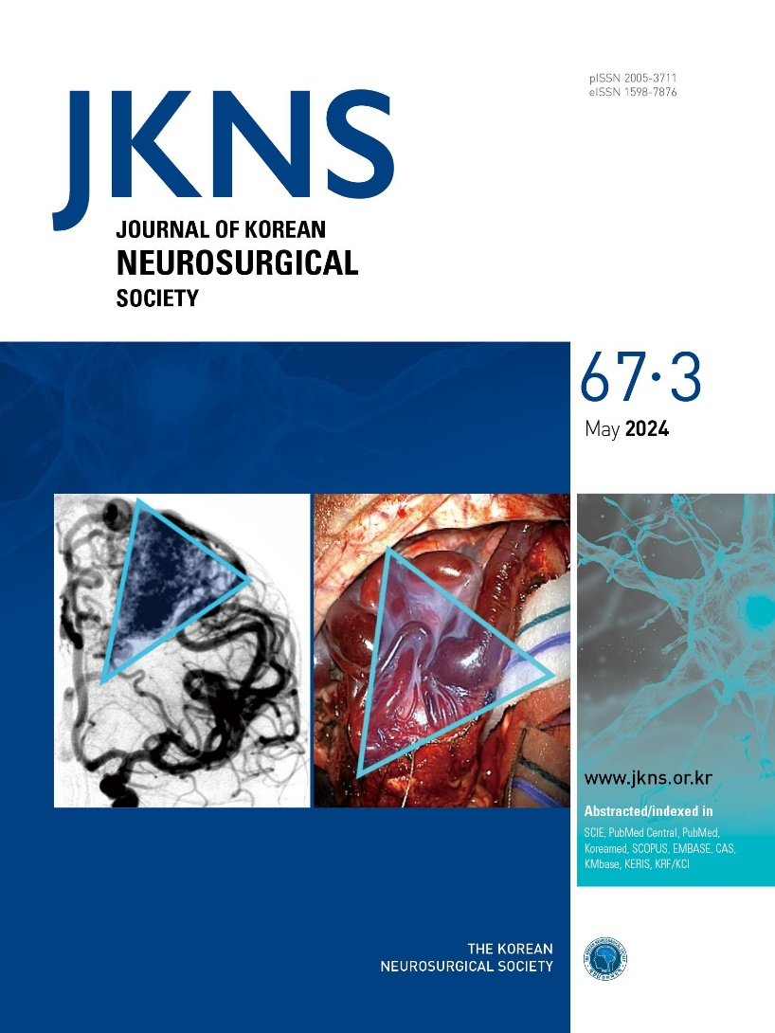
Diagnosis of CAD
CAD: Good Prognosis
“Most dissections of the vertebral arteries heal spontaneously and especially, extracranial VADs generally carry a good prognosis.”
Park, et al.
Vertebral artery dissection: natural history, clinical feature and therapeutic considerations.
J. Korean Neurosurg Soc. 2008.

Slide 42
Diagnosis of CAD
CAD: Good Prognosis
“…in general, individuals with VAD appear to have relatively good outcomes when treated in routine clinical fashion.”
Gottesman, et al.
Clinical characteristics of symptomatic vertebral artery dissection: a systematic review.
The Neurologist. 2012.

Slide 43

If the patient has an adverse reaction to CSM that could be a vascular event, it’s not likely:
Toxin release
Reaction to the adjustment
Sympathetic reaction/storm
Vaso-vagal response
Loose otolith (“crystals”)
Hypoglycemia (low blood sugar)
Dehydration
Flu
Anxiety attack
Vertigo attack
Cervicogenic dizziness

Slide 44
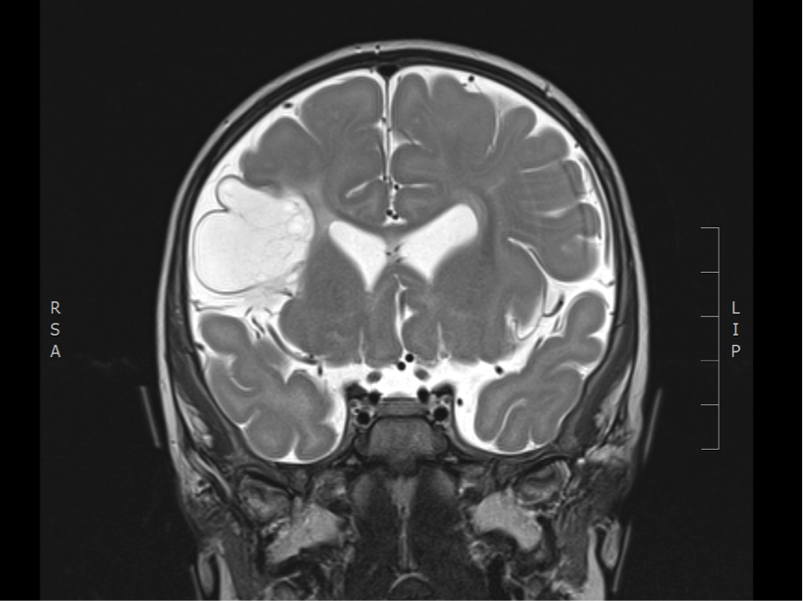
Diagnosis of Stroke
Signs & Symptoms of Stroke
DCs should be aware of the most common signs & symptoms of immediate post-manipulative stroke to make a referral to medical emergency:
HEADACHE
ATAXIA
NAUSEA/VOMITING
DIZZINESS/VERTIGO
SWEATING/DIAPHORESIS

Slide 45
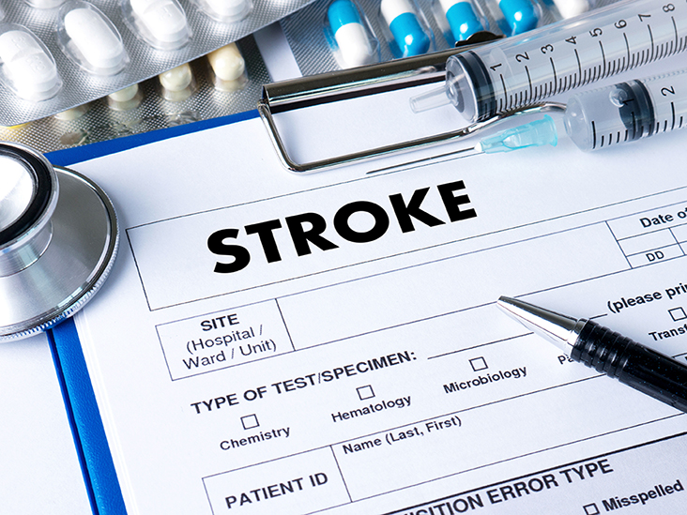
Diagnosis of Stroke
Signs & Symptoms of Stroke
5 “Ds”, 3 “Ns”, and an “A”
Dizziness (vertigo)
Drop attacks (loss of consciousness)
Diplopia (double vision)
Dysarthria (difficulty talking)
Dysphagia (difficulty swallowing)
Nausea (vomiting)
Numbness (of face)
Nystagmus (repetitive, uncontrolled eye movements)
Ataxia (loss of coordination & balance)

Slide 46

Importance of Proper Informed Consent
Informed consent is not having the patient sign a document and then treating.
It’s a face-to-face discussion of the risks pertinent to spinal manipulation, specifically in the cervical region.
Risks and alternatives to Spinal Manipulative Therapy need to be written, and then discussed verbally with the patient, and have them initial their understanding.
Many malpractice claims list lack of informed consent as a common reason for violating the standard of care.

Slide 47

What is the Standard of Care for a Chiropractor?
What a (licensed) prudent, competent doctor of chiropractic in the same region would do in the same or similar circumstances.
The chiropractic standard of care represents conduct that has been established with scientific, empirical, and/or clinical evidence.
Dynamic Chiropractic Sept 2005

Slide 48

In most cases, CAD symptoms present to the Chiropractic office, adjustments don’t cause dissections.
A Chiropractor’s job is to be thorough and recognize the symptoms before SMT.
Slow down with your patients and ask lots of questions when symptoms of neck pain, headaches, or dizziness arise.
When in doubt, proceed with caution and call an ambulance; do not let them leave/drive home.
Don’t assume all neck pain and headaches are the same.
Dizziness causation needs to be evaluated before SMT.

Slide 49


Questions and Discussion?
This Photo by Unknown Author is licensed under CC BY-SA
Notes:
Image source: Microsoft 365 content library
We’ve covered the main points of today’s topic. Now, we’d love to hear from you—do you have any questions or comments? Your feedback helps enrich our discussion and clarify any uncertainties. Please feel free to ask or share your thoughts with the group.

Slide 50
Richard Mason, MS, DC
Contact info: rmason@masonfamilychiro.com
Office phone: 317-577-9558

