Slide 1




Implementation of Clinical Decision Support Tools
Susan Minter DNP, NP-C, CCHP
Nurse Practitioner
NaphCare
P. Daniel McConnell MD
Corporate Medical Director
NaphCare
SM

Slide 2


Disclosure and Disclaimer
Option 1: I/We do not have any relevant ﬁnancial relationships with any ineligible companies.
This educational presentation was developed by independent experts. The information provided in this presentation is not the oﬃcial position or recommendation of NCCHC but rather expert opinion. This information is not intended to be appropriate for every clinical situation, nor does it replace clinical judgment.
NCCHC does not endorse or recommend any products or services mentioned.
SM

Slide 3
Educational Objectives
Define what constitutes a clinical decision support tool
Review common types of clinical conditions that may benefit from clinical decision support tools
Describe how to document the use of a clinical decision tool and the rationale for using the chosen tool in the patient's medical record
SM

Slide 4
What is a Clinical Decision Support Tool?
Clinical Decision Support Tools provides evidence-based decision algorithms to guide clinicians to make informed decisions regarding patient care and treatment.
Examples of Clinical Decision Support Tools:
Canadian Head CT Evaluation
Ottawa Ankle/Knee Evaluation
HEART Score
Nursing Protocols
SM

Slide 5
Why Use a Clinical Decision Support Tool?
Evidenced Based Practice Advantages
Generally tested and validated
Usually widely used
Easy to use
Helps guide the clinician to develop an appropriate plan of care for patients
Potentially mitigates liability by documenting a validated tool to develop the plan of care
SM

Slide 6
Why Not Use a Clinical Decision Support Tool?
May not fit every situation
Tends to be geared towards community settings instead of corrections (outpatient treatment vs. inpatient treatment as only options)
Can result in clinician “tunnel vision”-ie., not treating the whole patient
Limited use if not filled out correctly/accurately/fully or may result in incorrect recommendations
SM

Slide 7
Nursing Clinical Decision Support Tools
Examples (not inclusive):
Chest Pain Complaints
GI Complaints
Detox Protocols
Abdominal Complaints
SM

Slide 8
Nursing Clinical Decision Support Tools
Written instructions or guidelines that specify steps to be taken for evaluating a patient’s health
Are appropriate for the level of competency of the user
Comply with state and facility laws
Are not intended to replace a referral to a licensed provider
SM

Slide 9
Liabilities of Clinical Decision Support Tools
Potential Liability Areas:
If the clinician does not have the appropriate training or licensing level to complete the CDST (ie., RN protocol being filled out by LPN or paramedic)
Poorly written protocols may result in incorrect treatments
If not filled out correctly or accurately, the CDST may be a potential liability in case of a lawsuit
SM

Slide 10
Example
Runny Nose/Congestion Nursing Protocol:
Sneezing: Yes/No
Lung Sounds:
Clear: Yes/No
Crackles: Yes/No
Wheezing: Yes/No
Rhonchi: Yes/No
Fever: Yes/No (Contact health provider if fever greater than 101 or signs of infection)
SM

Slide 11
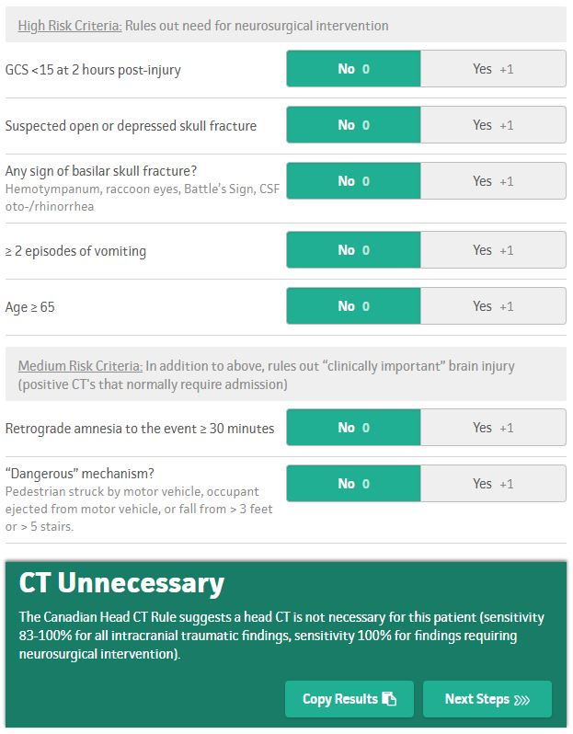
Medical Clinical Decision Support Tools (Examples)
Illustration 1: Stiell, 2026
Canadian Head CT Evaluation Tool
DM

Slide 12
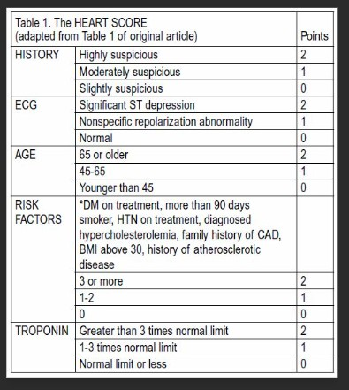
HEART Score
Illustration 2: Backus, 2026
Question: What’s the issue with this Tool in the correctional setting?
DM

Slide 13
Limitations in the Correctional Setting
Essential elements needed for Clinical Decision Tools may not be available in all Correctional settings.
EKG’s not available in all settings
Troponin/Labwork may not be available as Point of Care (POC) testing in a jail/prison setting
Interpretation of diagnostic testing may be limited if provider not available (ie., EKG interpretation)
DM

Slide 14
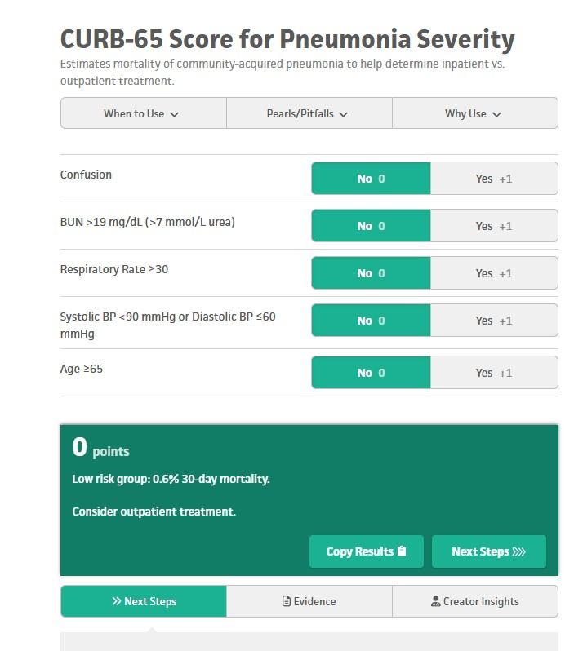
Example
Illustration 3: Macfarlane, 2026
DM

Slide 15
Review of Questions for CURB-65 Score in Corrections
Pt Age:
Can Confusion be Measured?
Can BUN (lab work) be measured?
Can Respiratory Rate be measured?
Can Blood Pressure be measured?
DM

Slide 16
CURB-65 Discussion
4 out of 5 questions should be able to be answered in the correctional setting
Lab work (BUN) question may not be able to answer if Stat labs not accessible
However, answers may guide the practitioner even if bloodwork not available (if other answers are positive)
Consider using Clinical Decision Support Tools that do not require specialized diagnostics (next slide)
DM

Slide 17
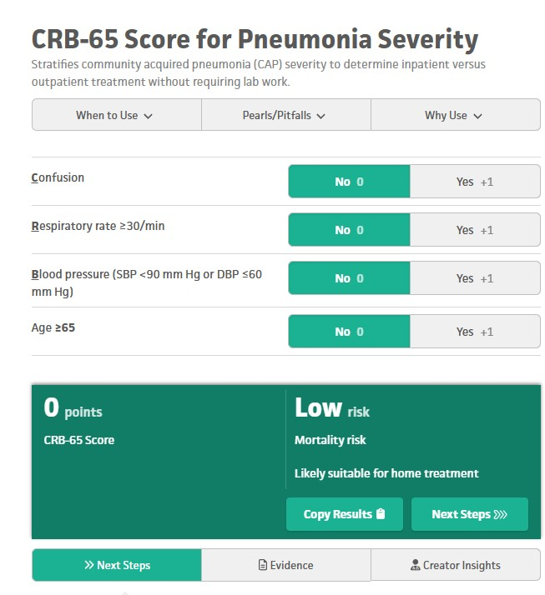
Example of Simplified Clinical Decision Support Tool
Use a CDST that does not require information to be inputted that may not be available in the correctional setting.
Example: Use CRB-65 instead of more common CURB-65 Tool
Illustration 3: Lim, 2026
DM

Slide 18
Other Clinical Decision Support Tools that may not require special diagnostics, suitable for most correctional settings
Ottawa Foot/Ankle Rules
Canadian Head CT Evaluation
Detox Scoring (COWS, CIWA, CIWA-B)
Wells Criteria for DVT
Caprini Score for Venous Thromboembolism
DM

Slide 19
Documentation of Clinical Decision Support Tools
Templates are helpful but don’t rely on them completely
Consider loading a template that forces the clinician to put the answers in manually. Example:
“Did the patient have any loss of consciousness”: Yes (or No)
Describe your plan of care after completing the Clinical Decision Support Tool:
“Canadian Head CT Evaluation completed, patient had no loss of consciousness, does not take blood thinners, age <65, therefore plan to keep patient in infirmary and start neuro checks from time of incident, etc., etc.,
SM

Slide 20
Documentation, Continued
Clearly document the Tool Used and Specific Answers
Ensure additional documentation reflects the answers on the CDST (ie., vital signs are the same that are recorded in all sections of the EMR
Make sure your Plan includes the next steps after the CDST responses
Document education, and document steps that should be taken if patient has no improvement or worsening of symptoms.
SM

Slide 21
Key Presentation Pearls or Practice Change Takeaway
At least one of the pearls should reinforce strategies that will improve skills or performance of an interprofessional healthcare team.
1: Clinical Decision Support Tools are a helpful, evidence-based approach for clinical issues
2: Clinical Decision Support Tools should be utilized by clinicians that are competent in their use
Clinical Decision Support Tools may require diagnostics that are not available in the correctional setting
Documentation of Clinical Decision Support Tools is key-they must be filled out accurately, completely, and have a plan of care that reflects the CDST answers.
SM

Slide 22
Questions/Discussions?
SM/DM

Slide 23
Thank You for Attending!

Slide 24
References
Backus, B. (2026) HEART Score for Major Cardiac Events. MDCALC. file:///C:/Users/Susan/Downloads/HEART%20Score%20for%20Major%20Cardiac%20Events.mhtml
Lim, W. (2026). CRB-65 Score for Pneumonia Severity. MDCALC. CRB-65 Score for Pneumonia Severity
Macfarlane, John (2026). CURB-65 Score for Pneumonia Severity. MDCALC. CURB-65 Score for Pneumonia Severity
NCCHC (2018). Standards for health services in jails. NCCHC.
Shiroshita, A., Kimura, Y., Shiba, H., Shirakawa, C., Sato, K., Matsushita, S., Tomii, K., & Kataoka, Y. (2022). Predicting in-hospital death in pneumonic COPD exacerbation via BAP-65, CURB-65 and machine learning. ERJ open research, 8(1), 00452-2021. htt
Sperl-Hillen, J. M., Crain, A. L., Margolis, K. L., Ekstrom, H. L., Appana, D., Amundson, G., Sharma, R., Desai, J. R., & O'Connor, P. J. (2018). Clinical decision support directed to primary care patients and providers reduces cardiovascular risk
Steill, I (2026). Canadian Head Injury/Trauma Rule. MDCALC. https://www.mdcalc.com/calc/608/canadian-ct-head-injury-trauma-rule
Sutton, R. T., Pincock, D., Baumgart, D. C., Sadowski, D. C., Fedorak, R. N., & Kroeker, K. I. (2020). An overview of clinical decision support systems: benefits, risks, and strategies for success. NPJ digital medicine, 3, 17. https://doi.org/10.1038/s417

