Slide 1




The Importance of Head Trauma Assessment
Susan Minter DNP APRN CCHP
Nurse Practitioner
Naphcare
P. Daniel McConnell MD FAAEM
Medical Director
Naphcare
SM

Slide 2


Disclosure and Disclaimer
I/We do not have any relevant ﬁnancial relationships with any commercial interests.
This educational presentation was developed by independent experts. The information provided in this presentation is not the oﬃcial position or recommendation of NCCHC but rather expert opinion. This information is not intended to be appropriate for every clinical situation nor does it replace clinical judgment.
NCCHC does not endorse or recommend any products or services mentioned.
SM

Slide 3
Educational Objectives
Describe Risk Factors for Serious Head Injuries
Discuss how to Manage Minor Head Injuries to Ensure a Positive Patient Outcome
Examine Risks Associated with Head Injuries and Ways to Minimize Liability
SM

Slide 4
Overview
Head injuries are one of the most common injuries encountered in corrections
Head injuries can be one of the most difficult to diagnose accurately in corrections
Over diagnosing head injuries results in unnecessary expenditure of personnel and resources
Underdiagnosing head injuries may result in adverse patient outcomes and increased liability for the correctional facility and staff
SM

Slide 5
Why Is It More Difficult To Accurately Diagnose Head Injuries In The Correctional Setting?
Correctional facilities are generally not equipped with advanced diagnostic equipment (CT scanners, MRI scanners, etc.,)
Patients are frequently not forthcoming with mechanism of injury or may not answer in a truthful manner (i.e., may state they had LOC when there wasn't, may state a different mechanism of injury than what happened ("I slipped in the shower" when in truth an altercation had occurred)
Patients may distort the history of the head injury for secondary gain (wanting to be moved to another housing unit, etc.,)
SM

Slide 6
Risk Factors for Head Injuries (continued)
Mechanism of Injury (was it a ground level fall or did they fall from a 2nd tier?)
Loss of consciousness
Recent or current use of blood thinners/anticoagulant medication (warfarin/apixaban/rivaroxaban/aspirin/ and the like)
Age (65 yrs or greater)
Temporal region impact
SM

Slide 7
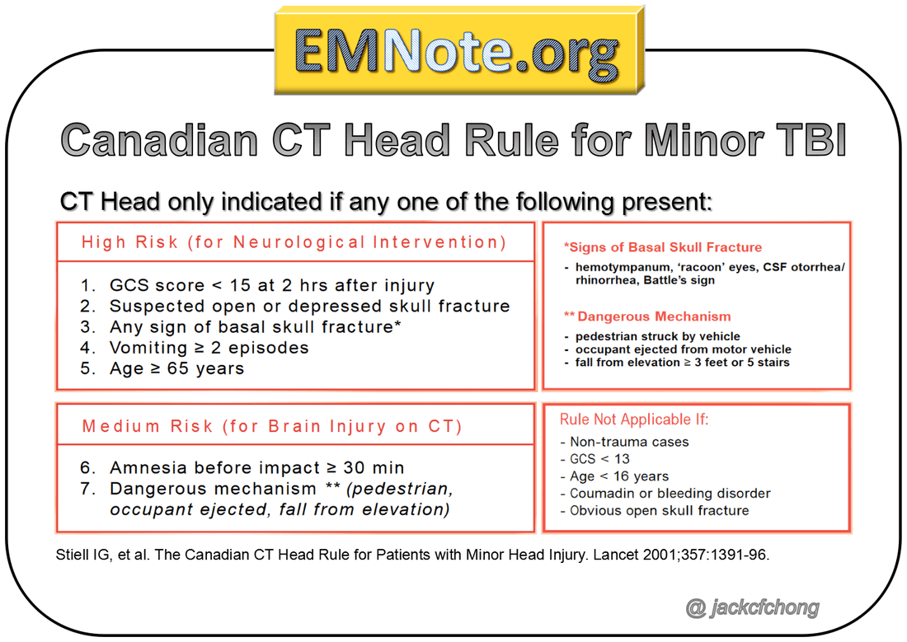
Risk Factors for Head Injuries (continued)
SM

Slide 8
Pathophysiology of Common Vascular Injuries
Epidural Hematoma
Subdural hematoma
Subarachnoid hematoma
Intraparenchymal/intraventricular hemorrhage
DM

Slide 9
Common Fractures In Head Injuries
Depressed Skull Fractures (not good)
Basilar Skull Fractures (Battle's sign, Raccoon eyes or Panda eyes)
Mandible/Maxillary Fractures (upper and lower jaw)
Orbital Blowout Fracture
Orbital Rim Fracture
Zygomatic Arch Fracture
DM

Slide 10
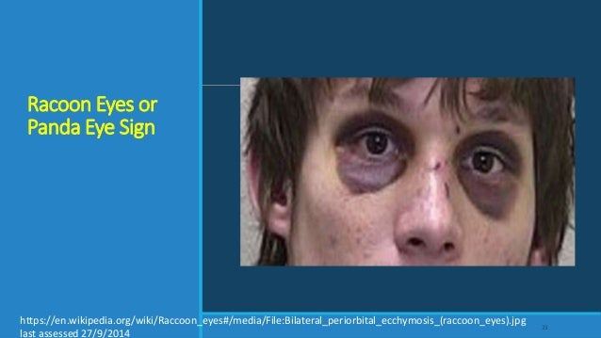
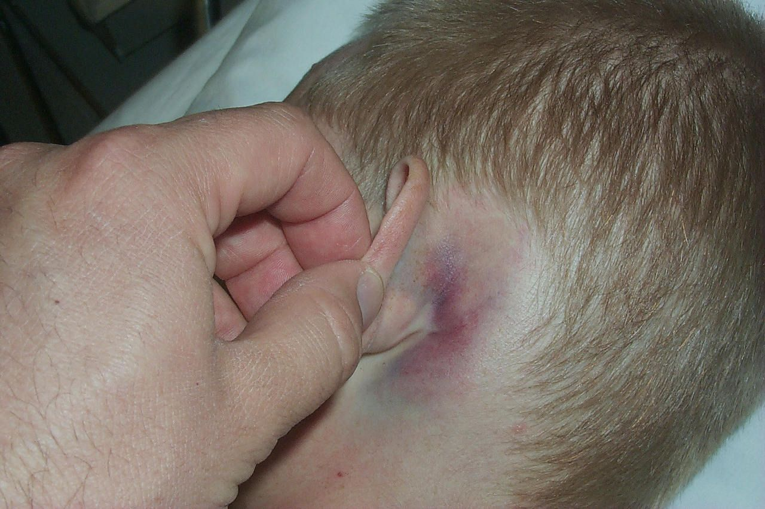
Illustrations
Raccoon Eyes
.
Battle's sign
DM

Slide 11
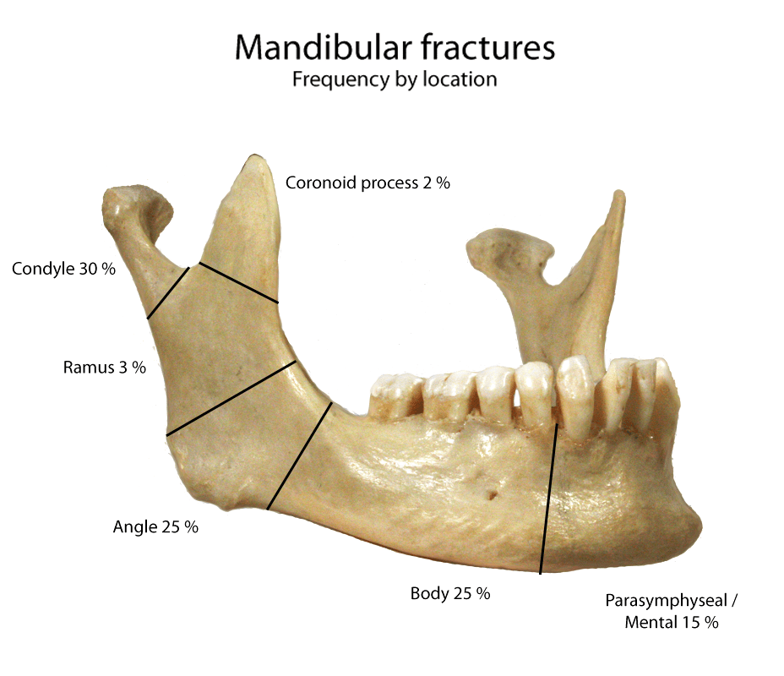
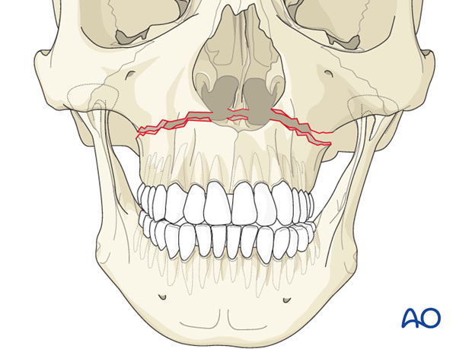
Illustrations
Maxillary Fracture
DM

Slide 12
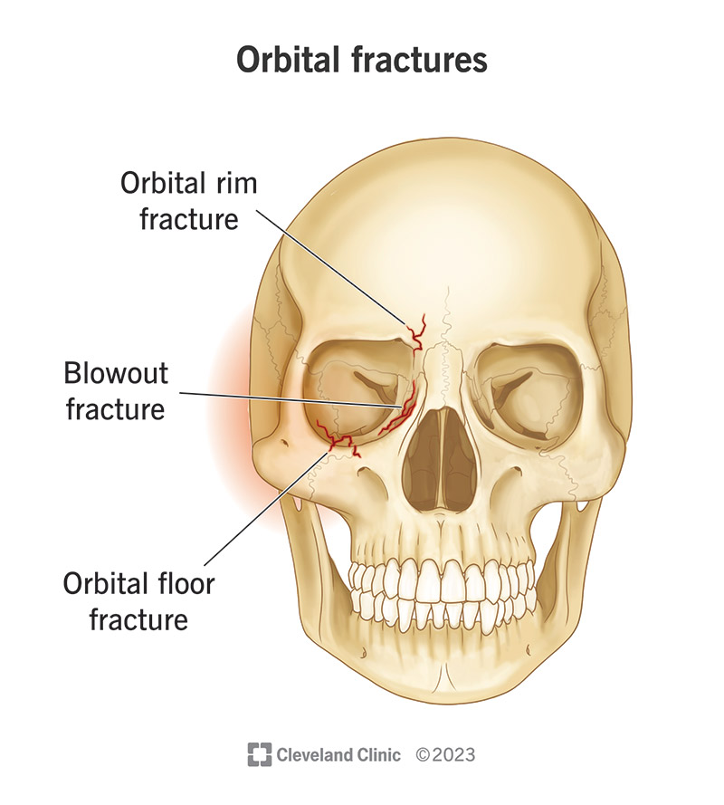
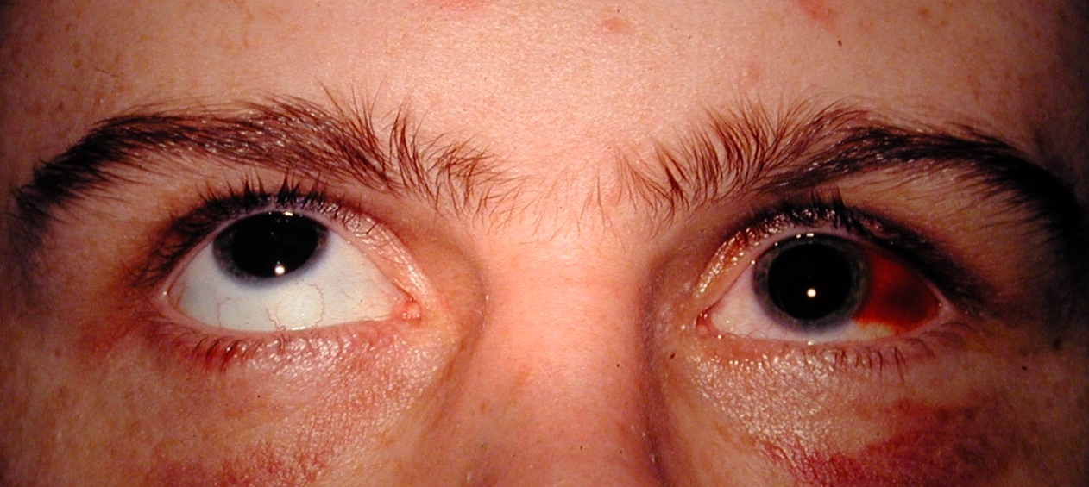
Illustrations
Orbital Blowout Fracture
DM

Slide 13
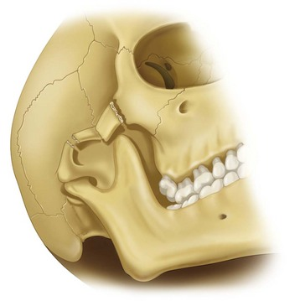
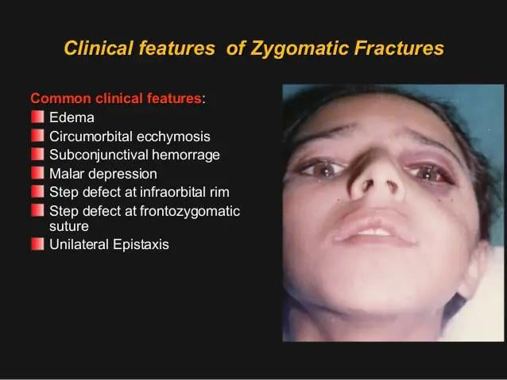
Illustrations
Zygomatic Arch Fracture
DM

Slide 14
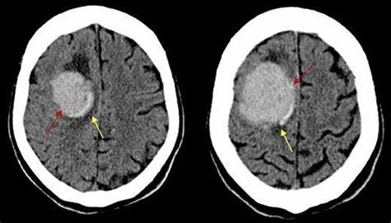
Illustrations Intraparenchymal hemorrhage
DM

Slide 15
How To Manage Head Injuries in Corrections
Thorough History!!!
What happened, witnesses, camera review, information from collateral stakeholders (custody staff, nursing staff, cellmates if needed)
Ask the inmate what happened (does it match the story-for example if stating LOC, but not verified by camera, etc.,)
Canadian Head CT Algorithm
DM

Slide 16
Physical Exam
(Assuming Canadian Head CT algorithm is negative)
Document orientation and answers to questions (what jail are they in), date (month and year).
Cranial nerve examination II-XII, thorough physical exam
Bruising overlying the temporal area, raccoon's eyes, or Battle's sign
Any motor deficits (ataxia, hemiplegia)
Bite test
DM

Slide 17
Managing Minor Head Injuries
All the bad things have been ruled out at least immediately....Now what?
You've made the decision that your patient does not need immediate intervention, so what's the next step?
Neuro checks (how frequently?-therein lies the question...
The goal is to catch an fairly immediate head bleed (epidural bleed), or a later bleed over a period of hours or days (subdural bleed, subarachnoid bleed)
Acetaminophen and ice for comfort
Avoid aspirin and NSAIDs (ibuprofen, naproxen) early on
DM

Slide 18
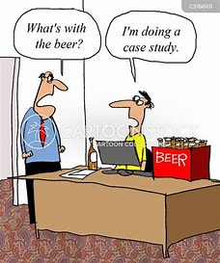
Now the Fun Begins...Case Studies!
DM/SM

Slide 19
Case Study # 1
45 year old male, fell out of bed.
What questions would you ask about the fall?
What would you ask in terms of medical history?
What is your plan?
Why or why not?
DM/SM

Slide 20
Case Study #2
28 year old male who was involved in an altercation.
What questions would you ask about the altercation?
What would you ask in terms of medical history?
What is your plan?
Why or why not?
DM/SM

Slide 21
Case Study #3
38 year old AA male, states he "fell in the shower" in the housing unit. Unfortunately, no camera footage was available as it was in the shower area.
He was helped up by custody staff, and brought in a wheelchair to the clinic area.
He stated that he could not move his right side, but was gesturing with his right hand. When asked to show his right hand, he denied it was his.
What was the diagnosis?
DM/SM

Slide 22
Case Study #3
What happened?
Patient was unable to identify his right hand or leg-indicating hemineglect.
Result:
Transferred to the hospital/ED, received head CT, indicating intraparenchymal hemorrhage
DM/SM

Slide 23
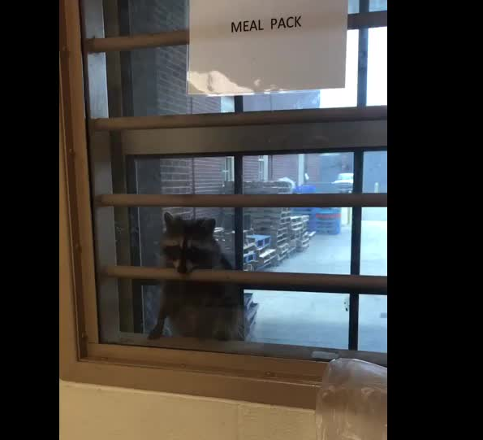
Questions????
DM/SM

Slide 24
Thank You!!!
Susan Minter DNP APRN
P. Daniel McConnell, MD FAAEM

Slide 25
References
Chong, J. C. (n.d.). Head CT for adult minor TBI. EMNote. https://www.emnote.org/emnotes/head-ct-for-adult-minor-tbi
Lavery, M. D., Williamson, R. A., Curran, J., Wilkey, J., & McCarroll, K. (2024). Canadian CT head rule adherence in a rural hospital without in-house computed tomography. Canadian journal of rural medicine : the official journal of the Society of Rural Physicians of Canada = Journal canadien de la medecine rurale : le journal officiel de la Societe de medecine rurale du Canada, 29(4), 167–172. https://doi.org/10.4103/cjrm.cjrm_1_24
Uchiyama, M., Mori, K., Abe, T., & Imaki, S. (2024). Risk factors for clinically important traumatic brain injury in minor head injury in older people. The American journal of emergency medicine, 80, 156–161. https://doi.org/10.1016/j.ajem.2024.04.003

