Slide 1
Interdisciplinary Management of Psychiatric Patients in Primary Care
Susan Minter, DNP, FNP-C, ANP-C
Dennis Petrocelli, MD

Slide 2
DISCLOSURE STATEMENT
Disclosure Statement: We do not have any financial interests or affiliation concerning the material discussed in this presentation.

Slide 3
Learning objectives
Identification of common psychiatric problems in primary care
Assessment of psychiatric patient in primary care
Collaboration of psychiatric patient in primary care
Treatment of psychiatric patient in primary care
Evaluation of treatment of psychiatric patient in primary care

Slide 4
Psychiatric patients in primary care
Why does it matter?
Primary care providers prescribe 79% of all antidepressants in the United States
Primary care providers are the gatekeepers and the safety net for scarce mental health resources
Access to care, affordability, timely treatment are key in appropriate management of psychiatric disorders-primary care providers are an important link in the chain for patient care.

Slide 5
Common psychiatric problems in primary care
Depression
Anxiety
ADD/ADHD
Adjustment disorders
Neurocognitive disorders
Bipolar
Sexual dysfunction(s)

Slide 6
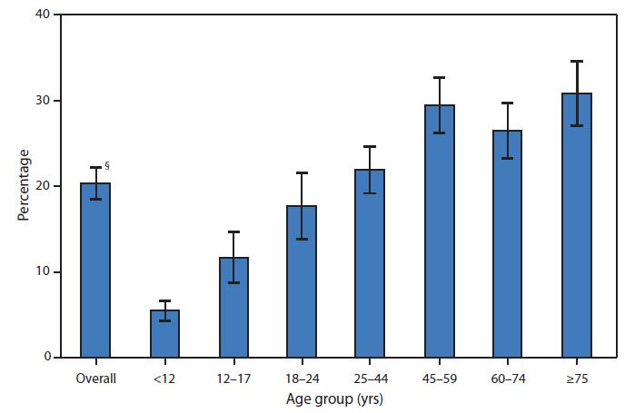
Prevalence of Mental health disorders in Primary Care
Source: CDC, Morbidity and Mortality Weekly Report, 2022

Slide 7
PCP/NP as gatekeepers
Psychiatric illnesses frequently present as somatic complaints.
Patients may not be forthcoming in stating their psychiatric distress and symptoms, and frequently may cite a physical ailment when the true issue is psychiatric in origin
Primary care providers are the gatekeepers and front line clinicians who are ideally poised to ensure an accurate diagnosis, and subsequent appropriate treatment and referrals as warranted

Slide 8
Assessment
Identify patients with validated screening tools
(PHQ-9, Hamilton, MOCA, Mini-Mental, etc)
Assess safety of patient (and caregivers). Is the patient safe? Is the caregiver(s) safe to be treated by PCP or does an urgent referral need to be initiated?
Comprehensive evaluation with screening tools, speaking to patient, caregivers, assessing home situation and support

Slide 9
Conditions to consider referral to psychiatric colleagues
Refer based upon severity/functional impairment rather than diagnosis:
History of psychiatric hospitalization
History of self-harm or current suicidal ideation

Slide 10
Conditions to consider referral continued…
History of failure of multiple psychiatric treatments
Active substance use disorder
Multi-system involved clients, e.g., social services, courts, school system
Current or foreseeable legal involvement (unless you like that sort of thing)

Slide 11
Evaluation of psychiatric patient in primary care
Always begin directly with safety: suicidality, homicidality, safety (domestic violence/child/elder endangerment), SUBSTANCE USE
Current level of functioning: “How do you spend your time?”
Determine markers of progress: “What would you do if you weren’t struggling with this?”
Directly ask about sleep, appetite, energy, thoughts that bother them, hearing voices, seeing things, believing things others do not
“Is there anything else I need to know to help you?”

Slide 12
Evaluation Continued…
The fastest route to therapeutic misadventure is to miss substance use
Assessment compounded by societal judgment, clinician distaste, specter of legal issues
Two approaches to questions to avoid being perceived as judgmental
“Which drugs or alcohol have you tried to make this better?”
OR “These are questions I ask all my clients: Which drugs have you used and what do you drink?”

Slide 13
Collaboration of psychiatric patients
PCP to investigate and determine any iatrogenic causes of behavioral issues
Examples: Hypothyroidism, infections, elevated ammonia levels, pain, etc.
Communicate results of workup to psychiatric colleagues

Slide 14
Collaborative case study
Your 19yo long-term client with Type I diabetes presents with his mother. He is distracted, talking to himself, disheveled.
Client returns in six weeks, but you cannot recognize him: he’s gained 30 pounds. Prescribed Zyprexa and Depakote for a diagnosis of schizoaffective disorder. No labs on file
DISCUSS!

Slide 15
Treatment of psychiatric patients in primary care
Make sure you have an accurate story: deputize collaterals with client consent
Request records
“What’s the number one thing you want to change with psychiatric medication (about how you think, feel, or act)?”

Slide 16
Treatment of Psychiatric patients continued…
“What worked for you previously, and in what way?”
“What didn’t work for you previously, and in what way?”
“What did/didn’t work for blood relatives?”
Start low, go slow, check in frequently to assess for toxicity (behavioral & metabolic)

Slide 17
Roadblocks/issues
Scarcity of psychiatric resources
Limitation of insurance panel providers
No insurance/self-pay patients
Delay in being seen and evaluated
Lack of communication from PCP to specialist and vice versa

Slide 18
Conclusion
Primary Care Providers see a large amount of psychiatric patients
NP’s are the gatekeepers and safety net for psychiatric patients
Somatic complaints may frequently present as the chief complaint, but a psychiatric issue is the true issue
Collaborate and use your contacts: Make friends with psychiatry friends in the community! Send them cookies! Remember their birthday!

Slide 19
Thank you for coming!

Slide 20
References
Anjara SG, Bonetto C, Ganguli P, Setiyawati D, Mahendradhata Y, Yoga BH, Trisnantoro L, Brayne C, Van Bortel T. Can General Practitioners manage mental disorders in primary care? A partially randomised, pragmatic, cluster trial. PLoS One. 2019 Nov 7;14(11):e0224724. doi: 10.1371/journal.pone.0224724. PMID: 31697724; PMCID: PMC6837310.
Centers for Disease Control and Prevention [CDC]. (2022). Morbidity and mortality weekly report. QuickStats: Percentage of Mental Health–Related* Primary Care† Office Visits, by Age Group — National Ambulatory Medical Care Survey, United States, 2010 (cdc.gov)
Hensel JM, Yang R, Rai M, Taylor VH. Optimizing Electronic Consultation Between Primary Care Providers and Psychiatrists: Mixed-Methods Study. J Med Internet Res. 2018 Apr 6;20(4):e124. doi: 10.2196/jmir.8943. PMID: 29625949; PMCID: PMC5910533.
Overbeck G, Davidsen AS, Kousgaard MB. Enablers and barriers to implementing collaborative care for anxiety and depression: a systematic qualitative review. Implement Sci. 2016 Dec 28;11(1):165. doi: 10.1186/s13012-016-0519-y. PMID: 28031028; PMCID: PMC5192575.
Possemato K, Shepardson RL, Funderburk JS. The Role of Integrated Primary Care in Increasing Access to Effective Psychotherapies in the Veterans Health Administration. Focus (Am Psychiatr Publ). 2018 Oct;16(4):384-392. doi: 10.1176/appi.focus.20180024. Epub 2018 Oct 18. PMID: 31975930; PMCID: PMC6493241
Rugkåsa J, Tveit OG, Berteig J, Hussain A, Ruud T. Collaborative care for mental health: a qualitative study of the experiences of patients and health professionals. BMC Health Serv Res. 2020 Sep 9;20(1):844. doi: 10.1186/s12913-020-05691-8. PMID: 32907559; PMCID: PMC7487713.

Slide 21
Collaborative Case study/Time Permitting/audience preference
PCP NP providing home care visit encounters the following:
88-year-old man with CHF, dementia, urinary retention, lives at home with his 50-year-old daughter who is his full-time caretaker.
Patient only sleeps 90 minutes at a time, keeps trying to get out of bed. Sometimes states he had to urinate, sometimes just tried to get out of bed and would get agitated when putting his leg when trying to get out of bed and would call for help.
Caregiver becoming frustrated because she is unable to get a good night’s rest.
Daughter does not want invasive or intensive intervention at this point.

Slide 22
Collaboration continued/Time permitting
Medical issues ruled out: UTI, urinary retention (via traveling ultrasound), electrolyte imbalances.
Once medical issues were ruled out, collaboration with psychiatry was implemented.
Various (and every) drug class was tried to decrease the patient’s agitation: anticholinergics, benzodiazepines, anti-psychotics, with no effect

Slide 23
What was the result?
Discuss

