Slide 1

Workplace Violence And Bad Behaviors: Identifying and Mitigating the Risk
Dennis Petrocelli, MD
Susan Minter, DNP, NP-C

Slide 2
Disclosures
We have no financial or commercial associations to disclose

Slide 3
Learning Objectives
Define unacceptable and/or escalating behavior as it relates to a healthcare setting
Explain the rationale as to why people act inappropriately in a healthcare setting
Describe methods to defuse escalating situations
Define strategies as to how (and when) to call or ask for help

Slide 4
Introduction to the Issue
Types of Workplace Violence
-Physical
-Sexual
-Psychological/Verbal

Slide 5
Rationale as to Why People Act Inapppropriately
-Staff shortages
-History of violent individuals
-Increased patient morbidities
-Lack of access to mental health services
-Drug addiction
-Cognitive and psychological impairments
-Anger regarding clinical relationships/perceived authoritarian attitude

Slide 6

Case Study-Why We Chose this Topic
-Prison Staffing Issue: Case Study
Nurses Station
Nurses Station
CO/Security
Door to Outside-locked by tower control
Door to Clinic Rooms
Waiting Area

Slide 7
Statistics
-World Health Organization reports 8.38% of nurses suffer violence during their career (worldwide)
-74% of workplace violence occurs in healthcare settings (US reportings)
-Workplace violence peaked in 2020 (?Covid) then came down in 2021
-Healthcare settings had the highest incidences of injuries and illnesses than any other reported sector
-

Slide 8
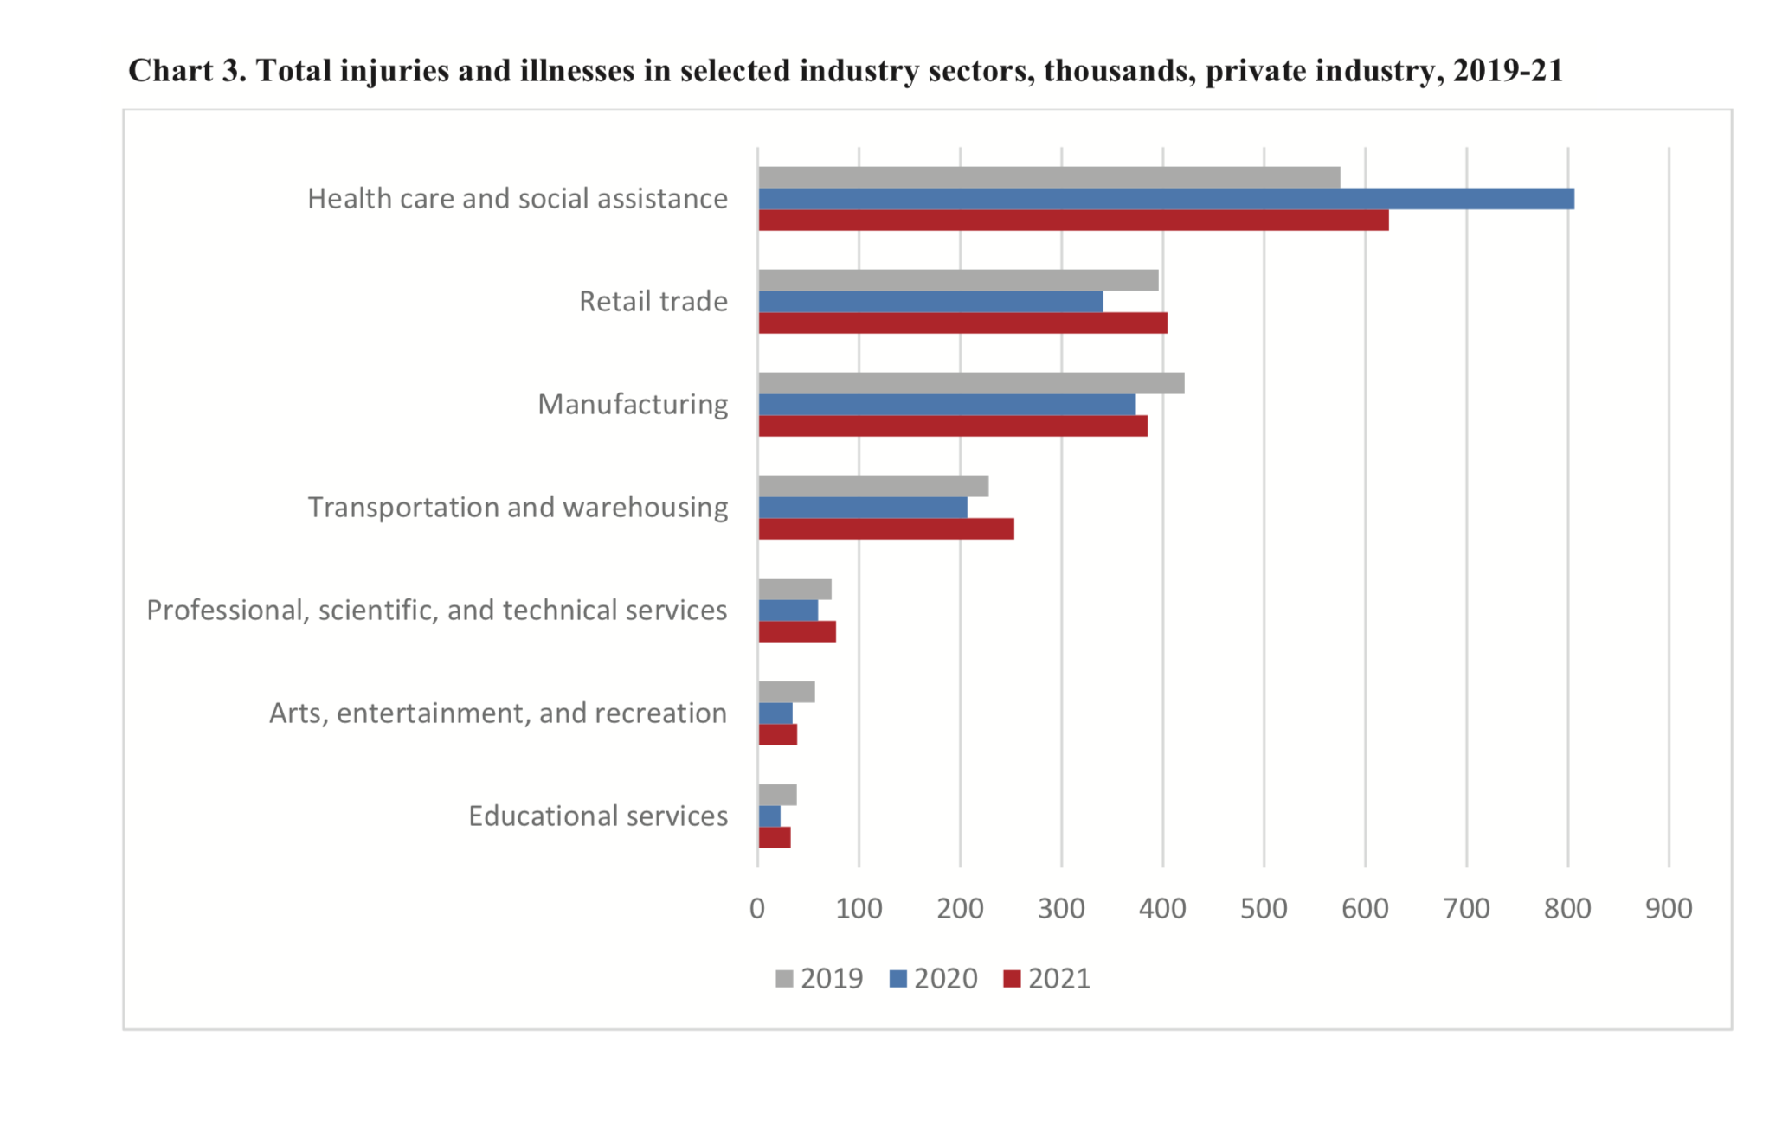
Statistics
Note. Data is from US Bureau of Labor Statistics

Slide 9
Psychological/Forensic Analysis
-Why do people behave badly, especially when someone is trying to help them???
“The road to h#ll is paved with the best of intentions.”
1)Staff generally convinced that their efforts are correct, will be well-received, a judged based upon the soundness of the science
2)Violence to staff, although not uncommon, is sufficiently uncommon that staff are not expecting it or preparing for it adequately
3)Patients and families are less rational: a) about themselves when ill, b) their loved ones when they are ill
4)Staff are not trained to navigate adversarial scenarios nor view themselves from a “customer service” perspective; patients increasingly demand the later

Slide 10
Psychological/Forensic Analysis Continued…
1)Past violence is predictive of future violence
2)Violence to self is also predictive of future violence to others
3)Substance use is often present at the time that people are violent to others, especially alcohol
4)History of disruptive behavior (criminal behavior) in other settings is predictive of violence
5)These are all historical factors worth discerning at intake rather than when broaching a difficult subject (bad outcome, etc)

Slide 11
Strategies to Mitigate Escalating Behavior-Self awareness is First
-Be aware that your mindset can exacerbate a situation
-Know your own mindset (Are YOU having a bad day???)
-Know what “pushes your buttons”. Self-awareness is key to behavior modification
-“Leave it at the door”
-Identify strategies for self-calming-even before any issue arises. Examples: listening to classical music on the way to work, yoga, hobbies, healthy outlets for a balanced life

Slide 12
Strategies to Mitigate Escalating Behavior
-First, set the scene for safety (more on next slide)
-If possible, prior to a potential issue, make sure safety nets are in place.
What does that mean?????
(Examples/Case Study of front desk issue).
-Physical setting-evaluate, make changes if necessary
-Staffing-additional staffing or more appropriate personnel (example)
-The right person for the job-who is trying to solve the problem? (ie., does the administrator need to be involved-someone more experienced for problem solving)

Slide 13
Strategies to Mitigate Escalating Behavior Continued…
***SAFETY FIRST***
-Physical Plant set up (both in general, and a survey prior to any discussion if possible-ie., phones, panic buttons, locked doors (are they locked? Check..)
-Exits (room exit, facility exits, placement of the individual versus the healthcare personnel)
-Code words (what is the safety code word, what does the person do with the code word-rehearse scenarios)

Slide 14
Strategies to Mitigate Escalating Behavior Continued…
-Restricted access if necessary in certain areas.
Know your resources
-Communicate with administration (in writing) concerns about
safety issues
-Security options-onsite? What can they do or not do?
-What is the average law enforcement response time-

Slide 15
Strategies to Mitigate Escalating Behavior Continued…
-Know your audience
-Have they been a problem before? If so, then take steps to mitigate the risk as people tend to be creatures of habit-if they were a problem before, they could be a problem again
-If in the community, know who you are dealing with if possible (one advantage to correctional medicine)
Examples:
-Home visits-use online maps
-Check criminal records online before making a home visit
-Check sexual predators in the area or home

Slide 16
Interaction Methodology
-Decide who will take the lead for the interaction
-LISTEN to what the person is saying
-Are they making sense?
-Is there an element of truth to the issue? (Frequently, there is)
-Repeat back to them the key issues to make sure you have it correct
-Make sure there is follow through on the issue. (If you say you are going to do something, do it)

Slide 17
Termination of the Interaction
When to Terminate:
-When you feel unsafe
-When the person doesn’t respect your requests to feel safe (ie., getting too close, not lowering their voice after you request them to, verbal threats (which can be veiled threats “I’m going to have you on the front page of the newspaper”, etc.,)
-When you have a bad feeling about the situation. Not a quantifiable measure, but if you don’t feel comfortable continuing the interaction, then terminate it
-Any threats or actual violence precursors (ie., hitting a countertop, shaking a fist, etc),

Slide 18
How to Terminate the Interaction
-Things to say:
“We’re done” (an all-time favorite)
“This conversation is ended”
“We need you to leave. Now.”
“I’m leaving now” (or, just leave-you don’t need to announce it).
“That’s close enough (when someone encroaches on your space)
“I can hear you from where you are” (when they start moving towards you)
“Hold that thought” – while reaching for your phone and exit the room. If you fear for your immediate safety, ACT, and there’s nothing wrong with creating a reason to exit.

Slide 19
Conclusion
-Your safety comes first. Period.
-If the situation is escalating, get help early
-Don’t worry about patient satisfaction scores if your safety is in question
-Use the tools we have provided to implement in your practice

Slide 20
Questions?
Thank You All For Coming Today!

Slide 21
References
BJS/BLS/NIOSH [2022]. Indicators of Workplace Violence, 2019. By Harrell, E, Langton, L, Petosa, J, Pegula, S, Zak, M, Derk, S, Hartley, D, and Reichard, A. Washington, DC: U.S. Department of Justice, Office of Justice Statistics, NCJ 250748. Washington, DC: U.S. Department of Labor, Office of Safety, Health, and Working Conditions, Bureau of Labor Statistics. Morgantown, WV: U.S. Department of Health and Human Services, Centers for Disease Control and Prevention, National Institute for Occupational Safety and Health, DHHS (NIOSH) Publication No. 2022-124. https://doi.org/10.26616/NIOSHPUB2022124
Kafle S, Paudel S, Thapaliya A, Acharya R. Workplace violence against nurses: a narrative review. J Clin Transl Res. 2022 Sep 13;8(5):421-424. PMID: 36212701; PMCID: PMC9536186.
Somani R, Muntaner C, Hillan E, Velonis AJ, Smith P. A Systematic Review: Effectiveness of Interventions to De-escalate Workplace Violence against Nurses in Healthcare Settings. Saf Health Work. 2021 Sep;12(3):289-295. doi: 10.1016/j.shaw.2021.04.004. Epub 2021 May 3. PMID: 34527388; PMCID: PMC8430427.

