Slide 2
Week 1
Name ______________________________Date ______________
DOCUMENTATION | COMPLETED EXAMPLES 4 slides 1 for each type of documentation | POINTS AVAILABLE | POINTS EARNED
https://s3.amazonaws.com/scschoolfiles/819/research_unit_mla_documentation_citation.pptx REMEMBER – DOCUMENTATION, DOCUMENTATION, DOCUMENTATION THIS IS PART OF YOUR FINAL EXAM GRADE. |  | COMPLETED POWERPOINT 100 POINTS
 |  | GRADE
Warm-up: everyday edit Materials: journals, ppts OR scrapbook, google, reading passages Procedures: 1. Vocabulary Routine: 5 words from reading 3 words from foreign language 3 words from most frequently misspelled words 2 words from root words 2 words from figurative language (review) 2. Writing SUMMARIES FOR SOURCES 3. Reading SOURCES FOR PAPERS outline the information using the following formats Reading Response AND Post It 4. Listening - classmates - "Tell Me About your project" 5. Speaking - "Tell Me About..." Evaluation: observation, exit ticket, reading journal, writing journals returned ppt. via email English I, II; ESOL I, II RESEARCH – WHAT IS DUE THIS WEEK? READ – PRINT OUT INFORMATION GATHERED THIS WEEK. USE YOUR READING STRATEGIES. USE PRE - WRITING STRATEGIES TO ORGANIZE YOUR PRESENTATION
Your Project must Include the following with summaries:
2 library books
2 Encyclopedias
2 Newspaper Articles
2 online books
1 Wikipedia
1 picture / slide with documentation
3 songs / with documentation
13 slides + Introduction and Conclusion
50 vocabulary words with synonyms

Slide 3
Daily Edits
Does you like to “reach out and touch someone” by phone. You can thank Alexander Graham Bell! Bell was born in scotland on March 3 1847. When he was a boy, he designs a machine that cleaned wheat. Later when he was a teacher of the def, Bell developed the idea of “electronic speech.” He sent his first message to his assistant, Mr. Watson, who was in the next
You may think that paper monie has been around for a long time, but in the United States, the first paper money was not introduced until march 10, 1862. On that day, the United States government issued it’s first paper money in the form of $5, $10, and $20 bill. Since then the look of the money has changed significently. For example the first $5 bill featured Alexander Hamilton. Abraham Lincoln did not appear on the $5 bill we know today untill 1929. Other bills have changed to. For example, the $20 bill featured lady Liberty, Pocahontas, and Grover Cleveland, before settling on Andrew Jackson on 1928.
On March 8, 1848, the buildor of the worlds first roller coaster was born. La Marcus Thompson who is often called the “Father of the Gravity Ride, created the first gravity-powered roller coaster in the U.S. at Coney island New York. La Marcus was a natural mechanic. At the age of 12, he design a butter churn and an oxcart his roller coaster paved the way for future rides such as Space Mountain at Disney world.
Imagine getting more then 55 inches of snow during one snowstorm. That’s what happened during the Blizzard of 1988. On March 11, 1888, a massive blissard hit the East coast of the United States. One of the hardest-hit areas was New York City. As winds of up to 85 MPH blew through the city, thousands of people were stranded on aboveground trains. Many persons who tried to walk to work collapsed in snowdrifts. Water and gas lines and telegraph wires frozen, making it hard to repair them. Over 200 people in New York City were killed during the blizzard. Others was stranded for days. After the storm, offichuls in New York City decided to prepare in case another blizzard hit. They built under groundtrains and buryed water and gas lines so they would be safe.

Slide 4
VOCABULARY
achromatic
amateur
aperture ratio
appeared
astronomers
camera
cast
center
century
concave construction
convex curvature
diameter
difﬁculty
disk
Dollond double stars
equatorial
equatorial mounting
eyepiece
focus
ﬁeld
ﬁgure
ﬁlm
ﬁnal
ﬁnd
ﬁtted
ﬂat
focal
length
Galileo
aperture instrument
invention
Laterl bid lens
lenses
London
magniﬁcation
meridian
metal
method
micrometer
minutes of arc
mirror
moon
motion
Mount Wilson
Mount Wilson Observatory
nebulae
Newtonian object-glass
objective observations
Observatory
optical
opticians
Paris Observatory
photographic
Planets
plate
Polar axis
polishing
prism
quadrant
Ramsden reﬂecting
telescope
reﬂector
refracting
refractor
right ascension
rotated
Royal Society
satellites
scientiﬁc
slit
solar
spectra
spectrograph
Spectro heliograph
spectrum
specula
speculum
speculum metal
spherical aberration
stellar surface
Trans transit circle
Troughton tube
Vide Ref Yerkes

Slide 5
VOCABULARY

Slide 6
VOCABULARY

Slide 7

MLA DOCUMENTATION RESEARCH CITATION
Use this bibliography engine: http://www.easybib.com/

Slide 8
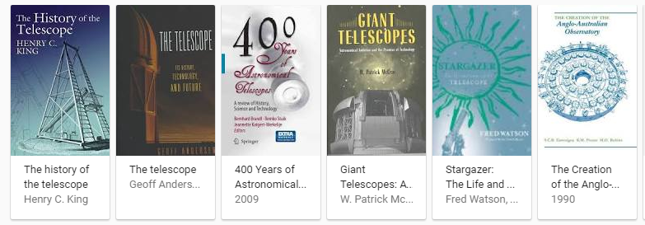
Practice Book Documentation:
1. Write the MLA documentation for 10
2. Copy only this SLIDE to a new Documentation Log
3. Write the documentation save, and email
4. Put one copy in your scrapbook or PPT.
1. King, Henry. The History of the Telescope. Courier Corporation, 1955. Reprint.
2. Andersen, Geoff. The Telescope: Its History, Technology, and Future. Princeton University Press. 2007. Reprint.
3. Parke, Ross. Fathers. Cambridge: Harvard University Press, 2000. Print.
4. Bailey, Gerry, Karen Foster, Leighton Noyes, and Karen Radford. Galileo's Telescope. New Taipei City: Win Pub., 2010. Print.
5. Massimo, Bucciantini. Galileo's Telescope: A European Story. N.p.: n.p., n.d. Print.
6. Brandl, Bernhard R., Remko Stuik, and J. K. Katgert-MerkeliÌjn. 400 Years of Astronomical Telescopes: A Review of History, Science and Technology. Dordrecht: Springer, 2010. Print.
7.
8.
9.
10.

Slide 9

Documentation: Music and Videos
1. Write the MLA documentation for 10 songs/videos
2. Copy only this SLIDE to a new Documentation Log
3. Write the documentation save, and email
4. Put one copy in your scrapbook or PPT.
1.
2.
3.
4.
5.
6.
7.
8.
9.
10.

Slide 10
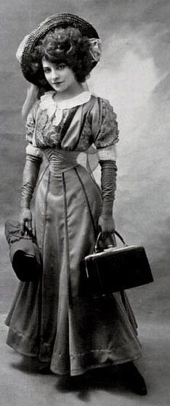
Documentation Website Pictures
1. Write the MLA documentation for 10
2. Copy only this SLIDE to a new Documentation Log
3. Write the documentation save, and email
4. Put one copy in your scrapbook or PPT
1.
2.
3.
4.
5.
6.
7.
8.
9.
10.

Slide 11

Documentation Website
1. Write the MLA documentation for 10
2. Copy only this SLIDE to a new Documentation Log
3. Write the documentation save, and email
4. Put one copy in your scrapbook or PPT.
1. "Telescopes Now Available at Suburban Libraries Check It out Telescopes: GoPros Available at Some Libraries." Daily Herald (Arlington Heights, IL). N.p., 5 May 2015. Web. 27 Mar. 2017.
2. "WASHBURN TELESCOPE'S OPTICS GET 130-YEAR CHECKUP, CLEANING." States News Service. N.p., 10 May 2012. Web. 27 Mar. 2017.
3. "Csiro Telescope Marks 25 Years of Success." States News Service. N.p., 26 Aug. 2013. Web. 27 Mar. 2017.
4. Raymo, Chet. "TELESCOPES SEEK BLASTS FROM PAST." The Boston Globe (Boston, MA). N.p., 12 Dec. 2000. Web. 27 Mar. 2017.
5. "A Telescope Is Born." States News Service. N.p., 11 June 2014. Web. 27 Mar. 2017.
6. "Telescope Timeline - Astronomy For Kids." Telescope Timeline - Astronomy For Kids - KidsAstronomy.com. N.p., n.d. Web. 27 Mar. 2017.
7. Herbert, Samantha. "The Timeline: Telescopes." The Independent. Independent Digital News and Media, 03 Oct. 2011. Web. 27 Mar. 2017.
8. Owen, James. "GALILEO'S TELESCOPE AT 400: Facts, Myths, More." National Geographic. National Geographic Society, n.d. Web. 27 Mar. 2017.
9. "Galileo's Discoveries - 400th Anniversary." Stanford Solar Center. Stanfords Solar Center, n.d. Web. 27 Mar. 2017.
10. Dunbar, Brian. "Telescope History." NASA. NASA, 12 Sept. 2003. Web. 28 Mar. 2017.

Slide 12
Week 2
Name __________________________________________________________Date ______________ RESEARCH PROJECT NAME___________________________________________________________
WEEK 2 SUMMARIZE INFORMATION YOU WILL NEED 3 SLIDES / WEEK - COMPLETED! (NOT JUST STARTED) THIS IS PART OF YOUR FINAL EXAM GRADE. | REQUIRED FOR EACH PAGE/SLIDE: 1. Pre - organization strategies used. 2. DECORATION TO FIT THE ERA/TOPIC 3. INFORMATION IS ACCURATE AND NOT Plagiarized 4. Project is neat and proceeding in an organized manner 5. Grammar and capitalization | PREADING STRATEGIES AND PRE-WRITING STRATEGIES 3 SLIDES | POINTS EARNED
 |  | GRADE
Warm-up: everyday edit Materials: journals, ppts OR scrapbook, google, reading passages Procedures: 1. Vocabulary Routine: 5 words from reading 3 words from foreign language 3 words from most frequently misspelled words 2 words from root words 2 words from figurative language (review) 2. Writing SUMMARIES FOR SOURCES 3. Reading SOURCES FOR PAPERS outline the information using the following formats Reading Response AND Post It 4. Listening - classmates - "Tell Me About your project" 5. Speaking - "Tell Me About..." Evaluation: observation, exit ticket, reading journal, writing journals returned ppt. via email https://s3.amazonaws.com/scschoolfiles/819/february_02-27-2017b.pptx https://s3.amazonaws.com/scschoolfiles/819/commonpersuasivetechniques.ppt https://s3.amazonaws.com/scschoolfiles/819/summary_paraphrasing_quotes.pptx https://s3.amazonaws.com/scschoolfiles/81

Slide 13
Daily Edits
People around the world celebrate Pi Day on march 14. We use the greek letter π (called pi) to represent the number we get when we divide the circumference of a circle by it’s diamiter. Because it is a Mathematical constant, the value of pi never changes That value rounds to 3.14, and the digits after the decimal point continues infinitly without repeating in any pattern. The best calculations of pi can be trillions of digit long! Will your math class do special activity’s on Pi Day?
beware the Ides of March. Those words come from William Shakespeare’s play Julius Caesar. In the play, a soothsayer, or a person able to predict the future, spoke those words. He were telling Julius Caesar that he was about to dye. Some other famous words were also uttered around the same time – Et tu, Brute?” Those were reportedly Caesar’s last words. They mean “and you, Brutus” He spoke them to his freind, Brutus, who was part of the group there too assassinate Caesar. Some say Caesar spoke the words as a warning to Brutus. Others think he spoke the words cuz he was sad his friend had betrayed him.
beware the Ides of March. Those words come from William Shakespeare’s play Julius Caesar. In the play, a soothsayer, or a person able to predict the future, spoke those words. He were telling Julius Caesar that he was about to dye. Some other famous words were also uttered around the same time – Et tu, Brute?” Those were reportedly Caesar’s last words. They mean “and you, Brutus” He spoke them to his freind, Brutus, who was part of the group there too assassinate Caesar. Some say Caesar spoke the words as a warning to Brutus. Others think he spoke the words cuz he was sad his friend had betrayed him.
St. Patrick’s Day celebrates a Catholic saint who livved long ago. The first St Patrick’s Day parade in the united States took place when Irish soldiers marched through New York City on March 17, 1762. Over the years, Irish immegrant groups began to holed parades with bagpipes and drums. In 1848, several groups unite their parades Today, New York City’s St. Patricks’ Day parade was the nation’s largest. Each year, nearly three milion people attend.

Slide 14
Introduction
Tell me about your research.
Documentation Week 1
1. Websites
2. Books
3. Pictures
Music
Organize and Summarize
Week 2
1.
2.
3.
4.
Organize and Summarize Week 3
1.
2.
3.
4.
Organize and Summarize Week 4
1.
2.
3.
4.
Organize and Summarize Week 5
1.
2.
3.
4.
Peer/Teacher Edit, Rewrite
Week 6
1.
2.
3.
4.
Peer/Teacher Edit, Rewrite
Week 7
1.
2.
3.
4.
Conclusion
1.

Slide 15
“Location in Scrapbook”
Week 1 websites
Pre - Organize
Title of the Document
Title of the Document
Summary to use in your paper
Summary to use in your paper
Summary to use in your paper
Summary to use in your paper
Title of the Document
Title of the Document

Slide 16
“Location in Scrapbook”
Week 1 Books used
Pre - Organize
Title of the Document
Title of the Document
Summary to use in your paper
Summary to use in your paper
Summary to use in your paper
Summary to use in your paper
Title of the Document
Title of the Document

Slide 17
“Location in Scrapbook”
Week 1
Picture
Pre - Organize
Picture
Picture
Documentation
Documentation
Documentation
Documentation
Picture
Documentation
Picture
Picture
Picture
Documentation
Picture
Documentation
Picture
Documentation

Slide 18
“Location in Scrapbook”
Week 1
Pre - Organize
Music
Music
Documentation
Documentation
Documentation
Documentation
Music
Music
Music
Documentation

Slide 19
WEEK 3
Name ______________________________________________________________________Date ______________ RESEARCH PROJECT ________________________________________________________________________
WEEK 3 SUMMARIZE INFORMATION YOU WILL NEED 4 SLIDES / WEEK - COMPLETED! (NOT JUST STARTED) THIS IS PART OF YOUR FINAL EXAM GRADE. | REQUIRED FOR EACH PAGE/SLIDE: 1. Pre - organization strategies used. 2. DECORATION TO FIT THE ERA/TOPIC 3. INFORMATION IS ACCURATE AND NOT Plagiarized 4. Project is neat and proceeding in an organized manner 5. Grammar and capitalization | READING STRATEGIES AND PRE-WRITING STRATEGIES 4 SLIDES | POINTS EARNED
 |  | GRADE
Warm-up: everyday edit Materials: journals, ppts, google, reading passages Procedures: 1. Vocabulary Routine: 5 words from reading 3 words from foreign language 3 words from most frequently misspelled words 2 words from root words 2 words from figurative language (review) 2. Writing SUMMARIES FOR SOURCES 3. Reading SOURCES FOR PAPERS outline the information using the following formats Reading Response AND Post It 4. Listening - classmates - "Tell Me About your project" 5. Speaking - "Tell Me About...“ Evaluation: observation, exit ticket, reading journal, writing journals returned ppt. via email https://s3.amazonaws.com/scschoolfiles/819/february_02-27-2017b.pptx https://s3.amazonaws.com/scschoolfiles/819/commonpersuasivetechniques.ppt https://s3.amazonaws.com/scschoolfiles/819/summary_paraphrasing_quotes.pptx https://s3.amazonaws.com/scschoolfiles/81

Slide 20
Daily Edits
Decorated eggs called pysanky" are a tradition in Ukraine. The craft has been practiced for thousands of year. An artist draw a pattern on an egg with a special pen and hot wax Than she applies dye to the egg. The wax protecks the covered areas from the dye, leaveing blank spaces where other colors can be applyed. She repeats this process to from patterns. The patterns celebrate spring and the easter holiday.
Some plants and seeds are unique because of there size. One kind of palm tree in the Seychelles ilands has a huge seed that can weigh more then 60 pounds. Found in california, the tallest tree speces is the coast redwood, which can grow over 375 feet high. The leaves of the giant Amazon water lily can grow as large as 8 feet across. Have you ever see Wolffia, the worlds smallest flowering plants, in a pond lake, or stream. two full-size Wolffia could fit inside a letter “o”!
People honor Arbor Day by planting tree’s. The first Arbor day was held in Nebraska on 1872 Soon after, the holiday became national and international. The official day is the last Friday in April, but sum states uses a different day thats better for planting. Northern states celebrate in may, and southern state celebrate in Febuary.
In April, many people start to plan they’re gardens. this is the best time of year to plant seeds for vegtables and fruits that will be harvested in summer. Would you enjoy a salad of crisp beans carrots, and lettuce, or are juicey tomatos and melons your favorites. Do’nt forget to water the plants and pulled the weeds. A garden take work, but it can be fun.
In 1970, America’s air, water, and land where dirty and polluted. To get people more involved, Senator Gaylord Nelson asked people form all over the United States to help. On April 22, 1970 an estimated 20 million american celebrated the first Earth Day with activitys in schools, colleges, cities, and towns. That same year, the U.S. Enviromental Protection Agency (EPA) was establish to help clean up are country

Slide 21
Week 2 Website Summaries
Post it and Reading Response
Make sure you are completing the reading response and post it notes with your documentation.

Slide 22
Week 2 Book Summaries - Post it
Make sure you are completing the reading response and post it notes with your documentation.
TOPIC - Thesis
EXAMPLE:
ANSWER THE QUESTION:
WHY DOES THIS MATTER?
  PROOF
ONE POINT MADE IN _______ IS ….
Transition
EXAMPLE
ANSWER THE QUESTION:
WHY DOES THIS MATTER?
  PROOF
ACCORDING TO ______....)
CONCLUSION

Slide 23
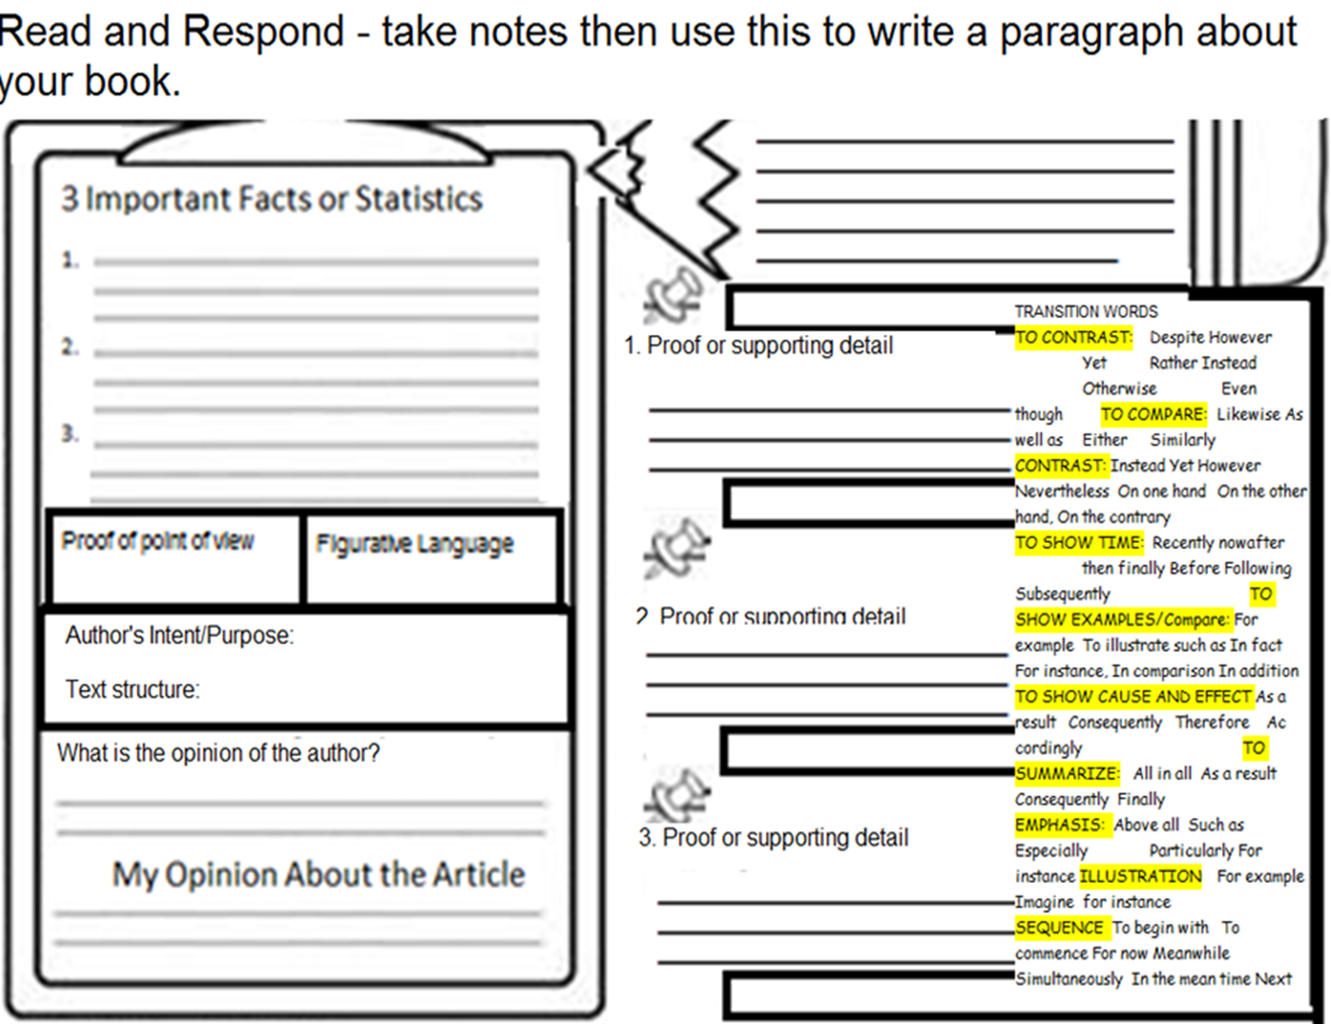
Week 2 Book Summaries
Make sure you are completing the reading response and post it notes with your documentation.
Conclusion ____________________________________________________________________.

Slide 24
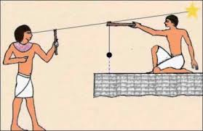
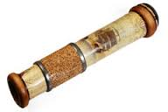
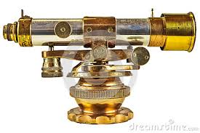
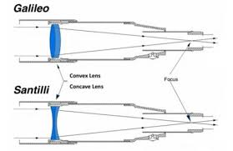
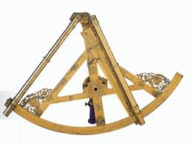
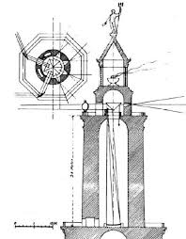
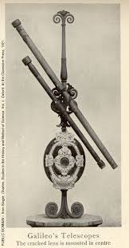
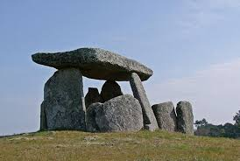
Week 2 Collage of Pictures
Post it and Reading Response

Slide 25
New Telescope Detects ‘Invisible’ INTELLIGENT ALIEN Entities on Earth
These mysterious images are proof that ‘invisible Alien entities ARE here on Earth’

Slide 26

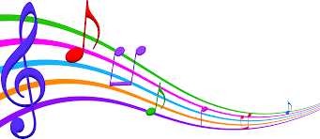
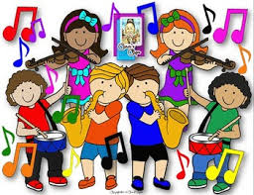


Week 2 Music
Post it and Reading Response

Slide 27
WEEK 3
Name ______________________________________________________________________Date ______________ RESEARCH PROJECT ________________________________________________________________________
WEEK 4 SUMMARIZE INFORMATION YOU WILL NEED 3 SLIDES / WEEK - COMPLETED! (NOT JUST STARTED) THIS IS PART OF YOUR FINAL EXAM GRADE. | REQUIRED FOR EACH PAGE/SLIDE: 1. Pre - organization strategies used. 2. DECORATION TO FIT THE ERA/TOPIC 3. INFORMATION IS ACCURATE AND NOT Plagiarized 4. Project is neat and proceeding in an organized manner 5. Grammar and capitalization | READING STRATEGIES AND PRE-WRITING STRATEGIES 3 SLIDES | POINTS EARNED
 |  | GRADE
Warm-up: everyday edit Materials: journals, ppts OR scrapbook, google, reading passages Procedures: 1. Vocabulary Routine: 5 words from reading 3 words from foreign language 3 words from most frequently misspelled words 2 words from root words 2 words from figurative language (review) 2. Writing SUMMARIES FOR SOURCES 3. Reading SOURCES FOR PAPERS outline the information using the following formats Reading Response AND Post It 4. Listening - classmates - "Tell Me About your project" 5. Speaking - "Tell Me About...“ Evaluation: observation, exit ticket, reading journal, writing journals returned ppt. via email https://s3.amazonaws.com/scschoolfiles/819/february_02-27-2017b.pptx https://s3.amazonaws.com/scschoolfiles/819/commonpersuasivetechniques.ppt https://s3.amazonaws.com/scschoolfiles/819/summary_paraphrasing_quotes.pptx https://s3.amazonaws.com/scschoolfiles/81

Slide 28
Every Day Edits
On a coool spring day in April off the year 1910, William Howard Taft become the first US president to start the baseball season by throwing our the first pitch. He had come to League Park in Washington, D.C. to sea the Senators play the A’s. His tradition has carried on every sinse. What other base ball traditions do you know about?
April is national poetry month. Its a time when kids’ can enjoy the fun of vurse. Children’s poet Jack Prelutsky remembers how one of his teachers made him feel that poetry was like liver. “I was told that it was good for me, but I wasnt convinced, Prelutsky said. Years later, he wrote some lines of poetry to go with drawings he maid of imaginary animals. Those lines of poetry become the first of his entertaining poems for children.
When Jane Goodall arrived in Tanzania at age 26. She was about to fulfill a dream. Goodall longed to lern more then anyone else might hope to know about chimpanzees. Born on April 3, 1934, her adventures into the African Jungle were most unique because she were a women. Her discoverys would amaze the scientific world. She found that chimps striped leaves from twigs to use as tool and that they hunted and ate other animals.
“No race can prosper, Booker T. Washington wrote “until it learns that their is as much dignity in tilling a field as in writing a pome.” Washington was born in April 1856. As a slave on a virginia plantation, he was not allow to enter the nearby school because he was black. He still walk to school each day, how ever, just so he could carry the books of the plantation owners daughter. Later he went to a all-black school and became a leading black educator.

Slide 32
Name ______________________________Date ______________ RESEARCH PROJECT
WEEK 5 SUMMARIZE INFORMATION YOU WILL NEED 3 SLIDES / WEEK - COMPLETED! (NOT JUST STARTED) THIS IS PART OF YOUR FINAL EXAM GRADE. USE THE FOLLOWING TO HELP YOU COMPLETE YOUR PROJECT. YOU MAY USE OTHERS WITH APPROVAL. PEER EDIT | REQUIRED FOR EACH PAGE/SLIDE: 1. Pre - organization strategies used. 2. DECORATION TO FIT THE ERA/TOPIC 3. INFORMATION IS ACCURATE AND NOT Plagiarized 4. Project is neat and proceeding in an organized manner 5. Grammar and capitalization | READING STRATEGIES AND PRE-WRITING STRATEGIES 3 SLIDES PEER AND TEACHER EDIT | POINTS EARNED
 |  | GRADE
Warm-up: everyday edit Materials: journals, ppts OR scrapbook, google, reading passages Procedures: 1. Vocabulary Routine: 5 words from reading 3 words from foreign language 3 words from most frequently misspelled words 2 words from root words 2 words from figurative language (review) 2. Writing SUMMARIES FOR SOURCES 3. Reading SOURCES FOR PAPERS outline the information using the following formats Reading Response AND Post It 4. Listening - classmates - "Tell Me About your project" 5. Speaking - "Tell Me About..." Evaluation: observation, exit ticket, reading journal, writing journals returned ppt. via email

Slide 33
DAILY EDITS
In April 1896, the lite of the ancient Olympic Games was rekindled at the first modern olympics in Athens Greece. The tradition was restart by Baron Pierre de Coubertin of france. Athlete had not competed in an Olympics in 1500 years. Today they engage in summer and winter sports such as biking basketball and hockey. The ancient greeks could never have imagine sports such as those!
In April 2001, the Mars Odyssey spacecraft blasted of toward planet, Mars. Odyssey hoped to observe changes to the planet through out its seasons. After discovering froze water, mapping the surface off the planet and run a safety check for future astronauts, Odyssey had completed all its' tasks. Then the spacecraft continued to orbit mars so it could help scientist learn more about the mysterious plant.
Ray Kroc was a traveling sales man. One of the businesses he sold to was a restaurant owned by two brothers Dick and Mac McDonald. Kroc liked what he saw he told the brothers they should open more restaurants. When the brothers asked who would run the new restaurants, Kroc said, Well, what about me.” Kroc opened his first McDonald’s in April 1955. Today their is more then 30,000 McDonald’s in more than 115 countrys.
On April 12, 1934, a big wind blue in New Hampshire? At 231 miles per hour, it was the strongest wind ever measured on earth’s surface the wind were recorded during the morning hours at a weather observatory atop Mount Washington. That observatory records hurricane-force winds more then 100 days each year. Mount Washington, what is in the clouds about 60 percent of the time, is called the “Home of the Worlds Worst Weather.
Which state was home to the first organized game of baseball, the first drive-in movie theater and the first saltwater taffy! New Jersey claim all of those titles and more New Jerseys first inhabitants was Delaware indians. In about 1524, Giovanni de Verrazano claimed the area for the dutch. Today, New Jersey has more then 8 million residents and it have two international airports. Each April 17th in the state is celebrate as New Jersey Day.

Slide 37
Name _______________________________________________________________________Date ______________ RESEARCH PROJECT __________________________________________________________________________
WEEK 6 SUMMARIZE INFORMATION YOU WILL NEED ALL SLIDES THIS WEEK - COMPLETED! (NOT JUST STARTED) FINISH INTRODUCTION TAKE FRIDAY AND PEER EDIT - REQUIRED THIS IS PART OF YOUR FINAL EXAM GRADE. | REQUIRED FOR EACH PAGE/SLIDE: 1. Pre - organization strategies used. 2. DECORATION TO FIT THE ERA/TOPIC 3. INFORMATION IS ACCURATE AND NOT Plagiarized 4. Project is neat and proceeding in an organized manner 5. Grammar and capitalization | READING STRATEGIES AND PRE-WRITING STRATEGIES ALL SLIDES PEER AND TEACHER EDIT | POINTS EARNED
 |  | GRADE
Warm-up: everyday edit Materials: journals, ppts OR scrapbook, google, reading passages Procedures: 1. Vocabulary Routine: 5 words from reading 3 words from foreign language 3 words from most frequently misspelled words 2 words from root words 2 words from figurative language (review) 2. Writing SUMMARIES FOR SOURCES 3. Reading SOURCES FOR PAPERS outline the information using the following formats Reading Response AND Post It 4. Listening - classmates - "Tell Me About your project" 5. Speaking - "Tell Me About..." Evaluation: observation, exit ticket, reading journal, writing journals returned ppt. via email

Slide 38
DAILY EDITS
Can you imagine not being able to see here or speak. That was the world in witch Helen Keller lived, but Keller was lucky to half a special teacher. Teacher Anne Sullivan taught Keller to use her fingers to spell words. She also taught Keller how to read Braille. Sullivan, who was born in April 1866 stayed with Keller for many years. The two woman remained constant companions late in to there lifes.
Which state was home to the first organized game of baseball, the first drive-in movie theater and the first saltwater taffy! New Jersey claim all of those titles and more New Jerseys first inhabitants was Delaware indians. In about 1524, Giovanni de Verrazano claimed the area for the dutch. Today, New Jersey has more then 8 million residents and it have two international airports. Each April 17th in the state is celebrate as New Jersey Day.
as a young man, theodore Roosevelt spent time hunting in the hills of north dakota. when he was President, Roosevelt showed his love of the environment by creating five national parks. thats why, after his deth, many acres of north dakota was set aside as a national memorial park named after him the park opened in April 1947 “i never would have been president if it had not been for my experiences in north dakota.” roosevelt once said
In April 2001, the Mars Odyssey spacecraft blasted of toward planet, Mars. Odyssey hoped to observe changes to the planet through out its seasons. After discovering froze water, mapping the surface off the planet and run a safety check for future astronauts, Odyssey had completed all its' tasks. Then the spacecraft continued to orbit mars so it could help scientist learn more about the mysterious plant.

Slide 39
Name _______________________________________________________________________Date ______________ RESEARCH PROJECT __________________________________________________________________________
WEEK 7 – End of the year PREPARE FOR THE PRESENTATION ALL SLIDES THIS WEEK - COMPLETED! (NOT JUST STARTED) 1 SLIDE CONCLUSION TAKE FRIDAY AND PEER EDIT - REQUIRED THIS IS PART OF YOUR FINAL EXAM GRADE. | REQUIRED FOR EACH PAGE/SLIDE: 1. Pre - organization strategies used. 2. DRESS TO FIT THE ERA/TOPIC 3. INFORMATION IS ACCURATE AND NOT Plagiarized 4. Project is neat and proceeding in an organized manner DIAGRAM IS REQUIRED 5. Grammar and capitalization | READING STRATEGIES AND PRE-WRITING STRATEGIES ALL SLIDES PEER AND TEACHER EDIT | POINTS EARNED
 |  | GRADE
Warm-up: everyday edit Materials: journals, ppts OR scrapbook, google, reading passages Procedures: 1. Vocabulary Routine: 5 words from reading 3 words from foreign language 3 words from most frequently misspelled words 2 words from root words 2 words from figurative language (review) 2. Writing SUMMARIES FOR SOURCES 3. Reading SOURCES FOR PAPERS outline the information using the following formats Reading Response AND Post It 4. Listening - classmates - "Tell Me About your project" 5. Speaking - "Tell Me About..." Evaluation: observation, exit ticket, reading journal, writing journals returned ppt. via email

Slide 40
DAILY EDITS
april 29 is the anniversary of the birth day of a Jazz musician who begun playing the piano at age 7. By age 15, Edward Kennedy “Duke” Ellington was composing original songs. As a bandleader, Ellington and his fellow musicians play together for more than 50 year. Ellington develops a unique sound. Many of his work, such as “In a Sentimental
april 18 1923, was opening day for yankee stadium. on that day, 74,000 baseball fans watch a game between the yankees and the boston red sox. the new stadium was “christened” when yankee slugger babe ruth knocked a game-winning homerun in to right flied. Yankee Stadium is offen called “The House That ruth Built because Babes popularity made it famous. yankee stadium has earned the title “The home of champions”
Captain John Smith of Jamestown, Virginia once said that Pocahontas saved his colony from death and famine. Pocahontas was the daughter of an Algonquin indian cheif. As a young girl, she is said to have saved Smiths life. No one nose for sure if the story is true, but she did help to keep piece between the colonists and Indians. Later, Pocahontas married a colonist name John Rolfe she dyed at age 22 on March 21, 1617.
They were the only airmen whom never lost a American bomber during there World War II missions. They were the Tuskegee Airmen, African-american pilots who took their name from the airfield in Tuskegee, Alabama where they trained. The 992 black pilots went to battle on March 22, 1941 they flew more than 15,000 missions in North Africa Sicily, and Europe. They shot down more then 100 enemy plains.

Slide 41
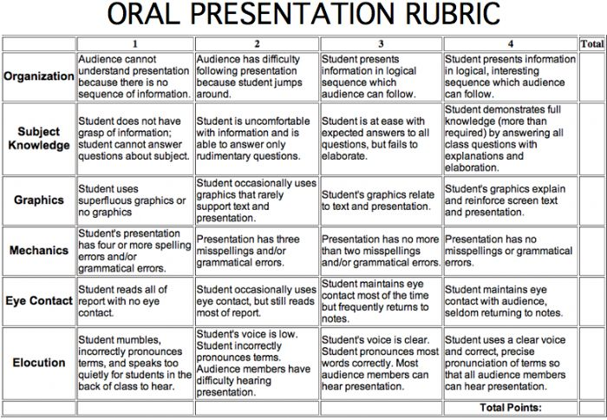

Slide 42
RESOURSES TIMELINES
https://s3.amazonaws.com/scschoolfiles/819/1600’s_timeline.pptx
https://s3.amazonaws.com/scschoolfiles/819/1700’s_timeline.pptx
https://s3.amazonaws.com/scschoolfiles/819/1800’s_timeline.pptx
ENCYCLOPEDIAS
https://www.britannica.com/
https://www.si.edu/explore
https://www.census.gov/history/www/through_the_decades/fast_facts/1900_fast_facts.html
http://www.encyclopedia.com/science-and-technology/computers-and-electrical-engineering/electrical-engineering/radio
LOG/DIARY
https://www.google.com/search?q=LOGS+DIARY+PAGES&rlz=1C1NHXL_enUS696US696&espv=2&tbm=isch&tbo=u&source=univ&sa=X&ved=0ahUKEwiMioLS8OLSAhWV0YMKHeQpDiIQsAQIGg&biw=1366&bih=638
BORDERS FOR LOG OR DIARY
https://www.google.com/search?q=BORDER&rlz=1C1NHXL_enUS696US696&source=lnms&tbm=isch&sa=X&ved=0ahUKEwjbq7-bkuPSAhWd2YMKHRCFCgIQ_AUICCgB&biw=1366&bih=638
https://s3.amazonaws.com/scschoolfiles/819/journal.docx
SOME TOPICS
https://www.doubledtrailers.com/45-random-amazing-bizarre-horse-facts/
http://www.encyclopedia.com/science-and-technology/computers-and-electrical-engineering/electrical-engineering/radio
https://www.thebalance.com/doctor-career-information-526008
http://learn.org/articles/Medical_Doctor_Education_Career_and_Salary_FAQs.html
ASSORTMENT
https://s3.amazonaws.com/scschoolfiles/819/february_02-27-2017b.pptx
https://s3.amazonaws.com/scschoolfiles/819/commonpersuasivetechniques.ppt
https://s3.amazonaws.com/scschoolfiles/819/summary_paraphrasing_quotes.pptx
https://s3.amazonaws.com/scschoolfiles/81

