Slide 1
Chapter 33
The Great Depression and the New Deal

Slide 2
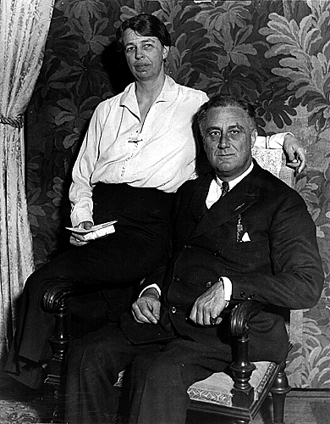
Election of1932
In 1932, voters had not seen economic improvement, and they wanted a new president.
President Herbert Hoover was nominated again without much enthusiasm
Said his policies prevented the Great Depression from being worse than it was.
Democrats nominated Franklin Delano Roosevelt
Tall, handsome, fifth cousin of famous Teddy Roosevelt
Suave and conciliatory (TR was pugnacious and confrontational)
FDR had been stricken with polio in 1921 and his wife, Eleanor, became his political partner.
Franklin lost a friend when he and Al Smith both sought the Democratic nomination.
Eleanor was to become the most active First Lady ever.
The Democrats found expression in the airy tune “Happy Days Are Here Again,” and clearly, the Democrats had the advantage in this race.
Noteworthy was the transition of the Black vote from the Republican to the Democratic Party.

Slide 3
FDR and the Three R’s: Relief, Recovery, and Reform
On Inauguration Day, FDR asserted, “The only thing we have to fear is fear itself.”
He called for a nationwide bank holiday to eliminate paranoid bank withdrawals, and then he commenced with his Three R’s.
The Democratic-controlled Congress was willing to do as FDR said, and the first Hundred Days of FDR’s administration were filled with more legislative activity than ever before.
Many of the New Deal Reforms had been adopted by European nations a decade before.

Slide 4
Money Reform
The Emergency Banking Relief Act of 1933 was passed first. FDR declared a one week “bank holiday” just so everyone would calm down and stop running on the banks.
Roosevelt settled down for the first of his thirty famous “Fireside Chats” with America and reassured people it was safer to put money in the bank than hidden in their houses.
The “Hundred Days Congress” passed the Glass-Steagall Banking Reform Act (gave FDR the power to run the bank) - provided the Federal Deposit Insurance Corporation (FDIC) which insured individual deposits up to $5000, thereby eliminating the epidemic of bank failure and restoring faith to banks.
FDR then took the nation off of the gold standard and achieved controlled inflation by ordering Congress to buy gold at increasingly higher prices.
FDR wanted to stop people from hoarding gold.
In February 1934, he announced that the U.S. would pay foreign gold at a rate of one ounce of gold per every $35 due.
He urged people to turn in gold for paper money.
He wanted inflation, to make debt payment easier, and urged the Treasury to buy gold with paper money.

Slide 5
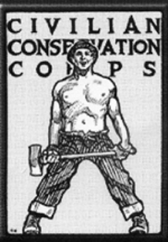
Civilian Conservation Corp (CCC)
Roosevelt had no qualms about using federal money to assist the unemployed, so he created the Civilian Conservation Corps (CCC), which provided employment in fresh-air government camps for about 3 million uniformed young men.
They reforested areas, fought fires, drained swamps, controlled floods, etc.
However, critics accused FDR of militarizing the youths and acting as dictator.

Slide 6
More Alphabet Soup
The Federal Emergency Relief Act looked for immediate relief rather than long-term alleviation, and its Federal Emergency Relief Administration (FERA) was headed by the zealous Harry L. Hopkins.
The Agricultural Adjustment Act (AAA) made available many millions of dollars to help farmers meet their mortgages.
The Home Owners’ Loan Corporation (HOLC) refinanced mortgages on non-farm homes and bolted down the loyalties of middle class, Democratic homeowners.
The Civil Works Administration (CWA) was established late in 1933, and it was designed to provide purely temporary jobs during the winter emergency.
Many of its tasks were rather frivolous (called “boondoggling”) and were designed for the sole purpose of making jobs.

Slide 7
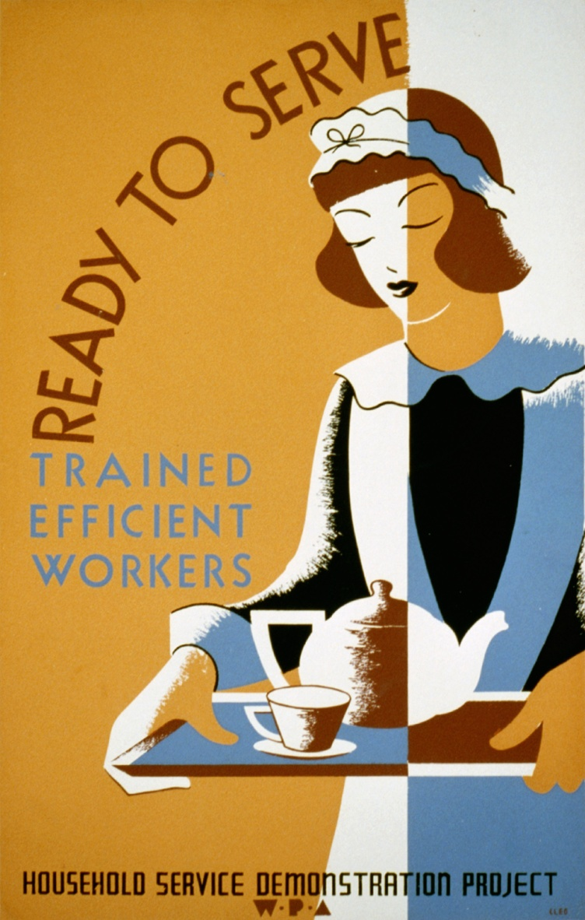
Works Progress Administration (WPA)
Congress also authorized the WPA in 1935, which put $11 million on thousands of public buildings, bridges, and hard-surfaced roads and gave 9 million people jobs in its eight years of existence.
It also found part-time jobs for needy high school and college students and for actors, musicians, and writers.
John Steinbeck counted dogs (boondoggled) in his California home of Salinas county.

Slide 8
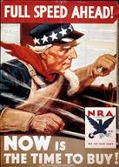
National Recovery Administration (NRA)
By far the most complicated of the programs
Designed to assist industry, labor, and the unemployed.
There were maximum hours of labor, minimum wages, and more rights for labor union members, including the right to choose their own representatives in bargaining.

Slide 9
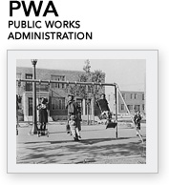
Public Works Administration (PWA)
The Public Works Administration (PWA) also intended both for industrial recovery and for unemployment relief.
Headed by Secretary of the Interior Harold L. Ickes, it aimed at long-range recovery by spending over $4 billion on some 34,000 projects that included public buildings, highways, and parkways (i.e. the Grand Coulee Dam of the Columbia River).

Slide 10
People of the New Deal
One FDR spokesperson was Father Charles Coughlin, a Catholic priest in Michigan who at first was with FDR then disliked the New Deal and voiced his opinions on radio.
Senator Huey P. Long of Louisiana was popular for his “Share the Wealth” program. Proposing “every man a king,” each family was to receive $5000, allegedly from the rich. The math of the plan was ludicrous.
His chief lieutenant was former clergyman Gerald L. K. Smith.
He was later shot by a deranged medical doctor in 1935.
Dr. Francis E. Townsend of California attracted the trusting support of perhaps 5 million “senior citizens” with his fantastic plan of each senior receiving $200 month, provided that all of it would be spent within the month. Also, this was a mathematically silly plan.

Slide 11
New Deal Women
Ballots newly in hand, women struck up new roles.
First Lady Eleanor Roosevelt was the most visible
Sec. of Labor Frances Perkins was the first female cabinet member
Mary McLeod Bethune headed the Office of Minority Affairs in the NYA, the “Black Cabinet”, and founded a Florida college.
Anthropologist Ruth Benedict helped develop the “culture and personality movement” and her student Margaret Mead reached even greater heights with Coming of Age in Samoa.
Pearl S. Buck wrote a beautiful and timeless novel, The Good Earth, about a simple Chinese farmer which earned her the Nobel Prize for literature in 1938.

Slide 12
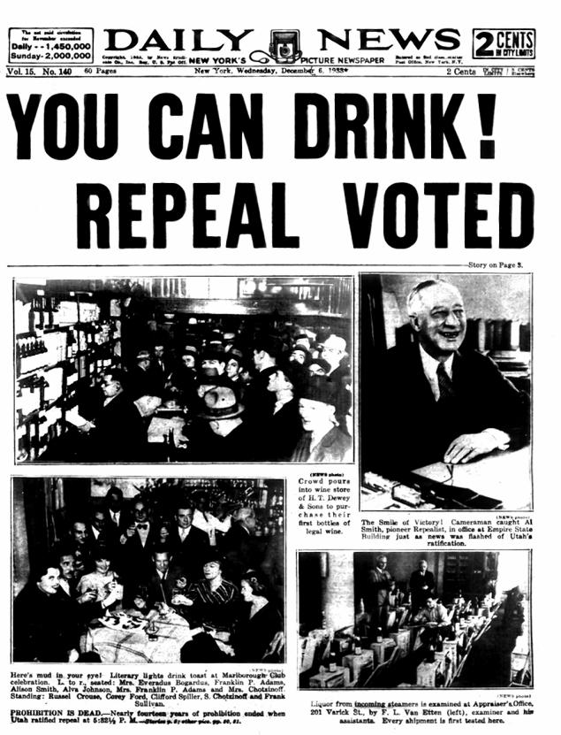
End of Prohibition
One of the Hundred Days Congress’s earliest acts was to legalize light wine and beer with an alcoholic content of 3.2% or less and also levied a $5 tax on every barrel manufactured.
Prohibition was officially repealed with the 21st Amendment.

Slide 13
Agricultural Adjustment Administration (AAA)
Established by Congress to help the farmers, which had been suffering ever since the end of World War I
Paid farmers to reduce their crop acreage and would eliminate price-depressing surpluses.
However, it got off to a rocky start when it killed lots of pigs for no good reason, and paying farmers not to farm actually increased unemployment.
The Supreme Court killed it in 1936.

Slide 14
Soil Conservation and Domestic Allotment Act
1936
Paid farmers to plant soil-conserving plants like soybeans or to let their land lie fallow.
The Second Agricultural Adjustment Act of 1938 was a more comprehensive substitute that continued conservation payments but was accepted by the Supreme Court.

Slide 15
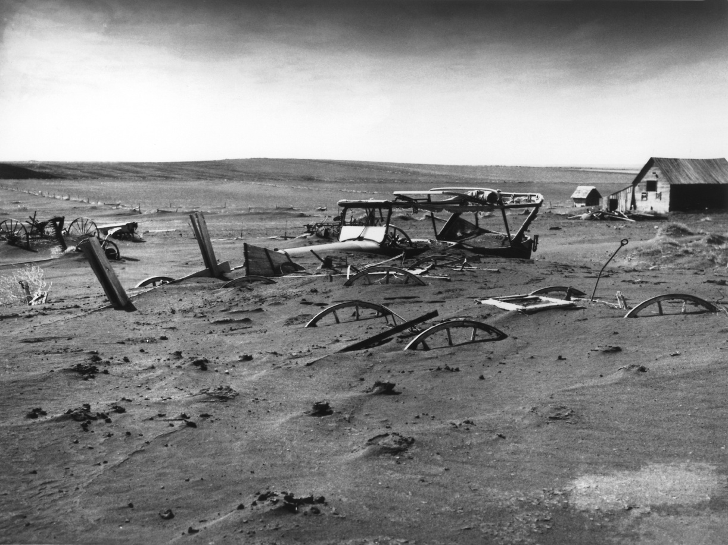
Dust Bowl
After the drought of 1933, furious winds whipped up dust into the air, turning parts of Missouri, Texas, Kansas, Arkansas, and Oklahoma into the Dust Bowl and forcing many farmers to migrate west to California
Inspired Steinbeck’s classic The Grapes of Wrath.
The dust was very hazardous to the health and to living, creating further misery.
The Frazier-Lemke Farm Bankruptcy Act, passed in 1934, made possible a suspension of mortgage foreclosure for five years, but it was voided in 1935 by the Supreme Court.
In 1935, FDR set up the Resettlement Administration, charged with the task of removing near-farmless farmers to better land.

Slide 16
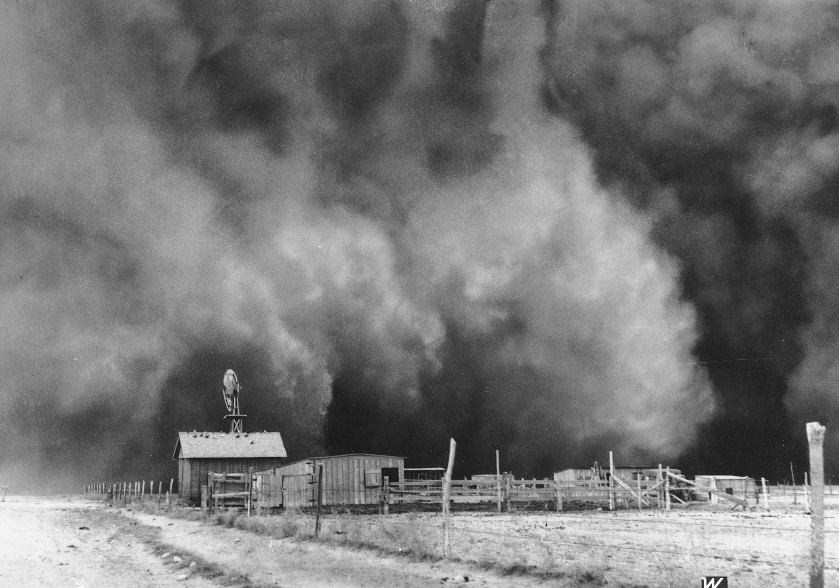

Slide 17
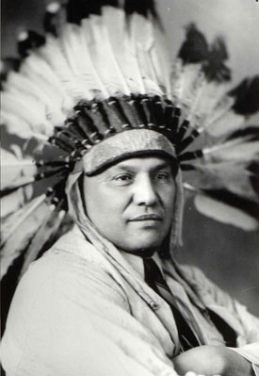
Native Americans
Commissioner of Indian Affairs was headed by John Collier who sought to reverse the forced-assimilation policies in place since the Dawes Act of 1887.
He promoted the Indian Reorganization Act of 1934 (the Indian “New Deal”), which encouraged tribes to preserve their culture and traditions.
Not all Indians liked it though, saying if they followed this “back-to-the-blanket” plan, they’d just become museum exhibits. 77 tribes refused to organize under its provisions (200 did).

Slide 18
Controlling Big Business
The Federal Securities Act (“Truth in Securities Act”) required promoters to transmit to the investor sworn information regarding the soundness of their stocks and bonds.
The Securities and Exchange Commission (SEC) was designed as a stock watchdog administrative agency, and stock markets henceforth were to operate more as trading marts than as casinos.
In 1932, Chicagoan Samuel Insull’s multi-billion dollar financial empire had crashed, and such cases as his resulted in the Public Utility Holding Company Act of 1935.

Slide 19

Tennessee Valley Authority (TVA)
The sprawling electric-power industry attracted the fire of New Deal reformers.
New Dealers accused it of gouging the public with excessive rates.
Thus the TVA (1933) sought to discover exactly how much money it took to produce electricity and then keep rates reasonable.
It constructed dams on the Tennessee River and helped the 2.5 million extremely poor citizens of the area improve their lives and their conditions.
Hydroelectric power of Tennessee would give rise to that of the West.

Slide 20

Housing Reform
To speed recovery and better homes, FDR set up the Federal Housing Administration (FHA) in 1934 to stimulate the building industry through small loans to householders.
It was one of the “alphabetical” agencies to outlast the age of Roosevelt.
Congress bolstered the program in 1937 by authorizing the U.S. Housing Authority (USHA), designed to lend money to states or communities for low-cost construction.
This was the first time in American history that slum areas stopped growing.

Slide 21

Social Security
The Social Security Act of 1935 was the greatest victory for New Dealers, since it created pension and insurance for the old-aged, the blind, the physically handicapped, delinquent children, and other dependents by taxing employees and employers.
Republicans attacked this bitterly, as such government-knows-best programs and policies that were communist leaning and penalized the rich for their success. They also opposed the pioneer spirit of “rugged individualism.”

Slide 22
“New Deal” for Labor
A rash of walkouts occurred in the summer of 1934, and after the NRA was axed, the Wagner Act (AKA, National Labor Relations Act) of 1935 took its place. The Wagner Act guaranteed the right of unions to organize and to collectively bargain with management.
Under the encouragement of a highly sympathetic National Labor Relations Board, unskilled laborers began to organize themselves into effective unions, one of which was John L. Lewis, the boss of the United Mine Workers who also succeeded in forming the Committee for Industrial Organization (CIO) within the ranks of the AF of L in 1935.
The CIO later left the AF of L and won a victory against General Motors.
The CIO also won a victory against the United States Steel Company, but smaller steel companies struck back, resulting in such incidences as the Memorial Day Massacre of 1937 at the plant of the Republic Steel Company of South Chicago in which police fired upon workers, leaving scores killed or injured.
In 1938, the Fair Labor Standards Act (AKA the “Wages and Hours Bill”) was passed, setting up minimum wage and maximum hours standards and forbidding children under the age of sixteen from working.
Roosevelt enjoyed immense support from the labor unions.
In 1938, the CIO broke completely with the AF of L and renamed itself the Congress of Industrial Organizations (the new CIO).

Slide 23
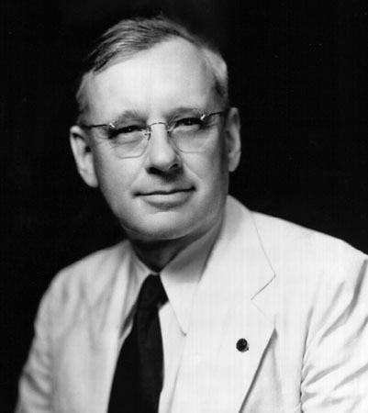
Election of 1936
The Republicans nominated Kansas Governor Alfred M. Landon to run against FDR.
Landon was weak on the radio and weaker in personal campaigning, and while he criticized FDR’s spending, he also favored enough of FDR’s New Deal to be ridiculed by the Democrats as an unsure idiot.
In 1934, the American Liberty League had been formed by conservative Democrats and wealthy Republicans to fight “socialistic” New Deal schemes.
Roosevelt won in a huge landslide, getting 523 electoral votes to Landon’s 8.
FDR won primarily because he appealed to the “forgotten man,” whom he never forgot.

Slide 24
Supreme Court Change?
The 20th Amendment had cut the lame-duck period down to six weeks, so FDR began his second term on January 20, 1937, instead of on March 4. He controlled Congress, but the Supreme Court kept blocking his programs, so he proposed a shocking plan that would add a member to the Supreme Court for every existing member over the age of 70, for a maximum possible total of 15 total members.
For once, Congress voted against him because it did not want to lose its power.
Roosevelt was ripped for trying to become a dictator.

Slide 25
A Switch in Time Saves Nine
FDR’s “court-packing scheme” failed, but he did get some of the justices to start to vote his way, including Owen J. Roberts, formerly regarded as a conservative.
So, FDR did achieve his purpose of getting the Supreme Court to vote his way.
However, his failure of the court-packing scheme also showed how Americans still did not wish to tamper with the sacred justice system.

Slide 26
Effects of the New Deal at the end of FDR’s First Term
During Roosevelt’s first term, the depression did not disappear, and unemployment, down from 25% in 1932, was still at 15%.
In 1937, the economy took another brief downturn when the “Roosevelt Recession,” caused by government policies.
Finally, FDR embraced the policies of British economist John Maynard Keynes.
In 1937, FDR announced a bold program to stimulate the economy by planned deficit spending.
In 1939, Congress relented to FDR’s pressure and passed the Reorganization Act, which gave him limited powers for administrative reforms, including the key new Executive Office in the White House.
The Hatch Act of 1939 barred federal administrative officials, except the highest policy-making officers, from active political campaigning and soliciting.

Slide 27
Foes of the New Deal condemned its waste, citing that nothing had been accomplished.
Critics were shocked by the “try anything” attitude of FDR, who had increased the federal debt from $19.487 million in 1932 to $40.440 million in 1939.
It took World War II, though, to really lower unemployment. But, the war also created a heavier debt than before.
New Dealers claimed that the New Deal had alleviated the worst of the Great Depression.
FDR also deflected popular resent against business and may have saved the American system of free enterprise, yet business tycoons hated him.
He provided bold reform without revolution.
Later, he would guide the nation through a titanic war in which the democracy of the world would be at stake.

