Slide 1
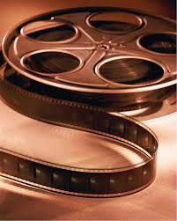
History of Film
From 1830 to Today

Slide 2
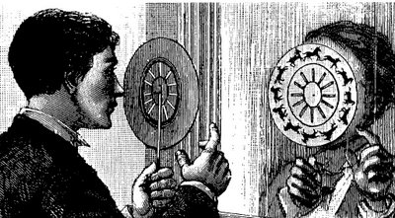
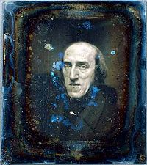
1832
The Phenakistoscope, a spinning wheel with an image at it’s center that seems to move, is invented by Joseph Plateau in Belgium.

Slide 3
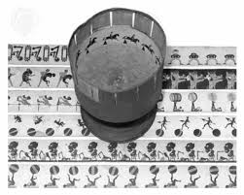
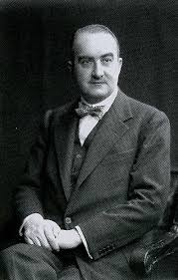
1834
William Horner refines Plateau’s Phenakistoscope into the Zeotrope.

Slide 4
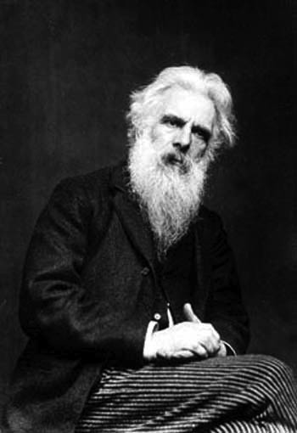
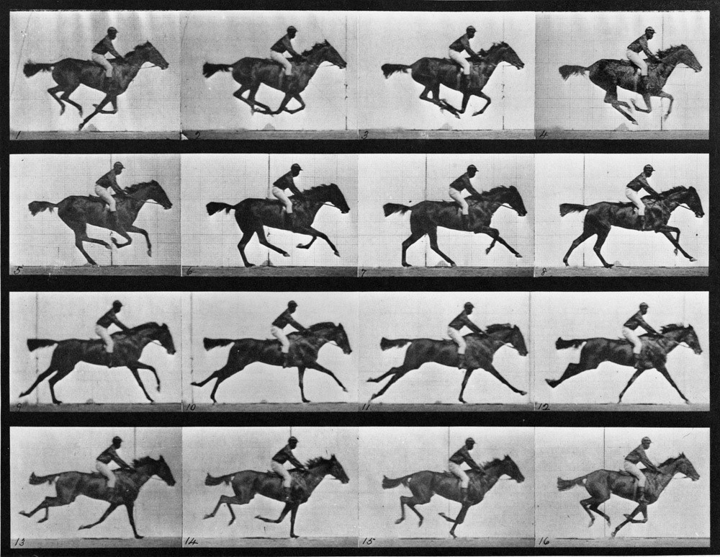
1872
Edweard Muybridge shoots his famous series of still images of a horse in motion to settle a bet; when viewed in sequence, the stills form a primitive movie.

Slide 5
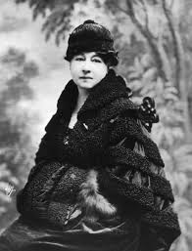
1873
Alice Guy, the first woman
film director, is born in France.

Slide 6
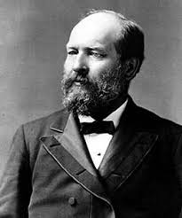
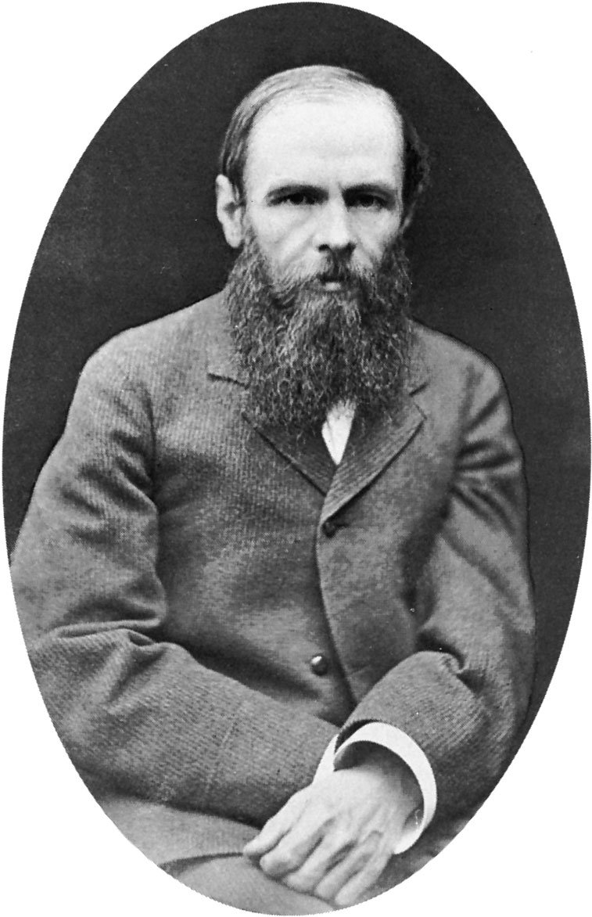
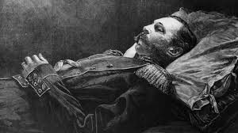
1881
U.S. President James Garfield is assassinated.
Fyodor Dostoevsky dies.
Czar Alexander II of Russia is assassinated.

Slide 7
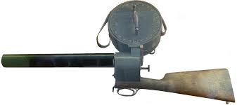
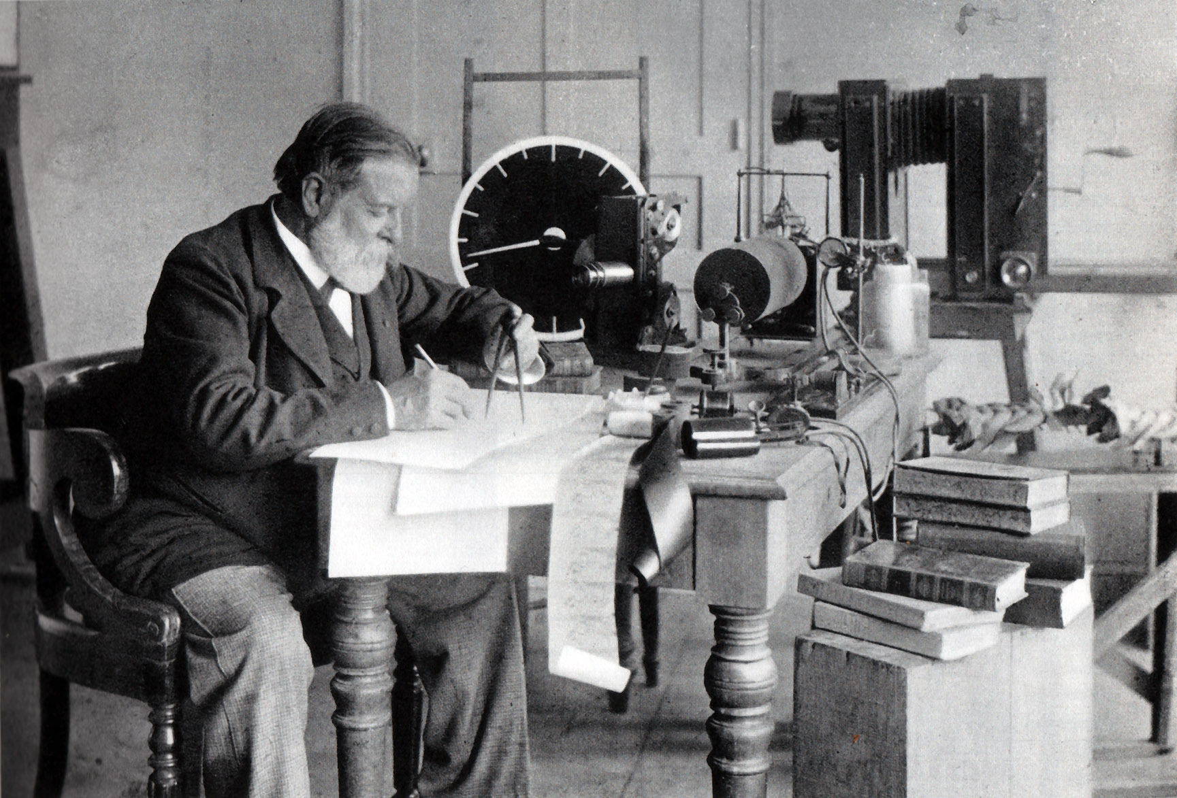
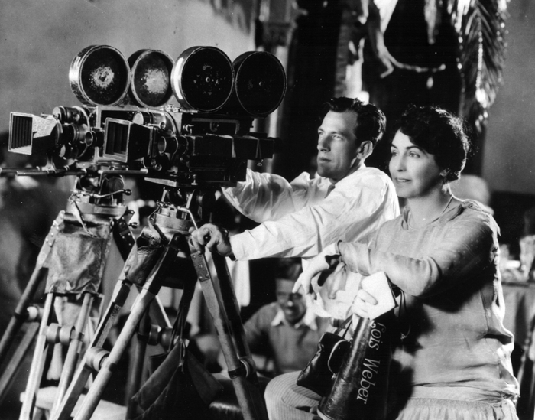
1882
Etienne-Jules Marey invents his “shotgun” camera.
Birth of Director Lois Weber.

Slide 8
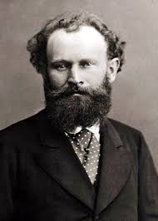
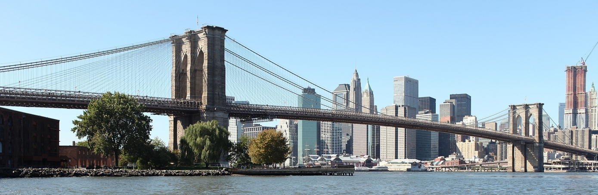
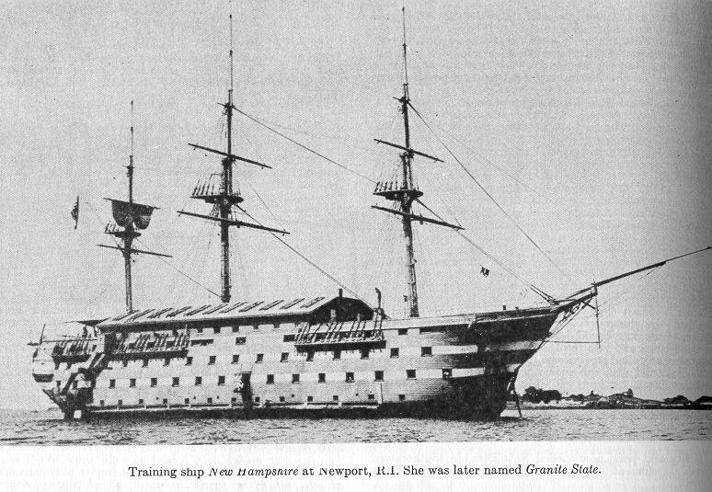
1883
The French Impressionist painter Edouard Manet dies.
The Brooklyn Bridge opens.
The birth of the US Navy, with construction of 3 battleships.

Slide 9
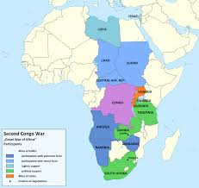
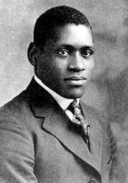
1884
Belgium opens Congo to Free trade, under colonial rule of King Leopold.
Birth of African American
filmmaker Oscar Micheaux.

Slide 10
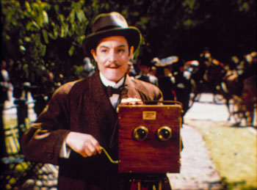
1886
British Film pioneer William Friese-Greene
Begins work on a motion picture
Camera and projector.

Slide 11
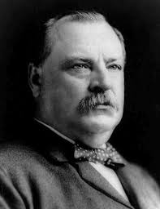
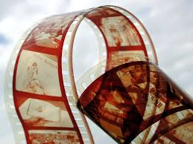
1887
President Grover Cleveland signs interstate
Commerce Act, regulating railroads.
Celluloid nitrate film is invented.

Slide 12
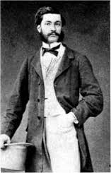
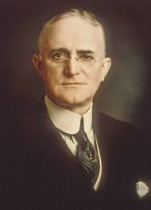
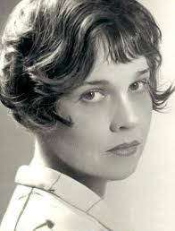
1888
Inventor Louis Aime Aigistin Le Prince shoots a short film of traffic on a bridge in Leeds, England. It is the first movie ever shot and then shown to the public.
George Eastman produces the first lightweight camera and trademarks the Kodak name.
Anita Loos, American Screenwriter, is born.

Slide 13
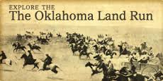
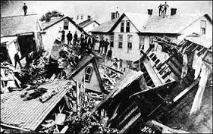
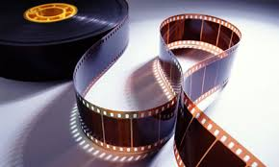
1889
Oklahoma Land Run
The Johnstown Flood in Pennsylvania kills 2000 people when the dam bursts.
George Eastman manufactures celluloid film role.

Slide 14
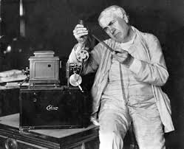
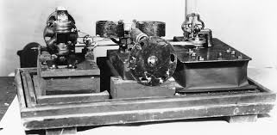
1890
William Kennedy Laurie Dickson builds the first modern movie camera, the Kinetograph, under instructions from Thomas Alva Edison.

Slide 15
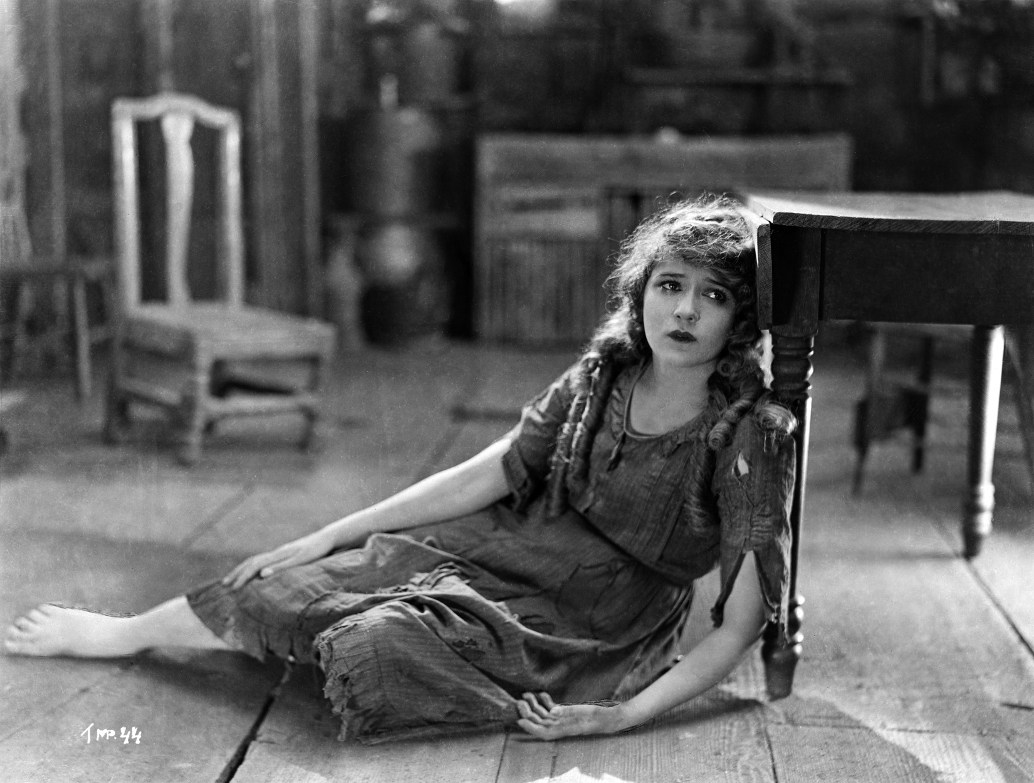
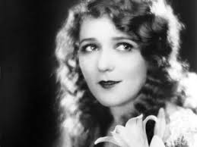
1893
Mary Pickford, silent screen star, is born.

Slide 16
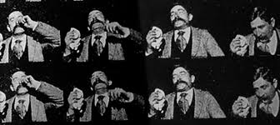
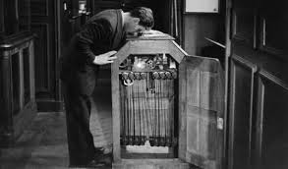
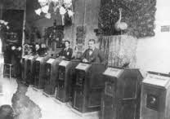
1894
Thomas Edison shoots Fred Ott’s Sneeze in his Black Maria.
The first Kinetoscope parlor opens in New York.

Slide 17
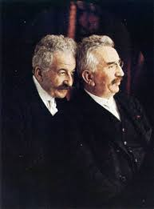
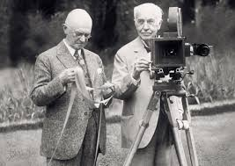
1895 *
*Auguste and Louis Lumiere hold the first public screening of their films.

Slide 18
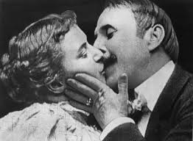
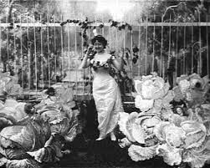
1896*
Alice Guy directs her first film, The Cabbage Patch Fairy.
Thomas Edison shoots *The Kiss, the first kiss in screen history.

Slide 19
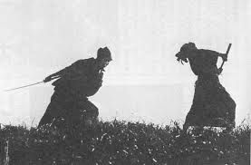
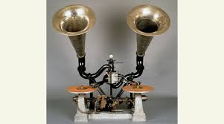
1898
Alice Guy shoots primitive sound films in France using the Chronophone process.
The first films are shot in Japan.

Slide 20
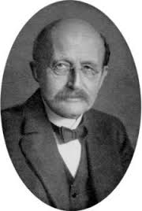
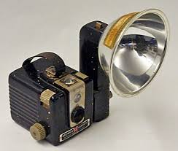
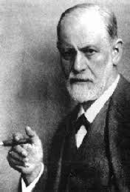
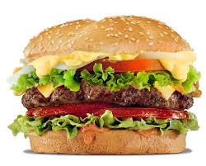
1900
Max Planck formulates quantum theory.
Kodak introduces the Brownie camera.
The Boxer Rebellion in China.
Sigmund Freud publishes The Interpretation of Dreams.
The hamburger is invented.

Slide 21
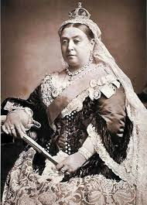
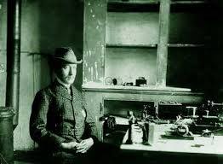
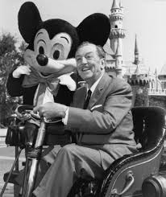
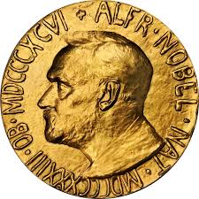
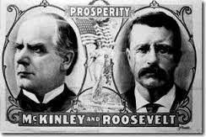
1901
Queen Victoria dies.
The first transatlantic radio signal.
Walt Disney is born.
The first Nobel Prizes are awarded.
U.S. President William McKinley is assassinated; Theodore Roosevelt becomes president.

Slide 22





1902*
Director William Wyler is born.
Mount Pelee erupts in Martinique.
The teddy bear is introduced, in homage to Theodore Roosevelt.
Georges Melies has a hit with is special effects extravaganza *A trip to the Moon.

Slide 23




1903*
The Wright brothers make their first airplane flight at Kitty Hawk, North Carolina.
The ice cream cone is patented.
The first World Series is played.
*The Great Train Robbery is filmed by director Edwin S. Porter. U.S. film production is centered in New York and New Jersey.

Slide 24




1904
The milkshake mixer is invented.
Construction starts on the Panama Canal.
The Trans-Siberian Railway is completed.
The New York City subway opens.

Slide 25





1905
Actress Greta Garbo is born.
First U.S. pizza parlor opens.
Einstein proposes the Special Theory of Relativity.
Cecil Hepworth produces and directs Reduced by Rover in England.

Slide 26





1906*
Upton Sinclair writes The Jungle, exposing conditions in meatpacking plants.
San Francisco earthquake occurs.*
The Biograph Film Studio opens in New York.
Edwin S. Porter directs the trick fantasy film Dream of a Rarebit Fiend.
Elvira Notari, Italy’s first woman director, begins making films.

Slide 27






1907
Pablo Picasso introduces Cubism.
First electric washing machine.
Edwin S. Porter directs Rescued from an Eagle’s Nest, starring future director D. W. Griffith.

Slide 28



1908
There are more than 8,000 nickelodeon movie theaters nationwide in the United States.
Ford introduces the Model- T automobile, in “any color you want, so long as it’s black”.
Earthquake in Italy kills 150,000.
Thomas Edison forms “The Trust” to monopolize motion pictures.
D.W. Griffth directs his first one-reel film, The Adventures of Dollie.”

Slide 29




1909
NAACP Founded
Plastic is invented.
There are 9,000 movie theaters in US.
35 mm becomes the internationally recognized theatrical film guage.

Slide 30




1910
Boy Scouts established
Thomas Edison presents his own sound film process, Kinetophone.
Florence Lawrence becomes the first real movie star for IMP (Independent Moving Pictures) as a result of Carl Laemmle’s publicity campaign.
D.W. Griffith shoots In Old California in Hollywood, the move west has begun. (John Wayne remade this movie in 1942).

Slide 31


Cont. 1910
Alice Guy founds Solax, her production company, after moving to the US.
The first African American film production company, William Foster’s , Fosters Photoplay Company, opens doors in Chicago.

Slide 32





1911
Standard Oil Company is broken up.
The Incan City of Machu Picchu is discovered.
Earnest Rutherford discovers structure of an atom.

Slide 33




1912
The Titanic sinks.
SOS universal distress signal.
Birth of Photoplay, the first movie “fan” magazine.
Carl Leammle forms Universal Pictures Company.
Mark Sennett sets up shop as the Keystone Film Company and begins making slapstick comedy.

Slide 34





1913
The zipper is invented.
Henry Ford creates the assembly line.
Income Tax in introduced in US
First crossword puzzle
LA Owens Valley aqueduct is opened.

Slide 35







1914
Archduke Ferdinand is assassinated; World War 1 begins.
The Panama Canal officially opens.
Cecil B. DeMille’s The Squaw Man is the first Hollywood feature film.
Charlie Chaplin’s tramp character first appears in Kid Auto Races at Venice.
Lois Weber’s feature-length parable The Hypocrites opens.

Slide 36




1915
D. W. Griffith’s The Birth of a Nation is released.
Theda Bara, one of the movies’ first “vamps”, stars in A Fool There Was.
Louis Feuillade directs the epic French crime serial The Vampires.
The Technicolor Corporation opens for business.

Slide 37




1916
Battle of Verdun.
The first self-service grocery store opens in the U.S.
Lois Weber’s film on abortion, Where Are My Children? opens to great controversy.

Slide 38





1917
The U.S. enters World War I
The Lincoln Motion Picture Company, a pioneering African American film studio, is founded.
John Ford directs his first film, The Tornado.
UFA, the giant German film studio, opens its doors.

Slide 39




1918
Influenza epidemic. (estimated 50 million died)
Daylight Savings Time is introduced.
Russian Czar Nicholas II and his family are killed.
The U.S. Supreme Court orders the Edison “Trust” to dissolve.

Slide 40





1919
Prohibition begins in the U.S.
Treaty of Versailles ends WWI.
Walt Disney and Ub Iwerks join forces as an animation team to make cartoons.
Robert Wiene directs the classic horror film The Cabinet of Dr. Caligari in Germany.
Oscar Micheaux directs his feature-length Within Our Gates.

Slide 41






1920*
The Harlem Renaissance begins.
The first commercial radio.
Women are granted the right to vote in the U.S.
Charlie Chaplin, Douglas Fairbanks, D. W. Griffith, and Mary Pickford form United Artists. Broken Blossoms (1st film)*
Alice Guy directs her 248th and final film, the feature length Tarnished Reputations.

Slide 42



1921
Rudolph Valentino stars in the steamy romantic melodrama The Sheik.
Comedian Roscoe “Fatty” Arbuckle is arrested for rape and murder; he is later acquainted, but the scandal rocks Hollywood.
Lois Weber’s The Blot, a plea for social tolerance, opens.

Slide 43




1922*
Reader’s Digest begins production.
Robert Flaherty completes the pioneering documentary Nanook of the North.
F. W. Murnau directs the classic vampire film Nosferatu in Germany.*
Rin Tin Tin becomes an animal star, predating Lassie by several decades.

Slide 44




1923
Time magazine is founded.
Warner Brothers if founded.
Lee de Forest demonstrates Phonofilm, his sound-on-film process, which will eventually become the industry standard.
Cecil B. DeMille directs first version of “The Ten Commandments”.

Slide 45




1924
The first Olympic winter games.
J. Edgar Hoover is appointed as FBI director.
Erich von Strocheim completes his epic film Greed, released in a brutally cut version.
Sam Goldwyn, Louis B. Mayer, and the Metro Pictures Corporation create MGM.

Slide 46




1925*
Adolf Hitler publishes Mein Kampf.
The Scopes monkey trail puts the theory of evolution in the public eye.
Universal releases Phantom of the Opera with Lon Chaney Sr., The Man of 1,000 Faces.”
Charles Chaplin writes, stars in, directs, and produces the classic comedy The Gold Rush.*

Slide 47






1926*
A. A. Milne publishes Winnie-the-Pooh.
Magician Harry Houdini dies.
Robert Goddard fires his first liquid-fuel rocket.
Warner Bros. debuts the film Don Juan with synchronized effects and music.
Death of screen romantic idol Rudolph Valentino.
Buster Keaton films The General.*

