Slide 1

La Joya ISD Learning Recovery and Acceleration Plan for the 2021 – 2022 School Year
Community & School Board Presentation
July 19, 2021

Slide 2
Resilient Schools Support Program (RSSP) Presentation on Identified Student and Staff Needs Created by the COVID-19 Pandemic

Slide 3
District Overview
Vision
“​Educational Excellence is the Right of Every Student.”
Mission
La Joya Independent School District is committed to providing Educational Excellence through rigor, relevance, relationships and personal responsibility. We are the integral part of learning where students become successful and productive contributors to our global society. We embrace, with passion, the commitment to continuous improvement, collaboration and accountability that will allow our students to imprint the world.

Slide 4
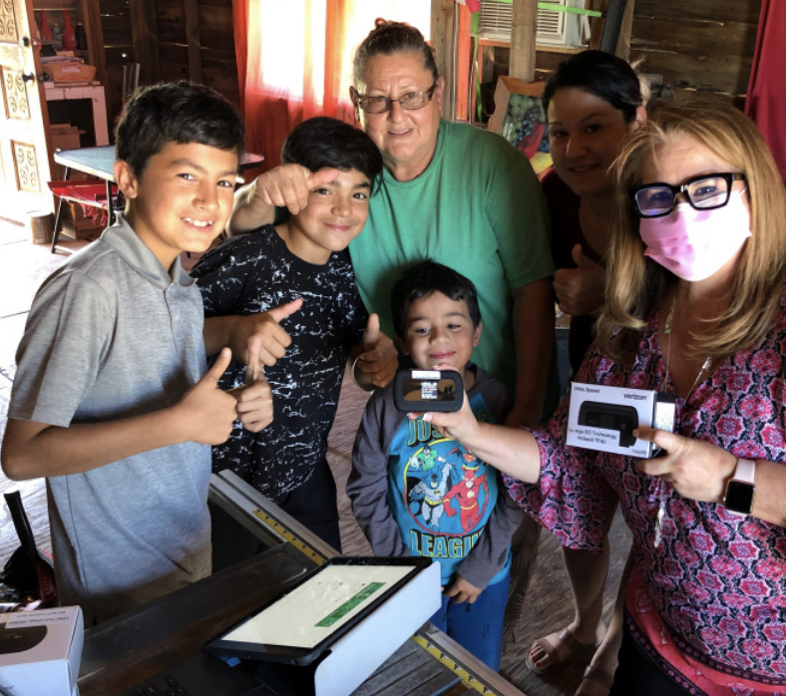
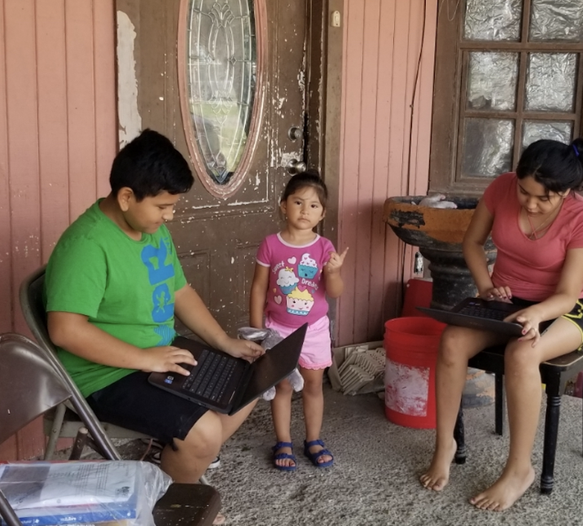
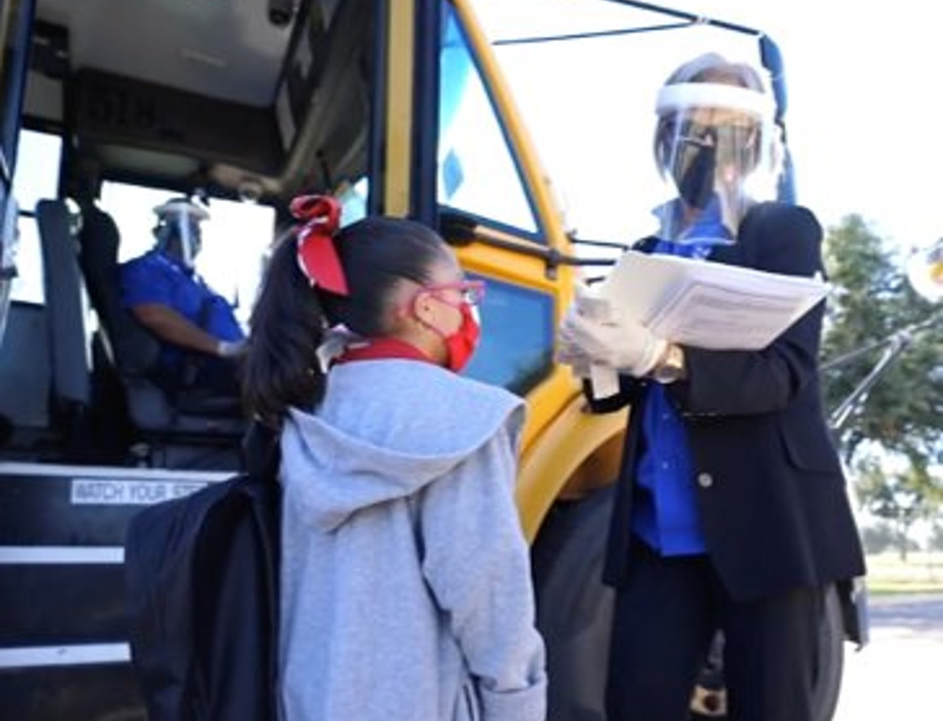
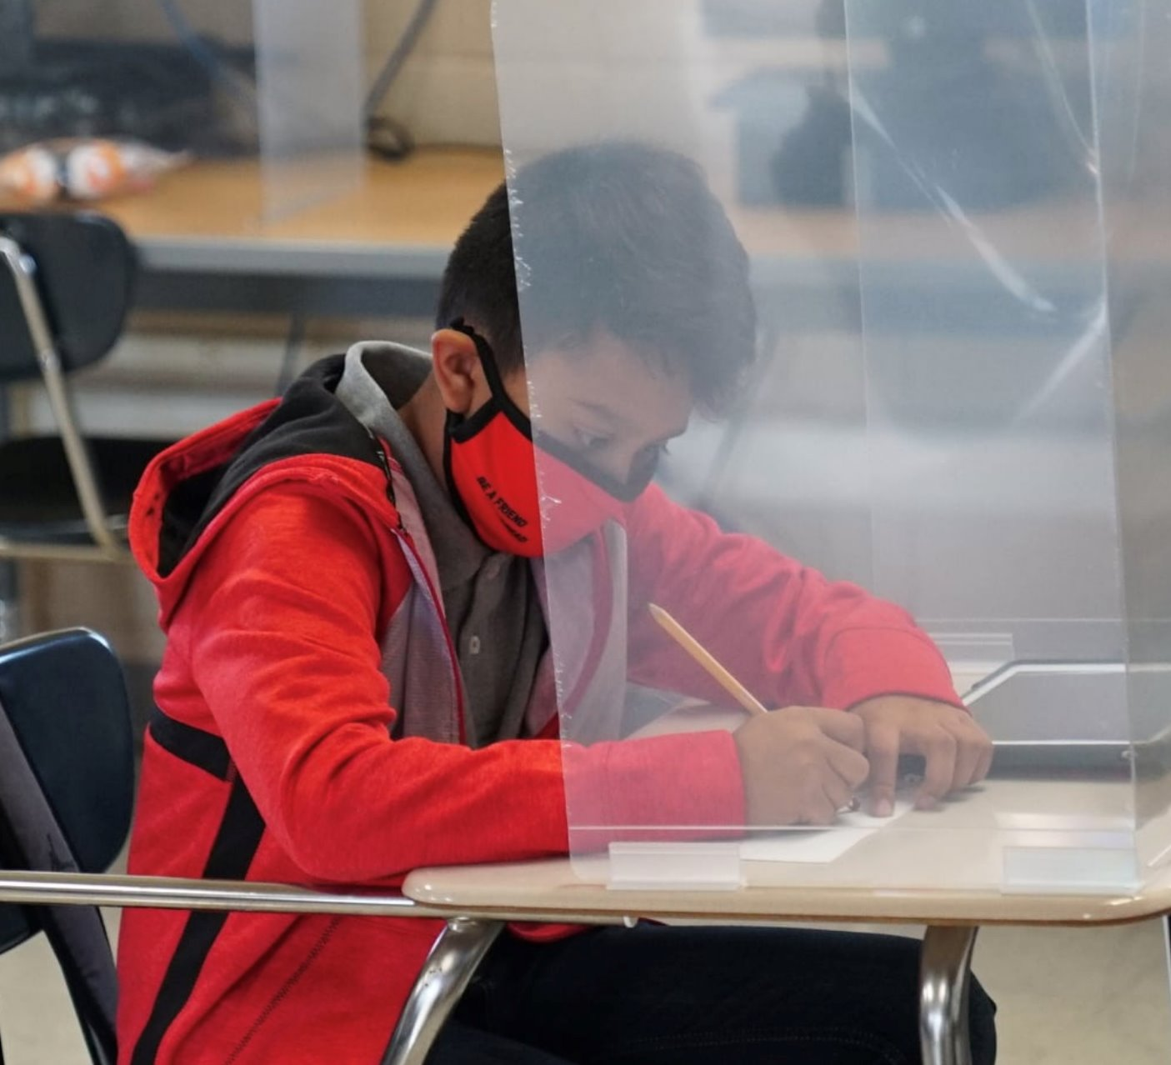
District/Community Challenges
Over the past two school years, the La Joya ISD school community experienced significant challenges associated with COVID-19.

Slide 5



Looking ahead, our community will continue to have significant needs across three key areas:
Learning Recovery
Social-Emotional Supports
Health and Wellness

Slide 6

Addressing Challenges: RSSP
To begin to address the needs related to unfinished learning, La Joya joined the Resilient Schools Support Program (RSSP) supported by TEA. Our district received customized technical assistance over the course of April - June to craft a COVID-19 recovery and acceleration plan that implemented continuous improvement cycles. Our recovery plan approach is one that is inclusive and supportive of the broader school community, particularly campus leaders, teachers, and families.

Slide 7
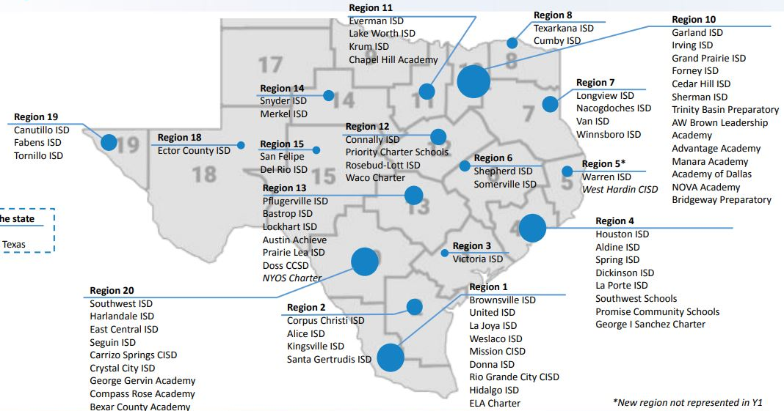
As one way to address unfinished learning, La Joya joined the TEA’s Resilient Schools Support Program [RSSP]

Slide 8
RSSP Planning Process
RSSP Project Timeline:
Phase | Essential Question
0. Project Set Up | How will we organize ourselves to do this work?
1. Analyze Student Data | What is the data telling us?
2. Understand Stakeholder Needs | What is our community telling us?
3. Make Key Decisions | What is our high level plan to address our community's needs over the next 12-18 months?
4. Identify Short Term Actions | What needs to happen in the next 1-2 months to make this plan possible?
5. Align to Other Work | How does our Recovery and Acceleration plan connect to other work in our LEA?
6. Share Plan with Community | What have we decided and why?

Slide 9
RSSP Project Set Up
Phase | Essential Question
0. Project Set Up | How will we organize ourselves to do this work?
1. Analyze Student Data | What is the data telling us?
2. Understand Stakeholder Needs | What is our community telling us?
3. Make Key Decisions | What is our high level plan to address our community's needs over the next 12-18 months?
4. Identify Short Term Actions | What needs to happen in the next 1-2 months to make this plan possible?
5. Align to Other Work | How does our Recovery and Acceleration plan connect to other work in our LEA?
6. Share Plan with Community | What have we decided and why?

Slide 10
RSSP: Project Set Up
Create a district-wide Learning Acceleration Taskforce:
The task force met weekly since April 23
It was comprised of approximately 30 members representing campuses and central office departments
The purpose of this task force was to review academic and stakeholder survey data and build a research-based plan to accelerate student learning

Slide 11
District-Wide Taskforce to plan to address unfinished learning for SY21-22
La Joya ISD Learning Recovery and Acceleration Taskforce
Elementary Planning Committee
Middle School Planning Committee
High School Planning Committee
District-level Leadership + Support

Slide 12
RSSP Planning Committee
District Level | Elementary | Middle School | High School
Dr. Gisela Saenz Martin Munoz Ricardo Villarreal | Executive Directors Content Coordinators Principals Assistant Principals Teachers | Executive Directors Content Coordinators Principals Assistant Principals Teachers | Executive Directors Content Coordinators Principals Assistant Principals Teachers

Slide 13
RSSP Analyzing Student Data
Phase | Essential Question
0. Project Set Up | How will we organize ourselves to do this work?
1. Analyze Student Data | What is the data telling us?
2. Understand Stakeholder Needs | What is our community telling us?
3. Make Key Decisions | What is our high level plan to address our community's needs over the next 12-18 months?
4. Identify Short Term Actions | What needs to happen in the next 1-2 months to make this plan possible?
5. Align to Other Work | How does our Recovery and Acceleration plan connect to other work in our LEA?
6. Share Plan with Community | What have we decided and why?

Slide 14
Analyzing Data: District Overview
La Joya ISD serves approximately 26,532 students in over 42 campuses:
23 Elementary Campuses
8 Middle School Campuses
3 Comprehensive High School Campuses
7 Specialty Schools
Head Start Program

Slide 15
Analyzing Data: District Overview
Student demographics
91.39% Economically Disadvantaged
77.6% At-Risk
56.64% Limited English Proficient
99% Hispanic
3,202 Special Education
435 Homeless
36 Foster Care

Slide 16
Analyzing Data: District Overview
Staff demographics
291 Instructional Assistants
1,889 Teachers
84 Counselors
27 SE Diagnosticians
2 Dyslexia Diagnosticians
109 Campus Administrators

Slide 17
Analyzing Data: Early Childhood Literacy
Grade | Data Measure | Reading |  | Difference
 |  | 2018-2019 | 2020-2021
PK | Rapid Letter Naming | 35 letters/avg. | 18 letters/avg | -17
KG | Fluency | 82% of students read 30+ wcpm | 35% of students read 30+ wcpm | -47% pts
1st | Fluency | 70% of students read 50-60+ wcpm | 33% of students read 50-60+ wcpm | -37% pts
2nd | Fluency | 64% of students read 80-90+ wcpm | 40% of students read 80-90+ wcpm | -24% pts
In the area of reading, in PK – 2nd, data indicates that school closures and disruptions in school year 19-20 and 20-21 resulted in unfinished learning and learning gaps.

Slide 18
Analyzing Data: Reading Data
Grade | Data Measure | All Students |  |  | ELL Students |  |  | SE Students |  |  | GT Students
 |  | Reading |  | Difference | Reading |  | Difference | Reading |  | Difference | Reading |  | Difference
 |  | 2018-2019 | 2020-2021 |  | 2018-2019 | 2020-2021 |  | 2018-2019 | 2020-2021 |  | 2018-2019 | 2020-2021
3rd | STAAR Comprehension | 77% | 38% | -39 | 75% | 36% | -39 | 38% | 29% | -9 | 100% | 66% | -34
4th | STAAR Comprehension | 72% | 36% | -36 | 67% | 34% | -33 | 36% | 28% | -8 | 99% | 65% | -34
5th | STAAR Comprehension | 89% | 52% | -37 | 88% | 56% | -32 | 51% | 34% | -17 | 100% | 72% | -28
6th | STAAR Comprehension | 50% | 26% | -24 | 44% | 24% | -20 | 17% | 13% | -4 | 95% | 51% | -44
7th | STAAR Comprehension | 65% | 32% | -33 | 49% | 30% | -19 | 18% | 17% | -1 | 100% | 51% | -49
8th | STAAR Comprehension | 76% | 32% | -44 | 66% | 29% | -37 | 33% | 17% | -16 | 100% | 48% | -52

Slide 19
Student Participation: Reading and ELA
Reading
 | Enrolled | Tested | %
3rd Grade | 1821 | 1356 | 74%
4th Grade | 1820 | 1367 | 75%
5th Grade | 1876 | 1410 | 75%
6th Grade | 2026 | 1224 | 60%
7th Grade | 1985 | 1240 | 62%
8th Grade | 2088 | 1223 | 59%
ELA I EOC | 2951 | 2255 | 76%
ELA II EOC | 2798 | 2121 | 76%

Slide 20
Analyzing Data: Reading Data (Excluding Non-Testers)
Grade | Data Measure | All Students |  |  | ELL Students |  |  | SE Students |  |  | GT Students
 |  | Reading |  | Difference | Reading |  | Difference | Reading |  | Difference | Reading |  | Difference
 |  | 2018-2019 | 2020-2021 |  | 2018-2019 | 2020-2021 |  | 2018-2019 | 2020-2021 |  | 2018-2019 | 2020-2021
3rd | STAAR Comprehension | 77% | 51% | -26 | 75% | 45% | -30 | 45% | 39% | -6 | 100% | 89% | -11
4th | STAAR Comprehension | 72% | 48% | -24 | 67% | 42% | -25 | 42% | 36% | -6 | 99% | 96% | -3
5th | STAAR Comprehension | 89% | 69% | -20 | 88% | 68% | -20 | 68% | 45% | -23 | 100% | 99% | -1
6th | STAAR Comprehension | 50% | 42% | -8 | 44% | 34% | -10 | 34% | 25% | -9 | 95% | 92% | -3
7th | STAAR Comprehension | 65% | 55% | -10 | 49% | 47% | -2 | 47% | 29% | -18 | 100% | 95% | -5
8th | STAAR Comprehension | 76% | 56% | -20 | 66% | 47% | -19 | 47% | 30% | -17 | 100% | 92% | -8

Slide 21
Analyzing Data: Mathematics
Grade | Data Measure | All Students |  |  | ELL Students |  |  | SE Students |  |  | GT Students
 |  | Math |  | Difference | Math |  | Difference | Math |  | Difference | Math |  | Difference
 |  | 2018-2019 | 2020-2021 |  | 2018-2019 | 2020-2021 |  | 2018-2019 | 2020-2021 |  | 2018-2019 | 2020-2021
3rd | STAAR Math | 80% | 30% | -50 | 78% | 26% | -52 | 40% | 28% | -12 | 100% | 65% | -35
4th | STAAR Math | 76% | 27% | -49 | 73% | 26% | -47 | 44% | 26% | -18 | 98% | 58% | -40
5th | STAAR Math | 86% | 39% | -47 | 89% | 38% | -51 | 82% | 33% | -49 | 100% | 69% | -31
6th | STAAR Math | 78% | 24% | -54 | 75% | 22% | -53 | 58% | 14% | -44 | 97% | 38% | -59
7th | STAAR Math | 74% | 15% | -59 | 66% | 14% | -52 | 44% | 16% | -28 | 99% | 22% | -77
8th | STAAR Math | 87% | 21% | -66 | 88% | 19% | -69 | 66% | 17% | -49 | 100% | 33% | -67

Slide 22
Student Participation: Math and Algebra
Math/Algebra
 | Enrolled | Tested | %
3rd Grade | 1821 | 1367 | 75%
4th Grade | 1820 | 1382 | 76%
5th Grade | 1876 | 1417 | 76%
6th Grade | 2026 | 1268 | 63%
7th Grade | 1985 | 1111 | 56%
8th Grade | 2088 | 1283 | 61%
Algebra | 2205 | 1691 | 77%

Slide 23
Analyzing Data: Math Data (Excluding Non-Testers)
Grade | Data Measure | All Students |  |  | ELL Students |  |  | SE Students |  |  | GT Students
 |  | Math |  | Difference | Math |  | Difference | Math |  | Difference | Math |  | Difference
 |  | 2018-2019 | 2020-2021 |  | 2018-2019 | 2020-2021 |  | 2018-2019 | 2020-2021 |  | 2018-2019 | 2020-2021
3rd | STAAR Math | 80% | 40% | -40 | 78% | 32% | -46 | 40% | 38% | -2 | 100% | 86% | -14
4th | STAAR Math | 76% | 36% | -40 | 73% | 31% | -42 | 44% | 33% | -11 | 98% | 85% | -13
5th | STAAR Math | 86% | 51% | -35 | 89% | 46% | -43 | 82% | 44% | -38 | 100% | 93% | -7
6th | STAAR Math | 78% | 39% | -39 | 75% | 33% | -42 | 58% | 26% | -32 | 97% | 84% | -13
7th | STAAR Math | 74% | 29% | -25 | 66% | 23% | -43 | 44% | 26% | -18 | 99% | 77% | -22
8th | STAAR Math | 87% | 39% | -48 | 88% | 31% | -57 | 66% | 28% | -38 | 100% | 77% | -23

Slide 24
Analyzing Data: EOC Data
Grade | Data Measure | All Students |  |  | ELL Students |  |  | SE Students |  |  | GT Students
 |  |  |  | Difference |  |  | Difference |  |  | Difference |  |  | Difference
 |  | 2018-2019 | 2020-2021 |  | 2018-2019 | 2020-2021 |  | 2018-2019 | 2020-2021 |  | 2018-2019 | 2020-2021
HS | English I | 40% | 39% | -1 | 31% | 26% | -5 | 17% | 13% | -4 | 98% | 89% | -9
 | English II | 48% | 43% | -5 | 36% | 28% | -8 | 13% | 12% | -1 | 99% | 95% | -4
 | Algebra I | 88% | 43% | -45 | 87% | 34% | -53 | 69% | 14% | -55 | 100% | 87% | -13
 | Biology | 77% | 51% | -26 | 66% | 39% | -27 | 41% | 22% | -19 | 99% | 92% | -7
 | US History | 89% | 62% | -27 | 70% | 46% | -24 | 45% | 26% | -19 | 100% | 96% | -4
*2020-2021 Scores include covid or absent coding

Slide 25
Student Participation: End of Course Exams
End Of Course Exams (EOC)
 | Enrolled | Tested | %
Algebra | 2205 | 1691 | 77%
Science | 2420 | 1782 | 74%
Social Studies | 2198 | 1786 | 81%
ELA I | 2951 | 2255 | 76%
ELA II | 2798 | 2121 | 76%

Slide 26
Analyzing Data: EOC Data (Excluding Non-Testers)
Grade | Data Measure | All Students |  |  | ELL Students |  |  | SE Students |  |  | GT Students
 |  |  |  | Difference |  |  | Difference |  |  | Difference |  |  | Difference
 |  | 2018-2019 | 2020-2021 |  | 2018-2019 | 2020-2021 |  | 2018-2019 | 2020-2021 |  | 2018-2019 | 2020-2021
HS | English I | 40% | 51% | +11 | 31% | 35% | +4 | 17% | 21% | +4 | 98% | 97% | -2
 | English II | 48% | 56% | +8 | 36% | 40% | +4 | 13% | 20% | +7 | 99% | 98% | -1
 | Algebra I | 88% | 57% | -31 | 87% | 46% | -41 | 69% | 24% | -45 | 100% | 92% | -8
 | Biology | 77% | 69% | +8 | 66% | 57% | -9 | 41% | 39% | -2 | 99% | 99% | -
 | US History | 89% | 76% | +13 | 70% | 60% | -10 | 45% | 38% | -7 | 100% | 100% | -

Slide 27
RSSP: Understanding Stakeholder Needs
Phase | Essential Question
0. Project Set Up | How will we organize ourselves to do this work?
1. Analyze Student Data | What is the data telling us?
2. Understand Stakeholder Needs | What is our community telling us?
3. Make Key Decisions | What is our high level plan to address our community's needs over the next 12-18 months?
4. Identify Short Term Actions | What needs to happen in the next 1-2 months to make this plan possible?
5. Align to Other Work | How does our Recovery and Acceleration plan connect to other work in our LEA?
6. Share Plan with Community | What have we decided and why?

Slide 28
Understanding Stakeholder Needs: Stakeholder Input
We surveyed parents, students, staff and our board of trustees to gather their input to determine priority areas on which our district should allocate time, energy and resources. The goal was to gather their input to help determine how to safely reopen and sustain the safe operation of our district and to address the impact of the coronavirus pandemic on our district’ students.
We had:
1,268 employees and community members
1,396 parents
196 students

Slide 29
Staff Survey Data

Slide 30
Staff Responses
When asked what the top issues currently facing students and our district during the COVID-19 pandemic?
The top three concerns were:
Connectivity Issues
Learning gaps
Social-Emotional Wellness

Slide 31
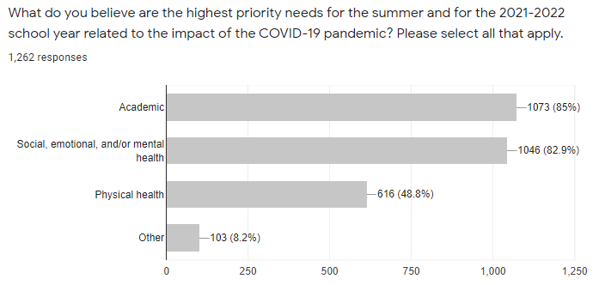
Staff Responses

Slide 32
Staff Responses
When asked on which demographic group our district should prioritize supports?
The top three responses were:
Low-Income students
English Language Learners
Students with Disabilities

Slide 33
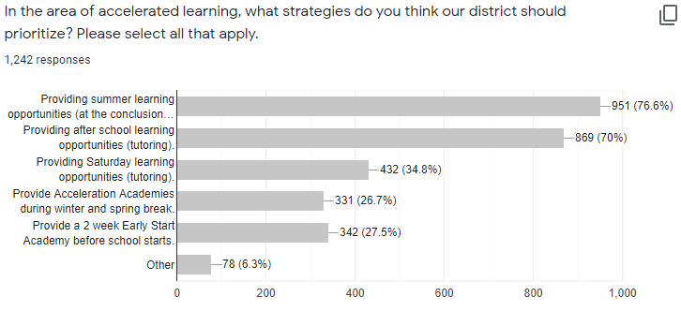
Staff Responses

Slide 34
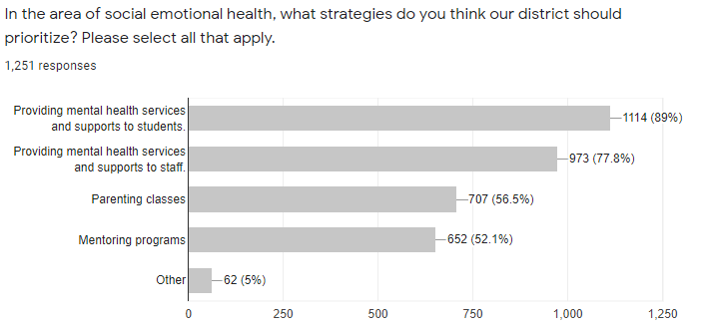
Staff Responses

Slide 35
Staff Responses
In the area of safety, when asked on what strategies our district should prioritize?
The top three responses were:
Purchasing supplies to clean and sanitize schools
Inspect and upgrade, if necessary, the ventilation and HVAC systems
School facility repairs and improvements to minimize the risk of viral transmission

Slide 36
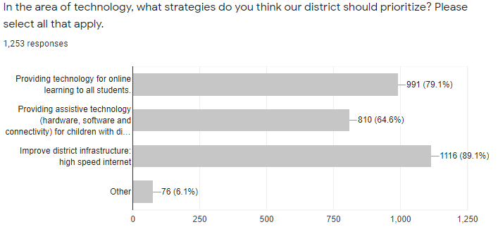
Staff Responses

Slide 37
Staff Responses – Other Considerations
Teachers have spent a considerable amount of money for technology.
Prioritize taking care of teachers & how can the district help us mentally, physically, and financially.
As teachers we experienced a lot more stress during COVID-19; lots of challenges, lots of additional time and resources, planning and helping students. Additional compensation would be very well received by teachers.
Provide parental involvement sessions to educate parents on how to check assignments if they are going to select virtual instruction.
Just that I am grateful as an educator for the support LJISD has offered teachers and the community through this pandemic! I love my district, it is amazing! But we need our kids back in class!

Slide 38
Parent Survey Data

Slide 39
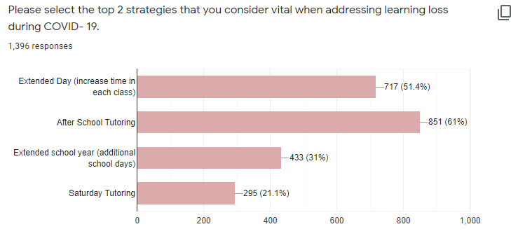
Parent Responses

Slide 40
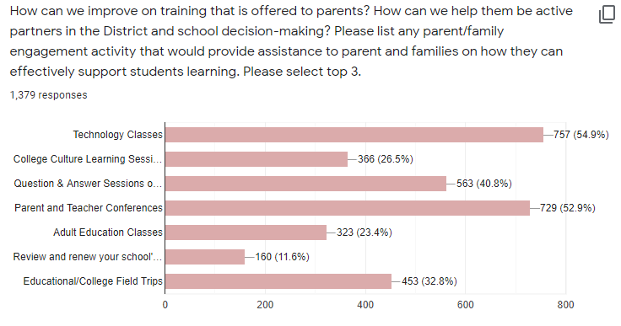
Parent Responses

Slide 41
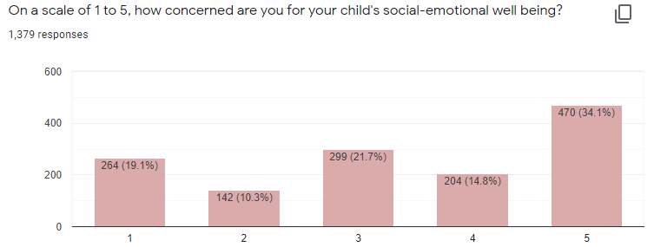
Parent Responses

Slide 42
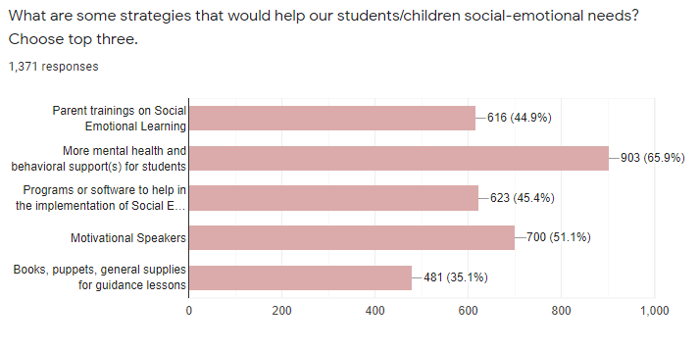
Where We Are: Parent Responses

Slide 43
Parent Responses
I think more counselors are going to need to be available for our kids next year. They need to be able to talk to someone.
Parent trainings on Social Emotional Learning, more mental health and behavioral support(s) for students, programs or software to help in the implementation of social emotional learning
You can never be safe; just for everyone with in the district to be extremely cautious with maintaining every aspect of the school sanitized at all times after every touch, every use and constantly advise our students to mask up, wash hands and keep distance.
INVEST IN BETTER AIR FILTRATION AND AIR PURIFIERS. ALSO, DO PE CLASS OUTDOORS, WHEN POSSIBLE, INSTEAD ON A CLOSED GYM.

Slide 44
Student Survey Data

Slide 45
Student Responses
When asked what supports they would need, the top three responses were:
Access to on-online self-help resources on managing stress, anxiety, developing resilience
Easy-access support groups focusing on encouragement/positive themes
Brief, supportive, confidential 1:1 opportunities with qualified counselors/trainees via secure virtual platforms

Slide 46
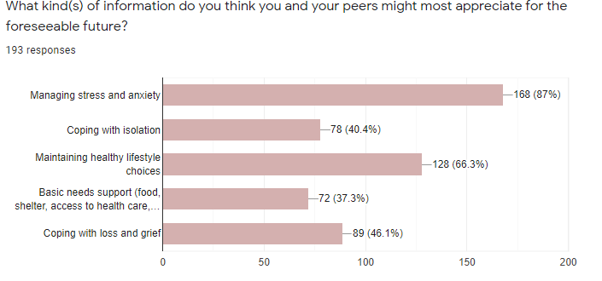
Student Responses

Slide 47
Student Responses
“Ways that it could improve would be by giving us an opportunity to cope with personal issues, or by giving us someone to talk to. Even though we already have counselors, we might just need a personal counselor. Changing the way teachers act towards students that are actually putting effort into passing their class but are still failing. I’m not sure if many teachers are like this at this school, but in my previous schools, from my experience, I have dealt with teachers that would get mad at students for not doing well in their class even if they would be trying their best. I say this mainly because some of the reasons as to why students might still be failing even if they are trying really hard might be because of personal issues, family issues, or many other problems out of school. I also say this because I have experienced it, and I know what it feels like to be at fault for not passing even when I’m trying my best. This response also gives reasons as to why we need better mental help providers at this school or at least administrators that can recommend students/parents to a counselor/and or therapist.” – La Joya ISD Student

Slide 48
Student Responses
FOCUS ON THE STUDENTS. For a school, you would think that students are their top priority, but it feels like as if the cash is their priority. So many students are falling apart in front of their eyes and teachers/parents ignore the signs because it is passed off as "being moody", It does not surprise me that many students think of suicide or result in using drugs or abusing alcohol. For the love of God pay attention because we won't ask for help because to us that's difficult, when you see a student with scars, underweight, crying in your class, under-eyes that are darker than they should be, DO SOMETHING ABOUT IT. Also, you really should renovate, or I don't know maybe put money into the school.” – La Joya ISD Student

Slide 49
RSSP: Make Key Decisions
Phase | Essential Question
0. Project Set Up | How will we organize ourselves to do this work?
1. Analyze Student Data | What is the data telling us?
2. Understand Stakeholder Needs | What is our community telling us?
3. Make Key Decisions | What is our high level plan to address our community's needs over the next 12-18 months?
4. Identify Short Term Actions | What needs to happen in the next 1-2 months to make this plan possible?
5. Align to Other Work | How does our Recovery and Acceleration plan connect to other work in our LEA?
6. Share Plan with Community | What have we decided and why?

Slide 50
Key Decisions
Informed by the task force’s work, La Joya ISD has identified the following district-wide priorities for Learning Acceleration for SY 21-22:
Learning Acceleration Strategies (Early start program, during school and afterschool tutorials, Saturday tutorials, Summer Recovery Programs)
Social-Emotional Recovery Interventions (Implementation of Mindfulness program, PBIS, OLWEUS and TIER III Student Intervention Programs)
Empowering Parents Training Series (Series of trainings to teach parents literacy, math, technology and social-emotional health strategies)
Technology Supports (Improve district bandwidth and purchase and maintain devices)
Physical Wellness (Implement a summer wellness program and upgrade district facilities to facilitate more open-air physical activities)
Facility Upgrades (improve air filtration systems and build outside covered areas)

Slide 51
Learning Acceleration Strategies

Slide 52
Learning Acceleration Plan: Elementary
At the elementary level, the following learning acceleration plan will be followed:
Early Start Program: 2-week program focusing on enrichment/acceleration activities for TIER I students (On level students)
In-School Tutorials: To address literacy skills recovery, during the instructional day, 45 minutes will be allocated to enrichment/enhancement opportunities. To provide small group intervention and student acceleration, support staff (GT, RS, SE) will pull out students.
Afterschool tutorials: To address math skills recovery, TIER II (Require urgent intervention) and TIER III (at-risk of retention) will receive 2 hours of additional instruction on Mondays and Tuesdays.
Computer-based tutorials: TIER III students will receive 2 hours of interventions through a combination of software and in-person supports on Thursdays and Fridays.
Saturday Enrichment Camps: TIER II and TIER III students will receive 4 hours of tutoring through a combination of software and in-person supports.
Summer Recovery Program: 20-day recovery program for struggling students.

Slide 53
Learning Acceleration Plan: Middle School
At the middle school level, the following learning acceleration plan will be followed:
Early Start Program: 2-week program focusing on enrichment/acceleration activities for TIER I (on level students) students.
Early Bird Tutorials: Students that arrive early will work on computer intervention programs.
Afterschool tutorials: To address math skills recovery, TIER II (require urgent intervention) and TIER III (at-risk of retention) students will receive 2 hours of additional instruction on Mondays and Tuesdays.
In-School Tutorials to address recovery during the instructional day. Tiered instructional groups will be created based on ongoing formative/summative data. Targeted instruction will be provided by teachers and tutors to provide small group intervention and student acceleration.
Computer tutorials: TIER III students will receive 2 hours on Wednesday and Thursday in the areas of reading and math through a combination of software and in-person supports.
Saturday Enrichment Camps: TIER II and TIER III students will receive 4 hours of tutoring through a combination of software and in-person supports.
Summer Recovery Program: 20-day recovery program for struggling students.

Slide 54
Learning Acceleration Plan: High School
At the high school level, the following learning acceleration plan will be followed:
Algebra I Focused Interventions utilizing the Silver Lining Curriculum
Strategic Learning for High School Mathematics Course (Intervention Algebra I EOC)
Algebra I Homework Assistance Academy
Algebra I Quarterly Campus Parent Engagement Meetings
In-School Tutorials to address math skills recovery during the instructional day. Tiered instructional groups will be created based on ongoing formative/summative data. Targeted instruction will be provided by Algebra I teachers and consultants to provide small group intervention and student acceleration.
Afterschool Extended Day Learning Tutorials to address math skills recovery, TIER II and TIER III (priority students) will receive 2 hours of additional instruction on Tuesdays and Thursdays.
Edgenuity Course Software for EOC, Credit Recovery and College Readiness
Summer End of Course & Credit Recovery Programs
Texas Virtual School Network Credit Acceleration Opportunities
2-Week Summer Bridge Program for incoming freshman that are attending our academies
Saturday Enrichment Camps

Slide 55
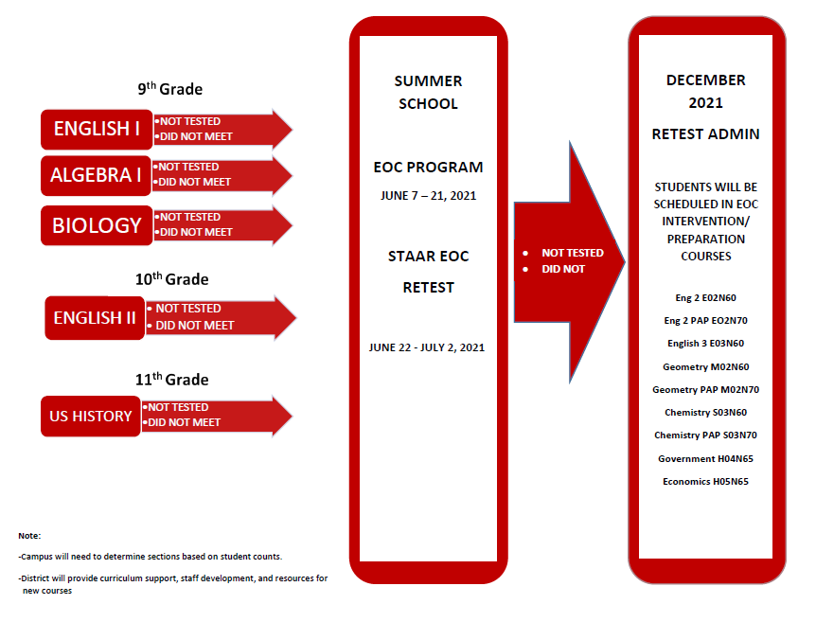
STAAR EOC Student Pathway Support
NOT TESTED
DID NOT MEET

Slide 56
Social-Emotional Recovery Interventions

Slide 57
Social-Emotional Recovery Interventions:
To mitigate the effect of COVID-19, La Joya ISD will be providing individual, group counseling and support groups (grief & loss and coping with anxiety) as part of a multi-tiered system of support.
TIER I Students: Our district will use the OLWEUS, PBIS, Mindfulness, Character Strong and counseling/guidance lessons to provide students social-emotional supports. For example, at the elementary level, students will receive bi-weekly guidance lessons with their certified counselor and follow-up lessons with their classroom teachers.
TIER II Students: In addition to the TIER I supports, these students, through RTI, will receive prescriptive small group supports.
TIER III Students: In addition to the TIER I and TIER II supports, these students, through RTI Behavior and 504, will receive prescriptive individualized supports. If necessary, campuses will receive staffing supports to help students transition back into the classroom. These students will also receive mentoring supports.

Slide 58
Empowering Parents Training Series

Slide 59
Empowering Parents
To mitigate the effect that COVID-19 has had on our students and community, the district will provide a series of trainings to parents in the areas of literacy, math, technology applications and social-emotional wellness. The Empowering Parents trainings will provide weekly trainings to parents that will help them help their children.
Literacy: Parents and caregivers will be trained on how to take an active role in the development of their children's literacy skills.
Math: Parents and caregivers will be trained on how to take an active role in the development of their children's math skills.
Technology Applications: Parents and caregivers will be trained on how to access online instructional resources and how to connect with the school.
Social-Emotional Wellness: Parents and caregivers will be trained on how to support their children's social-emotional health at home.

Slide 60
Technology Supports

Slide 61
Technology Supports
To assist with learning recovery, La Joya ISD will ensure students and teachers are fully equipped with the latest technology to facilitate the delivery of instruction, maximize learning and increase student engagement. The instructional tools will also help students build essential 21st-century skills, provide our students easy-access to information, accelerated learning, and blended learning opportunities to practice what they learn independently.
Some of the technology supports our district will provide:
Presentation carts (big screen tv, apple tv and laptop) for teachers
iPad with iPad pencils for teachers
Webcams for teachers
One to one device for students
Mobile hotspots for students that have connectivity issues
Improvements to district bandwidth and infrastructure

Slide 62
Physical Wellness

Slide 63
Physical Wellness Strategies
The COVID-19 pandemic decreased physical activity and increased sedentary behavior. This had an adverse effect on our students and staff physical and emotional health. To improve our students' and staff physical wellness, La Joya ISD will provide:
A 2-week summer physical wellness program that will increase social interactions and physical activity and have a positive effect on the social-emotional and mental health of our students.
Afterschool intramural sports program (partner with local Boys and Girls Clubs).
Ensure schools have instructional resources to implement physical and health program.
Reopen our Employee Wellness Center and provide recreational sports activities for staff.

Slide 64
Facility Upgrades

Slide 65
Facility Upgrades
To mitigate the spread of COVID-19 and other infectious diseases, La Joya ISD will:
Equip our district facilities with air purification systems.
Thermometers have been installed in all buses and building entrances.
Hand sanitation stations will be or have been installed in classrooms and hallways.
Touchless water stations will be installed at every campus.
Desks will be equipped with sneeze guards.
Increase the frequency of cleaning and disinfecting high touch areas (student desks, chairs, tables, desk shields, computers, light switches, etc.).
Add outside eating areas to allow for spatial distancing during lunch periods.

Slide 66
Prioritized Student Groups

Slide 67

Prioritized Student Groups
As noted on our survey and student performance data, all student groups struggled due to the COVID-19 pandemic. Therefore, our recovery plan is as comprehensive as possible and will provide recovery interventions to all groups. However, district data does indicate that our low-income students, our English language learners and our students with disabilities were impacted the most.
To address and prioritize services to these hardest hit populations, these students will be identified, and they will receive a prescriptive plan of support and interventions. In addition to in-class supports, these students will be offered after school tutorials and will also be offered summer recovery opportunities.

Slide 68
Special Emphasis: Algebra I Testers
Prioritized Student Group(s) | 9th and 10th Grade Algebra I Students & Re-Testers: Low-Income Students ELLs SWD
Rationale
The test results show more students not meeting grade level assessments in almost all subject areas and nearly every grade with the steepest learning loss in math.
Data Measure | All Students |  |  | ELL Students |  |  | SE Students |  |  | GT Students
 |  |  | Difference |  |  | Difference |  |  | Difference |  |  | Difference
 | 2018-2019 | 2020-2021 |  | 2018-2019 | 2020-2021 |  | 2018-2019 | 2020-2021 |  | 2018-2019 | 2020-2021
Algebra I | 88% | 43% | -45 | 87% | 34% | -53 | 69% | 14% | -55 | 100% | 57% | -43
8th STAAR Math | 87% | 21% | -66 | 88% | 19% | -69 | 66% | 17% | -49 | 100% | 33% | -67
*2020-2021 Scores include score code "A" and "O"

Slide 69
Special Emphasis: Algebra I Testers (Excluding Non-Testers)
Prioritized Student Group(s) | 9th and 10th Grade Algebra I Students & Re-Testers: Low-Income Students ELLs SWD
Rationale
The test results show more students not meeting grade level assessments in almost all subject areas and nearly every grade with the steepest learning loss in math.
Data Measure | All Students |  |  | ELL Students |  |  | SE Students |  |  | GT Students
 |  |  | Difference |  |  | Difference |  |  | Difference |  |  | Difference
 | 2018-2019 | 2020-2021 |  | 2018-2019 | 2020-2021 |  | 2018-2019 | 2020-2021 |  | 2018-2019 | 2020-2021
Algebra I | 88% | 57% | -31 | 87% | 46% | -41 | 69% | 24% | -45 | 100% | 92% | -8
8th STAAR Math | 87%​ | 39%​ | -48 | 88%​ | 31%​ | -57 | 66%​ | 28%​ | -38 | 100%​ | 77%​ | -23
*2020-2021 Scores include score code "A" and "O"

Slide 70
RSSP: Identify Short Term Actions
Phase | Essential Question
0. Project Set Up | How will we organize ourselves to do this work?
1. Analyze Student Data | What is the data telling us?
2. Understand Stakeholder Needs | What is our community telling us?
3. Make Key Decisions | What is our high level plan to address our community's needs over the next 12-18 months?
4. Identify Short Term Actions | What needs to happen in the next 1-2 months to make this plan possible?
5. Align to Other Work | How does our Recovery and Acceleration plan connect to other work in our LEA?
6. Share Plan with Community | What have we decided and why?

Slide 71
Short-Term Action Plan: Learning Recovery
Action Item | Owner | Timeline
Train administrators and instructional coordinators on Just-in-Time interventions during Leadership Academy by Region One | Martin Munoz | July
Hire Part-Time Tutors/Campus personnel to provide small group interventions | C & I Executive Directors | August - September
Develop tutoring curriculum | Content Coordinators | August - September
Train tutors on Just-In-Time Interventions and on curriculum | Principals | September
Screen students at BOY | Teachers | September
Identify Tier II and Tier III students | Teachers | September
Start High Dosage Tutoring | Teachers | September
Analyze six weeks data and make adjustments | Principals | October

Slide 72
RSSP: Alignment to Other Work
Phase | Essential Question
0. Project Set Up | How will we organize ourselves to do this work?
1. Analyze Student Data | What is the data telling us?
2. Understand Stakeholder Needs | What is our community telling us?
3. Make Key Decisions | What is our high level plan to address our community's needs over the next 12-18 months?
4. Identify Short Term Actions | What needs to happen in the next 1-2 months to make this plan possible?
5. Align to Other Work | How does our Recovery and Acceleration plan connect to other work in our LEA?
6. Share Plan with Community | What have we decided and why?

Slide 73
Alignment to Other Work
Initiative | Alignment with RSSP | Next Steps
ACE Program | 21st Century Grant (ACE Program) is an afterschool enrichment enhancement program. We currently have this program in 5 ES, 4 MS and 1 HS. For the 2021-2022 school year, we will be scaling the ACE program to include additional schools. | Create a schedule that will allow students to attend afterschool tutorials and the ACE program activities.
CIS | Communities in Schools is a program that provides guidance and counseling/mentoring to at-risk students We currently have CIS operating in some of our campuses but will be scaling this initiative district wide. | Identify priority needs students. Coordinate with CIS to staff all campuses with a CIS social worker.

Slide 74
RSSP: Sharing Plan with Community
Phase | Essential Question
0. Project Set Up | How will we organize ourselves to do this work?
1. Analyze Student Data | What is the data telling us?
2. Understand Stakeholder Needs | What is our community telling us?
3. Make Key Decisions | What is our high level plan to address our community's needs over the next 12-18 months?
4. Identify Short Term Actions | What needs to happen in the next 1-2 months to make this plan possible?
5. Align to Other Work | How does our Recovery and Acceleration plan connect to other work in our LEA?
6. Share Plan with Community | What have we decided and why?

Slide 75
Stakeholder Engagement Plan
Key Stakeholder Group | Communication Plan | Next Steps
Community Presentation | Present COVID-19 Recovery & Acceleration Plan and ESSER III Expenditure Plan at School Board Meeting on July 19, 2021 | Differentiate presentation for each focus school, including specific student achievement goals Designate and Identify administrators from each school to help present Allow community the opportunity to provide input and give recommendations through the RSSP Feedback Form: https://forms.gle/wwdRS3XyA1AvCtq38
Presentation for the Community & Parents (also recorded for website) | Present COVID-19 Recovery & Acceleration Plan at Campus Meetings | Allow parents and community the opportunity to provide input and give recommendations through the RSSP Feedback Form: https://forms.gle/wwdRS3XyA1AvCtq38
Campus Presentations for Staff | Principals will present the plan at their faculty meetings. | Allow staff the opportunity to provide input and give recommendations through the RSSP Feedback Form: https://forms.gle/wwdRS3XyA1AvCtq38

Slide 76
Thank RSSP Committee
Committee Members
Dr. Gisela Saenz, Superintendent
Martin Munoz, Assistant Superintendent
Leticia Mendiola, HS Language Arts Coordinator
Marena Contreras, ES Executive Director
Ana Dalia Oliveira, MS Executive Director
Claudia E. Munoz, ES Language Arts Coordinator
Antonio Cano, HS Principal
Veronica Chavez, College Readiness Director
Melinda Flores, HS Executive Director
Kathy Pulido, ES Language Arts Coordinator
Brenda G. Garcia, MS Math Coordinator
Annette Lozano, MS Assistant Principal
Carly Salinas, MS Principal
Sheila Y. Mata, ES Assistant Principal
Alma A. Perez, ES Principal
Marta Castillo, ES Executive Director
Juan Torres, ES Math Strategist
Jose Luis Morin, Executive Director for Student Services
Roger Gomez, MS Science Coordinator
Nanette Limas, Student Services
Daniel Villarreal, MS SS Coordinator
Myriam Tellez, Guidance and Counseling Director
Clem Garza, Technology Director
Cynthia Salinas, Staff Development Director
Irma Zuniga, Bilingual Director
Lucy Munoz, ES Math Coordinator
Juliana Garza, Academies Director
Magda Villarreal, Executive Director for Assessment and Accountability
Linda Laura Lopez, Executive Director for Elementary Education
Sandra Gonzalez, Student Services Director
Andrea Garza, Special Education Director
Guadalupe Chavez, Academies Director
Sebastian Duque, Director for Assessment and Accountability
Rosie Romo, 504 Director
Maria Isabel Rios, HS Assistant Principal
Velma Ochoa, Parental Involvement Coordinator

Slide 77
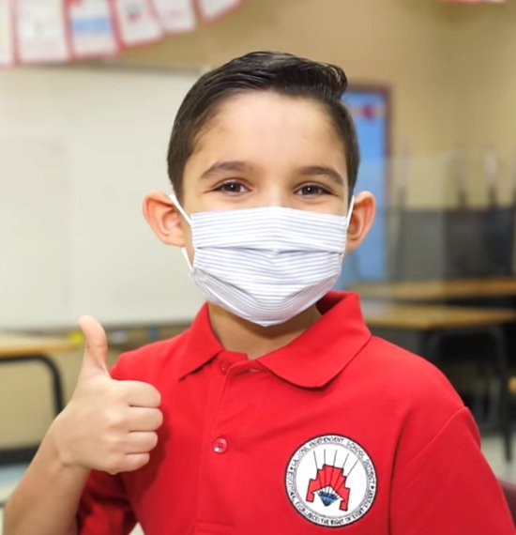
Questions? Feedback?
Contact Martin Munoz at m.munoz2@lajoyaisd.net or 956.323.2152
RSSP Feedback Form: https://forms.gle/wwdRS3XyA1AvCtq38

Slide 78
Discussion of 2020 – 2023 ARP, ESSER III District Initiatives

Slide 79

Purpose of ARP ESSER III Funds
ESSER III funds are to safely reopen and sustain the safe operation of schools and address the impact of the COVID pandemic on students.
At least 20% of the ESSER III funds must be set aside to address learning loss type activities.

Slide 80
ESSER III District Allocation
As per TEA, total allocation amounts for La Joya ISD are as follows:
Total Allocation Amount: $147,335,197
Initial Allocation (Two-Thirds): $98,223,465
Remaining Allocation (One-Third): $49,111,732

Slide 81
We are strategically aligning our ESSER funds to support each of the priority areas that were identified by the RSSP Taskforce
Priority areas identified by the RSSP task force:
Learning Recovery
Technology Upgrades and Enhancement
Social-Emotional and Wellness Supports
Professional Development
Facility Repair (COVID-19 Mitigation Strategies)
Staffing

Slide 82
ESSER III 2021 – 2022 Activities: $ 98,223,465.00
Activity | Allocation | %
Learning Recovery | $ 13,707,020.88 | 14%
Technology Upgrades | $ 17,890,461.12 | 18%
Social Emotional Supports | $ 4,754,233.00 | 5%
Staffing | $ 31,650,000.00 | 32%
Facilities | $ 17,416,250.00 | 18%
Safety | $ 12,805,500.00 | 13%
Total: | $ 98,223,465.00 | 100%

Slide 83
20% Learning Loss Requirement
Learning Loss
Activity | Allocation | %
Learning Recovery | $13,940,648.65 | 14%
SEL | $4,754,233.00 | 5%
Technology Upgrades | $17,890,461.12 | 18%
Staffing | $31,650,000.00 | 32%
Total: | $68,235,342.77 | 69%
Safety
Activity | Allocation | %
Facilities | $17,416,250.00 | 18%
Safety | $12,805,500.00 | 13%
Total: | $30,221,750.00 | 31%

Slide 84
Learning Recovery
Elementary Learning Acceleration: Early Start, Afterschool, Saturday Tutorials, Summer Recovery | $ 3,008,389.65
Middle School Learning Acceleration: Early Start, Afterschool, Saturday Tutorials, Summer Recovery | $ 1,232,563.92
High School Learning Acceleration: Early Start, Afterschool, Saturday Tutorials, Summer Recovery | $ 1,042,000.00
Part-Time Tutors (15 hours weekly): Tutors that will be hired to provide small group (3 to 1) tutoring sessions to TIER III students. | $ 833,334.00
Summer School Recovery Programs: Supplement summer recovery program. | $ 3,066,372.23

Slide 85
Learning Recovery
Afterschool and Saturday tutorials to provide CTE students the opportunity to receive Industry-Based Certifications. | $ 274,724.45
Purchase CTE Certification Kits to allow CTE students the opportunity to receive Industry-Based Certifications. | $ 300,000.00
Middle Schools College Board Pre-AP Springboard Materials /Resources for Curriculum Project: Purchase supplemental College Board’s Springboard Resources to Prepare 6th through 8th Advanced Grade Students to Succeed at College-Level Work. | $ 114,527.31
High Schools College Board Pre-AP Materials/Resources and Springboard Curriculum for Curriculum Project: to prepare eighth through twelfth grade students to succeed at college-level work. The Pre-AP supplemental curriculum includes student and teacher editions, a website license to Springboard Digital in ELA and Math at the high school level. | $ 164,036.92

Slide 86
Learning Recovery
In-District & STC Fall and Spring Saturday/Summer Robotics Camps for 3rd - 8th grade Gifted and Talented Students: provide learning opportunities that will allow students to engage in aspects of automation technologies and real-life robotics technology. These enrichment camps will be offered to 3rd thru 8th grade students participating in the La Joya ISD Gifted and Talented Program. | $ 305,000.00
AP teacher and student stipends to compensate those students and teachers of record that accomplished the goal of passing or having students pass the nationally recognized College Board AP Exam with a 3 or better. | $ 70,000.00
College Equipped Readiness Too (CERT): Provide individualized remedial lessons ensure that struggling students get the support they need either during the school day or during after-school hours. | $ 99,187.50
College Equipped Readiness Too (CERT) TSI Prep: Provide individualized lessons to assist with TSI. | $ 29,124.90

Slide 87
Learning Recovery
National Hispanic Institute (NHI): To provide a continuum of leadership opportunities and College Readiness activities that begin at the ninth grade and continue through undergraduate college studies. NHI engages students to provide community leadership roles for the betterment of the Hispanic community. | $ 114,000.00
College Board PSAT/SAT: PSAT for 8th and 9th graders, SAT testing for 10th-12th grade students as part of College Readiness. | $ 145,490.00
21st CCLC, Cycle 10 Funding for After School Teachers: Supplement our ACE Grant to continue services and the hiring of staff. | $ 106,520.00
Professional Development- Empowering Parents: Professional development to parents in the area of literacy, mathematics, social-emotional health and technology. | $ 85,000.00

Slide 88
Learning Recovery
Partner with Advice Texas College Advisors to support college readiness activities and initiatives for the Early College High Schools, West Academy and CCC. | $ 150,000.00
College Campus visits for district students to improve the college culture in the district as well as enrichment experiences. | $ 125,000.00
Hire consultants to provide dropout prevention interventions for one-on-one support for students that are behind in credits. | $ 120,750.00

Slide 89
Learning Recovery
Literacy Resources for Implementation of Reading Academy: Materials and supplies | $ 612,500.00
Math Resources for Elementary: Equipment and supplies | $ 690,500.00
Science Resources for Elementary: Equipment and supplies | $ 222,000.00
PE/Athletics Resources: Equipment and supplies | $ 796,000.00

Slide 90
Technology
Instructional Technology: To assist with learning recovery, La Joya ISD will ensure students and teachers are fully equipped with the latest technology to facilitate the delivery of instruction, maximize learning and increase student engagement. The instructional tools will also help students build essential 21st-century skills, provide our students easy-access to information, accelerated learning, and blended learning opportunities to practice what they learn independently. ​ | $ 14,790,730.31
Upgrade our Network Operation Center (NOC), internet bandwidth and Infrastructure to meet the increased bandwidth demand due to the streaming of lessons for online learning, hybrid / concurrent instruction, online testing as well as the increased number of mobile devices used by students. The NOC upgrade will ensure that there is a reliable and robust internet connection districtwide. | $ 1,461,180.00
Cyber Security Protection: To enhance cyber security protection against cyber threats due to the increased use of online/web services and resources. | $ 148,000.00

Slide 91
Technology
HB3906 Online Testing Hardware and Software: House Bill 3906 requires that all state assessments be administered online by the 2022-2023 school year. The transition to online testing mandates necessary testing hardware and software as well as additonal equipment at the Curriculuma and Evaluation Department. | $ 53,125.00
CTE Specific Technology: Purchase software and hardware for our CTE classrooms. | $ 960,000.00
Sensory Equipment for students with disabilities (SWD): Provide additional instructional supports to our SWD populations. | $ 221,360.00

Slide 92
Technology
Interactive Learning Stations for students with disabilities (SWD): Provide additional instructional supports to our SWD populations. | $ 95,400.00
Virtually Impaired Monitors for Students with Disabilities (SWD): Provide additional instructional supports to our SWD populations. | $ 1,750.00
Classroom Auditory Systems for Self-Contained Classrooms (SWD): Provide additional instructional supports to our SWD populations. | $ 158,915.81

Slide 93
Social Emotional Health and Physical Wellness
2-Week Summer Wellness Program to Increase physical and mental fitness | $1,086,000.00
TIER III RTI Behavioral Supports to provide campuses funds to hire certified substitutes to assist with TIER III discipline supports. | $ 40,000.00
Offer employees an Employee Wellness Program to encourage and promote physical and mental wellness. | $ 12,500.00
Social Emotional Development Trainings: 10 Day Professional Development Training on resiliency and SEL. | $ 42,400.00
Playground Equipment for 23 Elementaries to promote social emotional and physical wellness. | $ 1,150,000.00

Slide 94
Social Emotional Health and Physical Wellness
Communities in Schools for all LJISD campuses: Provide SEL supports to our At-Risk students (Homeless, Foster Care, Pregnancy) | $ 900,000.00
Afterschool Enrichment Program/Supplement ACE Enrichment Program: Provide enrichment activities for our students (dance, cheer, sports, esports, STEM). | $ 300,000.00
PBIS/Discipline Management Software program to automate discipline referral/taking charge form and keep track of PBIS positive behavior targets. | $ 125,000.00
Social Emotional Learning Software/Curriculum (online programs for students). | $ 125,000.00
Implementation of Districtwide PBIS – Employ consultants to support Positive Behavior Intervention & Supports in the classrooms. | $ 640,000.00
PBIS /Social-Emotional Activities: Funds to provide in-school and afterschool activities for students. | $ 333,333.00

Slide 95
Staffing
ESSER III Administrator: Grant shepherd yearly salary to oversee ESSER III grant. | $ 100,000.00
$2,500 Retention stipend for approximately 4,200 full-time employees of La Joya ISD ($1,250 per semester). | $ 10,500,000.00
$250 COVID-19 Immunization stipend for full-time and part-time employees of La Joya ISD | $ 1,050,000.00
$500 Teacher Technology and Classroom Resources stipend for full-time teachers of La Joya ISD | $ 1,000,000.00
Instructional Staff: To continue to employ staff to carry out learning recovery initiatives. | $ 15,000,000.00
Instructional Staff - Indirect staffing costs due to the continuation of employing staff to implement learning recovery initiatives. | $ 4,000,000.00

Slide 96
Facility Upgrades
HVAC equipment upgrades and replacement to allow for cleaner and safer indoor air | $ 12,000,000.00
Air purification systems upgrade and replacement to allow for cleaner and safer indoor air | $ 2,916,250.00
HVAC controls upgrade to allow cleaner and safer indoor air | $1,000,000.00
Purchase generators for CNS Dept. to safeguard food safety. | $ 300,000.00
Improve and Repair playing fields at three middle schools. | $ 1,200,000.00

Slide 97
Safety
Purchase additional buses and improve our transportation fleet to safely transport students to and from school. | $ 4,285,500.00
Add benches and outdoor covered areas (canopies) to allow our students to safely distance themselves during lunch or during passing periods. | $ 2,520,000.00
Provide schools with PPE (masks, shields, gloves, test kits, sanitizer, signage, water bottles, temperature scanners, water dispensers, etc.) | $ 6,000,000.00

Slide 98
ESSER III Remaining Allocation Plan
Our plan is to use the remaining allocation ($49,111,732) to continue to fund initiatives during the 2022 –2023 and 2023-2024 school year.

Slide 99
Questions? Feedback?
Contact Martin Munoz at m.munoz2@lajoyaisd.net or 956.323.2152

