Slide 1
Chapter 5
Beginnings of an American Identity (1689 – 1763)

Slide 2
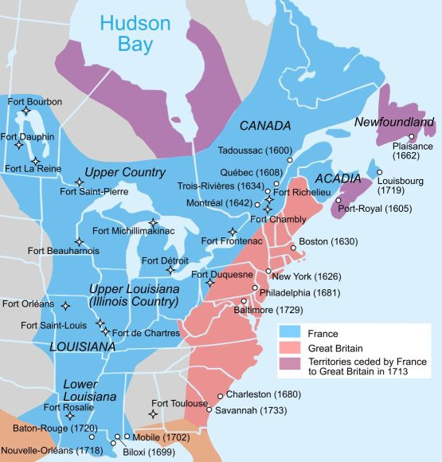

Slide 3
Early American Culture:
British culture remained a the foundation of all colonies societies
But with new climates and living conditions colonist had to adapt their old ways
Cheap farm land and abundant natural resources gave colonist a chance to prosper, as well as political rights
Only white male property owners could vote in the rural areas, and in cities people votes by paying a fee
American society had no titled aristocracy, a large middle class, and a huge underclass of slaves

Slide 4
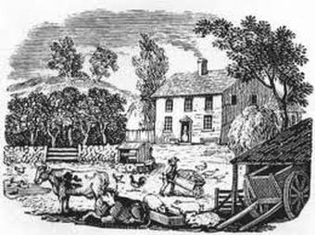
Colonial Life:
Farming women cooked, churned butter, made soap, candles, tended the garden, looked after the farm animals, and clothes
Women could not vote with the exception of the Quakers, but they could not preach
Men planted, raised, and harvested crops, sold items at the market, cared for livestock, cut trees, and chopped firewood, and butchered meat

Slide 5
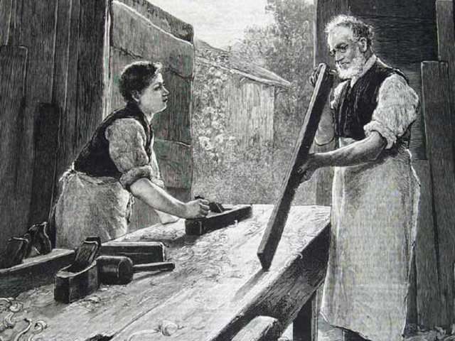
Life of the Young:
American families were large, most had about 6 to 8 kids
More children were expected to work the farm even toddlers had chores they were expected to do
At six, boys were “breeched” given pants and expected to help on the farm
At 13, many left home to become apprentices – learning a trade from an experienced craftsman
They received food, clothing, lodging, and a general education
Girls were rarely apprentices, they learned most of their skills from their mother
Some were sent to learn specialized skills such as weaving or making cheese

Slide 6
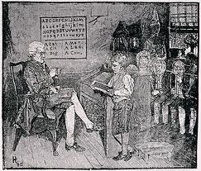
Education and Literacy:
The colonies were different than European societies in that colonial American had a high rate of literacy – ability to read and write
New England had 85%, Middle had 65%, South 50% compared to 60% in England
Slaves were rarely educated, it was illegal in the south in most parts
Literacy help unite the colonies
In the 1700’s there was only one newspaper, the Boston News Letter, but over the next 70 years, dozens more came about
Benjamin Franklin, in 1732, published Poor Richard’s Almanac, it contained saying that are still used today

Slide 7
Religious Revival:
American colonist drew inspiration from 2 cultural movements: the Great Awakening – a Christian religious revival and the Enlightenment – a movement stressing human reason
The Great Awakening appealed to faith and emotions unlike the Enlightenment which was more of a scientific reason and observation
Jonathan Edwards – a traveling preacher that preached that inner religion was more important that outer religious behavior, and that everyone could be saved
George Whitefield – drew in thousands with his sermons and raised money to start a home for orphans
The Great Awakening encouraged belief in spiritual equality, religious debates, and increased religious diversity

Slide 8
Religious Revival Cont…
The Enlightenment encouraged colonist to improve their society through rational thought
John Locke – challenged the belief that kings had a God-given right to rule, he also argued that people have natural rights: life, liberty, and property
The Enlightenment would become one of the fundamental beliefs of American culture

Slide 9
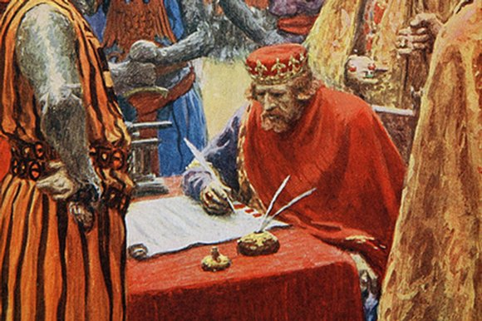
Roots of American Democracy:
American enjoyed the rights and liberties of English subjects.
American colonist were fiercely protective of these freedoms, which they called “rights of Englishmen”
In 1215, King John signed the Magna Carta (Great Charter) – saying the king was not above the law, like everyone else the king had to obey the laws of the land
Property could not be seized by the king, could not be taxed, unless a council of prominent – important and well-known men agreed, and could only be punished by a jury of their peers
Over time, right expended, such as to elect representatives to government
The foundation of modern American democracy

Slide 10
Parliament and Colonial Government:
Parliament – England’s lawmaking body made up of 2 houses, House of Common where people were elected, and House of Lords were nonelected nobles, judges, and clergy
Since the colonies were so far away king and Parliament let the colonies have some self-government
The first was Virginia’s House of Burgesses, which imposed taxes and managed the colonies
Until the 1600’s, where colonies were smuggling goods and ignoring the Navigation Acts, so King Charles II canceled the colony’s charter
Edmond Andros – was appointed governor of the northern colonies after the king combined them into one Dominion of New England

Slide 11
Parliament and Colonial Government Cont…
After a time of unrest in England, Parliament secretly offered the throne to King James’s daughter and her husband
In 1688, William and Mary were the new monarchs of England, this change in leadership was called England’s - Glorious Revolution
In 1689, William and Mary agreed to uphold the English Bill of Rights – a list of specific rights of English people and of Parliament
The monarch could not cancel laws, impose taxes unless Parliament agreed, free elections, frequent meeting of Parliament, no excessive fines, or cruel punishments, and to complain about the King or Queen without being arrested
During the 1700’s England’s policy towards the colonies was called salutary neglect

Slide 12
Parliament and Colonial Government:
As time went on and the colonies got used to governing themselves
They moved toward gaining freedom of press
In 1735, John Peter Zenger – publisher of the New York Weekly Journal, stood trial for criticism of New York’s governor, claiming the governor took bribes, removed a judge and fixed an election
At that time it was against the law to criticize the king in writing
Andrew Hamilton defended Zenger, claiming people had the right to speak the truth, and the jury agreed
The English rights were apart of colonial heritage - tradition

Slide 13
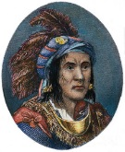
The French and Indian War:
A Native American group, the Ottawa, leader Chief Pontiac lead raids against the British after they took over French forts in the Great Lakes region
This conflict is known as – Pontiac’s Rebellion
The French and Indian War followed – which French fought British forces in North America, with both sides fighting with Native allies

Slide 14
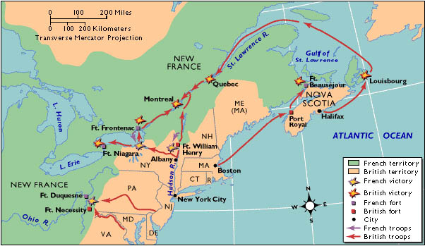
The French and Indian War Cont…
The French claimed the Ohio River valley, Mississippi River valley, and the Great Lakes region
The French territory of Louisiana, claimed by La Salle in 1682, stretched from the Ohio River valley to the Rocky Mountains, called “New France”
Competing for furs war often broke out between both sides

Slide 15
The French and Indian War:
In 1753, the governor of Virginia sent forces, led by George Washington, 21 at the time to tell the French to leave
Fort Duquesne, near the Ohio River forks, where Pittsburg now sits, Washington set up a small fort called Necessity
After a surprise attack by Washington, fort Necessity was attacked on July 3, 1754, Washington retreated back to Virginia and the French and Indian War had started (9 years)
The Huron, Native American, sided with the French, who lived around the Great Lakes
Albany Plan of Union – Benjamin Franklin, proposed the first formal proposal to unite the colonies, was rejected because each didn’t want to give up their right to control their own affairs

Slide 16
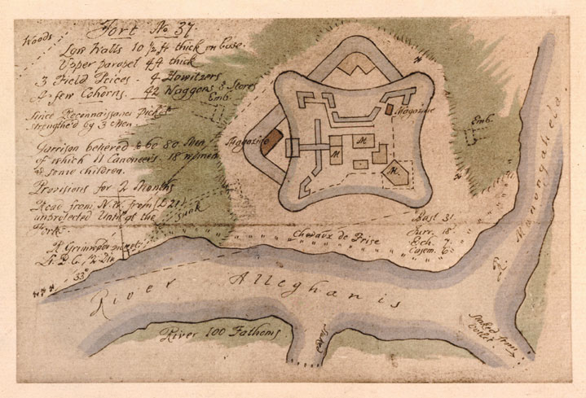
The French and Indian War:
The British sent General Edward Braddock and 2 regiments (2000 men) to Fort Duquesne in 1755, with Washington at his side
On July 9th, 8 miles from the fort they were attacked, General Braddock was killed
In 1757, Britain had a new secretary of state, William Pitt, who was determined to win the war
He sent his best generals to America and borrowed money to pay colonial troops
By 1759, the British controlled 6 forts including fort Duquesne (fort Pitt) and moved to attack New France’s capitol at Quebec

Slide 17
The French and Indian War:
The British lay siege to Quebec, which sits on 300 ft. cliffs above the St. Lawrence River
In September, General James Wolfe and 4,000 of his men climbed a path up the cliffs in the cover of darkness that night
The battle that followed the next morning was fierce, killing General Wolfe, Montcalm, the French Commander (died the next day), and Quebec surrendered
The Battle of Quebec was the turning point of the war, when Montreal fell the following year, all of Canada was in British hands
In out laying areas the battle continued for almost 3 years
Spain made a pact in 1761 to aid France, but help came too late
The Seven Year War ended in 1763, the Treaty of Paris was signed
The treaty ended nearly all of French control in North America

Slide 18
The New Colonial World:
The war also changed the way that colonial Americans and Native Americans viewed themselves and their relationship
The Pontiac Rebellion's followed, in 1763
After attacking settlers and destroying almost every British fort west of the Appalachian Mountains
The British came up with a vicious plan, inviting Lenni Lenape war leaders to a talk, and gave them blankets infected with smallpox as a gift
By the fall the Native Americans had retreated, to avoid further conflicts with Native Americans the Proclamation of 1763 was issued – it forbid colonist from settling areas west of the Appalachian Mountains
After winning the French and Indian War the colonist were confident with the way they unified against one common enemy
And the stage was set, with no French involvement, there was only one other country to deal with…

