Slide 1
ACA NY/NJ
Camp & Workplace
Violence

Slide 2
Housekeeping
Emergency Exits
Copy of Presentation
Survey
Cell Devices
★    

Slide 3


Slide 4
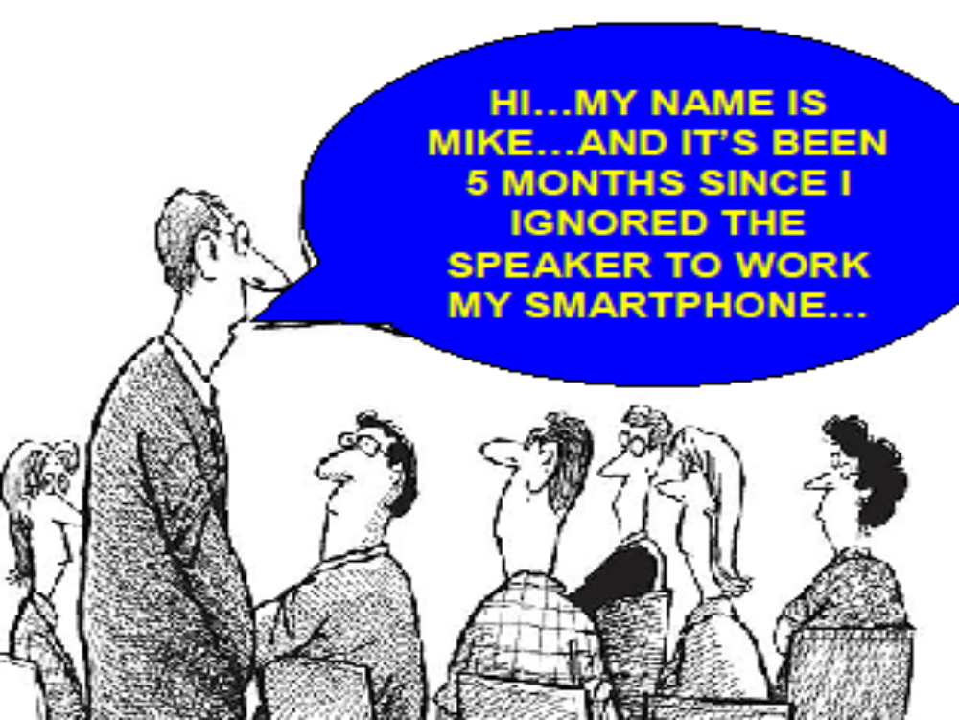
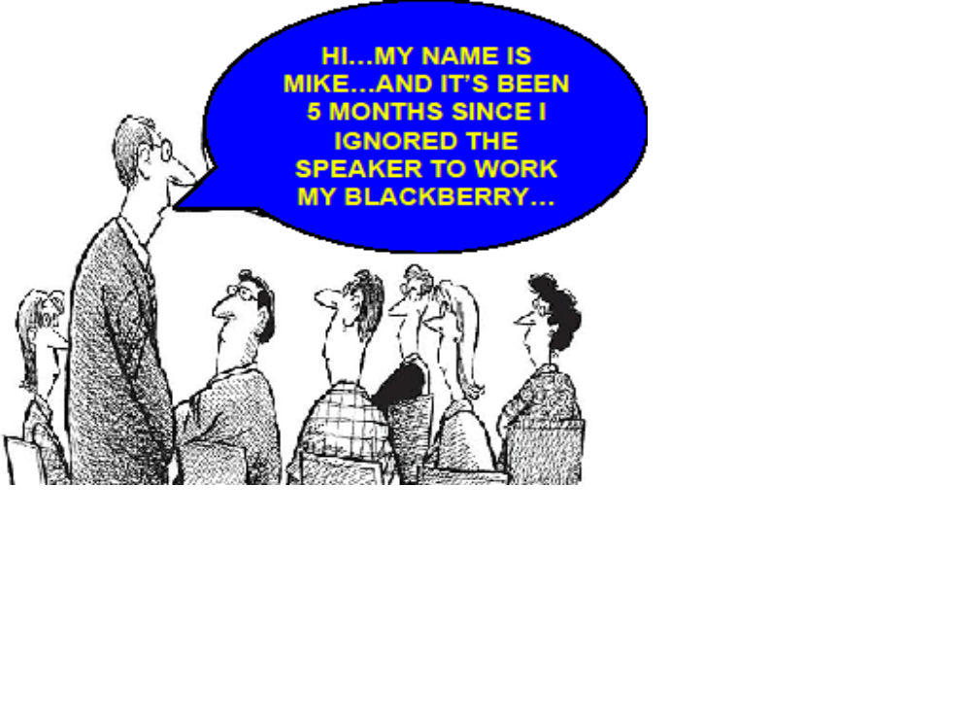

Slide 5
  Bo Mitchell
  911 Consulting
  President
  Police Commissioner (Ret.)
Certified Emergency Manager
CEM, CPP, CBCP, CHCM, CHSP, CHS-V, CHEP CSHM, CFC, CIPS, CSSM, CSC, CAS, TFCT3, CERT, CMC

Slide 6
Expert Consultant
Landmark Legal Cases
Expected Settlements:
$1 Billion Each
“Failure to Plan”
“Failure to Train”

Slide 7
Speaker
FEMA (4x)
CUPIC
NASRO
NCEF
IACLEA

Slide 8
Speaker
NFPA
SHRM
WSO
ASSE
GOV/
SEC

Slide 9
Speaker
ACA Tri-State (2)
ACA-NE (3)

Slide 10
911 Consulting Clients
    GE HQ
    Hyatt HQ
    Subway HQ
    H&R Block HQ
    MasterCard HQ
    Cablevision
    ExxonMobil
    Goodrich
    Pratt & Whitney
    Rolls Royce HQ

Slide 11
911 Consulting Clients
25 Secondary
Western CT Univ.
Central CT Univ.
John Jay College
Housatonic CC

Slide 12
Milton Academy
New Canaan Country
Pomfret
Rectory
Shrewsbury
St. Luke’s NYC
St. Stanislaus
Sprague
Taft
University School
Waldorf HS
Westminster
Whitby
Becket Camps
Christian Heritage
Cheshire Academy
Episcopal Academy
Fairfield CDS
Fenn
Flintridge
Frost Valley
Gateway School/NYC
Greater Hartford Montessori
Greens Farms
Kent
King

Slide 13
Cheshire Academy
Christian Heritage
Episcopal Academy
Fairfield CDS
Fenn
Flintridge
Gateway School/NYC
Greater Hartford Montessori
Greens Farms
Greenwich CDS
Kent
King
Milton Academy
New Canaan Country
Pomfret
Rectory
Shrewsbury
St. Luke’s NYC
St. Stanislaus
Sprague
Taft
University School
Waldorf HS
Westminster
Whitby
Becket Camps
Frost Valley Camps

Slide 14
911 Consulting Clients
Becket Camps
Frost Valley Camps

Slide 15
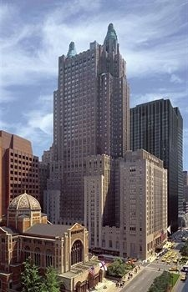
Waldorf=Astoria
NY, NY

Slide 16
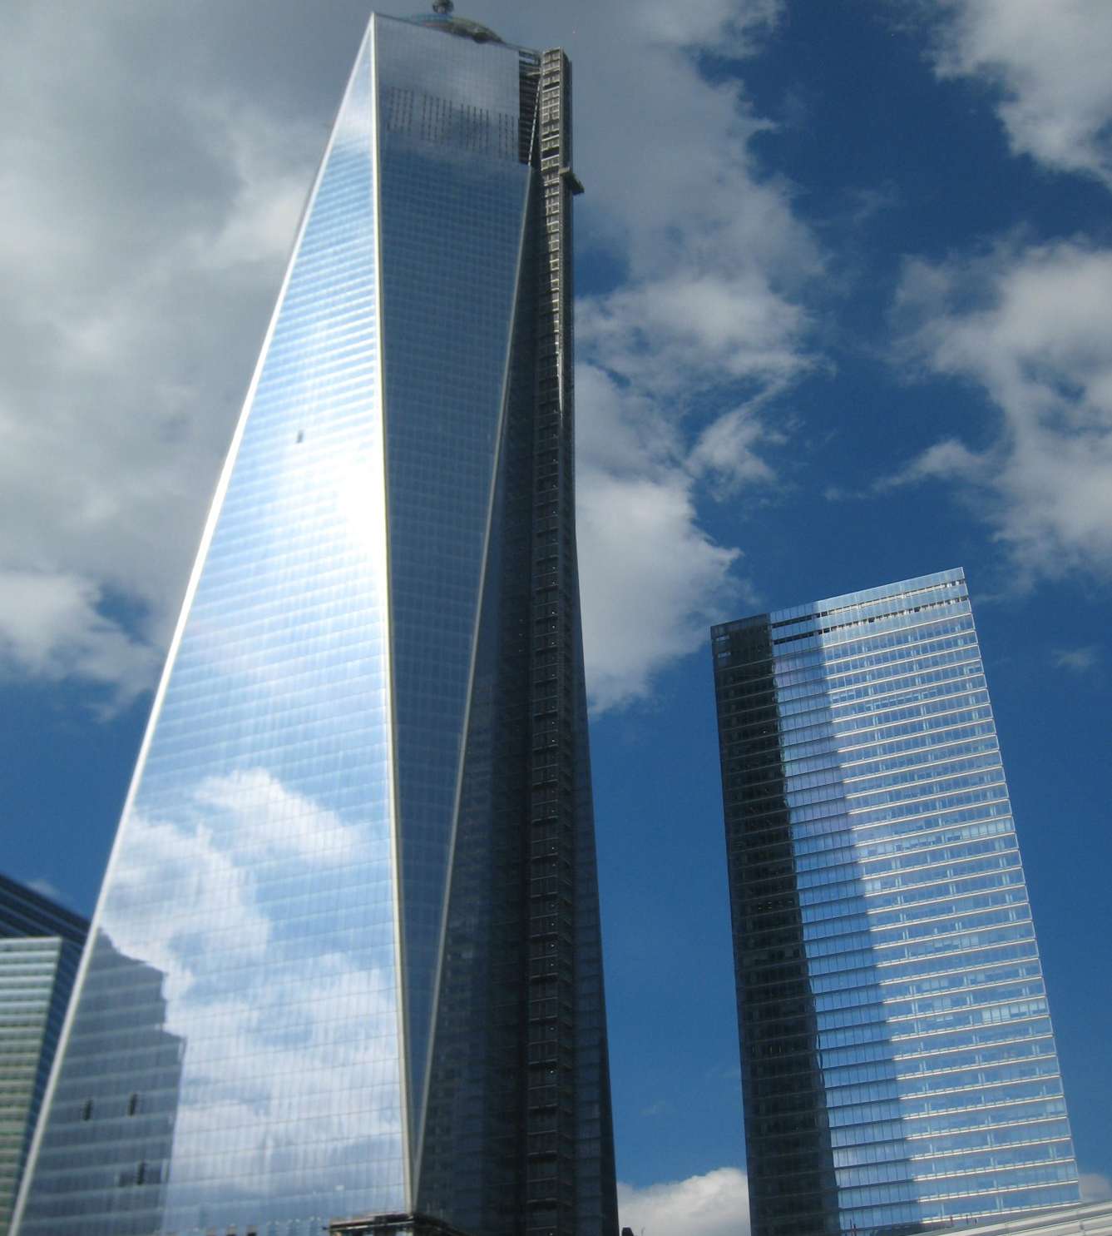
1 WTC 7 WTC

Slide 17
ACA NY/NJ
Camp
Violence

Slide 18
ACA NY/NJ
Workplace
Violence

Slide 19
Before You’re a Camp,
You’re a Workplace

Slide 20

Violence:
Workplace
Violence:
Camps

Slide 21
Violence:
Workplace
Violence:
Camps

Slide 22
WPV
Violence:
Workplace
Violence:
Camps

Slide 23
WPV
Violence:
Workplace
Violence:
Camps

Slide 24
WPV
Violence:
Workplace
Violence:
Camps

Slide 25
WPV
Violence:
Workplace
Violence:
Camps

Slide 26
WPV
Violence
Workplace
Camps

Slide 27
WPV
Violence:
Your Facility

Slide 28
Camp & WPV
Causes: Same

Slide 29
Camp & WPV
Causes: Same
Injuries & Death: Same

Slide 30
Camp & WPV
Causes: Same
Injuries & Death: Same
Fixes: Same

Slide 31
Camp & WPV
Causes: Same
Injuries & Death: Same
Fixes: Same
Only Difference: Age of Victims

Slide 32
Workplace Violence Prevention

Slide 33
18x
More Likely to Have
Violence than a
Fire
at Work
DOJ & NFPA

Slide 34
Today’s
Mission

Slide 35
Today’s Mission
Counter
Cultural

Slide 36
Like Me?

Slide 37
Trust

Slide 38
ACA NY/NJ
WPV

Slide 39
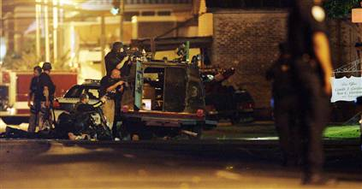
Police at Law Firm
Where Client Killed 2, Wounded 3

Slide 40
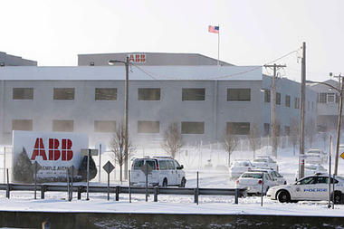
St Louis: 4 Dead

Slide 41
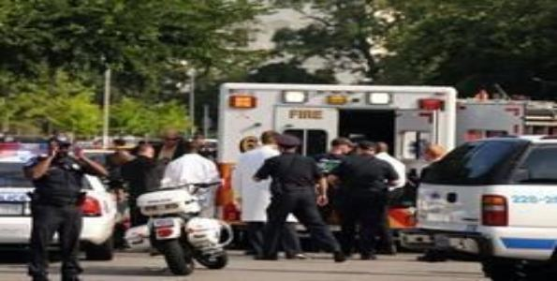
U.S. Capitol: Shooter Dead

Slide 42
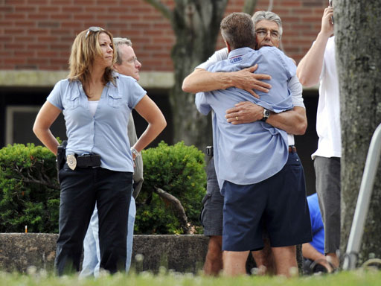
Hartford Distributors: 9 Dead

Slide 43
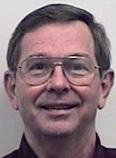
NASA Contractor: 2 Dead

Slide 44
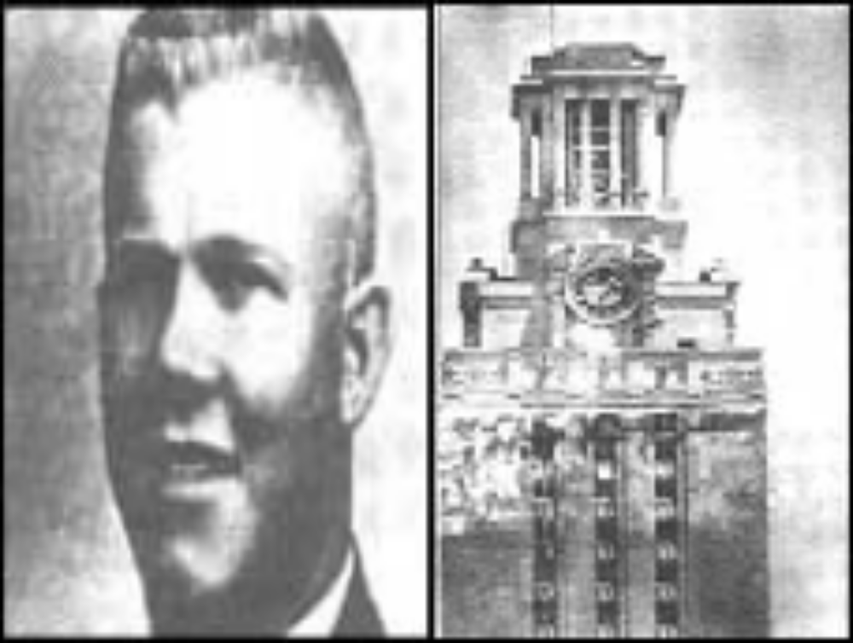
Texas School Tower

Slide 45
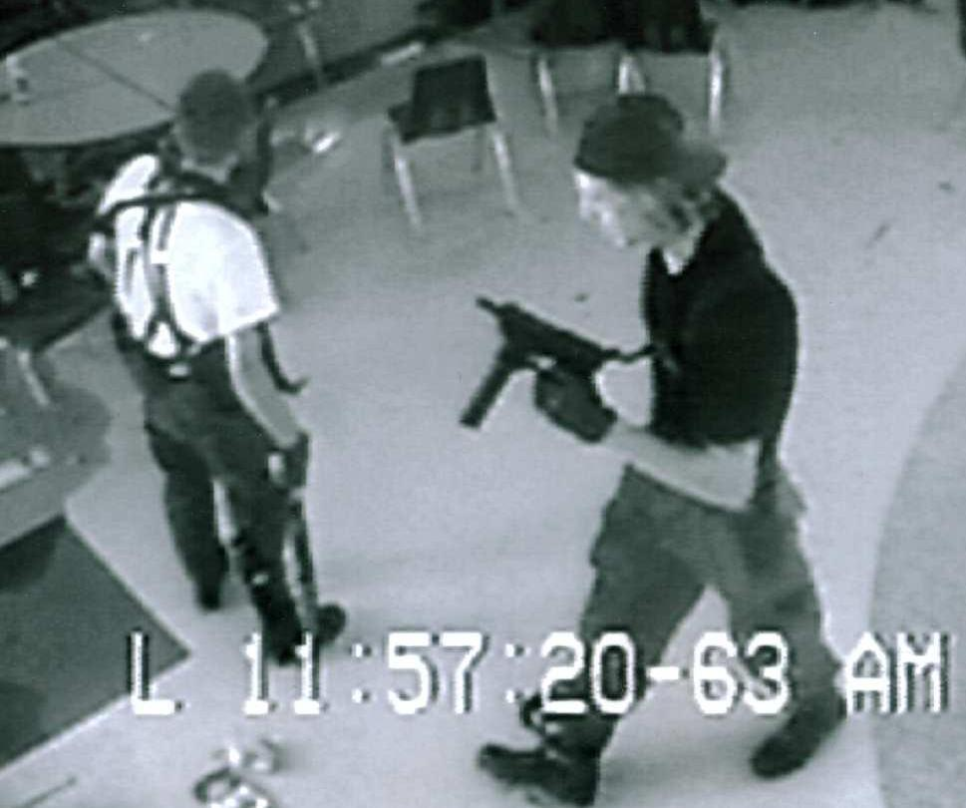
Columbine

Slide 46
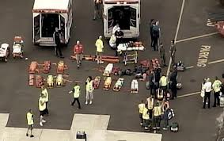
Sandy Hook Elementary

Slide 47
Fair Warning!!!
I Will Be
Candid
★    

Slide 48
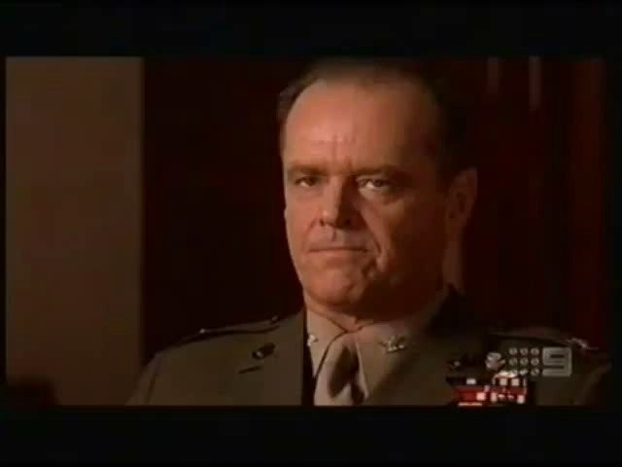

Slide 49
WPV
Camp

Slide 50
Bullying
& Hazing

Slide 51
Bullying: 12-18

Slide 52
Bullying: 12-18
32% Report as Victims

Slide 53
Bullying: 12-18
32% Report as Victims
21% 1-2X per Mo

Slide 54
Bullying: 12-18
32% Report as Victims
21% 1-2X per Mo
10% 1-2X per Wk

Slide 55
Bullying: 12-18
32% Report as Victims
21% 1-2X per Mo
10% 1-2X per Wk
7% Daily

Slide 56
Bullying: 12-18
32% Report as Victims
21% 1-2X per Mo
10% 1-2X per Wk
7% Daily
9% Physically Injured
NCES/BJS/DOE

Slide 57
Threats
Bullying
160,000 Kids Stay Out of Classes Every Day Because of the Threat of Bullying

Slide 58
Threats
18% of Kids in affluent suburban schools have carried weapons to classes

Slide 59
Threats
18% of Kids in affluent suburban schools have carried weapons to classes
48% of Kids in affluent suburban schools report knowing a friend who carried a weapon to classes.
Weapons in an Affluent Suburban School Study

Slide 60
Weapons Threatening
US: 7.8% on School Property
CDC/YRBSS

Slide 61
WPV: Camp
Camp/
School Massacres

Slide 62
Big Picture: Camp Violence
Not New

Slide 63
Big Picture: Camp Violence
Not New

Slide 64
Big Picture: Camp Violence
Not New
Deaths:

Slide 65
NOT NEW
Enoch Brown Camp Massacre, PA: 1764
Memphis, TN Riots incl. 12 Camps: 1866
Bath, MI: 1927
Bethel, OK: 1932

Slide 66
NCES
All Homicides Homicides
Psnl Camp Total
2000–01 34 14 1,501
2001–02 36 16 1,494
2002–03 36 18 1,538
2003–04 45 23 1,459
2004–05 52 22 1,545
2005–06 44 21 1,687
2006–07 63 32 1,796
2007–08 47 21 1,740
2008–09 41 17 1,579
2009–10 33 17 —

Slide 67
Camp/
School Massacres
Research

Slide 68
Safe Campus Initiative

Slide 69
Safe Camp Initiative
Largest Federal Study of Campus Shootings

Slide 70
Safe Camp Initiative
Largest Federal Study of Campus Shootings
Collaboration USSS & DOE

Slide 71
Safe Camp Initiative
Largest Federal Study of Campus Shootings
Collaboration USSS & DOE
37 incidents/41 attackers

Slide 72
Safe Camp Initiative
Largest Federal Study of Campus Shootings
Collaboration USSS & DOE
37 incidents/41 attackers
Profile?

Slide 73
SCI
Results

Slide 74
SCI Results
No One Snaps

Slide 75
SCI Results
No One Snaps
Told Others

Slide 76
SCI Results
No One Snaps
Told Others
Did Not Threaten Targets

Slide 77
SCI Results
No One Snaps
Told Others
Did Not Threaten Targets
No Profile

Slide 78
SCI Results
No One Snaps
Told Others
Did Not Threaten Targets
No Profile
Others Concerned

Slide 79
SCI Results
No One Snaps
Told Others
Did Not Threaten Targets
No Profile
Others Concerned
Had Losses/Failures. Suicidal

Slide 80
SCI Results
No One Snaps
Told Others
Did Not Threaten Targets
No Profile
Others Concerned
Had Losses/Failures. Suicidal
Bullied/Persecuted/Injured

Slide 81
SCI Results
No One Snaps
Told Others
Did Not Threaten Targets
No Profile
Others Concerned
Had Losses/Failures. Suicidal
Bullied/Persecuted/Injured
Easy Access to Weapons

Slide 82
SCI Results
No One Snaps
Told Others
Did Not Threaten Targets
No Profile
Others Concerned
Had Losses/Failures. Suicidal
Bullied/Persecuted/Injured
Easy Access to Weapons
Other Kids Involved

Slide 83
SCI Results
No One Snaps
Told Others
Did Not Threaten Targets
No Profile
Others Concerned
Had Losses/Failures. Suicidal
Bullied/Persecuted/Injured
Easy Access to Weapons
Other Kids Involved
Ended by Others Than Police

Slide 84
SCI Results
No One Snaps
Told Others
Did Not Threaten Targets
No Profile
Others Concerned
Had Losses/Failures. Suicidal
Bullied/Persecuted/Injured
Easy Access to Weapons
Other Kids Involved
Ended by Others Than Police

Slide 85
WPV
Workplace

Slide 86
Before You’re a Camp,
You’re a Workplace

Slide 87
WPV
Research

Slide 88
WPV: Many Forms

Slide 89
WPV: Many Forms
Violence

Slide 90
WPV: Many Forms
Violence
Intimate Partner Violence

Slide 91
WPV: Many Forms
Violence
Intimate Partner Violence
Stalking

Slide 92
WPV: Many Forms
Violence
Intimate Partner Violence
Stalking
Bullying

Slide 93


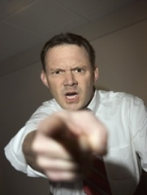
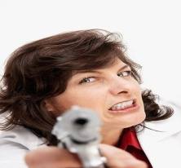
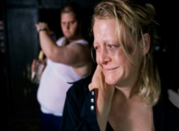
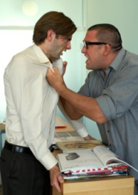
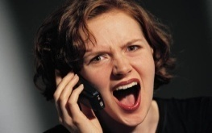
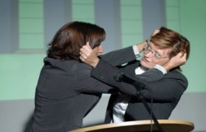
Workplace Violence Continuum
Discourtesy
Disrespect
Intimidation
Harassment
Retaliation
Verbal
Assault
Physical Aggression

Slide 94
Facts: WPV
$4.2 billion: spent yearly in medical costs, lost work time & legal fees due to WPV
Homicide : 2nd leading cause of all workplace deaths

Slide 95
Facts: WPV
2 people murdered/
day!

Slide 96
Facts: WPV
2 people murdered/day!
Every hour:
      26 rapes

Slide 97
Facts: WPV
2 people murdered/day!
Every hour:
      26 rapes
      44 robberies

Slide 98
Facts: WPV
2 people murdered/day!
Every hour:
      26 rapes
      44 robberies
      207 aggravated assaults

Slide 99
Facts: WPV
2 people murdered/day!
Every hour:
      26 rapes
      44 robberies
      207 aggravated assaults
      938 simple assaults

Slide 100
Facts: WPV
2 people murdered/day!
Every hour:
      26 rapes
      44 robberies
      207 aggravated assaults
      938 simple assaults
      3,125 threats.

Slide 101
Intimate Partner Violence

Slide 102
Intimate Partner Violence
IPV: Men & Women are Victims

Slide 103
Intimate Partner Violence
IPV: Men & Women are Victims
1/3 Female Homicides/Yr

Slide 104
Intimate Partner Violence
IPV: Men & Women are Victims
1/3 Female Homicides/Yr
5.3MM Incident/Yr

Slide 105
Intimate Partner Violence
IPV: Men & Women are Victims
1/3 Female Homicides/Yr
5.3MM Incident/Yr
2MM injuries. 1,300 Deaths

Slide 106
Intimate Partner Violence
IPV: Men & Women are Victims
1/3 Female Homicides/Yr
5.3MM Incident/Yr
2MM injuries. 1,300 Deaths
555M Req Medical Attention

Slide 107
Intimate Partner Violence
IPV: Men & Women are Victims
1/3 Female Homicides/Yr
5.3MM Incident/Yr
2MM injuries. 1,300 Deaths
555M Req Medical Attention
18.5 MM Mental Health Visits/Yr

Slide 108
Stalking @ Workplace

Slide 109
Stalking @ Workplace
3.4 MM Victims/Yr

Slide 110
Stalking @ Workplace
3.4 MM Victims/Yr
46%: 1 Unwanted Contact/Wk

Slide 111
Stalking @ Workplace
3.4 MM Victims/Yr
46%: 1 Unwanted Contact/Wk
11%: Stalked 5+ Yrs

Slide 112
Stalking @ Workplace
3.4 MM Victims/Yr
46%: 1 Unwanted Contact/Wk
11%: Stalked 5+ Yrs
Hi Risk: Divorced or Separated

Slide 113
Stalking @ Workplace
3.4 MM Victims/Yr
46%: 1 Unwanted Contact/Wk
11%: Stalked 5+ Yrs
Hi Risk: Divorced or Separated
Women at Greater Risk: Stalking

Slide 114
Stalking @ Workplace
3.4 MM Victims/Yr
46%: 1 Unwanted Contact/Wk
11%: Stalked 5+ Yrs
Hi Risk: Divorced or Separated
Women at Greater Risk: Stalking
Men=Women: Harassment

Slide 115
Stalking @ Workplace
3.4 MM Victims/Yr
46%: 1 Unwanted Contact/Wk
11%: Stalked 5+ Yrs
Hi Risk: Divorced or Separated
Women at Greater Risk: Stalking
Men=Women: Harassment
¼ Report Cyber stalking

Slide 116
Workplace Bullying

Slide 117
Workplace Bullying
37% Report WPB: 54MM

Slide 118
Workplace Bullying
37% Report WPB: 54MM
Add’l 12% Witness

Slide 119
Workplace Bullying
37% Report WPB: 54MM
Add’l 12% Witness
72% Bullies: Supervisors. 60% Male.

Slide 120
Workplace Bullying
37% Report WPB: 54MM
Add’l 12% Witness
72% Bullies: Supervisors. 60% Male.
Equal: M to M; M to F; F to F;
2/3 Less: F to M;

Slide 121
Workplace Bullying
37% Report WPB: 54MM
Add’l 12% Witness
72% Bullies: Supervisors. 60% Male.
Equal: M to M; M to F; F to F;
2/3 Less: F to M;
57% Targets: Women

Slide 122
Types of Violence

Slide 123
Types of Violence
Harassment and teasing
Hostility & bullying
Theft
Acts of aggression
Sabotage
Rape & other physical assaults
Homicide/Suicide

Slide 124
Myths

Slide 125
Myths
“It Can’t Happen Here”

Slide 126
Myths
“It Can’t Happen Here”
It Only Happens at 7/11s

Slide 127
Myths
“It Can’t Happen Here”
It Only Happens at 7/11s
People Snap/
It Can’t be Anticipate

Slide 128
Myths
“It Can’t Happen Here”
It Only Happens at 7/11s
People Snap/It Can’t be Anticipate
Educated people: not violent

Slide 129
Myths
“It Can’t Happen Here”
It Only Happens at 7/11s
People Snap/It Can’t be Anticipate
Educated people: not violent
Well-to-do: not violent

Slide 130
Myths
“It Can’t Happen Here”
It Only Happens at 7/11s
People Snap/It Can’t be Anticipate
Educated people: not violent
Well-to-do: not violent
Talking about violence will make it happen

Slide 131
Myths
“It Can’t Happen Here”
It Only Happens at 7/11s
People Snap/It Can’t be Anticipate
Educated people: not violent
Well-to-do: not violent
Talking about violence will make it happen
If a person can joke about violence they won’t become violent

Slide 132
Myths
“It Can’t Happen Here”
It Only Happens at 7/11s
People Snap/It Can’t be Anticipate
Educated people: not violent
Well-to-do: not violent
Talking about violence will make it happen
If a person can joke about violence they won’t become violent
People who threaten violence are just looking for attention

Slide 133
Myths
“It Can’t Happen Here”
It Only Happens at 7/11s
People Snap/It Can’t be Anticipate
Educated people: not violent
Well-to-do: not violent
Talking about violence will make it happen
If a person can joke about violence they won’t become violent
People who threaten violence are just looking for attention

Slide 134
One More Myth

Slide 135
Most
Dangerous
Myth

Slide 136
Most Dangerous Myth
“We’ve Done Something”

Slide 137
Most Dangerous Myth
“We’ve Done Something”
Policy: “We’re Against WPV”

Slide 138
Most Dangerous Myth
“We’ve Done Something”
Policy: “We’re Against WPV”
No Respns Plng, No Prcdrs, No Trng, No Xrcses

Slide 139
Most Dangerous Myth
“We’ve Done Something”
Policy: “We’re Against WPV”
No Respns Plng, No Prcdrs, No Trng, No Xrcses

Slide 140
WPV
        Can Be Prevented
        Should Be Prevented

Slide 141
Goals
Reduce the risk of WPV
Minimize personal & organizational suffering
Reduce Org’s/Individual’s Liability

Slide 142
3 Keys to Prevention
Education
Preparation
Early Intervention

Slide 143
Factors that Contribute: WPV

Slide 144
Factors that Contribute: WPV
Peer pressure
Need for attention & respect
Feelings of low self-worth
Feelings of chronic injustice
Early childhood abuse/neglect
Bullying: WPV or Camp
Witnessing of violence
Easy access to weapons
Drug & alcohol abuse

Slide 145
Prime Goal: Avoidance

Slide 146
Prime Goal: Avoidance
Prevention/Preparation/Education
The concept of “zero tolerance”
Understand Warning Signs
Responding to Threats
Counseling & Support

Slide 147
Prevention

Slide 148
Prevention
Early Recognition & Intervention
Security & Access Control
Policies, Protocols & Education
Modeling Appropriate Behavior
Conflict Resolution
Therapeutic Services: EAP
Listen…Listen…Listen
Attending to Warning Signs
Multiple Points of Identification

Slide 149
Types of Threats

Slide 150
Types of Threats
Direct
Conditional
Veiled

Slide 151
Types of Threats
Direct: “I’m gonna kill you”

Slide 152
Types of Threats
Direct
Conditional: “I’m going to get you.”

Slide 153
Types of Threats
Direct
Conditional
Veiled: “I know where you live.”

Slide 154
Common Warning Signs

Slide 155
Common Warning Signs
Hx of violence, threats or repeated discipline

Slide 156
Common Warning Signs
Hx of violence, threats or repeated discipline
Difficulty controlling temper

Slide 157
Common Warning Signs
Hx of violence, threats or repeated discipline
Difficulty controlling temper
Substance Abuse

Slide 158
Common Warning Signs
Hx of violence, threats or repeated discipline
Difficulty controlling temper
Substance Abuse
Excessive fascination with weapons

Slide 159
Common Warning Signs
Hx of violence, threats or repeated discipline
Difficulty controlling temper
Substance Abuse
Excessive fascination with weapons
Paranoid thought patterns

Slide 160
Common Warning Signs
Hx of violence, threats or repeated discipline
Difficulty controlling temper
Substance Abuse
Excessive fascination with weapons
Paranoid thought patterns
Major stressors

Slide 161
Common Warning Signs
Hx of violence, threats or repeated discipline
Difficulty controlling temper
Substance Abuse
Excessive fascination with weapons
Paranoid thought patterns
Major stressors
Frequent unresolved conflicts

Slide 162
Common Warning Signs
Hx of violence, threats or repeated discipline
Difficulty controlling temper
Substance Abuse
Excessive fascination with weapons
Paranoid thought patterns
Major stressors
Frequent unresolved conflicts
Feeling excluded

Slide 163
Common Warning Signs
Hx of violence, threats or repeated discipline
Difficulty controlling temper
Substance Abuse
Excessive fascination with weapons
Paranoid thought patterns
Major stressors
Frequent unresolved conflicts
Feeling excluded
Destructive behaviors

Slide 164
Common Warning Signs
Hx of violence, threats or repeated discipline
Difficulty controlling temper
Substance Abuse
Excessive fascination with weapons
Paranoid thought patterns
Major stressors
Frequent unresolved conflicts
Feeling excluded
Destructive behaviors
Feels unfairly wronged

Slide 165
Common Warning Signs
Hx of violence, threats or repeated discipline
Difficulty controlling temper
Substance Abuse
Excessive fascination with weapons
Paranoid thought patterns
Major stressors
Frequent unresolved conflicts
Feeling excluded
Destructive behaviors
Feels unfairly wronged
Major mood swings

Slide 166
Common Warning Signs
Hx of violence, threats or repeated discipline
Difficulty controlling temper
Substance Abuse
Excessive fascination with weapons
Paranoid thought patterns
Major stressors
Frequent unresolved conflicts
Feeling excluded
Destructive behaviors
Feels unfairly wronged
Major mood swings
Few social supports

Slide 167
Common Warning Signs
Hx of violence, threats or repeated discipline
Difficulty controlling temper
Substance Abuse
Excessive fascination with weapons
Paranoid thought patterns
Major stressors
Frequent unresolved conflicts
Feeling excluded
Destructive behaviors
Feels unfairly wronged
Major mood swings
Few social supports
Isolation

Slide 168
Common Warning Signs
Hx of violence, threats or repeated discipline
Difficulty controlling temper
Substance Abuse
Excessive fascination with weapons
Paranoid thought patterns
Major stressors
Frequent unresolved conflicts
Feeling excluded
Destructive behaviors
Feels unfairly wronged
Major mood swings
Few social supports
Isolation
Deteriorating social situation

Slide 169
Common Warning Signs
Hx of violence, threats or repeated discipline
Difficulty controlling temper
Substance Abuse
Excessive fascination with weapons
Paranoid thought patterns
Major stressors
Frequent unresolved conflicts
Feeling excluded
Destructive behaviors
Feels unfairly wronged
Major mood swings
Few social supports
Isolation
Deteriorating social situation
Rigid work environment

Slide 170
Common Warning Signs
Hx of violence, threats or repeated discipline
Difficulty controlling temper
Substance Abuse
Excessive fascination with weapons
Paranoid thought patterns
Major stressors
Frequent unresolved conflicts
Feeling excluded
Destructive behaviors
Feels unfairly wronged
Major mood swings
Few social supports
Isolation
Deteriorating social situation
Rigid work/Camp environment
Bullying or victimization

Slide 171
Common Warning Signs
Hx of violence, threats or repeated discipline
Difficulty controlling temper
Substance Abuse
Excessive fascination with weapons
Paranoid thought patterns
Major stressors
Frequent unresolved conflicts
Feeling excluded
Destructive behaviors
Feels unfairly wronged
Major mood swings
Few social supports
Isolation
Deteriorating social situation
Rigid work/Camp environment
Bullying or victimization
Work trysts & cliques

Slide 172
Common Warning Signs
Hx of violence, threats or repeated discipline
Difficulty controlling temper
Substance Abuse
Excessive fascination with weapons
Paranoid thought patterns
Major stressors
Frequent unresolved conflicts
Feeling excluded
Destructive behaviors
Feels unfairly wronged
Major mood swings
Few social supports
Isolation
Deteriorating social situation
Rigid work environment
Bullying or victimization
Work trysts & cliques

Slide 173
Campus Prevention?

Slide 174
Campus Prevention?
Many: Prevented

Slide 175
Campus Prevention?
Many: Prevented
Plans: Discovered Prior

Slide 176
Campus Prevention?
Many: Prevented
Plans: Discovered Prior
Must Connect Dots

Slide 177
Campus Prevention?
Many: Prevented
Plans: Discovered Prior
Must Connect Dots
Key: Act on Reports

Slide 178
Campus Prevention?
Many: Prevented
Plans: Discovered Prior
Must Connect Dots
Key: Act on Reports
Assess: Curiosity

Slide 179
Multiple Points of ID
Peers & Co-Workers
Supervisors
Spouse
Parents & Family
Self
Friends
Health Care System: EAP
Clergy
Police

Slide 180
Responding to Signs

Slide 181
Responding to Signs
Safety 1st
Report to Your Supervisor
Consult with others
Do NOT Confront
Don’t be a hero
Follow-up, follow-up, follow-up

Slide 182
Camp
Threat
Assessment

Slide 183
Camp Threat Assessment
Process

Slide 184
Camp Threat Assessment
Process
ID Kids of Concern

Slide 185
Camp Threat Assessment
Process
ID Kids of Concern
Gather Info/Investigate

Slide 186
Camp Threat Assessment
Process
ID Kids of Concern
Gather Info/Investigate
Assess: Student & Situation

Slide 187
Camp Threat Assessment
Process
ID Kids of Concern
Gather Info/Investigate
Assess: Student & Situation
Manage: Student & Situation

Slide 188
Camp Threat Assessment
Process
ID Kids of Concern
Gather Info/Investigate
Assess: Student & Situation
Manage: Student & Situation

Slide 189
Immediate Threat

Slide 190
Immediate Threat
Try to Remain Calm
Do NOT Confront: No Heroes
No weapon vs... knife vs... gun
Try to Exit Scene
Give assailant what he/she wants
Call for Help

Slide 191
After an Incident

Slide 192
After an Incident
Deal with media and police
Avoiding self-blame
Address Post-Traumatic Stress Disorder
The importance of support
The myth of “being strong”
Signs & symptoms: alcohol, drugs, depression, anxiety, physical problems, nightmares

Slide 193
Confidentiality
The “Need to Know”
Appropriate notification of authorities
Protection of key individuals
  possible victims
  other employees
  family

Slide 194
Preventing
Workplace Violence
Establish a culture based on prevention
Train the workplace in violence prevention
Establish multiple points of identification
Develop response systems for threat assessment and management
Listen, be aware and respond…

Slide 195
Demand Reporting
4 S

Slide 196
Demand Reporting
See
Something,
Say
Something

Slide 197
Violence
Scenarios

Slide 198
Scenarios
A program director (who runs an important program which is very successful) yells and curses employees on a regular basis. He recently punched another employee in the arm after that employee insulted him at camp social event

Slide 199
Scenarios
Counselor reports he believes another is carrying a knife/gun

Slide 200
Scenarios
Counselors “initiate” new Jr. Counselors by waking them at midnight, bullying them to funnel alcohol and skinny dip.

Slide 201
Scenarios
You see two Camp staffers angry and pushing each other. Does it matter if they report to you?

Slide 202
Scenarios
A admin asst & director seem to be having an intimate relationship

Slide 203
Scenarios
A Counselor asks parent to move their vehicle. They object, state they’re a parent and call Counselor a “jerk”

Slide 204
Scenarios
An email that is sent to 10 people that is critical of the work of one counselor

Slide 205
Scenarios
You have to terminate an employee who is unpopular, lives alone and has been known to crush soda cans when angry/provoked

Slide 206
Scenarios
Employee’s behavior changes: bizarre. He scowls/stares. Fellow emps uncomfortable. Sups order counseling under threat of termination.

Slide 207
Scenarios
Employee’s behavior changes: bizarre. He scowls/stares. Fellow emps uncomfortable. Sups order counseling under threat of termination. Post counseling, EAP recommended anger-mgmt training, then his return to work. Sups uncomfortable.

Slide 208
Scenarios
Employee’s behavior changes: bizarre. He scowls/stares. Fellow emps uncomfortable. Sups order counseling under threat of termination. Post counseling, EAP recommended anger-mgmt training, then his return to work. Sups uncomfortable. Got signed waiver from emp to permit HR to review his EAP results. Bizarre behavior caused by personal issues outside the workplace. He returned to work with no further incident.

Slide 209
Female supervisor wonders if profanity is an indicator of violent behavior. She felt that much of this should be ignored. But, one employee’s profane behavior was frightening esp. as he grew more vulgar and loud.

Slide 210
Female supervisor wonders if profanity is an indicator of violent behavior. She felt that much of this should be ignored. But, one employee’s profane behavior was frightening esp. as he grew more vulgar and loud. When questioned, it was revealed that he started his frightening profanity when he started to lose an argument. He was using his language to threaten fellow employees to get them to back down.

Slide 211
These behaviors have no operational need; they are totally inappropriate for the camp world. Thus, there is no need to tolerate low-level aggression or to wonder when is the right time to intervene.

Slide 212
Active
Shooter

Slide 213
Stats
Active
Shooters

Slide 214
2013-2014
Banner Years
Active Shooters

Slide 215
US AG
5-Yr Ave
2008-2012

Slide 216
US AG
1/Mo.
5-Yr Ave 2008-2012

Slide 217
2013-
2014

Slide 218
US AG-FBI-NYPD
1/Wk
2013-2014

Slide 219
Lessons
Learned

Slide 220
Definition DHS:
Actively engaged in killing or attempting to kill people in a confined and populated area

Slide 221
Description
Profile?

Slide 222
Description
Profile?

Slide 223


Slide 224
NYPD: Active Shooter Analysis
2011
202 Cases
Nationwide
All American

Slide 225
NYPD: Active Shooter Analysis
Male 96%
Age: 10-64!

Slide 226
NYPD: Active Shooter Analysis
Alone 98%
Plans: Y & N
Familiar: 78%
Emps: Current + Fired

Slide 227
NYPD: Active Shooter Analysis
Deaths: 3.0 Ave
Injured: 3.6 Ave

Slide 228
NYPD: Active Shooter Analysis
Campuses: 29%
Other Workplaces:
71%

Slide 229
NYPD: Active Shooter Analysis
Weapons: 36% Multiple

Slide 230
NYPD: Active Shooter Analysis
Force: 46%
Suicide: 40%
Arrested: 14%

Slide 231
This Is Not Just About Campuses or Camps…

Slide 232
This Is Not Just About Campuses…
It’s About All Workplaces in America

Slide 233
Lessons Learned
Individuals
Employer

Slide 234
Lessons Learned
Individuals

Slide 235
Run
Hide
Fight

Slide 236
Run Hide Fight
Generalities: Dangerous

Slide 237
Run Hide Fight
Generalities: Dangerous
Make Specific to:
Your People
Your Site

Slide 238
Run Hide Fight
Training
Training
Training

Slide 239
Lessons Learned
Individuals
Employer

Slide 240
Run
Hide
Fight

Slide 241
Run

Slide 242
Hide
Lockdown

Slide 243
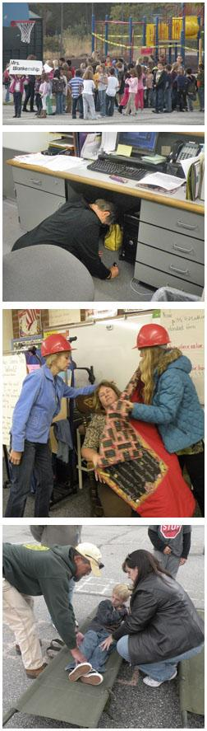

Slide 244
Lockdown
Lock Doors

Slide 245
Lockdown
Lock Doors
Barricade

Slide 246
Lockdown
Lock Doors
Barricade
Silence
People
Devices

Slide 247
Not Just about
Lockdown…

Slide 248
Not Just about
Lockdown…
Lockout!

Slide 249
Fight
Last Resort

Slide 250
Fight
Last Resort
Gang Up

Slide 251
Fight
Last Resort
Gang Up
Alone:
Surprise
Hard
Fast

Slide 252
What’s
Missing
Here???

Slide 253
Almost All
Shootings:
Over in <
8 Minutes

Slide 254
So, Police
Probably
Can’t Help

Slide 255
Emergency
Team

Slide 256
Emergency
Team:
Employees

Slide 257
Police /Fire /EMTs are not the 1st responders

Slide 258
Police /Fire /EMTs are not the 1st responders
Employees are the
1st responders

Slide 259
So, Employees
Shall Be Organized
Into An Emergency
Team…

Slide 260
So, Employees
Shall Be Organized
Into An Emergency
Team…
By Federal Law

Slide 261
Why We Plan
OSHA
is not a town in
Wisconsin.

Slide 262

Required by Federal Law

Slide 263
OSHA
29 CFR 1910.34

Slide 264
“Sections 1910.34 through 1910.39 apply to workplaces in general industry except mobile workplaces such as vehicles or vessels”

Slide 265
Mandatory
    OSHA Regulations
    29 CFR 1910.38/.39
      Emergency Action Plan
      Fire Prevention Plan

Slide 266
OSHA
Requires
Every Emp:
Emergency Team

Slide 267
Many Threats & Many Procedures:

Slide 268
Yikes!
Many Threats & Many Procedures:
One Team!

Slide 269
Emergency
Team:
Employees

Slide 270
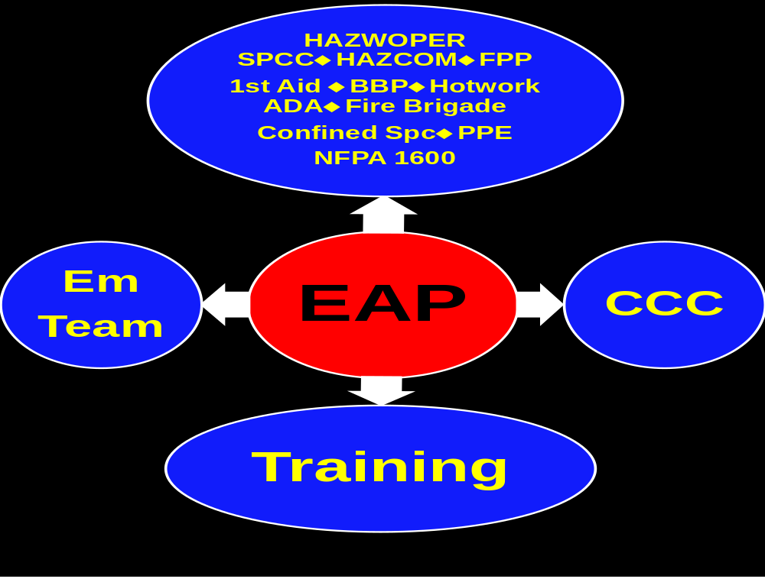

Slide 271
Employer
Shall Have
A Plan &
Training
By Law

Slide 272
Employee
Training
Required
By Federal Law

Slide 273
We Don’t Rise to the Occasion…

Slide 274


Slide 275
We Don’t Rise to the Occasion…

Slide 276
We Don’t Rise to the Occasion.
We Sink to Our Level of Our Training

Slide 277
Training Required
All Employees

Slide 278
OSHA Training
WHEN?
At Hire
Annually
When Plan Changes
When People Change

Slide 279
OSHA Training
WHERE?
In a Classroom
“Hands On”
“Where Trainees Can Ask Qs & Get Answers”

Slide 280
OSHA Training
TRAINER?
“Qualified”
Experience
Training

Slide 281
How?
On-Screen
Training??

Slide 282
On-Screen Training?
OSHA Since 1985
On-Screen: Great!
Can Supplement ONLY
Can’t Substitute

Slide 283
No Plan & Training
Run
Hide
Fight =
Failure

Slide 284
We Hang Together, or…
We Hang Separately

Slide 285
Workplace
No Planning +
No Training =
Chaos

Slide 286
CCC
Command
Control
Communications

Slide 287
Workplace
Emergency:
Must: Someone In
Overall
Command

Slide 288
Workplace
Emergency:
Control
Using a Team
Of Employees

Slide 289
Workplace
Emergency:
We All Have To
Communicate

Slide 290
If We Can
Command
Control
Communicate
= A Good Day

Slide 291
If We Can’t
Command
Control
Communicate
= A Bad Day

Slide 292
Workplace
Emergency:
Must: Someone In
Overall
Command

Slide 293
Command =
Chain of Command:
Enough Commanders
To Cover Absences,
Shifts, Total Headcount

Slide 294
Control =
Enough Employees
To Cover All Space &
Total Headcount

Slide 295
Communications =
If You Can’t Communicate,
You Can’t Respond

Slide 296
Communications
Cells, Land Lands, IT & Power Will All Fail
How Will You Communicate:
      Headcounts
      Injured Person
      Unfolding Situations

Slide 297
Communications
Only Way:
2-Way Radios
For All

Slide 298
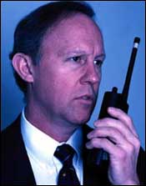

Slide 299
CCC
Command
Control
Communications

Slide 300
Only Way CCC Happens
Planning

Slide 301
Only Way CCC Happens
Planning
Training

Slide 302
Only Way CCC Happens
Planning
Training
Drills

Slide 303
Only Way CCC Happens
Planning
Training
Drills
Exercises

Slide 304
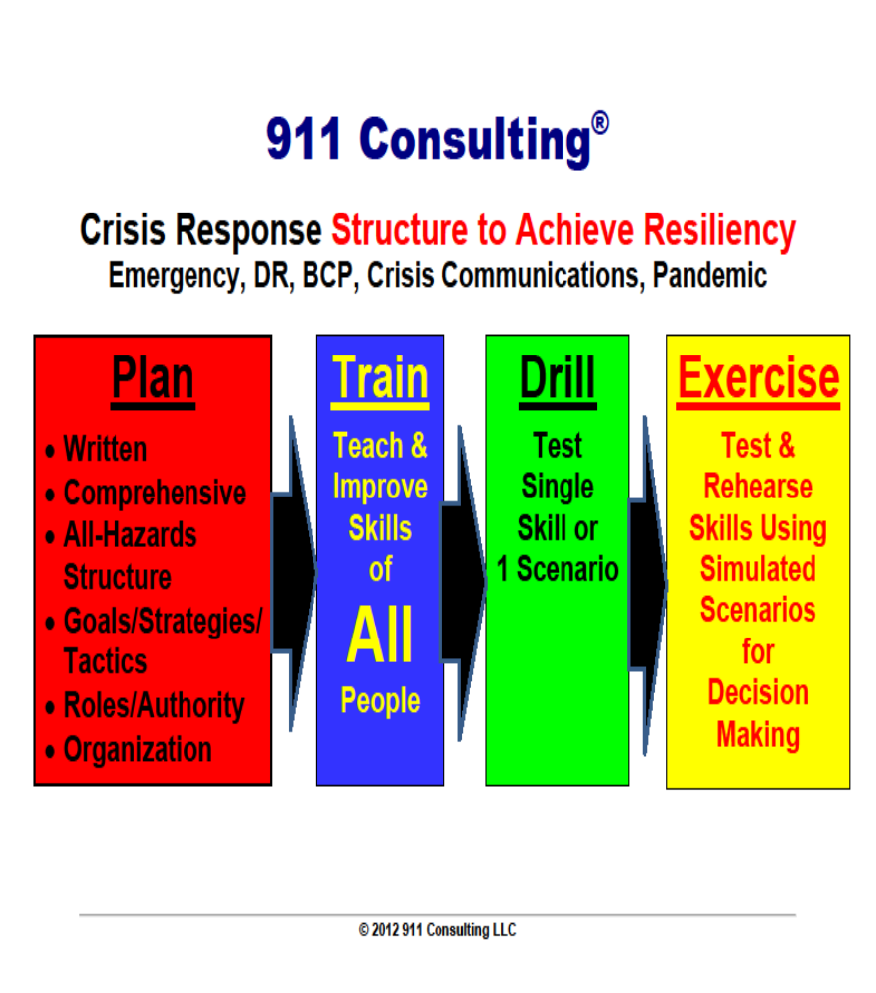

Slide 305
Planning

Slide 306
Planning =
Req by Fed Law

Slide 307
Planning =
Req by Fed Law
All Emps w/o Exception

Slide 308
Planning =
Req by Fed Law
All Emps w/o Exception
All Hazards

Slide 309
Planning =
Req by Fed Law
All Emps w/o Exception
All Hazards
Creates Team

Slide 310
Planning =
Req by Fed Law
All Emps w/o Exception
All Hazards
Creates Team
Chain of Command

Slide 311
Your Workplace Emergency Plan
Active
Shooter
Protocol

Slide 312
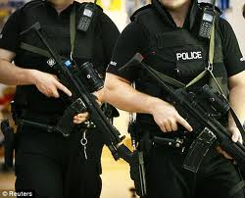

Slide 313
Active Shooter Protocol
Your PD’s Procedure for
Responding to Your Workplace

Slide 314
Active Shooter Protocol
Find Shooter

Slide 315
Active Shooter Protocol
Find Shooter
“Neutralize” Him

Slide 316
Active Shooter Protocol
No 1st Aid

Slide 317
Active Shooter Protocol
No 1st Aid
No Hand Holding

Slide 318
Active Shooter Protocol
No 1st Aid
No Hand Holding
No Clearing Rooms

Slide 319
Active Shooter Protocol
No 1st Aid
No Hand Holding
No Clearing Rooms
Don’t Scream + Point

Slide 320
Active Shooter Protocol
No 1st Aid
No Hand Holding
No Clearing Rooms
Don’t Scream + Point
Engage Only If You have Important 411

Slide 321
Active Shooter Protocol

Slide 322
Active Shooter Protocol and
Your Workplace Emergency Plan

Slide 323
Your Workplace Emergency Plan
Must Be Coord w. Your PD

Slide 324
Your Workplace Emergency Plan
Must Be Coord w. Your PD
Every PD Does This Differently

Slide 325
Your Workplace Emergency Plan
Must Be Coord w. Your PD
Every PD Does This Differently
Ex: Curtains Closed? Opened?

Slide 326
Your Workplace Emergency Plan
IFF
Identify Friend From Foe

Slide 327
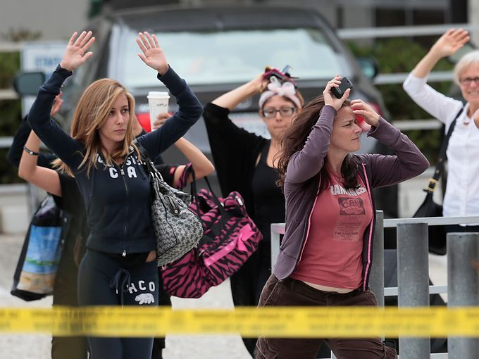

Slide 328
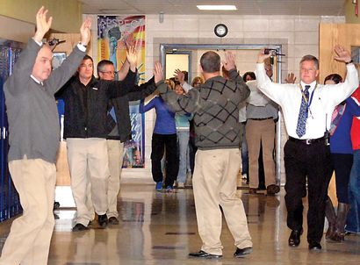

Slide 333
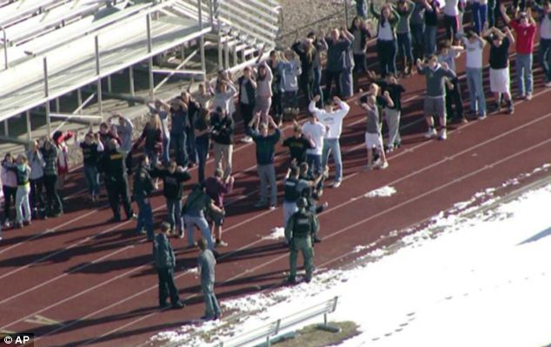

Slide 334
Great Plans
Are a Smart Thing;

Slide 335
Great Plans
Are a Smart Thing;
Training is
Everything!

Slide 336
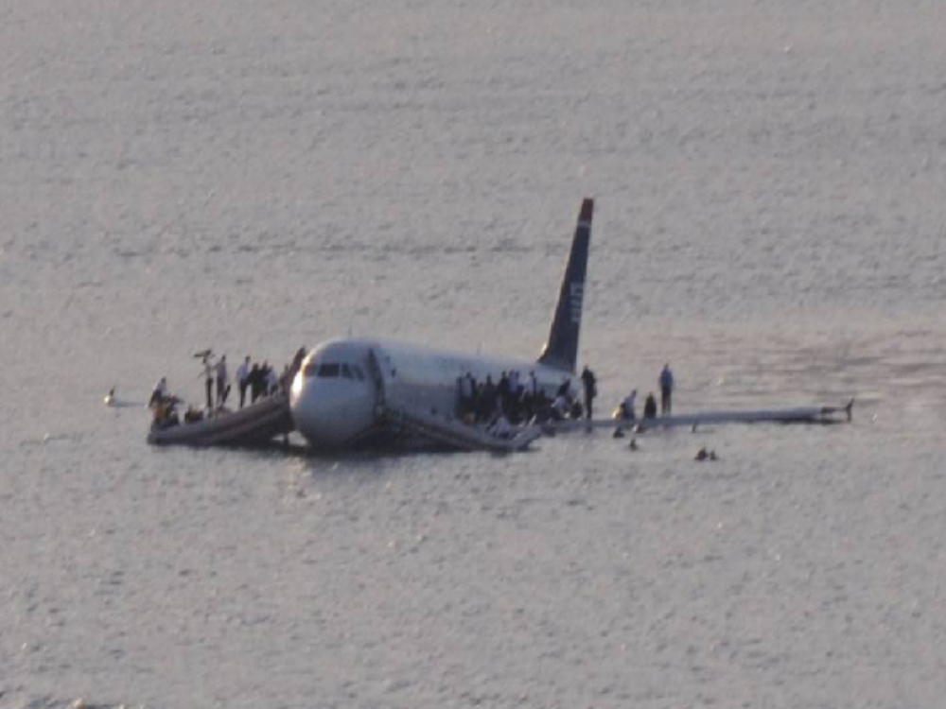

Slide 337
Training is Everything
737 Canada Fiery Crash Evacuation
No Fatalities
737 Greek Fiery Crash
55/137 Fatalities

Slide 338
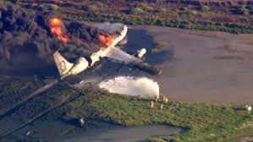

Slide 339
Training is Everything
Difference?
Non-Fatal Crash: 75% were frequent business flyers
55 Fatalities: Almost 100% were 1st-time flyers

Slide 340
Hudson River
Survival was not the result of a miracle…

Slide 341
Hudson River
Survival was
the result of training.

Slide 342
We Don’t Rise to the Occasion…

Slide 343
We Don’t Rise to the Occasion.
We Sink to Our Level of Our Training

Slide 344
Exercises

Slide 345
Exercises
NOT Req by Law

Slide 346
Exercises
NOT Req by Law
Best Way to Test

Slide 347
Exercises
NOT Req by Law
Best Way to Test
Effectiveness:
Planning
Training
Drills

Slide 348
Responsible
Officer?

Slide 349
Responsible Party?
CEO
SCOTUS

Slide 350
CEO: Responsible Party
Civilly

Slide 351
CEO: Responsible Party
Civilly
Personally

Slide 352
CEO: Responsible Party
Civilly
Personally
Criminally

Slide 353
CEO = Resp Officer
Does Your CEO Know This?

Slide 354
CEO = Resp Officer
Does Your CEO Know This?
Shouldn’t They?

Slide 355
CEO = Resp Officer
Does Your CEO Know This?
Shouldn’t They?
Wouldn’t You?

Slide 356
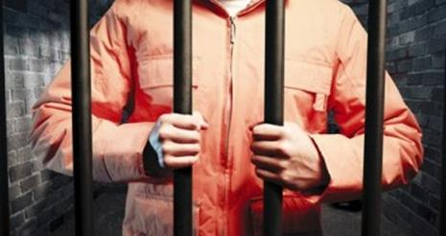

Slide 357
Responsible Parties
CEO
Trustees/Directors
Sr. Ops Personnel

Slide 358
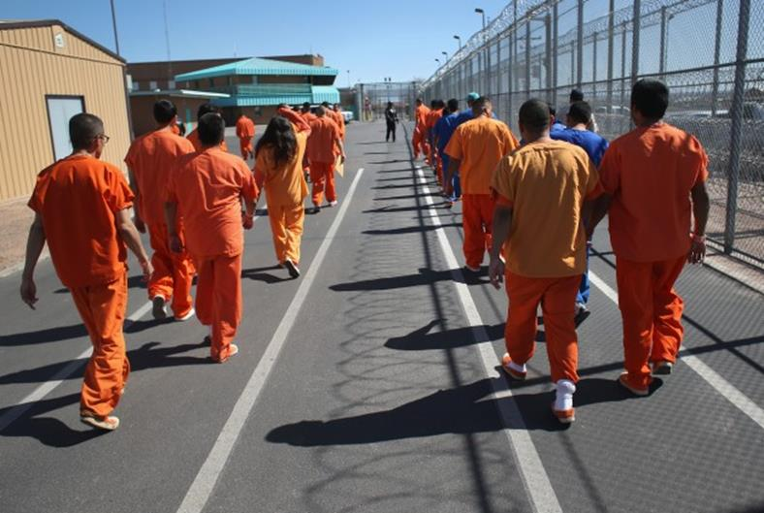

Slide 359
Summary

Slide 360
Before You’re a Camp,
You’re a Workplace

Slide 361
18x
More Likely to Have
Violence than a
Fire
at Work
DOJ & NFPA

Slide 362
Bullying
& Hazing

Slide 363
Big Picture: Campus Violence
Not New
Deaths:

Slide 364
SCI Results
No One Snaps
Told Others
Did Not Threaten Targets
No Profile
Others Concerned
Had Losses/Failures. Suicidal
Bullied/Persecuted/Injured
Easy Access to Weapons
Other Kids Involved
Ended by Others Than Police

Slide 365
WPV: Many Forms
Violence
Intimate Partner Violence
Stalking
Bullying

Slide 366
Myths
“It Can’t Happen Here”
It Only Happens at 7/11s
People Snap/It Can’t be Anticipate
Educated people: not violent
Well-to-do: not violent
Talking about violence will make it happen
If a person can joke about violence they won’t become violent
People who threaten violence are just looking for attention

Slide 367
Demand Reporting
See
Something,
Say
Something

Slide 369
Almost All
Shootings:
Over in <
8 Minutes

Slide 370
Police /Fire /EMTs are not the 1st responders
Employees are the
1st responders

Slide 371
OSHA Training
WHEN?
At Hire
Annually
When Plan Changes
When People Change

Slide 372
OSHA Training
WHERE?
In a Classroom
“Hands On”
“Where Trainees Can Ask Qs & Get Answers”

Slide 374
We Don’t Rise to the Occasion…

Slide 375
We Don’t Rise to the Occasion.
We Sink to Our Level of Our Training

Slide 376
CEO: Responsible Party
Civilly
Personally
Criminally

Slide 377
Responsible Parties
CEO
Trustees/Directors
Sr. Ops Personnel

Slide 382
Getting It Done Is Tough!

Slide 383
The Scariest Word at Any
Org?

Slide 384
NOT:
“Cost” or
“Price” or
“Budget” or
“Headcount”

Slide 385
Scariest Word?
Change!

Slide 386
In all Orgs, Change Almost Always Occurs Because of…

Slide 387
Blunt Force Trauma from the Outside…

Slide 388
…Never by Inspired Leadership from the Inside…

Slide 389


Slide 390
“Jaws”:
Cultural
Earthquake

Slide 391
“Jaws”: Cultural Earthquake
1975: 1st Hollywood Blockbuster

Slide 392
“Jaws”: Cultural Earthquake
1975: 1st Hollywood Blockbuster
$260,000,000: 75 days

Slide 393
“Jaws”: Cultural Earthquake
1975: 1st Hollywood Blockbuster
$260,000,000: 75 days
130MM: All US Adults 18+

Slide 394
“Jaws”: Cultural Earthquake
1975: 1st Hollywood Blockbuster
$260,000,000: 75 days
130MM: All US Adults 18+
Scared the @#%* out of America

Slide 395
“Jaws”: Cultural Earthquake
1975: 1st Hollywood Blockbuster
$260,000,000: 75 days
130MM: All US Adults 18+
Scared the @#%* out of America
Music Recognized Today Worldwide

Slide 396
HDWSI
“JAWS”:
About
Denial

Slide 397
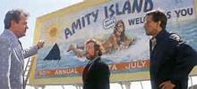

Slide 398
“Jaws”: Cultural Earthquake
“Won’t Close the
Beaches” = $$$

Slide 399
“Jaws”: Cultural Earthquake
“Won’t Close the
Beaches” = $$$
“Can’t Hire More
Lifeguards” =$$$

Slide 400
“Jaws”: Cultural Earthquake
“Won’t Close the
Beaches” = $$$
“Can’t Hire More
Lifeguards” =$$$
“I’ve Never Seen this Shark”

Slide 401
“Jaws”: Cultural Earthquake
“Won’t Close the
Beaches” = $$$
“Can’t Hire More
Lifeguards” =$$$
“I’ve Never Seen this Shark”
“Are You Sure We Have a
Problem?”

Slide 402
We Never See the Monster in the 1st 60 Minutes
★    

Slide 403
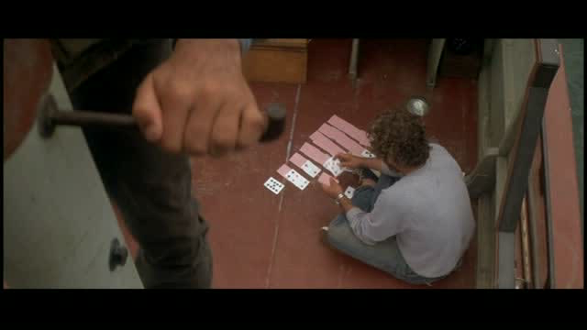

Slide 404
HDWSI?
“We Need a Bigger Boat!”

Slide 405
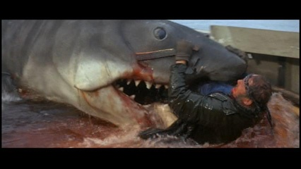

Slide 406
Recommendations

Slide 407
WPV Policy

Slide 408
WPV Policy
Goal: Safe, Secure Workplace

Slide 409
WPV Policy
Goal: Safe, Secure Workplace
Everyone is Responsible

Slide 410
WPV Policy
Goal: Safe, Secure Workplace
Everyone is Responsible
Zero Tolerance

Slide 411
WPV Policy
Goal: Safe, Secure Workplace
Everyone is Responsible
Zero Tolerance
No Weapons

Slide 412
WPV Policy
Goal: Safe, Secure Workplace
Everyone is Responsible
Zero Tolerance
No Weapons
No Threatening, Intimidation

Slide 413
WPV Policy
Goal: Safe, Secure Workplace
Everyone is Responsible
Zero Tolerance
No Weapons
No Threatening, Intimidation
Covers Visitors, Contractors

Slide 414
WPV Policy
Goal: Safe, Secure Workplace
Everyone is Responsible
Zero Tolerance
No Weapons
No Threatening, Intimidation
Covers Visitors, Contractors
Reporting Is the Key

Slide 415
Demand Reporting
See
Something,
Say
Something

Slide 416
Recommendations

Slide 417
We Need a Bigger Boat
Abandon Denial

Slide 418
We Need a Bigger Boat
Abandon Denial
Recognize Titanic Threats

Slide 419
We Need a Bigger Boat
Abandon Denial
Recognize Titanic Threats
Alert Your Captain

Slide 420
We Need a Bigger Boat
Abandon Denial
Recognize Titanic Threats
Alert Your Captain
Assess Your Boat

Slide 421
We Need a Bigger Boat
Abandon Denial
Recognize Titanic Threats
Alert Your Captain
Assess Your Boat
Get Compliant

Slide 422
We Need a Bigger Boat
Abandon Denial
Recognize Titanic Threats
Alert Your Captain
Assess Your Boat
Get Compliant
All-Hazards Plan

Slide 423
We Need a Bigger Boat
Abandon Denial
Recognize Titanic Threats
Alert Your Captain
Assess Your Boat
Get Compliant
All-Hazards Plan
Train ALL

Slide 424
We Need a Bigger Boat
Abandon Denial
Recognize Titanic Threats
Alert Your Captain
Assess Your Boat
Get Compliant
All-Hazards Plan
Train ALL
Exercise

Slide 425
We Need a Bigger Boat
Abandon Denial
Recognize Titanic Threats
Alert Your Captain
Assess Your Boat
Get Compliant
All-Hazards Plan
Train ALL
Exercise

Slide 426
Action
Plan

Slide 427
HDWSI?
“We Need a Bigger Boat!”

Slide 428
Action Plan
Assessment of Your Camp’s Current Emergency Planning + Training

Slide 429
Action Plan
Assessment of Your Camp’s Current Emergency Planning + Training
Just Like Your Financial Audits

Slide 430
Action Plan
Assessment of Your Camp’s Current Emergency Planning + Training
Just Like Your Financial Audits
Outside, Independent

Slide 431
Action Plan
Assessment of Your Camp’s Current Emergency Planning + Training
Just Like Your Financial Audits
Outside, Independent

Slide 432
Help for
You

Slide 433
Help for YOU
Copy of This Presentation

Slide 434
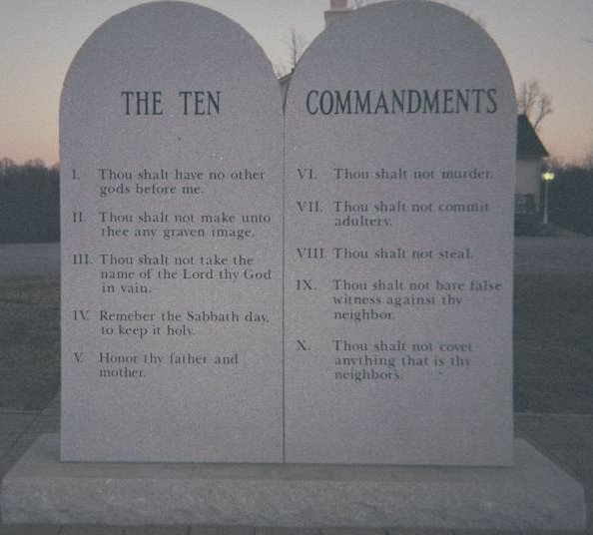
10
Commandments
Planning

Slide 435
10
Commandments
Training

Slide 436
“We Need a Bigger Boat!”

Slide 437


Slide 438

⬆ ⬆ ⬆ ⬆ ⬆ Survey

Slide 440
ACA NY/NJ
Workplace
Violence

Slide 441
“We Need a Bigger Boat!”

