Slide 1

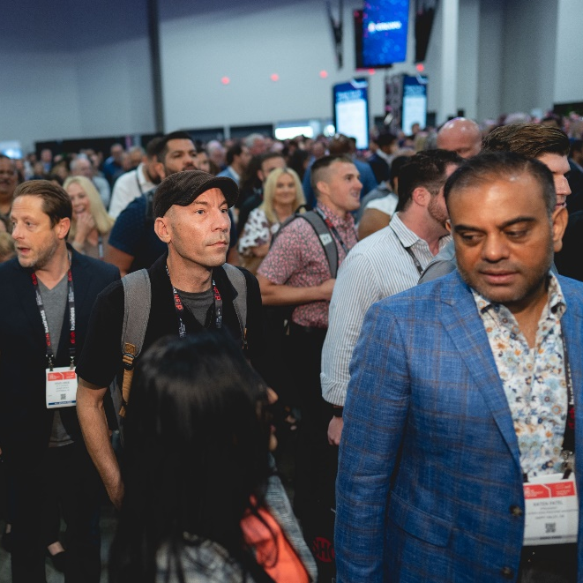








A one-stop shop to
network with:
Industry leaders
Senior executives of hotel brands
Owners
Operators
Management companies
Developers
Investors
Technology partners
and more!
October 28–30, 2024
San Antonio, TX
67%
of attendees own or operate hotels
3,800+
attendees
Driving profitability for owners, operators and hospitality innovators
400+
innovative partners & vendors
100+
industry-leading speakers
13+
hours of networking
BROUGHT TO YOU BY:
Use code THSAB100 to save $100 on your pass!
thehospitalityshow.com
@thehospshow The Hospitality Show @hosp_show

