Slide 1
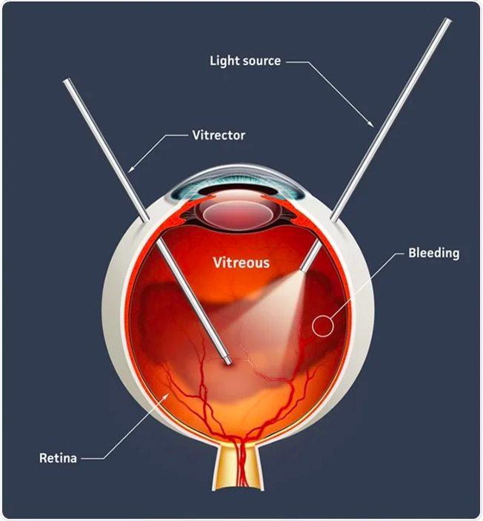



Protocol AP
Combination Faricimab + PRP vs. Vitrectomy + Endolaser for PDR

Slide 2
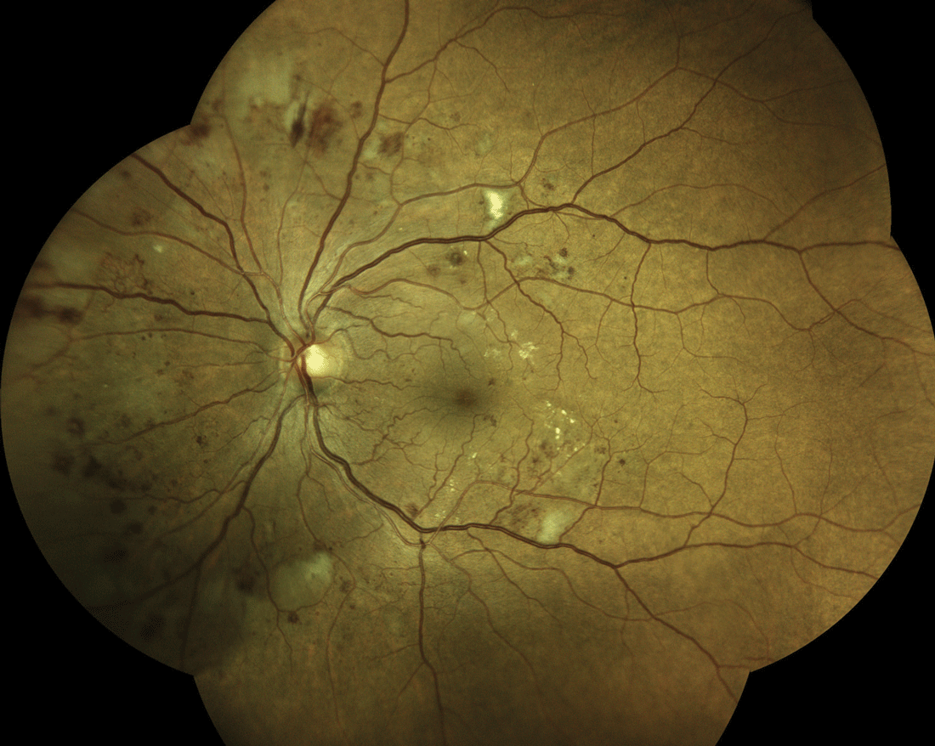
Prevalence of Diabetic Retinopathy in the US in 2021*
DM: 36 M
DR: ~10 M (1/33)
**
*Lundeen, et. al. JAMA Oph 2023
** breakdown of VTDR based on Protocol W progression rates

Slide 3
Current PDR Treatments
Prior studies (Protocol S, CLARITY) show anti-VEGF and PRP are viable treatments for PDR
Neither anti-VEGF nor PRP is a perfectly effective or durable therapy for PDR
PRP: ~50% of eyes with full PRP will need additional treatment for NV recurrence or VH; causes on average greater visual field loss, greater chance of DME development, and greater chance of vitreous hemorrhage within 2 years
Anti-VEGF: most eyes with PDR need continued anti-VEGF injections through at least 5 years; noncompliance with injections may cause recurrent NV

Slide 4
Injection burden in PDR does not go to ZERO!
Current PDR Treatment: Anti-VEGF
Unlike DME, PDR treatment continues long term
Year | DME (Protocol I – Lucentis group) # of injections (Median) | Diabetic Retinopathy (Protocol S – PDR group)
1 | 9 | 7
2 | 3 | 3
3 | 2 | 3
4 | 1 | 2
5 | 0 | 3

Slide 5
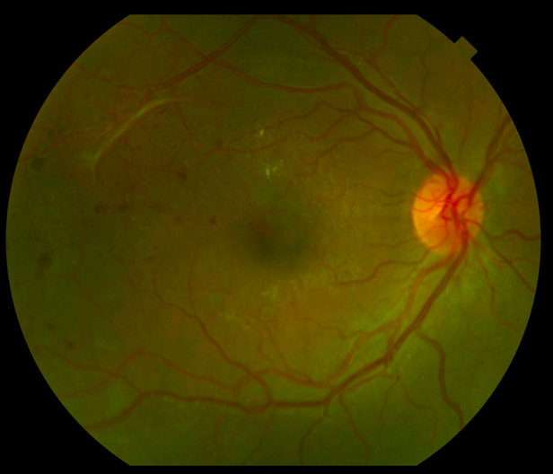
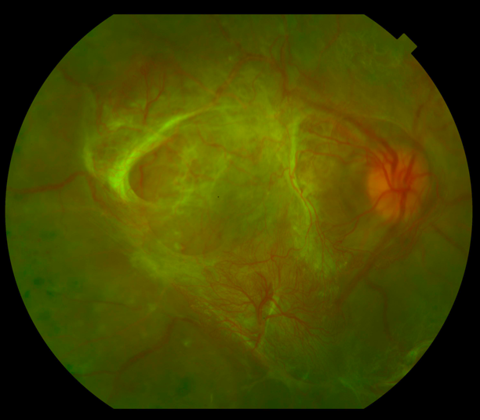
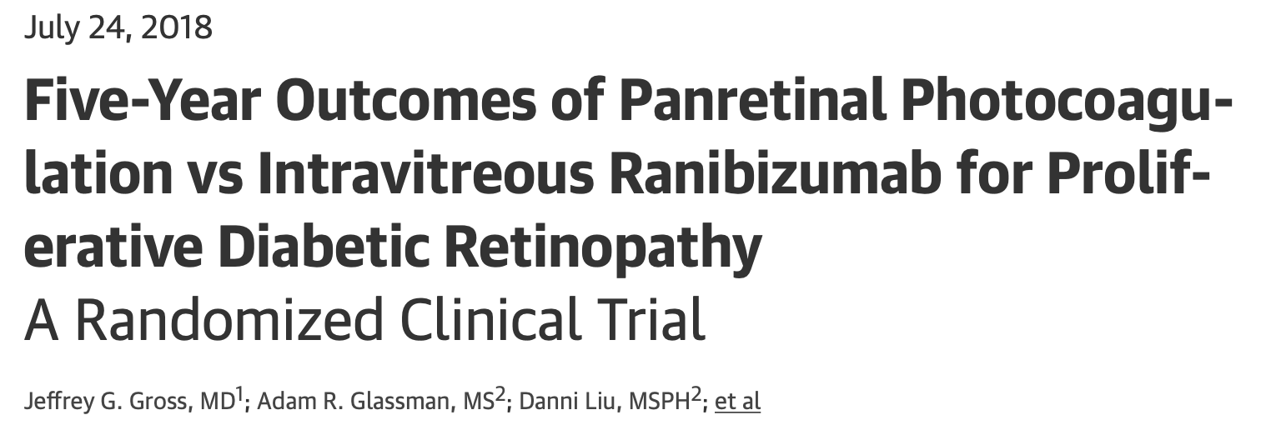
Current PDR Treatment: PRP
PRP is not always a permanent solution in eyes with PDR
PRP arm in Protocol S 5y - mean age 51- unknown how many had attached hyaloid
Only 49% needed a single PRP
46% developed VH
12%TRD
19% underwent PPV
11% ranibizumab arm
4% NVG
14 months progression despite PRP-over 2,000 spots
Courtesy of: Maria Berrocal, 2022 ASRS Founders lecture

Slide 6
Study Treatments
Faricimab + PRP
Many clinicians are using combination therapy, but there is little data on the long-term visual acuity outcomes of this approach
Vitrectomy with Endolaser
PPV allows full PRP while also removing attached hyaloid, which can contribute to PDR worsening, development of TRD and other complications
Modern techniques have reduced surgical times and complications

Slide 7
Study Rationale
No long-term data on a standardized approach to combination therapy from a large randomized clinical trial
Advances in surgical technique in addition to the advantages of removing the hyaloid during surgery make vitrectomy with endolaser an appealing option needing further investigation

Slide 8
Study Objectives
To evaluate the safety and efficacy of the two treatment strategies:
Long-term visual acuity outcomes
Visit and treatment burden
Complications (VH, recurrent NV, TRD)
Develop reliable methods for characterizing the presence and extent of vitreous adherence at baseline using OCT
Assess whether degree of adherence of the vitreous predicts treatment prognosis
Provide a standardized strategy for combination treatment
Provide a standardized vitrectomy approach

Slide 9
Study Design
Multi-Center Randomized Clinical Trial:
N ~426 eyes (2 study eyes allowed)
At least 1 eye that meets the following criteria:
Moderate PDR or worse on UWF imaging, confirmed by central reading center
No TRD involving the macula
No significant VH that would preclude PRP
No CI-DME
Immediate PPV + Endolaser
Faricimab + PRP
Primary Outcomes: Change in visual acuity from baseline to 3 years
Number of post-randomization treatments for PDR (injections, laser, vitrectomy) over 3 years

Slide 10
Key Secondary Outcomes
Development of complications (VH, active NV, any TRD, macula threatening TRD) over 3 years
Change in VA AUC over 3 years
Number of visits over 3 years
Number of in-office procedures after end of randomization treatment to treat PDR (injections, laser) over 3 years

Slide 11
Other Key Eligibility Criteria
VA ≥ 20/100
No significant VMT
No prior vitrectomy
No prior PRP
No treatment for DME within the prior 6 months
No intravitreal anti-VEGF for any indication, other than DME, within the prior year
No intravitreal or peribulbar corticosteroid in prior 4 months

Slide 12
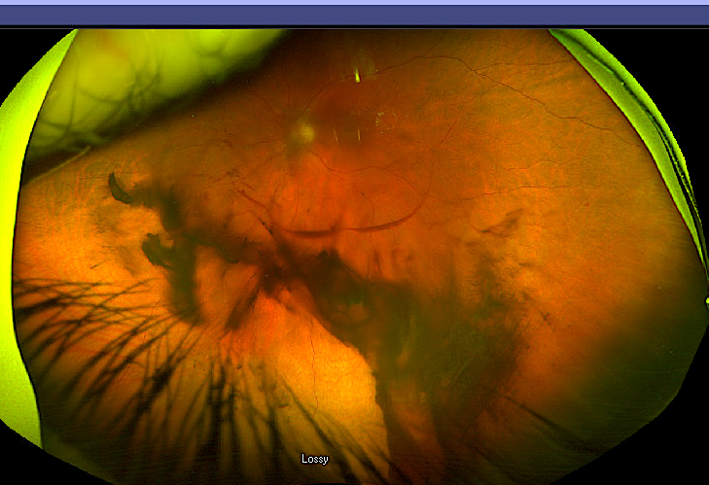
Exclusion Criteria: Determined by Investigator
Real-time RC eligibility review is for DRSS only! These exclusion criteria will be the responsibility of the investigator to carefully assess:
Significant vitreous hemorrhage (precluding full PRP)
Traction RD involving or threatening the macula
Significant vitreo-macular traction (i.e. likely to require surgery within 6M)

Slide 13
Treatment Groups “Randomization Treatment”
Faricimab + PRP*
Vitrectomy with endolaser*
3 injections (1st is at randomization then q4 week injections)
Complete PRP in 1-3 sessions
All completed within 90 days of randomization
Must be within 4 weeks of randomization
1 injection of faricimab allowed prior to vitrectomy
Non-study eyes with PDR or DME can use study faricimab!
*See Procedure manual for definitions of complete PRP and endolaser

Slide 14
Study Procedures
 | Screening Visit | Randomization Visit (up to 3 weeks after Screening) | Annual Visits | Non-annual* Visits
ETDRS BCVA | X | X | X | X
Eye Exam | X | X | X | X
OCT and OCT RNFL | X |  | X | X
UWF Fundus Photos | X |  | X
UWF FA | X |  | X
Objective field Analyzer | X |  | X
HbA1c | X |  | X
Blood Pressure | X |  | X
* Photos and FA will be required at the 16-week visit. If the eye is not quiescent at the 16-week visits, photos only will be taken at each subsequent visit until quiescence is achieved.
Vitrectomy group will also have a 1 month post-vitrectomy study visit for safety evaluation only.

Slide 15
Follow-up Schedule
16,24,36, 52 week visits
68, 84, 104 week visits
120, 136, 156 week visits
Imaging
Imaging
Imaging
1st Year
2nd Year
3rd Year
Wide field fundus photographs, wide-field FA, OCT
Additional visits will occur if treatment for PDR or DME is given

Slide 16
Treatment of Active PDR during Follow Up
The eye must be treated if either criteria are met:
Worsened NVD or NVE compared to last quiescent image
New or worsened VH
Treatment is 1 faricimab injection plus fill-in PRP, if room
Next PDR Assessment is 8 weeks following the injection
Compare the eye at the current visit to the most recent quiescent photos and FA (if available)
Treatment during follow up is the same for both groups

Slide 17
Vitrectomy for PDR during Follow Up
Vitrectomy is permitted if any of the following criteria are met:
Persistent or recurrent vitreous hemorrhage affecting vision and not improving after two or more 8-week visits with injections (i.e., 4 months)
Worsening traction or traction threatening the macula
Steroid injections for treatment of post-surgical edema are NOT permitted.
Only topical steroid treatment is permitted

Slide 18
Treatment for DME during Follow Up
DME Assessment
DME Criteria – Must initiate treatment if met
DME Treatment
Assess beginning at 16 Week Visit
CST on OCT ≥ machine- and sex-specific thresholds* (and investigator confirms thickening is due to DME and not post-surgical edema or other cause) AND
Protocol T retreatment algorithm
VA is 20/32 letters or worse
*≥290 μm for women and ≥ 305 μm for men on Zeiss Cirrus; ≥ 305 μm for women and ≥ 320 μm for men on Heidelberg Spectralis

Slide 19
Reminder - Recruitment Projections
Sample size is 426 eyes
Goal is minimum of 15 eyes per month
Participants can have 2 study eyes
Recruitment will take approximately 29 months

Slide 20

Thank you

