Slide 1
Association of Patient Age with Response to Anti-VEGF Agents for Treating DME

Slide 2
Background
In previous DRCR studies, patients with older age achieved less improvement in best-corrected visual acuity:
  Protocol I (ranibizumab): 11 vs. 8 letters at 1 year for <60y vs. ≥60y
  Protocol T: 2-letter decrease per decade
  Protocol S (ranibizumab): 5.7 vs. 3.9 letters at 2 years for <50y vs. ≥50y
In Protocol AC, older age was found to be associated with an increased risk of meeting the protocol-defined criteria for switching from bevacizumab to aflibercept for treating DME due to suboptimal treatment response.
Notes:
AC criteria: 1) suboptimal vision (i.e., 20/50 or worse if 12-<24 weeks, or 20/32 or worse if ≥24 weeks), 2) lack of improvement by ≥ 5 letters compared with and between the last two consecutive visits, 3) persistent CI-DME (with CST above the sex- and machine-specific CI-DME threshold) and 4) lack of improvement (by ≥10% reduction) compared with and between the last two consecutive visits after two consecutive anti-VEGF injections

Slide 3
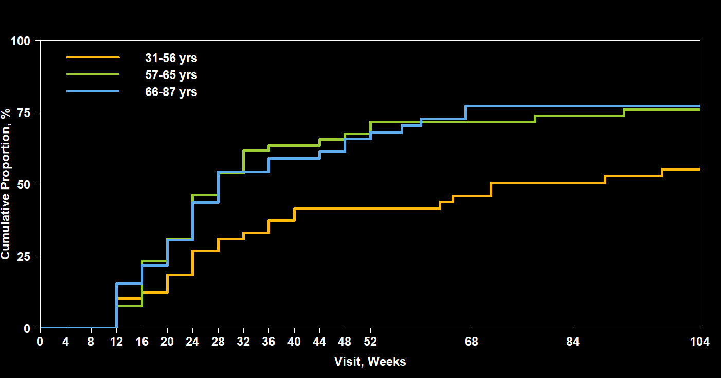
Older participants had higher risk of meeting the switching criteria during follow-up
DRCR Protocol AC
77%
76%
55%
No. at Risk 52 54 48 | 49 52 46 | 39 36 32 | 28 16 15 | 5 3 5
Notes:
In the bevacizumab first group, older participants had higher risk of meeting the switching criteria at any time, with a hazard ratio for a 10-year increase in age of 1.32 (95% CI: 1.11 – 1.58; P=0.002).

Slide 4
Objectives
To further explore the association of age with response in visual acuity (VA) and central subfield thickness (CST) after treatment with anti-VEGF agents for DME across multiple DRCR randomized clinical trials.

Slide 5
Methods
Data from anti-VEGF groups in 3 completed trials
Protocol I
Ranibizumab + Deferred Laser
(N = 188)
Protocol T
Aflibercept
Bevacizumab
Ranibizumab
(N = 660)
Protocol AC
Aflibercept Monotherapy
(N = 158)
<50y
50-59y
60-69y
≥70y

Slide 6
Methods
Outcomes of interest:
  Mean change in VA from baseline through 2 years
  Mean change in CST from baseline through 2 years
  Cumulative proportion of weak response in VA over 2 years *
    Defined as change in VA < 31.08 – 0.33 × Baseline VA
  Cumulative proportion of weak response in CST over 2 years *
    Defined as change in CST < -15.96 – 0.72 × baseline microns above CI-DME threshold
* Based on the predictive equations developed by Sun JK, Beaulieu WT, Melia M, et al. Defining “Strong” versus “Weak” Response to Anti-VEGF Treatment for Center-Involved Diabetic Macular Edema. Retina. 2023;43(4):616-623.

Slide 7
Methods
The associations of age with change in VA or CST from baseline and weak treatment response were assessed in regression models with adjustment for Protocol and anti-VEGF agent, and additional potential confounders:
  Duration of diabetes, hemoglobin A1c, VA, CST, sex, race/ethnicity, diabetes type, DME status in the fellow eye, presence of PDR, prior treatment of DME, and lens status.

Slide 8
Baseline Characteristics
 | <50y | 50-59y | 60-69y | ≥70y
No. of Participants | 119 | 306 | 387 | 194
White, % | 49% | 62% | 66% | 74%
Female, % | 29% | 49% | 49% | 46%
Type 2 Diabetes, % * | 78% | 94% | 96% | 94%
Duration of Diabetes (y), median (IQR) | 14 (9, 18) | 15 (8, 21) | 16 (10, 23) | 21 (15, 29)
Hemoglobin A1c (%), median (IQR) § | 8.4 (7.3, 9.7) | 8.1 (7.0, 9.4) | 7.6 (6.7, 8.7) | 7.3 (6.6, 8.2)
* % calculated excluding participants with uncertain type
§ Missing for 22 participants: 4 in <50y, 4 in 50-59y, 8 in 60-69y, and 6 in ≥70y

Slide 9
Baseline Characteristics
 | <50y | 50-59y | 60-69y | ≥70y
No. of Participants | 119 | 306 | 387 | 194
Visual Acuity
Median | 20/50 | 20/50 | 20/50 | 20/50
IQR | (20/80, 20/40) | (20/80, 20/40) | (20/80, 20/40) | (20/63, 20/40)
CST (μm) *
Median | 399 | 407 | 398 | 355
IQR | (313, 534) | (317, 510) | (320, 487) | (296, 432)
* Missing for 11 participants: 2 in 50-59y, 5 in 60-69y, and 4 in ≥70y.

Slide 10
Change in VA and CST from Baseline
Over 2 Years

Slide 11
Change in VA From Baseline Over 2 Years
+17.4
+12.8
+10.8
+8.5
No. of Eyes
<50y | 119 |  | 113 |  | 112 | 105 | 102 | 103
50-59y | 306 |  | 275 |  | 277 | 268 | 258 | 260
60-69y | 387 |  | 355 |  | 368 | 350 | 345 | 344
≥70y | 194 |  | 171 |  | 183 | 170 | 162 | 167

Slide 12
Change in VA From Baseline at 2 Years
P < 0.001 for the overall trend
  * Estimated from a robust regression model with adjustment for Protocol, anti-VEGF agent, duration of diabetes, hemoglobin A1c, VA, CST, sex, race/ethnicity, diabetes type, DME status in the fellow eye, presence of proliferative diabetic retinopathy, prior treatment of DME, and lens status; P = 0.98 for the interaction between age and anti-VEGF.

Slide 13
Change in CST From Baseline Over 2 Years
-115
-152
-165
-211
No. of Eyes
<50y | 119 |  | 113 |  | 112 | 105 | 100 | 103
50-59y | 304 |  | 272 |  | 274 | 266 | 255 | 254
60-69y | 382 |  | 348 |  | 360 | 344 | 336 | 334
≥70y | 190 |  | 168 |  | 177 | 165 | 156 | 162

Slide 14
Change in CST From Baseline at 2 Years
P = 0.02 for the overall trend
  * Estimated from a robust regression model with adjustment for Protocol, anti-VEGF agent, duration of diabetes, hemoglobin A1c, VA, CST, sex, race/ethnicity, diabetes type, DME status in the fellow eye, presence of proliferative diabetic retinopathy, prior treatment of DME, and lens status; P = 0.60 for the interaction between age and anti-VEGF.

Slide 15
Association of Age with Weak Treatment Response Over 2 Years

Slide 16
VA Weak Treatment Response Over 2 Years
88%
79%
71%
57%
No. of at Risk
<50y | 117 |  | 61 |  | 54 | 48 | 47 | 45
50-59y | 301 |  | 119 |  | 95 | 87 | 82 | 78
60-69y | 372 |  | 118 |  | 91 | 81 | 78 | 73
≥70y | 184 |  | 42 |  | 30 | 29 | 23 | 22
Notes:
change in VA < 31.08 – 0.33 × Baseline VA

Slide 17
VA Weak Treatment Response Over 2 Years​
P < 0.001 for the overall trend
  * Estimated from a Cox proportional hazards model with adjustment for Protocol, anti-VEGF agent, duration of diabetes, hemoglobin A1c, VA, CST, sex, race/ethnicity, diabetes type, DME status in the fellow eye, presence of proliferative diabetic retinopathy, prior treatment of DME, and lens status; P = 0.17 for the interaction between age and anti-VEGF.

Slide 18
CST Weak Treatment Response Over 2 Years
66%
63%
60%
43%
No. of at Risk
<50y | 117 |  | 76 |  | 72 | 63 | 61 | 56
50-59y | 301 |  | 135 |  | 119 | 115 | 111 | 106
60-69y | 372 |  | 159 |  | 138 | 130 | 127 | 124
≥70y | 184 |  | 75 |  | 66 | 60 | 54 | 52
Notes:
change in CST < –15.96 – 0.72 × baseline microns above CI-DME threshold

Slide 19
CST Weak Treatment Response Over 2 Years
P = 0.009 for the overall trend
  * Estimated from a Cox proportional hazards model with adjustment for Protocol, anti-VEGF agent, duration of diabetes, hemoglobin A1c, VA, CST, sex, race/ethnicity, diabetes type, DME status in the fellow eye, presence of proliferative diabetic retinopathy, prior treatment of DME, and lens status; P = 0.29 for the interaction between age and anti-VEGF.

Slide 20
Summary
Baseline characteristics varied by age:
  In the youngest group:
    Lower percentage of White, female, Type 2 diabetes
    Shorter duration and higher median hemoglobin A1c
  Analyses need adjustment for these characteristics

Slide 21
Summary
Patient age was associated with all 4 measures of treatment response:
These trends were present for all anti-VEGF agent subgroups.
The adjusted improvement in VA and reduction in CST from baseline both decreased with older age.
<50y | 50-59y | 60-69y | ≥70y
The adjusted proportion with weak treatment response in VA and CST both increased with older age.

Slide 22
Strengths
This study evaluated a total of 1,006 study participants from 3 randomized controlled trials, which allowed for description of follow-up data that were prospectively collected and standardized and also provided satisfactory statistical power for detecting a trend for treatment response.
Although all analyses were adjusted for Protocol and anti-VEGF agent, the eligibility criteria, schedule of follow-up examinations, and retreatment algorithm were similar across the studies.
Consistent trends observed in the anti-VEGF subgroups support the robustness of the study findings.

Slide 23
Limitations
Age groups differ on several baseline demographic and clinical characteristics which may affect treatment response.
  It is possible not all key baseline factors were measured and/or controlled for in the analysis.
The effect of age on treatment response cannot be isolated completely from the effects of diabetes type and duration in this analysis.
Notes:
Despite our findings were consistent with other previous DME studies such as RIDE/RISE and READ-2, our larger and more comprehensive dataset allows for a more robust and detailed analysis of the association between patient age and treatment response in 3 types of anti-VEGF drugs.

Slide 24
Conclusions
Older participants had less improvement from baseline and greater proportions of weak response to anti-VEGF treatment of DME in DRCR clinical trials.
  Weak treatment response was more likely in older participants with regard to changes in both VA and CST.
  This trend persisted even after accounting for known differences in baseline characteristics.
These findings may be helpful to refine expectations regarding treatment outcomes when initiating therapy for DME with anti-VEGF drugs.

Slide 25
Thank you!

