Slide 1
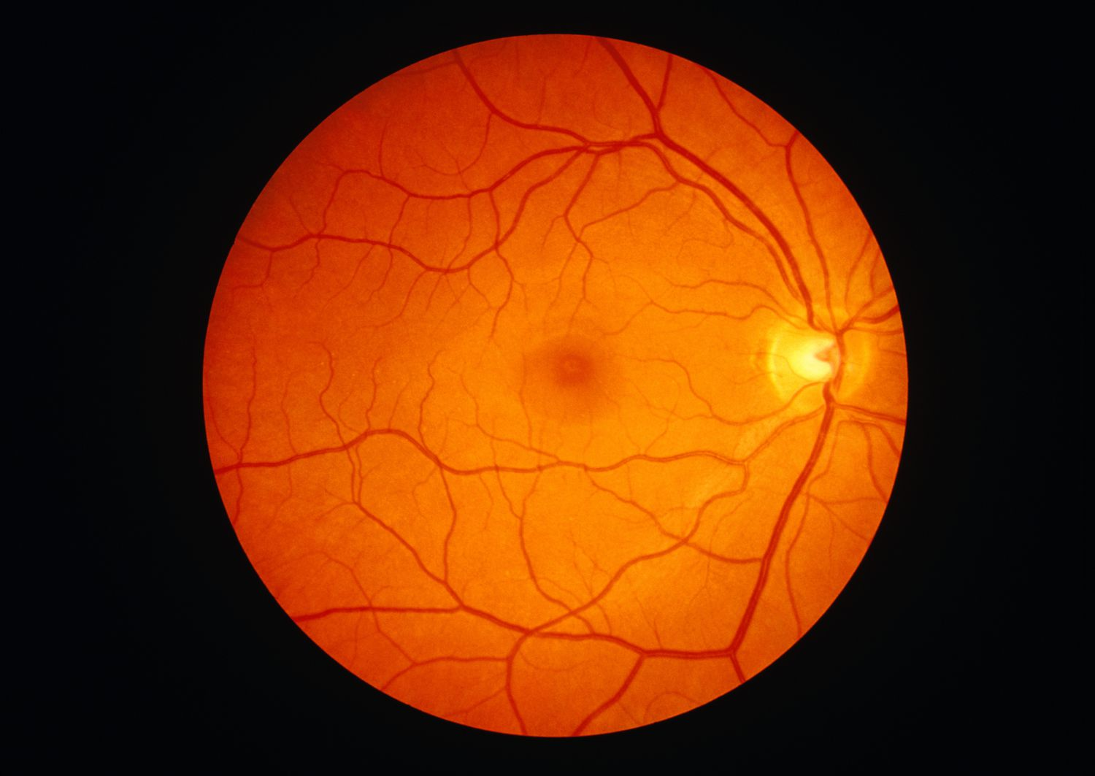




DRCR Retina Network
Overview
UG1EY014231

Slide 2

DRCR Retina Network

Slide 3

Network Evolution and Scope
2002
2019
DRCR.net founded to focus on diabetic retinopathy research
Rebranded as DRCR Retina Network to reflect expanded mission
1
2
3
4
2017
Today
Network expands scope to include broader retinal disorders
Over 140 participating sites with 400+ physicians across US, Canada, and UK

Slide 4


Funding - UG1EY014231
Current award 2024-2028

Slide 5
Other Financial Relationships
Entity | Type of Funding | Protocol
Breakthrough T1D Foundation | Funding | AF, AR, AS
Helmsley Charitable Trust Foundation | Funding | AF
Roche/Genentech | Funding and Study Drug | AF, AO, AL, AP
Notal | Study Device Discounts | AO
ANI | Funding and Study Drug | AL
Regeneron | Funding and Study Drug | AR, AS
MTM Vision Initiative | Funding | AR, AS

Slide 6



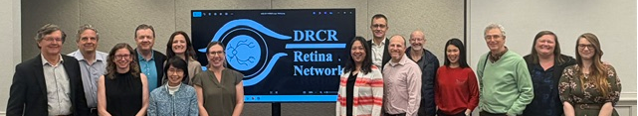
Collaborative Network
Site locations across the US, CA, and UK
400+ Investigators
1,000+ Other Clinic Personnel

Slide 7
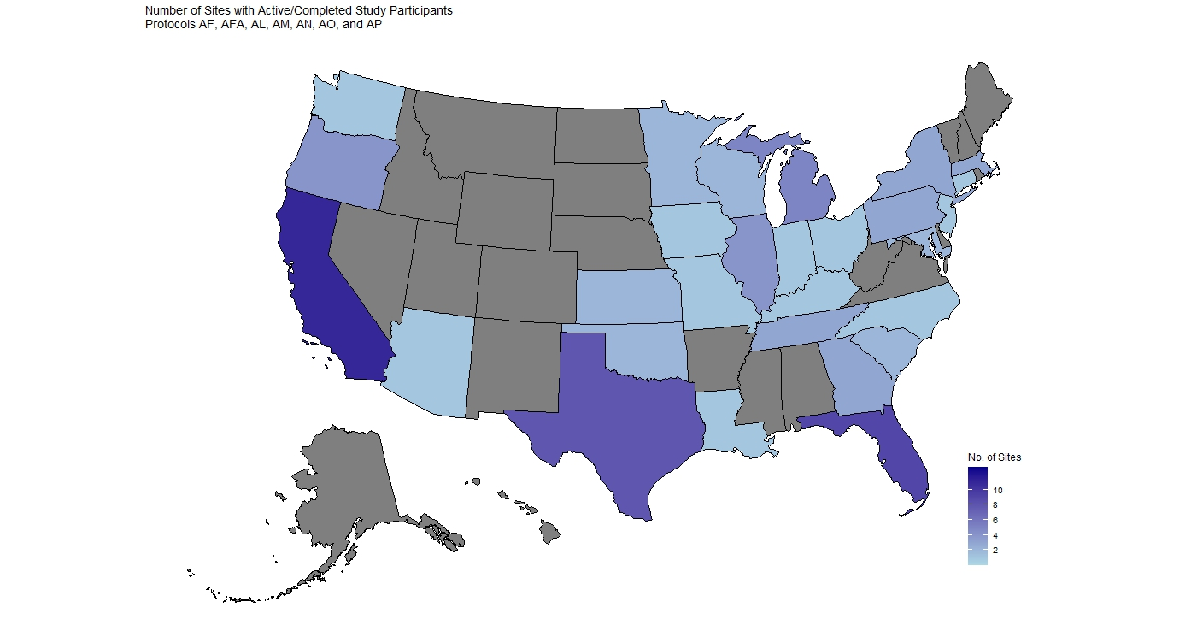
Number of Active Sites by Location

Slide 8
Number of Participants by Location
Country | # Pts | # Sites
Canada | 15 | 2
UK | 2 | 1

Slide 9
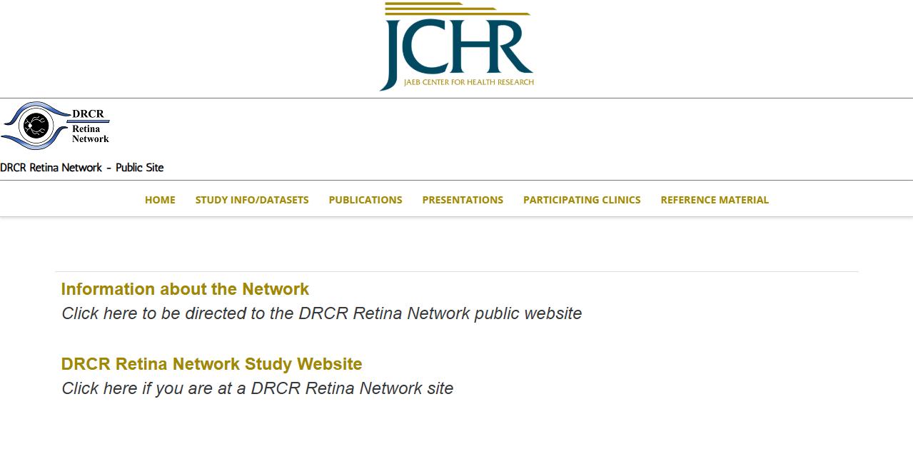
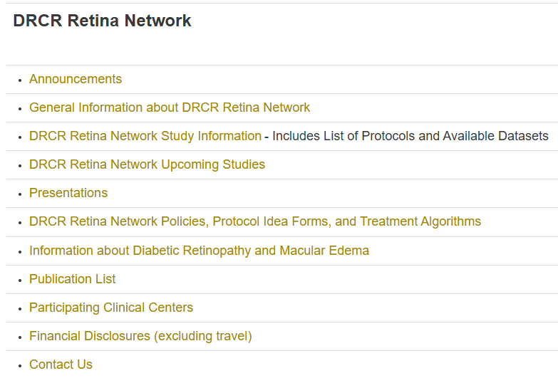
Helpful Links - drcr.net

Slide 10
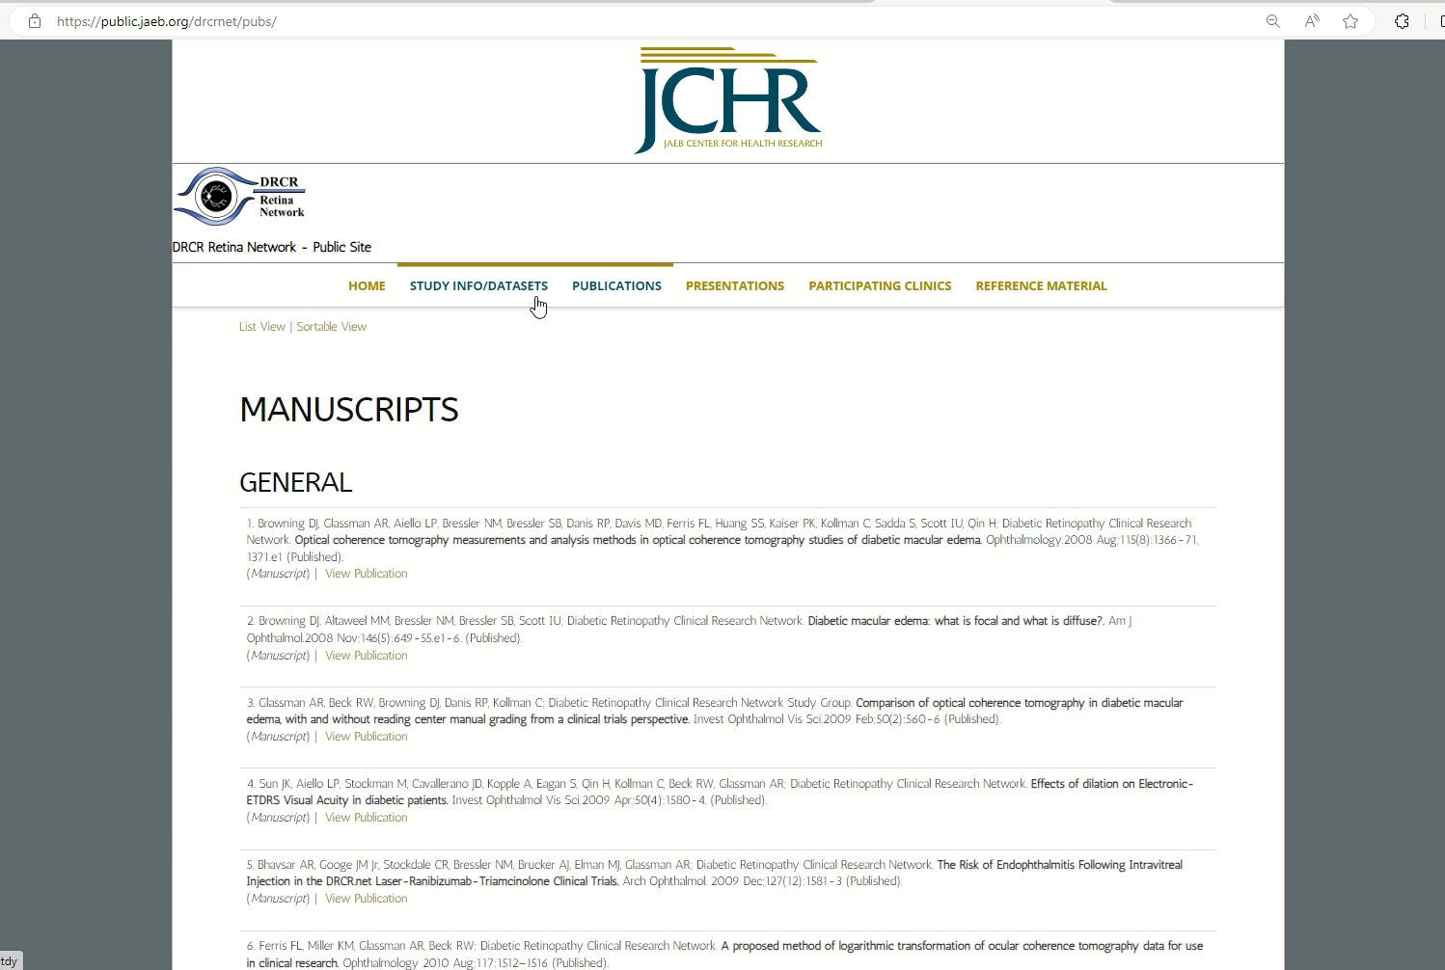
Publication List drcr.net

Slide 11

Protocol Idea Review Process

Slide 12
1
Submit ideas to drcr@jaeb.org
3
SC designated ideas presented at semiannual meeting
5
SC recommendation to EC
Present to the applicable SC
2
Investigator feedback taken back to SC
4
The EC makes final decision as to whether a PDC will be created or not
6

Slide 13

DRCR Major Findings
Two Decades of Revolutionizing Diabetic Retinopathy Care:
Diabetic Macular Edema
2008 2009 2010 2011 2012 2013 2014 2015 2016 2017 2018 2019 2020 2021 2022 2023 2024 2025 2026
Protocol B
Laser superior to corticosteroid for DME

Slide 14
DRCR Major Findings
Two Decades of Revolutionizing Diabetic Retinopathy Care:
Diabetic Macular Edema
2008 2009 2010 2011 2012 2013 2014 2015 2016 2017 2018 2019 2020 2021 2022 2023 2024 2025 2026
Protocol I
Anti-VEGF superior to laser for DME

Slide 15
DRCR Major Findings
Two Decades of Revolutionizing Diabetic Retinopathy Care:
Diabetic Macular Edema
2008 2009 2010 2011 2012 2013 2014 2015 2016 2017 2018 2019 2020 2021 2022 2023 2024 2025 2026
On average, aflibercept outperforms other anti-VEGF agents for DME at one year when starting with moderate or worse vision loss (20/50 or worse)
On average, bevacizumab and ranibizumab 0.3-mg perform similarly to aflibercept at 1 year when starting with mild vision loss (20/32 to 20/40)
Protocol T

Slide 16
DRCR Major Findings
Two Decades of Revolutionizing Diabetic Retinopathy Care:
Diabetic Macular Edema
2008 2009 2010 2011 2012 2013 2014 2015 2016 2017 2018 2019 2020 2021 2022 2023 2024 2025 2026
Protocol U
Dexamethasone + ranibizumab does not improve VA
At 6 months compared with ranibizumab alone for eyes with persistent DME following anti-VEGF therapy

Slide 17
DRCR Major Findings
Two Decades of Revolutionizing Diabetic Retinopathy Care:
Diabetic Macular Edema
2008 2009 2010 2011 2012 2013 2014 2015 2016 2017 2018 2019 2020 2021 2022 2023 2024 2025 2026
2008
Protocol V
Among eyes with CI-DME and good visual acuity
(20/25 or better), VA loss after 2 years was similar regardless of whether initial management was aflibercept, laser, or observation

Slide 18
DRCR Major Findings
Two Decades of Revolutionizing Diabetic Retinopathy Care:
Diabetic Macular Edema
2008 2009 2010 2011 2012 2013 2014 2015 2016 2017 2018 2019 2020 2021 2022 2023 2024 2025 2026
Protocol AE
Photobiomodulation as given in this study, while safe and well tolerated, was not found to be effective for the treatment of CI-DME in eyes with good vision
No evidence of a significant difference in visual outcomes over a 2-year period between aflibercept monotherapy and treatment with bevacizumab first with a switch to aflibercept in the case of suboptimal response
Protocol AC

Slide 19
DRCR Major Findings
Two Decades of Revolutionizing Diabetic Retinopathy Care:
Diabetic Macular Edema
2008 2009 2010 2011 2012 2013 2014 2015 2016 2017 2018 2019 2020 2021 2022 2023 2024 2025 2026
No statistically significant improvement in CST at 6 months in the tonabersat versus placebo groups.
A post hoc analysis that limited anti-VEGF impact demonstrated statistically significant benefit in the tonabersat group.
Protocol AN

Slide 20
DRCR Major Findings
Two Decades of Revolutionizing Diabetic Retinopathy Care:
Diabetic Retinopathy
2008 2009 2010 2011 2012 2013 2014 2015 2016 2017 2018 2019 2020 2021 2022 2023 2024 2025 2026
Protocol S
Anti-VEGF at least as good as PRP for VA at 2 years

Slide 21
DRCR Major Findings
Two Decades of Revolutionizing Diabetic Retinopathy Care:
Diabetic Retinopathy
2008 2009 2010 2011 2012 2013 2014 2015 2016 2017 2018 2019 2020 2021 2022 2023 2024 2025 2026
Protocol S
Mean change in VA with ranibizumab similar to PRP at 5 years

Slide 22
DRCR Major Findings
Two Decades of Revolutionizing Diabetic Retinopathy Care:
Diabetic Retinopathy
2008 2009 2010 2011 2012 2013 2014 2015 2016 2017 2018 2019 2020 2021 2022 2023 2024 2025 2026
Protocol AB
In eyes with VH from PDR, vision improved more quickly with vitrectomy compared with aflibercept but there was no significant difference in mean VA letter score over 24 weeks

Slide 23
DRCR Major Findings
Two Decades of Revolutionizing Diabetic Retinopathy Care:
Diabetic Retinopathy
2008 2009 2010 2011 2012 2013 2014 2015 2016 2017 2018 2019 2020 2021 2022 2023 2024 2025 2026
(2-Year): Among eyes with moderately severe to severe NPDR, the proportion that developed PDR or
CI-DME was lower with periodic aflibercept treatment compared with sham but did not result in VA benefit through at least 2 years
Protocol W

Slide 24
DRCR Major Findings
Two Decades of Revolutionizing Diabetic Retinopathy Care:
Diabetic Retinopathy
2008 2009 2010 2011 2012 2013 2014 2015 2016 2017 2018 2019 2020 2021 2022 2023 2024 2025 2026
No association with future DR progression was identified from peripheral lesions on UWF baseline color photos. The presence of peripheral lesions on UWF FA images were associated with a greater risk of disease worsening over 4 yrs.
On UWF-FA images, greater baseline retinal nonperfusion was also associated with a higher risk of DR worsening over 4 yrs.
Protocol AA

Slide 25
DRCR Major Findings
Two Decades of Revolutionizing Diabetic Retinopathy Care:
Diabetic Retinopathy
2008 2009 2010 2011 2012 2013 2014 2015 2016 2017 2018 2019 2020 2021 2022 2023 2024 2025 2026
(4-Year): Preventative aflibercept treatment compared to sham in eyes with moderate to severe NPDR
(DRSS level 43-53) and VA 20/25 or better (≥ 79 letters)
Lowered the probability of developing PDR or
CI-DME within 4 years
Did not confer VA benefit at 4 years
Protocol W

Slide 26
Protocols Currently Certifying Sites
AR | Longitudinal Natural History Study of Retinal Function in Eyes of Patients with Diabetes
AS | Longitudinal Study of Retinal Function in Eyes Treated for Diabetic Macular Edema with Anti-VEGF Agents

Slide 27
Protocols Currently Certifying Sites & Enrolling
AFA | Diabetic Retinopathy and Changes in Lipid Metabolism
AL | A Randomized Clinical Trial Evaluating Intravitreal Faricimab (6.0 mg) Injections or Fluocinolone Acetonide (0.19 mg) Intravitreal Implants vs Observation for Prevention of Visual Acuity Loss due to Radiation Retinopathy
AM | Randomized Trial Comparing Immediate versus Deferred Surgery for Symptomatic Epiretinal Membranes
AP | A Randomized Clinical Trial Evaluating Combination Faricimab + PRP vs. Vitrectomy + Endolaser for Treatment of Proliferative Diabetic Retinopathy
GEN | Genetics in Retinal Diseases Project

Slide 28
Protocols Currently In Follow Up
AF | A Randomized Trial Evaluating Fenofibrate for Prevention of Diabetic Retinopathy Worsening
AO | Home OCT-Guided Treatment versus Treat and Extend for the Management of Neovascular AMD

Slide 29
Other Projects
ROP4 | Collaboration with the Pediatric Eye Disease Investigator Group evaluating bevacizumab for treatment of type 1 retinopathy of prematurity
AI | Collaborations with groups that have active machine or deep learning efforts underway for automated detection of retinal disease or automated predication of disease progression

Slide 30
Current Studies

Slide 31
Protocol AF
A Randomized Trial Evaluating Fenofibrate for Prevention of Diabetic Retinopathy Worsening

Slide 32
Study Rationale
Widespread use of an oral agent, fenofibrate, that is effective at reducing worsening of DR might decrease the numbers of patients who develop vision-threatening complications and need to undergo invasive treatment
  Reduce vision loss from advanced DR
  Reduce complications/adverse events associated with invasive and expensive treatments
Long term study will provide opportunities to evaluate new imaging, visual function tests, methods for DR detection

Slide 33
History of Fenofibrate
Two placebo-controlled clinical trials (FIELD and ACCORD) demonstrated a beneficial effect of fenofibrate on diabetic retinopathy as part of pre-planned secondary analyses
However, for various reasons, treatment with fenofibrate has not been adopted by retina or systemic care practitioners
  lack of information
  belief that data is not strong enough to change practice
  hesitation to use a systemic drug by ophthalmologists
  inability to successfully grade retinal disease by PCPs

Slide 34
DRCR Retina Network Study Objectives
To determine if fenofibrate is effective at preventing DR worsening in participants with mild to moderate non-proliferative DR and no CI-DME at baseline through up to 6 years of follow-up
If effective, additional goals of the study are
To provide a model for ophthalmologists to prescribe and/or collaborate with an internist to prescribe and monitor the drug safely
Disseminate standardized prescribing guidelines with the aim to encourage broader use
Collect information on potential predictive biomarkers via blood sampling, functional and structural testing as well as glucose level from CGM over course of DR progression.

Slide 35
Ancillary Ocular Components
Data from visual function assessments such as contrast sensitivity, visual field (VF) testing and structural data from OCT angiography (OCTA) will provide valuable info on potential predictive biomarkers of functional outcomes over natural history of DR progression
Specific objectives include:
  Quantification of VF and contrast sensitivity at baseline & evaluation of relationship with DR severity level
  Identification of biomarkers on OCTA at baseline that are associated with retinopathy progression
  Explore whether fenofibrate treatment has any effect on VF and/or contrast sensitivity

Slide 36
Study Design
Multi-Center Randomized Clinical Trial
(N = 560)
Major Patient-level criteria:
No contraindication to fenofibrate use, no severe renal disease, no liver disease (defined via central lab values)
At least one eye that meets these criteria* (according to the investigator, confirmed by RC grading):
ETDRS DR severity level between 35 and 47 (mild NPDR to moderately severe NPDR)
Best-corrected E-ETDRS VA letter score ≥74
No evidence of CI-DME (using standard DRCR OCT thresholds)
No prior treatment for DME or DR (other than focal/grid laser, but must be > 12 months prior)
No anticipated need for intravitreous anti-VEGF or PRP in the next 6 months
No history of intravitreous anti-VEGF or corticosteroid treatment within the prior year
* If only one eye is eligible, the non-study eye must have at least microaneurysms only (DR severity level 20) but there is no upper limit in DR severity level, and no exclusion criteria based on prior treatment.
160 mg Fenofibrate
Placebo
Primary Outcome: Proportion of eyes with DR worsening through 6 years

Slide 37
Protocol AF Ancillary Study: Protocol AFA
Diabetic Retinopathy and Changes in Lipid Metabolism

Slide 38
Predictive Biomarkers
While the primary objective of Protocol AF is to determine if fenofibrate is effective at preventing DR worsening, an additional goal is to collect information on potential predictive biomarkers via blood sampling over the course of DR progression
Diabetic Retinopathy and Changes in Lipid Metabolism (Protocol AFA) is an ancillary study for Protocol AF
Protocol AFA will include AF participants in analyses, but will also recruit populations with DR severity differing from the Protocol AF cohort (DR severity <35 & >47)

Slide 39


Collaboration
Protocol AFA is a collaborative effort between DRCR and the Lowy Medical Research Institute (LMRI)
LMRI will be performing the metabolite analyses with the de-identified serum samples and the genetic sequencing and associated analyses
This Photo by Unknown Author is licensed under CC BY

Slide 40
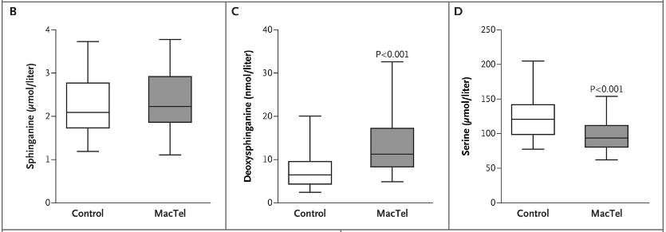
Protocol AFA Rationale
Deoxysphingolipids have been demonstrated to be elevated in both type 1 and 2 diabetes, and to be associated with an increased risk of developing diabetic polyneuropathy
A 2019 NEJM paper found an association between elevated deoxysphingolipids and MacTel Type 2
This study will help evaluate
if deoxysphingolipid serum
levels are correlated with
DR severity

Slide 41
Description of Groups for Analyses
Analysis Group | Group Description Participants with Type 2 Diabetes, and worse eye: | Number of Participants
AFA Group 1 | Absent of DR, or microaneurysms only (Diabetes ≥15 yrs) (DR severity level 10 to 20) | 80
Group 2 (Protocol AF Cohort) | Mild to moderately severe DR (DR severity level 35 to 47) | 200
AFA Group 3 | Severe non-proliferative DR (DR severity level 53) | 80
AFA Group 4 | Proliferative DR (DR severity level 61 to 81) | 80
AFA Group 5 (Healthy Controls) | Absent of any diagnosis of diabetes and absent evidence of retinal disease as determined by color fundus photography and OCT imaging | 20
Total Number of Participants in the Analysis Pool (AF & AFA) |  | 460

Slide 42
Major Eligibility Criteria
Inclusion
Age ≥ 18 and < 80 years
Diagnosis of T2DM, falling under:
  DR Severity 10 to 20 the patient must have been diagnosed ≥15 years ago
  Any amount of time if DR Severity ≥ 35
  OR
  Non-diabetic, healthy controls (n=20)
Able and willing to provide genetics sample for AFA analyses
Exclusion
Participation in an investigational trial that involved Tx in last 30 days (with exception of Protocol AF)
Known allergy to fluorescein dye
Any retinal condition that complicates the Dx & grading of DR, or shows signs of retinal diseases other than DR
Has taken a PPAR-agonist in last 90 days or a serine or glycine supplement in last 60 days
Currently pregnant or lactating

Slide 43

Procedures
Medical History
BP, weight and height
Fasting blood & serum samples, including serum shipped on dry ice and genetics sample collection
Urine sample
Protocol refraction/ETDRS VA
Spectralis SD OCT (including RNFL)
Ocular exam
Fundus photos and FA**, using widest field
OCT Angiography*
Contrast Sensitivity*
Study procedures mirror the Protocol AF Screening visit
except OCTA* and Contrast Sensitivity* will also
be completed
*Ancillary component at select sites/select participants
** FA will NOT be done for healthy controls

Slide 44
Protocol AM
Randomized Trial Comparing Immediate vs Deferred Surgery for Symptomatic ERMs

Slide 45
Rationale
Vitrectomy with ERM peeling has a high success rate, yet some patients experience less than optimal VA improvement
Patients with significant macular changes on OCT but relatively good vision advised to defer surgery until vision declines to 20/40 or worse

Slide 46
Rationale
It is unknown whether delaying surgery, which allows the foveal architecture to remain compromised and potentially to deteriorate, results in worse VA outcomes than if surgery is performed earlier
There is a need to better understand predictors of outcomes when surgery is performed and predictors of progression when surgery is deferred

Slide 47
Study Objectives
Primary
  Compare visual acuity outcomes at 36 months between eyes randomized to immediate versus deferred surgery
Secondary – between-group comparisons
  Compare changes in visual function (using M-CHARTS), reading speed (using MNREAD), and OCT outcomes from randomization at 36 months between eyes randomized to immediate versus deferred surgery
  Compare complication rates between eyes randomized to immediate versus deferred surgery

Slide 48
Study Objectives
Secondary – within-group comparisons
  Determine the rate of and time to progression of ERM to needing vitrectomy in eyes randomized to deferred surgery
  Determine if there are baseline or later variables (such as performance of cataract surgery or OCT findings) that predict ERM progression to needing vitrectomy in eyes randomized to deferred surgery

Slide 49
Study Objectives
Other objectives
  Explore associations between participant factors and retinal anatomy with outcomes
  Assess how often lens removal is needed after phakic vitrectomy (among eyes receiving surgery during the study)
  Collect natural history data for deferred surgery eyes
  Assess whether fundus autofluorescence (FAF) images are of value in assessing the progression of ERM or improvement in macular anatomy after ERM removal (as part of an ancillary study among sites with machine capabilities)

Slide 50
Study Design
Multi-Center Randomized Clinical Trial
(400 Eyes)
At least 1 eye meeting all the following criteria
E-ETDRS visual acuity 20/40 or better (≥69 letters)
  ERM must be thought to be the primary cause of vision loss
ERM meeting the following criteria (no RC confirmation required)
  ERM is not secondary to another condition
  Symptoms of visual loss and/or distortion (and in the opinion of the investigator, the ERM is contributing to the participant’s symptoms); either new or worsening in the past 24 months
  Epiretinal membrane involving or altering the central 3 mm of the macula on OCT
  Distortion within the central subfield by ERM on OCT
Deferred Surgery (vitrectomy only if protocol criteria met)
Immediate Surgery (within 4 weeks)
Primary Outcome: Mean change in visual acuity letter score from baseline to 36 months

Slide 51
Schematic of Study Design
Enrollment visit and Randomization
Deferred Surgery Group
Immediate Surgery Group
Vitrectomy (within 1 month of randomization)
Follow-up visits at 1-month post-vitrectomy and 3, 6, 12, 18, 24, 30 (phone call) and 36 months post-randomization
Follow-up visits at 3, 6, 12, 18, 24, 30 (phone call), and 36 months post-randomization.
Vitrectomy may be performed during follow-up if protocol criteria is met. Eyes receiving vitrectomy during study will complete a 1-month post-vitrectomy visit

Slide 52
Protocol AO
Home OCT-Guided Treatment versus Treat and Extend for the Management of Neovascular AMD

Slide 53
Background
Treatment of nAMD with anti-VEGF is highly effective but is associated with considerable treatment burden and cost for patients and healthcare systems
Optimal timing and the number of injections needed to achieve best visual acuity and disease control for each patient is unknown
Innovations are needed to reduce the burden of anti-VEGF injections and monitoring while still maintaining vision and treatment efficacy

Slide 54
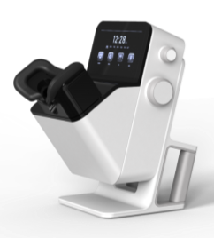
Notal Home OCT
Designed for technician-free operation in the home setting
Allows daily disease activity monitoring and the possibility of a tailored and more personalized approach to managing nAMD
Notal Vision provides Home OCT device, data analytics and compliance monitoring

Slide 55
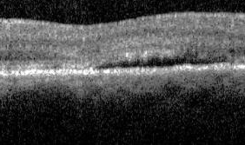
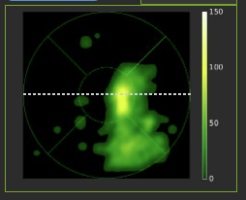
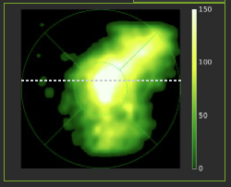
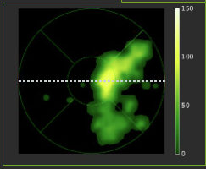
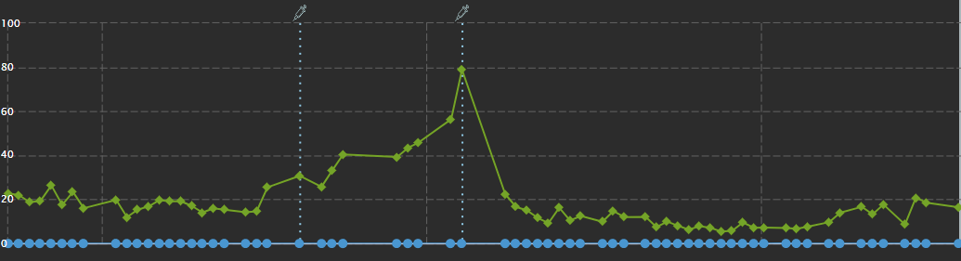
Notal Home OCT
Patients Acquire Daily OCT Scans
3 mm,
88 B-scans
3 mm,
88 B-scans
3 mm,
88 B-scans
3 mm,
500 A-scans
3-mm,
500 A-scans
3 mm,
500 A-scans
AI detects fluids, provides quantified spatial fluid maps
Total volume for each day is mapped to fluid volume trajectory
days

Slide 56
Summary of Rationale
A large randomized trial is needed to determine the role of Home OCT in clinical practice
This trial will also provide guidance for using Home OCT
  Setting fluid thresholds
  Rules for bringing participants into the office for assessment
It is important to understand visual acuity outcomes and visit and injection frequencies using a Home OCT-guided treatment strategy versus Treat and Extend (T&E), the most common regimen used in clinical practice

Slide 57
Protocol AO: Home OCT vs. T&E
Multi-Center Randomized Clinical Trial
600 Eyes from 80 Sites
  Inclusion Criteria:
    Age ≥ 50 years
    Best corrected E-ETDRS VA ≥24 letters (20/320 or better)
    Active MNV lesion (IRF or SRF) secondary to AMD
    MNV or sequela of the MNV involving the foveal center
    ≥ 1 drusen (>63 microns) in either eye OR late AMD (MNV or macular atrophy) in the other eye
Treat
and Extend
Home OCT-Guided Treatment
Co-primary outcomes: Superiority comparison of mean change in visual acuity and number of injections from baseline to 104 weeks

Slide 58
Objectives
Primary
  Determine if Home OCT results in 1) better visual acuity outcomes and/or 2) fewer number of injections over 104 weeks compared with T&E
Secondary
  Compare the number of visits
  Compare the rates of development of fibrosis and macular atrophy
  Understand fluid dynamics in the retina (Home OCT group)
  Understand the distribution of injection intervals
  Compare participant- and site-reported outcomes related to treatment and monitoring burden
  Compare cost over 2 years

Slide 59
Ancillary Study
Based on CATT and other studies:
  50-75% of patients at baseline will have unilateral disease
  Risk of fellow eye conversion to exudative disease is 10% per year
Fellow eyes at risk will be followed with multimodal imaging (including OCTA) to:
  Describe the incidence and prevalence of non-exudative CNV and the rate of progression to exudative disease
  Compare time to diagnosis of nAMD, visual acuity when diagnosed, and 2-year vision and imaging outcomes between groups

Slide 60

Visit Schedule
Required visits for both groups
  52 weeks
  104 weeks
All other visits occur according to treatment group:
  Treat and Extend – monthly injections until stable, increase by 2-week increments to a maximum of 18 weeks until recurrent disease activity
  Home OCT – after initial injection, participant returns based on fluid detected by Home OCT algorithm

Slide 61
Protocol AL
A Randomized Clinical Trial Evaluating Faricimab or Iluvien vs Observation for the Prevention of VA loss due to Radiation Retinopathy

Slide 62
Radiation Retinopathy (RR)
RR is a common complication after I-125 plaque brachytherapy for choroidal melanoma
Development is similar to other retinal vascular diseases and may include:
  Capillary leakage
  Macular edema
  Vision loss secondary to progressive macular and retinal ischemia
RR frequently progresses over time to profound vision loss
  The Collaborative Ocular Melanoma Study (COMS) reported that at 3 years, only 43% of patients have VA better than 20/200

Slide 63
Rationale
Previous studies suggest that anti-VEGF and steroids may each have a role in preventing macular edema and vision loss associated with radiation retinopathy.
A large randomized, controlled trial has not been performed
A treatment that prevents the development of RR would have important consequences for many eyes successfully treated for choroidal melanoma but are at risk of severe RR and vision loss over time.

Slide 64
Objectives
Compare long-term VA outcomes in eyes treated with repeated anti-VEGF injections or sustained-release steroid with eyes initially observed and treated only if ME develops.
Determine if treatment with repeated anti-VEGF or sustained-release steroid versus initial observation can prevent or alter the course of RR and its consequences, such as ME.
Evaluate the natural history of RR with frequent multimodal imaging.

Slide 65
Study Design
Multi-Center Randomized Clinical Trial
(600 Eyes, 600 Participants)
At least 1 eye that meets all the following criteria:
Primary choroidal melanoma receiving treatment with I-125 plaque
Baseline VA ≥ 20/200
Calculated planned dose to the macula ≥ 30 Gy
Tumor cannot be directly under the geometric center of the fovea
Tumor cannot touch the optic disc
Faricimab
Primary Outcomes:
Change in VA from baseline to 3 years,
Loss of 15 or more letters of VA from baseline to 3 years
Iluvien
Key Secondary Outcome: Development of ME on OCT
Observation

Slide 66
Treatment Groups
Faricimab
  Injection at randomization & every 3 months
Iluvien
  Implant at randomization and at 24* months
Observation
  No treatment unless ME develops
* If the 24-month visit is missed, or the implant cannot be given at the 24 month visit for any reason, the second implant may be administered at the next study visit through the 33-month visit.

Slide 67
Follow Up
4-week
Visit
(Iluvien
arm only)
Visits q3 months
Visits q 3 months
Visits q 3 months
Imaging
Imaging
Imaging
1st Year
2nd Year
3rd Year
    Wide field fundus photographs, wide-field FA, OCT, and OCTA

Slide 68
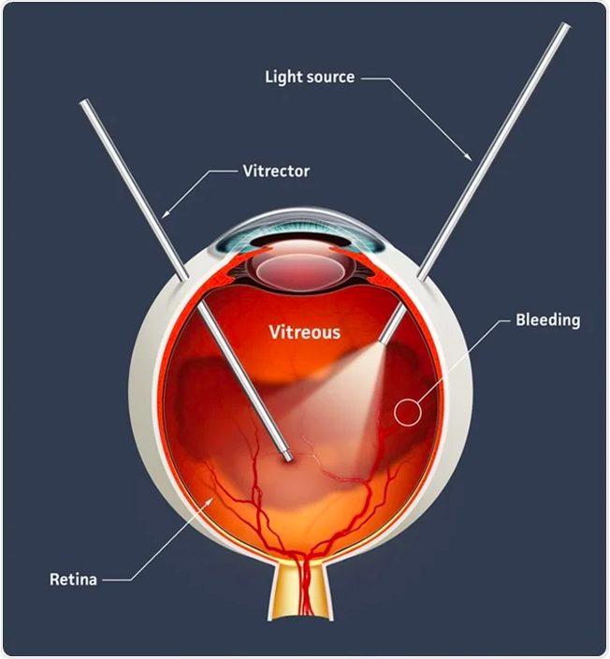
Protocol AP
Combination Anti-VEGF + PRP vs. Vitrectomy + Endolaser for PDR
Presenter: Raj K. Maturi, MD

Slide 69
Prevalence of Diabetic Retinopathy in the US in 2021*
DM: 36 M
DR: ~10 M (1/33)
**
*Lundeen, et. al. JAMA Oph 2023
** breakdown of VTDR based on Protocol W progression rates

Slide 70
Current PDR Treatments
Prior studies (Protocol S, CLARITY) show anti-VEGF and PRP are viable treatments for PDR
Neither anti-VEGF nor PRP is a perfectly effective or durable therapy for PDR
  PRP: ~50% of eyes with full PRP will need additional treatment for NV recurrence or VH; causes on average greater visual field loss, greater chance of DME development, and greater chance of vitreous hemorrhage within 2 years
  Anti-VEGF: most eyes with PDR need continued anti-VEGF injections through at least 5 years; noncompliance with injections may cause recurrent NV

Slide 71
Study Rationale
No long-term data on a standardized approach to combination therapy from a large randomized clinical trial
Advances in surgical technique in addition to the advantages of removing the hyaloid during surgery make vitrectomy with endolaser an appealing option needing further investigation

Slide 72
Study Treatments
Anti-VEGF + PRP
  Many clinicians are using combination therapy, but there is little data on the long-term visual acuity outcomes of this approach
Vitrectomy with Endolaser
  PPV allows full PRP while also removing attached hyaloid, which can contribute to PDR worsening, development of TRD and other complications
  Modern techniques have reduced surgical times and complications

Slide 73
Study Objectives
To evaluate the safety and efficacy of the two treatment strategies:
  Assess long-term visual acuity outcomes
  Assess visit and treatment burden
  Assess complications (VH, recurrent NV, TRD)

Slide 74
Study Objectives
Develop reliable methods for characterizing the presence and extent of vitreous adherence at baseline using OCT
Assess whether degree of adherence of the vitreous predicts treatment prognosis
Provide a standardized strategy for combination treatment
Provide a standardized vitrectomy approach

Slide 75
Study Design
Multi-Center Randomized Clinical Trial:
N ~426 eyes (2 study eyes allowed)
At least 1 eye that meets the following criteria:
  PDR (level 65 or worse) by central reading center
  No TRD involving the macula
  No significant VH that would preclude PRP
  No CI-DME
Immediate PPV + Endolaser
Anti-VEGF + PRP
Primary Outcomes:
Change in visual acuity from baseline to 3 years
Number of in-office treatments (injections or PRP) following the end of randomized treatment over 3 years

Slide 76
Key Secondary Outcomes
Development of complications (VH, recurrent NV, any TRD, macula threatening TRD) over 3 years
Change in VA AUC over 3 years
Number of visits over 3 years
Number of additional procedures after end of randomization treatment to treat PDR (injections, laser, vitrectomy) over 3 years

Slide 77
Treatment Groups
Anti-VEGF + PRP
Vitrectomy with endolaser
  3 injections (1st is at randomization then q4 week injections)
  Complete PRP in 1-3 sessions
  All completed within 90 days of randomization
Must be within 4 weeks of randomization
1 injection of anti-VEGF allowed prior to vitrectomy
The window was increased to 90 days based on feedback at the last meeting

Slide 78
Follow-up Schedule
16,24,36, 52-week visits
68, 84, 104-week visits
120, 136, 156-week visits
Imaging
Imaging
Imaging
1st Year
2nd Year
3rd Year
    Wide field fundus photographs, wide-field FA, OCT

Slide 79
Genetics
Genes in Diabetic Retinopathy Project

Slide 80
Genes in Diabetic Retinopathy Project
Objective
  To create a repository of genetic material and clinical phenotype information as a resource for the research community
  The database may provide the opportunity to assess genetic susceptibility and resistance to DR and also variants impacting visually important biomarkers for ME and neovascularization
Major Eligibility Criteria
  Previous/current participant in a DRCR Retina Network study
Enrollment (Ongoing)
  Total enrolled: 2,739 subjects (as of 5/19/23)

Slide 81
Protocols AR/AS
Endpoints in Diabetic Retinal Disease
DRCR Retina Network and MTM Vision Collaboration

Slide 82


Complementary Missions
DRCR Retina Network and MTM Vision
To conduct high-quality, collaborative clinical research that improves vision and quality of life for people with retinal diseases
To accelerate the development of new methods to preserve and restore vision in people with diabetes

Slide 83
Biomarkers
Characteristic that is objectively measured and evaluated as an indicator of:
Normal biological processes
Pathogenic processes
Pharmacologic responses to a therapeutic intervention
Surrogate Endpoints
Shown to predict
clinical benefit
Clinical Endpoints
Reflect how a patient feels, functions or survives
Validation for a specific context of use
FDA-NIH Biomarker Working Group. BEST (Biomarkers, Endpoints, and other Tools) Resource [Internet]. Silver Spring (MD): Food and Drug Administration (US); 2016-. FDA-NIH Biomarker Working Group. 2016 Jan 28 [Updated 2021 Jan 25].
Primary Endpoints for Registration Trials
Notes:
exFrom “Strimbu K, Tavel JA. What are biomarkers? Curr Opin HIV AIDS. 2010 Nov;5(6):463-6. doi: 10.1097/COH.0b013e32833ed177. PMID: 20978388; PMCID: PMC3078627.”: In 1998, the National Institutes of Health Biomarkers Definitions Working Group defined a biomarker as “a characteristic that is objectively measured and evaluated as an indicator of normal biological processes, pathogenic processes, or pharmacologic responses to a therapeutic intervention.” [**1] A joint venture on chemical safety, the International Programme on Chemical Safety, led by the World Health Organization (WHO) and in coordination with the United Nations and the International Labor Organization, has defined a biomarker as “any substance, structure, or process that can be measured in the body or its products and influence or predict the incidence of outcome or disease” [2]. An even broader definition takes into account not just incidence and outcome of disease, but also the effects of treatments, interventions, and even unintended environmental exposure, such as to chemicals or nutrients. In their report on the validity of biomarkers in environment risk assessment, the WHO has stated that a true definition of biomarkers includes “almost any measurement reflecting an interaction between a biological system and a potential hazard, which may be chemical, physical, or biological. The measured response may be functional and physiological, biochemical at the cellular level, or a molecular interaction.” [3]. Examples of biomarkers include everything from pulse and blood pressure through basic chemistries to more complex laboratory tests of blood and other tissues. Medical signs have a long history of use in clinical practice—as old as medical practice itself—and biomarkers are merely the most objective, quantifiable medical signs modern laboratory science allows us to measure reproducibly.

Slide 84
Background and Rationale
Regulatory-approved primary endpoints for diabetic retinal disease (ex: change in vision and ETDRS DRSS score) are limited because they require long trial durations and only reflect change for highly effective interventions
Other accepted primary endpoints (ex: anatomic measures, change in visual functions, and quality of life) do not always reflect prognostic correlation to the disease state
Therefore, it is difficult to evaluate potential superiority of interventions using approved primary endpoints especially in earlier-stage disease
We need to identify new primary
endpoints for clinical trials in
diabetic retinal disease to enable
a more efficient path to regulatory approval for new therapies and preventions

Slide 85
Major Goals for Endpoint Studies
Primary goal
  Identify new primary endpoints that are acceptable for use in clinical trials for regulatory approval
Key secondary goals:
  Validate surrogate or clinical endpoints that can be used to enhance research or clinical care (even if not suitable for registration trials)
  Validation process will require:
        Multiple, prospective studies
        Diverse cohorts
        Defining specific contexts of use

Slide 86
Assessment of Key Test Properties
Definition of retinal pathways assessed
Normative data availability
Test-retest variability
Floor or ceiling effects within the range of disease under study
Degree of subjectivity in testing
Effect size (between normal and any DRD or between different stages of DRD)
Device availability and cost
Clinical relevance
Patient acceptance and time requirement

Slide 87
Two Concurrent Studies
Protocol AR
Longitudinal Natural History Study of Retinal Function in Eyes of Patients with Diabetes
Protocol AS
Longitudinal Study of Retinal Function in Eyes Treated for Diabetic Macular Edema with Anti-VEGF Agents

Slide 88
Study Design and Objectives (AR and AS)
Multicenter, longitudinal observational studies
Primary Objectives:
Define ocular structural and functional characteristics in people with diabetes / DME
Secondary Objectives:
Investigate retinal structure-function relationships
Investigate the degree to which each measure changes over time
Understand test-retest variability for visual function measures
Evaluate the correlation in test characteristics between the 2 eyes of patients
Understand whether these structural/functional measurements can be validated as surrogate outcomes or clinical endpoints

Slide 89
Key Inclusion Criteria
Natural History Study
  Nondiabetic controls and patients with varying levels of DR
  Best corrected VA of 20/32 or better (Snellen)
  No anticipated treatment in the next 6 months
Anti-VEGF for DME Study
  CI- DME based on OCT thresholds
  Best corrected VA of 20/320 or better (Snellen)
  Initiating treatment with anti-VEGF for CI-DME

Slide 90
Study Procedures
Eye exam
E-ETDRS VA
UWF-Color
UWF-FA
SD-OCT
OCTA (if available)
Blood and urine sample
Systemic co-morbidities hx
Social determinants of health
4 Years; annual visits + 6-month visits if DRSS >20
Protocol AR
1 Year; visits at 4*, 8, 16, 24*, 32, 40*, and 48 weeks
*Injection only
Protocol AS
Notes:
Additional visits in AR at 60 and 72 months until last participant completes 4 years FU

Slide 91
Study Procedures
Manifold platform contrast sensitivity function
Objective field analyzer
RETeval ERG (performed in light- and dark-adapted settings)
Reading Speed (MNREAD)
Humphrey visual fields (if available)
4 Years; annual visits + 6-month visits if DRSS >20
Protocol AR
1 Year; visits at 4*, 8, 16, 24*, 32, 40*, and 48 weeks
*Injection only
Protocol AS
Notes:
Additional visits in AR at 60 and 72 months until last participant completes 4 years FU

Slide 92
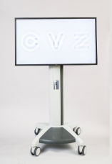
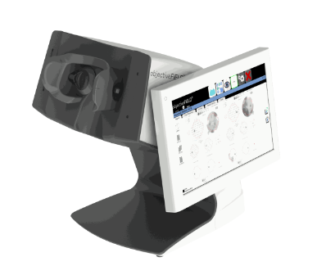
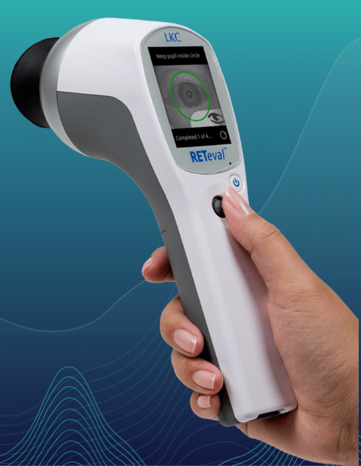
Manifold Contrast Sensitivity
Objective Field Analyzer
RETeval Electroretinography
Multifocal pupillographic object perimetry (mfPOP) is a novel innovation in perimetric testing
Assesses visual function by monitoring pupillary response to retinal stimuli presented at multiple locations in the visual field
The test is non-contact and records responses from many locations in the visual field from both eyes concurrently (amplitude and time to peak response delay)
Measures retinal function in two ways:
    Electroretinography (ERG)
    Pupillography (pupil response)
Performed in both light and dark-adapted settings
Light, portable device does not require refraction for testing
Contrast sensitivity testing
Obtains the full contrast sensitivity curve across a spectrum of spatial frequencies that is summarized by the area under the contrast sensitivity function (AULCSF)
Currently used in Protocols AF, AFA

Slide 93

ROP Studies – Collaboration with PEDIG

Slide 94
ROP4 Study Questions
Primary study question: For eyes with type 1 ROP in zone I, what is the short-term effectiveness of 0.063 mg and 0.25mg?
Secondary questions:
  What are refractive outcomes?
  What is the extent of retinal vascularization?

Slide 95
Design
RCT, with 1:1 randomization to:
  0.063 mg bevacizumab
  0.25 mg bevacizumab

Slide 96
ROP4 Update
33 subjects enrolled so far towards goal of 80
23 Sites, 3 pending certification
Protocol amendment to add 2-year Bayley IV Neurological Testing and Ocular Exam

Slide 97
DRCR Retina Network Role in
AI Efforts for Retinal Disease

Slide 98
DRCR Retina Network Role in
AI Efforts for Retinal Disease
Multiple groups currently working on detection algorithms for DR, AMD, and other retinal disease
The Network is uniquely poised to contribute to these efforts
  High-quality images
  Rigorous phenotyping of study participants
  Longitudinal datasets
  Outcomes addressing treatment response
  Collective expertise in diagnosis and management of retinal disease

Slide 99
DRCR Retina Collaborations in AI
The Network is interested in collaborating with groups with active AI efforts
  Detecting retinal disease
  Identifying the risk of worsening
  Predicting treatment response
Collaborators may be academic or industry partners
  AI/Deep Learning Proposal Idea Form available on the Public Website
Major goals:
  Encourage widespread use of DRCR Retina Network images/data
  Meaningful Network participation in interpreting and reporting results

Slide 100

Thank you!
To join the DRCR Retina Network email drcrnet@jaeb.org

