Slide 1

DRCR Retina Network
Transforming Vision Care Through Collaborative Research - Advancing Treatments That Restore Sight

Slide 2

Our Mission: Advancing Vision Care
Driving Excellence in Retinal Disease Research
Leading high-quality, collaborative clinical research
Multicenter involvement to accelerate discoveries
Your support directly fuels these life-changing advancements

Slide 3

Why Your Support Matters
Changing Standard of Care
Improving Treatment Selection
Your funding enables vital research that directly shapes national clinical guidelines and treatment protocols, improving care for all.
Thanks to donor-supported research, clinicians gain evidence-based data, empowering them to choose the most effective therapies for each patient's unique needs.
Enhancing Vision Outcomes
Funding makes possible the clinical trials that demonstrate improved visual acuity and quality of life, directly benefiting countless individuals affected by retinal diseases.

Slide 4

Proven Results: DME Treatment Breakthrough
Groundbreaking discoveries enabled by collaborative research, showcases how our network achieves significant advancements
Protocol V
Protocol AC
Decrease Treatment Burden
Significantly Reduced Cost
Years of research funding allowed for the discovery that postponing treatment for patients with good vision is a safe choice for DME.
Equivalent 2-year vision outcomes and a lower cost with initiation of bevacizumab as first line for DME patients.
Protocol I
Long-Term Maintenance & Outcomes
Revealed a remarkable reduction to just 0-1 injections per year in years 3-5, leading to improved long-term patient outcomes and quality of life.
"This was a remarkable finding, and something that we did not expect. DME can be a relatively self-limited disease, and that may be particularly true with appropriate treatment." — Dan Martin, MD

Slide 5

Network Evolution and Scope
September 2002
April 2019
DRCR.net founded to focus on diabetic retinopathy research
Rebranded as DRCR Retina Network to reflect expanded mission
1
2
3
4
2018
Today
Network expands scope to include broader retinal disorders
Over 140 participating sites with 400+ physicians across US and Canada

Slide 6
Our Impact by the Numbers
140+
1,800
30+
100+
A Network of Trust:
140+ Sites
Dedicated Experts:
1,800 Investigators
Proven Track Record:
30+ Studies
Scientific Rigor:
100+ Publications
These numbers represent more than just statistics; they are the foundation of our ability to preserve vision for countless individuals affected by retinal diseases. Your support directly amplifies this profound impact.
"Over the past ** years, the research from this network has set new standards of care for patient treatment to prevent vision loss from retinal disease." — **

Slide 7

Smarter Treatment Strategies
Our groundbreaking research has revealed smarter ways to manage patient care.
Clinicians are enabled to personalize treatment timing, avoiding unnecessary interventions and reducing patient burden, all while maintaining excellent long-term results.
Your continued support funds these critical insights, unlocking future breakthroughs that redefine treatment paradigms. Invest in research that truly makes a difference in patients' lives.

Slide 8



The Broader Impact of Your Investment
Healthcare Policy
Economic Impact
Patient Impact
Your funding drives research that shapes national clinical guidelines
Generates significant cost savings across the healthcare system
Preserves vision and independence, changing countless lives
Ensures standardized, evidence-based treatment for retinal diseases
Boosts workforce productivity by preventing vision-related disability
Reduces the burden of disease through early interventions
Contributes to reduced healthcare costs through optimal care strategies
Enhances quality of life, for a healthier, more productive society
Restores hope for individuals and families facing retinal conditions

Slide 9

Evidence-Based Treatment Options
Our commitment to research funding not only yields groundbreaking discoveries but also equips clinicians with a spectrum of safe, effective, and evidence-based treatment options.
Selection of Anti-VEGF Options
Thanks to robust research, clinicians can confidently select from three approved anti-VEGF drugs, all proven effective for diabetic macular edema patients with vision of 20/40 or better:
Bevacizumab
Ranibizumab
Aflibercept
Cost-Effectiveness & Accessibility
Further research has revealed that Bevacizumab provides comparable clinical efficacy to the other approved treatments, yet at a significantly lower cost. This critical economic insight, driven by research funding, directly benefits patients by improving accessibility to effective treatment, and demonstrates responsible stewardship of healthcare resources by offering substantial system-wide savings.

Slide 10
Organizational Structure
Network Chairs
Coordinating Center
National Eye Institute
Jennifer K. Sun, M.D., M.P.H.Joslin Diabetes Center, Harvard Medical School
Adam R. Glassman, M.S., Director
Jaeb Center for Health Research, Tampa, FL
Negin Atri, Dr.Ph., M.P.H., C.P.H.Project Officer, NEI/NIH
Daniel F. Martin, M.D.Emory Eye Center, Emory University
The DRCR Retina Network is funded by the National Eye Institute (NEI), part of the National Institutes of Health—the federal agency responsible for funding medical research across the United States.

Slide 11





DRCR Retinal Network Leadership
Lloyd Paul Aiello
Neil Bressler
Lee Jampol
Jennifer Sun
Dan Martin

Slide 12


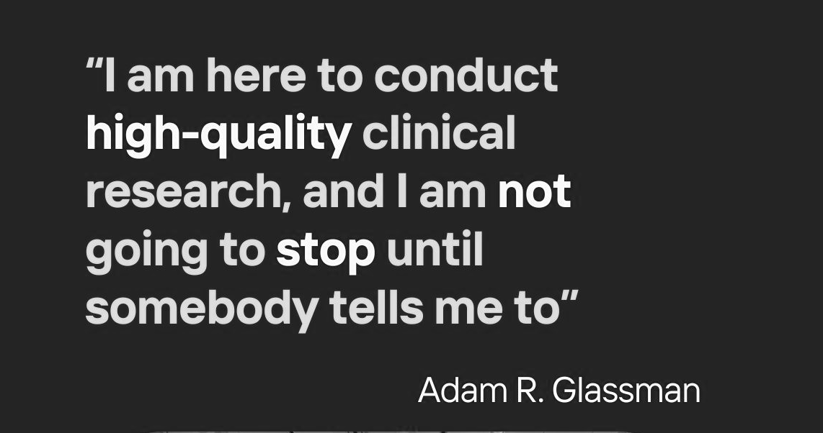

Slide 13
