Slide 1
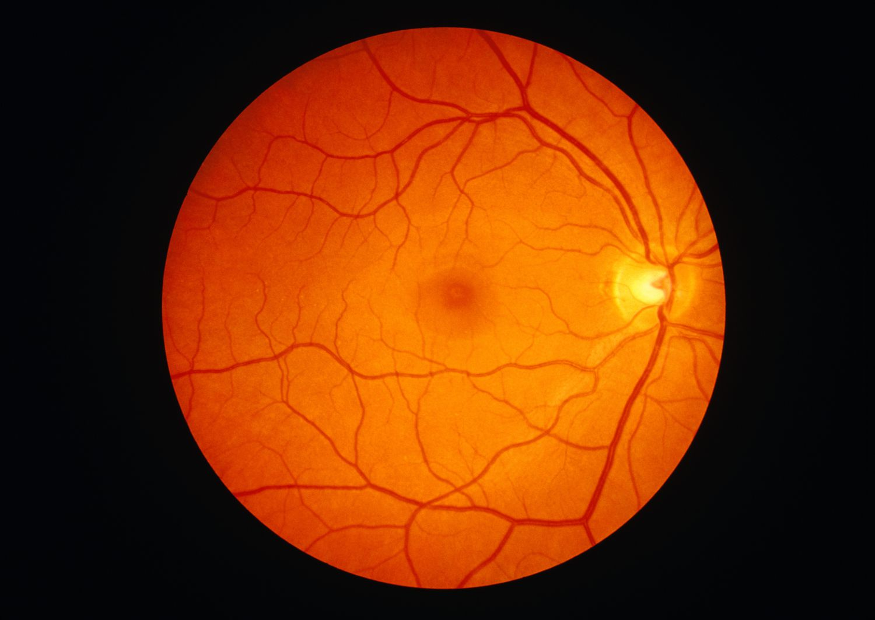




DRCR Retina Network
UG1EY014231

Slide 2


DRCR Retina Network

Slide 3

Network Evolution and Scope
2002
2019
DRCR.net founded to focus on diabetic retinopathy research
Rebranded as DRCR Retina Network to reflect expanded mission
1
2
3
4
2017
Today
Network expands scope to include broader retinal disorders
Over 140 participating sites with 400+ physicians across US, Canada, and UK

Slide 4


Funding - UG1EY014231
Current award 2024-2028

Slide 5
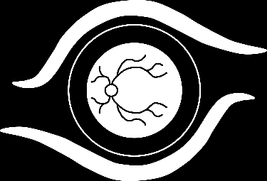
DRCR Major Findings
Two Decades of Revolutionizing Diabetic Retinopathy Care:
Diabetic Macular Edema
2008 2009 2010 2011 2012 2013 2014 2015 2016 2017 2018 2019 2020 2021 2022 2023 2024 2025 2026
Protocol B
Laser superior to corticosteroid for DME

Slide 6
DRCR Major Findings
Two Decades of Revolutionizing Diabetic Retinopathy Care:
Diabetic Macular Edema
2008 2009 2010 2011 2012 2013 2014 2015 2016 2017 2018 2019 2020 2021 2022 2023 2024 2025 2026
Protocol I
Anti-VEGF superior to laser for DME

Slide 7
DRCR Major Findings
Two Decades of Revolutionizing Diabetic Retinopathy Care:
Diabetic Macular Edema
2008 2009 2010 2011 2012 2013 2014 2015 2016 2017 2018 2019 2020 2021 2022 2023 2024 2025 2026
On average, aflibercept outperforms other anti-VEGF agents for DME at one year when starting with moderate or worse vision loss (20/50 or worse)
On average, bevacizumab and ranibizumab 0.3-mg perform similarly to aflibercept at 1 year when starting with mild vision loss (20/32 to 20/40)
Protocol T

Slide 8
DRCR Major Findings
Two Decades of Revolutionizing Diabetic Retinopathy Care:
Diabetic Macular Edema
2008 2009 2010 2011 2012 2013 2014 2015 2016 2017 2018 2019 2020 2021 2022 2023 2024 2025 2026
Protocol U
Dexamethasone + ranibizumab does not improve VA
At 6 months compared with ranibizumab alone for eyes with persistent DME following anti-VEGF therapy

Slide 9
DRCR Major Findings
Two Decades of Revolutionizing Diabetic Retinopathy Care:
Diabetic Macular Edema
2008 2009 2010 2011 2012 2013 2014 2015 2016 2017 2018 2019 2020 2021 2022 2023 2024 2025 2026
2008
Protocol V
Among eyes with CI-DME and good visual acuity
(20/25 or better), VA loss after 2 years was similar regardless of whether initial management was aflibercept, laser, or observation

Slide 10
DRCR Major Findings
Two Decades of Revolutionizing Diabetic Retinopathy Care:
Diabetic Macular Edema
2008 2009 2010 2011 2012 2013 2014 2015 2016 2017 2018 2019 2020 2021 2022 2023 2024 2025 2026
Protocol AE
Photobiomodulation as given in this study, while safe and well tolerated, was not found to be effective for the treatment of CI-DME in eyes with good vision
No evidence of a significant difference in visual outcomes over a 2-year period between aflibercept monotherapy and treatment with bevacizumab first with a switch to aflibercept in the case of suboptimal response
Protocol AC

Slide 11
DRCR Major Findings
Two Decades of Revolutionizing Diabetic Retinopathy Care:
Diabetic Macular Edema
2008 2009 2010 2011 2012 2013 2014 2015 2016 2017 2018 2019 2020 2021 2022 2023 2024 2025 2026
No statistically significant improvement in CST at 6 months in the tonabersat versus placebo groups.
A post hoc analysis that limited anti-VEGF impact demonstrated statistically significant benefit in the tonabersat group.
Protocol AN

Slide 12
DRCR Major Findings
Two Decades of Revolutionizing Diabetic Retinopathy Care:
Diabetic Retinopathy
2008 2009 2010 2011 2012 2013 2014 2015 2016 2017 2018 2019 2020 2021 2022 2023 2024 2025 2026
Protocol S
Anti-VEGF at least as good as PRP for VA at 2 years

Slide 13
DRCR Major Findings
Two Decades of Revolutionizing Diabetic Retinopathy Care:
Diabetic Retinopathy
2008 2009 2010 2011 2012 2013 2014 2015 2016 2017 2018 2019 2020 2021 2022 2023 2024 2025 2026
Protocol S
Mean change in VA with ranibizumab similar to PRP at 5 years

Slide 14
DRCR Major Findings
Two Decades of Revolutionizing Diabetic Retinopathy Care:
Diabetic Retinopathy
2008 2009 2010 2011 2012 2013 2014 2015 2016 2017 2018 2019 2020 2021 2022 2023 2024 2025 2026
Protocol AB
In eyes with VH from PDR, vision improved more quickly with vitrectomy compared with aflibercept but there was no significant difference in mean VA letter score over 24 weeks

Slide 15
DRCR Major Findings
Two Decades of Revolutionizing Diabetic Retinopathy Care:
Diabetic Retinopathy
2008 2009 2010 2011 2012 2013 2014 2015 2016 2017 2018 2019 2020 2021 2022 2023 2024 2025 2026
(2-Year): Among eyes with moderately severe to severe NPDR, the proportion that developed PDR or
CI-DME was lower with periodic aflibercept treatment compared with sham but did not result in VA benefit through at least 2 years
Protocol W

Slide 16
DRCR Major Findings
Two Decades of Revolutionizing Diabetic Retinopathy Care:
Diabetic Retinopathy
2008 2009 2010 2011 2012 2013 2014 2015 2016 2017 2018 2019 2020 2021 2022 2023 2024 2025 2026
No association with future DR progression was identified from peripheral lesions on UWF baseline color photos. The presence of peripheral lesions on UWF FA images were associated with a greater risk of disease worsening over 4 yrs.
On UWF-FA images, greater baseline retinal nonperfusion was also associated with a higher risk of DR worsening over 4 yrs.
Protocol AA

Slide 17
DRCR Major Findings
Two Decades of Revolutionizing Diabetic Retinopathy Care:
Diabetic Retinopathy
2008 2009 2010 2011 2012 2013 2014 2015 2016 2017 2018 2019 2020 2021 2022 2023 2024 2025 2026
(4-Year): Preventative aflibercept treatment compared to sham in eyes with moderate to severe NPDR
(DRSS level 43-53) and VA 20/25 or better (≥ 79 letters)
Lowered the probability of developing PDR or
CI-DME within 4 years
Did not confer VA benefit at 4 years
Protocol W

Slide 18

Protocols AG/AH
Treatment for vitreomacular traction with and without macular hole
Protocol AJ
Biobanking vitreous samples in eyes with macular hole
Expansion to Other Retinal Diseases
Protocol AM
Surgical Management of Epiretinal Membrane
Protocols AK/AO
Home OCT

Slide 19

Participation
Opportunity to be involved in protocol development
Collaborative environment with twice yearly study group meetings
Primary manuscripts published with group authorship
High enrollment can lead to invitations to be an author on manuscripts

Slide 20
Budget Considerations
50-100% funding for dedicated DRCR coordinator available
Procedure rates recently increased 55% on average
Site-specific rates may be negotiated
Imaging and functional testing devices sometimes provided
Notes:
Being a part of the Network doesn’t need to replace an industry trial at your site, but instead can supplement your research center. Often the inclusion criteria is not overlapping other industry trials.

Slide 21

Other Ancillary Benefits
Being involved in the latest DRCR Research can boost your site’s reputation!
  Potential for more referrals/patients
Groundbreaking Findings
  DRCR studies have led to major advancements in diabetic retinopathy, macular edema, and other retinal conditions
Access to High-Impact Research
  DRCR publications are often in high-impact journals such as JAMA and NEJM, which directly contributes to an increase in h-index for authors who contribute
Collaboration with Experts
  Collaborating with this community can lead to additional
  opportunities to publish and present at society meetings

Slide 22
Protocols Currently Certifying Sites
AR | Longitudinal Natural History Study of Retinal Function in Eyes of Patients with Diabetes
AS | Longitudinal Study of Retinal Function in Eyes Treated for Diabetic Macular Edema with Anti-VEGF Agents

Slide 23
Protocols Currently Certifying Sites & Enrolling
AFA | Diabetic Retinopathy and Changes in Lipid Metabolism
AL | A Randomized Clinical Trial Evaluating Intravitreal Faricimab (6.0 mg) Injections or Fluocinolone Acetonide (0.19 mg) Intravitreal Implants vs Observation for Prevention of Visual Acuity Loss due to Radiation Retinopathy
AM | Randomized Trial Comparing Immediate versus Deferred Surgery for Symptomatic Epiretinal Membranes
AP | A Randomized Clinical Trial Evaluating Combination Faricimab + PRP vs. Vitrectomy + Endolaser for Treatment of Proliferative Diabetic Retinopathy
GEN | Genetics in Retinal Diseases Project

Slide 24
Protocols Currently In Follow Up
AF | A Randomized Trial Evaluating Fenofibrate for Prevention of Diabetic Retinopathy Worsening
AO | Home OCT-Guided Treatment versus Treat and Extend for the Management of Neovascular AMD

Slide 25
Other Projects
ROP4 | Collaboration with the Pediatric Eye Disease Investigator Group evaluating bevacizumab for treatment of type 1 retinopathy of prematurity
AI | Collaborations with groups that have active machine or deep learning efforts underway for automated detection of retinal disease or automated predication of disease progression

Slide 26

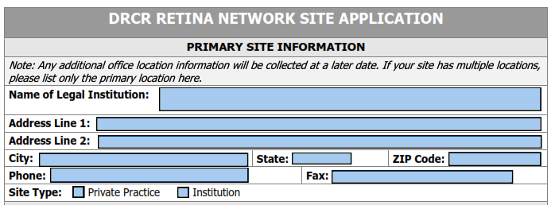
How to Get Started
Notes:
Email drcrnet for application.

Slide 27
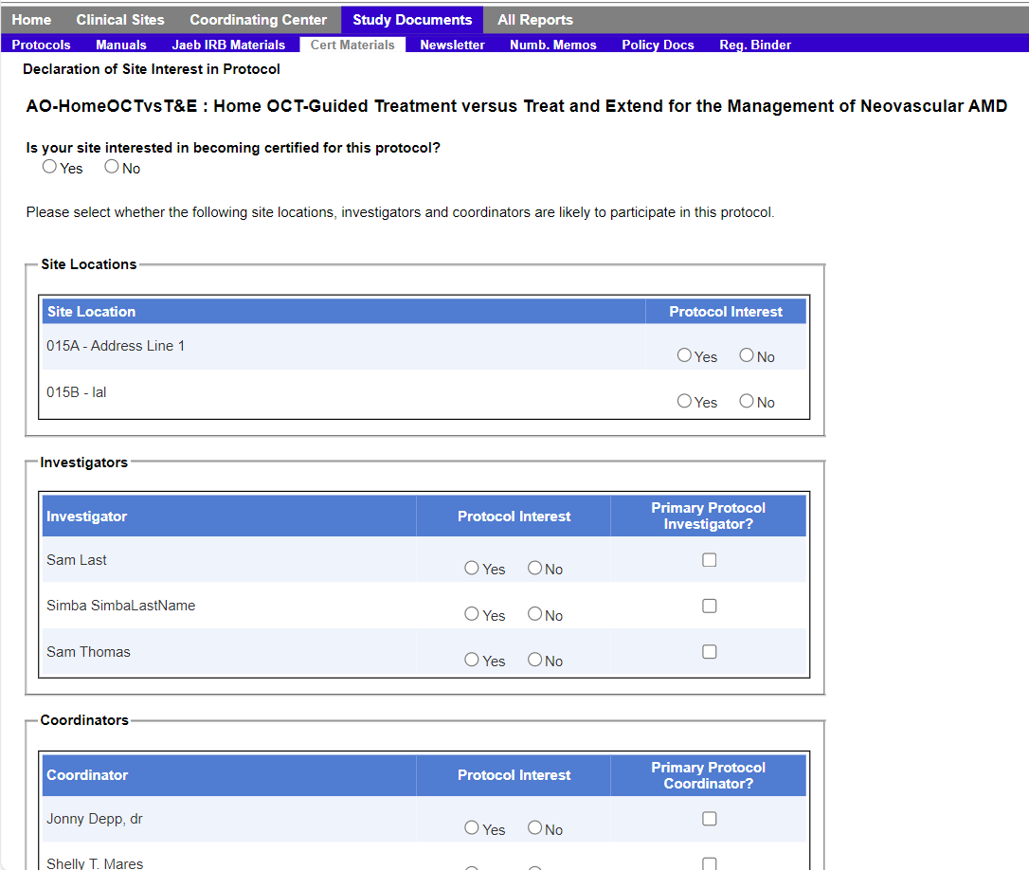
Protocol Certification Process
Once a protocol is open for certification, sites will be notified via email and can indicate interest in a protocol on the study website

Slide 28
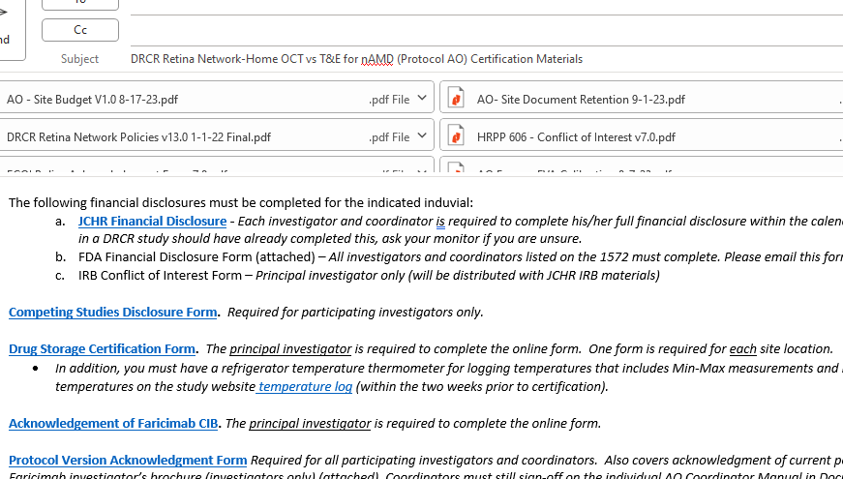
Certification Kick-Off
Jaeb monitor sends the site Protocol Certification Requirements e-mail
  IRB instructions
  Certification checklist
  All protocol specific
  documents/forms to be
  completed by investigators
  and coordinators
  Links to required general
  forms
Notes:
One email with ALL the requirements including links to the forms on the website is sent upon indicating interest. This is the best reference to determine what is needed and where to go. If you have not seen this, ask your site coordinator to forward it along to keep you in the loop and help ensure progress toward certification.

Slide 29
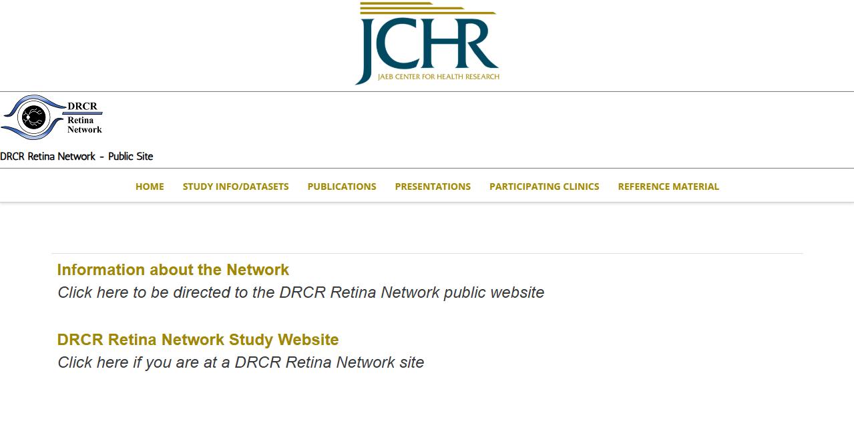
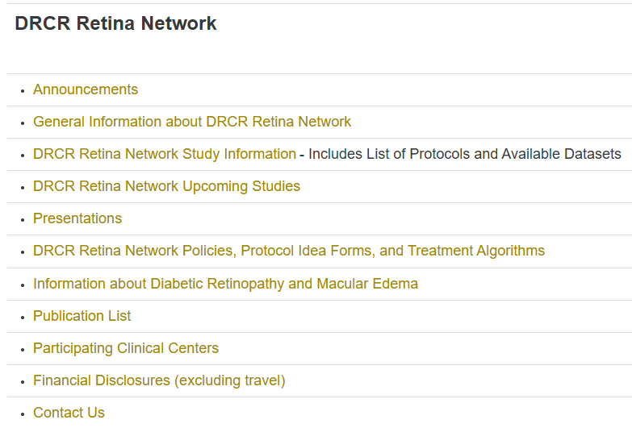
Helpful Links - drcr.net

Slide 30
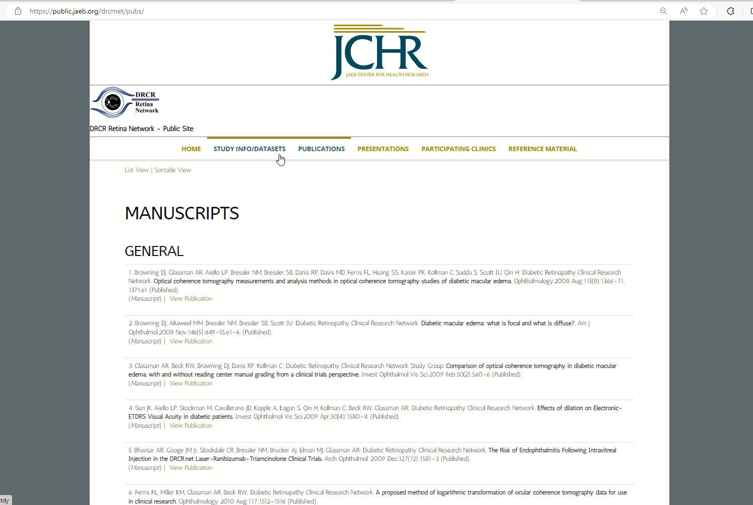
Publication List drcr.net

Slide 31
Thank you

