Slide 1



Protocol AN
A Phase 2 Evaluation of Tonabersat for Diabetic Macular Edema
DRCR Retina Network, Barkmeier AJ, Vu TP, Elman M, Franklin CA, Friedman SM, Glassman A, Jampol LM, Labriola LT, Marcus DM, Martin DF, Papakostas T, Salehi-Had H, Stockdale CR, Tian W, Sun JK. Oral tonabersat connexin-43 modulator for diabetic macular edema with good vision (DRCR Protocol AN). Ophthalmol Sci. Published online 2026. doi:10.1016/j.xops.2026.101167

Slide 2

Phase 2 Study Objective
Assess the effects of orally available tonabersat on central subfield thickness (CST) compared to placebo in eyes with center-involved DME (CI-DME) and good visual acuity

Slide 3
Study Rationale
Current DME treatments are costly, invasive and can require frequent visits
An effective, well-tolerated, and non-invasive treatment for DR/DME that can modify the inflammatory disease process, rather than acutely treating signs and symptoms, would reduce patient burden by:
reducing frequency of treatment visits
delay or avoid injections or other invasive treatments

Slide 4
Purpose of a Phase 2 Study
To explore whether the study drug demonstrates a biologic effect on the targeted pathway, not to definitively prove efficacy
Identify patterns of effect across analyses that suggest the drug is active and warrants further testing

Slide 5
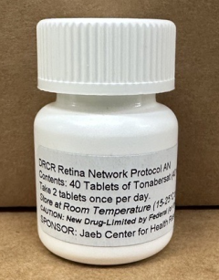
Tonabersat Background
Orally available
Dosed once daily (two pills, 80mg total)
Targets connexin43 hemichannels that are overexpressed in DR, reducing the activation and recycling of proinflammatory cytokines
Initially developed for treatment of migraine

Slide 6
Tonabersat Background: Safety Data
>1,500 participants dosed in phase 1 and 2B studies
Well-tolerated with no significant safety issues
Most common side effects: headache, drowsiness, dizziness
Pregnant or breastfeeding women excluded, unknown risks
Systemic effects of tonabersat will be evaluated in this trial via routine lab testing and collection of AE data

Slide 7
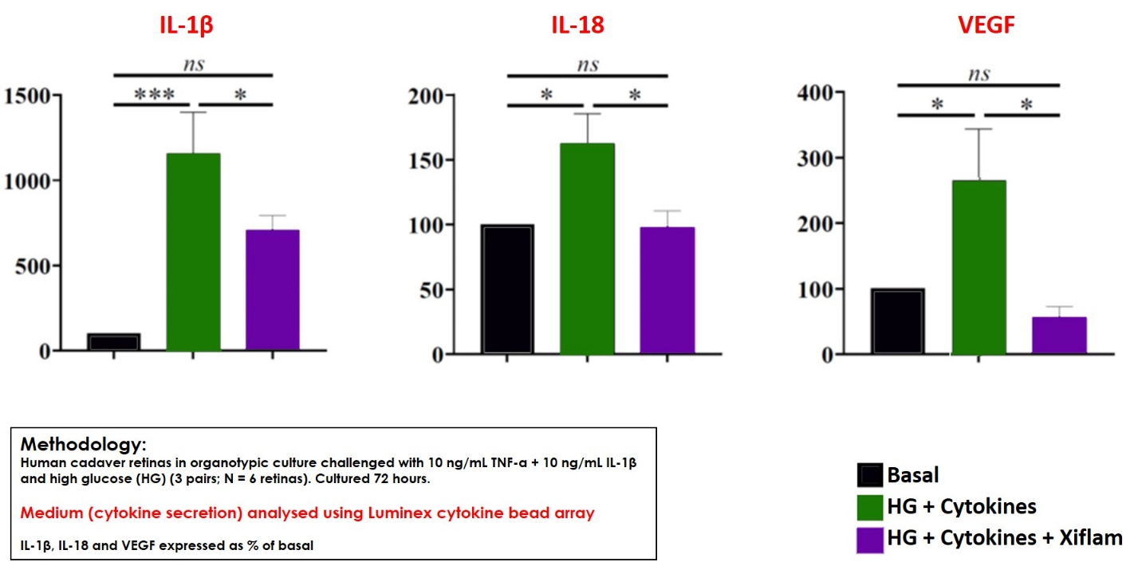
Tonabersat Background
Ex Vivo Human Retina DR Model
(high glucose, IL-1β, TNFα challenge)
Tonabersat blocked the release of key inflammatory cytokines, including VEGF
Notes:
Figure 1: Human tissue cultures data support that tonabersat has blocked the release of key inflammatory cytokines, including VEGF (First figure).

Slide 8
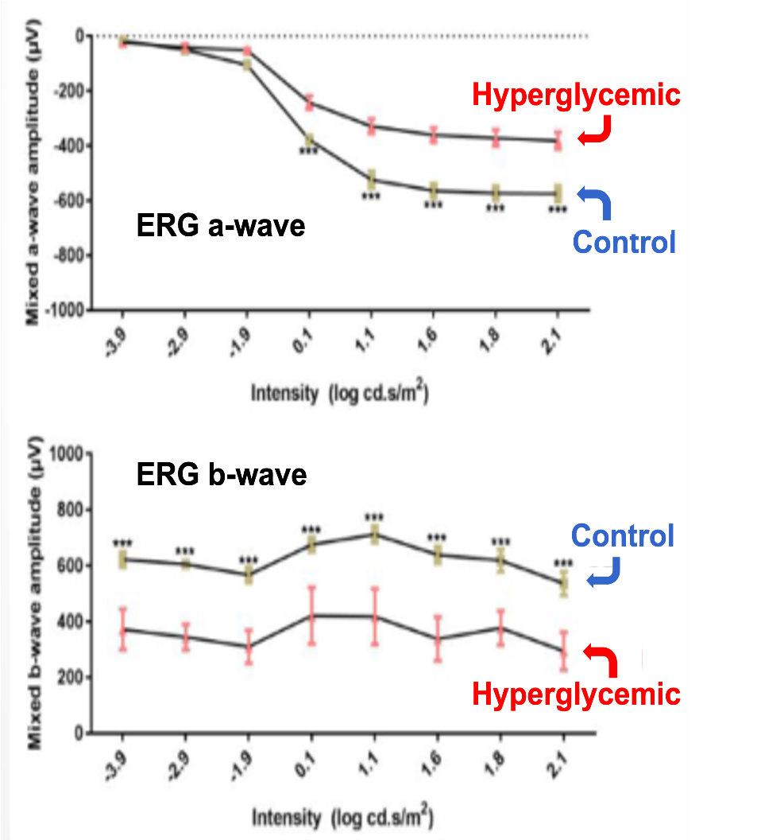
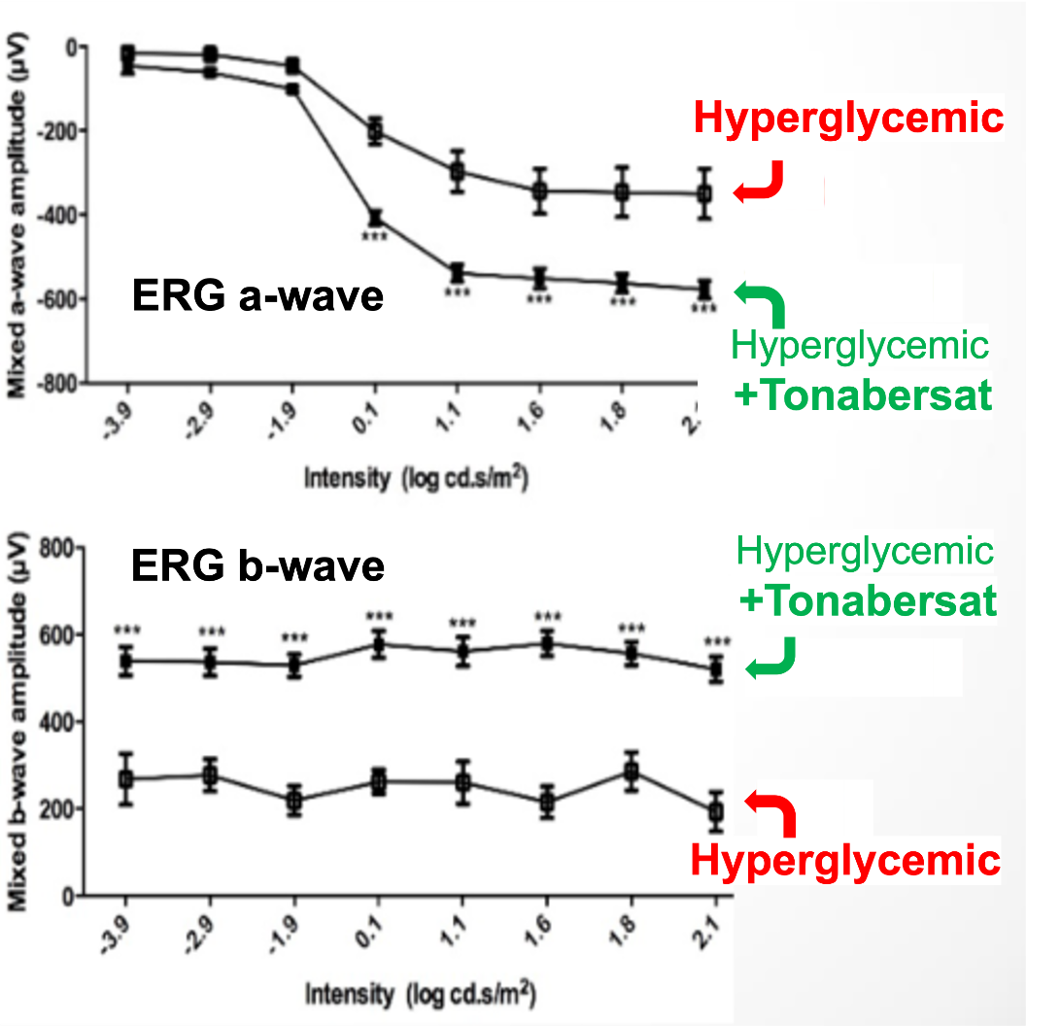
Tonabersat Background
Hyperglycemic Rat Model of DR (MSD)
Tonabersat-treated hyperglycemic rats had preserved ERG function at 8 wks
Reduced microaneurysm formation
Additionally, reduced vascular leakage and edema in a rat model of ischemic retinal injury
Notes:
Additional models of ischemic retinal injury in rats demonstrated that tonabersat reduced vascular leakage up to 86%, and edema.

Slide 9




Study Design: Phase 2 Randomized Trial
Adults with type 1 or 2 diabetes
CI-DME on OCT above sex-based thresholds
VA 20/32 or better
No tx for DME in prior year and no more than 4 injections in prior 3 years
Enrollment
Tonabersat, 80 mg
N = 71 Eyes*
Placebo
N = 73 Eyes*
Randomized
*7 and 8 participants in the tonabersat and placebo groups, respectively enrolled 2 study eyes
Notes:
187 screened; 58 not eligible = consider adding reasons for not eligible

Slide 10

Study Design
2 Pills once daily
Monthly visits through month 6
Primary outcome OCT CST
Enrollment
Month 6
Tonabersat, 80 mg
N = 68 Eyes
Placebo
N = 68 Eyes
Completed the 6-month visit
Notes:
Tonabersat
1 Eye missed visit
2 Eyes dropped
1 Withdrew
1 Lost-to-follow-up
Placebo
2 Eyes missed visit
3 Eyes dropped
1 Death
2 Withdrew

Slide 11
Study Design
No study drug after 6-month visit
Enrollment
Month 6
Primary Outcome Visit
Month 12
Final Visit
Tonabersat, 80 mg
N = 68 Eyes
95% of Participants
Placebo
N = 68 Eyes
92% of Participants
Completed the 6-month visit
*1 and 2 eyes missed the 6-month visit and 2 and 3 eyes were dropped in the tonabersat and placebo groups, respectively.
Notes:
Tonabersat
1 Eye missed visit
2 Eyes dropped
1 Withdrew
1 Lost-to-follow-up
Placebo
2 Eyes missed visit
3 Eyes dropped
1 Death
2 Withdrew

Slide 12
Results

Slide 13
Participant Baseline Characteristics
 |  | Tonabersat 80mg (N = 64) | Placebo (N = 65)
Mean Age, y |  | 63 | 63
Bilateral study eyes |  | 7 | 8
Female |  | 34% | 40%
Mean HbA1c, % |  | 7.1 | 7.5
Race/ Ethnicity | White | 64% | 65%
 | Black/African American | 20% | 15%
 | Hispanic or Latino | 13% | 18%
 | More than one race | 2% | 2%

Slide 14
Participant Baseline Characteristics
 | Tonabersat 80mg (N = 64) | Placebo (N = 65)
Type 2 diabetes | 97% | 95%
Mean diabetes duration, y | 19 | 16
Insulin used | 69% | 54%
History of renal disease | 23% | 9%
Mean estimated glomerular filtration rate (eGFR), mL/min/1.73 m² | 74 | 82
History of heart failure | 11% | 3%
History of myocardial infarction | 11% | 9%
History of cardiac conditions | 25% | 23%

Slide 15
Ocular Baseline Characteristics
 |  | Tonabersat 80mg (N = 71 Eyes) | Placebo (N = 73 Eyes)
Prior treatment for DME |  | 4% | 5%
Phakic |  | 62% | 68%
Mean OCTª CST, μm |  | 359 | 362
OCT Category | CST <75 μm above threshold^{b} | 68% | 63%
 | CST ≥75 μm above threshold^{b} | 30% | 36%
 | Does not have CI-DME | 3% | 1%
ªCirrus Equivalent
^{b}Threshold for center-involved DME = Zeiss Cirrus CST: ≥290 µm in females and ≥305 µm in males or Heidelberg Spectralis CST: ≥305 µm in females and ≥ 320µm in males; CST categories based on reading center grading.

Slide 16
Ocular Baseline Characteristics
 |  | Tonabersat 80mg (N = 71 Eyes) | Placebo (N = 73 Eyes)
Mean visual acuity letter score (Snellen equivalent) |  | 84 (20/25) | 83 (20/25)
Mean OCT retinal volumeª, mm³ |  | 7.8 | 7.9
^{DR Severity Scale (Level)} | DR absent or minimal (≤ 20) | 10% | 12%
 | Mild NPDR (35) | 41% | 42%
 | Moderate NPDR (43) | 27% | 29%
 | Moderately severe NPDR (47) | 13% | 10%
 | Severe NPDR (53) | 3% | 1%
ªOCT Retinal volume measurements were missing for 14% and 10% in the Tonabersat and Placebo groups, respectively.

Slide 17
Primary Outcome: OCT CST Change Baseline to 6-Months
LOCF data was used for 4 (Tonabersat)
and 5 (Placebo)
eyes that received anti-VEGF for DME.
Adjusted Mean Difference (95% CI): -16 (-34, 2)
p = 0.08
5 (51)
-15 (55)
N Eyes =
Tonabersat | 63 | 65 | 62 | 63 | 57 | 67
Placebo | 71 | 66 | 63 | 67 | 62 | 68
Notes:
For eyes that received alternate DME prior to 6 months, the last measurement prior to alternative DME treatment was used for the summary of descriptive statistics and the statistical model for the 6-months visit Mean differences and odds ratios were adjusted for baseline CST (continuous), baseline values of the outcome (where applicable), and a random intercept for the correlation within participants having two study eyes Multiple imputation (m = 100) was used for missing values of the outcomes
1 eye in Tonabersat missing CST due to OCT not done despite completing 6-month visit

Slide 18
Post-hoc analysis: OCT CST Change Baseline to 6-Months
4 and 7 eyes had LOCF following
anti-VEGF treatment for any indication
.
Adjusted Mean Difference (95% CI): -21 (-38, -3)
p = 0.02
10 (47)
-15 (53)
N Eyes =
Tonabersat | 63 | 65 | 62 | 63 | 57 | 67
Placebo | 71 | 66 | 63 | 66 | 61 | 68
Notes:
1 eye in Tonabersat missing CST due to OCT not done despite completing 6-month visit
Post-hoc analyses follows the same methodology as the primary and secondary analyses. However, eyes that received alternate DME treatment or anti-vegf treatment for any condition prior to 6-months (2 eyes in the placebo group: 1 for neovascular glaucoma, 1 for diabetic retinopathy), the last OCT measurement prior to the treatment was used for the summary of descriptive statistics and the statistical model for the 6-months visit.

Slide 19
OCT CST Change – Stratified by Baseline CST Baseline to 6-Months
<75 µm above the CI-DME Threshold
≥75 µm above the CI-DME Threshold
Adjusted Mean Difference (95% CI): -2 (-26, 22)
Adjusted Mean Difference (95% CI): -51 (-83, -19)
0 (73)
7 (33)
-1 (46)
-49 (61)
N Eyes =
Tonabersat | 43 | 44 | 41 | 41 | 37 | 45
Placebo | 44 | 42 | 38 | 41 | 40 | 43
N Eyes =
Tonabersat | 18 | 19 | 19 | 20 | 18 | 20
Placebo | 26 | 23 | 24 | 25 | 22 | 24
Interaction: p = 0.02
Notes:
ª CI-DME is indicated if Zeiss Cirrus CST: ≥290µm in females and ≥305µm in males or Heidelberg Spectralis CST: ≥305µm in females and ≥320µm in males; CST categories were determined based on reading center grading. Eligibility, however, was assessed using site-reported values; therefore, participants who were not identified as having CI-DME at baseline by the reading center were excluded from the subgroup analysis

Slide 20
Secondary Outcomes: OCT
 | Tonabersat 80mg (N = 67 eyes) | Placebo (N = 68 eyes) | Adjusted mean difference or odds ratio (95% CI) ^{b}
Retinal volumeª mean change from baseline to 6-month visit | N = 51 | N = 59
 | -0.12 | 0.03 | -0.15 (-0.33, 0.03) p = 0.16
No CI-DME at 6 months and ≥10% improvement in CST from baseline to 6 months | 12% | 4% | 2.9 (0.2, 43.2) p = 0.39
ªStratus equivalent.
^{b}Adjusted p-values and CIs (pending validation) based on the adaptive FDR threshold.
Notes:
1 eye in Tonabersat missing CST due to OCT not done despite completing 6-month visit

Slide 21
Secondary Outcomes: VA Change Baseline to 6-months
Adjusted Mean Difference (95% CI) ª: 0.8 (-1.6, 3.2)
p = 0.39
Worsened ≥10 at a single visit or ≥5 at two consecutive visits
Tonabersat | Placebo | Adjusted odds ratio (95% CI) ª
9% | 18% | 0.17 (0.01, 3.59) p = 0.30
84 (20/25)
0 (5.7)
83 (20/25)
-0.4 (5.7)
N Eyes =
Tonabersat | 63 | 65 | 62 | 63 | 57 | 68
Placebo | 71 | 66 | 65 | 67 | 61 | 68
ªAdjusted p-values and CIs (pending validation) based on the adaptive FDR threshold.

Slide 22
Treatment Compliance
 | Tonabersat 80mg (N = 64) | Placebo (N = 65)
Median compliance | 98% | 96%
Reduced dosage (40 mg) | 0 | 3 (5%)
Discontinued study drug before 6-month visit | 13 (20%)ª | 6 (9%)
ªThe reasons for study drug discontinuation were adverse events (9 tonabersat and 1 placebo) and initiation of alternative DME treatment (4 tonabersat and 5 placebo)

Slide 23
Systemic Adverse Events of Interest
% of participants with ≥1 event | Tonabersat 80mg (N = 63)* | Placebo (N = 65)
Dizziness | 27% | 8%
Drowsiness | 11% | 11%
Headache | 6% | 17%
*One participant randomized to tonabersat did not receive study treatment and was therefore excluded from the safety cohort

Slide 24
Exploratory - Lab Sample Outcomes
Thyroid stimulating hormone (TSH), uIU/mL
Additional Lab Assessments | Wilcoxon rank-sum P value
c-Reactive protein (CRP) | 0.75
Urine Albumin | 0.36
Cystatin C, mg/L
Hemoglobin A1c (HbA1c), %
Estimated glomerular filtration rate (eGFR), mL/min/1.73 m²
Urine Creatinine, mg/dL

Slide 25
Exploratory - Lab Sample Outcomes
Change from baseline to 6 months | Tonabersat 80mg | Placebo | Adjusted Mean Difference (95% CI) or p-value)
Thyroid stimulating hormone (TSH), uIU/mL, Mean | -0.04 | -0.04 | 0.04 (-0.20, 0.27)
Cystatin C, mg/L, Mean | 0.06 | 0.04 | 0.02 (-0.05, 0.08)
Hemoglobin A1c (HbA1c), %, Mean | -0.2 | -0.1 | -0.2 (-0.5, 0.1)
Estimated glomerular filtration rate (eGFR), mL/min/1.73 m², Mean | -2 | -1 | -1 (-5, 2)
Urine creatinine, mg/dL, Mean | 4 | 11 | -7 (-29, 15)
Urine albumin, mg/L, Median | 0 | -2 | p = 0.36
c-Reactive protein (CRP), mg/L, Median | -0.11 | -0.07 | p = 0.75

Slide 26
Systemic Adverse Events of Interest - Renal
 | Any visit through 6 months |  | Last completed visitª / 6-Month^{b}
mL/min/1.73 m² | Tonabersat 80mg | Placebo | Tonabersat 80mg | Placebo
Baseline eGFR ≥60 | N = 44 | N = 53 | N = 44 | N = 53
eGFR <60 | 23% | 9% | 9%ª | 6%ª
Baseline eGFR ≥30 | N = 57 | N = 64 | N = 57 | N = 64
eGFR <30 | 9% | 2% | 4%ª | 0ª
 | -- | -- | N = 57 | N = 57
eGFR mean change (SD) | -- | -- | -2 (9)^{b} | -1 (8)^{b}
Dialysis or kidney transplant | 0 | 0 | 0 | 0
Baseline mean eGFR: 74 (Tonabersat), 83 (Placebo)
Notes:
For eGFR <60 or <30, no. of participants with baseline eGFR ≥60 or ≥30 and at least one non-missing follow-up value

Slide 27
Systemic Adverse Events of Interest - Liver
No. of participants with ≥1 event | Tonabersat 80mg (N = 63) | Placebo (N = 65)
ALT >3 times the upper limit of the normal range by sexª | 1 (2%) | 0
AST >3 times the upper limit of the normal range by sex^{b} | 0 | 0
ª ALT: male >123 U/L, female >99 U/L ^{b} AST: male >120 U/L, female >96 U/L

Slide 28
Systemic Adverse Events
 | Tonabersat 80mg (N = 63)* | Placebo (N = 65)
≥ 1 AE | 73% | 65%
≥ 1 SAE | 19% | 8%
≥ 1 hospitalization | 16% | 3%
Death | 0 | 0
*One participant randomized to tonabersat did not receive study treatment and was therefore excluded from the safety cohort

Slide 29
Reasons for Hospitalizations
Event* | Tonabersat (N = 63)
Cardiac Disorders
Heart failure | 3 (5%)
Cardiac arrhythmia | 1 (2%)
Tachycardia | 1 (2%)
Dizziness | 2 (3%)
Acute kidney injury and Kidney stones | 1 (2%)
Hypertension worsened | 1 (2%)
Respiratory infection | 1 (2%)
Sepsis | 1 (2%)
Shoulder Pain | 1 (2%)
Event* | Placebo (N = 65)
Fall | 1 (2%)
Pneumonia | 1 (2%)
*No. participants with at least one event (%)

Slide 30
Ocular Adverse Events: Study Eye
 | Tonabersat 80mg N = 70 | Placebo N = 73
≥ 1 AE | 8 (11%) | 17 (23%)
≥ 1 SAE | 1 (1%) (papillitis*) | 1 (1%) (neovascular glaucoma)
*The only ocular adverse event reasonably considered related to study treatment.

Slide 31
Discussion
No statistically significant difference in CST at 24 weeks. However, there were consistent, modest anatomic trends favoring tonabersat across additional analyses
Secondary outcomes: retinal volume, presence of CI-DME
Post Hoc Outcome: Last observation carried forward for all anti-VEGF injections; reducing confounding effects from anti-VEGF
Subgroup Analyses: Greater reduction in thicker eyes
Despite protocol revisions aimed to enroll thicker maculas, 67% of eyes were in the thinnest subgroup, potentially limiting overall power.
Notes:
Subgroup CST above CI-DME – Total 132 eyes, 88 thinner (CST <75 above), 44 thicker (CST ≥75)
67% (88/132) thin
33% (44/132) thick

Slide 32
Discussion
Dizziness was the most common systemic adverse (27% with tonabersat and 8% with placebo).
In response to early reports of dizziness, all study drug dosing was recommended at bedtime. Nevertheless, more patients receiving tonabersat discontinued the study drug due to adverse events
In contrast to prior trials for migraine, there was no difference in drowsiness between groups, and fewer patients reported headache with tonabersat than with placebo.

Slide 33
Discussion
There were imbalances in baseline renal function; with tonabersat group having worse renal function
A higher proportion of participants in the tonabersat group experienced low eGFR values at some point during the study; however, rates were similar at 6 months
The average change in eGFR was similar between two groups
There were no apparent differences between groups in other laboratory tests.
One serious ocular AE in the study eye in each group respectively, (papillitis and neovascular glaucoma) was reported.

Slide 34
Conclusion
Among eyes with CI-DME and good visual acuity, there was not a statistically significant improvement in CST at 6 months with orally-administered tonabersat versus placebo.
However, analyses limiting anti-VEGF treatment impact and subgroup analyses of thicker eyes showed statistically significant improvement and demonstrated potential signals for favorable biologic effect of tonabersat on DME.
These results may inform further investigation of tonabersat and continued research into the role of the NLRP3 inflammasome in DME.

