Slide 1
20+ Years of DRCR Retina Trials: What Every Retina Fellow and Specialist Need to Know

Slide 2
Financial Disclosures
None relevant, unless otherwise specified by the individual speaker

Slide 3
Network Overview
Darrell E. Baskin, MD

Slide 4


Funding
Sponsored cooperative agreement; initiated September 2002
Current award 2024-2028; UG1EY014231

Slide 5
Other Financial Relationships
Entity | Type of Funding | Protocol
Breakthrough T1D Foundation | Funding | AN, AA, W, AE, AF
Helmsley Charitable Trust Foundation | Funding | AF
Roche/Genentech | Funding and Study Drug | AF, AO, AL, AP
Notal | Supplies (Devices) | AO
Alimera | Funding and Study Drug | AL
InflammX | Funding and Study Drug | AN
Regeneron | DNA Sequencing, Statistical Analysis | Genetics

Slide 6
DRCR Retina Network
Our mission
is to conduct high-quality, collaborative clinical research that improves vision and quality of life for people with retinal diseases.
We support the identification, design, and implementation of multicenter clinical research initiatives focused on retinal disorders.
With a principal emphasis on clinical trials and epidemiologic outcomes; other research may also be supported.

Slide 7
Priority Initiatives
Involvement of community-based practices, as well as “academic” or university-based centers.
Collaborate with industry to facilitate investigations and pursue opportunities otherwise not possible and to do so in a manner consistent with the Network’s dedication to academic integrity and optimal clinical trial performance.

Slide 8

DRCR Retina Network Evolution
2003 - 2025
42 Multicenter Studies
132 Publications*
132 Active Clinical Sites
2017
Expansion to All Retinal Diseases
2002
DRCR.net
Created
*http://public.jaeb.org/drcrnet/pubs
Notes:
Need to update publications

Slide 9
Collaborative Network
NEI
Negin Atri
Network Chairs
Jennifer Sun
Daniel Martin
Clinical Sites
426 Active Investigators
Coordinating Center
Adam Glassman
Cindy Stockdale

Slide 10
Collaborative Network
Certified
Clinics
132
32
1031
US States
Clinic
Personnel
3
Canadian
Provinces
426
Investigators

Slide 11
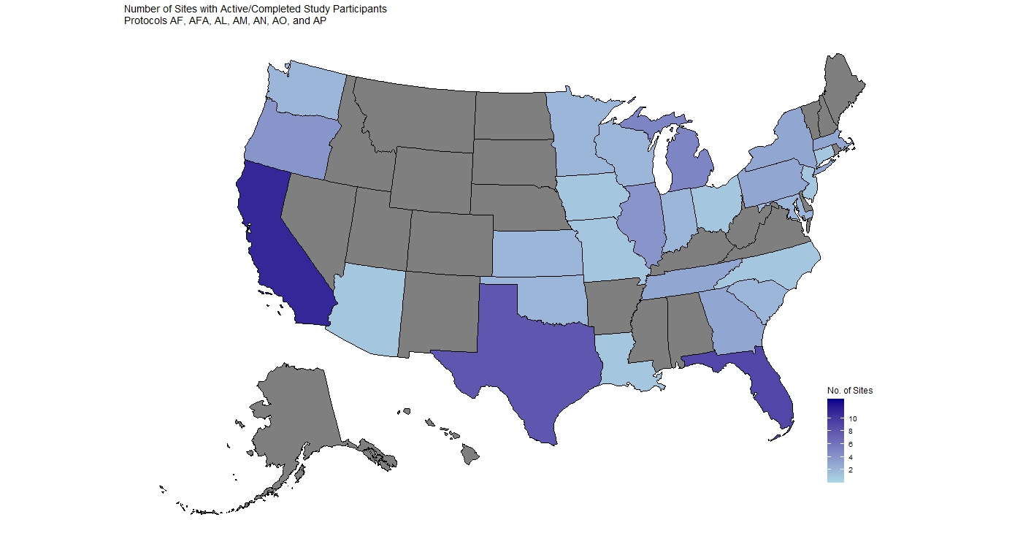
Number of Active Sites by Location
Notes:
Need to update map - Done

Slide 12
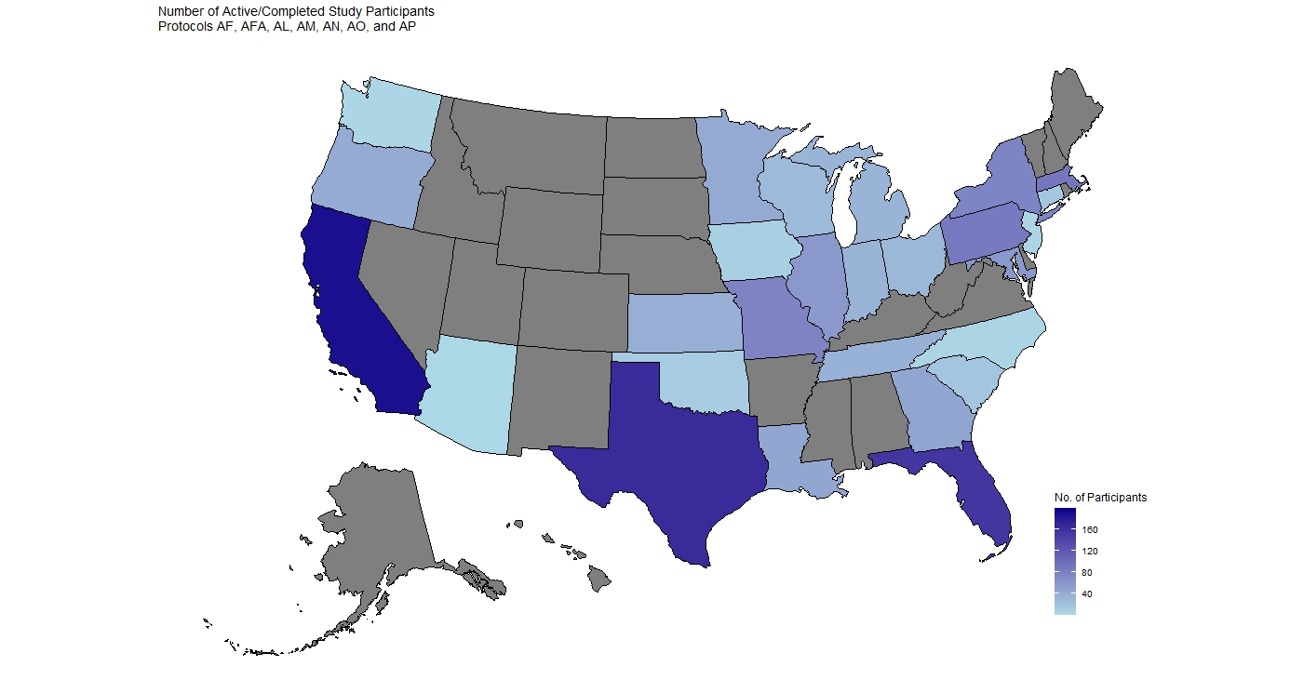
Number of Participants by Location
Province | # Pts | # Sites
ON | 11 | 2
Notes:
Updated Canada info - Done
Need to update map - Done

Slide 13
Helpful Links www.drcr.net
https://public.jaeb.org/drcrnet/view/Home_Page
Information about the Network
Publication List: References, links to PubMed manuscripts, and recent results presentations.
Network Policies, Protocols; downloadable idea forms:
Protocol
Ancillary Protocol,
Abstracts, and
Analysis/Manuscript.
https://public.jaeb.org/drcrnet/pubs/
https://public.jaeb.org/drcrnet/view/Investig_Info

Slide 14
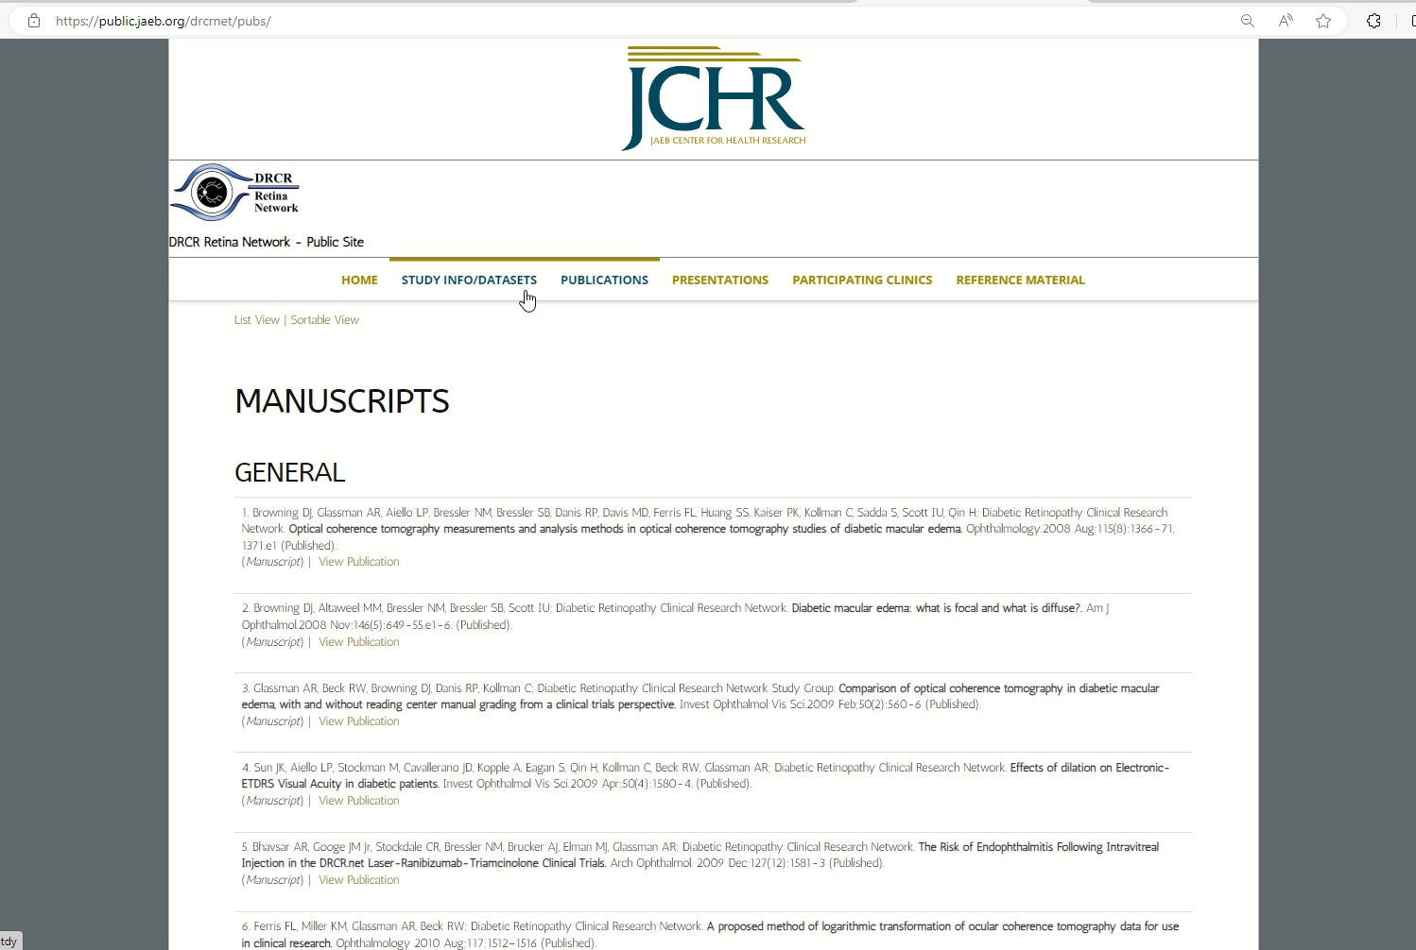
Publication List www.drcr.net

Slide 15
Protocol Idea Review Process

Slide 16







1
Submit ideas to drcr@jaeb.org
3
SC designated ideas presented at semiannual meeting
5
SC recommendation to EC
Present to the applicable SC
2
Investigator feedback taken back to SC
4
The EC makes final decision as to whether a PDC will be created or not
6

Slide 17
Diabetic Macular Edema
Jennifer K. Sun, MD, MPH

Slide 18
Completed DRCR Retina Network Protocols
Notes:
38 total studies

Slide 19
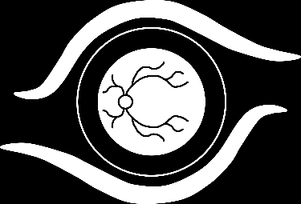
DRCR Major DME Findings
2008
2010
2015
2018
2019
2020
2021
2022
2023
Protocol B
Diabetic Retinopathy Clinical Research Network. A randomized trial comparing intravitreal triamcinolone acetonide and focal/grid photocoagulation for diabetic macular edema. Ophthalmology.2008 Sep;115(9):1447-9.e1-10

Slide 20
Study Design: Protocol B
Multicenter, randomized trial
(840 eyes, 693 participants)
Primary outcome: Mean change in visual acuity at 2 Years
Inclusion Criteria:
Adults with VA 20/40 to 20/320
And CSF ≥ 250 µm
Visits every 4 months through 3 years
Primary outcome at 2 years
Laser (N = 330)
1 mg Intravitreal Triamcinolone (N = 256)
4 mg Intravitreal Triamcinolone (N = 254)

Slide 21
Protocol B Primary Outcome: Mean Change in Visual Acuity at 2 Years
Mean Change in VA (letter score) | Laser N = 330 | 1-mg N = 256 | 4-mg N = 254
 | +1 | -2 | -3
Pairwise Comparisons | Mean Difference* | P value*
Laser vs. 1 mg | +3.5 letters | 0.02
Laser vs. 4 mg | +4.6 letters | 0.002
1 mg vs. 4 mg | +1.1 letters | 0.49
* Adjusted for baseline VA and prior focal/grid laser

Slide 22
Protocol B Mean VA Over 3 Years: All Eyes
20/32
20/40
20/50
20/63
20/80

Slide 23
Protocol B Conclusions
Visual acuity benefit in 4 mg IVT group at 4 months consistent with case series
Greater visual acuity benefit and fewer side effects (IOP & cataract) in laser group at 2 years and 3 years
OCT results mirrored visual acuity results
As monotherapy, laser is superior to corticosteroid for DME

Slide 24
DRCR Major DME Findings
2007
2008
2009
2010
2011
2012
2013
2022
2023
Bevacizumab therapy resulted in short-term improvements in vision and retinal thickness, providing key proof-of-concept data that guided the design of the pivotal phase 3 Protocol I trial with ranibizumab.
Diabetic Retinopathy Clinical Research Network, Scott IU, Edwards AR, Beck RW, Bressler NM, Chan CK, Elman MJ, Friedman SM, Greven CM, Maturi RK, Pieramici DJ, Shami M, Singerman LJ, Stockdale CR. A phase II randomized clinical trial of intravitreal bevacizumab for diabetic macular edema. Ophthalmology.2007 Oct;114(10):1860-7
Protocol H

Slide 25
DRCR Major DME Findings
2008
2010
2015
2018
2019
2020
2021
2022
2023
Protocol I
Diabetic Retinopathy Clinical Research Network. Randomized trial evaluating ranibizumab plus prompt or deferred laser or triamcinolone plus prompt laser for diabetic macular edema. Ophthalmology. 2010 June;117(6):1064-1077.e35

Slide 26
Study Design: Protocol I
Randomized, multi-center clinical trial
At least one eye meeting all the following criteria:
Electronic-ETDRS© best corrected visual acuity letter score of 78 to 24 (~20/32 to 20/320)
Definite retinal thickening due to diabetic macular edema involving the center of the macula on clinical examination
Central subfield (Stratus OCT™) ≥250 µm
Primary outcome: Change in visual acuity from baseline to 1 year (intent to treat analysis)
Sham
+Prompt Laser
N = 293
Ranibizumab
+Prompt Laser
N = 187
Ranibizumab
+Deferred Laser
N = 188
Triamcinolone
+Prompt Laser
N = 186
Notes:
Eligible patients were at least 18 years old with type 1 or type 2 diabetes.
Change in VA from baseline to 1 year was adjusted for baseline Visual acuity in stat models

Slide 27
Anti-VEGF Visual Outcomes Superior to Laser
DRCR.net Protocol I
Ranibizumab
+ deferred laser
Ranibizumab
+ prompt laser
P<0.001
Mean Letter Improvement
Sham
+ prompt laser
Weeks
Diabetic Retinopathy Clinical Research Network. Randomized trial evaluating ranibizumab plus prompt or deferred laser or triamcinolone plus prompt laser for diabetic macular edema. Ophthalmology. 2010 Jun;117(6):1064-1077.
Notes:
* Values that were ±30 letters were assigned a value of 30
P-values for difference in mean change in visual acuity from sham+prompt laser at the 52-week visit: ranibizumab+prompt laser <0.001; ranibizumab+deferred laser <0.001; and triamcinolone+prompt laser=0.31.

Slide 28
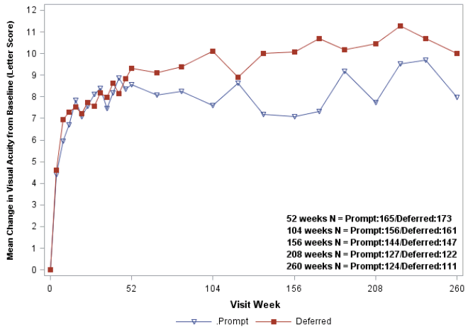
Vision Gains Maintained Through 5 Years
DRCR.net Protocol I
+9.8
+7.2

Slide 29
Need for Injections Decreases Over 5 Years
DRCR.net Protocol I
Median # of Injections | Ranibizumab + Prompt Laser N=124 | Ranibizumab + Deferred Laser N=111
Year 1 | 8 | 9
Year 2 | 2 | 3
Year 3 | 1 | 2
Year 4 | 0 | 1
Year 5 | 0 | 0
Total prior to 5 year visit | 13 | 17
*Only eyes that completed 5 year visit

Slide 30
DRCR.net DME Treatment Algorithm in 3 easy steps
6 initial injections q 4 weeks
One exception: if no DME and VA is normal at
4-month or 5-month visit, then injection withheld
Starting at 6-month visit:
Inject if DME improved or worsened compared with previous 2 injection visits
Defer injections if DME stable compared with previous 2 injection visits
After injections withheld, resume injections if DME worsens

Slide 31
Protocol I Conclusions
Anti-VEGF (+/- laser) is superior
to laser and to
corticosteroid + laser for DME

Slide 32
DRCR Major DME Findings
2008
2010
2015
2018
2019
2020
2021
2022
2023
Protocol T
Diabetic Retinopathy Clinical Research Network, Wells JA, Glassman AR, Ayala AR, Jampol LM, Aiello LP, Antoszyk AN, Arnold-Bush B, Baker CW, Bressler NM, Browning DJ, Elman MJ, Ferris FL, Friedman SM, Melia M, Pieramici DJ, Sun JK, Beck RW. Aflibercept, Bevacizumab, or Ranibizumab for Diabetic Macular Edema. N Engl J Med. 2015 Mar 26; 372(13): 1193–1203. DOI: 10.1056/NEJMoa1414264

Slide 33
Study Design Protocol T
Randomized, multi-center clinical trial (N = 89 Sites)
Participants meeting all the following criteria:
At least 18 years old
Type 1 or type 2 diabetes
Study eye meeting all the following criteria:
~Snellen equivalent visual acuity 20/32 or worse and 20/320 or better
Central-involved DME on clinical exam
CST ≥ protocol-defined gender and OCT machine-specific thresholds
No history of an anti-VEGF treatment for DME in the past 12 months or any other DME treatment in the past 4 months
Primary Outcome: Change in visual acuity at one year adjusted for baseline visual acuity using the intent-to-treat principle
Aflibercept (2.0 mg)
N = 224
Bevacizumab (1.25 mg)
N = 218
Ranibizumab
(0.3 mg)
N = 218

Slide 34
Protocol T Mean Change in VA Over 2 Years Full Cohort
+13.3
+12.8
+11.2
+12.3
+9.7
+10.0
104-Week Treatment Group Comparison*:
Aflibercept vs. Bevacizumab P = 0.02
Aflibercept vs. Ranibizumab P = 0.47
Ranibizumab vs. Bevacizumab P = 0.11
* P-values adjusted for baseline visual acuity and multiple comparisons

Slide 35
Protocol T Mean Change in VA Over 2 Years By Baseline Visual Acuity Subgroup

Slide 36
Protocol T Mean Change in OCT CST Over 2 Years: Full Cohort
2-Year Treatment Group Comparison*:
Aflibercept vs. Bevacizumab P<0.001
Aflibercept vs. Ranibizumab P = 0.08
Ranibizumab vs. Bevacizumab P = 0.001
-101
-126
-147
-149
-169
-171
* P-values adjusted for baseline visual acuity, OCT central subfield thickness, and multiple comparisons

Slide 37
Protocol T Conclusions
Overall, vision gains (from baseline) at 2 years were seen in all 3 groups
There were ~half the number of injections, slightly decreased frequency of visits, and decreased amounts of laser in the 2nd year
In eyes with mild visual impairment from DME (20/32 or 20/40), on average, bevacizumab and ranibizumab 0.3-mg perform similarly to aflibercept at 1 and 2 years
In eyes with moderate or worse visual impairment from DME (20/50 or worse), on average, aflibercept outperforms other anti-VEGF agents for DME at one year and remains superior to bevacizumab at 2 years

Slide 38
DRCR Major DME Findings
2008
2010
2015
2018
2019
2020
2021
2022
2023
Protocol U
Maturi RK, Glassman AR, Liu D, Beck RW, Bhavsar AR, Bressler NM, Jampol LM, Melia M, Punjabi OS, Salehi-Had H, Sun JK; Diabetic Retinopathy Clinical Research Network. Effect of Adding Dexamethasone to Continued Ranibizumab Treatment in Patients With Persistent Diabetic Macular Edema: A DRCR Network Phase 2 Randomized Clinical Trial. JAMA Ophthalmol. 2018 Jan 1;136(1):29-38. doi: 10.1001/jamaophthalmol.2017.4914.

Slide 39
Study Design Protocol U Randomized Multi-center Clinical Trial (Enrolled = 236 eyes, N = 129 Eyes randomized)
≥18 years old with Type 1 or Type 2 diabetes
≥3 injections of any anti-VEGF within the prior 20 weeks
VA letter score ≤78 and ≥24 (20/32 to 20/320)
Central-involved DME on clinical exam and OCT
Outcomes
Primary Mean Visual Acuity Change at 24 Weeks
Secondary Mean OCT CST Change at 24 Weeks
Dexamethasone
+ Continued Ranibizumab
“Combination”
VS
Sham
+ Continued Ranibizumab
“Ranibizumab”

Slide 40
Protocol U VA Mean Change
Adjusted Mean Difference: -0.5 letters
95% CI: (-3.6, +2.5), P = 0.73
+ 3.0
+ 2.7
Run-In
Randomization
N = 65
N = 63

Slide 41
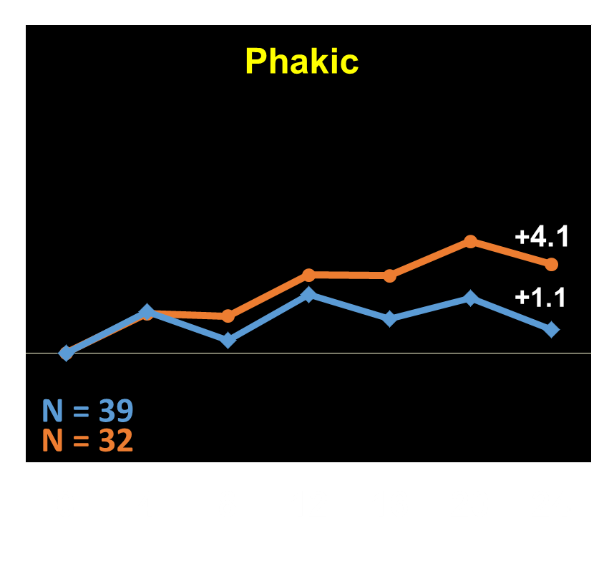
Protocol U VA Mean Change: Baseline Lens Status
Pseudophakic
+5.1
+2.0
N = 26
N = 25
N = 32
N = 32
* P-value for interaction = 0.08

Slide 42
Protocol U OCT CST Mean Change
Adjusted Mean Difference: -52 µm
95% CI: (-82,-22), P < 0.001
-62
-110
N = 65
N = 62
N = 64
N = 64
*Outlying values were truncated to 3 SD from the mean. One image was nongradable due to low resolution.

Slide 43
Protocol U Conclusions
Mean VA improvement by 6 months was no better in the dexamethasone + ranibizumab group than in the sham + ranibizumab group
On average, there was a greater reduction in retinal thickness in the dexamethasone + ranibizumab group
Study was not sufficiently sized to determine whether treatment response might differ by lens status
Dexamethasone + ranibizumab does not improve VA
At 6 months compared with ranibizumab alone for eyes with persistent DME following anti-VEGF therapy

Slide 44
DRCR Major Findings
2008
2010
2015
2018
2019
2020
2021
2022
2023
Baker CW, Glassman AR, Beaulieu WT, Antoszyk AN, Browning DJ, Chalam KV, Grover S, Jampol LM, Jhaveri CD, Melia M, Stockdale CR, Martin DF, Sun JK; DRCR Retina Network. Effect of Initial Management With Aflibercept vs Laser Photocoagulation vs Observation on Vision Loss Among Patients With Diabetic Macular Edema Involving the Center of the Macula and Good Visual Acuity: A Randomized Clinical Trial. JAMA. 2019 May 21;321(19):1880-1894
Protocol V

Slide 45
Protocol V Study Design Randomized Multicenter Clinical Trial (N = 91 Sites)
≥18 years old with type 1 or type 2 diabetes
Center-involved DME on OCT*
VA letter score 20/25 or better*
No or minimal** prior treatment for DME
Aflibercept
Outcomes
Primary
Proportion of eyes that lost ≥5 letters of VA at 2 years
Secondary
Mean change in VA and CST from baseline at
1 and 2 years
Laser+
(Aflibercept prn)
Observation+
(Aflibercept prn)
*Confirmed at 2 visits 1-28 days apart (screening and randomization)
**No more than 1 laser and/or 4 injections, at least 12 months ago

Slide 46
Mean VA Letter Score At 2 Years
86.0 (20/20)
85.3 (20/20)
84.2 (20/20)
N = 226
N = 240
N = 236
N = 205
N = 212
N = 208
8-Week
1-Year
2-Year
Error bars represent 95% confidence Intervals

Slide 47
Visual Acuity at 2 Years
20/25 or Better
86%
84%
86%
N = 205 N = 212 N = 208

Slide 48
Protocol V Time to First Aflibercept Injection: (Laser and Observation Groups)
Laser vs. Observation Hazard Ratio: 0.66 (95% CI, 0.47-0.92) P = .01
Cumulative Probability, %
36%
28%
26%
13%
Weeks
# of Eyes at Risk | N = 236 | N = 157 | N = 132
 | N = 240 | N = 202 | N = 156

Slide 49
Protocol V Number of Injections Over 2 Years
Aflibercept (N = 205)
Laser (N = 212)
Observation (N = 208)
* 2-year completers only

Slide 50
Protocol V Conclusion
Among eyes with CI-DME and good VA, no significant difference in VA loss at 2 years whether eyes were initially managed with aflibercept, or with laser photocoagulation or observation and given aflibercept only if VA worsened.
Majority of eyes in laser group (~3/4) and observation group (~2/3) did not receive aflibercept during study
Given the costs and risk associated with interventions, observation without treatment unless VA worsens may be a reasonable strategy for these eyes.

Slide 51
DRCR Major Findings
2008
2010
2015
2018
2019
2020
2023
2024
2025
Protocol AC
Baker CW, Glassman AR, Beaulieu WT, Antoszyk AN, Browning DJ, Chalam KV, Grover S, Jampol LM, Jhaveri CD, Melia M, Stockdale CR, Martin DF, Sun JK; DRCR Retina Network. Effect of Initial Management With Aflibercept vs Laser Photocoagulation vs Observation on Vision Loss Among Patients With Diabetic Macular Edema Involving the Center of the Macula and Good Visual Acuity: A Randomized Clinical Trial. JAMA. 2019 May 21;321(19):1880-1894

Slide 52
Background Protocol AC
Protocol T Baseline Visual Acuity 20/50 or Worse
+18.9
+18.1
+16.1
+14.2
+13.3
+11.8
Aflibercept group resulted in better vision through 2 years compared with bevacizumab, and better vision through 1 year compared with ranibizumab.
Bevacizumab group had good vision outcomes: 68% achieved a final visual acuity of 20/40 or better at 2 years.

Slide 53
Study Design Protocol AC Randomized Multicenter Clinical Trial (312 Eyes)
Objective:
To compare the efficacy of aflibercept with bevacizumab + aflibercept if needed in eyes with CI-DME and moderate vision loss
Primary Outcome: Mean change in VA over 2 years (AUC)
≥ 18 years old
Type 1 or 2 diabetes
CI-DME with CST above gender specific thresholds on OCT*
VA 20/50 to 20/320
No history of anti-VEGF for DME within 12 months or any other treatment for DME within 4 months
Aflibercept Monotherapy
Bevacizumab
First
* For Zeiss Cirrus, ≥ 290 µm for females and ≥ 305 µm for males. For Heidelberg Spectralis, ≥ 305 µm for females and ≥ 320 µm for males

Slide 54
Protocol AC Mean Change in Visual Acuity From Baseline Through 2 Years
Adjusted treatment group difference (95% CI)
in AUC over 104 weeks *
Aflibercept Monotherapy vs Bevacizumab First: +0.8 (-0.9 to +2.5); P = 0.37
+15.0
+14.0
N = 142
N = 139
N = 132
N = 128
* Adjusted for baseline VA, number of study eyes, and the correlation between two study eyes from the same patients

Slide 55
Protocol AC Visual Acuity at 2 Years
(N = 132) | (N = 128)
Adjusted difference * (95% CI) | -1% ( -11%, +8%) | -7% (-19%, +5%) | +3% (-1%, +7%)
* Adjusted for baseline VA, number of study eyes, and the correlation between two study eyes from the same patients

Slide 56
Protocol AC Mean Change in Central Subfield Thickness from Baseline Through 2 Years
Adjusted mean difference at 104 weeks
Aflibercept Monotherapy vs Bevacizumab First* (95% CI): -16 μm (-39 to +7)
-192
-198
N = 126
N = 127
* Adjusted for baseline CST, number of study eyes, and the correlation between two study eyes from the same patients

Slide 57
Protocol AC Conclusions
In this trial, no significant difference was found in visual outcomes over 2 years in eyes treated with aflibercept monotherapy compared with eyes treated with bevacizumab first.
Initiating therapy with bevacizumab and switching to aflibercept as done in this trial is a safe and effective alternative to aflibercept monotherapy in eyes with moderate vision loss due to center-involved DME.

Slide 58
Care for Diabetic Macular Edema
Evidence-based Care for Diabetic Macular Edema
Protocol I: Anti-VEGF is first-line therapy for most eyes with center-involved DME
Protocol V: Good vision (20/25 or better): Initial observation is reasonable if anti-VEGF is given for vision worsening during follow-up
Protocol T: Mild-moderate visual impairment (20/32-20/40): Aflibercept, bevacizumab and ranibizumab are similarly effective for vision outcomes
Protocol T: Poor vision (20/50 or worse): Aflibercept superior to bevacizumab
Protocol AC: Similar visual outcomes between initiating treatment with bevacizumab first (with aflibercept rescue as needed) compared to aflibercept monotherapy
Protocols A,B,I: Steroids and macular laser have a role for selected eyes with DME

Slide 59
Evidence-based Care for Diabetic Macular Edema
Protocol I: Anti-VEGF is first-line therapy for most eyes with center-involved DME
Protocol V: Good vision (20/25 or better): Initial observation is reasonable if anti-VEGF is given for vision worsening during follow-up
Protocol T: Mild-moderate visual impairment (20/32-20/40): Aflibercept, bevacizumab and ranibizumab are similarly effective for vision outcomes
Protocol T: Poor vision (20/50 or worse): Aflibercept superior to bevacizumab
Protocol AC: Similar visual outcomes between initiating treatment with bevacizumab first (with aflibercept rescue as needed) compared to aflibercept monotherapy
Protocols A,B,I: Steroids and macular laser have a role for selected eyes with DME

Slide 60
Non-Proliferative Diabetic Retinopathy
Darrell E. Baskin, MD

Slide 61
DRCR Major Findings: NPDR
2008
2010
2015
2018
2019
2020
2021
2022
2023
Marcus DM, Silva PS, Liu D, Aiello LP, Antoszyk A, Elman M, Friedman S, Glassman AR, Googe JM, Jampol LM, Martin DF, Melia M, Preston CM, Wykoff CC, Sun JK; DRCR Retina Network. Association of Predominantly Peripheral Lesions on Ultra-Widefield Imaging and the Risk of Diabetic Retinopathy Worsening Over Time. JAMA Ophthalmol. 2022 Oct 1;140(10):946-954
Silva PS, Marcus DM, Liu D, Aiello LP, Antoszyk A, Elman M, Friedman S, Glassman AR, Googe JM, Jampol LM, Martin DF, Melia M, Preston CM, Wykoff CC, Sun JK; DRCR Retina Network. Association of Ultra-Widefield Fluorescein Angiography–Identified Retinal Nonperfusion and the Risk of Diabetic Retinopathy Worsening Over Time. JAMA Ophthalmol. 2022 Oct 1;140(10):936-945
Protocol AA
Notes:
Update date

Slide 62
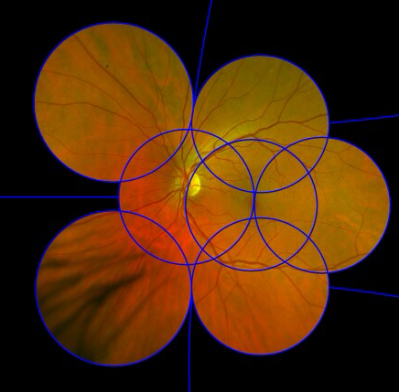
ETDRS classification based on 30% of the retina

Slide 63
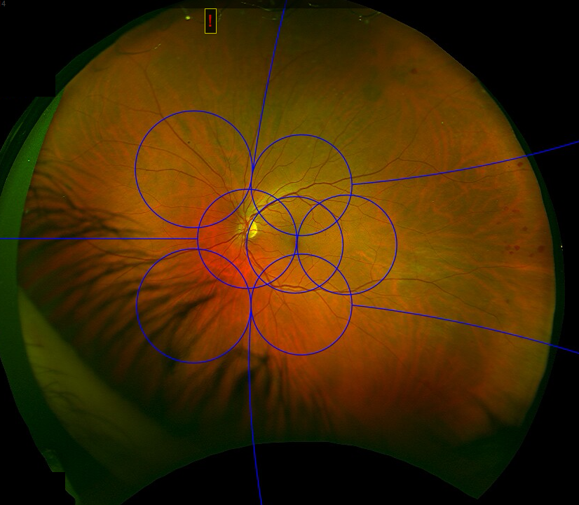
UWF reveals up to 82% of the retina

Slide 64
Study Design Protocol AA
Prospective, Observational Longitudinal Study
Eligibility Criteria:
At least one eye with NPDR and without CI-DME
Treatment for any indication is at investigator discretion
Annual Visits for 4 Years
Notes:
Study rationale (DEB’s take): are the findings from UWF color and/or FA just as useful or more so than standard DRSS classification (those from color ETDRS images) in predicting DR worsening and DR outcomes
Officially: to Evaluate whether the detection of predominantly peripheral lesions (PPL) improves the ability to predict rates of retinopathy worsening over time beyond the risk associated with baseline ETDRS DRSS level.

Slide 65
How we defined PPLs
6
4 Peripheral
6 Peripheral
4
1
2
3
3 Peripheral
4 Buckets:
- IRH + MA
- Venous beading
- IRMA
- NVE
7
5
7 Peripheral
5 Peripheral

Slide 66
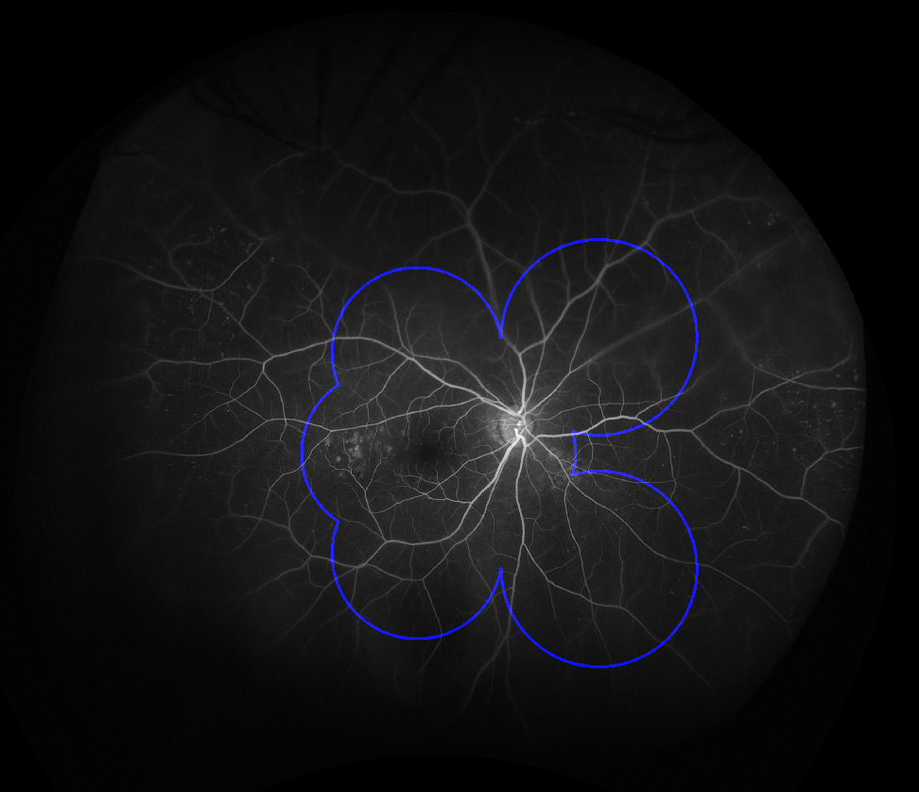
Mild NPDR with PPL
Notes:
Each lesion type (hemorrhages and/or microaneurysms [H/Ma], intraretinal microvascular abnormalities [IRMA], venous beading, and new vessels elsewhere) was graded separately and considered predominantly peripheral in a specific field if more than 50% of the lesions were in the retinal periphery compared with inside the ETDRS fields. An eye was considered to have PPL if any lesion graded in any of fields 3 through 7 was predominantly peripheral.¹²

Slide 67
Protocol AA DR Disease Worsening and PPL (Color)
*Adjusted Hazard Ratio
PPL Present vs. PPL Absent = 0.78
(95% CI = 0.57, 1.08); P = .13
43%
38%
PPL Absent | 323 | 290 | 225 | 164 | 127
PPL Present | 221 | 195 | 166 | 134 | 109
* Adjusting for baseline DR severity on UWF color images and correlation between 2 study eyes in the same participant

Slide 68
Protocol AA DR Disease Worsening and PPL (FA)
*Adjusted Hazard Ratio
PPL Present vs. PPL Absent = 1.72
(95% CI = 1.25, 2.36); P < .001
50%
31%
PPL Absent | 295 | 253 | 202 | 159 | 132
PPL Present | 247 | 230 | 188 | 139 | 104
* Adjusting for baseline DR severity on UWF color images and correlation between 2 study eyes in the same participant

Slide 69
Protocol AA Retinal Nonperfusion
UWF-FA images were also evaluated for
Total gradable area (mm²)
Extent of retinal nonperfusion (mm²)
Nonperfusion index (NPI; ratio of nonperfused to total gradable area)

Slide 70



Protocol AA Baseline Characteristics
 | 508 Study Eyes*
Nonperfusion on UWF-FA§
No NP | 9%
Low NPI | 30%
Medium NPI | 30%
High NPI | 30%
Low NPI
≤ 0.028
Med NPI
> 0.028 to
0.182
High NPI
> 0.182
Notes:
* Only eyes with NPDR on UWF-color and gradable NP on UWF-FA were included
§ Eyes with measured NP were divided into 3 equally sized subgroups based on tertiles of overall NPI: low NP (NPI ≤ 0.028), medium NP (NPI >0.028 to 0.182), or high NP (NPI >0.182 to 0.861).

Slide 71
Protocol AA Retinal Nonperfusion & DRSS worsening
*Adjusted Hazard Ratio
For 0.1-unit increase in NPI = 1.11
(95% CI = 1.02, 1.21); P = 0.02
46%
43%
38%
26%
No NP | 47 | 40 | 34 | 32 | 29
Low NPI | 153 | 135 | 108 | 76 | 60
Medium NPI | 154 | 135 | 115 | 91 | 67
High NPI | 154 | 140 | 104 | 77 | 60
* Adjusting for baseline DRSS level on UWF-color images, % of total gradable area on UWF-FA, and correlation between 2 study eyes in the same participant

Slide 72
Protocol AA Retinal Nonperfusion & DR Outcomes
 | Adjusted Hazard Ratio (95% CI) * for every 0.1-unit increase in Overall NPI | P value
Development of PDR | 1.16 (1.04, 1.29) | .008
Development of vitreous hemorrhage | 1.30 (1.14, 1.48) | <.001
* Adjusting for baseline DRSS level on UWF-color images, % of total gradable area on UWF-FA, and correlation between 2 study eyes in the same participant
§ Due to low outcome proportions in the mild and moderate NPDR subgroups, the adjusted hazard ratio and P value were only estimated for eyes with moderately severe to very severe NPDR.

Slide 73
Protocol AA Key Take Aways
Risk of DRSS worsening or treatment was not associated with Color-PPL but was significantly associated with FA-PPL, when adjusting for baseline DR severity.
Eyes with FA-PPL had a 1.7-fold greater risk of disease worsening over 4 years.
Increasing baseline retinal NPI on UWF-FA is associated with
higher risk of DRSS worsening or treatment over time,
and secondary outcomes such as PDR development and vitreous hemorrhage over time.

Slide 74
DRCR Major Findings: NPDR
2008
2010
2015
2018
2019
2020
2021
2022
2023
Maturi RK, Glassman AR, Josic K, Antoszyk AN, Blodi BA, Jampol LM, Marcus DM, Martin DF, Melia M, Salehi-Had H, Stockdale CR, Punjabi OS, Sun JK, DRCR Retina Network. Effect of Intravitreous Anti–Vascular Endothelial Growth Factor vs Sham Treatment for Prevention of Vision-Threatening Complications of Diabetic Retinopathy: The Protocol W Randomized Clinical Trial. JAMA Ophthalmol. 2021 Jul 1;139(7):701-712.
Protocol W

Slide 75
Study Design Protocol W Randomized Multicenter Clinical Trial (N = 64 Sites)
≥18 years old with type 1 or type 2 diabetes
Severe NPDR in at least 1 eye*
DRSS between 43 and 53 on reading center grading^{ꝉ}
No evidence of NV on FA within the 7 modified ETDRS fields
Best-corrected VA letter score ≥79 (20/25 or better)
No hx of DME/DR treatment within 12 months and ≤4 prior injections
No prior PRP
Primary Outcomes
Development of PDR or CI-DME with vision loss
Visual acuity
2 mg Intravitreous Aflibercept
Sham Injection
*NPDR determined by investigator; eyes with CI-DME were excluded.
^{ꝉ}After 9 months of recruitment the lower cutoff was modified from 47B
Notes:
Study rationale: in eyes with mod-severe NPDR, very good vision, and no CI-DME, does periodic aflibercept result in preventing DR complications and/or affect visual acuity outcomes
A participant could have 2 study eyes; one eye per tx group.
DRSS Mod NPDR to Sev NPDR
Bear in mind that rescue therapy was allowed in the control group: 1) for PDR: Treatment with aflibercept initiated if:
High-risk characteristics develop
VH from PDR develops
Once initiated, treatment followed Protocol S algorithm
And 2) for CI-DME: CI-DME on clinical exam with ≥10% increase in CST from baseline and VA loss
VA loss defined as ≥10 letter score loss at a single visit or 5 to 9 letter score loss at 2 consecutive visits from DME

Slide 76
Protocol W Follow-Up Visits and Treatment
Baseline (0)
Month 1
Month 2
Month 12
Month 16
Month 20
Month 24
Month 28
Month 32
Month 4
Month 8
Month 36
Month 40
Month 44
Final Visit (48M)
Before 2 Years: Injections given at every visit
≥2 Years: Injections given if worse than mild NPDR
(> level 35 on clinical exam)
Participants and VA/OCT/Photo technicians masked to treatment

Slide 77
PDR or CI-DME Development
Adjusted Hazard Ratio
Aflibercept vs Sham = 0.40
(97.5% CI = 0.28, 0.57); P <0.001
57%
34%
N at risk
200 | 175 | 147 | 119 | 95
199 | 154 | 108 | 75 | 64

Slide 78
Protocol W PDR Development
Adjusted Hazard Ratio
Aflibercept vs Sham = 0.42
(97.5% CI = 0.29, 0.61); P <0.001
49%
28%
N at risk
200 | 177 | 151 | 126 | 103
199 | 158 | 123 | 94 | 80

Slide 79
Protocol W CI-DME Development
Adjusted Hazard Ratio
Aflibercept vs Sham = 0.51
(97.5% CI = 0.27, 0.97); P 0.02
19%
11%
N at risk
200 | 180 | 159 | 139 | 124
199 | 175 | 146 | 121 | 108

Slide 80
Protocol W Visual Acuity Mean Change
Adjusted Mean Difference at 4-Years
Aflibercept vs. Sham: -0.5 (-2.3, 1.3); P =0.52
-2.4
-2.7
N = 200
N = 199
N = 137
N = 134

Slide 81
Protocol W Key Take Aways
Among patients with NPDR (DRSS level 43-53), good vision (20/25 or better), and without CI-DME, early aflibercept compared with initial observation and treatment if disease worsened resulted in
A statistically significant reduction in the probability of developing PDR or CI-DME within 4 years
No difference in visual acuity at 4 years
Notes:
(4-Year): Preventative aflibercept treatment compared to sham in eyes with moderate to severe NPDR
(DRSS level 43-53) and VA 20/25 or better (≥ 79 letters)
Lowered the probability of developing PDR or
CI-DME within 4 years
Did not confer VA benefit at 4 years

Slide 82
Proliferative Diabetic Retinopathy
Darrell E. Baskin, MD

Slide 83
DRCR Major Findings: PDR
2008
2013
2015
2018
2019
2020
2021
2022
2023
Protocol N
Diabetic Retinopathy Clinical Research Network*. Randomized Clinical Trial Evaluating Intravitreal Ranibizumab or Saline for Vitreous Hemorrhage From Proliferative Diabetic Retinopathy. JAMA Ophthalmol. 2013;131(3):283–293.

Slide 84
Study Rationale Protocol N
Does intravitreal ranibizumab versus intravitreal saline facilitate clearing of vitreous hemorrhage?

Slide 85
Study Design Protocol N
Randomized Multicenter Double Masked Trial
At least one eye that met all of the following criteria:
Vitreous hemorrhage causing vision impairment, presumed to be from PDR, and precluding completion of PRP
Immediate vitrectomy is not required
Visual acuity is light perception or better
No prior anti-VEGF treatment for VH
Primary Outcome:
Cumulative probability of vitrectomy by 16 weeks
Notes:
Prior to the 8-week visit, vitrectomy was not to be performed unless 1 of the following was present: (1) traction retinal detachment involving (within 1 disc diameter) or actively threatening the macula; (2) rhegmatogenous retinal detachment; (3) neovascular glaucoma resulting in increased intraocular pressure that could not be controlled medically, angle neovascularization, or progressive neovascularization of the iris; and (4) ghost cell glaucoma resulting in increased intraocular pressure that could not be controlled medically. Between the 8-week visit and 16-week end point, vitrectomy was not required but could have been performed, based on investigator discretion, if there was failure of substantial clearing of the vitreous hemorrhage such that the participant’s need for vitrectomy and its associated benefits outweighed its risks.

Slide 86
Study Enrollment Protocol N
261 Eyes Randomized
(61 Sites)
Intravitreal Injection of ranibizumab 0.5 mg
N = 125
Intravitreal Injection 0.9% sodium chloride
N = 136
12 Week Visit Completion
95% Overall*
(96% Ranibizumab Injection; 95% Saline Injection)
* One death occurred prior to the 12-week visit.
Notes:
Add note here to explain why 11 more eyes in saline injection
Response : Imbalanced in the treatment arms could occur when using stratified randomization. In this case the randomization schedule was stratified by site.

Slide 87
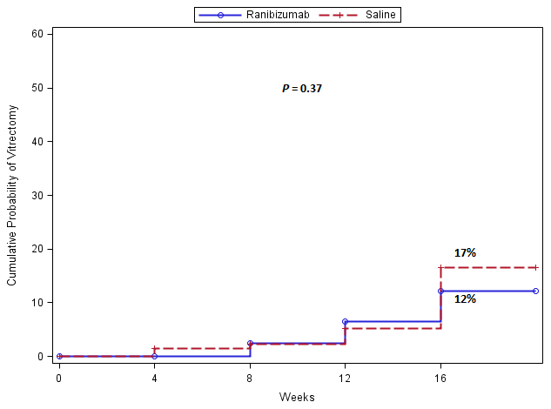
Protocol N Cumulative Probability of Vitrectomy by 16 Weeks

Slide 88
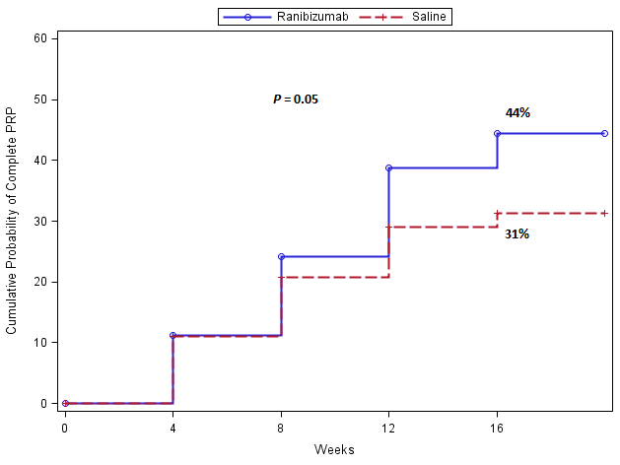
Protocol N Cumulative Probability of “Complete” PRP (in absence of vitrectomy) by 16 Weeks
Notes:
Panretinal photocoagulation was to be performed as soon as possible after the baseline injection until “complete” PRP had been performed. For purposes of this study, “complete” PRP was defined as 500- m burns on the retina placed no farther than 1- to 2-burn widths apart beginning approximately 3000 m from the macular center and extending to the equator for 12 clock hours (or at least 10 clock hours if vitreous hemorrhage precluded sufficient treatment or evaluation of all 12 clock hours).

Slide 89
Protocol N Retinal Detachments Prior to 16 weeks
 | Ranibizumab Injection N = 125 | Saline Injection N = 136
Traction retinal detachment only | 8 (6%) | 9 (7%)
Rhegmatogenous retinal detachment only | 1 (<1%) | 2 (2%)
Combined retinal detachment | 1 (<1%) | 0
Any Retinal Detachment | 10 (8%) | 11 (8%)

Slide 90
Protocol N Key Take Aways
As a result of having substantially overestimated the control group rate when estimating sample size, the study may not have been sufficiently powered to detect a treatment group difference.
This study suggests little likelihood of a clinically important difference between ranibizumab and saline on the rate of vitrectomy by 16 weeks in eyes with VH from PDR
At 16 weeks, 8% of each group experienced a retinal detachment
Notes:
Edited

Slide 91
DRCR Major Findings: PDR
2008
2010
2015
2018
2019
2020
2021
2022
2023
Antoszyk AN, Glassman AR, Beaulieu WT, Jampol LM, Jhaveri CD, Punjabi OS, Salehi-had H, Wells JA 3RD, Maguire MG, Stockdale CR, Martin DF, Sun JK. Effect of intravitreous aflibercept vs vitrectomy with panretinal photocoagulation on visual acuity in patients with vitreous hemorrhage from proliferative diabetic retinopathy: A randomized clinical trial. JAMA. 2020; 324(23):2383-2395
Protocol AB

Slide 92
Study Design Protocol AB Randomized Multicenter Clinical Trial (N = 39 Sites)
Outcomes
Primary
Average VA Over 24 Weeks (Area Under the Curve)
Secondary
Treatment With Vitrectomy or Aflibercept During Follow-up
205 adults with type 1 or 2 diabetes
One study eye with vitreous hemorrhage from PDR
Causing vision impairment (20/32 or worse)
Requiring intervention
2 mg Aflibercept
(Vitrectomy prn*)
Vitrectomy and PRP
(Aflibercept prn*)
*Based on pre-specified study guidelines
Notes:
Aflibercept group given 4 monthly injections and afterwards PRN study criteria
Prior PRP allowed (42% in Afl group, 55% in PPV group)
Preop IVE allowed, and 43% of PPVs had preop IVE
Secondary outcomes collected over 2 years

Slide 93
Study Design Protocol AB Study Treatment During Follow-up
Outcome | Initial Aflibercept N = 100 | Initial Vitrectomy and PRP N = 105
Vitrectomy during follow-up | 33% | 8%
PRP during vitrectomy at follow-up | 32% | 4%
Aflibercept injection during follow-up | 99% | 32%
Number of aflibercept injections through 2 years, mean | 8.9 | 2.3

Slide 94
Protocol AB VA Over 24 Weeks: Primary Outcome
Aflibercept vs. Vitrectomy + PRP adjusted difference over 24 weeks:
-5.0 letters (95% CI, -10.2 to 0.3) P = .06
N = 105
N = 100
N = 87
N = 90
Error bars represent 95% confidence Intervals

Slide 95
Protocol AB Ocular Safety Outcomes
 | Initial Aflibercept N = 100 | Initial Vitrectomy and PRP N = 105
Endophthalmitis | 1% | 2%
Any retinal detachment | 23% | 14%
Traction retinal detachment (TRD) | 22% | 13%
Rhegmatogenous retinal detachment | 4% | 5%
Ocular inflammation | 6% | 4%
Visually significant cataract* | 45% | 43%
Cataract extraction* | 31% | 27%
*Evaluated in eyes that were phakic at baseline (N = 75 for aflibercept and 81 for vitrectomy)
Notes:
Aflibercept: 100 eyes; 13/99 had TRD when VH cleared (or at time of PPV); that leaves 86, 9 of those had subsequent TRD: 9/86 = 10.5%
1 aflibercept participant refused tx

Slide 96
Protocol AB Ocular Safety Outcomes
 | Initial Aflibercept N = 100 | Initial Vitrectomy and PRP N = 105
Tractional retinal detachment (TRD) | 22% | 13%
Notes:
Aflibercept: 100 eyes; 13/99 had TRD when VH cleared (or at time of PPV); that leaves 86, 9 of those had subsequent TRD: 9/86 = 10.5%
1 aflibercept participant refused tx

Slide 97
Protocol AB Ocular Safety Outcomes
 | Initial Aflibercept N = 100 | Initial Vitrectomy and PRP N = 105
Tractional retinal detachment (TRD) | 22% | 13%
Mac-involved TRD | 8% | 4%
Notes:
Aflibercept: 100 eyes; 13/99 had TRD when VH cleared (or at time of PPV); that leaves 86, 9 of those had subsequent TRD: 9/86 = 10.5%
1 aflibercept participant refused tx

Slide 98
Protocol AB Ocular Safety Outcomes
 | Initial Aflibercept N = 100 | Initial Vitrectomy and PRP N = 105
Tractional retinal detachment (TRD) | 22% | 13%
Mac-involved TRD | 8% | 4%
Mac-threatened TRD | 7% | 2%
Notes:
Aflibercept: 100 eyes; 13/99 had TRD when VH cleared (or at time of PPV); that leaves 86, 9 of those had subsequent TRD: 9/86 = 10.5%
1 aflibercept participant refused tx

Slide 99
Protocol AB Ocular Safety Outcomes
 | Initial Aflibercept N = 100 | Initial Vitrectomy and PRP N = 105
Tractional retinal detachment (TRD) | 22% | 13%
Mac-involved TRD | 8% | 4%
Mac-threatened TRD | 7% | 2%
Timing
Notes:
Aflibercept: 100 eyes; 13/99 had TRD when VH cleared (or at time of PPV); that leaves 86, 9 of those had subsequent TRD: 9/86 = 10.5%
1 aflibercept participant refused tx

Slide 100
Protocol AB Ocular Safety Outcomes
 | Initial Aflibercept N = 100 | Initial Vitrectomy and PRP N = 105
Tractional retinal detachment (TRD) | 22% | 13%
Mac-involved TRD | 8% | 4%
Mac-threatened TRD | 7% | 2%
Timing
TRD found at or before fundus 1st seen | 13% | 12%
Notes:
Aflibercept: 100 eyes; 13/99 had TRD when VH cleared (or at time of PPV); that leaves 86, 9 of those had subsequent TRD: 9/86 = 10.5%
1 aflibercept participant refused tx

Slide 101
Protocol AB Ocular Safety Outcomes
 | Initial Aflibercept N = 100 | Initial Vitrectomy and PRP N = 105
Tractional retinal detachment (TRD) | 22% | 13%
Mac-involved TRD | 8% | 4%
Mac-threatened TRD | 7% | 2%
Timing
TRD found at or before fundus 1st seen | 13% | 12%
TRD found after that time point | 9% | <1%
Notes:
Aflibercept: 100 eyes; 13/99 had TRD when VH cleared (or at time of PPV); that leaves 86, 9 of those had subsequent TRD: 9/86 = 10.5%
1 aflibercept participant refused tx

Slide 102
Protocol AB Key Take Aways
In eyes with vitreous hemorrhage (VH) from PDR, there was no significant difference in mean VA letter score over 24 weeks following initial treatment of aflibercept versus vitrectomy with PRP.
1 in 3 eyes assigned to aflibercept underwent vitrectomy; 1 in 3 eyes assigned to vitrectomy initiated aflibercept.
In each group, upon clearing of the VH (either with or w/o vitrectomy), 12-13% of eyes were found to have a tractional retinal detachment (TRD); after that time point, in the aflibercept group 9% developed TRD versus <1% in the PPV group
Notes:
In eyes with VH from PDR, vision improved more quickly with vitrectomy compared with aflibercept but there was no significant difference in mean VA letter score over 24 weeks
AB and N: Prior PRP allowed
Aflibercept: 100 eyes; (one refused IVE) 13 had TRD when VH cleared; that leaves 87 (technically 86), 9 of those had subsequent TRD: 9/86 = 10.5%

Slide 103
DRCR Major Findings: PDR
2008
2010
2015
2018
2019
2020
2021
2022
2023
Protocol S
Diabetic Retinopathy Clinical Research Network. Panretinal Photocoagulation vs Intravitreous Ranibizumab for Proliferative Diabetic Retinopathy: A Randomized Trial. JAMA. 2015; 314(20):2137-2146.

Slide 104
Study Design Protocol S
Randomized, multi-center clinical trial (55 Sites)
Participants meeting all the following criteria:
Age ≥18 years with type 1 or 2 diabetes
Study eye(s) meeting all the following criteria (a participant can have 2 study eyes):
Proliferative diabetic retinopathy (PDR)
No history of panretinal photocoagulation (PRP)
Best corrected visual acuity letter score ≥24 (~Snellen ≥ 20/320)
Eyes with or without central-involved DME were eligible
Primary Objective
Compare the efficacy and safety of PRP with that of intravitreal ranibizumab (0.5mg in 0.05 mL) for PDR

Slide 105
Protocol S Mean Changes in VA From Baseline
5-Year Adjusted Mean Difference: +0.6 letters
95% Confidence Interval: (-2.3, +3.5), P = .68
+3.1
+3.0
Lost to Follow Up 😢
N = 191
N = 160
16%
39%
N = 117
N = 203
N = 168
17%
39%
N = 123

Slide 106
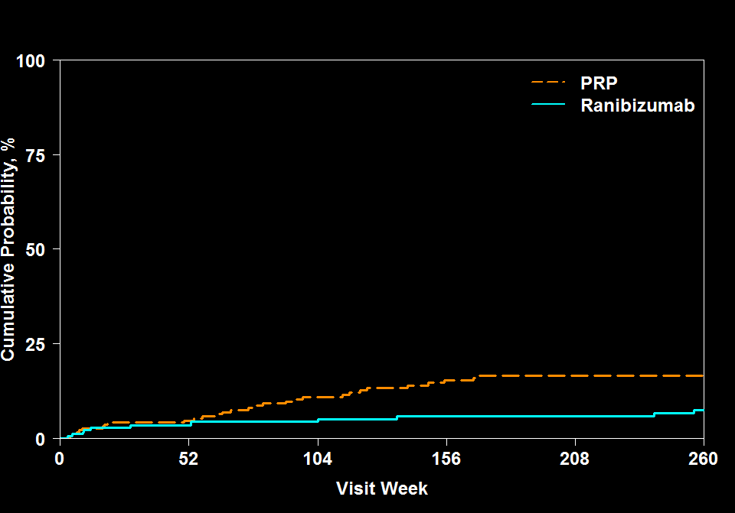
Protocol S Development of Retinal Detachment
Hazard Ratio = 0.4
95% CI: 0.2 to 0.8
P = .004
18%
7%
191 | 167 | 148 | 134 | 121 | 53
203 | 175 | 152 | 132 | 117 | 59

Slide 107
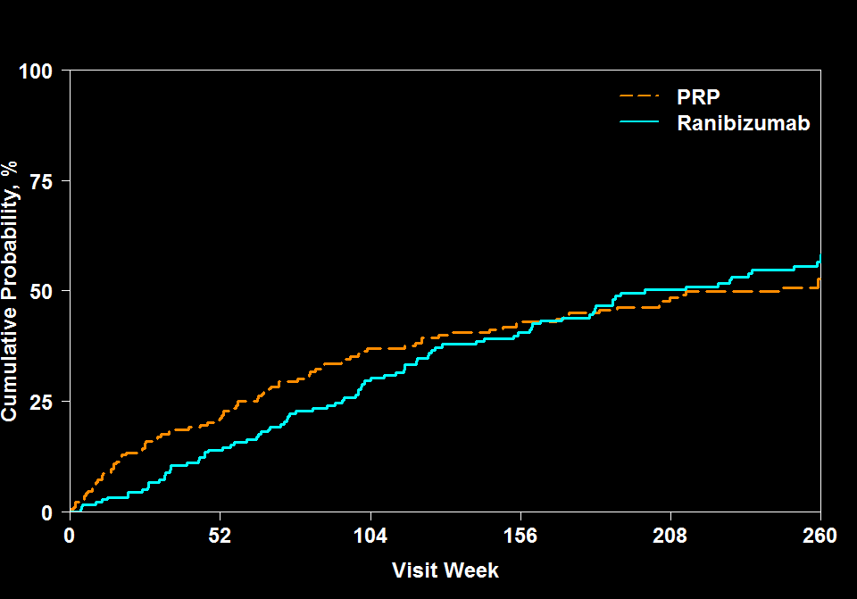
Protocol S Development of First VH after Baseline
Difference = 4%
95% CI: -7% to 16%
P = .47
58%
54%
191 | 150 | 112 | 89 | 69 | 29
203 | 147 | 110 | 91 | 73 | 37

Slide 108
Protocol S Mean Change in Cumulative Visual Field Total Point Score (30-2 + 60-4)
-330
-527
5-Year Adjusted Mean Difference: 208 dB
95% Confidence Interval (-9, 408), P = .04
N = 81
N = 41
N = 86
N = 38
Outlying values were truncated to 3 SD from the mean

Slide 109
Protocol S Key Take Aways
Visual acuity outcomes were similar in both groups at 5 years
Loss to follow-up was nearly 40% in each group
RD occurred in 18% of PRP group and 7% of ranibizumab group
VH occurred in 54% of PRP group and 58% of ranibizumab group
Visual field loss was greater in PRP group, but difference grew smaller after two-year time point

Slide 110
Age-Related Macular Degeneration
Christina Y. Weng, MD, MBA

Slide 111
DRCR Major Findings: AMD
2008
2010
2015
2018
2019
2022
2023
2024
2025
Blinder KJ, Calhoun C, Maguire MG, Glassman AR, Mein CE, Baskin DE, Vieyra G, Jampol LM, Chica MA, Sun JK, Martin DF; DRCR Retina Network. Home OCT Imaging for Newly Diagnosed Neovascular Age-Related Macular Degeneration: A Feasibility Study. Ophthalmol Retina. 2024 Apr;8(4):376-38
Protocol AK
Notes:
Update date

Slide 112
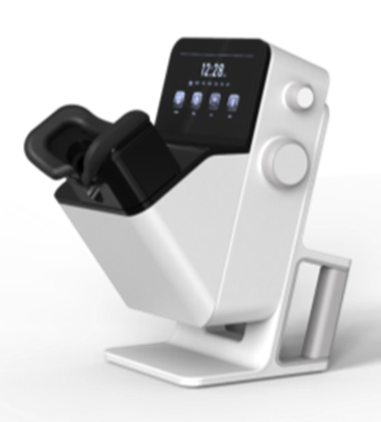
Objectives Protocol AK
Assess the feasibility of the Home OCT system outside of the clinic setting
Collect data on the logistics of the Home OCT system for future planning of larger studies
Obtain data to validate the ability to detect fluid volumes and fluid absence or presence

Slide 113
Study Design Protocol AK
Observational Study (14 participants, 3 sites)
Inclusion Criteria:
Newly diagnosed untreated neovascular AMD
≥ 1 drusen (>63 microns) in either eye OR late AMD (MNV or macular atrophy) in the other eye
Best corrected E-ETDRS VA 20/20 to 20/320
Ability to take daily Home OCT scans
Home OCT

Slide 114
Study Design Protocol AK
Participants obtained daily Home OCT scans for 6 months
Participants were followed and treated for nAMD according to the standard of care based on in-office OCTs
Retina specialists did not have access to Home OCT scans
In-office OCT scans were obtained, assessed for fluid by the Reading Center, and compared with the results of Home OCT scans taken the same day by the participant
Home OCT

Slide 115
Protocol AK Average Number of Scans Performed Across all Weeks of Study
Error bars represent ±1 standard deviation from the mean
N = | 14 | 10 | 8 | 4

Slide 116
Protocol AK Comparison of Notal Scan to Reading Center Grading of Office SD-OCT
 | Reading Center Fluid (Presence of IRF or SRF)
Home OCT Fluid | No N (Col %) | Yes N (Col %)
0 nL | 10 (71) | 4 (11)
>0 to ≤10 nL | 4 (29) | 15 (43)
>10 nL | 0 (0) | 16 (46)
Total | 14 (100) | 35 (100)
RC and NOA grade agreed 84% of the time
In all cases of disagreement, the fluid involved was small
*N = 49 scan pairs
Limited to Home OCT scans where NOA was run and obtained prior to injection
Notes:
Ten nL of fluid is considered as a threshold for a notification in a future study, hence used in this study to evaluate the performance of NOA in a single encounter comparison.
There was no instance of a NOA fluid level >10 nL when the RC’s interpretation of the in-office was no intraretinal or subretinal fluid; thus, there were no false
Among the 35 in-office OCT’s interpreted as having fluid by the RC, 15 (43%) had >0 to <10 nL and 4 (11%) had 0 nL as measured by NOA. On manual review of these 4 cases, there were small amounts of fluid on all 4 in-office OCTs (within the central 3x3 mm), and 3 Home OCT scans (the remaining 4th Home OCT scan did not reveal any fluid upon review).

Slide 117
Protocol AK Fluid Curves Over Time Per Participant
0 | 50 | 100 | 150 | 200
Notes:
Fluid curves over time showed a high degree of heterogeneity

Slide 118
Protocol AK Summary
Patients demonstrated adherence to protocol with mean 6.3 scans/week and overall had a good qualitative experience self-scanning
47 seconds per scan
Most scans were eligible for fluid quantification (86.5% among 2304 scans)
NOA and grader agreement was high
Of 35 scan pairs with fluid, NOA detected fluid in 31 (89%)
Of 14 scan pairs without fluid, NOA did not detect fluid on 10 scans (71%).
Daily fluid patterns after treatment initiation varied considerably between patients

Slide 119
Current Retina Studies
Christina Y. Weng, MD, MBA and Daniel F. Martin, MD

Slide 120
DRCR Current Retina Studies
2008
2010
2015
2018
2019
2022
2023
2024
2025
Protocol AO
Home OCT-Guided Treatment versus Treat and Extend for the Management of Neovascular AMD. Recruiting
Notes:
Update date

Slide 121
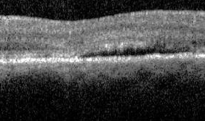
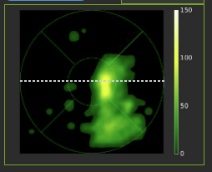
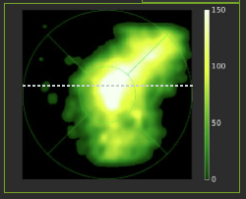
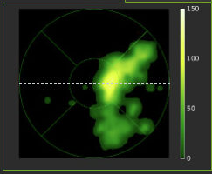
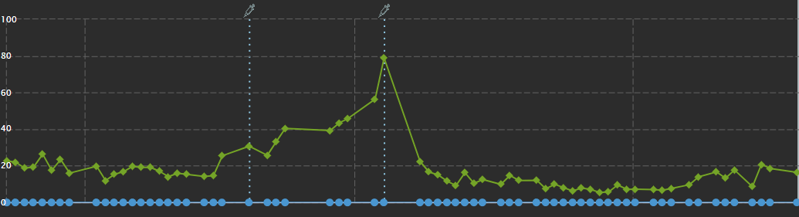
Notal Home OCT
Patients Acquire Daily OCT Scans
3 mm,
88 B-scans
3 mm,
88 B-scans
3 mm,
88 B-scans
3 mm,
500 A-scans
3-mm,
500 A-scans
3 mm,
500 A-scans
AI detects fluids, provides quantified spatial fluid maps
Total volume for each day is mapped to fluid volume trajectory
days

Slide 122
Summary of Rationale
A large randomized trial is needed to determine the role of Home OCT in clinical practice
This trial will also provide guidance for using Home OCT
Setting fluid thresholds
Rules for bringing participants into the office for assessment
It is important to understand visual acuity outcomes and visit and injection frequencies using a Home OCT-guided treatment strategy versus Treat and Extend (T&E), the most common regimen used in clinical practice

Slide 123
Objectives
Primary
Determine if Home OCT results in 1) better visual acuity outcomes and/or 2) fewer number of injections over 104 weeks compared with T&E
Secondary
Compare the number of visits
Compare the rates of development of fibrosis and of macular atrophy
Understand fluid dynamics in the retina (Home OCT group)
Understand the distribution of injection intervals
Compare participant- and site-reported outcomes related to treatment and monitoring burden
Compare cost over 2 years

Slide 124
Protocol AO: Home OCT vs. T&E
Multi-Center Randomized Clinical Trial
600 Eyes from 80 Sites
Inclusion Criteria:
Age ≥ 50 years
Best corrected E-ETDRS VA ≥24 letters (20/320 or better)
Active MNV lesion (IRF or SRF in center 3 mm diameter circle on OCT) secondary to AMD
≥ 1 drusen (>63 microns) in either eye OR late AMD (MNV or macular atrophy) in the other eye
All eyes
will receive
Faricimab
Treat
and Extend
Home OCT-Guided Treatment
Co-primary outcomes: Superiority comparison of mean change in visual acuity and number of injections from baseline to 104 weeks
Notes:
A large randomized trial is needed to determine the role of Home OCT in clinical practice
This trial will also provide guidance for using Home OCT
Setting fluid thresholds
Rules for bringing participants into the office for assessment

Slide 125
DRCR Current Retina Studies
2008
2010
2015
2018
2019
2022
2023
2024
2025
Protocol AL
Randomized Clinical Trial Evaluating Intravitreal Faricimab Injections or Fluocinolone Acetonide Intravitreal Implants vs Observation for Prevention of Visual Acuity Loss due to Radiation Retinopathy. Recruiting
Notes:
Update date

Slide 126
Radiation Retinopathy (RR)
RR is a common complication after I-125 plaque brachytherapy for choroidal melanoma.
Development is similar to other retinal vascular diseases and may include:
Capillary leakage
Macular edema
Vision loss secondary to progressive macular and retinal ischemia.
RR frequently progresses over time to profound vision loss.
The Collaborative Ocular Melanoma Study (COMS) reported that at 3 years, only 43% of patients have VA better than 20/200.

Slide 127
Rationale
Previous studies suggest that anti-VEGF and steroids may each have a role in prevention of macular edema and vision loss associated with radiation retinopathy.
A large randomized, controlled trial has not been performed
A treatment that prevents the development of RR would have important consequences for many eyes that are successfully treated for choroidal melanoma but are at risk to develop severe RR and vision loss over time.

Slide 128
Objectives
Compare long-term VA outcomes in eyes treated with repeated anti-VEGF injections or sustained-release steroid with eyes initially observed and treated only if ME develops.
Determine if treatment with repeated anti-VEGF or sustained-release steroid versus initial observation can prevent or alter the course of RR and its consequences, such as ME.
Evaluate the natural history of RR with frequent multimodal imaging.

Slide 129
Study Design
Multi-Center Randomized Clinical Trial
(600 Eyes, 600 Participants)
At least 1 eye that meets all the following criteria:
Primary choroidal melanoma receiving treatment with I-125 plaque
Baseline VA ≥ 20/200
Calculated planned dose to the macula ≥ 30 Gy
Tumor cannot be directly under the geometric center of the fovea
Tumor cannot touch the optic disc
Faricimab
Primary Outcomes:
Change in VA from baseline to 3 years,
Loss of 15 or more letters of VA from baseline to 3 years
Iluvien
Key Secondary Outcome: Development of ME on OCT
Observation

Slide 130
DRCR Current Retina Studies
2008
2010
2015
2018
2019
2022
2023
2024
2025
Protocol AM
Randomized Trial Comparing Immediate versus Deferred Surgery for Symptomatic Epiretinal Membranes. Recruiting
Notes:
Update date

Slide 131
Study Objectives
Primary
Compare visual acuity outcomes at 36 months between eyes randomized to immediate versus deferred surgery
Secondary - between group comparisons
Compare changes in visual function (using M-CHARTS), reading speed (using MNREAD), and OCT outcomes from randomization at 36 months between eyes randomized to immediate versus deferred surgery
Compare complication rates between eyes randomized to immediate versus deferred surgery

Slide 132
Study Objectives
Secondary - within group comparisons
Determine the rate of and time to progression of ERM to needing vitrectomy in eyes randomized to deferred surgery
Determine if there are baseline or later variables (such as performance of cataract surgery or OCT findings) that predict ERM progression to needing vitrectomy in eyes randomized to deferred surgery

Slide 133
Study Design
Multi-Center Randomized Clinical Trial
(400 Eyes)
At least 1 eye meeting all the following criteria
E-ETDRS visual acuity 20/40 or better (≥69 letters)
ERM must be thought to be the primary cause of vision loss
ERM meeting the following criteria (no RC confirmation required)
ERM is not secondary to another condition
Symptoms of visual loss and/or distortion (and in the opinion of the investigator, the ERM is contributing to the participant’s symptoms); either new or worsening in the past 24 months
Epiretinal membrane involving or altering the central 3 mm of the macula on OCT
Distortion within the central subfield by ERM on OCT
Deferred Surgery (vitrectomy only if protocol criteria met)
Immediate Surgery (within 4 weeks)
Primary Outcome: Mean change in visual acuity letter score from baseline to 36 months
133

Slide 134
Current Diabetes Studies
Andrew J. Barkmeier, MD

Slide 135
DRCR Diabetes Studies
2008
2010
2015
2018
2021
2022
2023
2024
2025
Protocol AF
A Randomized Trial Evaluating Fenofibrate for Prevention of Diabetic Retinopathy Worsening. Recruiting
Notes:
Update date

Slide 136
Study Rationale
Widespread use of an oral agent, fenofibrate, that is effective at reducing worsening of DR might decrease the numbers of patients who develop vision-threatening complications and need to undergo invasive treatment
Reduce vision loss from advanced DR
Reduce complications/adverse events associated with invasive and expensive treatments
Long term study will provide opportunities to evaluate new imaging, visual function tests, methods for DR detection

Slide 137
Study Design
Multi-Center Randomized Clinical Trial
(N = 560)
Major Patient-level criteria:
No contraindication to fenofibrate use, no severe renal disease, no liver disease (defined via central lab values)
At least one eye that meets these criteria* (according to the investigator, confirmed by RC grading):
ETDRS DR severity level between 35 and 47 (mild NPDR to moderately severe NPDR)
Best-corrected E-ETDRS VA letter score ≥74
No evidence of CI-DME (using standard DRCR OCT thresholds)
No prior treatment for DME or DR (other than focal/grid laser, but must be > 12 months prior)
No anticipated need for intravitreous anti-VEGF or PRP in the next 6 months
No history of intravitreous anti-VEGF or corticosteroid treatment within the prior year
* If only one eye is eligible, the non-study eye must have at least microaneurysms only (DR severity level 20) but there is no upper limit in DR severity level, and no exclusion criteria based on prior treatment.
160 mg Fenofibrate
Placebo
Primary Outcome: Proportion of eyes with DR worsening through 6 years

Slide 138
DRCR Diabetes Studies
2008
2010
2015
2018
2021
2022
2023
2024
2025
Protocol AFA
Protocol AF Ancillary Study: Protocol AFA Diabetic Retinopathy and Changes in Lipid Metabolism. Recruiting
Notes:
Update date

Slide 139
Predictive Biomarkers
While the primary objective of Protocol AF is to determine if fenofibrate is effective at preventing DR worsening, an additional goal is to collect information on potential predictive biomarkers via blood sampling over the course of DR progression
Diabetic Retinopathy and Changes in Lipid Metabolism (Protocol AFA) is an ancillary study for Protocol AF
Protocol AFA will include AF participants in analyses, but will also recruit populations with DR severity differing from the Protocol AF cohort (DR severity <35 & >47)

Slide 140


Collaboration
Protocol AFA is a collaborative effort between DRCR and the Lowy Medical Research Institute (LMRI)
LMRI will be performing the metabolite analyses with the de-identified serum samples and the genetic sequencing and associated analyses
This Photo by Unknown Author is licensed under CC BY

Slide 141

Procedures
Medical History
BP, weight and height
Fasting blood & serum samples, including serum shipped on dry ice and genetics sample collection
Urine sample
Protocol refraction/ETDRS VA
Spectralis SD OCT (including RNFL)
Ocular exam
Fundus photos and FA**, using widest field
OCT Angiography*
Contrast Sensitivity*
Study procedures mirror the Protocol AF Screening visit
except OCTA* and Contrast Sensitivity* will also
be completed
*Ancillary component at select sites/select participants
** FA will NOT be done for healthy controls

Slide 142
DRCR Diabetes Studies
2008
2010
2015
2018
2021
2012…
2023
2024
2025...
Genetics
Genes in diabetic retinopathy project. Recruiting
Notes:
Update date

Slide 143
Genes in Diabetic Retinopathy Project
Objective
To create a repository of genetic material and clinical phenotype information as a resource for the research community
The database may provide the opportunity to assess genetic susceptibility and resistance to DR and also variants impacting visually important biomarkers for ME and neovascularization
Major Eligibility Criteria
Previous/current participant in a DRCR Retina Network study
Enrollment (Ongoing)
Total enrolled: 2,739 subjects (as of 5/19/23)

Slide 144
DRCR Diabetes Studies
2008
2010
2015
2018
2021
2017…
2023
2024
2025
Protocol AP
A Randomized Clinical Trial Evaluating Combination Faricimab + PRP vs. Vitrectomy + Endolaser for Treatment of Proliferative Diabetic Retinopathy. Recruiting
Notes:
Update date

Slide 145
Current PDR Treatments
Prior studies (Protocol S, CLARITY) show anti-VEGF and PRP are viable treatments for PDR
Neither anti-VEGF nor PRP is a perfectly effective or durable therapy for PDR
PRP: ~50% of eyes with full PRP will need additional treatment for NV recurrence or VH; causes on average greater visual field loss, greater chance of DME development, and greater chance of vitreous hemorrhage within 2 years
Anti-VEGF: most eyes with PDR need continued anti-VEGF injections through at least 5 years; noncompliance with injections may cause recurrent NV

Slide 146
Study Rationale
No long-term data on a standardized approach to combination therapy from a large randomized clinical trial
Advances in surgical technique in addition to the advantages of removing the hyaloid during surgery make vitrectomy with endolaser an appealing option needing further investigation

Slide 147
Study Objectives
To evaluate the safety and efficacy of two treatment strategies for PDR (combination therapy vs surgery):
Assess long-term visual acuity outcomes
Assess visit and treatment burden
Assess complications (VH, recurrent NV, TRD)

Slide 148
Study Design
Multi-Center Randomized Clinical Trial:
N ~426 eyes (2 study eyes allowed)
At least 1 eye that meets the following criteria:
PDR (level 65 or worse) by central reading center
No TRD involving the macula
No significant VH that would preclude PRP
No CI-DME
Immediate PPV + Endolaser
Anti-VEGF + PRP
Primary Outcomes: Change in visual acuity from baseline to 3 years
Number of in-office treatments (injections or PRP) following the end of randomized treatment over 3 years

Slide 149
DRCR Diabetes Studies
2008
2010
2015
2018
2021
2022
2023
2024
2025
Protocol AR/AS
Endpoints in Diabetic Retinal Disease: DRCR Retina Network and MTM Vision Collaboration. Not yet recruiting
Notes:
Update date

Slide 150
Background and Rationale
Regulatory-approved primary endpoints for diabetic retinal disease (ex: change in vision and ETDRS DRSS score) are limited because they require long trial durations and only reflect change for highly effective interventions
Other accepted primary endpoints (ex: anatomic measures, change in visual functions, and quality of life) do not always reflect prognostic correlation to the disease state
Therefore, it is difficult to evaluate potential superiority of interventions using approved primary endpoints especially in earlier-stage disease
Validation of new biomarkers and surrogate markers for use as primary endpoints is needed to enable a more efficient path to regulatory approval for new therapies and preventions
Notes:
JKS- changed "Identification" to "Validation". Edited text in green box

Slide 151
Validation for a specific context of use
Biomarkers
Characteristic that is objectively measured and evaluated as an indicator of:
Normal biological processes
Pathogenic processes
Pharmacologic responses to a therapeutic intervention
Surrogate Endpoints
Shown to predict
clinical benefit
Clinical Endpoints
Reflect how a patient feels, functions or survives
FDA-NIH Biomarker Working Group. BEST (Biomarkers, Endpoints, and other Tools) Resource [Internet]. Silver Spring (MD): Food and Drug Administration (US); 2016-. FDA-NIH Biomarker Working Group. 2016 Jan 28 [Updated 2021 Jan 25].
Primary Endpoints for Registration Trials
Notes:
exFrom “Strimbu K, Tavel JA. What are biomarkers? Curr Opin HIV AIDS. 2010 Nov;5(6):463-6. doi: 10.1097/COH.0b013e32833ed177. PMID: 20978388; PMCID: PMC3078627.”: In 1998, the National Institutes of Health Biomarkers Definitions Working Group defined a biomarker as “a characteristic that is objectively measured and evaluated as an indicator of normal biological processes, pathogenic processes, or pharmacologic responses to a therapeutic intervention.” [**1] A joint venture on chemical safety, the International Programme on Chemical Safety, led by the World Health Organization (WHO) and in coordination with the United Nations and the International Labor Organization, has defined a biomarker as “any substance, structure, or process that can be measured in the body or its products and influence or predict the incidence of outcome or disease” [2]. An even broader definition takes into account not just incidence and outcome of disease, but also the effects of treatments, interventions, and even unintended environmental exposure, such as to chemicals or nutrients. In their report on the validity of biomarkers in environment risk assessment, the WHO has stated that a true definition of biomarkers includes “almost any measurement reflecting an interaction between a biological system and a potential hazard, which may be chemical, physical, or biological. The measured response may be functional and physiological, biochemical at the cellular level, or a molecular interaction.” [3]. Examples of biomarkers include everything from pulse and blood pressure through basic chemistries to more complex laboratory tests of blood and other tissues. Medical signs have a long history of use in clinical practice—as old as medical practice itself—and biomarkers are merely the most objective, quantifiable medical signs modern laboratory science allows us to measure reproducibly.

Slide 152
Major Goals for Endpoint Studies
Primary goal
Identify new primary endpoints that are acceptable for use in clinical trials for regulatory approval
Key secondary goals:
Validate surrogate or clinical endpoints that can be used to enhance research or clinical care (even if not suitable for registration trials)
Validation process will require:
Multiple, prospective studies
Diverse cohorts
Defining specific contexts of use
Better understand the pathophysiology of DRD

Slide 153
Assessment of Key Test Properties
Definition of retinal pathways assessed
Normative data availability
Test-retest variability
Floor or ceiling effects within the range of disease under study
Degree of subjectivity in testing
Effect size (between normal and any DRD or between different stages of DRD)
Device availability and cost
Clinical relevance
Patient acceptance and time requirement

Slide 154
Two Concurrent Studies
Protocol AR
Longitudinal Natural History Study of Retinal Function in Eyes of Patients with Diabetes
Protocol AS
Longitudinal Study of Retinal Function in Eyes Treated for Diabetic Macular Edema with Anti-VEGF Agents

Slide 155
Study Design and Objectives (AR and AS)
Multicenter, longitudinal observational studies
Primary Outcomes:
Define ocular structural and functional characteristics in people with diabetes / DME
Secondary Outcomes:
Investigate retinal structure-function relationships
Investigate the degree to which each measure changes over time
Understand test-retest variability for visual function measures
Evaluate the correlation in test characteristics between the 2 eyes of patients
Understand whether these structural/functional measurements can be validated as surrogate outcomes or clinical endpoints

Slide 156
Natural History Groups
Non-diabetic controls: No diabetes
Subclinical DRD: DRSS = 10, and no CI-DME
Minimal to Mild NPDR: DRSS = 20-35, and no CI-DME
Moderate NPDR: DRSS = 43-47, and no CI-DME
Severe NPDR: DRSS = 53, and no CI-DME
PDR: DRSS > 60, and no CI-DME
Groups will each have 75 participants evenly enrolled

Slide 157
Anti-VEGF for DME Groups
Mild CI-DME: Eyes with OCT CST <75 µm above DRCR standard thresholds
Moderate CI-DME: Eyes with OCT CST 75 to <175 µm above DRCR standard thresholds
Severe CI-DME: Eyes with OCT CST ≥175µm above DRCR standard thresholds
Participants will be enrolled until the overall sample size is reached, regardless of the distribution by group

Slide 158
Trial Results Coming Soon
Andrew J. Barkmeier, MD

Slide 159
DRCR Diabetes Studies
2008
2010
2015
2018
2021
2022
2023
2024
2025
Protocol AN
A Phase 2 Evaluation of Tonabersat for Diabetic Macular Edema (DME). Follow-up
Notes:
Update date

Slide 160

Phase 2 Study Objective
Assess the effects of orally available tonabersat on central subfield thickness (CST) compared to placebo in eyes with center-involved DME (CI-DME) and good visual acuity

Slide 161
Protocol AN: Tonabersat for DME
Phase 2 trial will determine whether a phase 3 trial has merit
Short duration: 12 months
6 months
on oral
study drug
6 months
follow-up
(no study drug)

Slide 162
Study Rationale
Current DME treatments are costly, invasive and can require frequent visits
An effective, well-tolerated, low-cost, and non-invasive treatment that can modify the inflammatory disease process, rather than acutely treating signs and symptoms, for DME would reduce patient burden by:
reducing costs
reducing frequency of treatment visits
delay or avoid injections or other invasive treatments

Slide 163
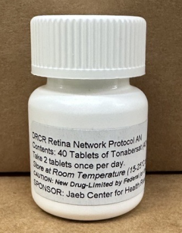
Tonabersat Background
Orally available, once daily 80mg dosing
Targets connexin43 hemichannels
>1,500 participants dosed in phase 1 and 2B studies for migraine – well tolerated
Most common side effects: headache, drowsiness, dizziness

Slide 164
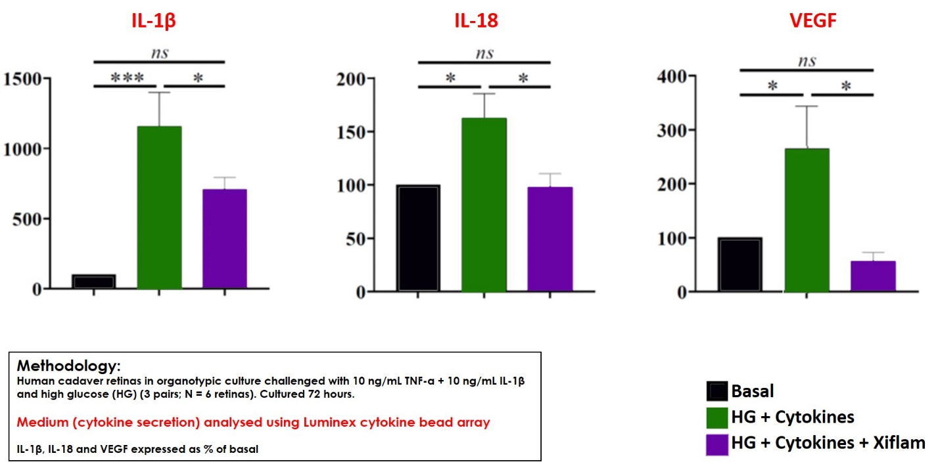
Tonabersat Background
Ex Vivo Human Retina DR Model
(high glucose, IL-1β, TNFα challenge)
Tonabersat blocked the release of key inflammatory cytokines, including VEGF
Notes:
Figure 1: Human tissue cultures data support that tonabersat has blocked the release of key inflammatory cytokines, including VEGF (First figure).

Slide 165
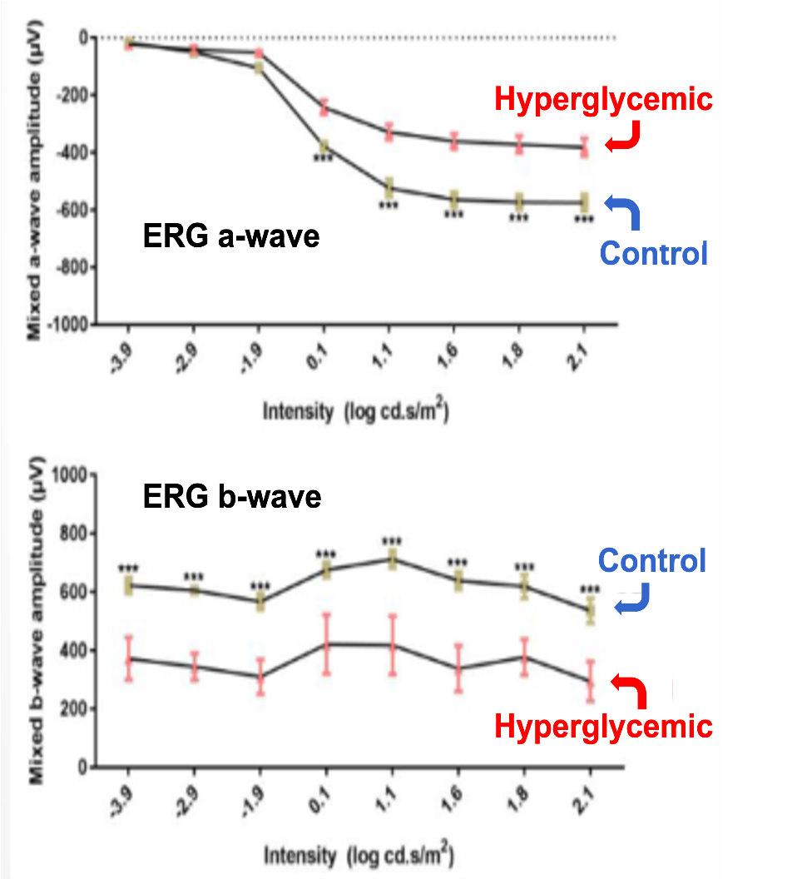
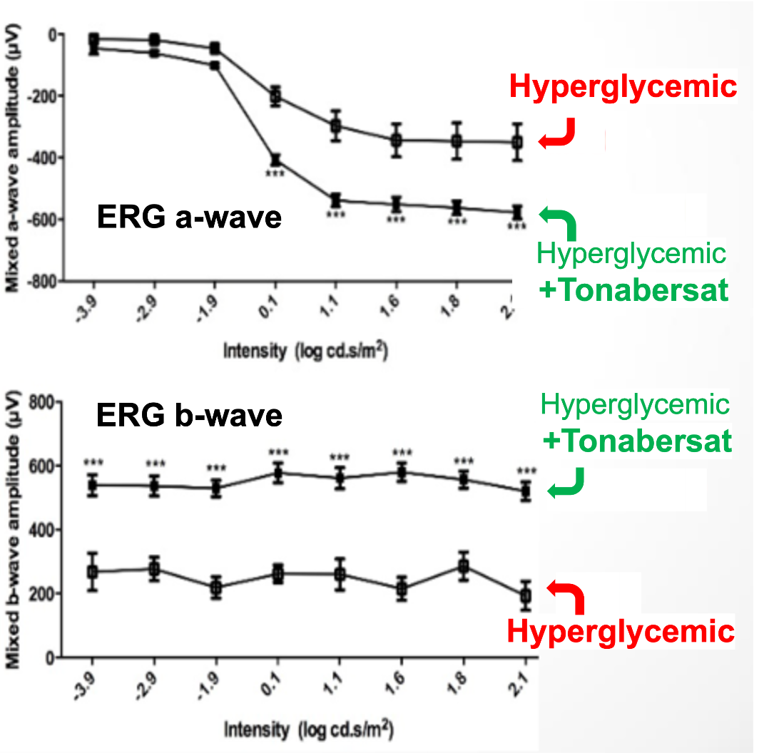
Tonabersat Background
Hyperglycemic Rat Model of DR (MSD)
Tonabersat-treated hyperglycemic rats had preserved ERG function at 8 wks
Reduced microaneurysm formation
Additionally, reduced vascular leakage and edema in a rat model of ischemic retinal injury
Notes:
Additional models of ischemic retinal injury in rats demonstrated that tonabersat reduced vascular leakage up to 86%, and edema.

Slide 166
Follow-up Schedule
Baseline (0)
Week 1
Months
1 - 5
Month 6
Month 12
Phone Call
Drug Compliance
Visit
Primary Outcome
Stop Study Drug
Final Visit
All participants and clinical staff masked

Slide 167
Treatment Regimen
Two pills (80 mg tonabersat or placebo) once daily at bedtime to reduce known side effects (dizziness, nausea)
Dose can be decreased if participants have intolerable side effects
If a participant stops drug for any reason, they should be encouraged to remain in the trial for follow-up

Slide 168
Thank you!

