Slide 1
4-Year Assessment of UWF-FA Quantitative Leakage Parameters with Clinical Parameters in DR: Protocol AA

Slide 2
Protocol AA
Study Purpose: Was to understand whether Ultrawide Field (UWF) imaging improves our ability to evaluate diabetic retinopathy (DR) and predict DR worsening
Prospective, observational longitudinal study
(N = 650 eyes, 360 participants)
Eligibility Criteria:
At least one eye with NPDR and without center-involved DME
Annual visits for 4 years

Slide 3
Background
Recent developments in automated machine learning-enhanced analysis have allowed quantitative UWF-FA assessment on a large scale.
DRCR Protocol AA highlighted the potential superiority of UWF-FA over UWF-color photographs in predicting DR worsening
Predominantly peripheral lesions (PPLs) on UWF-FA
Nonperfusion Index (NPI) on UWF-FA

Slide 4
Baseline PPL
and Overall Nonperfusion
PPL on Color
PPL on FA
PPL: predominantly peripheral lesions
Notes:
AA3 table 3

Slide 5
Baseline DR Severity and
Overall Nonperfusion
P = .002
DR: diabetic retinopathy; NPDR: nonproliferative DR; PDR: proliferative DR: Sev/V.Sev: severe or very severe
Notes:
AA3 table 2

Slide 6
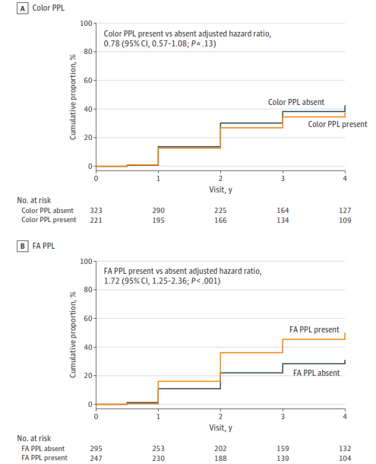
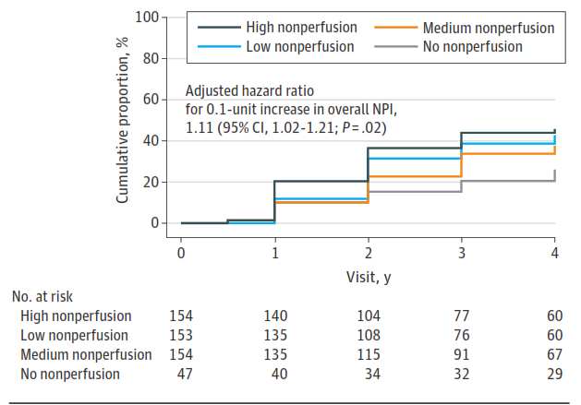
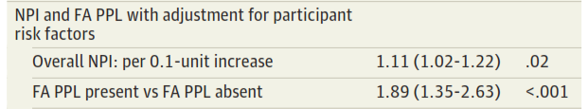
DR worsening over 4 Years by baseline PPL and NPI

Slide 7
Nonperfusion on UWF-FA Summary
Baseline nonperfusion associated with
Baseline PPL presence on FA but not Color
Baseline DR
DR worsening over 4 years associated with
Baseline PPL presence on FA but not Color
Baseline nonperfusion
Other significant findings
Baseline nonperfusion associated with VH and PDR development over 4 years
Baseline DR associated with nonperfusion in the posterior pole, mid-periphery and far periphery regions

Slide 8
Objective
Evaluate quantitative leakage parameters on UWF-FA images
Explore baseline associations between leakage and DR severity, PPLs and other clinical factors
Assess baseline leakage as a risk factor for future DR-related complications (DR worsening and development of VH, PDR, CI-DME and PPLs over 4 years)
Assess change in leakage from baseline to 1 year as a risk factor for future DR-related complication
Evaluate associations between 4-year leakage change and 4-year DR outcomes.
8

Slide 9
Background: Quantitative UWF-FA Parameters and DR Severity
Ehlers, JP et al. “Automated quantitative characterisation of retinal vascular leakage and microaneurysms in ultra-widefield fluorescein angiography. Br J Ophthalmol. 2017Jun;101(6):696-699.
Ehlers JP et al. Ophthqlmology. 2019.

Slide 10
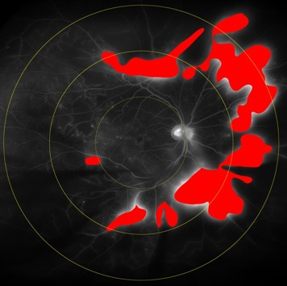
Background: Leakage Index
Mild NPDR
Mod NPDR
Severe NPDR
PDR
< .5%
1.7%
5.3%
27.9%
Ehlers, JP et al. “Automated quantitative characterisation of retinal vascular leakage and microaneurysms in ultra-widefield fluorescein angiography. Br J Ophthalmol. 2017Jun;101(6):696-699.
Ehlers JP et al. Ophthqlmology. 2019.

Slide 11
Methods
A post hoc analysis of UWF-FA images
Machine learning-enhanced feature extraction platform
Provided initial leakage segmentation
Participants (N = 574 Eyes)
from Protocol AA had:
Gradable UWF-FA leakage
NPDR in at least 1 eye
Sequentially reviewed by 2 expert readers for accuracy
Primary Outcome:
UWF-FA Leakage Index

Slide 12
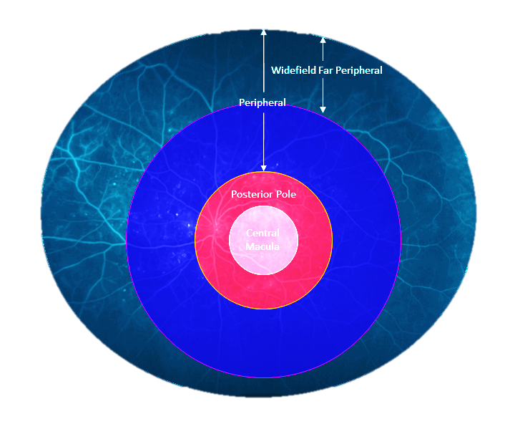
Methods
UWF-FA Leakage Index = the proportion of area with leakage divided by the analyzable area
Calculated in the overall panretinal region and within retinal zones
DR outcomes evaluated on UWF-Color images
Widefield far Peripheral
Posterior Pole
Peripheral
Central Macular
Panretinal
(Overall)

Slide 13
Statistical Analysis
Baseline analysis
Baseline leakage indexes were evaluated using multivariable marginal beta regression models to test associations with factors of interest
Longitudinal analysis
Baseline leakage and baseline to 1-year change in leakage were evaluated as risk factors for 4-year time-to-event DR outcomes using multivariable marginal Cox proportional hazard models
Change in leakage from baseline to 4 years were analyzed as a continuous outcome using mixed effect linear regression models

Slide 14
Results

Slide 15
Baseline Participant Characteristics
Participant Characteristics | Baseline Analysis N = 384 | Longitudinal Analysis N = 363
Age (y), Mean | 61 | 61
Female | 50% | 50%
White / Black / Other / Unknown | 66% / 19% / 13% / 1% | 68% / 18% / 13% / 1%
Type 2 Diabetes | 85% | 85%
Duration of diabetes (y), Mean | 21 | 21
HbA1c* (%), Mean | 8.2 | 8.2
1 Study Eye | 50% | 52%
* HbA1c missing for 7 participants in baseline analysis and 6 in longitudinal

Slide 16
Baseline Analysis
Notes:
P-values reflect statistical significance in the final multivariable analysis for each leakage parameter

Slide 17
DR Severity and Panretinal Leakage on UWF-FA
P < .001
P < .001 for leakage within all regions also (central macular, posterior pole, peripheral and widefield far peripheral)

Slide 18
DME and Leakage on UWF-FA
P =.005
Other DME
Factors:
P <.001
for continuous CST
P <.001
for prior DME tx
P <.001
for continuous CST

Slide 19
Other Baseline Factors and Panretinal Leakage on UWF-FA
P <.001
Male (n=290) | Female (n=285) |  | HbA1c <8% (n = 282) | HbA1c ≥8% (n = 285) |  | VA 20/25 or better (n = 489) | VA 20/32 or worse (n = 86)
Other Regions:
P <.001 in peripheral
P =.001 in wide-field far peripheral
P <.001 in central macular
P =.01 in peripheral
P =.03 in posterior pole
P <.001 in peripheral
P =.007 in wide-field far peripheral

Slide 20
PPL and Panretinal / Widefield Far Leakage on UWF-FA
Any PPL on Color
Any PPL on FA
P = 0.06
P = 0.006
PPL Types:
P <.001 for HMA (2.3% vs. 3.6%)
P =.002 for IRMA (2.4% vs. 4.3%)
P = .001 for NVE (2.6% vs. 5.5%)
Notes:
P-values adjusted for baseline DR and other clinical factors identified in the multivariable analysis

Slide 21
Baseline Analysis Summary
Overall mean panretinal leakage was higher (P<.05) for eyes with
More severe DR
Thicker central subfield thickness on OCT
Poorer visual acuity
Females (vs. males)
Higher HbA1c
Regional leakage associations (P<.05) were found between the
Central macular/posterior pole regions and non-central DME
Widefield far peripheral regions and PPLs (on color and FA)

Slide 22
Longitudinal Analysis Baseline Leakage and 4-Year Outcomes

Slide 23
DR Disease Worsening and Baseline Panretinal Leakage
Adjusted Hazard Ratio*
For a 1% increase in leakage = 1.06
95% CI = (1.01, 1.11); p = 0.01
51%
46%
35%
33%
N at
Risk:
Q4 Q3 Q2 Q1 | 134 135 134 134 |  |  |  | 45 52 62 72
*Adjusted for baseline NPI, FA-PPL, DR, % of total gradable area on UWF-FA, and other systemic risk factors (age, diabetes type, hbA1c and ACR).

Slide 24
VH Development and Baseline Panretinal Leakage
28%
12%
5%
3%
N at
Risk:
Q4 Q3 Q2 Q1 | 134 135 134 134 |  |  |  | 55 80 84 97
*Adjusted for baseline NPI, DR, and % of total gradable area on UWF-FA.

Slide 25
PDR Development and Baseline Panretinal Leakage
Adjusted Hazard Ratio*
For a 1% increase in leakage = 1.08
95% CI = (1.03, 1.14); p = 0.003
39%
26%
15%
12%
N at
Risk:
Q4 Q3 Q2 Q1 | 134 135 134 134 |  |  |  | 45 52 62 72
*Adjusted for baseline NPI, DR, and % of total gradable area on UWF-FA.

Slide 26
CI-DME Development and Baseline Central Macular Leakage
Adjusted Hazard Ratio*
For 1% increase in leakage = 1.03
95% CI = (1.01, 1.06) p = 0.004
38%
37%
29%
21%
N at
Risk:
Q4 Q3 Q2 Q1 | 121 115 125 129 |  |  |  | 45 54 68 82
*Adjusted for baseline CST and DR.

Slide 27
Baseline leakage and 4-year outcomes summary
Overall panretinal leakage was associated (P<.05) with 4-year development of
DR worsening
PDR
VH
Color-PPL and FA-PPLs
Regional leakage associations (P<.05) were found between the
Central macular/posterior pole region and CI-DME development
Widefield far peripheral region for color- and FA-PPL development

Slide 28
Longitudinal Leakage Analysis

Slide 29
Mean Leakage on UWF-FA at Baseline, 1 and 4 Years

Slide 30
Percentage with ≥1% Increase in Leakage from Baseline to 1 and 4 Years
Comparison groups for analysis: ≥1 increase vs. <1% increase

Slide 31
Baseline to 1-Year change in Leakage and 4-Year Outcomes

Slide 32
DR Disease Worsening and 1-Year Increase in Panretinal Leakage
Adjusted Hazard Ratio*
For a ≥1% increase in leakage BL-Y1 = 2.64
95% CI = (1.89, 3.69); p < 0.001
61%
33%
N at
Risk:
≥1% Inc. <1% Inc. | 109 338 |  |  |  | 62 72
*Adjusted for baseline leakage, NPI, FA-PPL, DR, % of total gradable area on UWF-FA, and other systemic risk factors (age, diabetes type, hbA1c and ACR).

Slide 33
VH Development and 1-Year Increase in Panretinal Leakage
Adjusted Hazard Ratio*
For a ≥1% increase in leakage BL-Y1 = 5.90
95% CI = (3.00, 11.60); p < 0.001
27%
7%
N at
Risk:
≥1% Inc. <1% Inc. | 109 339 |  |  |  | 58 241
*Adjusted for baseline leakage, NPI, DR, and % of total gradable area on UWF-FA.

Slide 34
PDR Development and 1-Year Increase Panretinal Leakage
Adjusted Hazard Ratio*
For a ≥1% increase in leakage BL-Y1 = 3.29
95% CI = (2.10, 5.15); p < 0.001
39%
16%
N at
Risk:
≥1% Inc. <1% Inc. | 109 338 |  |  |  | 52 221
*Adjusted for baseline leakage, NPI, DR, and % of total gradable area on UWF-FA

Slide 35
CI-DME Development and 1-Year Increase Panretinal Leakage
Adjusted Hazard Ratio*
For a ≥1% increase in leakage BL-Y1 = 2.05
95% CI = (1.40, 3.02); p < 0.001
44%
24%
N at
Risk:
≥1% Inc. <1% Inc. | 99 308 |  |  |  | 44 194
*Adjusted for baseline leakage, DRSS, and CST
Regional leakage increases BL-Y1 were all statistically significant.

Slide 36
VA decrease ≥10 letters and 1-Year Increase in Panretinal Leakage
Adjusted Hazard Ratio*
For a ≥1% increase in leakage BL-Y1 = 3.05
95% CI = (1.94, 4.81); p < 0.001
24%
14%
N at
Risk:
≥1% Inc. <1% Inc. | 114 339 |  |  |  | 74 244
*Adjusted for baseline leakage, DR and VA.

Slide 37
DR at 4 Years and 4-Year Change in Panretinal Leakage
DR worsened ≥1 step
from baseline to 4 years
Mean change in Panretinal Leakage BL-Y4
Mean change in Panretinal Leakage BL-Y4
Adjusted Mean Difference* = 0.9%
95% CI = (0.3%, 1.6%); p = 0.005
*Adjusted for baseline leakage and DR.

Slide 38
Summary
Baseline panretinal leakage was associated (P<.05) with
Baseline DR, central subfield thickness, visual acuity, and hbA1c
4-Year DR worsening, VH, PDR, color-PPL and FA-PPL development
A 1-Year increase of ≥1% in panretinal leakage was associated (P<.05) with
4-Year DR worsening, VH, PDR, CI-DME, visual acuity decrease and color-PPL development
Mean 4-Year change in panretinal leakage was associated (P<.05) with
4-year DR worsening of 1- and 2-steps or more

Slide 39
Limitations
Post hoc analysis not specifically designed to detect differences in UWF-FA leakage parameters
Many factors tested and some results could be spurious
DR Severity was defined using UWF-color images within the 7 standard ETDRS fields
In some cases, the DR grade was inconsistent with the NV expected on FA
UWF-FA only assessed at baseline, 1 and 4 years

Slide 40
Conclusions
This study provided significant support for the link between quantitative UWF-FA leakage parameters and numerous key DR-related features at baseline and risk for future DR-related complications
Ongoing advancements in ML technology and automated systems provide exciting opportunities for future automated quantitative outputs that could provide clinicians and clinical trials with a continuous severity scale of leakage dynamics.

Slide 41




Thank you!
To join the DRCR Retina Network email drcrnet@jaeb.org

