Slide 1



DRCR.net
Gas for Vitreomacular Traction RCT
(Protocol AG)
Gas for Macular Hole Single-Arm Study (Protocol AH)
Protocol AG Chair: Clement Chan, MD
Protocol AH Chair: Calvin Mein, MD

Slide 2
Protocol AG
Randomized Clinical Trial Assessing the Effects of Pneumatic Vitreolysis on Vitreomacular Traction

Slide 3
Background
Treatment options for VMT include observation, intraocular injection of ocriplasmin, and vitrectomy.
  Observation: VMT may spontaneously resolve
    Multiple reports (30-40% given sufficient waiting period, but unpredictable, prolonged)
  Ocriplasmin: reports of ocular complications
    26 to 48% success; high cost; anecdotal reports of complications (vision loss, ERG changes, photoreceptor/zonule dehiscence, dyschromatopsia)
  Vitrectomy: costly and includes usual risks of surgery
    >90% success, invasive, high cost
3

Slide 4
Background
1.5% of the population is estimated to have eye diseases caused by or associated with vitreomacular adhesion¹
Pneumatic vitreolysis (PVL) may serve as an alternative
  Lower cost
  In-office setting (no scheduling or coordinating issues associated with surgery)
  Case series (1995 to 2017) have reported:
    56-85% success rate of VMT release
    Low rate of adverse events
1. Karth, PA, Shah SA. Vitreomacular traction syndrome. http://eyewiki.aao.org/Vitreomacular_Traction_Syndrome. Oct 17, 2015
4

Slide 5
Public Health Impact
Retrospective data alone (with all the confounding variables) are unable to provide sufficient information to guide management options
If level-one evidence is achieved in favor of PVL, it can lead to a change in practice pattern on management of VMT not only in the US, but also on the global stage
Such a paradigm shift in management of VMT could have major implications on medical economics and cost savings

Slide 6
Study Objective
Primary
  To compare the proportion of eyes with foveal VMT (symptomatic VMA) release on OCT after PVL with gas injection vs. observation (sham injection) in eyes with VMT without an associated macular hole
Secondary
  To evaluate visual function outcomes at 24 weeks after gas injection is performed compared with observation.
6

Slide 7
Study Design
Multi-Center Randomized Clinical Trial
(124 Eyes)
At least 1 eye that meets all of the following criteria:
Vitreomacular adhesion on OCT ≤3,000 µm
Reading center confirmation required for eligibility
Best corrected ETDRS visual acuity equivalent of 20/32 to 20/400
Decreased visual function attributed to VMT
No macular or lamellar hole
Prompt Vitrectomy not required
PVL
(Injection of C3F8 gas)
Observation (Sham injection)
Primary Outcome: Proportion of eyes with VMT release on OCT without rescue vitrectomy at 24 weeks
7

Slide 8
Major Patient Eligibility Criteria
Able and willing to avoid high altitude travel, including airline travel, until gas resolution (~6-8 weeks)
Able and willing to avoid supine position until gas resolution for phakic patients
Able and willing to wear a wristband that informs any medical personnel that the patient has a gas bubble in the eye
8

Slide 9
Major Ocular Eligibility Criteria
Investigator and participant willing to wait 6 months before surgical intervention if visual acuity remains stable (unless complications; e.g. macular hole development, retinal tears or detachment)
Exclusions:
  History of prior gas injection, ocriplasmin injection, or intraocular injection for any reason
  Prior vitrectomy
  High level of myopia
  History of uncontrolled glaucoma
  IOP ≥ 30 mmHg
9

Slide 10
Study Design
Informed Consent, Baseline Testing
Dropped Ineligible
Reading Center Review
Dropped Ineligible
Randomization
Observation (Sham Injection)
Injection of C3F8 Gas (0.3 mL)
1 week
1 week
4 weeks
4 weeks
12 weeks
12 weeks
24 weeks
24 weeks
Primary outcome visit

Slide 11
Baseline Testing Procedures
  The following will be performed on both eyes
  E-ETDRS visual acuity
  Visual function testing (myVisionTrack)
  OCT
  Eye exam
Reading Center will review OCT scans to confirm eligibility
  Same day RC review will be available if required but should be limited to cases when scheduling a separate randomization day is difficult
Eligible eyes may then be randomized (must be within 8 days of baseline testing)

Slide 12

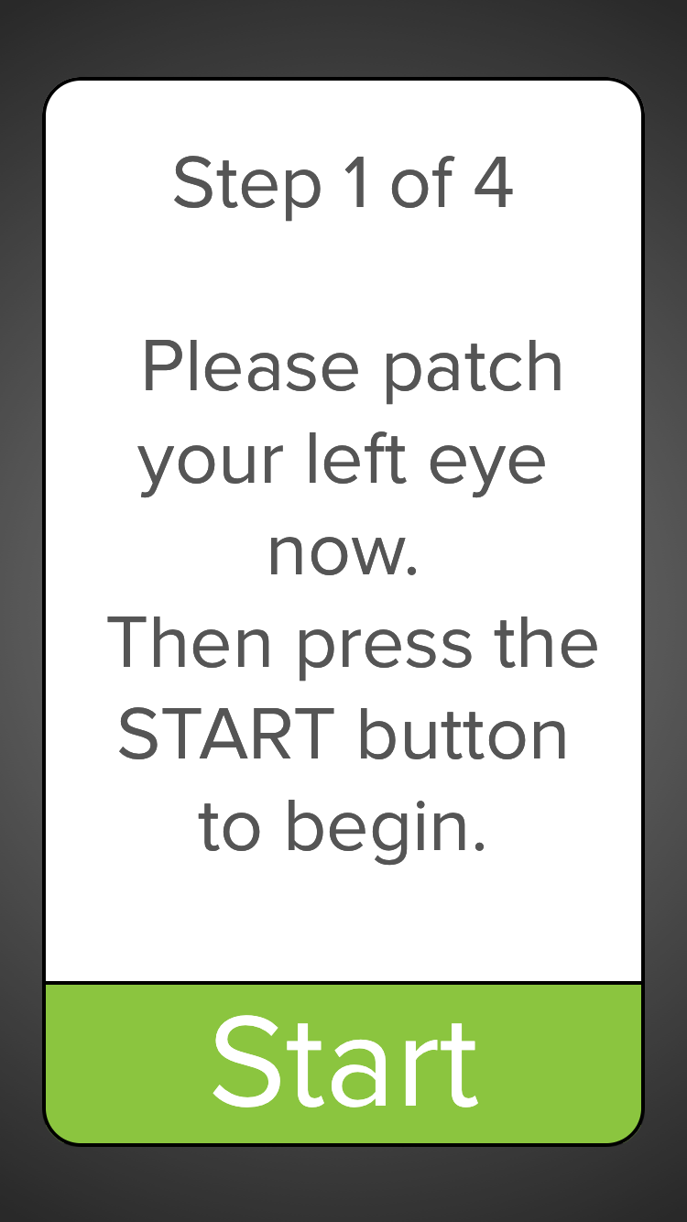

myVisionTrack
Notes:
Visual function testing will be performed using the myVisionTrack application on an iPad or tablet.
myVisionTrack® is an FDA cleared application to track disease progression in patients with certain retinal diseases.
During the test, the patient will select the circle that is shaped differently among a series of three side-by-side circles on the screen. The series continues with increasing difficulty until the patient’s visual function is determined.
Visual function is measured using the shape discrimination hyperacuity (SDH) (logMAR) score.

Slide 13
Process of Reading Center Confirmation
The Reading Center must confirm study eye eligibility on OCT
For same day grading, OCT scans must be uploaded by 2 pm Eastern
Otherwise, the participant will need to return on a separate day for randomization (RCT only) and the injection

Slide 14
Follow-Up Testing Procedures
E-ETDRS visual acuity
Visual function testing (myVisionTrack)
  12 and 24 weeks only
OCT
  study eye only
Eye exam
  study eye only

Slide 15
Criteria for Rescue Vitrectomy
For study eyes in both treatment groups, vitrectomy may be performed if one of the following occurs:
  Visual acuity decreases at least 10 letters at a single visit (not including the 1-week visit) or at least 5 letters at two consecutive visits (not including the 1-week visit) compared with baseline that is thought to be related to VMT
  Complication requires prompt surgical intervention (e.g., macular hole, retinal detachment, non-clearing vitreous hemorrhage).
Otherwise, protocol chair approval must be obtained for alternative treatment.

Slide 16
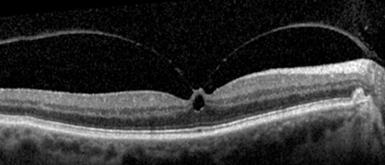

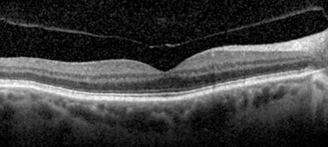
Example of a good candidate for AG (RCT)
“Eagle sign”
PVL

Slide 17
Protocol AH
Single-Arm Study Assessing the Effects of Pneumatic Vitreolysis on Macular Hole

Slide 18
Background
PVL for Macular Hole (MH) offers a lower cost, low risk alternative to Vitrectomy
Understanding the rates of MH closure and VMT release in eyes with full-thickness macular holes treated with PVL is of interest given the low cost and convenience of gas injection in the office setting as well as a low rate of adverse events reported in prior retrospective studies
18

Slide 19
Prior case series of PVL for Macular Hole
Chan (1995)
  Closure of stage-2 MH: 50% (N = 6)
Jorge et al
  Closure of stage-2 MH: 83% (N = 6)
Steinle et al
  Closure of full-thickness MH: 67% (N = 3)
Chan and Mein (Retina, 2017)
  Closure stage-2 MH: 67% with single injection (N = 15)

Slide 20
Rationale for Single-Arm Study
Eyes with MH need treatment, therefore randomization to a sham arm would be inappropriate
Vitrectomy results in nearly 100% hole closure making it an unnecessary (and expensive) control group choice
Even if this proposed study finds that PVL is only moderately successful, physicians and patients may decide to attempt PVL in the office first, before proceeding with more costly, invasive surgery
Thus, even without a control group, the results from this study will provide data of value for physicians and patients to make informed decisions about treatment course
20

Slide 21
Public Health Impact
If a large percentage of eyes can achieve MH closure with a simple in-office, low-cost procedure, while averting the invasiveness and expense of a vitrectomy for this condition, this would provide a viable first-line treatment option
21

Slide 22
Study Objective
To obtain estimates for the proportion of eyes with macular hole closure of the inner retinal layers for eyes with VMT and full-thickness macular holes treated with PVL
22

Slide 23
Study Design
Multi-Center Single-Arm Study
(50 Eyes)
At least 1 eye that meets all of the following criteria:
Full-thickness macular hole ≤250 microns at the narrowest point, confirmed by central reading center
Vitreomacular adhesion on OCT ≤3,000 microns, confirmed by central reading center
Best corrected ETDRS visual acuity equivalent of 20/25 to 20/400
PVL (Injection of C3F8 gas)
Primary Outcome: Proportion of eyes with macular hole closure of the inner retinal layers at 8 weeks without rescue treatment
23

Slide 24
Major Patient Eligibility Criteria
Able and willing to avoid high altitude travel, including airline travel, until gas resolution (~6-8 weeks)
Able and willing to avoid supine position until gas resolution for phakic patients
Able and willing to wear a wristband that informs any medical personnel that the patient has a gas bubble in the eye
Able and willing to position face down for at least 50% of the time for at least 4 days post-injection to facilitate macular hole closure
24

Slide 25
Major Ocular Eligibility Criteria
Exclusions:
  History of prior gas injection, ocriplasmin injection, or intraocular injection for any reason
  Prior vitrectomy
  High level of myopia
  History of uncontrolled glaucoma
  IOP ≥ 30 mmHg
25

Slide 26
Study Design
Informed Consent, Baseline Testing
Dropped Ineligible
Reading Center Review
Dropped Ineligible
Injection of C3F8 Gas (0.3 mL)
1 week
4 weeks
8 weeks
Primary outcome visit
24 weeks

Slide 27
Baseline Testing Procedures
  The following will be performed on both eyes
  E-ETDRS visual acuity
  OCT
  Eye exam
Reading Center will review OCT scans to confirm eligibility
  Same process as Protocol AG regarding Reading Center confirmation of study eye eligibility
Eligible eyes may then receive gas injection (must be within 8 days of baseline testing)
Notes:
No visual function testing using myVisionTrack application for the single-arm study

Slide 28
Follow-Up Testing Procedures
E-ETDRS visual acuity
OCT
  study eye only
Eye exam
  study eye only

Slide 29
Criteria for Rescue Vitrectomy
Vitrectomy should not be performed due to failure of macular hole closure prior to 4 weeks without protocol chair approval
Between 4 and 8 weeks, vitrectomy may only be performed (but is not required) if the macular hole size is not improving from baseline
After 8 weeks, vitrectomy can be performed at investigator discretion.
Notes:
JKS- presenter should specify that we are talking about smallest inner diameter of hole in bullet #2

Slide 30
Example of a good candidate for AG (RCT)
“Eagle sign”
PVL

Slide 31
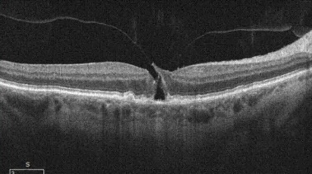
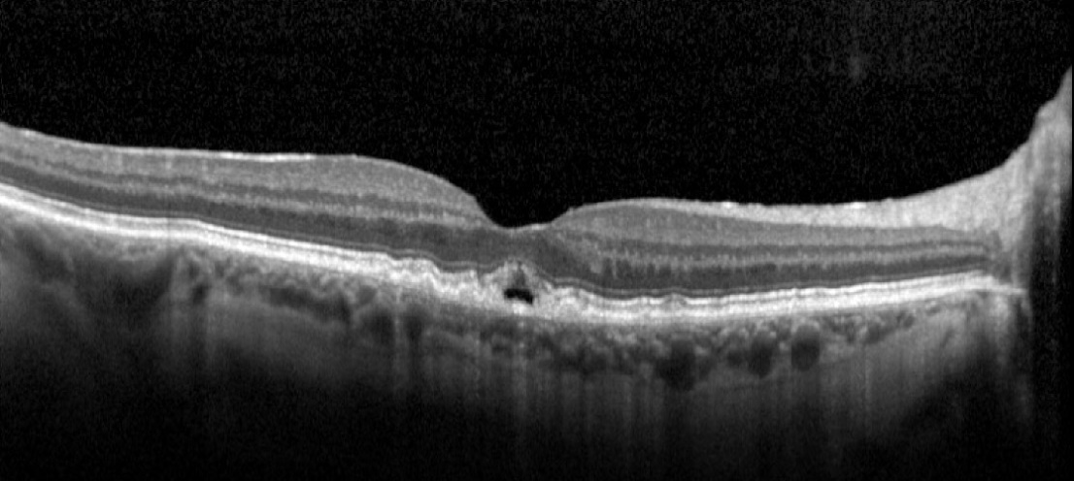
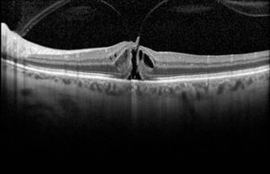
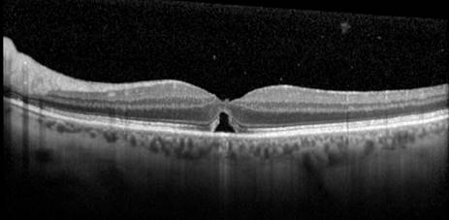
Example of good candidate for AH (single-arm)
Case 1
PVL
Case 2
PVL

Slide 32
Procedures for Both Studies

Slide 33
C3F8 Perfluoropropane
Commercially available C3F8 (Alcon or Sonomed Escalon) delivered from a pressurized canister and passed through a Millipore filter for injection into the vitreous cavity
FDA approved as a surgical aid for use in the treatment of retinal detachment by pneumatic retinopexy
Diffuses from the eye in ~6-8 weeks
Must not be used if the cylinder pressure is below 50 psi as the expansion performance of the gas may change resulting in elevated IOP
Nitrous Oxide should not be administered when a gas bubble is present in the eye
Increase in elevation may cause elevated IOP
Proper head positioning is required for phakic patients and patients with a macular hole

Slide 34
Injection Procedure
For the RCT, the injection must be given on the day of randomization
Two individuals must confirm the study eye and treatment assignment against the printout or website
Injection preparation
  Apply topical anesthetic (solution or gel)
  Place a lid speculum
  Apply povidone iodine
  Pre- and post-injection topical antibiotics should NOT be used without prior approval from the Protocol Chair or Coordinating Center designee
Notes:
Further detail provided in the injection procedures manual

Slide 35
Injection Procedure: PVL
Confirm the C3F8 supply has not expired
Confirm the cylinder pressure is at least 50 psi
Prepare the C3F8 in agreement with manufacturer requirements (detailed in Gas Injection Procedures)
The injection may be performed supratemporal, infratemporal, or infranasal at the discretion of the investigator
  The position of the needle tip should be monitored by an assistant during the process
Inject 0.3 mL C₃F₈ into the vitreous
Immediately block the injection site with a sterile cotton tipped applicator, and rotate the study participant’s head away from the injection site to avoid bubble leakage

Slide 36
Injection Procedure: Observation
(RCT Only)
Use a syringe without a needle
Apply syringe hub to the conjunctival surface, pressing gently to stimulate the force of an actual injection
Notes:
Further detail provided in the injection procedures manual

Slide 37
Post-Injection
Assess for any complications via an indirect ophthalmoscopy or a vision check to confirm perception of vision
Review and provide the post-injection subject instruction sheet
Participants in Protocol AH (single-arm study) are automatically unmasked
PVL participants in Protocol AG (RCT) may be unmasked to their treatment group since the gas bubble will be visible
For the RCT, sham injection participants must remain masked and should be given the same post-injection instructions as the PVL group

Slide 38
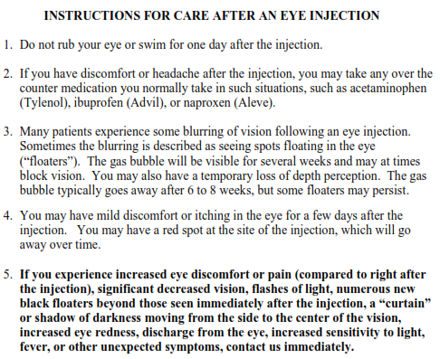
Post-Injection Subject Instructions

Slide 39
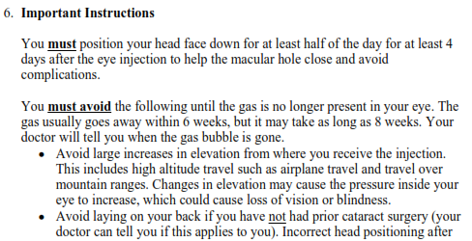
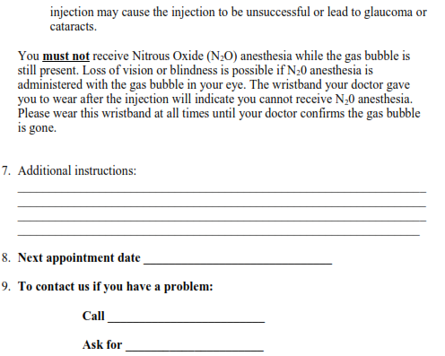
Single-arm study only
Both studies
Notes:
Post-injection subject instruction sheet

Slide 40
Optional Paracentesis for PVL Eyes
Pre-injection paracentesis should be considered due to the 4x expansion of C₃F₈ gas and the associated risk of shallowing of the anterior chamber
However, the choice of when or whether or not to do a paracentesis is ultimately at the investigator’s discretion

Slide 41
Aqueous Sample Collection
It is expected that sites with the capability to ship intraocular fluids will participate, though not a requirement
Participants will consent to the optional sample collection separately from the main study consent
If paracentesis is performed and participant consent is obtained, aqueous fluid already being drawn as part of paracentesis may be collected and shipped on dry ice to a central laboratory for storage for future analyses

Slide 42
Reporting of Adverse Events
Unlike prior DRCR.net studies, not all adverse events will be collected
Reportable Adverse Events include:
  An ocular adverse event in the study eye
  A serious adverse event
  An adverse device effect (AE that may have been caused by the gas)
  An adverse event occurring in association with a study procedure
Notes:
Adverse Device Effect (ADE): Any untoward medical occurrence in a study participant which the device may have caused or to which the device may have contributed (Note that an Adverse Event Form is to be completed in addition to being reported on a Gas Injection Form).
Serious Adverse Event (SAE): Any untoward medical occurrence that:
Results in death.
Is life-threatening; (a non-life-threatening event which, had it been more severe, might have become life-threatening, is not necessarily considered a serious adverse event).
Requires inpatient hospitalization or prolongation of existing hospitalization.
Results in persistent or significant disability/incapacity or substantial disruption of the ability to conduct normal life functions (e.g. sight threatening).
Is a congenital anomaly or birth defect.
Is considered a significant medical event by the investigator based on medical judgment (e.g., may jeopardize the participant or may require medical/surgical intervention to prevent one of the outcomes listed above).
In general, an ocular adverse event should be reported as serious (considered sight threatening) if it meets one of the following criteria:
1. It causes a decrease of ≥ 30 letters in visual acuity compared with the last visual acuity measurement prior to onset (e.g. central retinal artery occlusion).
2. In the opinion of the investigator, it requires prompt surgical intervention (e.g. vitrectomy, vitreous tap, intravitreous antibiotics) to prevent permanent loss of sight. Examples include endophthalmitis or rhegmatogenous retinal detachment.
Ocular adverse events that require eventual surgical intervention would not be considered serious. Ocular adverse events that do not have the potential to result in permanent loss of sight also would not be considered serious.

Slide 43
DRCR.net Website
Like all DRCR.net trials, the website will help guide you though each visit, including:
  Assessing eligibility
  Rescue vitrectomy criteria
  Visit schedule

Slide 44
Certification
Both studies are expected to start in September
C3F8 is considered a device, thus both studies are considered IDE studies
  The FDA has approved the use of C3F8 in both studies
Any U.S. site that believes they can enroll at least 3 participants (2 for RCT, 1 for Single-Arm study) are invited to indicate interest on the DRCR website.
  51 sites have indicated interest so far
  It is expected sites will participate in the single-arm study as well
Be on the lookout for certification materials following expressing interest
All sites must use the Jaeb IRB
  Please contact Jaeb IRB to begin reliance agreement if needed
Notes:
Institutional sites – If you do not have a reliance agreement, your IRB must contact the Jaeb IRB to negotiate an agreement. Please start this process ASAP as it can take several months.

Slide 45
Certification Requirements
Protocol acknowledgement form
Delegation log
C3F8 Form
Injection experience form
IDE investigator agreement
  Required by the FDA for IDE studies
  All coordinators must be included on the form
  Needs to be signed ASAP so FDA can approve site participation in study
Masked OCT technician, VA tester, and refractionist for (RCT only)
Aqueous sampling certification form
Ipad or Tablet for myVisionTrack (RCT only)
Notes:
C3F8 form will capture info on expiration date, manufacturer, and availability of wristbands warning against N2O use
Injection experience form – investigators will ensure previous experience administering at least 10 intraocular gas injections on 10 patients, and that they fully understand the gas injection procedure
Aqueous sampling certification form will confirm site equipment requirements of dry ice and freezer, and personnel requirements of at least one staff member with IATA/dry ice training.
The iPad or tablet must not currently have the myVisionTrack app downloaded and in use outside of the study.

Slide 46
Thank You
46

